Slide 1
Surrogate modelling for laser plasma acceleration
Kane Gueladio
Orsay, 13/05/2024

Slide 2
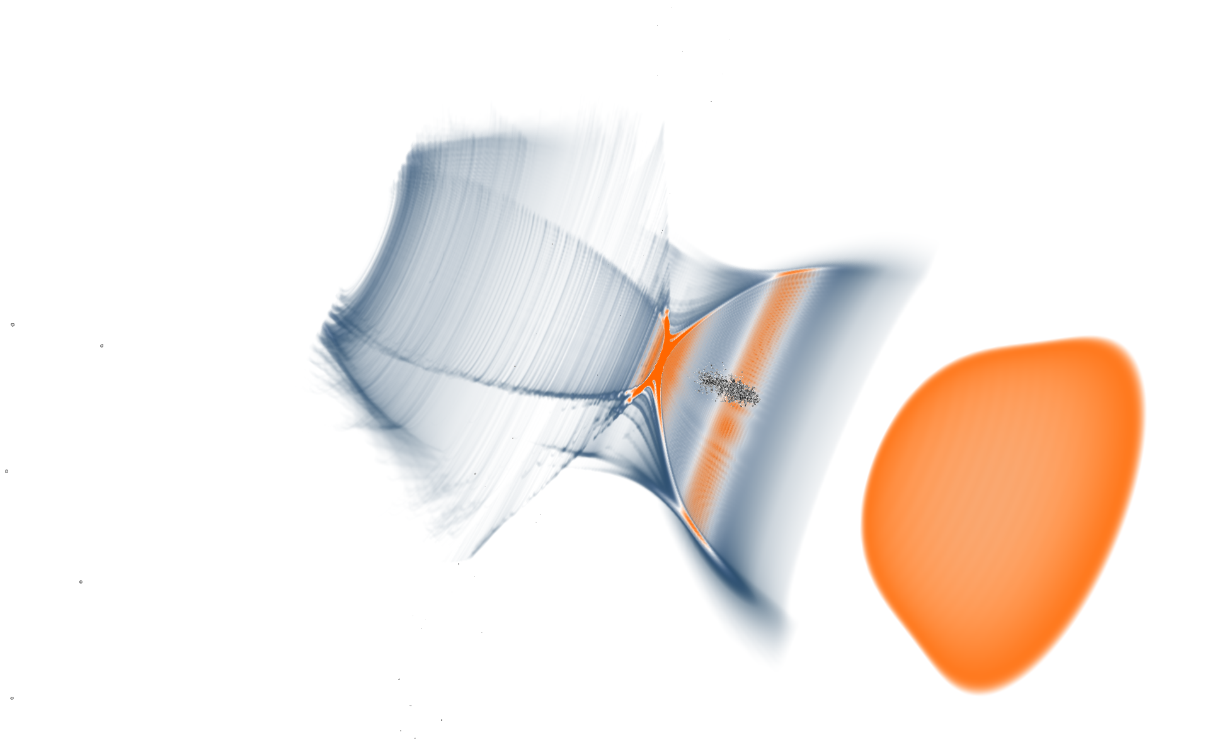
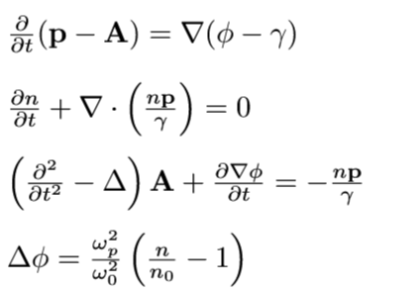
Laser plasma acceleration
J. Serhal, PhD student PALLAS
Electron acceleration using plasma Wakefield
1000 times higher acceleration field than in conventional accelerators
Laser-plasma acceleration consists of many nonlinear processes
plasma “cavity” radius ~ 10 um
Typical parameters of the interaction:
Laser Intensity: ${10}^{18}[\frac{w}{cm2}]$
Laser duration: 30 fs
plasma density : ${10}^{18}$[${cm}^{−3}$]
Longitudinal electric field: $100[GV/m]$

Slide 3
PALLAS
Laser plasma injector 150-250 MeV, >30pC, <5% energy dispersion, <2 um normalised emittance aiming to work at 10 Hz
Demonstrate control performances comparable to RF accelerators
Setting up feedback loops
Nonlinear coupled process requires the use of numerical methods
Advanced laser system stability studies data-logging, and reliable operation [2]
⚡️ more details on PALLAS with K. Cassou et al. presentation after coffee break ☕️
Plasma targetry development [3,4]
Electron beam characterisation, state of the art control, command and acquisition [5]
[2] S. Feister arXiv:2306.01661 (2024)
[3] P. Drobniak et al arXiv:2305.09264 (2023),
[4] P. Drobniak et al. RSI 96 (3): 033304 (2025) https://doi.org/10.1063/5.0226055
[5] C. Guyot et al. in preparation (2025)

Slide 4
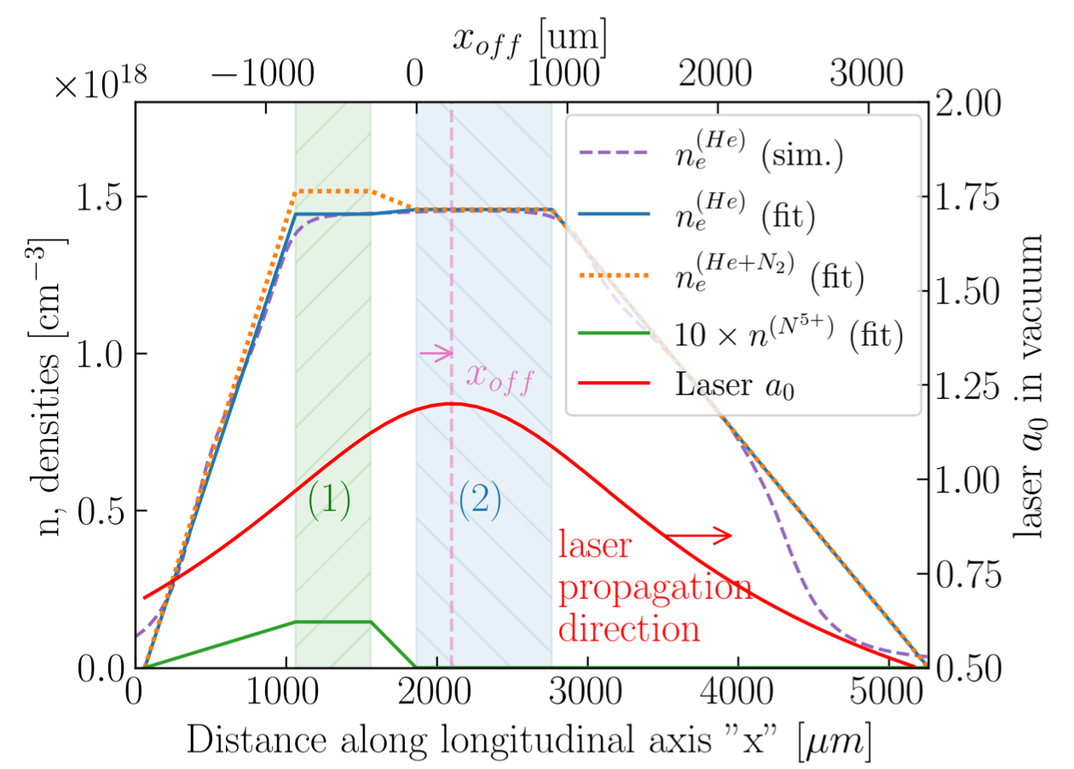
PALLAS electron source numerical studies
Learn while building the accelerator test facility
Laser-driven plasma wakefield accelerator based on ionisation injection
LASERIX laser driven input parameters
Simple two-cell target with dopant confinement [1]
Laser parameters:
1.1<a₀<1.5
w₀ = 19 um
t_{L} ~40 fs
Plasma input [xi^{(P)}]
$$C_{N2},P_{1}$$
fig from P. Drobniak et al. Phys. Rev. Accel. Beams 26, 091302
Laser input [xi^{(L)}]
e- beam source output [y^{(b)}]
$$a_{0}$$
$$E_{med,}δE_{mad, }ε_{y},Q$$
$$X_{of}$$

Slide 5
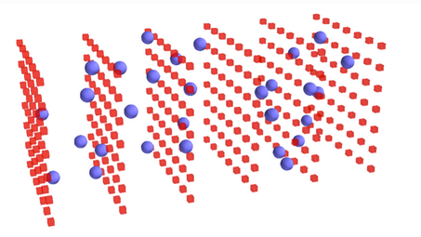
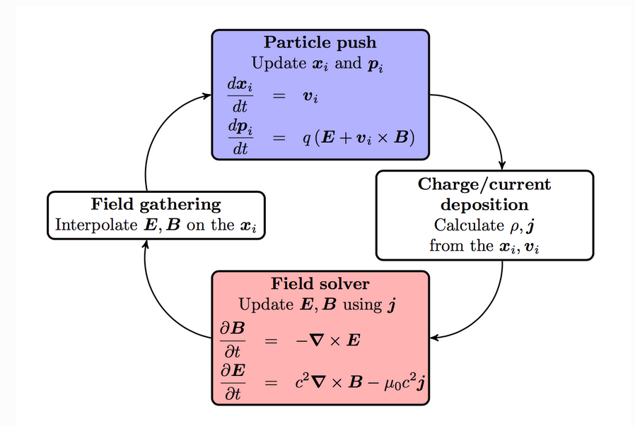
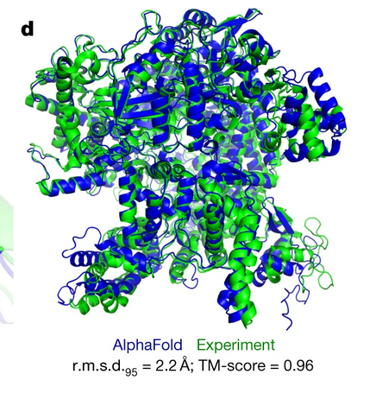
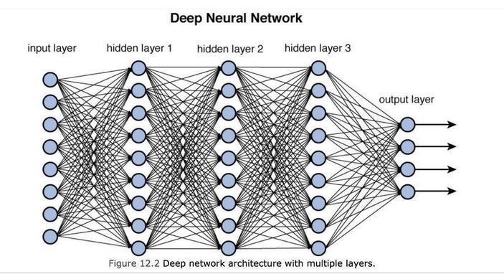
Machine learning (ML) and simulation in LPA
PIC code solves the discretised Maxwell-Vlasov system. In practice: SMILEI loop :
Initialisation ( macroparticles, charge, etc…)
Interpolating the electromagnetic field
Computing positions and velocities
Projection of charge and current densities on the grid
Computing electromagnetic fields on the grid
Restart
Computationally expensive process, especially for full 3D resolved simulation
https://fbpic.github.io/overview/pic_algorithm.html
Machine Learning:
Statistical algorithms that can learn from data and generalise to unseen data and thus perform tasks without explicit instructions.
Numerous successful uses of ML in physics and other scientific domains
Well-suited to nonlinear regression
https://botpenguin.com/glossary/deep-neural-network
Jumper, J., et al. nature 596.7873 583-589 (2021).

Slide 6
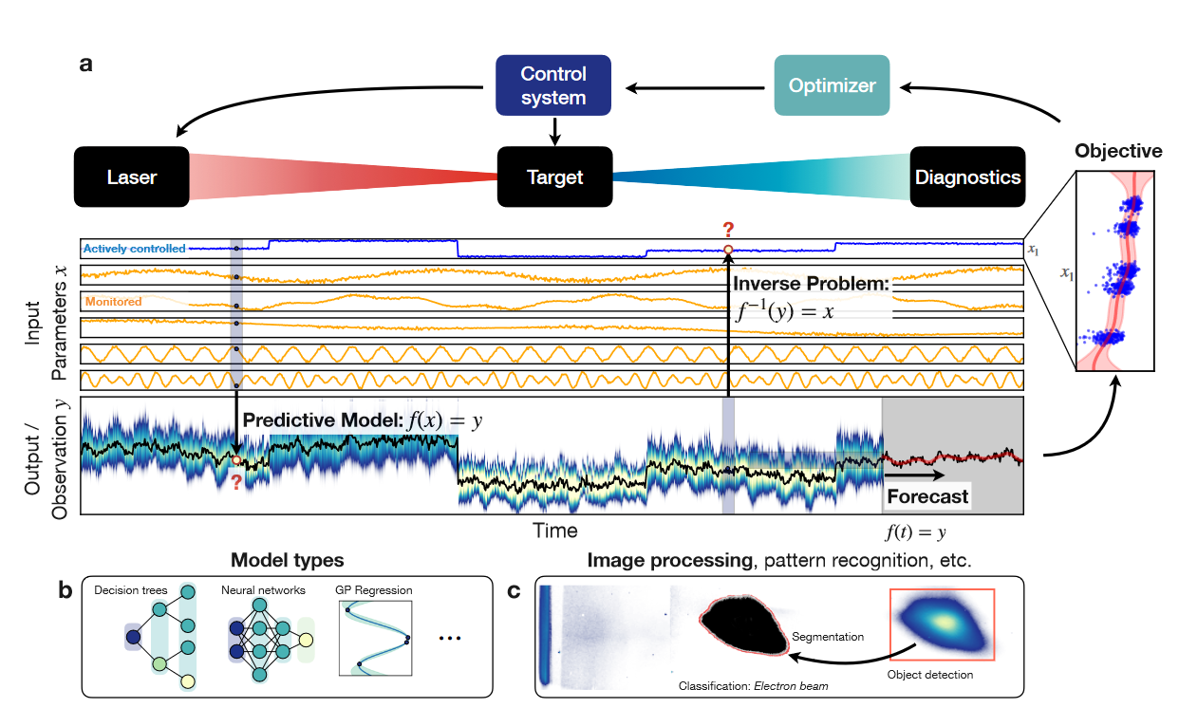
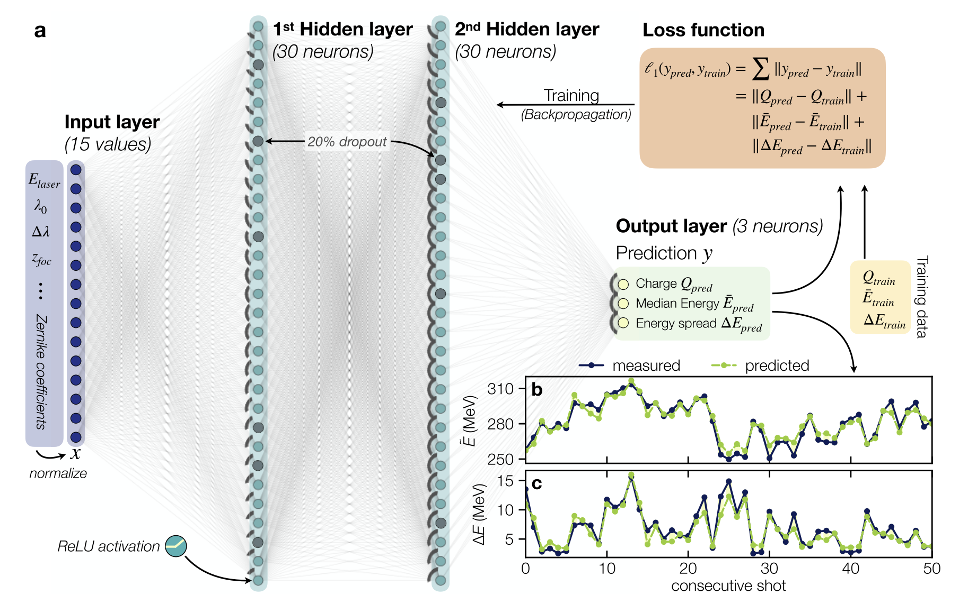
Machine learning and simulation in LPA
Different types of models:
Multi Layer Perceptron (MLP), Gaussian process(GP), Decision trees(XGB),etc …
Different types of problems to solve:
Forward
Inverse problem
ML enables the creation of efficient surrogate models, which facilitate the exploration of the parameter space.
Surrogate models enable the search for optimal operating points and stable regions of operation.
Better understanding of the relations between parameters
A Dopp et al., Data-driven Science and Machine Learning Methods in Laser-Plasma Physics
arXiv:2212.00026
M. Kirchen, et al., Phys. Rev. Lett. 126, 174801 (2021).

Slide 7
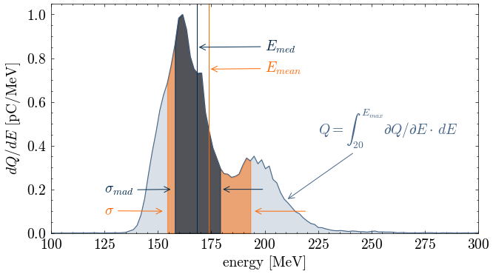
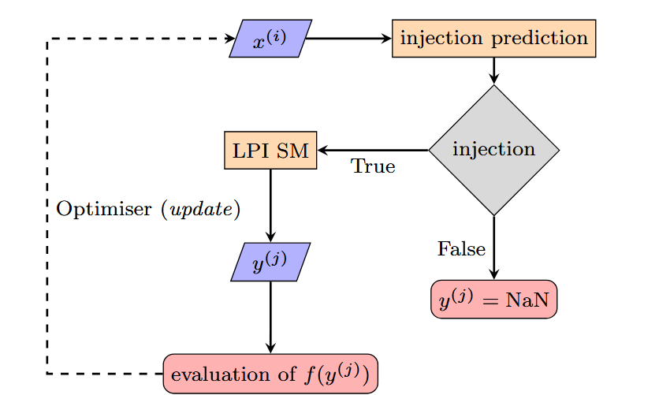
Methodology and data generations
Dataset generation hyperspace random scan with low-fidelity PIC modelling
SMILEI PIC code – with envelope approximation, one azimuthal mode decomposition and a low number of macro-particules / cell
=> gain 50 on cpu time but low fidelity simulation
15000 simulation of the electron source Random scans :
inputs
outputs
Method
Injection prediction from the input data
Creation of surrogate models less computationally expensive than simulations, trained on simulation data.
$$E_{med,}δE_{mad, }ε_{y},Q=F(a_{0,}X_{of}\text{,}C_{N2,}P_{1})$$
Using Both injection and surrogate models to find optimal and stable working points.
The surrogate models can be used as a particle source generator for start-to-end simulations design studies with beam-tracking code RF-TRACK[1] , ASTRA[3] or in Monte Carlo particle transport GEANT4 [3,4]
[1] https://gitlab.cern.ch/rf-track [2] https://www.desy.de/~mpyflo/ [3] https://geant4.web.cern.ch/ [4]A. Sytov et al. arXiv2503.12154 (2025).

Slide 8
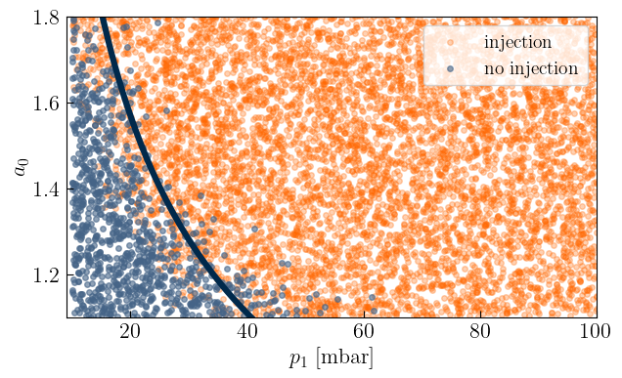
Injection model
Random forest classification algorithm to predict injection ($E>25 Mev,Q>3pC$)
Accuracy of the model is of 98%
Useful to save computational time before launching new simulation or as a constraint for Bayesian optimisation
The injection model follows the theoretical limits for self-focusing threshold
example of projection in 2 plan (a0,p1)

Slide 9
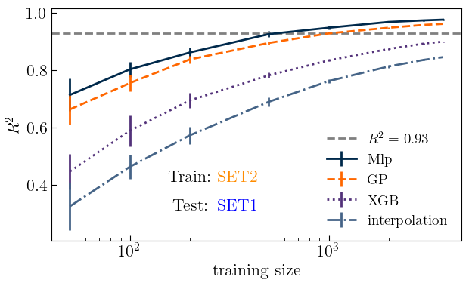
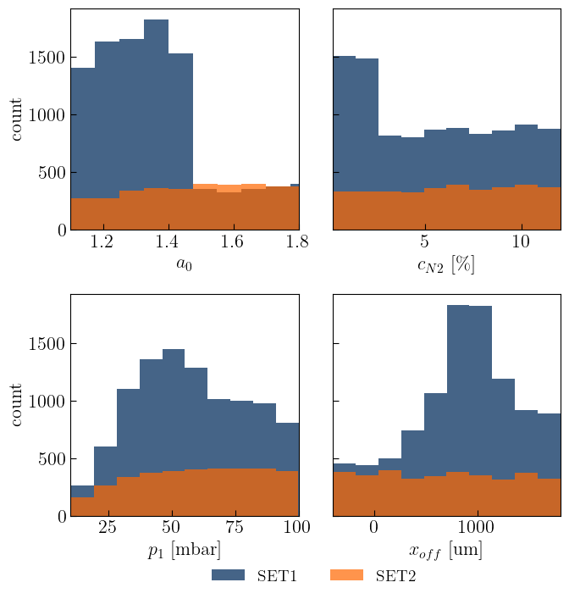
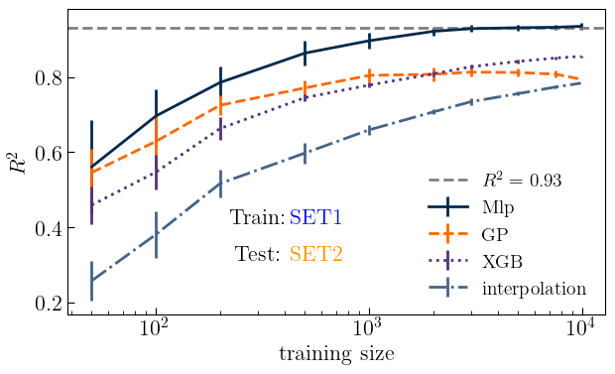
Surrogate model prediction accuracy
Construction of surrogate models with high predictive accuracy,${ R}^{2}$=0,97 for 3000 training points (MLP,GP)
MLP generalize better and achieve a $R^{2}$=0,93 for just 500 training points
Highlighting the importance of uniform training data.
G. Kane et al. Surrogate Models studies for laser-plasma accelerator electron source design through numerical optimisation https://hal-obspm.ccsd.cnrs.fr/X-LLR/hal-04675477v2 (2024)

Slide 10
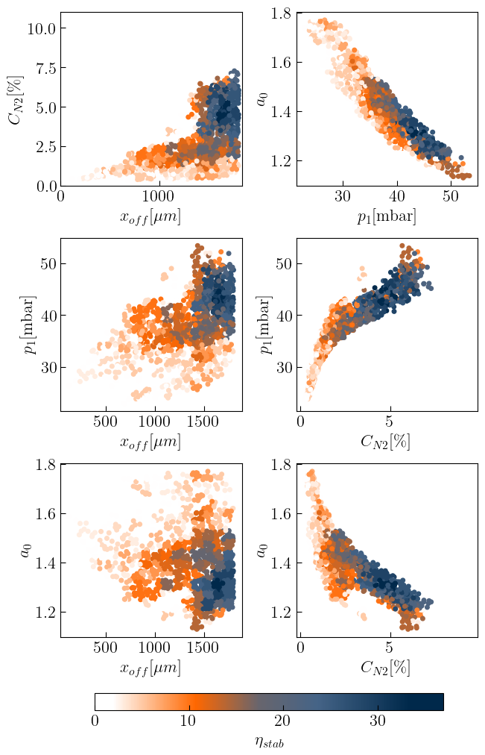
Surrogate models in LPA
Using the surrogate model to search for optimal working points
5 millions configurations randomly generated 2347 selected by filter F
$F=\left\{E_{med}∈\left[195,205\right]Mev,E_{mad}<5\%,Q\left[25,35\right]pC,ε_{y}<2mm.mrad\right\}$
Creation of a stability criteria
:Density of remaining points after applying filter F

Slide 11
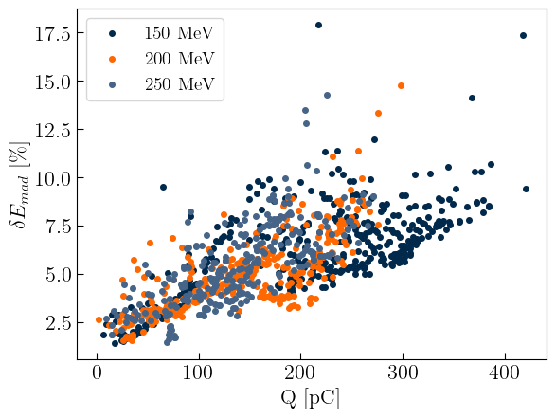
Bayesian optimisation and Multi objective Bayesian optimisation
Alternative methods to look for optimal working points are Bayesian optimisation (BO) and Multi objective Bayesian optimisation (MOBO).
The goal of The BO is to extremise an objective function usually expensive to evaluate. MOBO maximise multiple objective functions simultaneously, which leads to the Pareto front.
This is not the most efficient method to look for target working points, but it is really efficient with a real- life experiment. Numerous experiments have demonstrated it.
F. Irshad.Physical review letters, 133:085001, 2024
S. Jalas PRAB 26, 071302 (2023)
Xopt user friendly library to start using BO,MOBO
https://github.com/ChristopherMayes/Xopt
The two objective functions
$$G(Q\left(x\right),{δE}_{mad, }\left(x\right),{|E}_{med}\left(x\right)−E_{0}|)$$

Slide 12
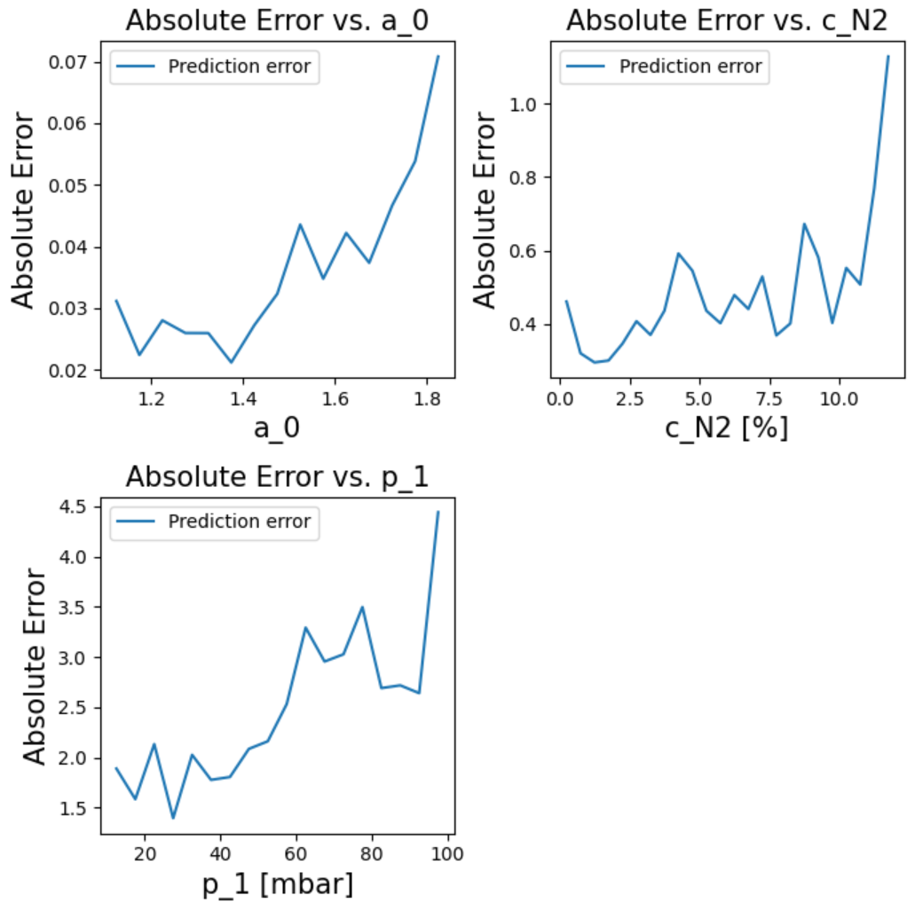
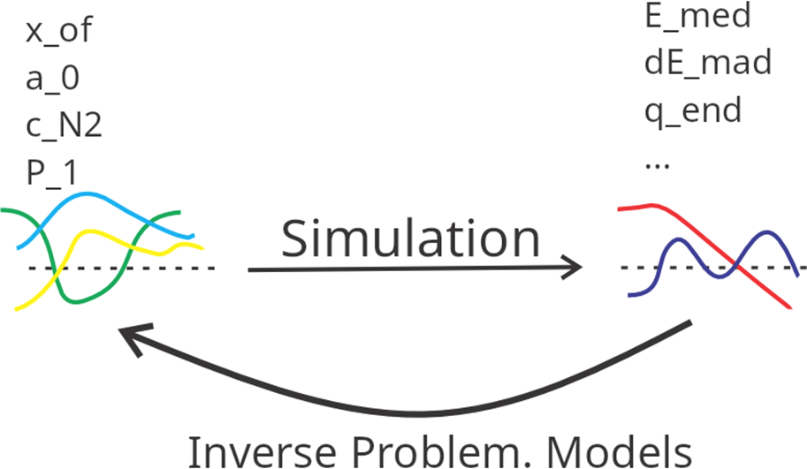
Surrogate model for inverse problem
Inverse problem :
$$a_{0,}X_{of}\text{,}C_{N2,}P_{1}=F^{−1}(E_{med,}δE_{mad, }ε_{y},Q)$$
Ill posed problem, uniquness, existence and stability, is not guaranted
Focal position is not predictable ,due to uniqueness issue: $a_{0,}\text{,}C_{N2,}P_{1}=F^{−1}(E_{med,}δE_{mad, }ε_{y},Q,X_{of})$
With 4 inputs and focal position as scan parameter:
$R^{2}=0.89$
M. Lenivenko, PhD student PALLAS

Slide 13
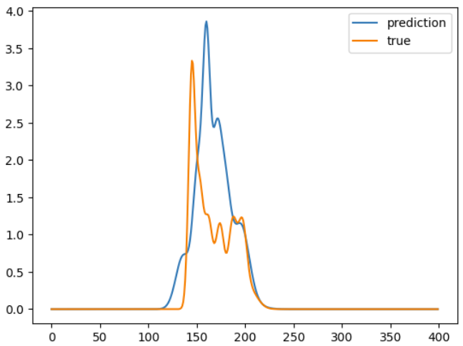
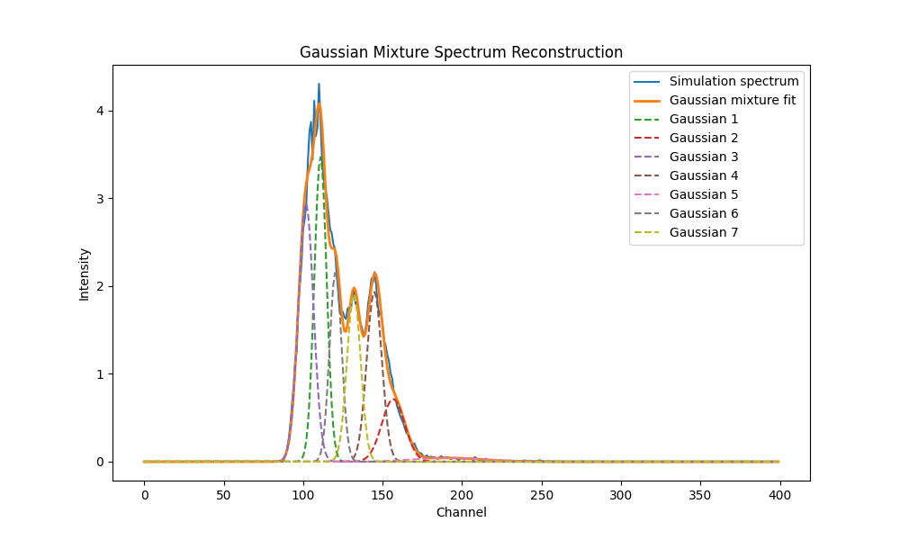
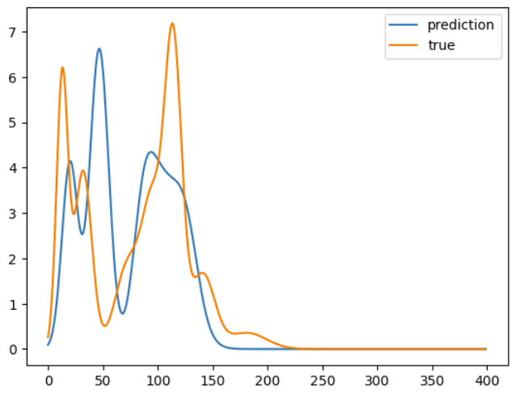
Attempt at Spectrum reconstruction
Electron spectra are fitted with a Gaussian Mixture Model, 7 Gaussians below
MLP try to predict the 21 parameters from:
$$F(a_{0,}X_{of}\text{,}C_{N2,}P_{1})$$

Slide 14
Conclusion
ML models achieved high prediction performance with $R^{2}$ score converging toward 1
ML models allowed us to identify numerical optimal and stable working points
We have highlighted some guidelines to construct performant models, uniformity in the training data and only a couple of hundred of training data points
Inverse models need to be improved, but promising
Next step: these surrogate models will be used with experimental data eventually
The ML tools will be needed to build a stable and high-performance laser plasma injector or accelerator.

Slide 15
Merci pour votre attention

Slide 16
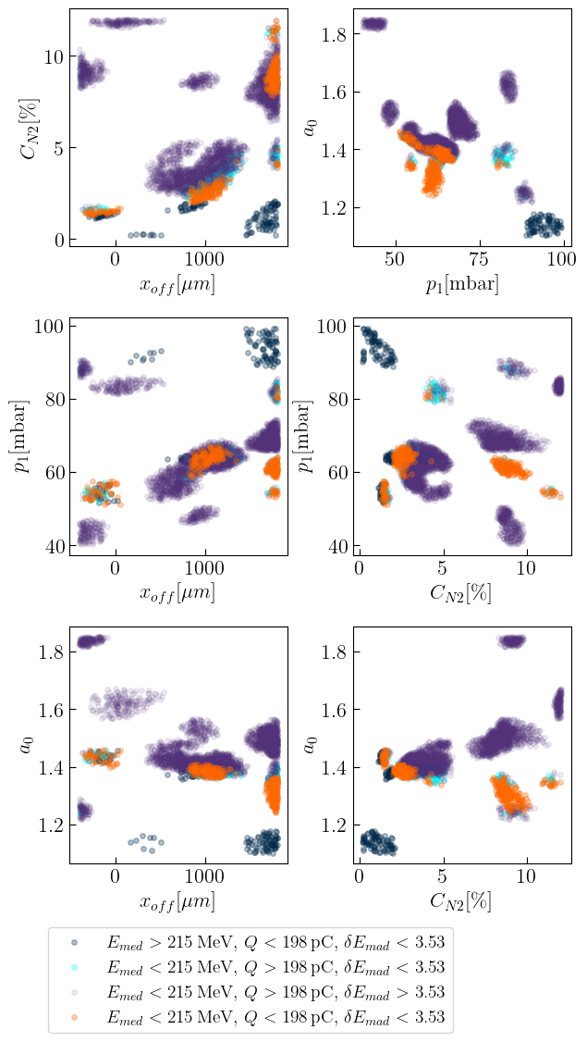
Surrogate models in LPA
Surrogate models allows to find better beams than Random scan search.
$F_{3}=\frac{QE_{med}}{δE_{mad}}$ 3779 configurations surpasses the best of the Random scan
Allow to concentrate on regions of interest

Slide 17
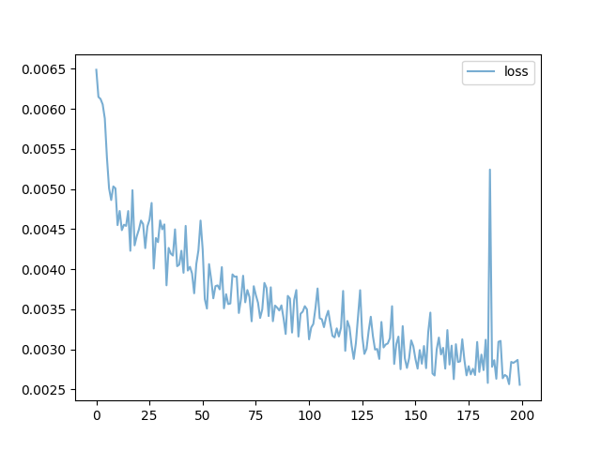
MLP
Loss: error between the calculated value and the true value, example: $$MSE=\frac{1}{n}\sum_{i=1}^{n}{{(y_{i}−y_{true})}^{2}}$$
$$x_{j}$$
$$y_{i}$$
Learning Back Propagation:
$$w_{ij}\left(t+1\right)=w_{ij}\left(t\right)−α\frac{∂MSE}{∂w_{ij}}$$
Forward propagation
Each neurons after the first layer receives:
$$y_{i}=σ(\sum_{j=1}^{n}{w_{ij}x_{j}+b_{i}})$$
$σ :$Activation function brings the non linearity in the MLP
Final step the model is tested on unseen data

Slide 18
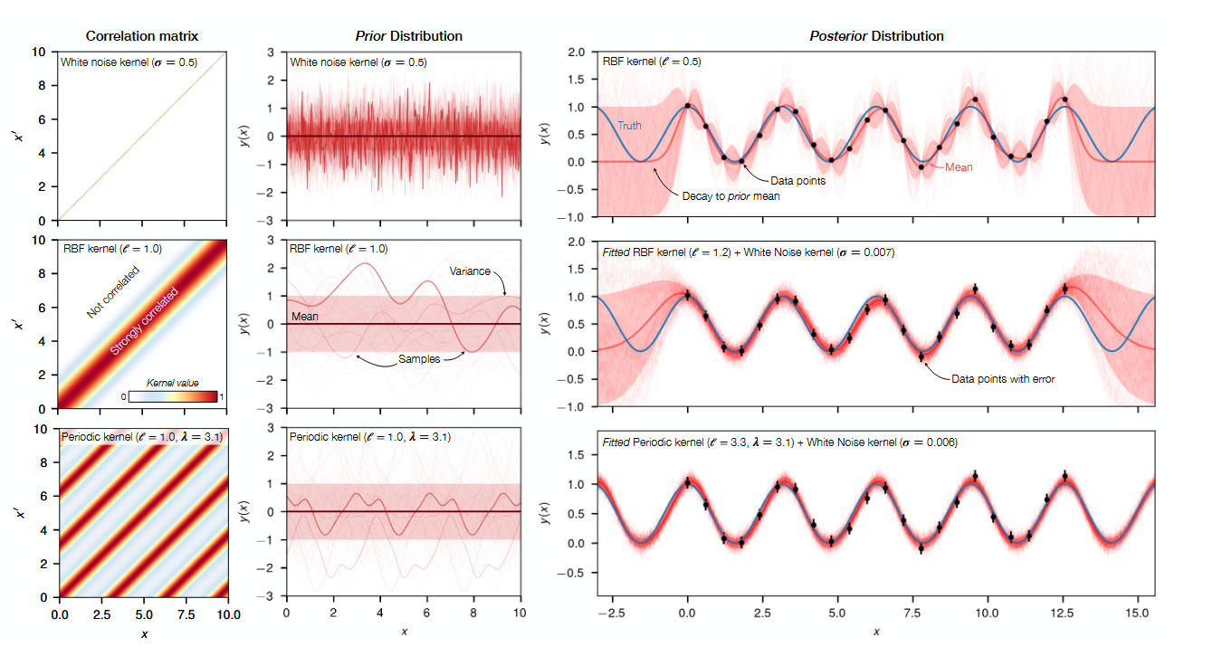
GP
Prior distribution:
We assume that the function we are looking for is drawn from a gaussian process which means any finite collection of function values ($f\left(x1\right),f\left(x2\right),…,f(xn)$)fallows a multivariate normal distribution. Reflects the belief we have about the function
$σ :$Covariance function or kernel function encode assumption about function attributes and the correlation between input points
Likelihood:
Probability of observing the actual data $Y$ given the kernel parameters $θ$.
Training: maximise the likelihood to find the parameters that best explains the data
Posterior distribution:
Traineed model for any new input point x gives you the mean prediction and uncertainty.
A Dopp et al., Data-driven Science and Machine Learning Methods in Laser-Plasma Physics
arXiv:2212.00026

Slide 19
Bayesian optimisation
Use a probabilistic surrogate model to make predictions on an objective function. (Usually GP)
Then an acquisition function suggests the next points to evaluate.
Upper confidence bound: Classical acquisition function to choose the next point to evaluate

