Slide 1
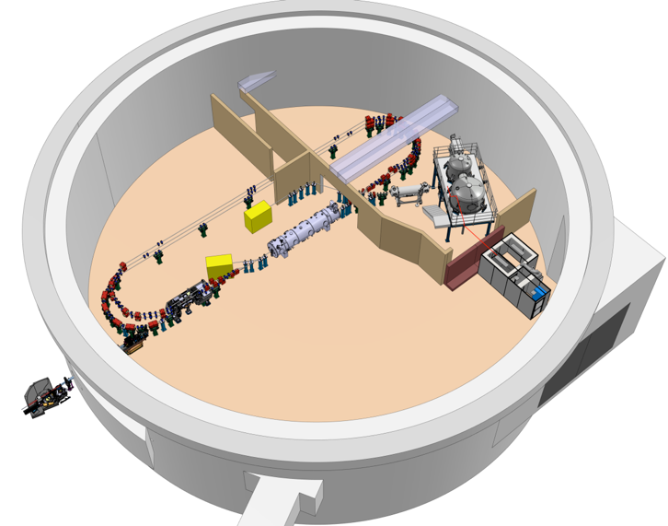
Project Progress Review (PPR) 2-2025
WP- 03
Mohammed Ben Abdillah
January 16th 2025
16/01/2025
PERLE- Project Progress Review
1

Slide 2
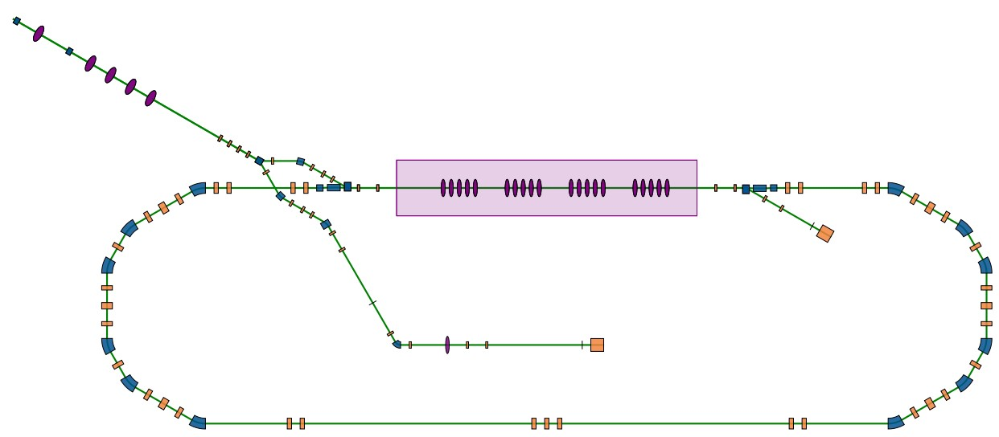
Diagnostics in PERLE
MPS
Project Management
Vacuum
Diagnostics
Beam Dynamics
C&C
Gun
Injector
Ring
Injector
RF systems
Magnets
Diagnostics
Line
Diagnostics
Electronics
Software
RF
Mechanics
16/01/2025
PERLE- Project Progress Review
2
Notes:
Basically I separated PERLE, in terms of diags, into 4 locations.
First the GUN and that because of the milestone regarding the funding ERL4ALL (Q1 2026)
Second, the Injector because it’s milestone is the next one (Q4 2027) with the hope to characterize the beam at booster exit
Third, diagnostics line entrance is mirroring the entrance of the cryomodule. Therefore, this would allow the monitoring of the beam at cryomodule entrance.
the diag line milestone is just 1 year later that the injector
And last the ring (1 turn and then 3 turns) where we aim to monitor the beam in accelerating and decelerating phases.
This work package is related to 7 other work packages in PERLE and asks for credentials in different teams

Slide 3
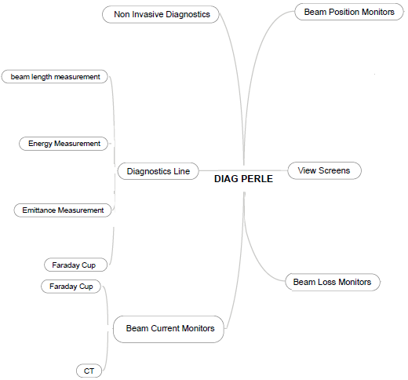
PERLE Beam Diagnostics: mind view
J.W (Cockcroft Institute)
Deadline Q4-31
MBA
Workload & deadlines
Up to 10 BPMs for Q4-27
At least 10 BPMs for Q4-28
At least 20 BPMs for Q4-31
Specific electronics needed
Update on next slide
Solution to be discussed
Duration: 12 m, Deadline Q4-28
Timeline: Q1 to Q4-26.
R.R
Duration: 6 m, Deadline Q4-27
Timeline: Q3 & Q4-25
S.W
H.G
S.W
Solution to be discussed
Duration: 12 m, Deadline: Q4 2027
Timeline: to be scheduled
C.M (IPHC)
Up to 10 view screens
Duration: 24 m, Deadline Q4-28
Timeline: Q2-25 to Q1-27
MBA
Duration: 12 m, Deadline Q4-25
Timeline: Q4-24 to Q4-25
H.G
MBA
10 BLMs for Q4-27
25 BLMs for Q4-28
30 BLMs for Q4-31
No update
Solution to be discussed
Duration: 12 m, Deadline Q4-27
Timeline: Q2-25 to Q1-26
S.V
(ESS Bilbao)
16/01/2025
PERLE- Project Progress Review
3
Notes:
As I mentioned before, the milestone for the gun is kinda tomorrow and hopefully in the RI deal we got 2 BPMs to monitor the position of the beam; a view screen to check it’s transverse profile and we ordered a faraday cup to measure the beam current profile. The faraday cup should be available and monitored fall of this year
Following discussions with beam dynamics, current will be also checked at booster exit, this task is driven by ESS Bilbao since last month and discussions should start in this semester.
Specific diagnostics (emittance, energy and longitudinal length) will be first used to monitor the beam at the booster exit, then they will be definitely installed on the diagnostics line. The corresponding task managers are Raphael Roux, Sandry Wallon from IJClab, and Chaker Maazouzi from IPHC in Strasbourg. Timeline are quite well defined and discussion with IPHC should also start this semester.
View Screens are needed for these specific measurements but also at specific locations along the ring, this transverse task is handled by sandry wallon and it ms on the right track
Position and losses are checked along all the injector diag line and ring. Therefore, big workload is on BPMs (40 are needed) and BLMs (65 are needed)

Slide 4
PERLE Beam Diagnostics: Tasks Status
Task | News | Mechanics | Electronics | Other
FCup | Ordered 12/24 | PBS & WBS fixed
CT | Task attribution 12/24 | Planned Q2-26: ESS Bilbao or Bergoz
Injector BPMs | BPM model Calibration planned Q2-25 | PBS & WBS fixed | Internal or Libera | Task load for RF if internal solution
1st turn BPMs | Simulations launched Electronics: 3 possible solutions. Decision on Q3-25 | PBS and WBS to be discussed | Task load & planning depends on solution | RF Task load & planning depends on solution
View Screens | PBS and WBS fixed | Planned in 26 & 27
Loss | Task attribution 10/24 | No Update | No Update
Energy | PBS and WBS to be agreed | PBS & WBS fixed |  | Task load for Magnets
Length | Solution with BPM under study | Strong Work load on mechanics if BPM solution is not OK
Emittance | Task attribution 12/24 | Back up solution with Quads
16/01/2025
PERLE- Project Progress Review
4

Slide 5
PERLE Beam Diagnostics: FTE issues (period 2025 to 2029)
Injector & Diag line
FTE | Total | Missing | Comments
Mechanics | 1 to 2 | 0.5 to 1 | It depends on the chosen solution for length and emittance monitors
Electronics | 1 to 2 | 0 to 1 | It depends on the chosen solution + with or without Libera
RF | 0.2 to 0.5 | 0 to 0.3 | It depends on the chosen solution + with or without Libera
Other | Depending on the task: check C&C, Vacuum, RF sources, Magnets presentation
1st turn
FTE | Total | Missing | Comments
Mechanics | 0.5
Electronics | 1 | 0 to 0.7 | It depends on the chosen solution + with or without Libera
RF | 0.5 to 1 | 0 to 0.5 | It depends on the chosen solution (with or without LIBERA)
Other | Depending on the task: check C&C, Vacuum, RF sources, Magnets presentation
16/01/2025
16/01/2025
PERLE- Project Progress Review
5
5

Slide 6
PERLE Beam Diagnostics: Costs (based on Libera & Bergoz Options)
Task | Sub task | Number | Cost (k€) | Delivery Time (months) |  | Comments
Faraday Cup |  | 1 | 62 | 10 |  | Purchased
CT | Detector | Up to 2 | Up to 36 | 6
 | Electronics | Up to 2 | Up to 12 | 6
Injector & Diag line BPMs | Detector | Up to 8 | Up to 55 | 12 |  | 2 Purchased
 | Electronics | Up to 8 | Up to 60 | 12 to 18 months
1st Turn BPMs | Detector | 10 | 90 | 12
 | Electronics | 20 | 140(*) | (*): only position of Acc & Dec Beams
View Screens | Injector & Diag line | 5 | 25 |  |  | 1 Purchased
 | 1st Turn | Up to 3 | 15 | SUB PARTS | Total cost (k€) | Cost due to Libera & Bergoz
Injector & Diag line BLMs | Detector | 8 to 12 | 6 to 9
 | Electronics | 2 to 3 | 14 to 21 | Injector & Diag line | Up to 220 | Up to 110
1st Turn BLMs | Detector | 12 to 16 | 9 to 12
 | Electronics | 2 to 3 | 21 to 28 | 1st Turn | Up to 290 | Up to 190
16/01/2025
16/01/2025
PERLE- Project Progress Review
6
6

Slide 7
PERLE Beam Diagnostics: Conclusions
Diagnostics WP quite well structured
Some tasks are starting, strong workload on other tasks
Studies to be run to finalize WBS and timeline of some Tasks
Missing FTE's particularly on electronics
Cost estimation with least FTE and abandoned features.
Funding for diagnostics will be an issue in 2026 and later
16/01/2025
16/01/2025
PERLE- Project Progress Review
7
7

Slide 8
PERLE Beam Diagnostics: FTE estimations 2025 to 2029
Work Package |  | Collaborator | Affiliation | Division-Team | Resource available (Yes/No) | Implication (FTE) |  |  |  |  |  |  | Task in the project
 |  |  |  |  |  | 2024 |  | 2025 | 2026 | 2027 | 2028 | 2029
 | Tasks |  |  |  |  | S1 | S2
WP3:Diagnostics and Instrumentation | BPMs | Mohammed Ben Abdillah | IJCLab | Pôle Accélérateurs - Service RF | Yes | 0,2 | 0,04 | 0,5 | 0,5 | 0,3 | 0,2 | 0,5 | BPM design specifications and procurements
 |  | Fabrice Fournier | IJCLab | Pôle Accélérateurs - Service RF | Yes | 0 |  | 0,15 | 0,2 | 0,25 | 0,3 | 0,3 | BPM qualification and characterization
 |  | Christophe Joly | IJCLab | Pôle Accélérateurs - Service RF | Yes | 0 |  | 0 | 0,03 | 0,03 | 0 | 0,03 | RF sources
 |  | Electronics CAO & cablage | IJCLab | Pôle Ingenerie ou CDD IR |  | 0 |  | 0,5 | 0,5 | 0,5 | 0,5 | 0,5 | BPM electronics design
 |  | Mechanics | IJCLab | Pôle Ingenerie-Service CPR |  | 0 |  | 0 | 0 | 0,3 | 0,3 | 0,1 | BPM Mechanical Design (Manufacturing File) Fabrication follow up
 |  | C&C | IJCLab | Pôle Ingénieurie - Service Online |  | 0 |  | 0,02 | 0,02 | 0,02 | 0 | 0 | Integration, IHM
 |  | O. Frossard | IJCLab | Pôle Accélérateurs - Service RF | Yes | 0 |  | 0 | 0,02 | 0,02 | 0 | 0 | Racks Installation / RF cables paths
 |  | S. Berthelot | IJCLab | Pôle Accélérateurs - Service RF | Yes | 0 |  | 0 | 0,02 | 0,02 | 0,01 | 0,01 | RF Racks and Crates
 |  | Olivier Pochon | IJCLab | Pôle Ingénieurie -BE Mécanique | Yes | 0 |  | 0,05 | 0,05 |  |  |  | Matchning pieces of the BPMs to IJClab test Bench
 | BCMs | Mohammed Ben Abdillah | IJCLab | Pôle Accélérateurs - Service RF | Yes | 0,02 | 0,2 | 0,1 | 0,05 | 0 | 0 | 0 | Faraday Cup
 |  | Seadat Varnasseri | ESS bilbao | ## | Yes |  |  | 0 | 0,5 | 0,1 | 0 | 0 | Current Transformer
 |  | C&C | IJCLab | Pôle Ingénieurie - Service Online |  |  |  | 0,02 | 0,02 | 0,02 | 0 | 0 | Integration, IHM
 |  | Mechanics | IJCLab | Pôle Ingénieurie -BE Mécanique |  |  |  | 0,02 | 0,02 | 0,02 | 0 | 0 | Installation
 | Diagnostic line | Sandry Wallon | IJCLab | Pôle Accélérateurs - BIMP | Yes |  | 0,06 | 0,1 | 0,3 | 0 | 0,1 | 0 | Beam energy Monitoring
 |  | C&C | IJCLab | Pôle Ingénieurie - Service Online |  |  |  | 0 | 0,02 | 0,02 | 0 | 0 | Integration, IHM
 |  | Hayg Guler | IJCLab | Pôle Accélérateurs - BIMP | Yes | 0,19 |  | 0,02 | 0,02 | 0,02 | 0,02 | 0,02 | Beam dynamics in Diag line
 |  | Mohammed Ben Abdillah | IJCLab | Pôle Accélérateurs - Service RF | Yes | 0,06 | 0,05 | 0 | 0 | 0 | 0 | 0 | Partnerships and Tasks Dispatching
 |  | Raphael Roux | IJCLab | Pôle Accélérateurs - Service RF | Yes |  |  | 0 | 0,05 | 0,05 | 0 | 0,02 | Deflecting cavity for beam length monitor
 |  | Christophe Joly | IJCLab | Pôle Accélérateurs - Service RF | Yes |  |  | 0 | 0 | 0,03 | 0 | 0 | RF source for Deflecting Cavity
 |  | Chaker Maazouzi | IPHC | ## | Yes |  |  | 0,5 | 1 | 0,5 | 0 | 0 | Beam Emittance Monitor
 |  | Mechanics | IJCLab | Pôle Ingénieurie -BE Mécanique |  |  |  | 0 | 0,02 | 0,02 | 0,02 | 0,02 | Installation
 | BLMs | Hayg Guler | IJCLab | Pôle Accélérateurs - BIMP | Yes |  |  | 0,4 | 0,3 | 0,1 | 0,1 | 0,1 | BLM specifications, procurement
 |  | C&C | IJCLab | Pôle Ingénieurie - Service Online |  |  |  | 0,02 | 0,02 | 0 | 0 | 0 | Integration, IHM
 |  | Mechanics | IJCLab | Pôle Ingénieurie -BE Mécanique |  |  |  | 0,02 | 0,02 | 0,00 | 0,00 | 0,02 | Installation
 | Other Systems | Sandry Wallon | IJCLab | Pôle Accélérateurs - BIMP | Yes | 0,12 | 0,03 | 0,4 | 0,3 | 0,1 | 0,1 | 0,1 | Screens
 |  | Joseph Wolfenden | Cockcroft Institute | ## | Yes |  |  | 0 | 0,02 | 0,02 | 0,02 | 0,02 | NID design and integration
 |  | C&C | IJCLab | Pôle Ingénieurie - Service Online |  |  |  | 0,02 | 0,02 | 0,02 | 0 | 0 | Integration, IHM
 |  | Mechanics | IJCLab | Pôle Ingénieurie -BE Mécanique |  |  |  | 0,02 | 0,02 | 0,00 | 0,02 | 0,02 | Installation, fabrication support écrans +tests

Slide 9
PERLE Beam Diagnostics Scope
Instrument | BPM |  | BCM |  | View Screens |  |  |  | BLM
Location | Position | Timing | CT | FC | Emittance | Energy | Transverse | Longitudinal | Fast | Slow
Gun (Q4-25) | 2(*) | 0 | 0 | 1 | 0 | 0 | 1(*) | 0 | 0 | 0
Injector (Q4-27) | 2 | 0 | 1 | 0 | 1(**) | 1(**) | 1(**) | 0 | 10(~) | 0
Diag Line (Q4-28)? | 4 | 0 | 0 | 0 | 1 | 1 | 1 | 1 | 15(~) | 0
Ring (Q4-31)? | 18+12 | 12 | 0 | 0 | 0 | 0 | 6 | 0 | 30 | 10
Total | ~40 |  | 2 |  | 10 |  |  |  | 55 | 10
(*): already purchased (**): temporary (~): some are fixed

