Slide 1

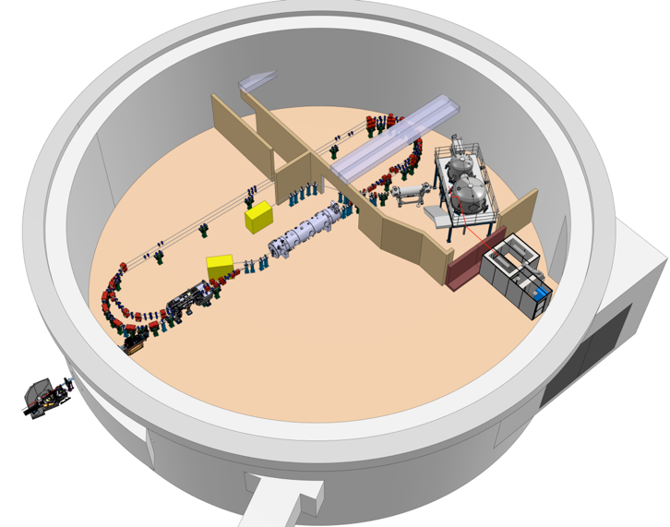
Project Progress Review (PPR) 1-2025
WP- 08: RF systems
Présenté par: C. JOLY
16 Janvier 2025

Slide 2
Périmètre et Objectifs du WP
Needed RF systems for superconducting elliptic cavities used in Booster and ERL LINAC cryomodules and the buncher:
Cavity qualification facility upgrade for testing @801.58MHz with 1kW max.
Distributed Master Oscillator and Timing system for providing all Reference Phases & Timing signals to the Cavities, beam Diagnostics and probably experiments.
9 RF Power Amplifiers for providing the RF power needed by cavities (from 5kW to 50kW).
8 or 9 Low Level Radio Frequency feedback systems (Amplitude, Phase and Frequency)
Developments with contributions to all WP except n° 4 (magnets) and 9 (Vacuum)

Slide 3
Etat d’Avancement
Project definition (RH, WBS, Budget) in progress : Consolidation
TDR part: first version with a global definition of the RF systems
Cavity qualification facility upgrade : RFPA, circulator, RF measurements coupler and RF power load delivered in 2024. RFPA SAT realized Q4 of 2024
MO & Timing : Use of IDROGEN board solution associated to one mezzanine board (FMC REFGEN) and a µRTM board locally providing the timings signal. First REFGEN prototype realized end of Q4 2024 → available in end of February.
RF powers Amplifiers : 4 IOT + 5 SSA strategy seems the best . First version of the SSA requirements done and project of collaboration with THALES and CERN for the IOT prototype.
LLRF system : IOXOS based HW solution adapted at 801,58MHz. RF front-end prototype will be delivered Q1 2025. PhD student hiring for developing a superconducting cavity real time embedded simulator for PERLE and the optimization of LLRF firmware algorithms.

Slide 4
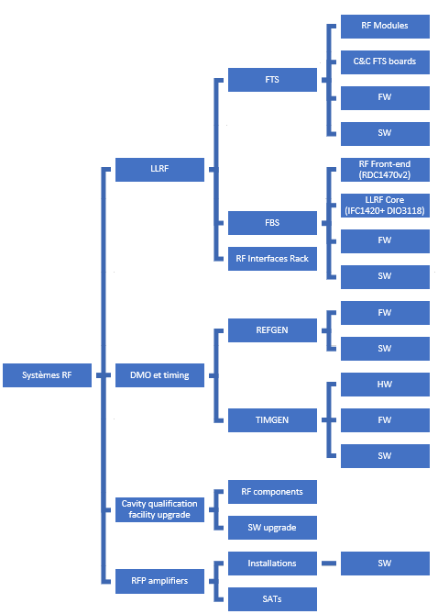
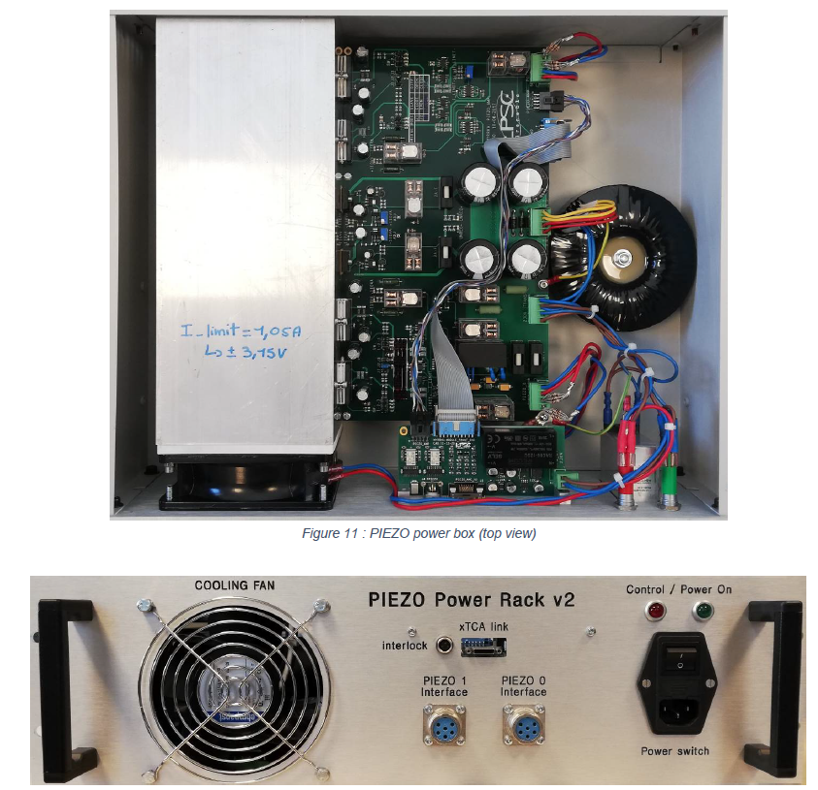
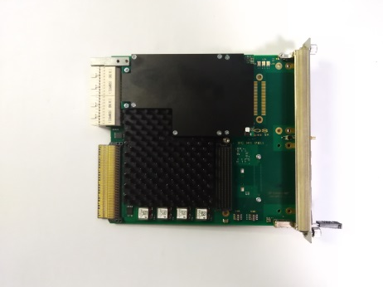
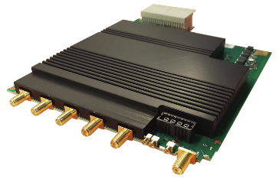
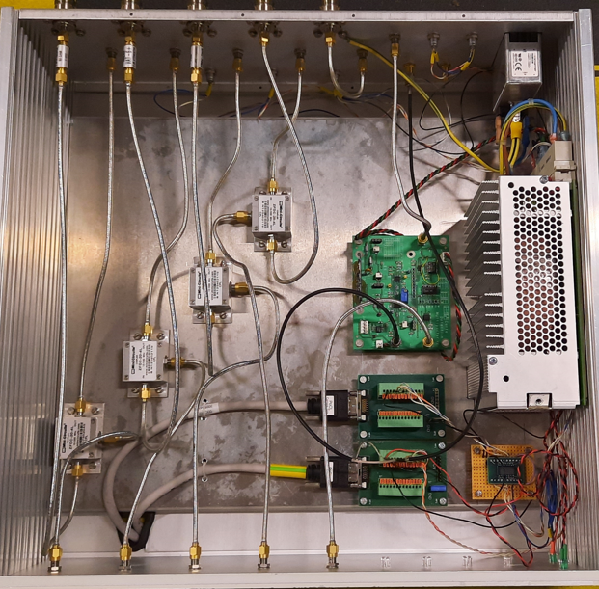
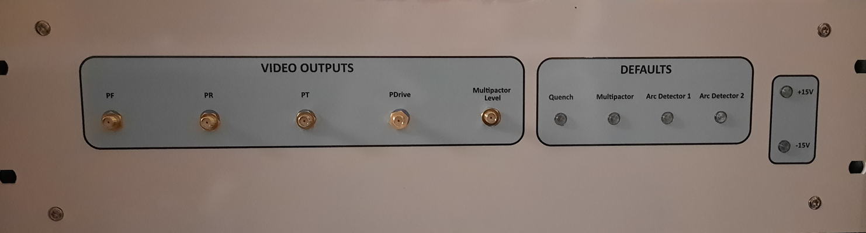
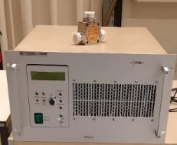
Structuration du WP-08
Pw
C&C FTS (µRTM)
IDROGEN (AMC)
Power modules
RDC1470 (µRTM)
IFC1420
TIMGEN (µRTM)
IDROGEN (AMC) + REFGEN (FMC)
RFPA 1kW@801,058MHz
Circulator, Measurement Coupler,…
IOT and SSA
* in the framework of the new IOT project (CERN, THALES and IJCLab) : IDEMO
Ex :IOT 80kW @700MHz IJCLab

Slide 5
Planning et Principaux Jalons du WP-8 : RF systems
DC Gun @350 keV
Design
20 mA
Procuirement / Construction / Installation
DC gun
operation
Commissioning
Injector @ 7MeV
Injector installed
DMO & Timing
€
Board proto
series
20 mA
FeedBack system
€€
Series proc.
Frequency tuning system
€
Pw mod.series
& Board proto
series
Cavity Sim. and algorithms opt.
PhD student work
€
Cavity Qualification facility upgrade
RF proc. & modification
PERLE 1-LOOP 89MeV
€€€
series
RF power Amplifiers (5 x SSA)
(4 x IOT)
!
prototype
series
€€€
ERL 1-LOOP
TDR
Cryomodule
tested
First ERL
demonstration
2MW
Cryogenic
installed
Cryomodule
Installed
IGLOO ready
2024
2025
2026
2027
2028
2029
2030
2031

Slide 6
RH engagés et besoins manquants ( 2024-2029)
~8 FTE including 1.25 FTE missing
~3.4 FTE including 1.75 FTE missing
~19 FTE
WITHOUT OTHERS
WP CONTRIBUTIONS
~0.75 FTE
~6.6 FTE including 4.3 FTE missing

Slide 7
Points de vigilance
Disponibilité des ressources:
  Ing Conception, 2 T/AI CAO, routage , suivi de prod,
  Départs à anticiper: F. Campos (à partir de fin 2025), D. Charlet (~ mi 2026 ?)
Décision à prendre dans le court terme
  Solution pour Timing et FTS → IDROGEN based
Dépenses à prévoir ( à consolider):
2025
  6k€ pour développement des cartes proto (TIMGEN et C&C FTS)
  40k€ pour réaliser la série des modules de puissance FTS
  30k€ pour réaliser la série des châssis d’interfaces RF
  ? Câbles
2026
  116k€ approvisionnements cartes IOXOS (8 + 2 spares)
  ? k€ Châssis MTCA (
  ? Lignes RF
  ? Circulateurs and Load (minimum 4 but perhaps 8 )
  400k€ Amplificateurs SSA ( power 10kW)
2027
  1.2M€ Amplificateurs IOT (50kW)
  ? Upgrade Amplificateurs SSA ( power 20 kW to 50kW, bandwidth-dependent)

Slide 8
Annexe : RH engagés et besoins manquants
Pw
J-F. Yaniche
Series realization : F. Campos integration Modules, racks or cabinet
CDD Virt T/AI CAO/ Layout
C. Joly
CDD IR
Design Board
(C. Joly or ?)
X. Lafay
C. Joly
(see WP C&C)
C. Joly
Series realization : call for tender ( single manufacturer but several distributors)
C. Joly
C. Joly
DEPHI: To be confirmed
+ PhD student : N. Belouchrani
C&C
(see WP C&C)
Series realization : F. Campos integration Modules, racks or cabinet
CDD Virt T/AI CAO/ Layout
J-F. Yaniche
D. Charlet
see TImeD
C. Joly
C. Joly
Series realization : CDD Virt T/AI CAO/ series Follow-up
see TImeD
CDD IR
Design Board
X. Lafay
Series realization : CDD Virt T/AI CAO/ series Follow-up
C. Joly or ?
( CDD IR)
C. Joly
(see WP C&C)
S. Berthelot
( CDD IR)
CDD IR*
S. Berthelot
C&C : Name to be confirmed
S. Berthelot
CDD IR*
* in the framework of the new IOT project (CERN, THALES and IJCLab) : IDEMO

