Slide 1
Update on Beam measurement Ring studies
25th November 2024

Slide 2
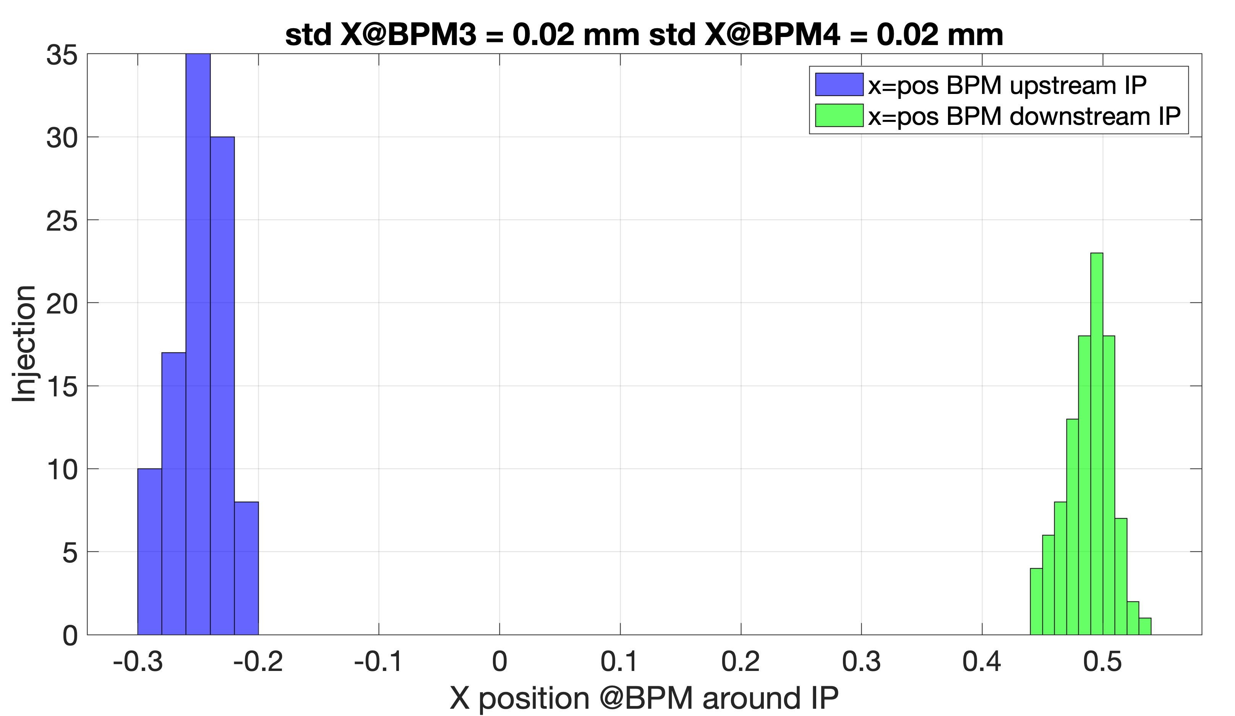
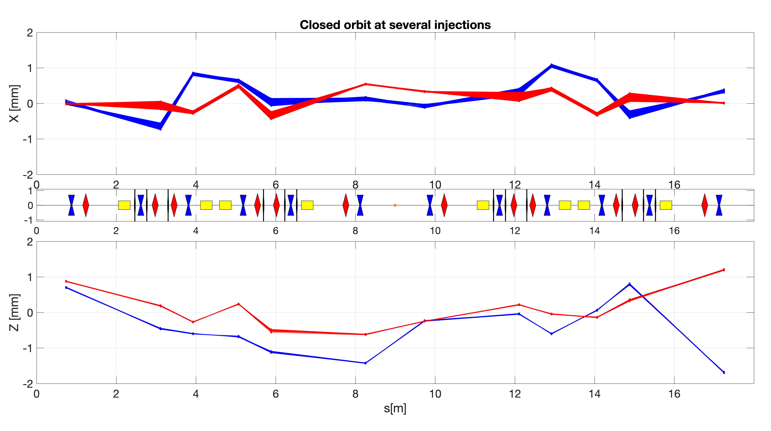
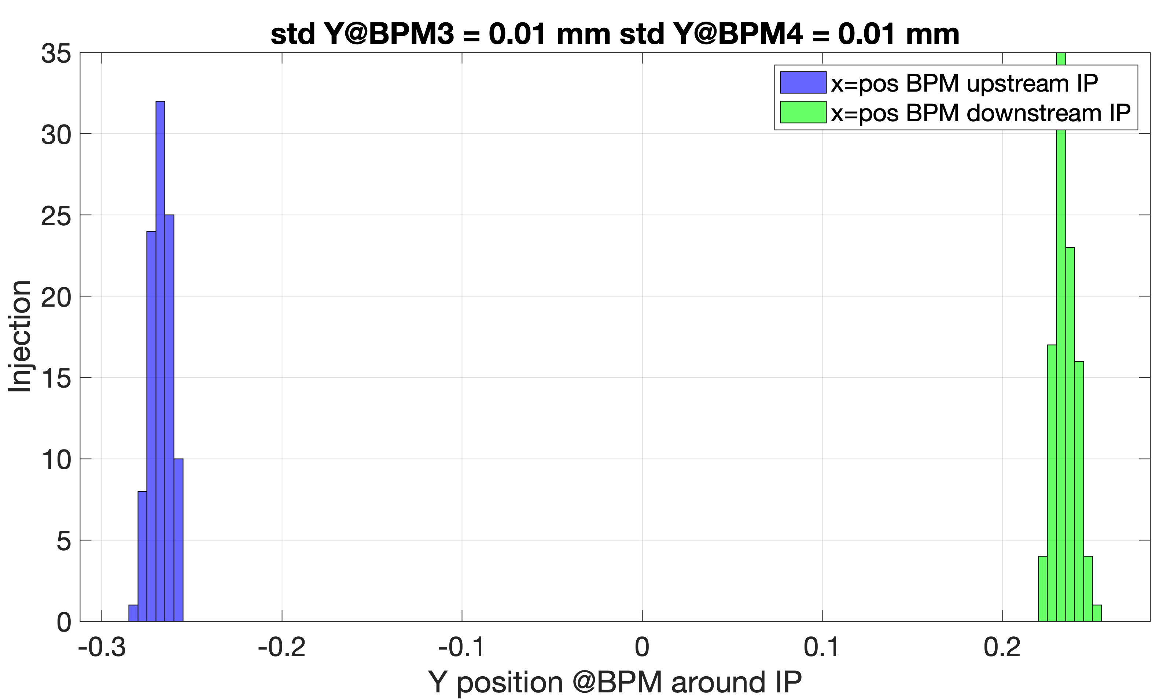
Stability (inj-to-inj) and IP BPMs
15th November

Slide 3
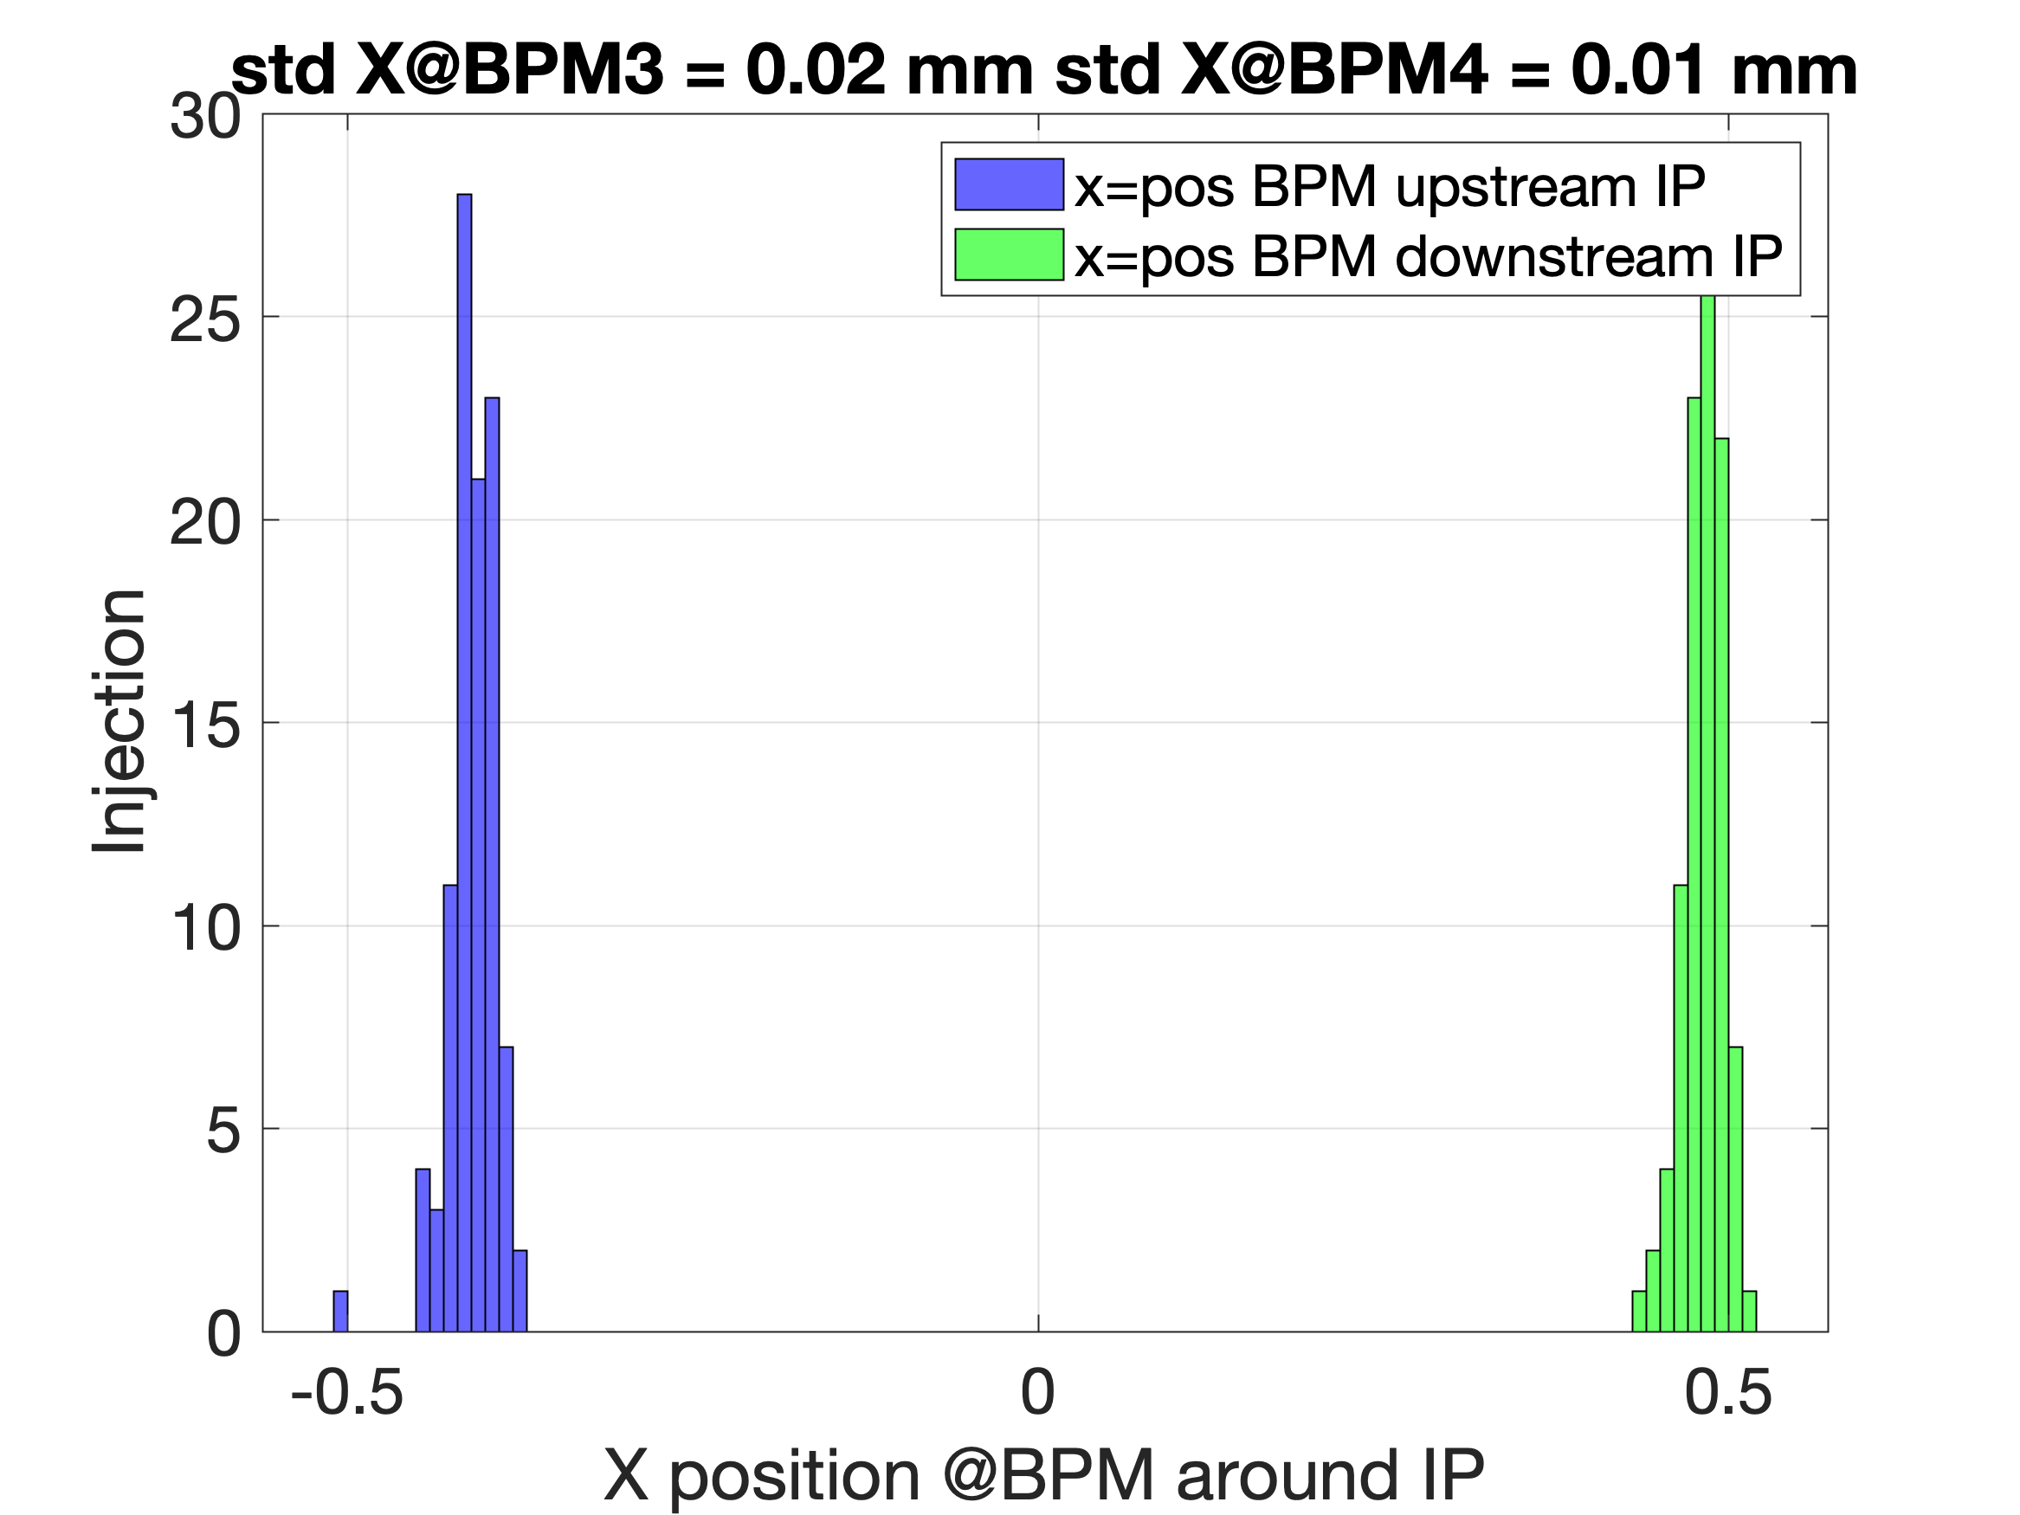
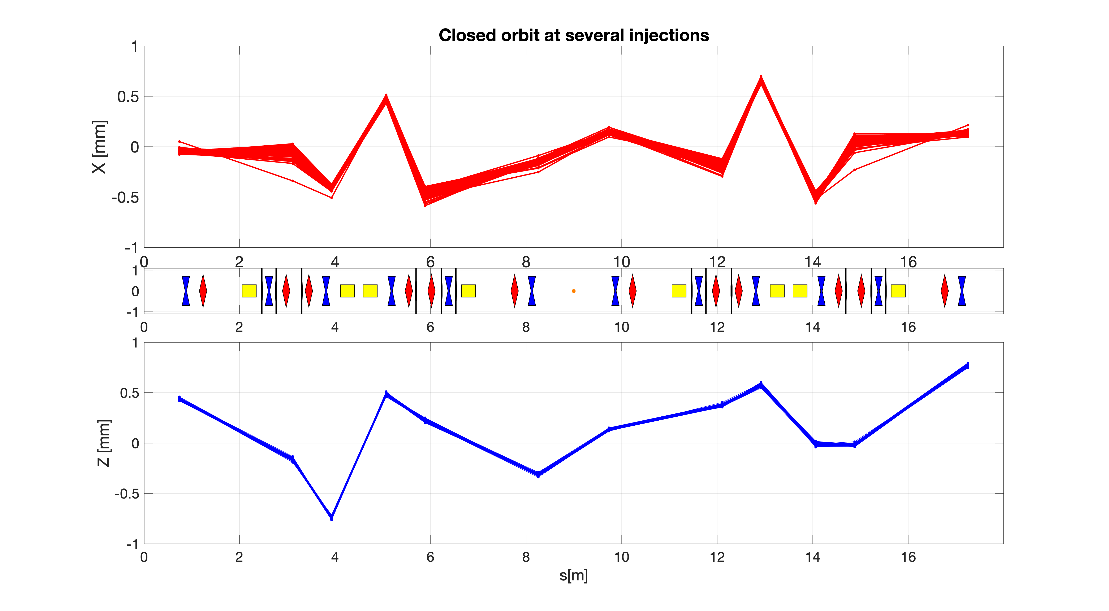
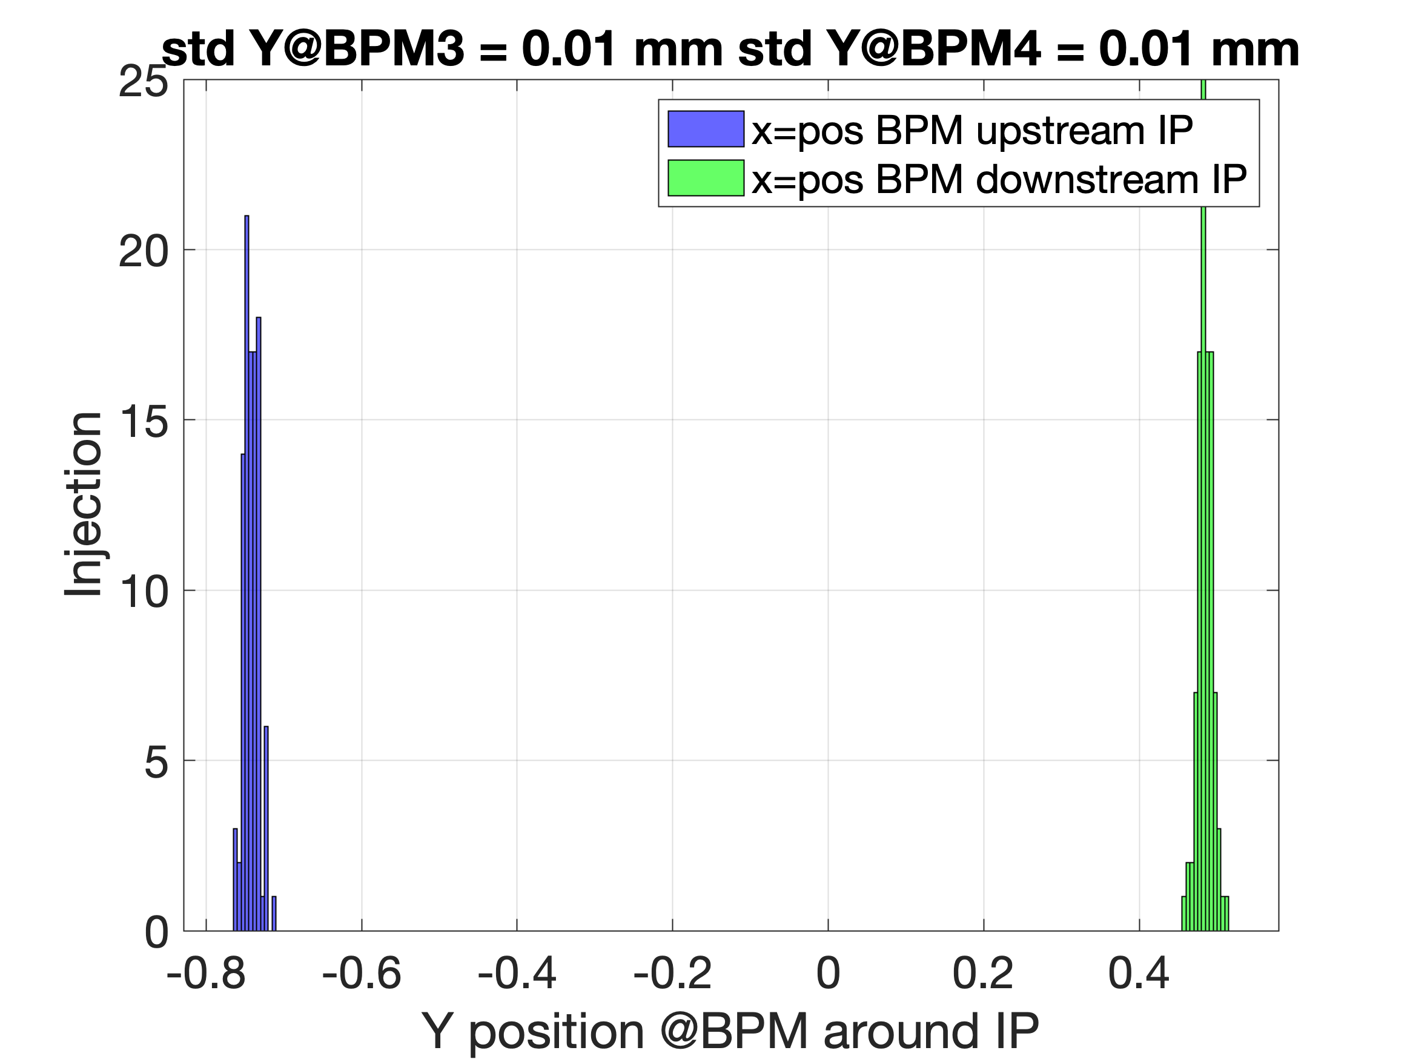
Stability (inj-to-inj) and IP BPMs
21st November

Slide 4
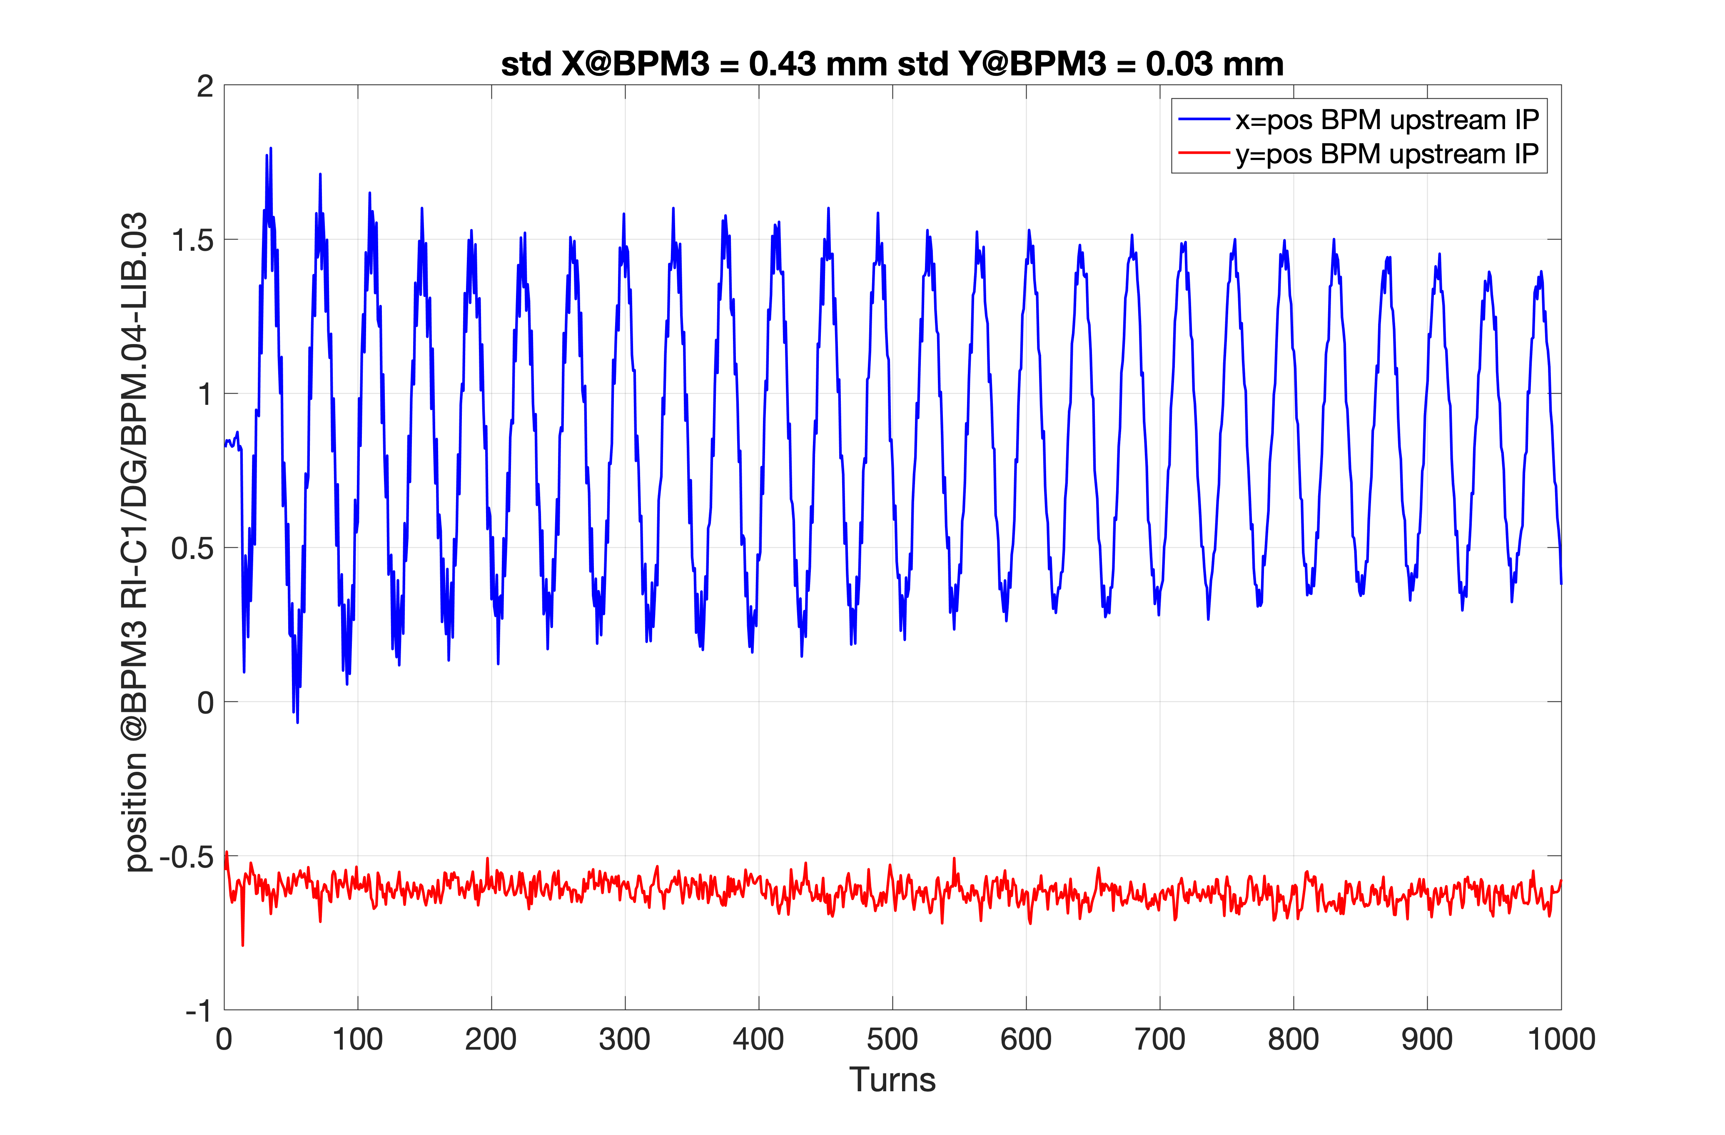
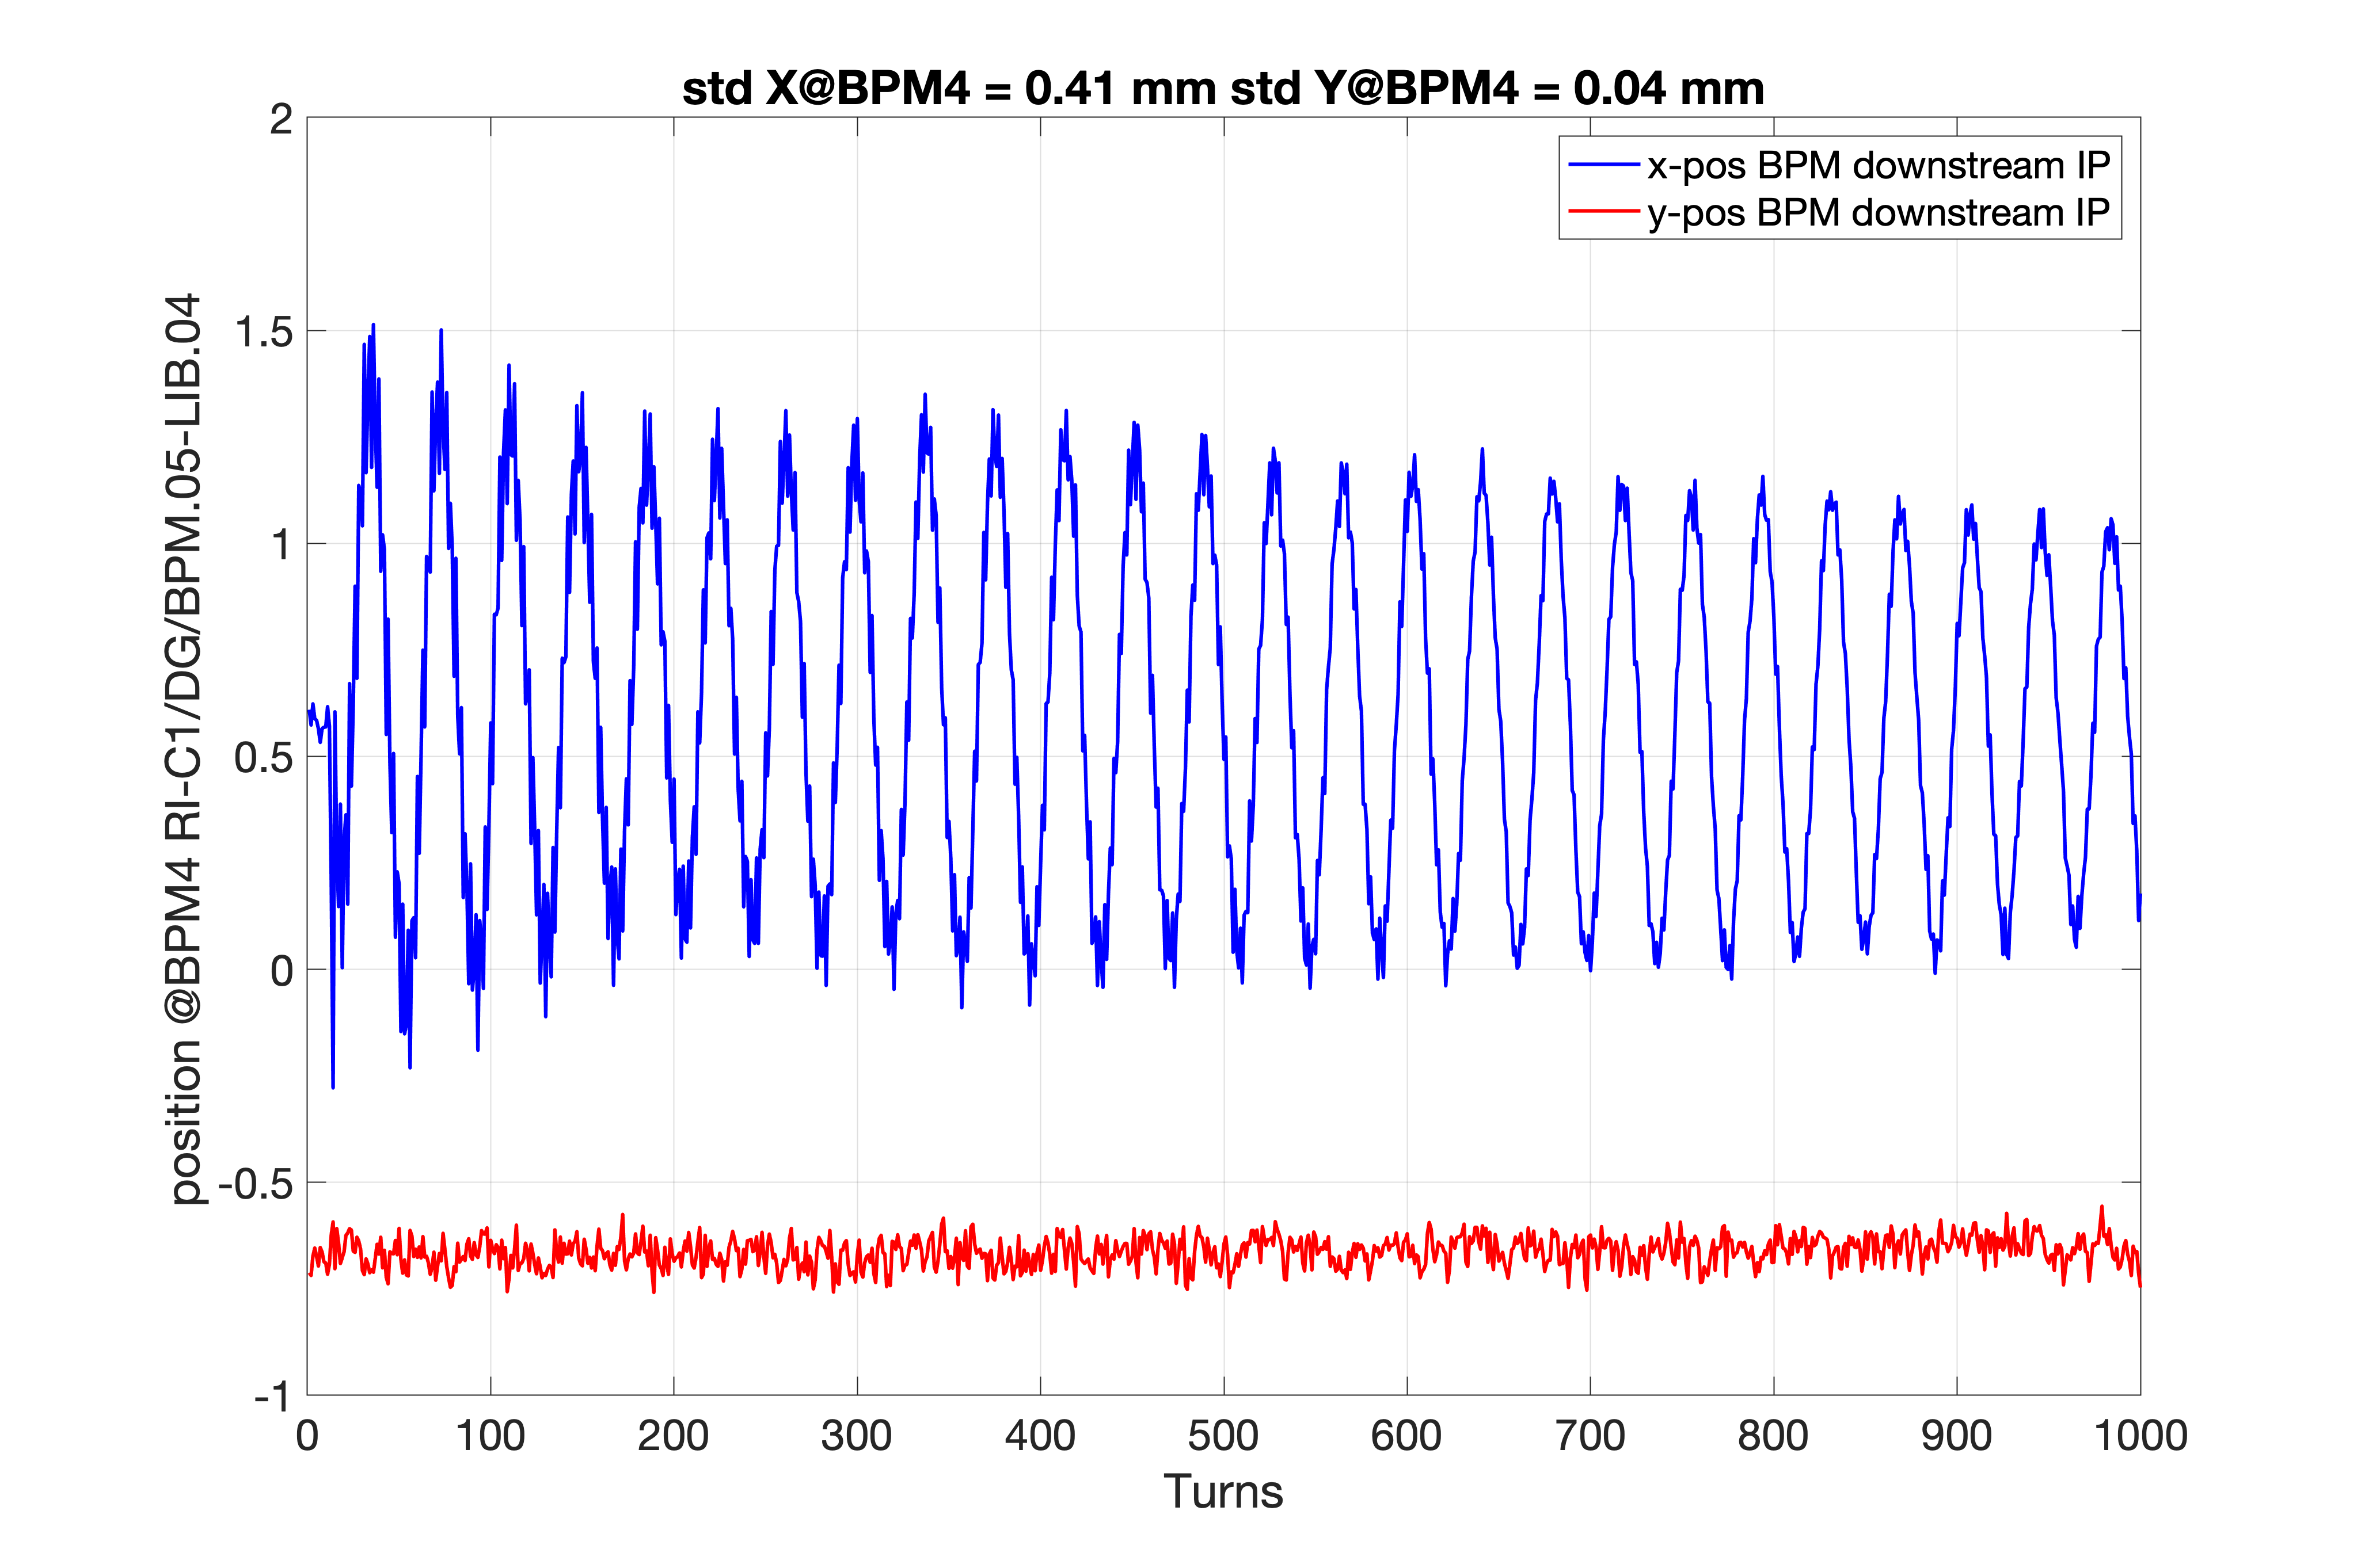
IP BPMs
15th November

Slide 5
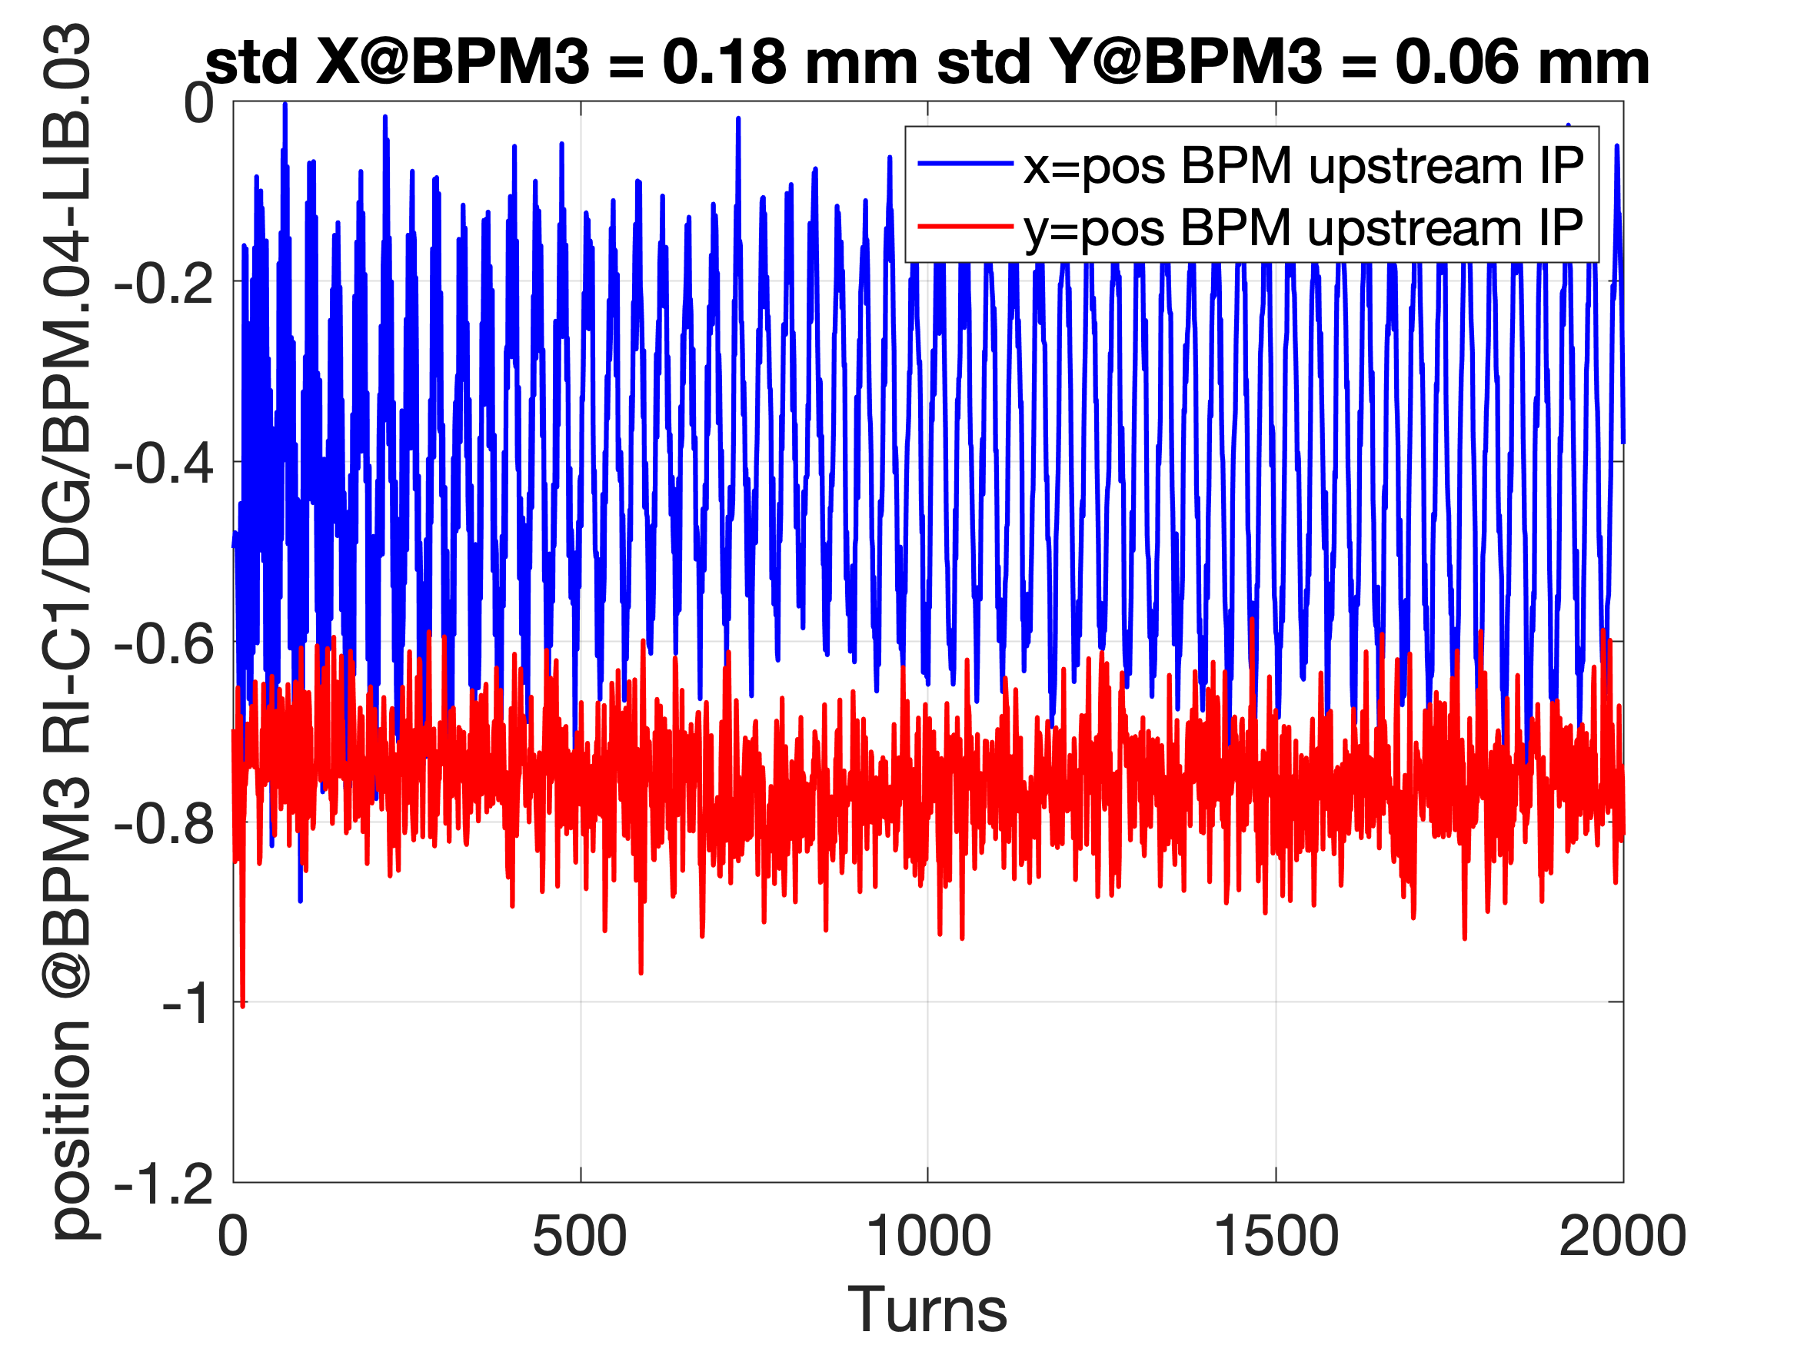
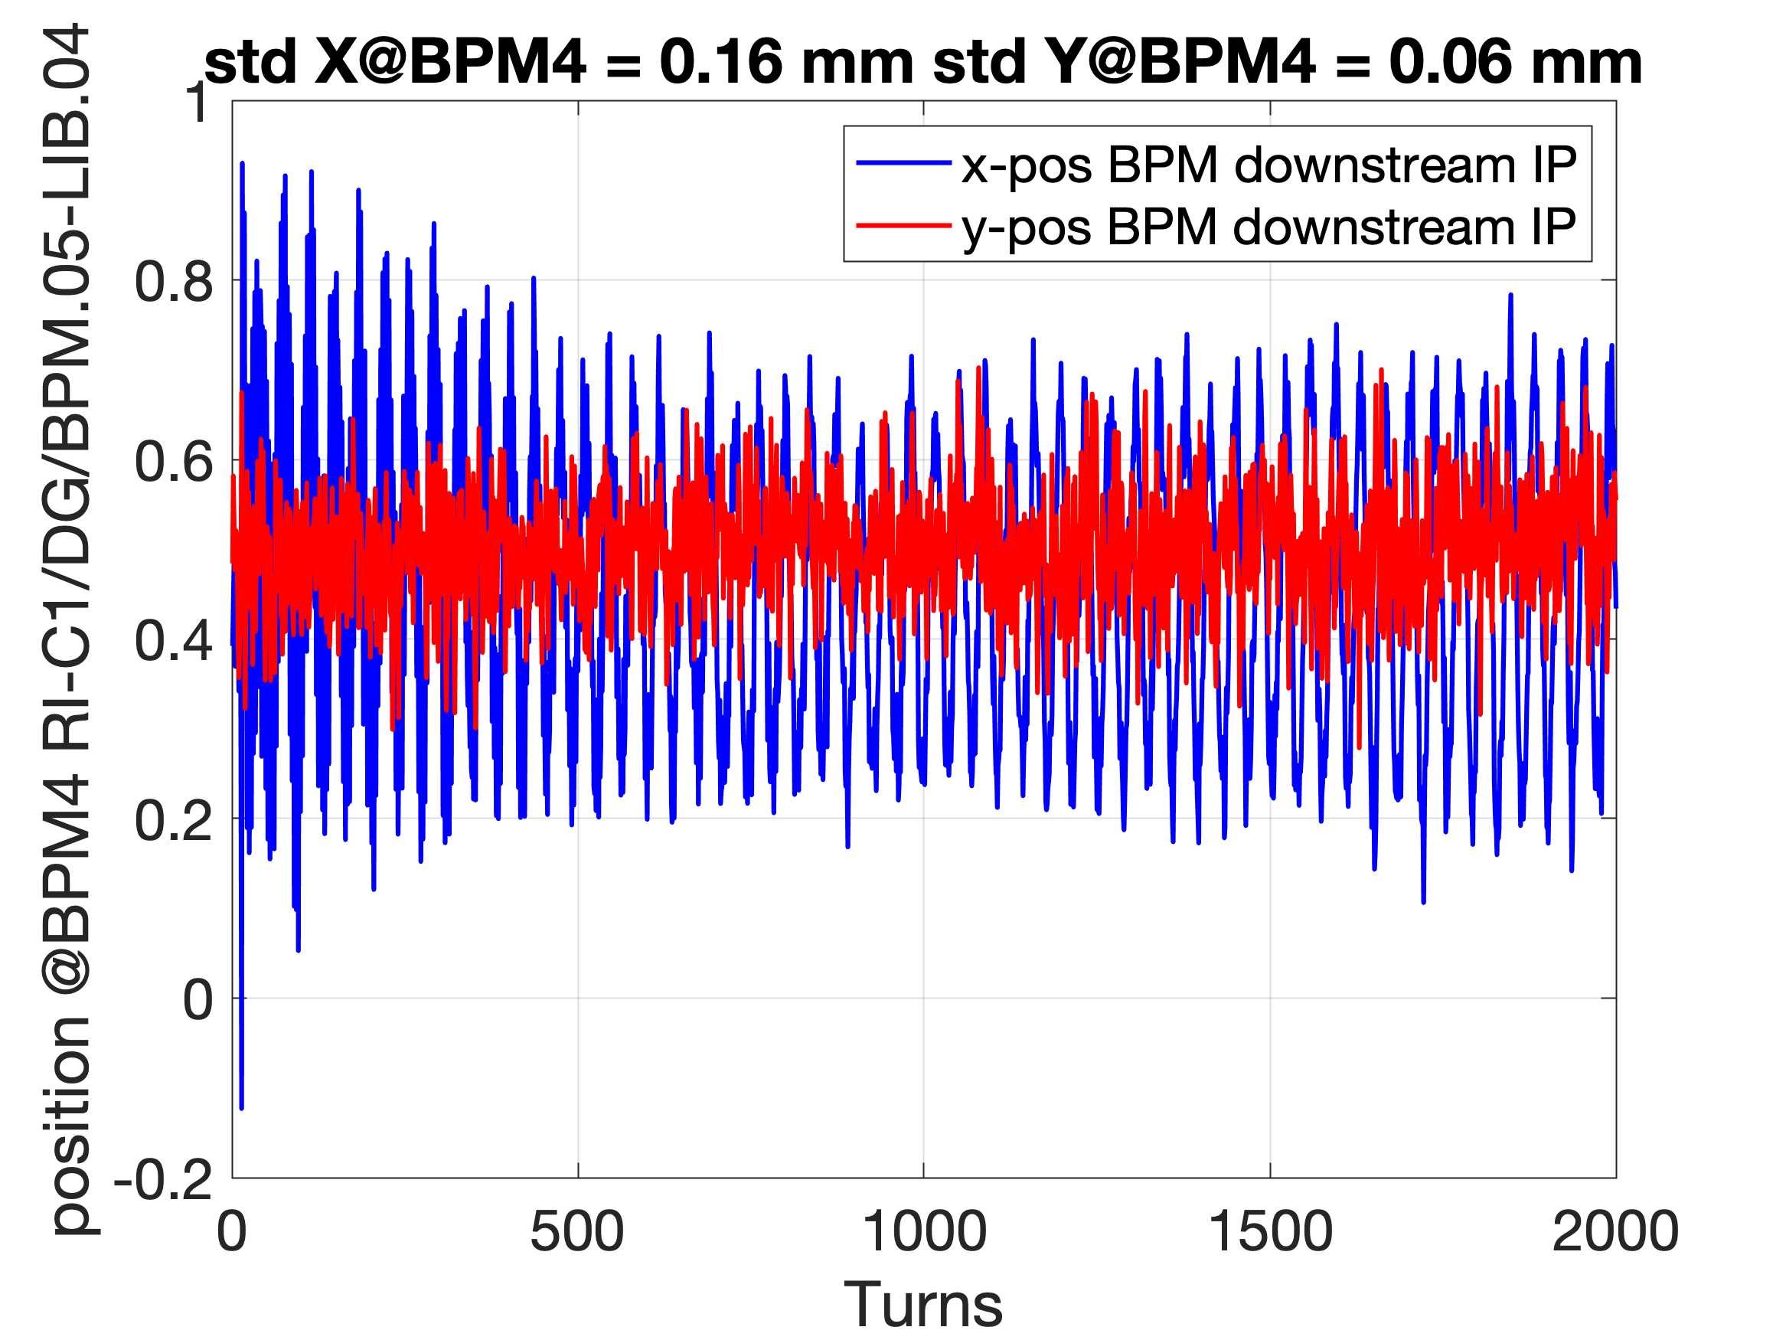
IP BPMs
21st November

Slide 6
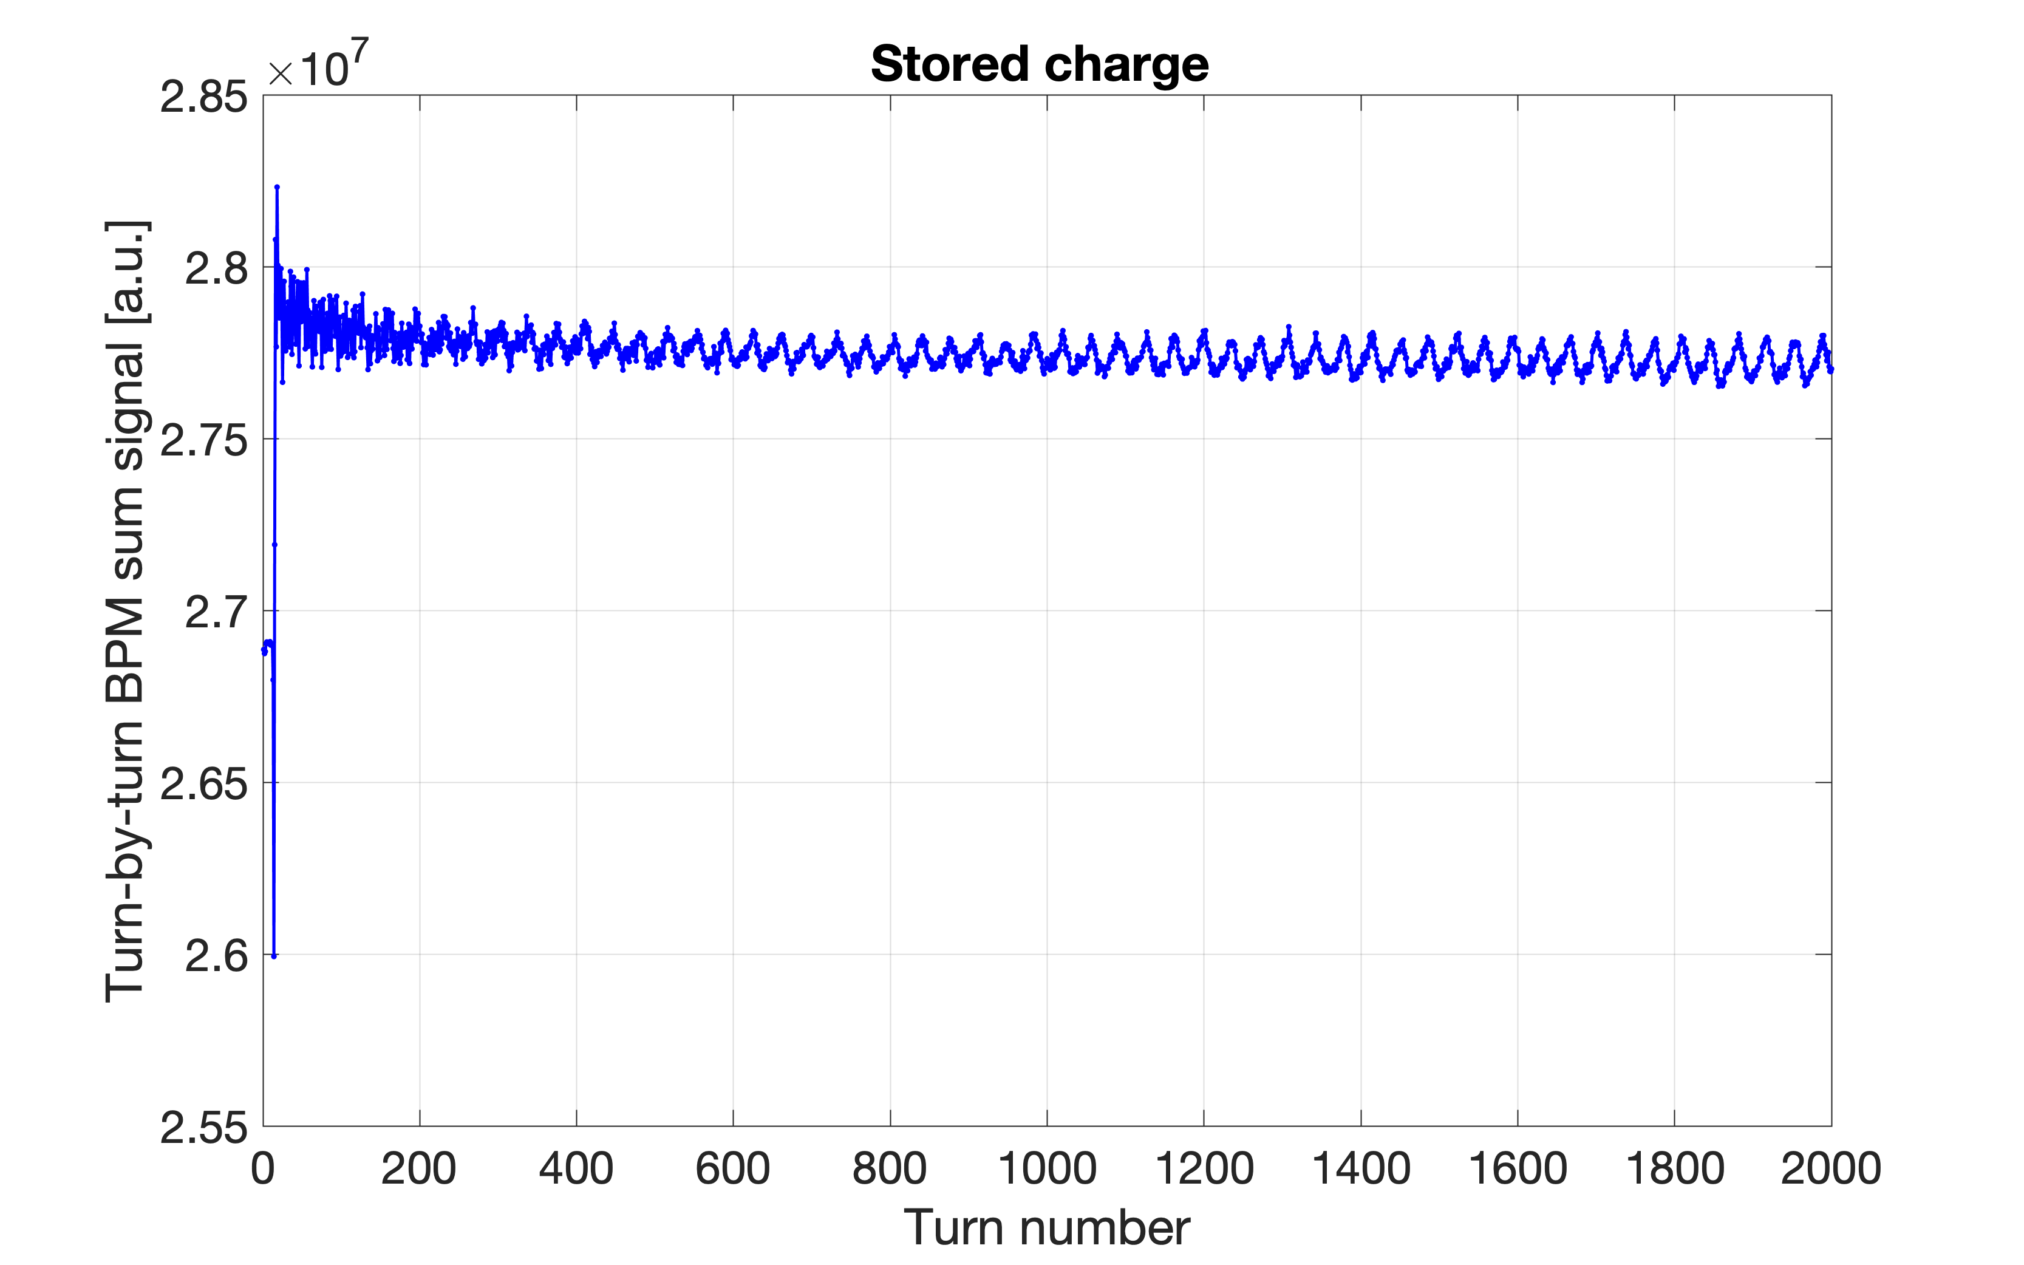
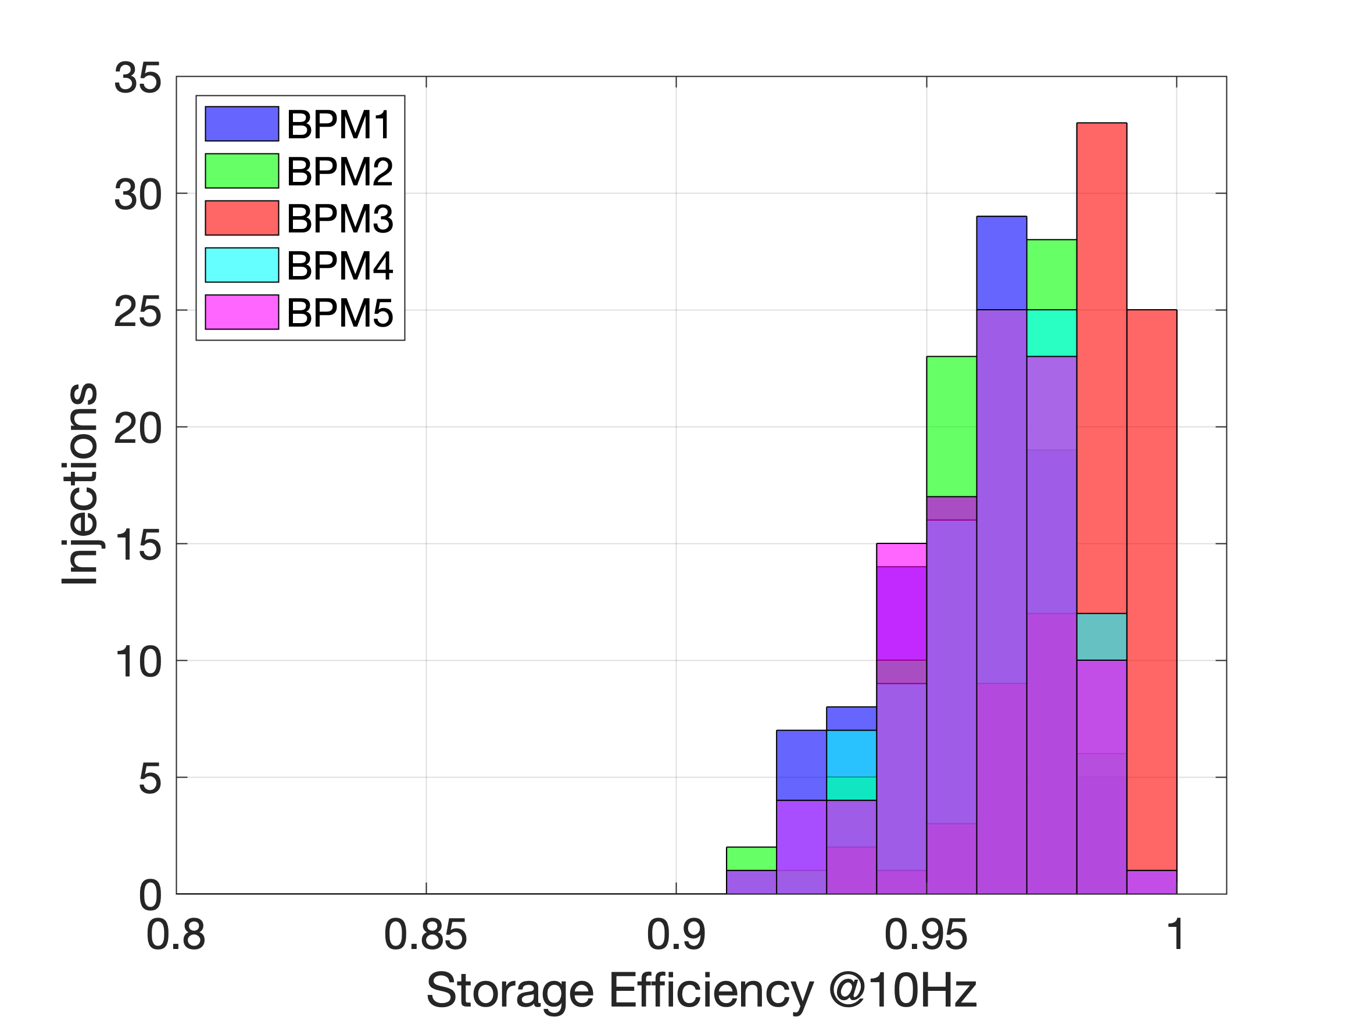
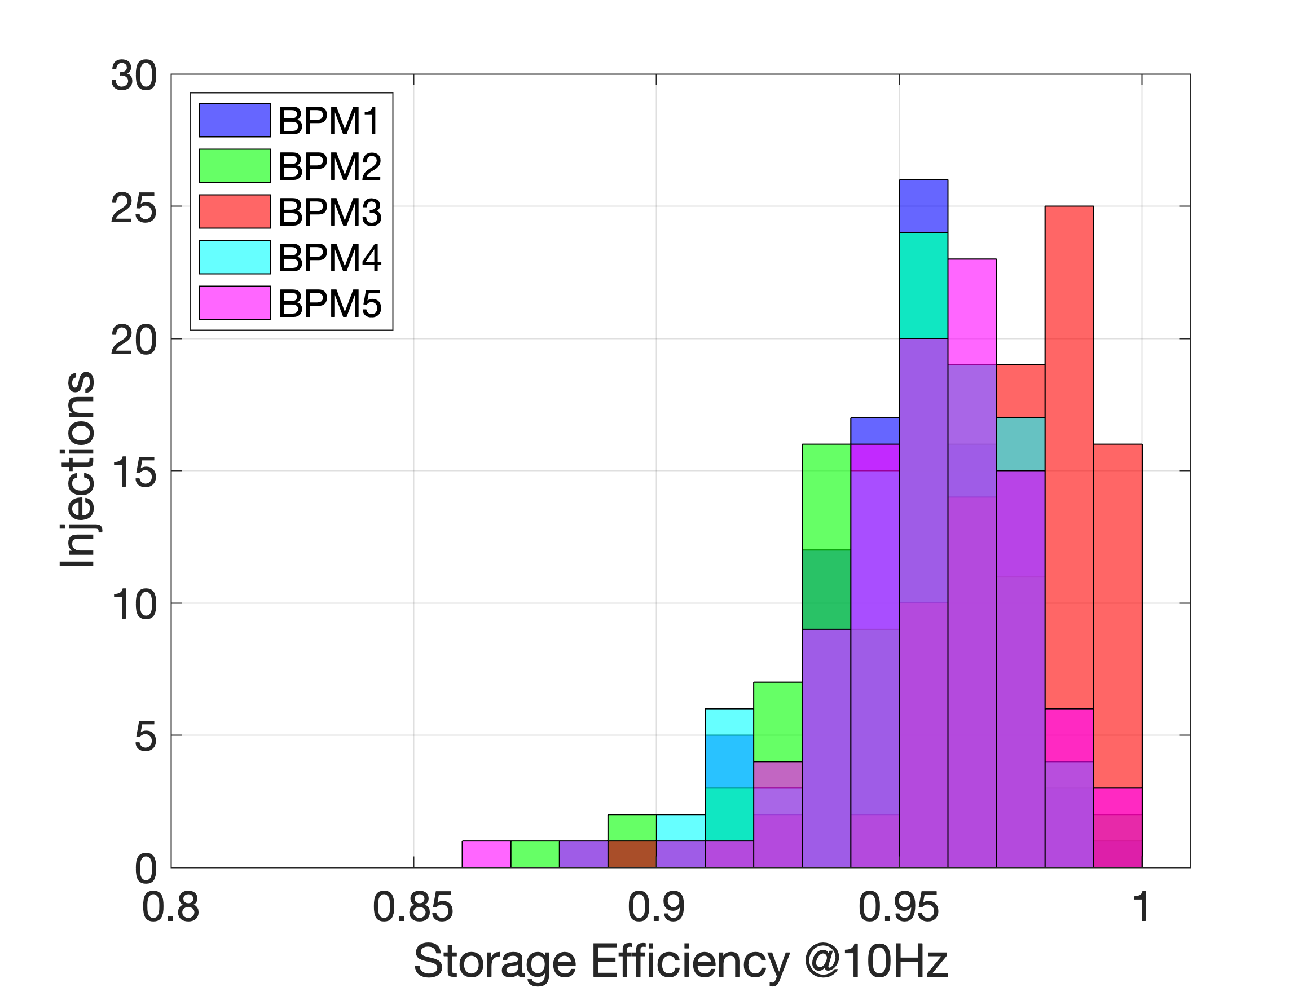
Storage Efficiency over 100 ms
21st November

Slide 7
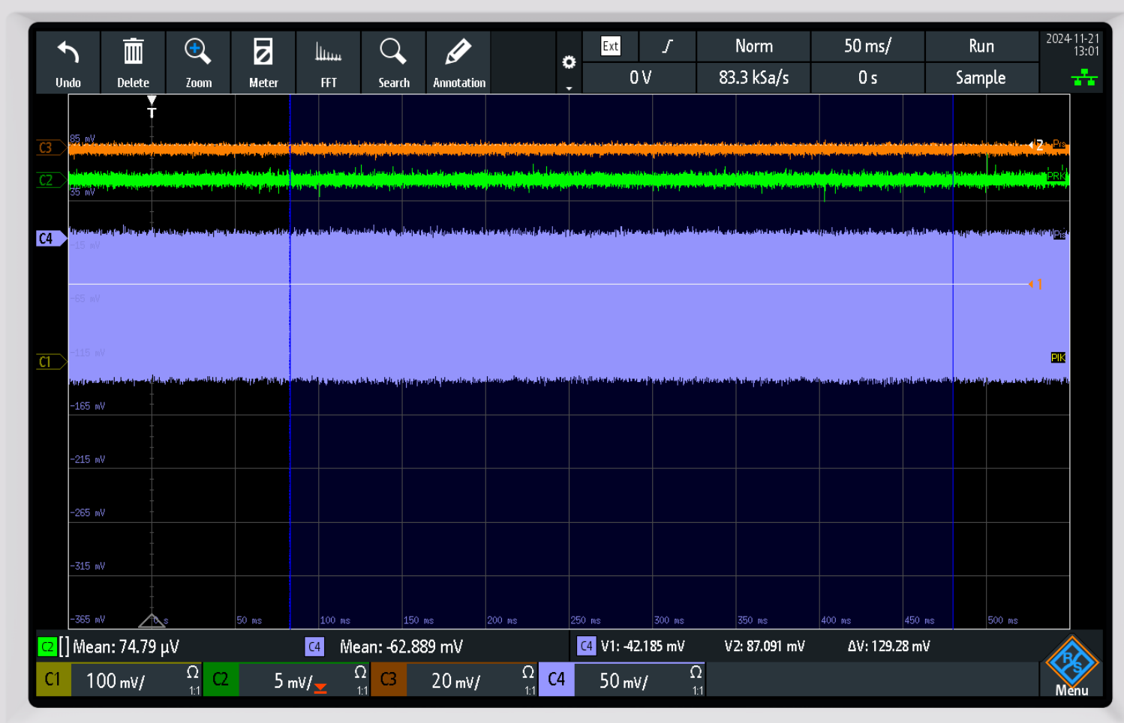
Storage efficiency on 21/11/2024

Slide 8
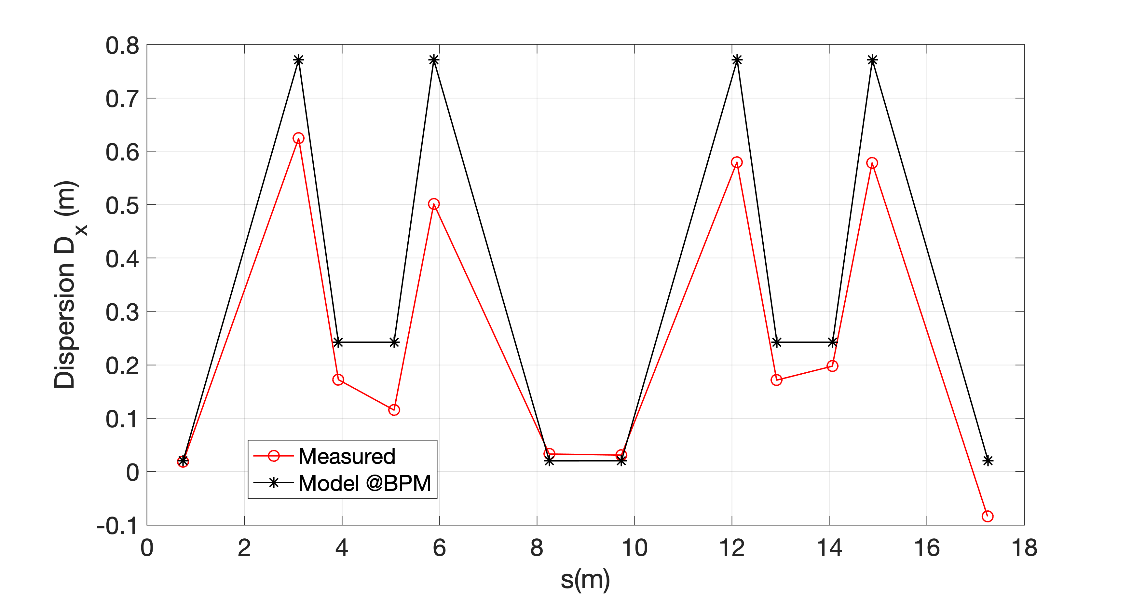
Dispersion measurement

Slide 9
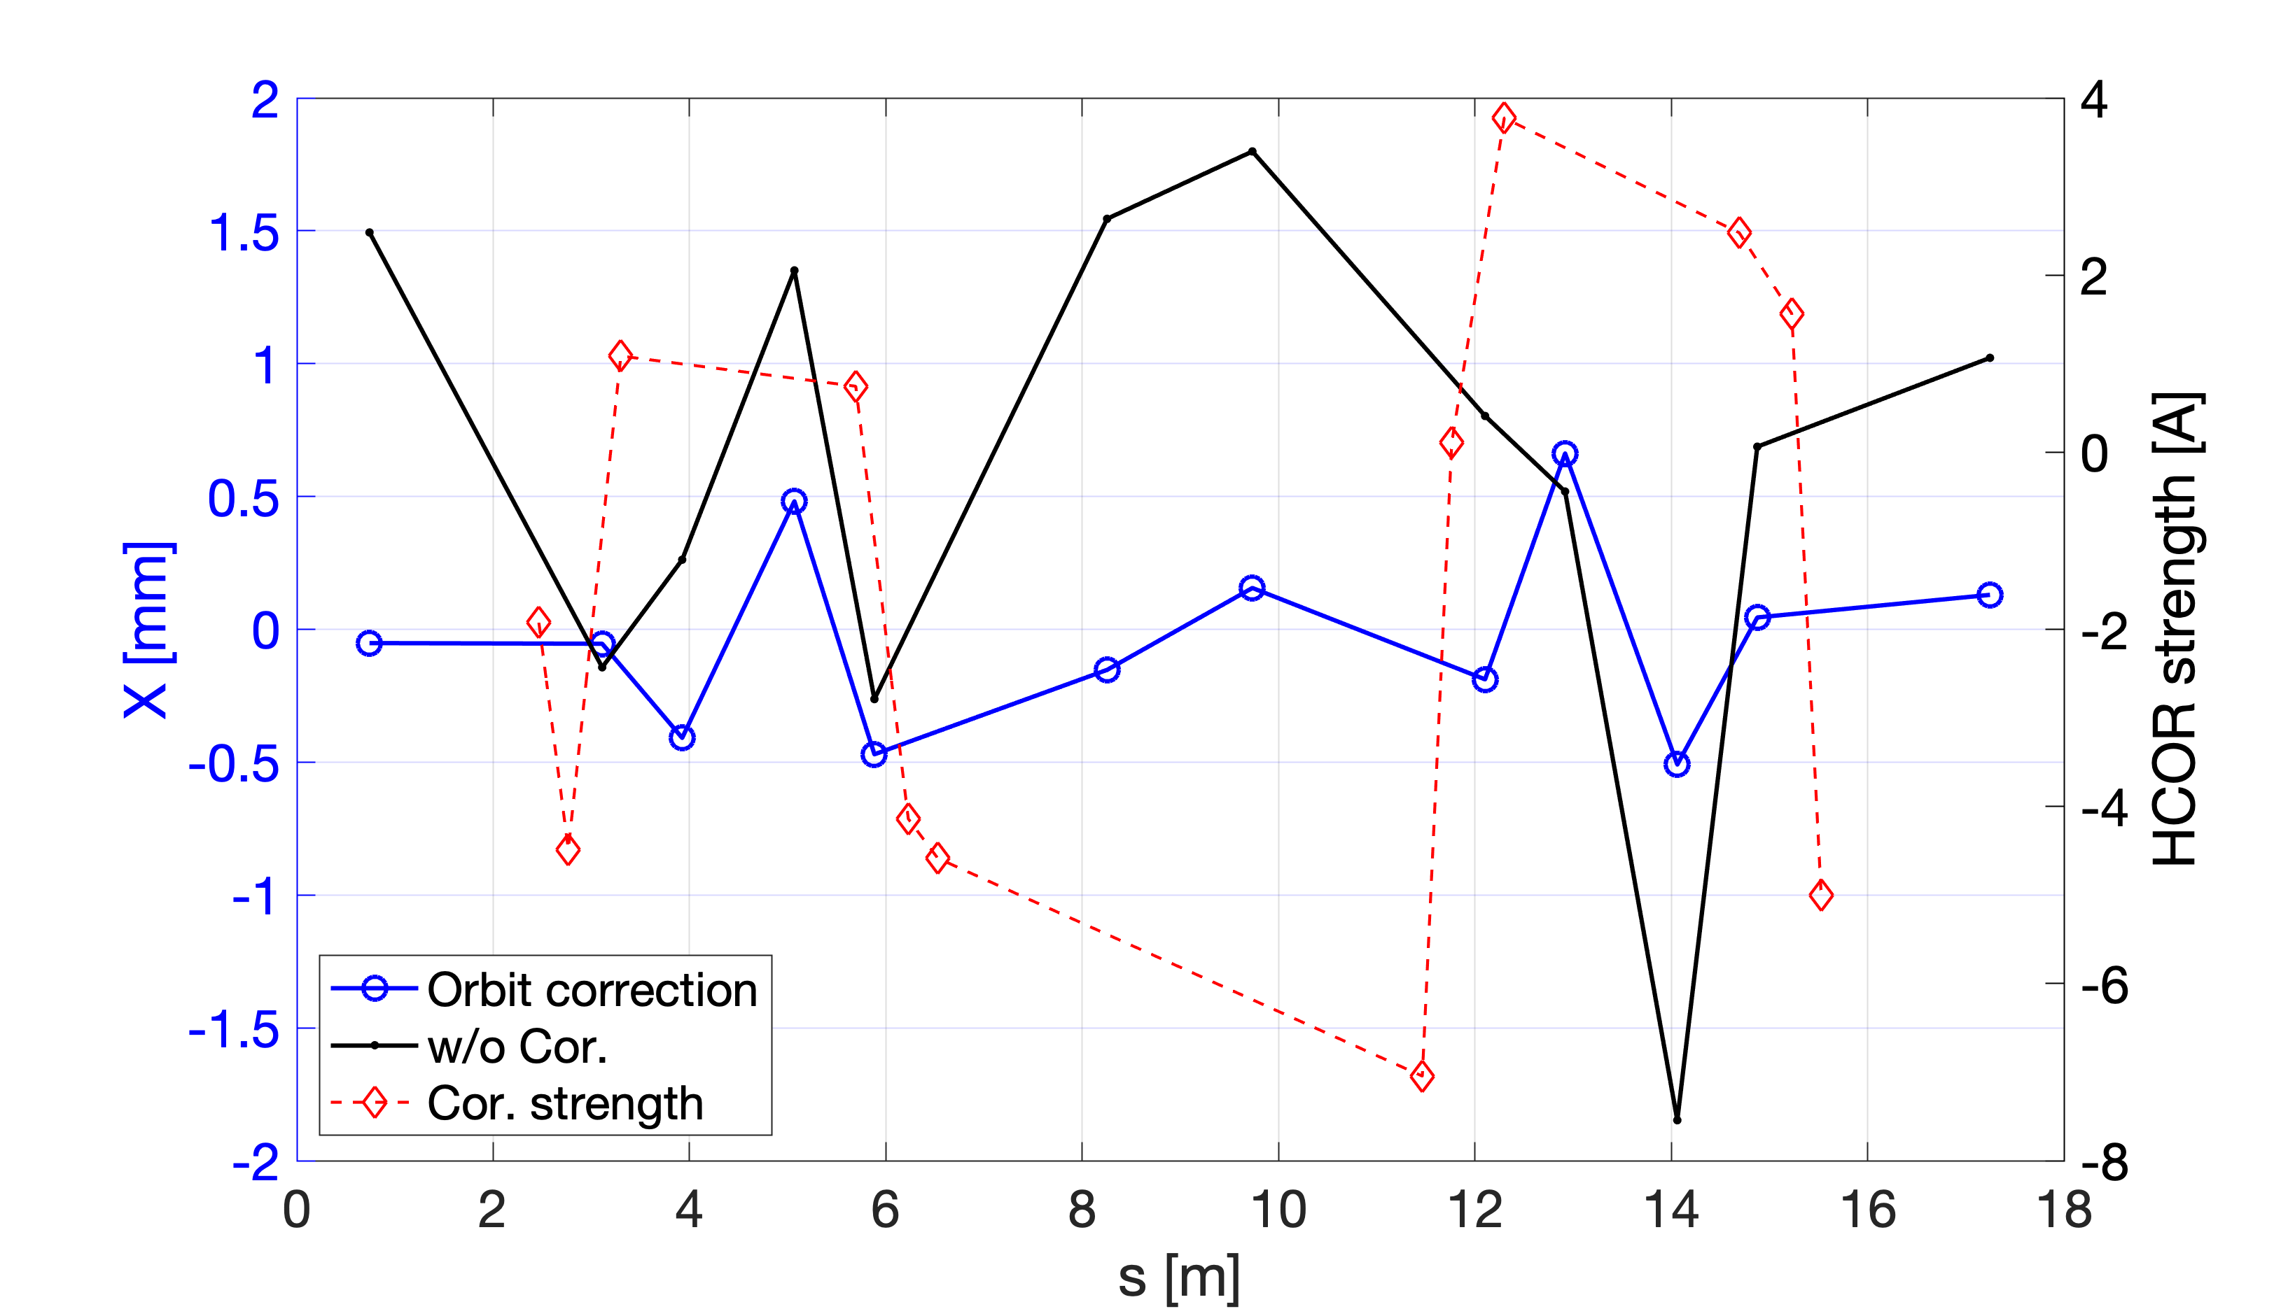
Orbit studies

Slide 10
Summary
Beam injected from the linac has a strange shape. Big oscillation of the charge (trigger-to-trigger and with time). It seems that there is a satellite placed at ~10ps range. To be investigated. Viktor checked the range od ~200 ps, it was OK and the shorter range to be checked.
Beam studies ongoing: orbit, dispersion, beta, chromaticity
Good storage demonstrated => efficiency 95-100 %
We need the diagnostics trigger, which can work for “single” injection.
MRSV: to supress the reflections, the movable polarized filter probably can be used. We need the dimensions to estimate the beam size. The full intensity can be used for charge monitoring. It would be good to have the measurements of the bunch length.
Shunt resistance for the dipoles should be re-installed.

