Slide 1
Update on
Beam measurement
Ring studies
2nd December 2024

Slide 2
Scope of work
Dispersion measurement for a set of the ring frequencies.
Shunt resistors of the ring bends were changed with a new ones (two resistors in parallel 22 Ohm 17 W and 47 Ohm 17 W = 15 Ohms)
Beam orbit for different ring frequencies (from 500.086 MHz to 500.1013 MHz ) were optimized to find frequency with minimum values of correctors.
It seems that 500.096 MHz is more promising.

Slide 3
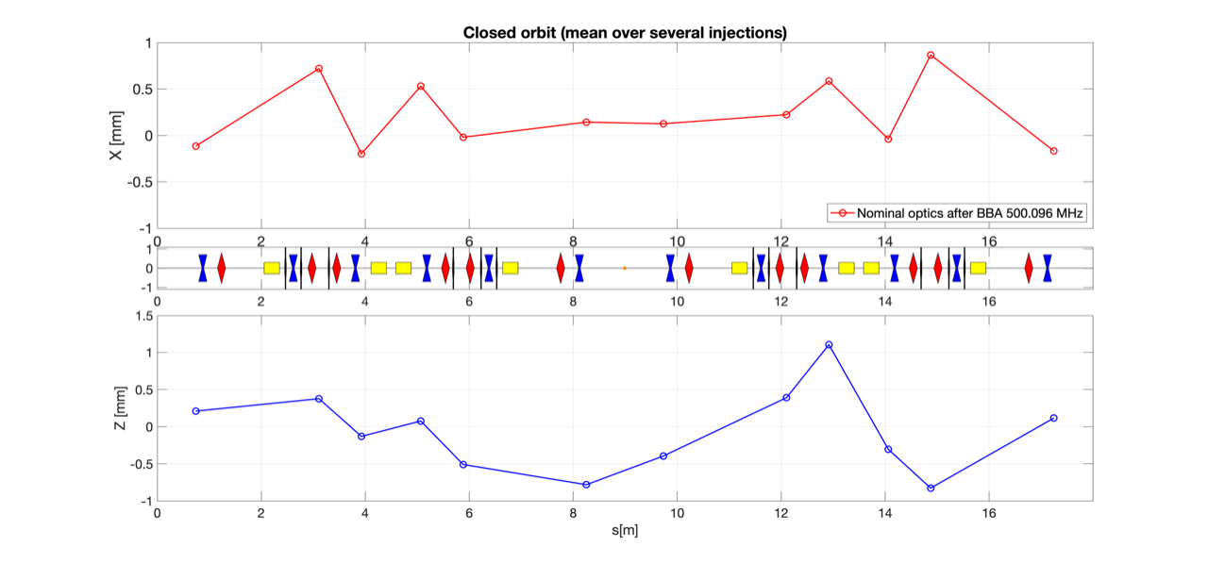
Orbit studies (F = 500.096 MHz)

Slide 4
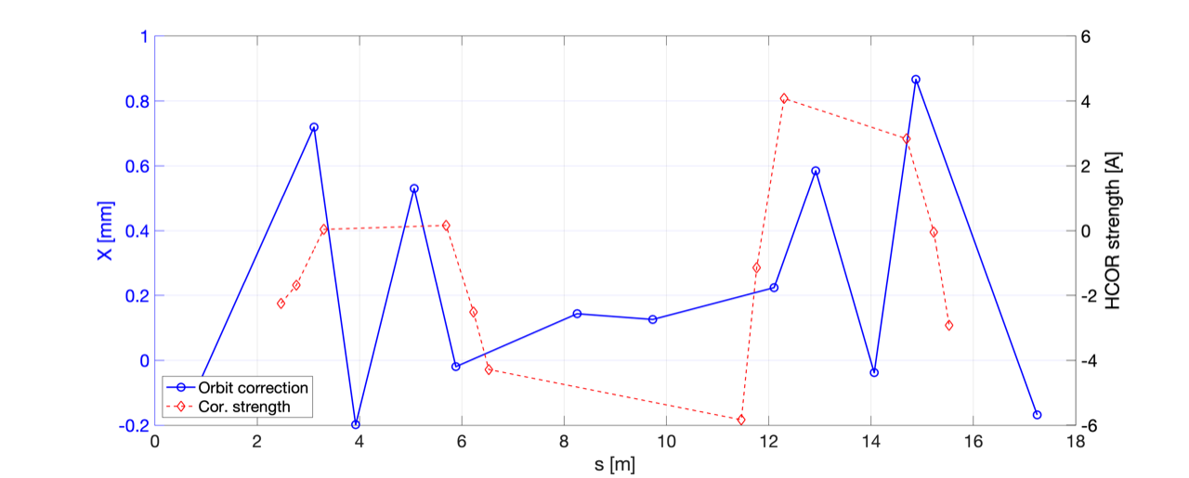

Slide 5
Simulation of particle motion through a couple of the ThomiX bends at 50 MeV

Slide 6
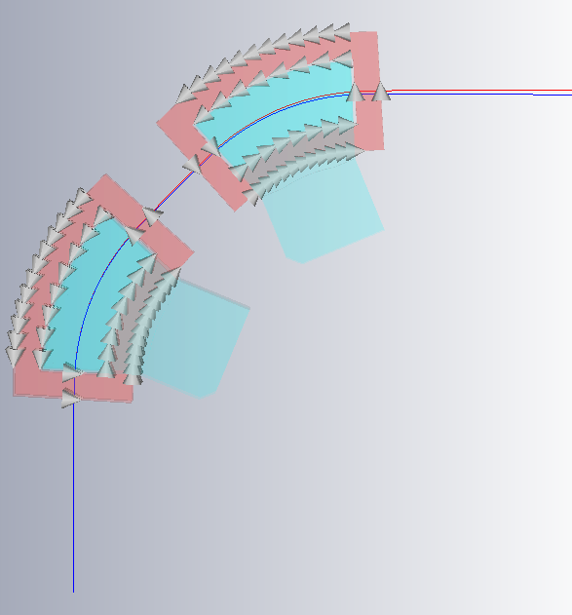
Simulation of particle trajectory at 50 MeV
An arbitrary straight line with tilt of 45° and the 50 MeV particle trajectory
Zoom
The trajectory of a particle is not linear between the bends.

Slide 7
Summary
We need to continue BBA for the new frequency.
Beam studies ongoing: orbit, dispersion, beta, chromaticity.
We still need the diagnostics trigger, which can work for “single” injection.
It is necessary to perform extraction to determine whether the beam, which might persist following the firing of the injection kicker, impacts beam storage.
To proceed with higher energy, we need two sets of linac working points @61.5 MeV, @70 MeV.

