Slide 1
Bilan X-ray
Shift 26/11/2024

Slide 2
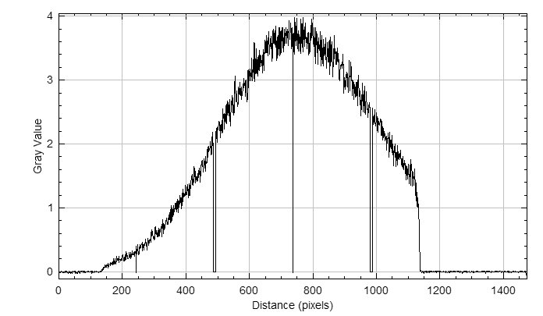

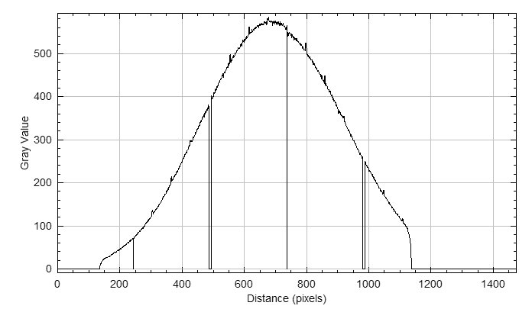

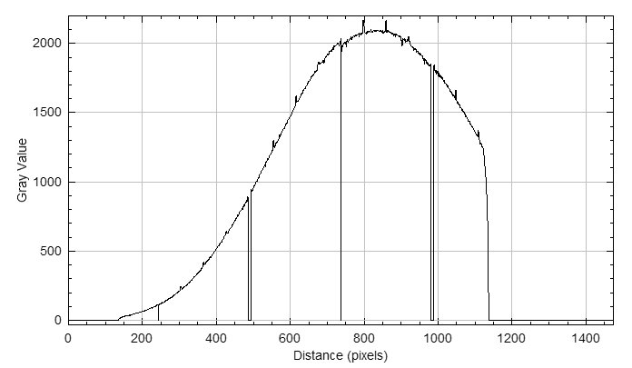

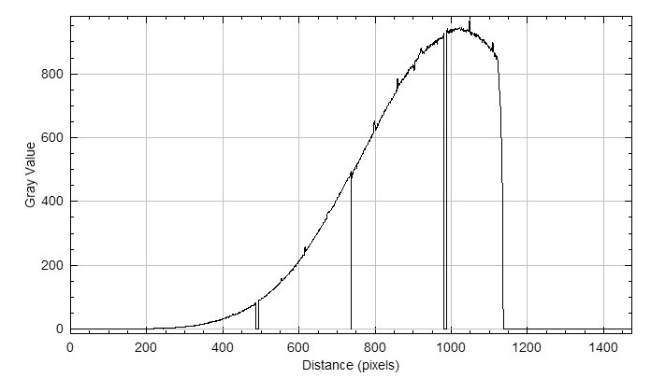

Shift VS phase
Phase :
4,45V
~= 115°
Phase :
5,45V
~= 154°
Phase :
6,45V
~= 181°
Phase :
7,45V
~= 198°

Slide 3
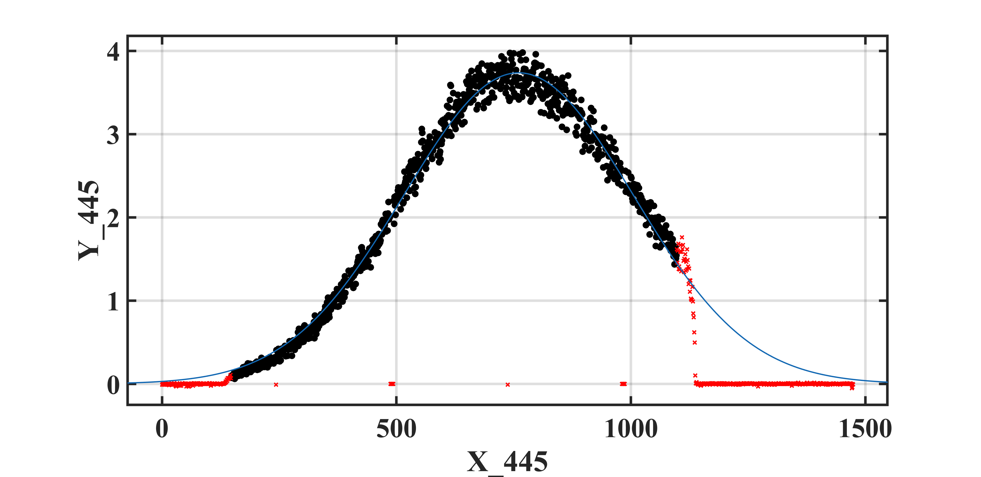
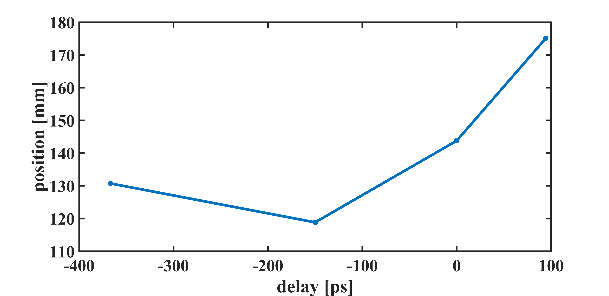
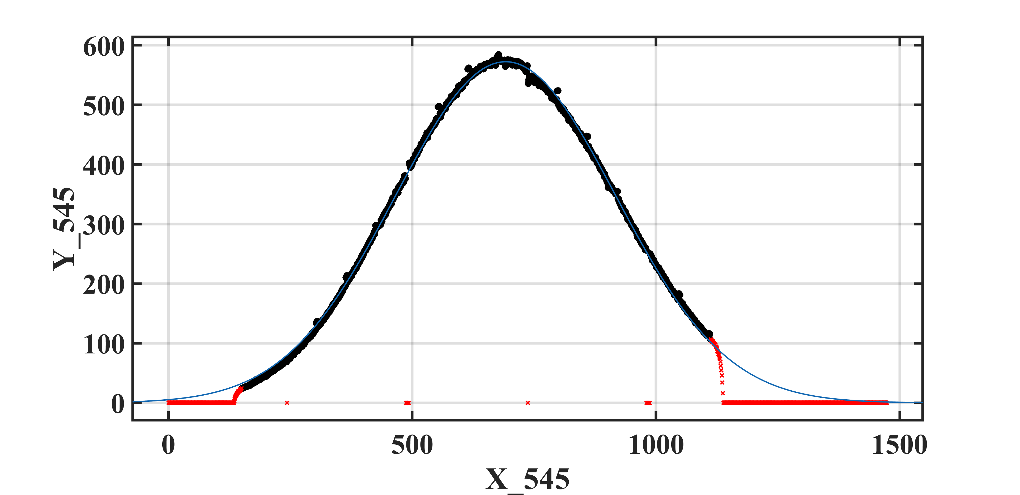
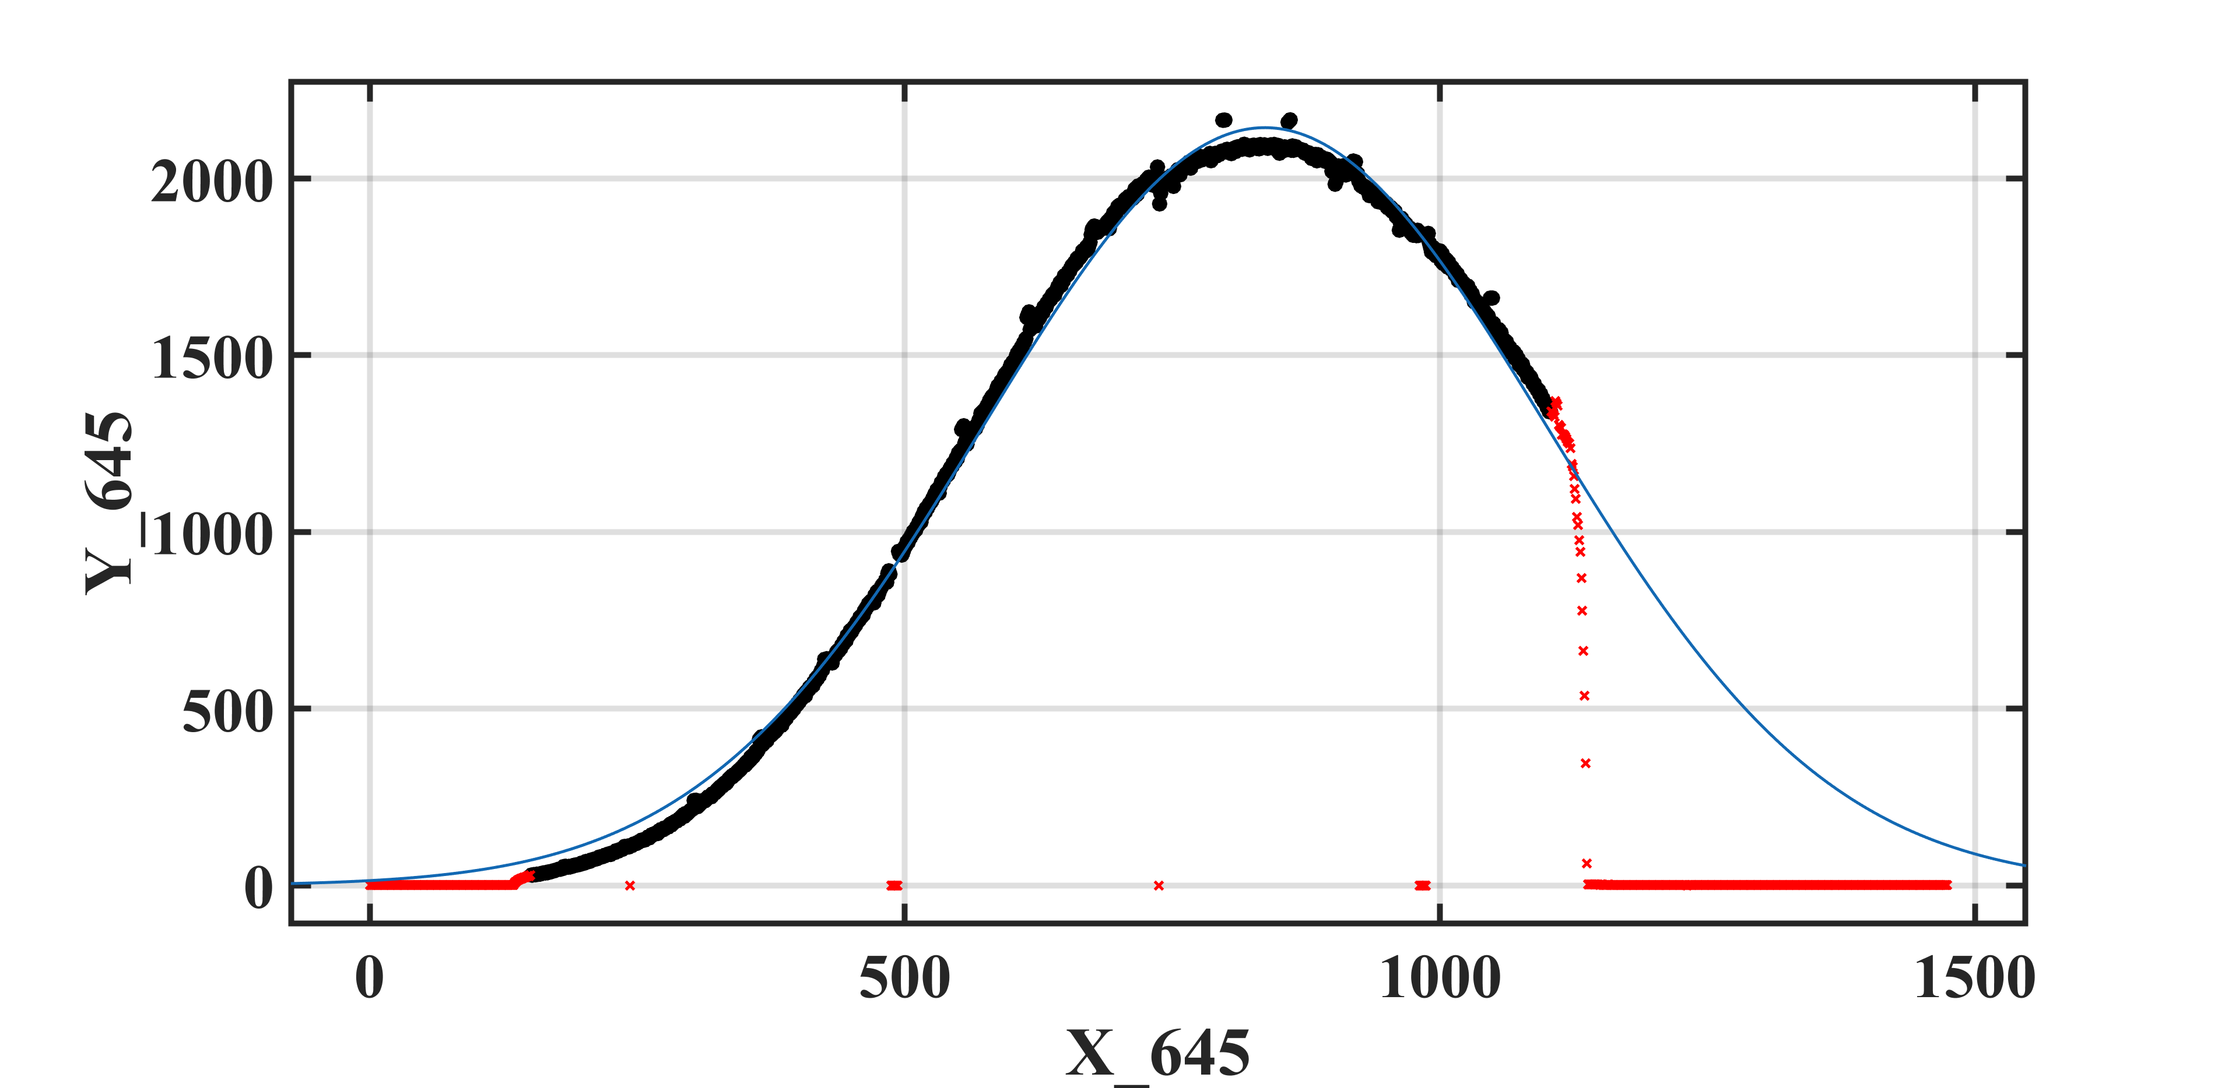
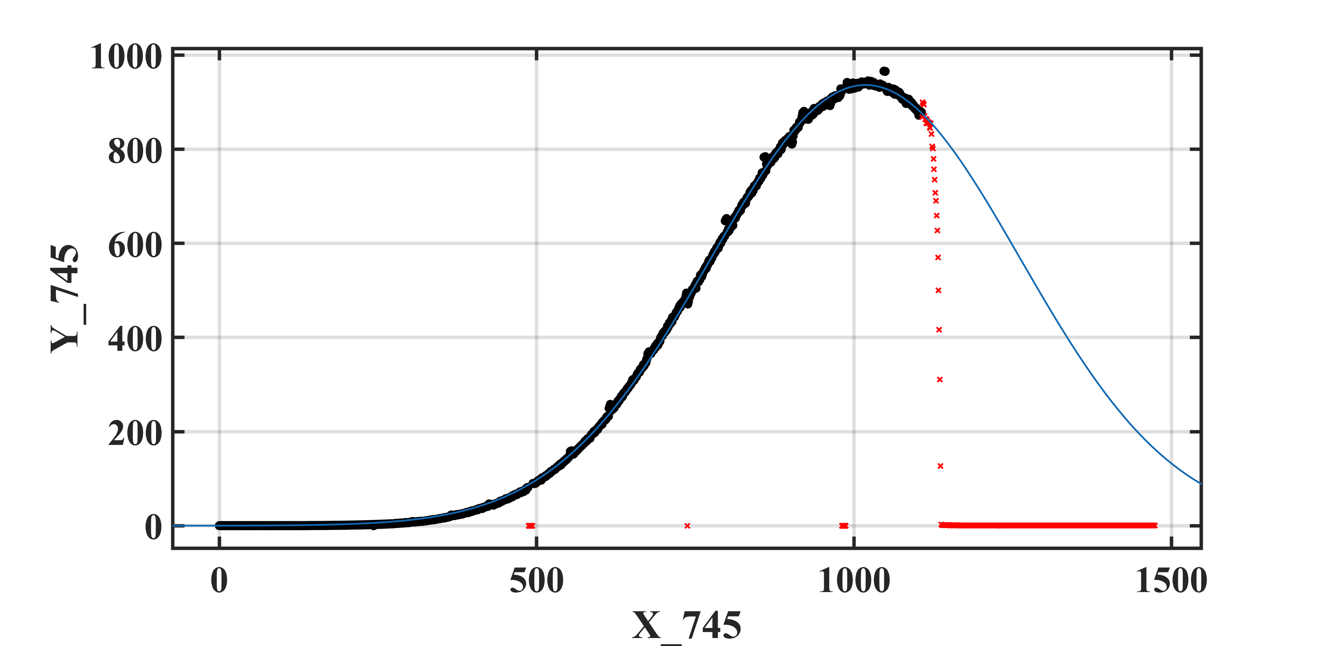
Résultats fit et position Vs delay
Position of beam VS delay (e-/laser)
Phase shifter response

Slide 4
Issues to be adressed/discussed
X-ray beam position
Beam on right of the tube (left downstream)
➔ electron beam direction defect:
Incorrect orbit
Incorrect interaction point position (in dipole field)
Else ?
X-ray beam position shift with phase
➔ electron beam direction defect:
Incorrect interaction point position (in dipole field)
Incorrect electron beam path (residual dipole field between dipole)
Incorrect beam shape ? Cm scale ?
Else ?

Slide 5
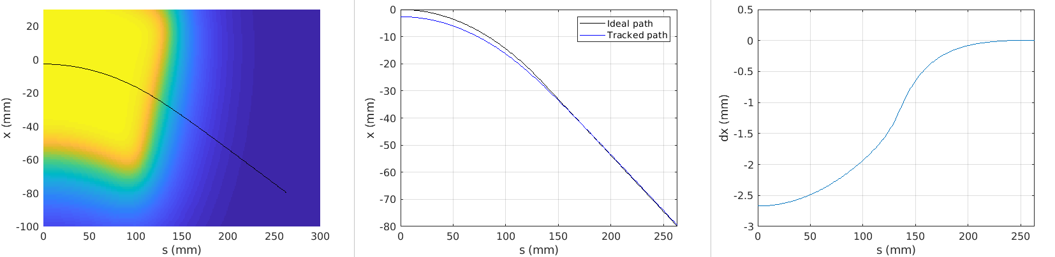
geometry
Axe CFP (2°)
~200mm
Main X-ray direction (to be confirmed)

