Slide 1
Some update for ThomX from 17 December and 19 December

Slide 2
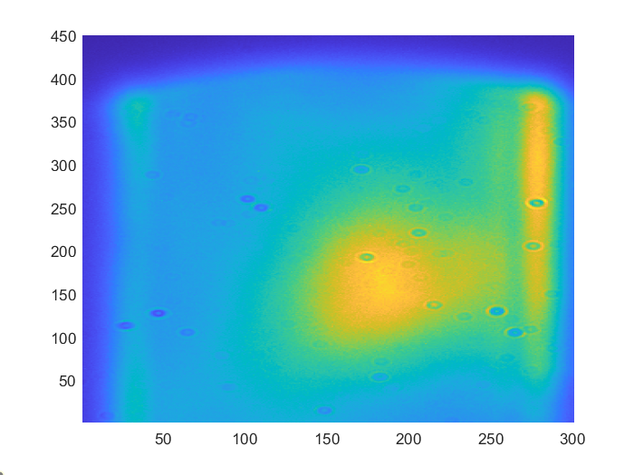
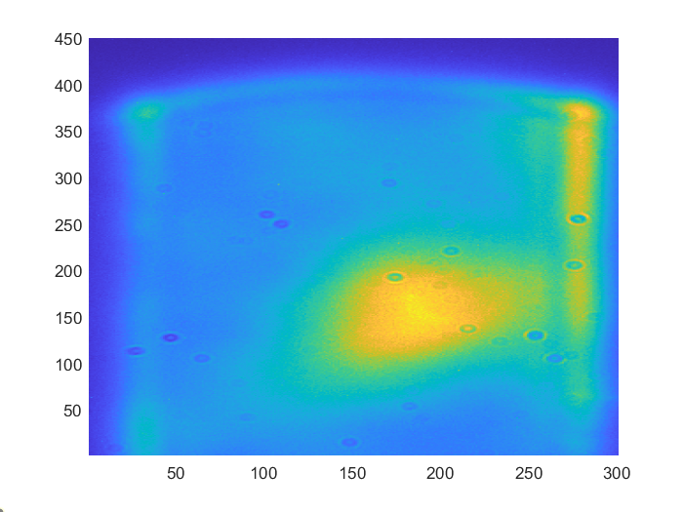

Single trigger mode was set at 17:31
SynchrotronLight20241217_17h31
SynchrotronLight20241217_17h32
SynchrotronLight20241217_17h33

Slide 3

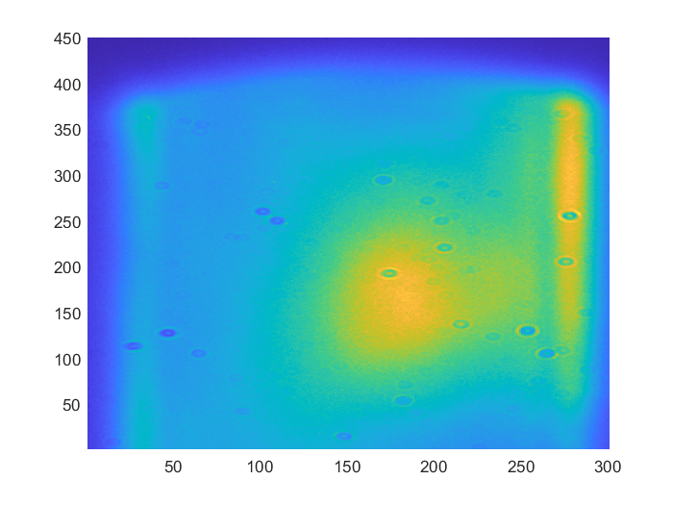
Continue of the single trigger mode
Trigger was set to 10 pps
Results from vertical profile of synchrotron light processing
SynchrotronLight20241217_17h34
SynchrotronLight20241217_17h36

Slide 4
Decay of integral pixels intensity (full image).
Two decay time constants: 20 s and 387 s

Slide 5
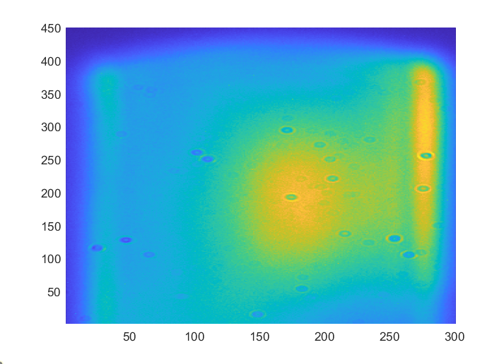
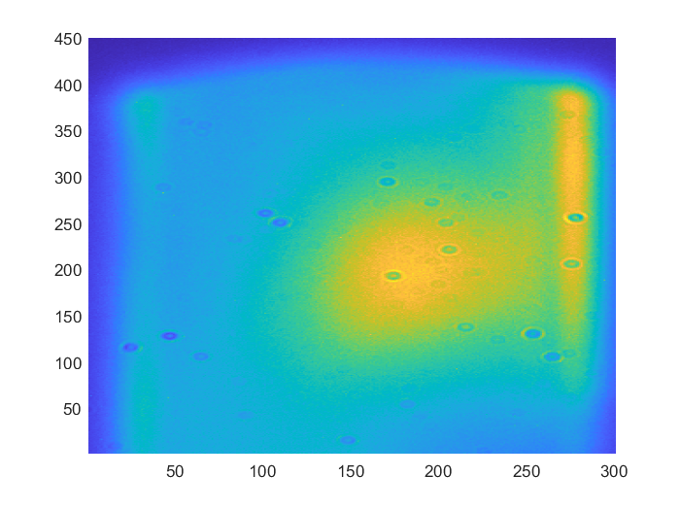
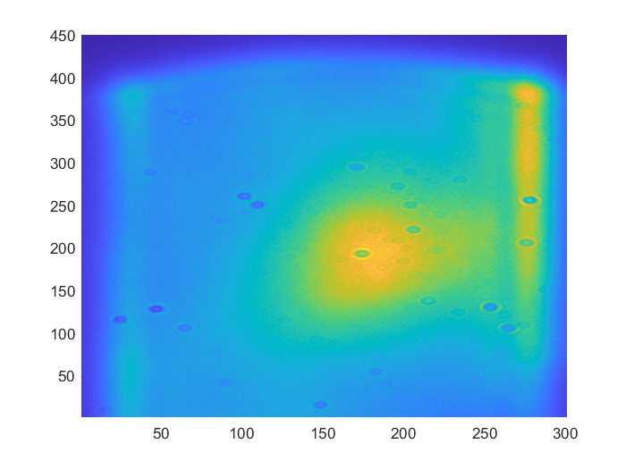
SynchrotronLight20241219_17h59
SynchrotronLight20241219_18h09
SynchrotronLight20241219_18h29

Slide 6
FPC table vertical scan from 19/12/2024

