Slide 1
iSAS WP5 from a beam dynamics perspective
Possible codes, workflows, and applications

Slide 2
iSAS beam dynamics: my tasks
Perform SRF cavity, wakefield, higher order mode, beam loading, beam breakup,… studies and provide feedback for the iSAS cavity design at ESS
Find possible collider/light source applications for iSAS ERL technology
ERL collider efficiency simulations after degrading of beams in collisions ➔ collective effects, stability, and efficiency studies for a possible application of the technology to colliders.

Slide 3
Wakefields
Wakefields
Any variation in the beam pipe causes a perturbation in the particle EM field ➔ part of particle energy to establish EM wakefields that remain behind
Excitation of higher order modes in RF structures beside the fundamental accelerating mode

Slide 4
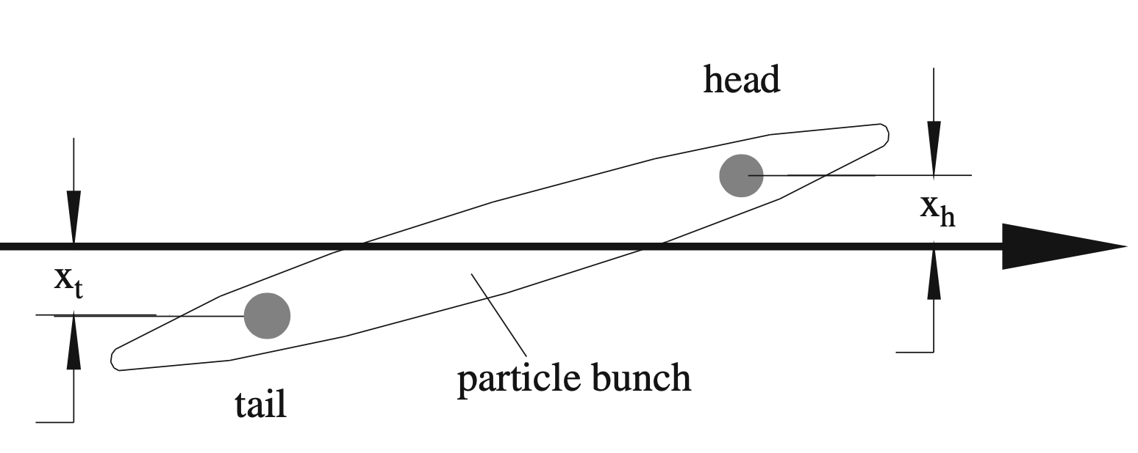
Single bunch instabilities
Longitudinal instabilities:
Beam loading
Longitudinal wakefields of a particle travelling through RF cavity influence the accelerating gradient the particle sees and subsequent particles see
➔ Problems in efficiency of the cavity both in acceleration/deceleration mode
Transverse instabilities:
Beam breakup
Strong transverse wakefields of the head of a single bunch influencing the tail causing beam blow up

Slide 5
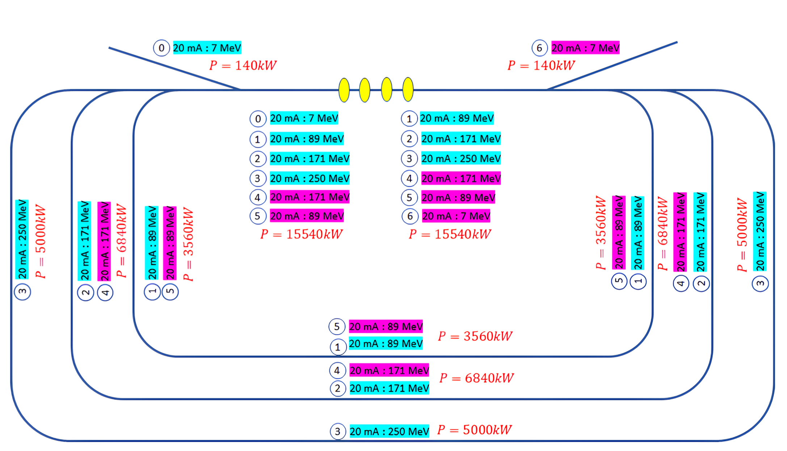
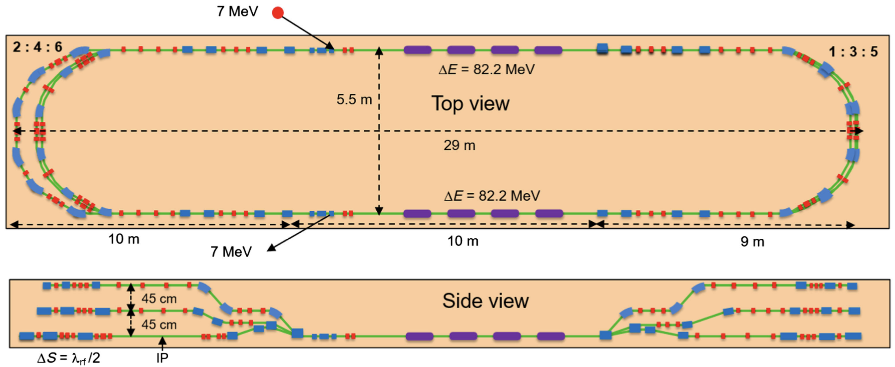
Multi-bunch instabilities
Multi-bunch instabilities
Wakefields that persist long enough to influence subsequent bunches ➔ unstable bunches: Beam loading, beam breakup
Importance for a multi-pass ERL
➔ Subsequent bunches with varying beam energies and bunch spacing; example PERLE [1]
➔ Complex! What tools we need?

Slide 6
Evaluation of possible beam dynamic codes
Bmad/Tao (Cornell)
Large accelerator toolkit containing single and multi--particle beam dynamics; collective effects; wakefields; multi-pass recirculation; Linacs and circular machines ➔ great comparison tool for CERN codes
Xsuite (CERN)
Initiative to combine all capabilities of different accelerator tools developed at CERN in a single flexible and modern framework (Sixtrack, PyHEADTAIL (collective effects, wakefields), …); Optimized for circular machines; No multi-pass recirculation
➔LHC, SPS, FCC, ...; Extensively benchmarked versus observations!
BLonD (CERN)
Fork of PyHEADTAIL with additional longitudinal diagnostic and feedback tools ➔ plans for implementation in Xsuite
PLACET2 (CLIC - CERN)
Wakefields in linacs + single- and multi-bunch effects; multi-pass recirculation
RF-Track (CERN)
Wakefields in linacs + single- and multi-bunch effects (same model as PLACET2); no multi-pass recirculation; Interfaced to Xsuite
➔ Employ combination of RF-Track and Xsuite

Slide 7
RF-Track (Andrea Latina)
Complex 1D, 2D, 3D EM fieldmaps for RF structures (with fieldmap interpolation)
Accurate integration of the equations of motion
Collective effects
Incoherent synchrotron radiation
Coherent synchrotron radiation (to be added)
Space charge
transverse and longitudinal long-range and short-range wakefields (monopole and dipole higher order modes )
Beam loading
Instability studies
No multi-pass recirculation
Interfaced to Xsuite ➔ can be used for existing (CERN) circular lattices
Modular, flexible, and fast (parallel and optimised in C++) with Python and Octave interface
Currently used to design and optimise: FCC-ee pre-injectors linacs, CLIC and FCC-ee positron source, muon collider's final cooling channel, medical accelerators, etc.

Slide 8
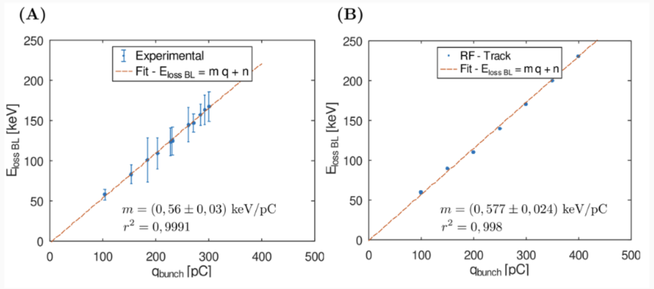
RF-Track: beam loading study example
Beam loading at CLEAR (150 bunches injected in CLEAR photo-injector) [2]

Slide 9
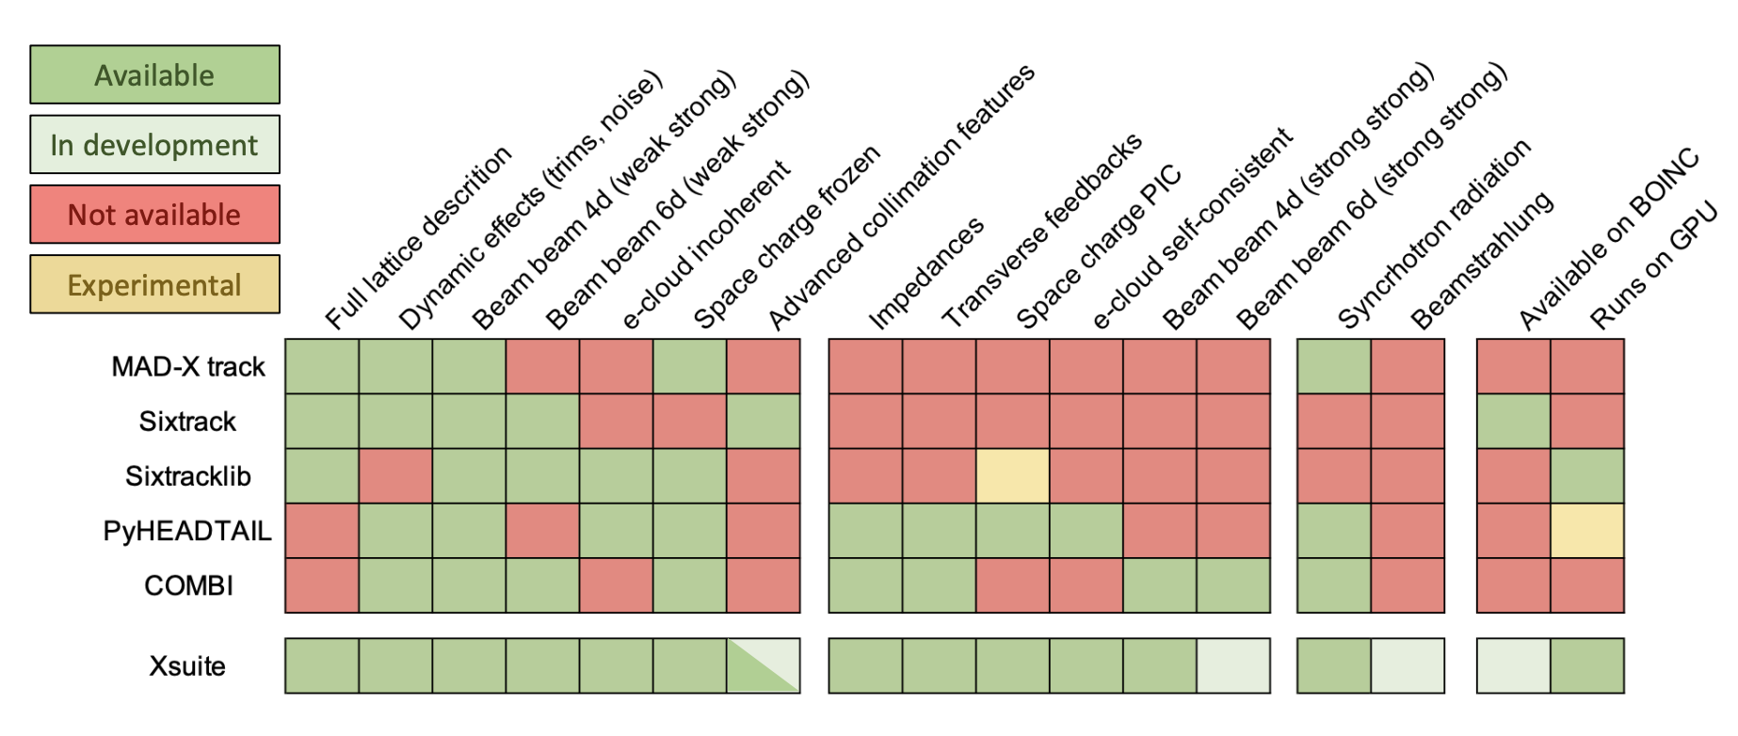
Xsuite [3]
However, no multi-pass recirculation through multiple beamlines (ERL’s) ➔ Can be implemented in time ➔ Possibility to perform full ERL simulations

Slide 10
Current simulation plans
First: Simulate single bunches through RF structure in RF-Track
Beam loading, beam breakup studies, What's the impact of the HOM’s? What’s the accelerating/decelerating efficiency?
➔ Parameter scans for dependency of bunch charge, distribution, etc.
Next: Simulate multi-bunch beams by hand \ Degradation of bunches due to collisions by hand and use as input to RF-Track
➔ Parameter scans for dependency of bunch current, energy, spacing, etc.
Finally: Full recirculating simulation in Xsuite + RF-Track
Xsuite: implement recirculation and multi-bunch effects (Like in Placet2)
Simulate multi-bunch beams through multi-pass (collider) ERL’s
Self-consistent multi-bunch dynamic studies
Collisions
Beam-beam effects
Energy recover efficiency

Slide 11
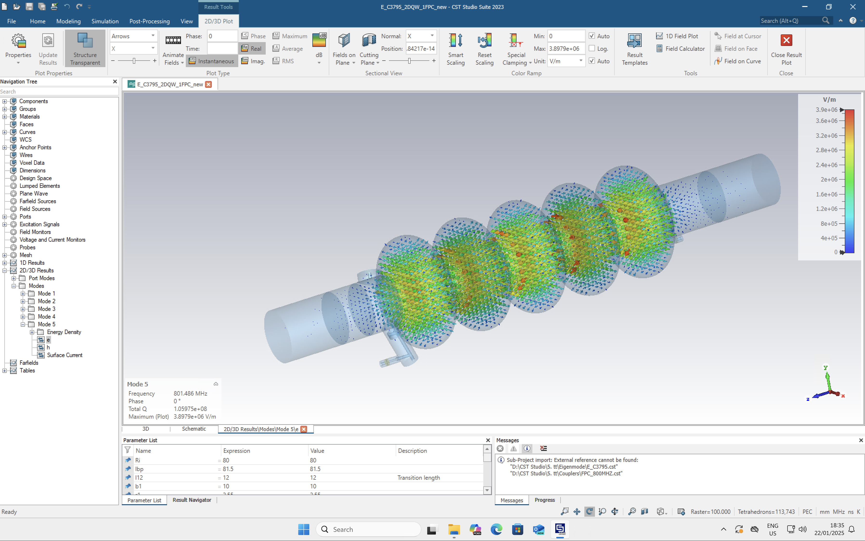
First RF-Track simulations: FCC-ee
FCC-ee cavity (SRF; SW; 5cell) (Rama Callaga & Sosoho-abasi Udongwo)
Received 1D fieldmap + HOM’s
Learning how to retrieve HOM’s from CST files with Benoit Salvant ➔ Reproducible HOM’s
➔ Must define parameters and HOM format we need!
First RF-cavity simulations, able to run multiple bunches through cavity

Slide 12
First RF-Track simulations: PERLE
PERLE cavity (SRF; SW; 5cell) (Alex Fomin, Julien Michaud, Akira Miyazaki, Carmelo Barbagallo, Shahnam Zadeh)
Received 1D fieldmap
ERL multi-pass recirculation by manually creating train of bunches with different energies
Meeting soon discussing details of HOM’s
➔ FCC-ee + PERLE: Testing simulation tools, possible comparison between designs

Slide 13
First RF-Track simulations: iSAS
iSAS cavity
Received 1D fieldmap
Information about HOM’s when we pinpoint the format we need
Cavity geometry or 3D fieldmap?
As much details as possible!

Slide 14
ERL applications
Many different possibilities: future colliders, light sources, …
Proposed colliders:
PERLE - Orsay, France
Compact three-pass ERL; around10 MW beam power
LHeC – CERN
Possible LHC side grade with a new electron ERL
➔ PERLE as its testing facility
CERC – CERN (Vladimir N Litvinenko et al.)
ERL version of FCC-ee
ERC – CERN (Andrew Hutton)
Modification of CERC to fit in LHC tunnel
Discussion soon
Options keep popping up!
➔Eventualy narrow down options!

Slide 15
Outlook: before Padova…
Figure out a workflow with RF-Track/CST using the FCC-ee/PERLE (/iSAS) cavities
Perhaps preliminary studies on single bunch instabilities and collective effects (Elias Metral)
What is needed from the software development side (Xsuite/RF-Track) for a full-blown multi-pass recirculation ERL simulation?
Consider ERL (collider) concepts

