Slide 1
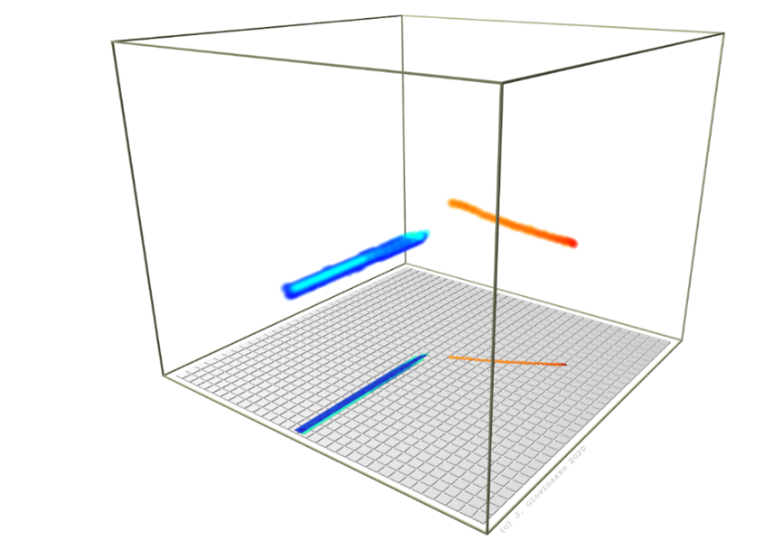
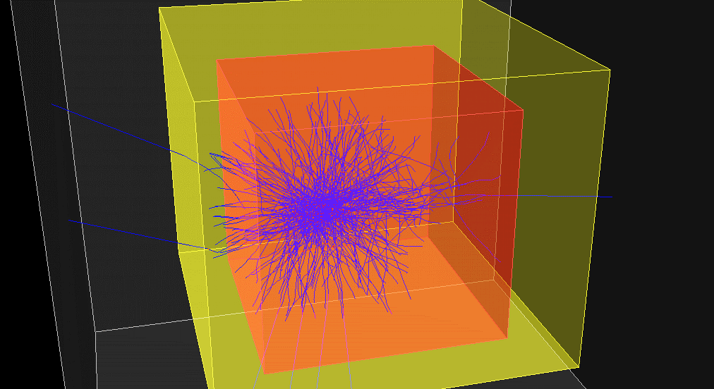


Réseau R&D Détecteurs à Gaz
March 31th –April 1st 2025 – Saclay
simulations for ACTAR TPC decay experiments
J. Giovinazzo – LP2iB (former CENBG) – Bordeaux
⬥ decay experiments with ACTAR TPC
⬥ simulations for detection efficiency
⬥ decay simulation principles
⬥ application to tracks analysis

Slide 2
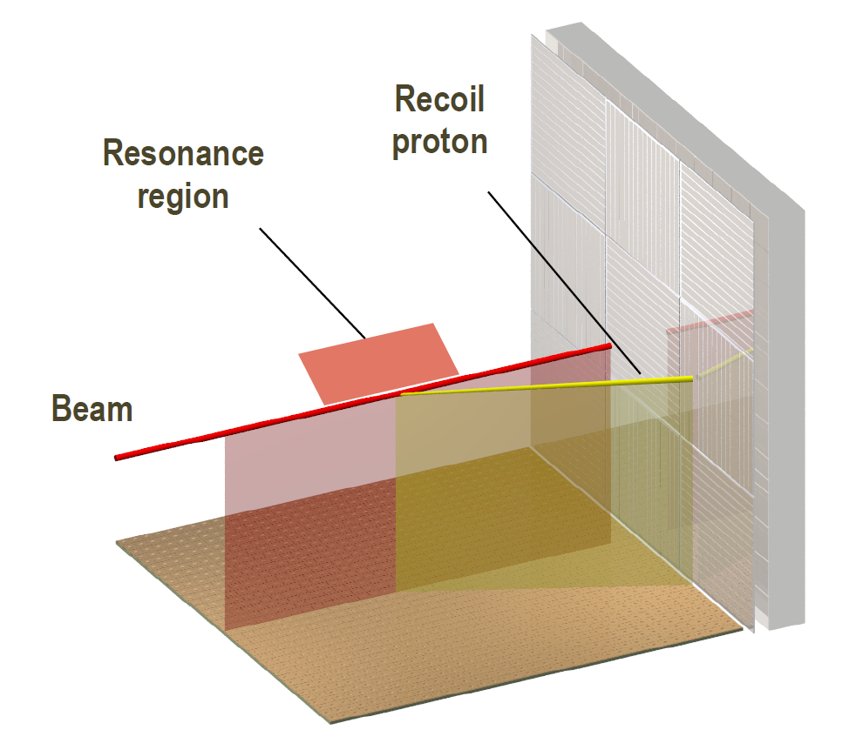
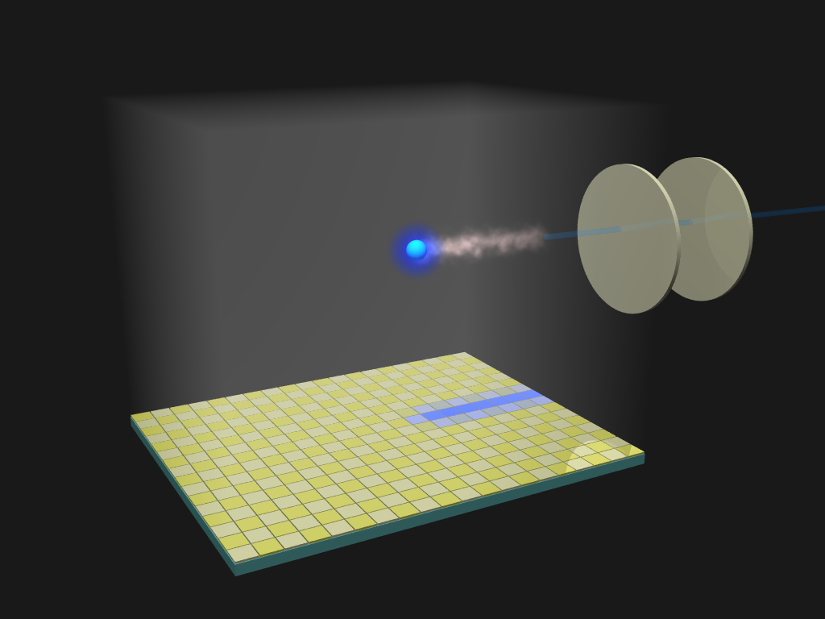

decay experiments with ACTAR TPC
designed as “active target”…
high efficiency, thick target, vertex, tracking,
good energy resolution…
inverse kinematic reactions
unbound resonances, highly excited states
transfer & charge exchange reactions
J. Giovinazzo (LP2iB – CNRS IN2P2 / Univ. Bordeaux)
2025/03 réseau R&D détecteurs à gaz – simulations for ACTAR TPC decay experiments
…and implantation/decay TPC
high efficiency, transp. to beta, low threshold
multi-particle tracking…
charged particles / exotic decay modes
beta-delayed (multi-)proton
particle decay of excited states

Slide 3
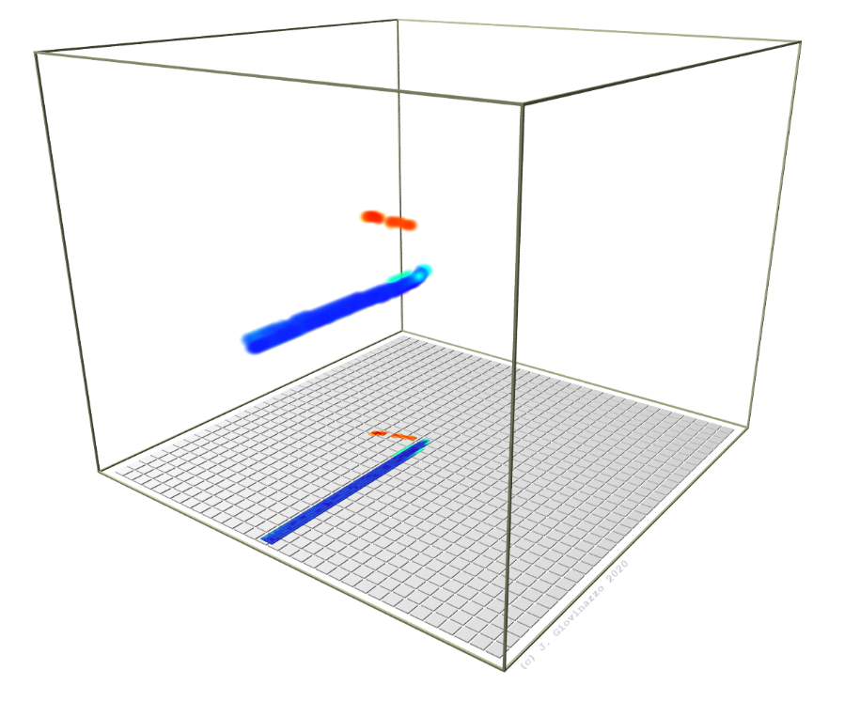
decay experiments with ACTAR TPC
E690 (GANIL, 2019): proton decay of ^{54m}Ni
track length
time offset
J. Giovinazzo (LP2iB – CNRS IN2P2 / Univ. Bordeaux)
2025/03 réseau R&D détecteurs à gaz – simulations for ACTAR TPC decay experiments
ion ∼ 1 GeV
proton ∼ 1 MeV
150 ns
t/z
y
x

Slide 4
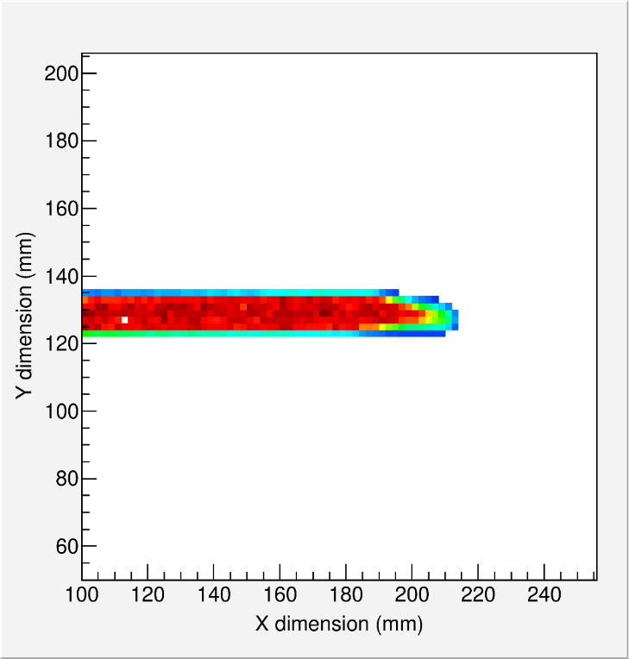
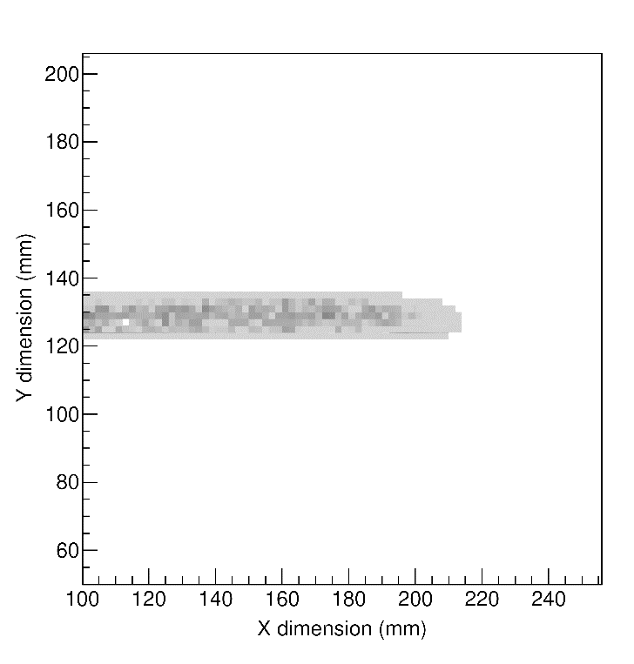
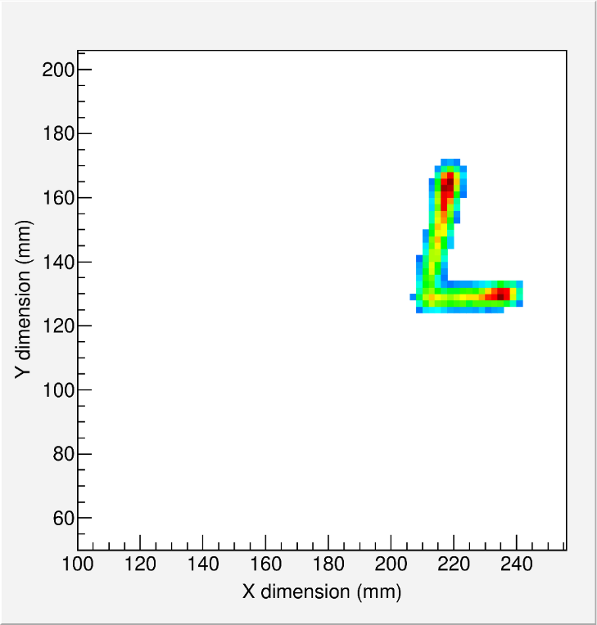
decay experiments with ACTAR TPC
E690 (GANIL, 2019): proton decay of ^{54m}Ni
E791 (GANIL, 2021): 2p radioactivity of ⁴⁵Fe & ⁴⁸Ni
track length
few ms
time offset
J. Giovinazzo (LP2iB – CNRS IN2P2 / Univ. Bordeaux)
2025/03 réseau R&D détecteurs à gaz – simulations for ACTAR TPC decay experiments
different events
for implantation
and decay
ion ∼ 1 GeV
proton ∼ 1 MeV
150 ns
t/z
y
x

Slide 5
simulations for detection efficiency
J. Giovinazzo (LP2iB – CNRS IN2P2 / Univ. Bordeaux)
2025/03 réseau R&D détecteurs à gaz – simulations for ACTAR TPC decay experiments

Slide 6
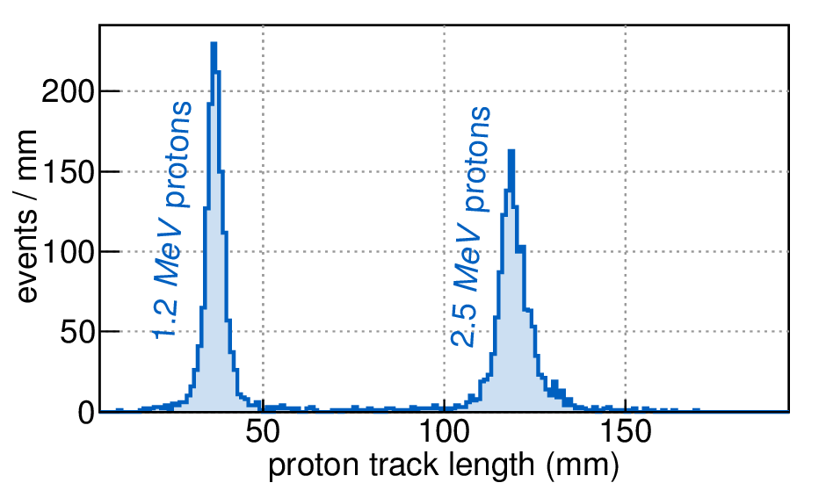

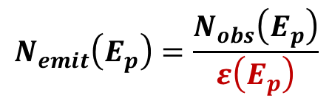
need for simulations: escape probability
track length ↔ proton energy
E690
2 proton energies
→ relative decay branches intensity ?
○ different track energy / length
↔ different escape probabilities
○ proton track hidden in ion track
○ missing regions in the pad plane
(+ analysis procedure and cuts)
$$N_{emit}\left(E_{p}\right)=\frac{N_{obs}\left(E_{p}\right)}{ε\left(E_{p}\right)}$$
J. Giovinazzo (LP2iB – CNRS IN2P2 / Univ. Bordeaux)
2025/03 réseau R&D détecteurs à gaz – simulations for ACTAR TPC decay experiments

Slide 7
need for simulations: escape probability
E791
2-proton radioactivity
single decay branch
event by event analysis (counting)
J. Giovinazzo (LP2iB – CNRS IN2P2 / Univ. Bordeaux)
2025/03 réseau R&D détecteurs à gaz – simulations for ACTAR TPC decay experiments

Slide 8
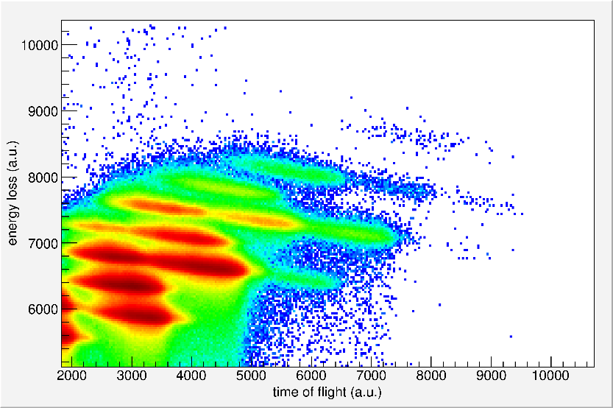




need for simulations: escape probability
E791
2-proton radioactivity
single decay branch
event by event analysis (counting)
beta-delayed 1,2,3-proton(s)
→ from several nuclei (cocktail beam)
→ decay scheme
J. Giovinazzo (LP2iB – CNRS IN2P2 / Univ. Bordeaux)
2025/03 réseau R&D détecteurs à gaz – simulations for ACTAR TPC decay experiments
$${}_{N}^{A}{Xa}$$
F
⁴⁸Ni
IAS
β⁺ / EC
p
⁴⁵Fe
Q_{EC}
p
γ
2p?
GT
${}_{N+1}^{A−2}{Xd}$ $(+2p)$
γ
${}_{N+1}^{A−1}{Xc}$ $(+p)$
S_{2p}(Xb)
$${}_{N+1}^{A}{Xb}$$

Slide 9
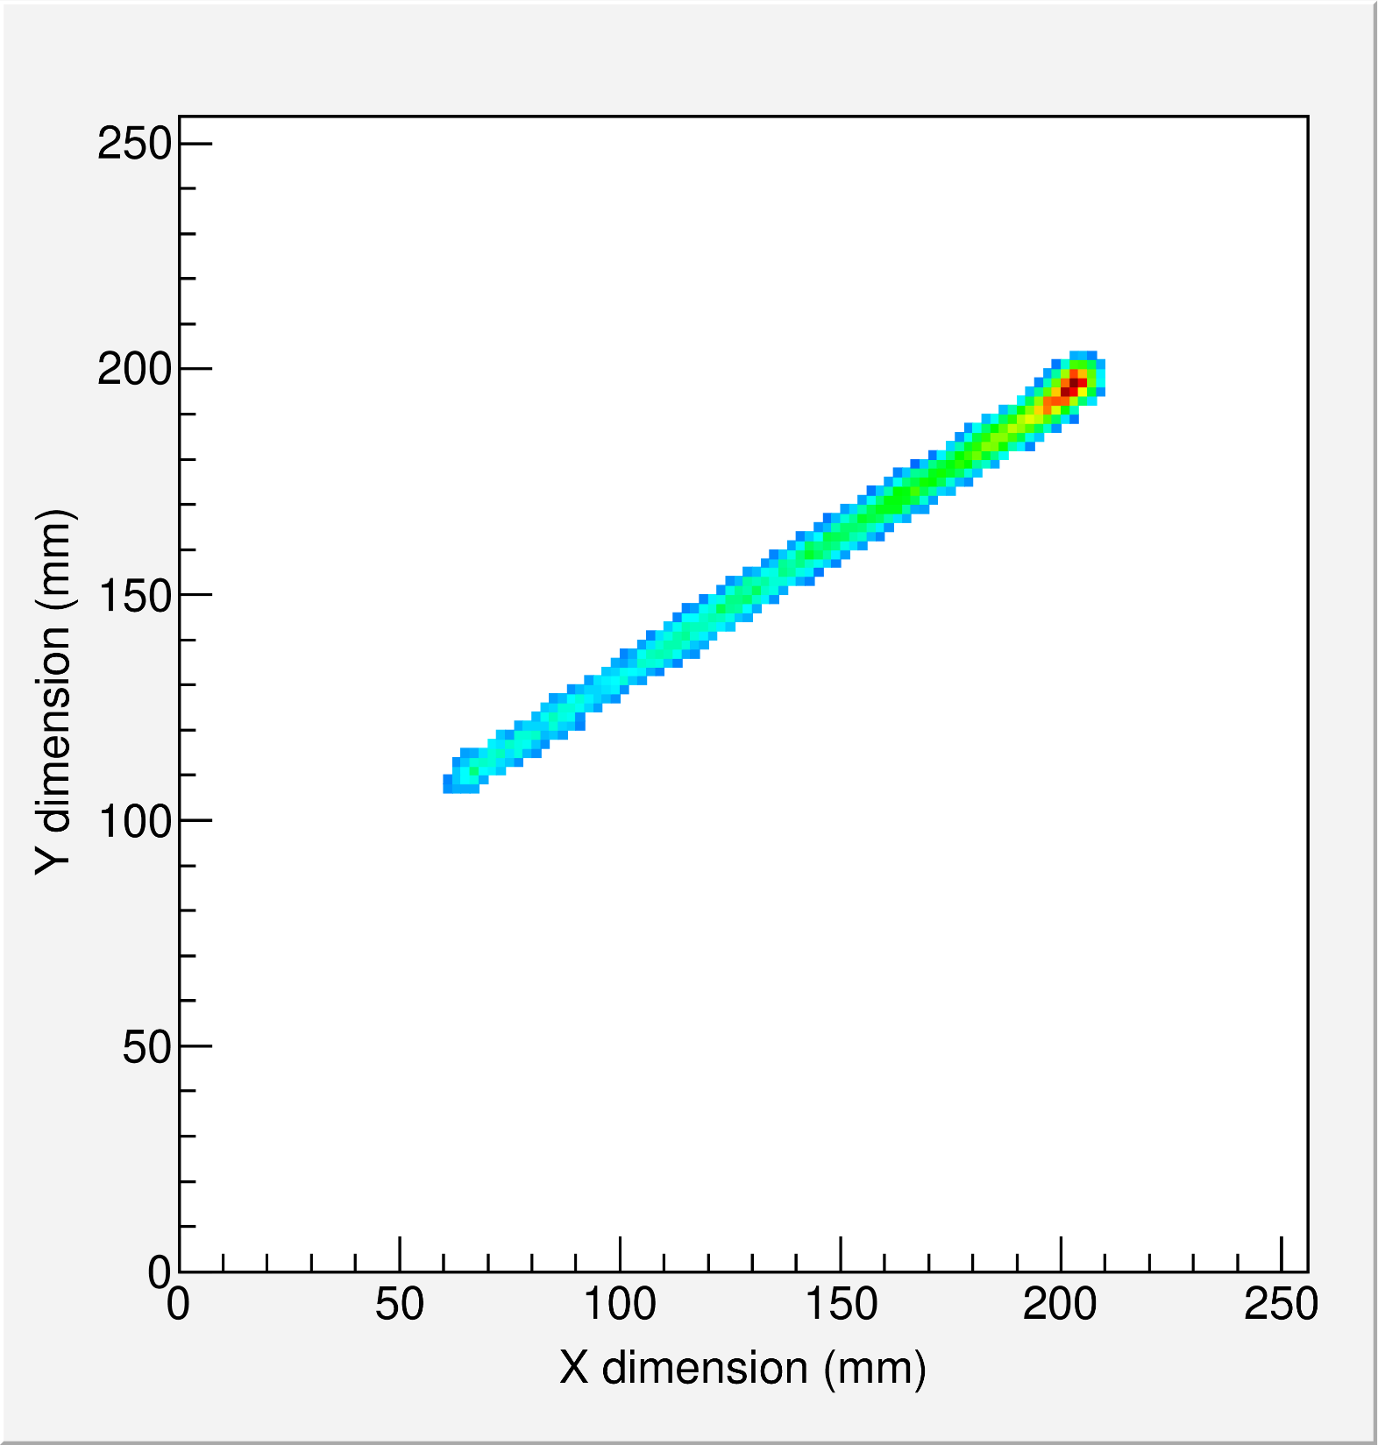
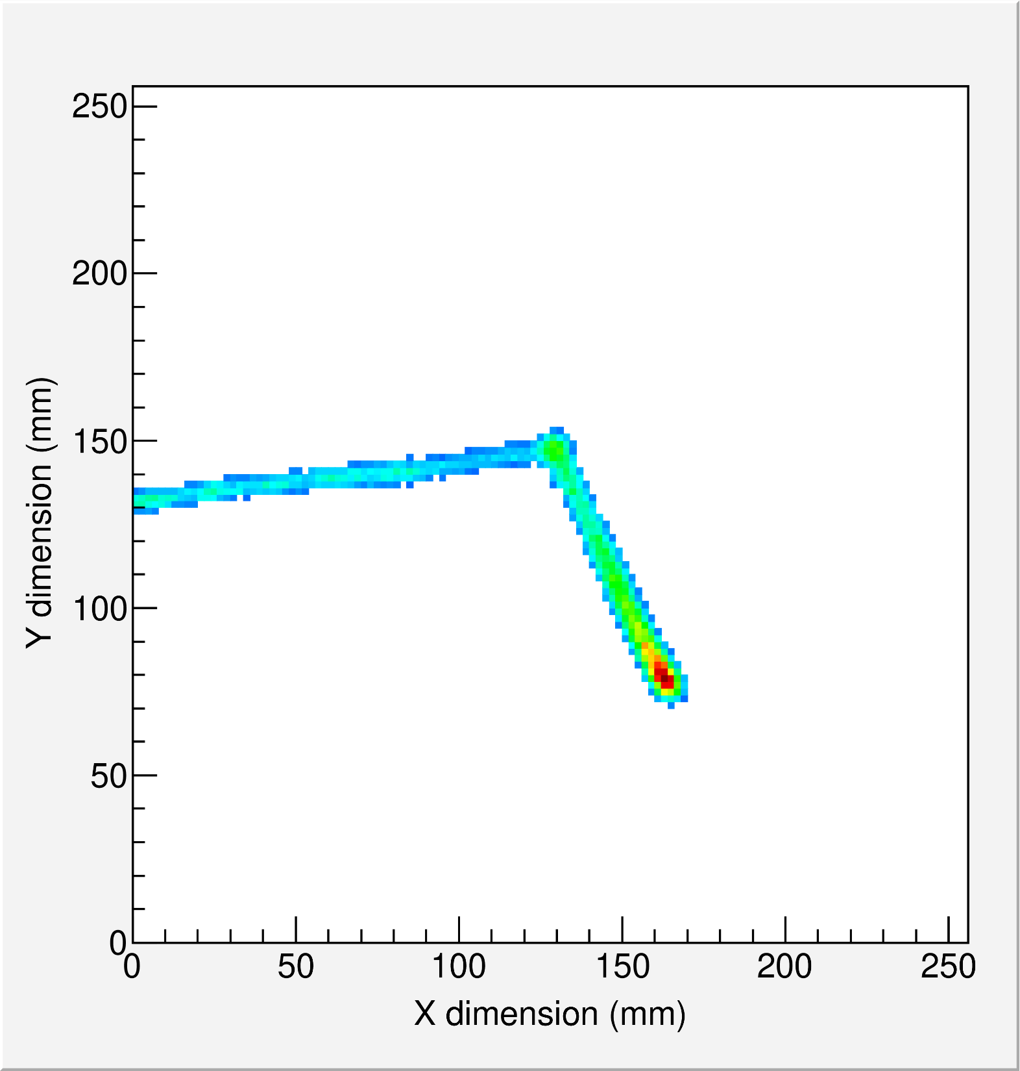
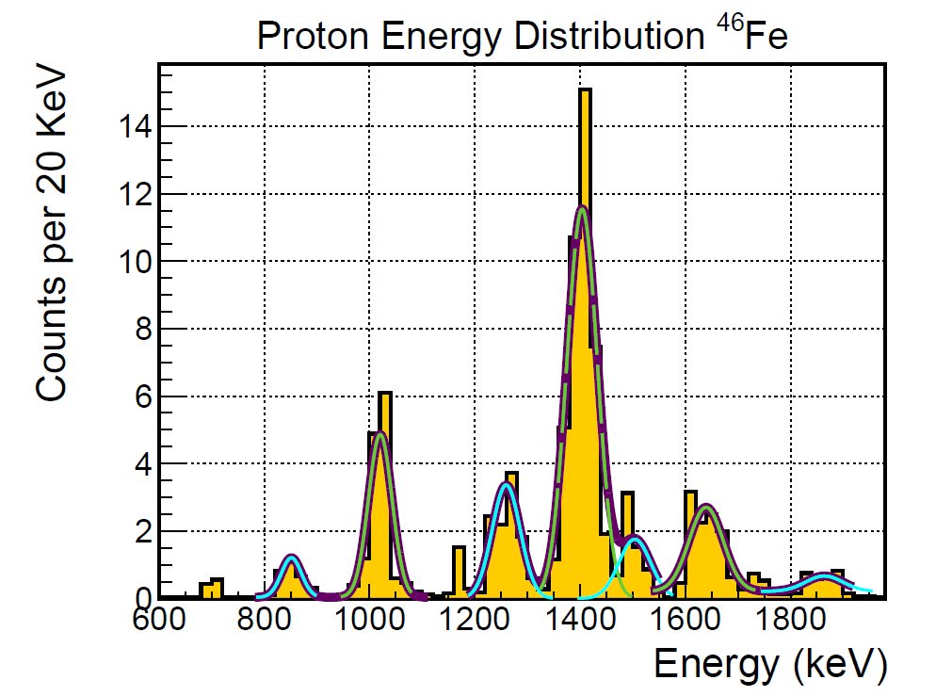
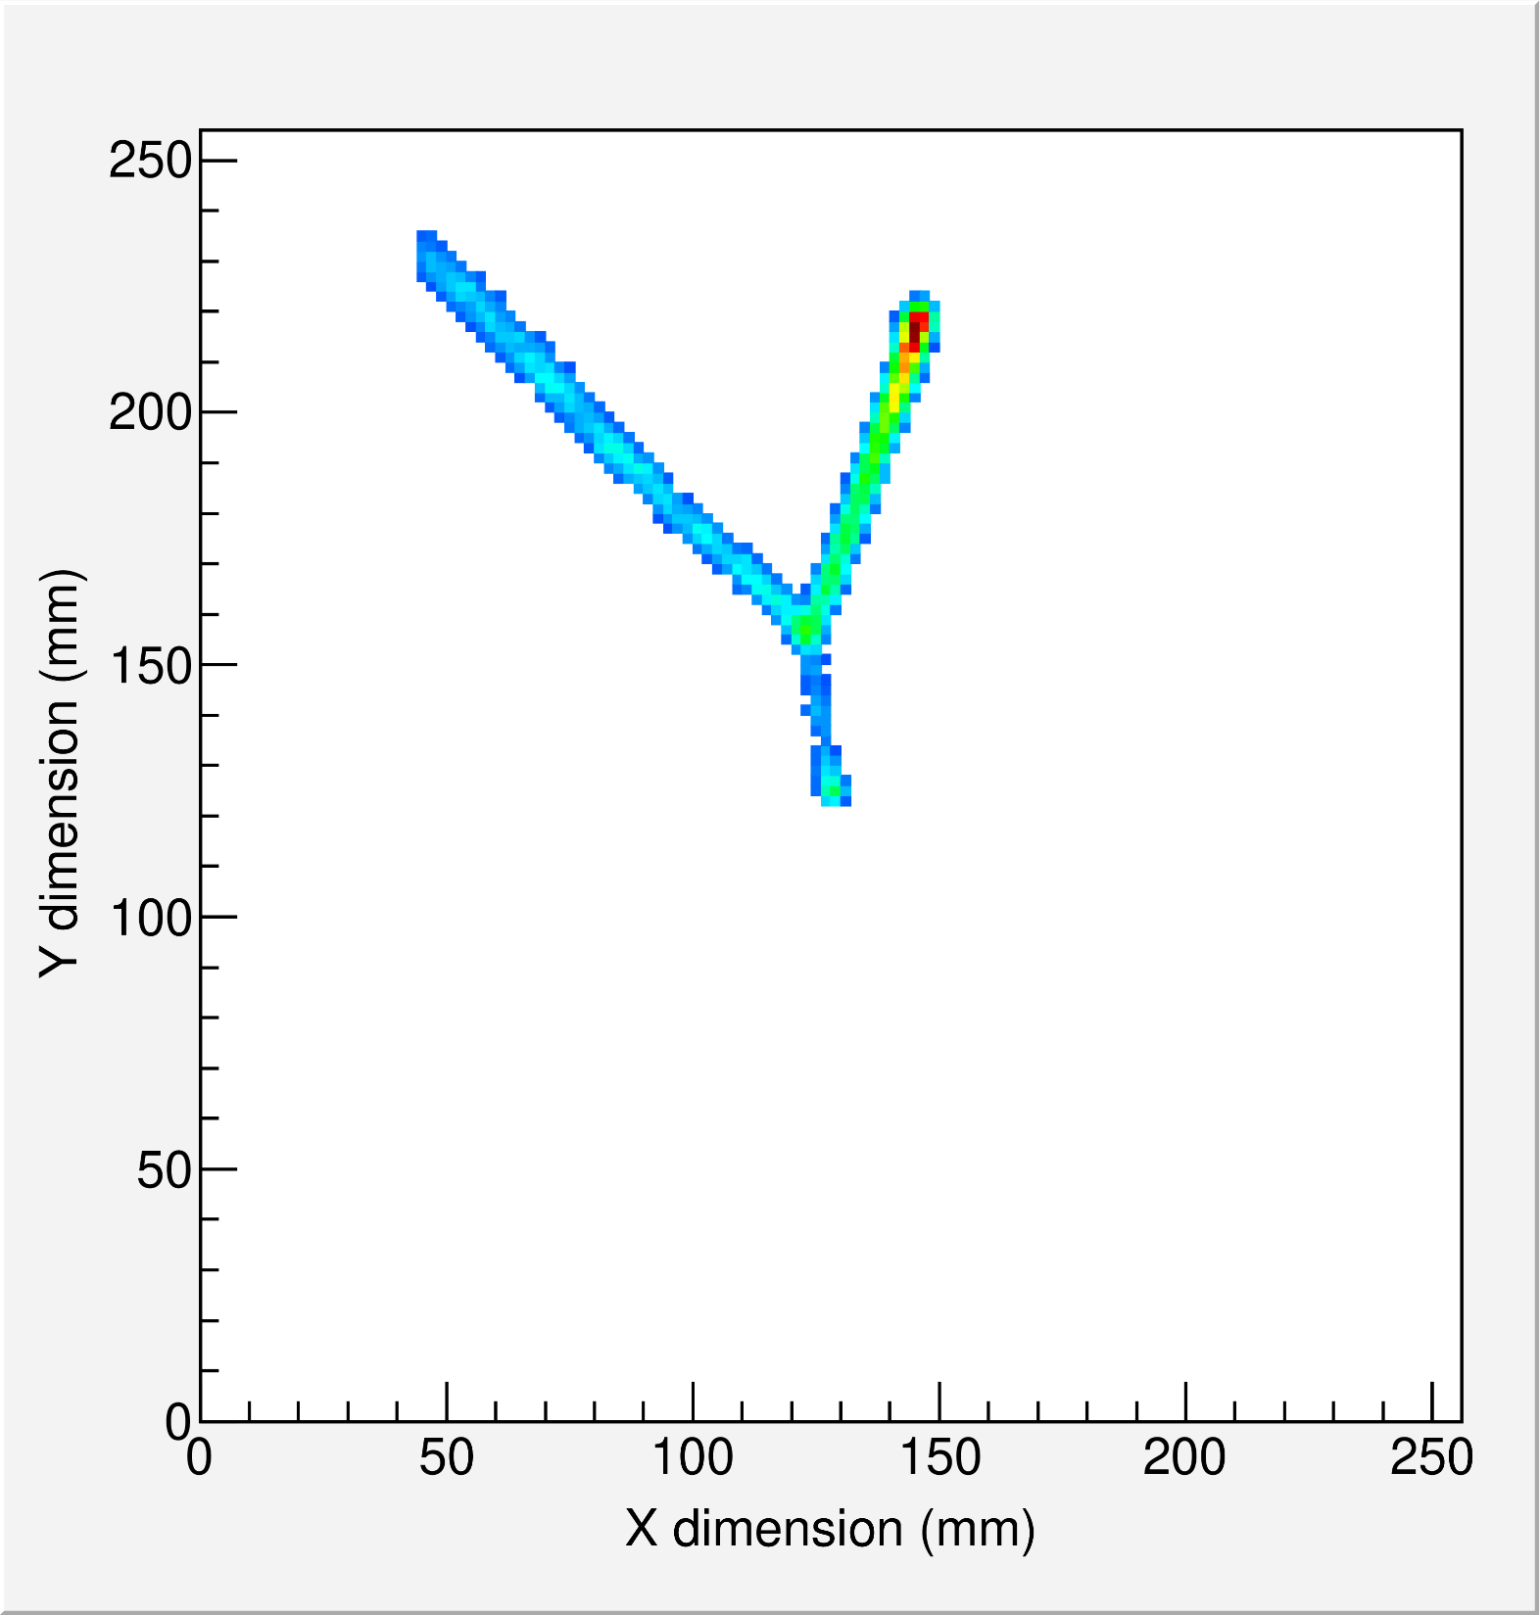
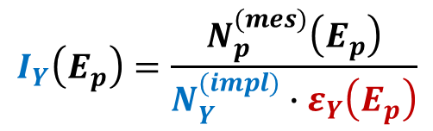
need for simulations: escape probability
E791
2-proton radioactivity
single decay branch
event by event analysis (counting)
beta-delayed 1,2,3-proton(s)
→ from several nuclei (cocktail beam)
→ decay scheme
absolute transitions intensities
→ function of transition energy
β-1p
β-2p
J. Giovinazzo (LP2iB – CNRS IN2P2 / Univ. Bordeaux)
2025/03 réseau R&D détecteurs à gaz – simulations for ACTAR TPC decay experiments
⁴⁸Ni
β-1p
⁴⁵Fe
β-3p
$$I_{Y}\left(E_{p}\right)=\frac{N_{p}^{(mes)}\left(E_{p}\right)}{N_{Y}^{(impl)}∙ε_{Y}\left(E_{p}\right)}$$

Slide 10
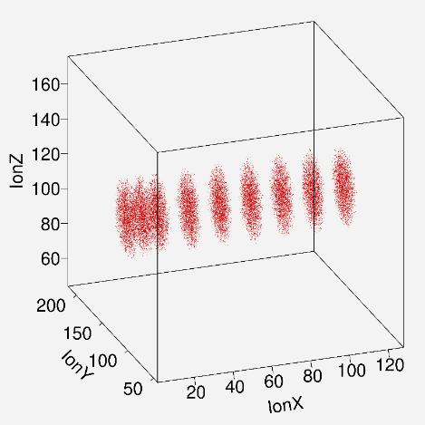
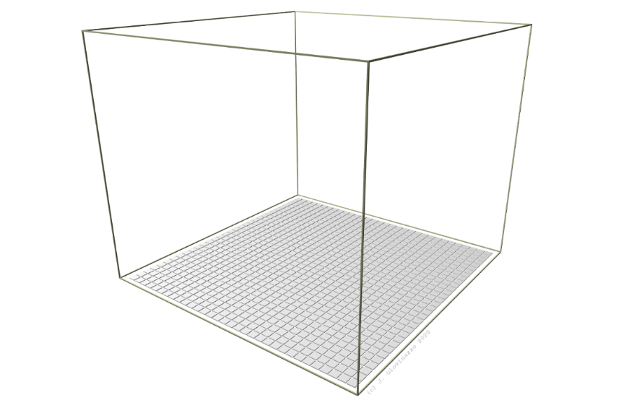

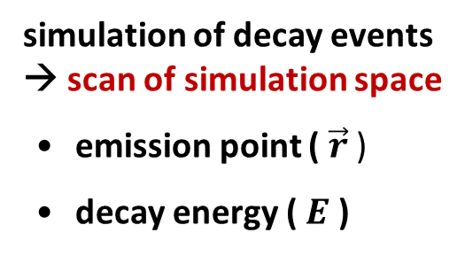
detection efficiency
simulation run
$$\left[{\vec{r}}_{i},E_{i}\right]$$
simulation of decay events
→ scan of simulation space
• emission point ( $\vec{r}$ )
• decay energy ( $E$ )
J. Giovinazzo (LP2iB – CNRS IN2P2 / Univ. Bordeaux)
2025/03 réseau R&D détecteurs à gaz – simulations for ACTAR TPC decay experiments
simulation is only
the first step

Slide 11
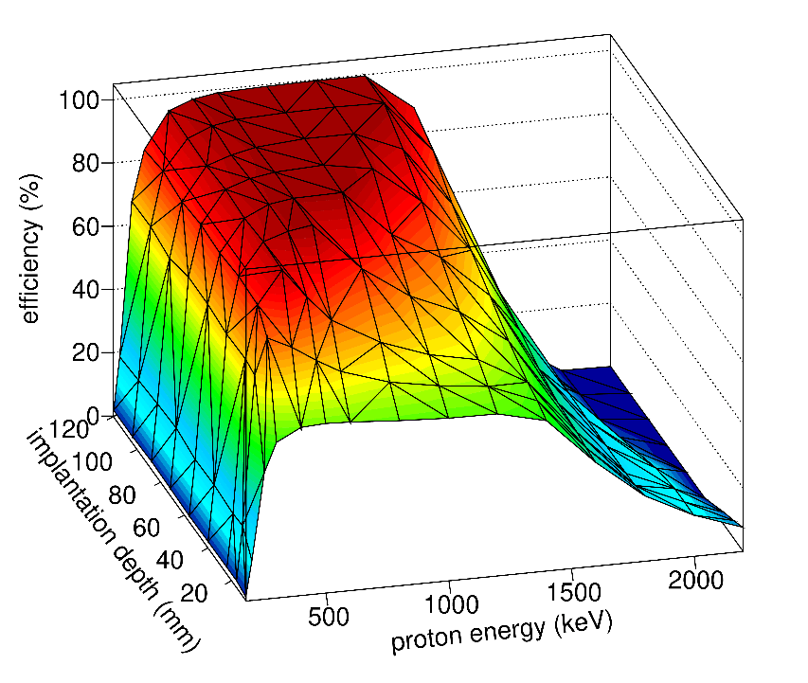
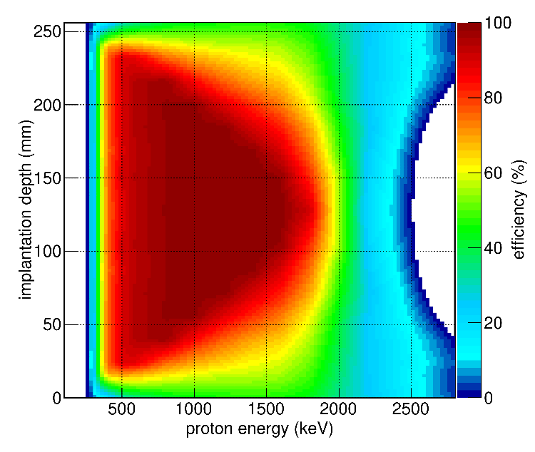
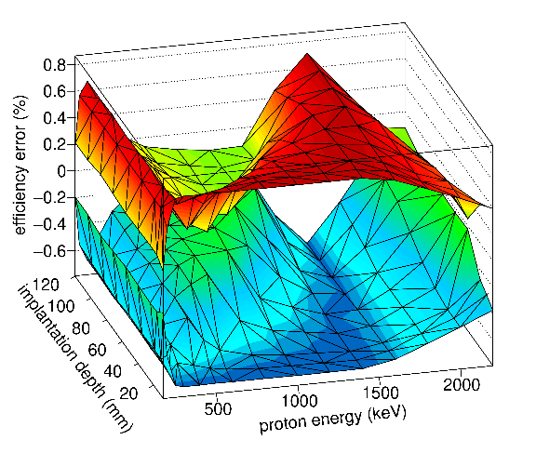
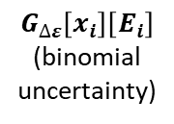




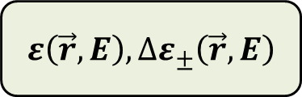


detection efficiency
$$ε_{p}\left(\vec{r},E_{p}\right)$$
intrinsic efficiency…
analysis
• pads mult.
• X-Y escape
• Z escape
result
$$N_{sim}\left[{\vec{r}}_{i},E_{i}\right]$$
$$N_{det}\left[{\vec{r}}_{i},E_{i}\right]$$
simulation run
$$\left[{\vec{r}}_{i},E_{i}\right]$$
${\vec{r}}_{i},E_{i}, ε_{i},{∆ε}_{i±}$
stat. confidence
intervals
probability of full detection
of a proton emitted with
energy $E_{p}$
J. Giovinazzo (LP2iB – CNRS IN2P2 / Univ. Bordeaux)
2025/03 réseau R&D détecteurs à gaz – simulations for ACTAR TPC decay experiments
graph $G_{ε}\left[x_{i}\right]\left[E_{i}\right]$
interpolation
interpolated
histogram
$H_{ε}\left(\vec{r},E\right)$
$$ε\left(\vec{r},E\right), {∆ε}_{±}\left(\vec{r},E\right)$$
$$G_{∆ε}\left[x_{i}\right]\left[E_{i}\right]$$
(binomial
uncertainty)

Slide 12
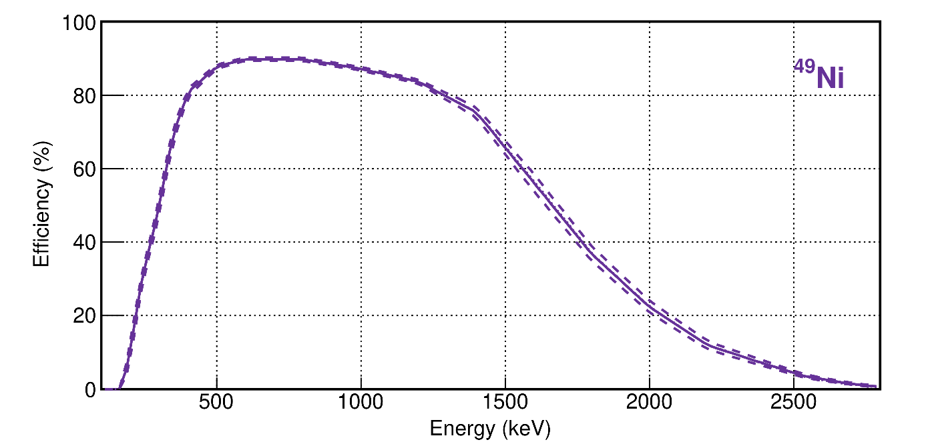
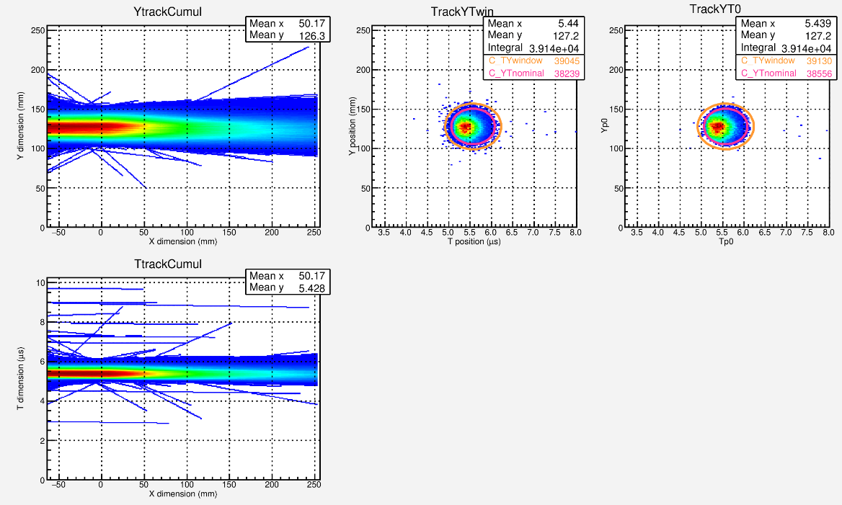
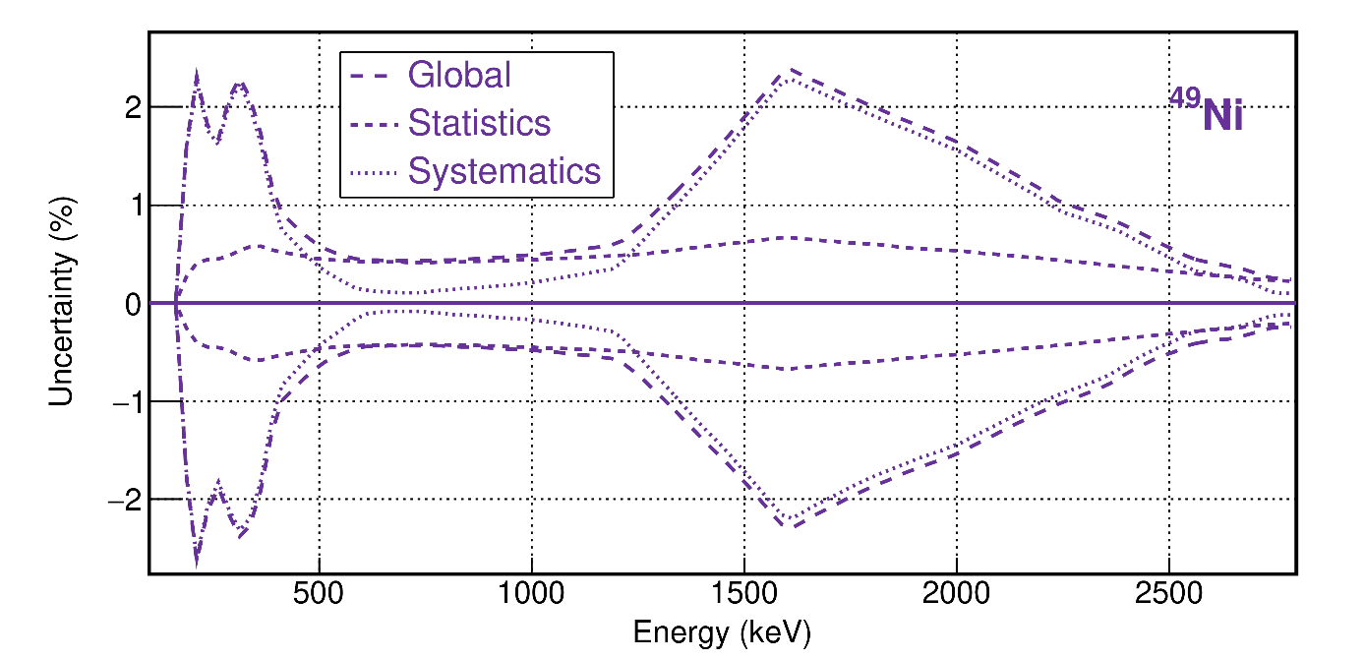


detection efficiency
intrinsic efficiency…
…convoluted with experimental implantation
…distribution for nucleus Y
$$ε_{Y}\left(E_{p}\right)=ε_{p}\left({\vec{r}}_{Y},E_{p}\right) ⨂{ 𝓟}_{Y}\left({\vec{r}}_{Y} \right)$$
beam parallel to X axis: $\vec{r}↔x$
J. Giovinazzo (LP2iB – CNRS IN2P2 / Univ. Bordeaux)
2025/03 réseau R&D détecteurs à gaz – simulations for ACTAR TPC decay experiments
uncertainty:
• statistics
number of sim. events
• systematics
+ simul. param.: pressure, ampl., disp., noise, TZ profile…
+ analysis param.: threshold, escape cuts
(see further)

Slide 13
ACTAR TPC simulations main lines
J. Giovinazzo (LP2iB – CNRS IN2P2 / Univ. Bordeaux)
2025/03 réseau R&D détecteurs à gaz – simulations for ACTAR TPC decay experiments

Slide 14
simulation
purpose is not the full reproduction of the experiments
(unlike particle physics)
estimate the number of protons escaping full detection
J. Giovinazzo (LP2iB – CNRS IN2P2 / Univ. Bordeaux)
2025/03 réseau R&D détecteurs à gaz – simulations for ACTAR TPC decay experiments

Slide 15
simulation: event generator
event generator
simple ad hoc generator
implantation basically not needed
(but backward tracking for E690 – see further…)
generate primary particles at
any (implantation) point
→ direction
→ energy
J. Giovinazzo (LP2iB – CNRS IN2P2 / Univ. Bordeaux)
2025/03 réseau R&D détecteurs à gaz – simulations for ACTAR TPC decay experiments
proton
beta
recoil
incoming ion

Slide 16
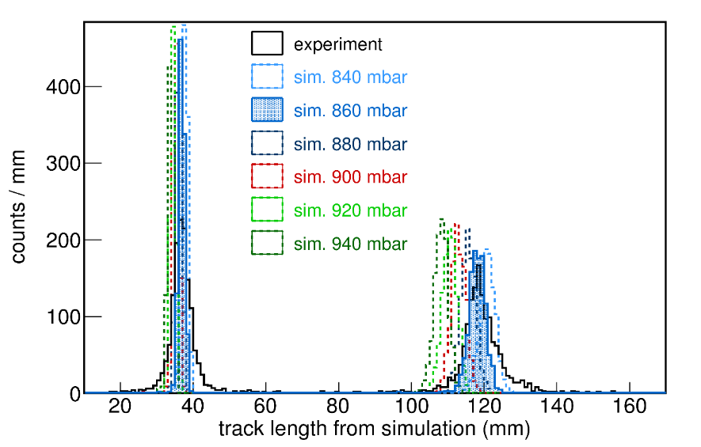
simulation: tracking
event generator
tracking with Geant4
basically a simple gas volume
with particles travelling inside
• primary vertex
• tracking of primary particle
recording all steps / hits
tracking
→ energy loss along the
particles path
tracking parameters
• gas pressure
• physics list (processes)
J. Giovinazzo (LP2iB – CNRS IN2P2 / Univ. Bordeaux)
2025/03 réseau R&D détecteurs à gaz – simulations for ACTAR TPC decay experiments
proton
beta
E690
recoil

Slide 17
simulation: signal collection
event generator
drift of ionization signal
• from tracking steps energy loss
• parameter: drift velocity (from exp. data)
→ Z to T conversion
tracking
signal collection
J. Giovinazzo (LP2iB – CNRS IN2P2 / Univ. Bordeaux)
2025/03 réseau R&D détecteurs à gaz – simulations for ACTAR TPC decay experiments
proton
beta
recoil

Slide 18
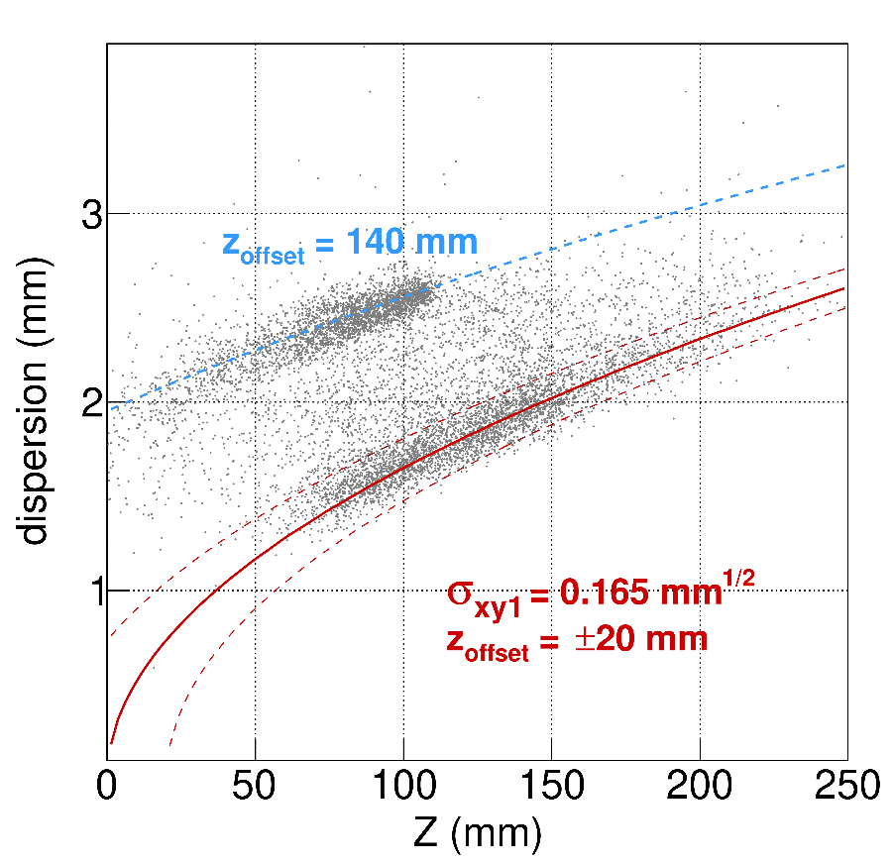
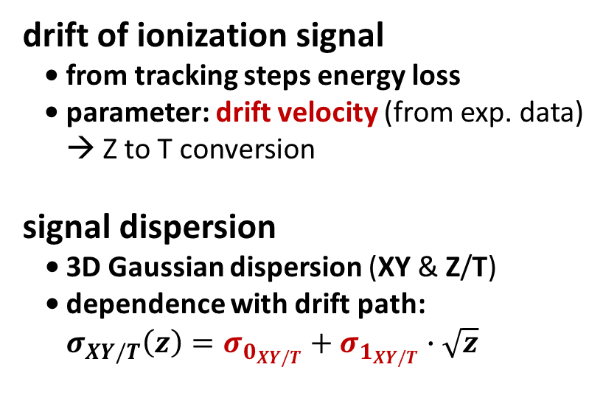
simulation: signal collection
event generator
size of the
entrance
window
drift of ionization signal
• from tracking steps energy loss
• parameter: drift velocity (from exp. data)
→ Z to T conversion
signal dispersion
• 3D Gaussian dispersion (XY & Z/T)
• dependence with drift path:
$σ_{XY/T}\left(z\right)=σ_{0_{XY/T}}+σ_{1_{XY/T}}∙\sqrt{z}$
preliminary
tracking
signal collection
J. Giovinazzo (LP2iB – CNRS IN2P2 / Univ. Bordeaux)
2025/03 réseau R&D détecteurs à gaz – simulations for ACTAR TPC decay experiments
proton
beta
recoil

Slide 19
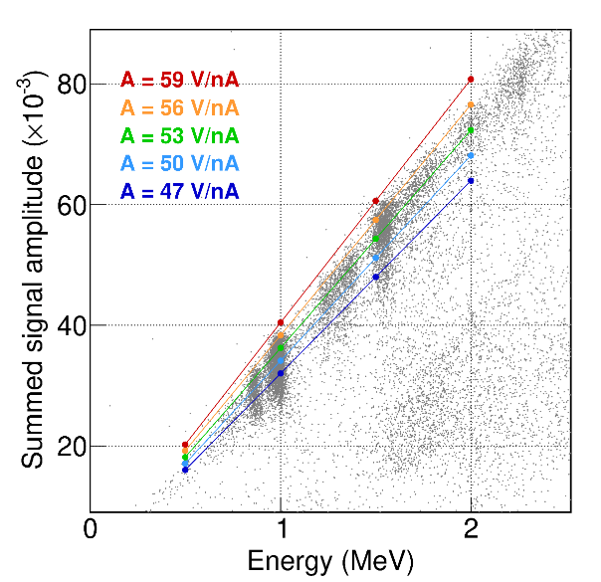
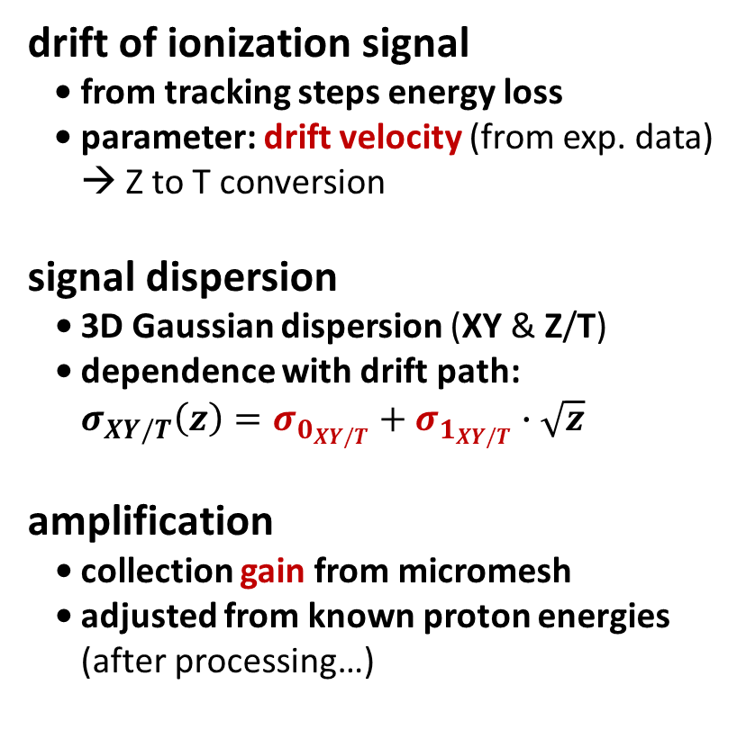
simulation: signal collection
event generator
size of the
entrance
window
drift of ionization signal
• from tracking steps energy loss
• parameter: drift velocity (from exp. data)
→ Z to T conversion
signal dispersion
• 3D Gaussian dispersion (XY & Z/T)
• dependence with drift path:
$σ_{XY/T}\left(z\right)=σ_{0_{XY/T}}+σ_{1_{XY/T}}∙\sqrt{z}$
amplification
• collection gain from micromesh
• adjusted from known proton energies
(after processing…)
preliminary
tracking
signal collection
J. Giovinazzo (LP2iB – CNRS IN2P2 / Univ. Bordeaux)
2025/03 réseau R&D détecteurs à gaz – simulations for ACTAR TPC decay experiments
proton
beta
recoil
preliminary

Slide 20
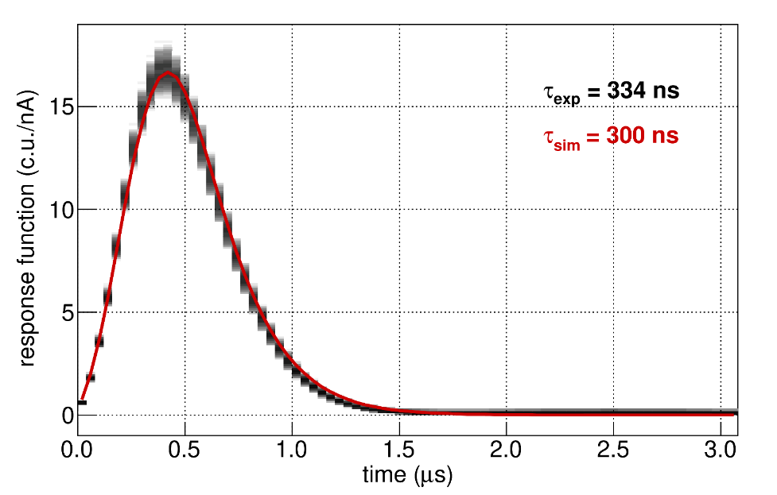
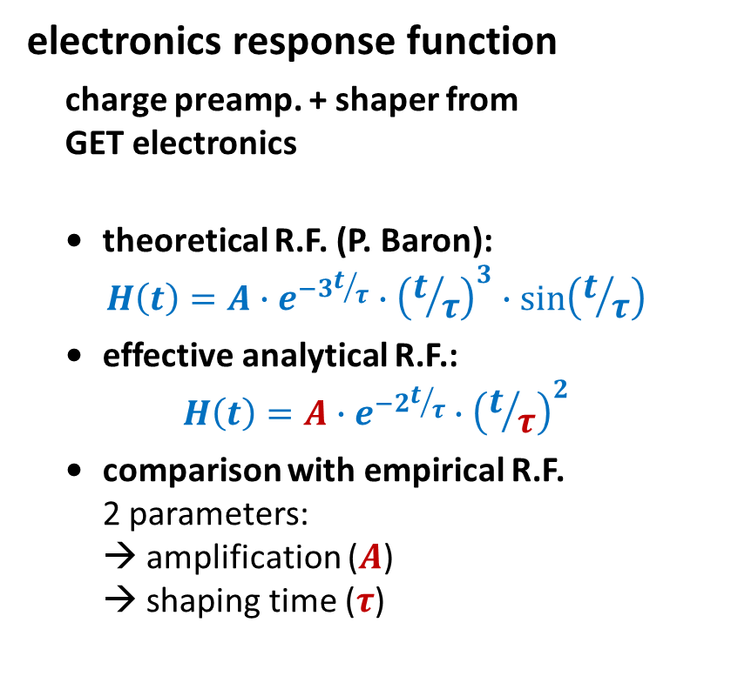
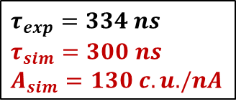
simulation: signal processing
$τ_{exp}=334 ns$
$τ_{sim}=300 ns$
$A_{sim}=130 c.u. /nA$
event generator
electronics response function
charge preamp. + shaper from
GET electronics
• theoretical R.F. (P. Baron):
$$H\left(t\right)=A∙e^{−3t/τ}∙{\left(t/τ\right)}^{3}∙sin\left(t/τ\right)$$
• effective analytical R.F.:
$$H\left(t\right)=A∙e^{−2t/τ}∙{\left(t/τ\right)}^{2}$$
• comparison with empirical R.F.
2 parameters:
→ amplification ($A$)
→ shaping time ($τ$)
tracking
signal collection
J. Giovinazzo (LP2iB – CNRS IN2P2 / Univ. Bordeaux)
2025/03 réseau R&D détecteurs à gaz – simulations for ACTAR TPC decay experiments
signal processing
memory
shaper
CSA

Slide 21
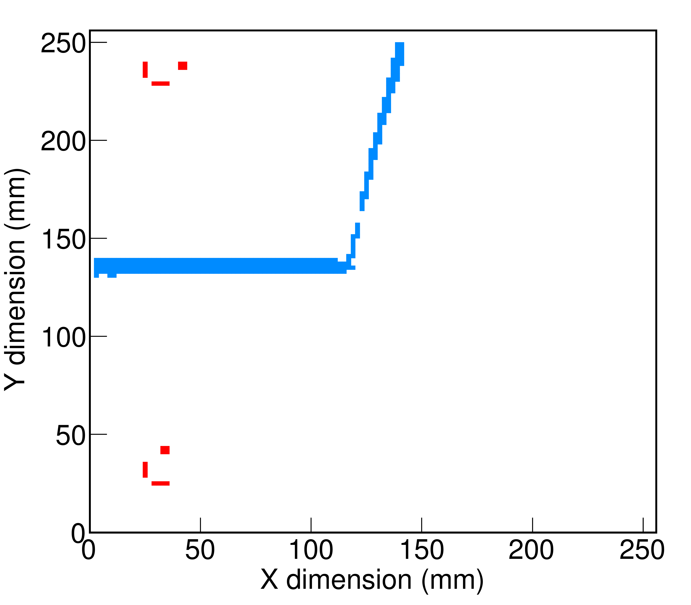
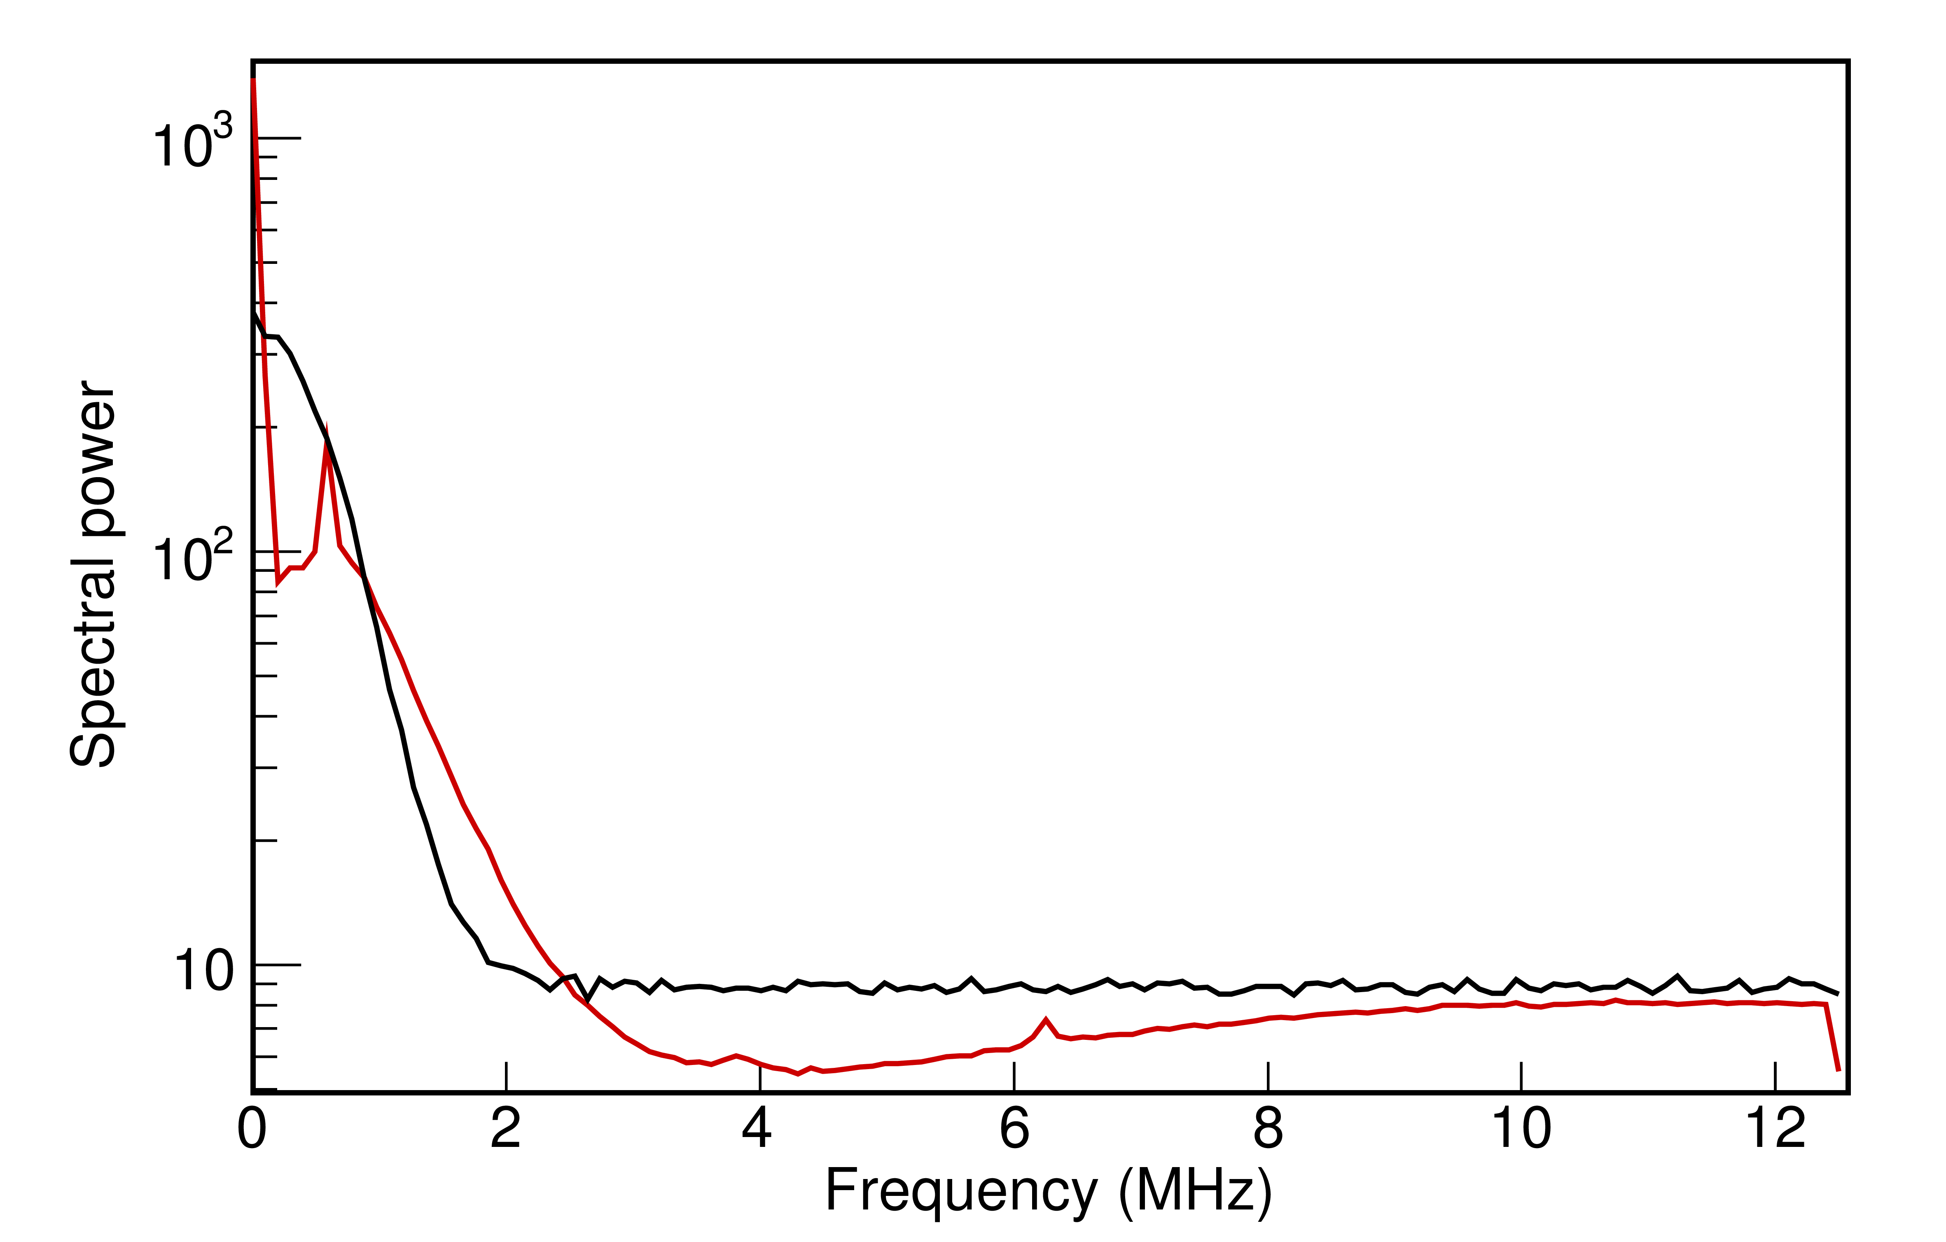
simulation: fluctuations and noise
event generator
more realistic signals ?
input & output (Gaussian) noise
amplitude for simulation
→ input noise filtered by resp. function
→ output noise not modified
tracking
analysis of spectral power distribution
adjust noise on experimental S.P.D.
→ from pads in “read always” pads
(if no signal)
→ from events with no signal
signal collection
J. Giovinazzo (LP2iB – CNRS IN2P2 / Univ. Bordeaux)
2025/03 réseau R&D détecteurs à gaz – simulations for ACTAR TPC decay experiments
input
noise
output
noise
pads noise
simulated noise
signal processing
resp.
function
chip architecture
effects no reproduced
input noise constraints:
power vs filtering (shaper)
input
noise
input
pads noise
simulated noise
output
output noise

Slide 22
analysis cuts
simulation → tracks signal on each pad
include exp. data analysis parameters
→ bad pads suppression
→ pad validation from signal threshold
→ global trigger multiplicity
→ number of border pads for
for escape condition
for E690
→ suppression of pads “hidden” by
implantation signal
ion track back-traced according to
experiment directions distribution
for ion pads suppression
number of fully reconstructed tracks:
detection efficiency
event generator
tracking
signal collection
J. Giovinazzo (LP2iB – CNRS IN2P2 / Univ. Bordeaux)
2025/03 réseau R&D détecteurs à gaz – simulations for ACTAR TPC decay experiments
signal processing
analysis cuts

Slide 23
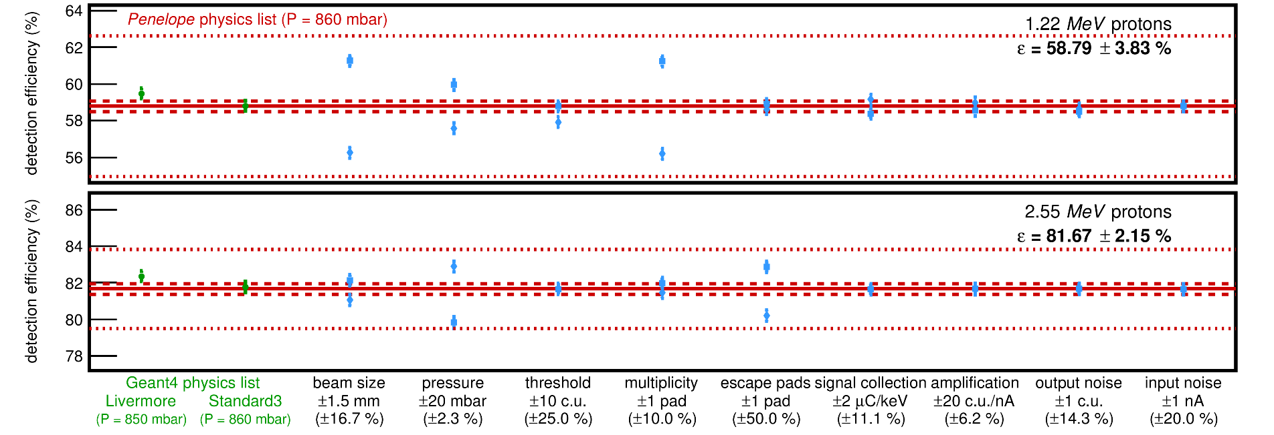
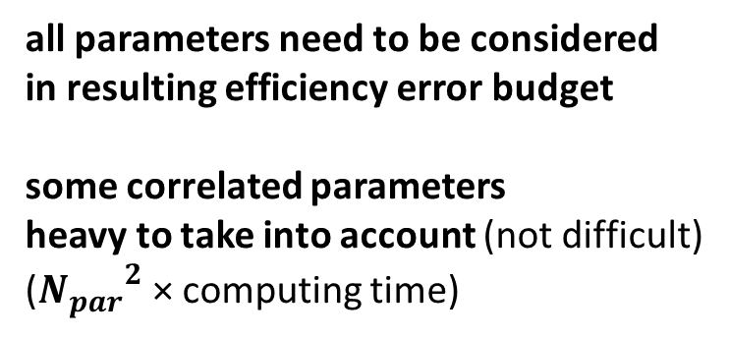
efficiency uncertainties
simulation
event generator
tracking
gas pressure
physics list
dispersion
collection gain
input noise
amplification
output noise
threshold
XY escape border
trigger multiplicity
all parameters need to be considered
in resulting efficiency error budget
some correlated parameters
heavy to take into account (not difficult)
(${N_{par}}^{2}$ × computing time)
signal collection
J. Giovinazzo (LP2iB – CNRS IN2P2 / Univ. Bordeaux)
2025/03 réseau R&D détecteurs à gaz – simulations for ACTAR TPC decay experiments
E690
signal processing
analysis cuts

Slide 24
simulations for tracks analysis
J. Giovinazzo (LP2iB – CNRS IN2P2 / Univ. Bordeaux)
2025/03 réseau R&D détecteurs à gaz – simulations for ACTAR TPC decay experiments

Slide 25
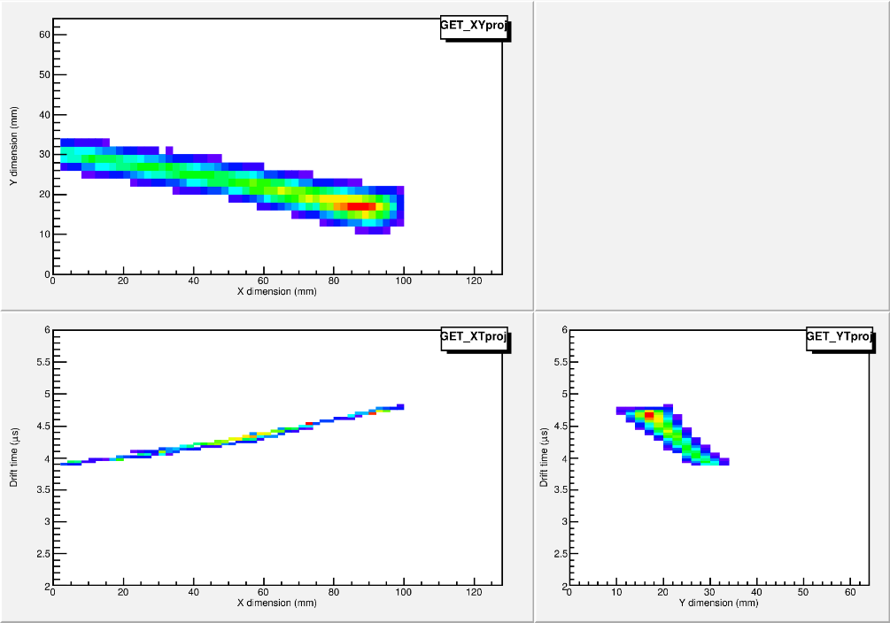
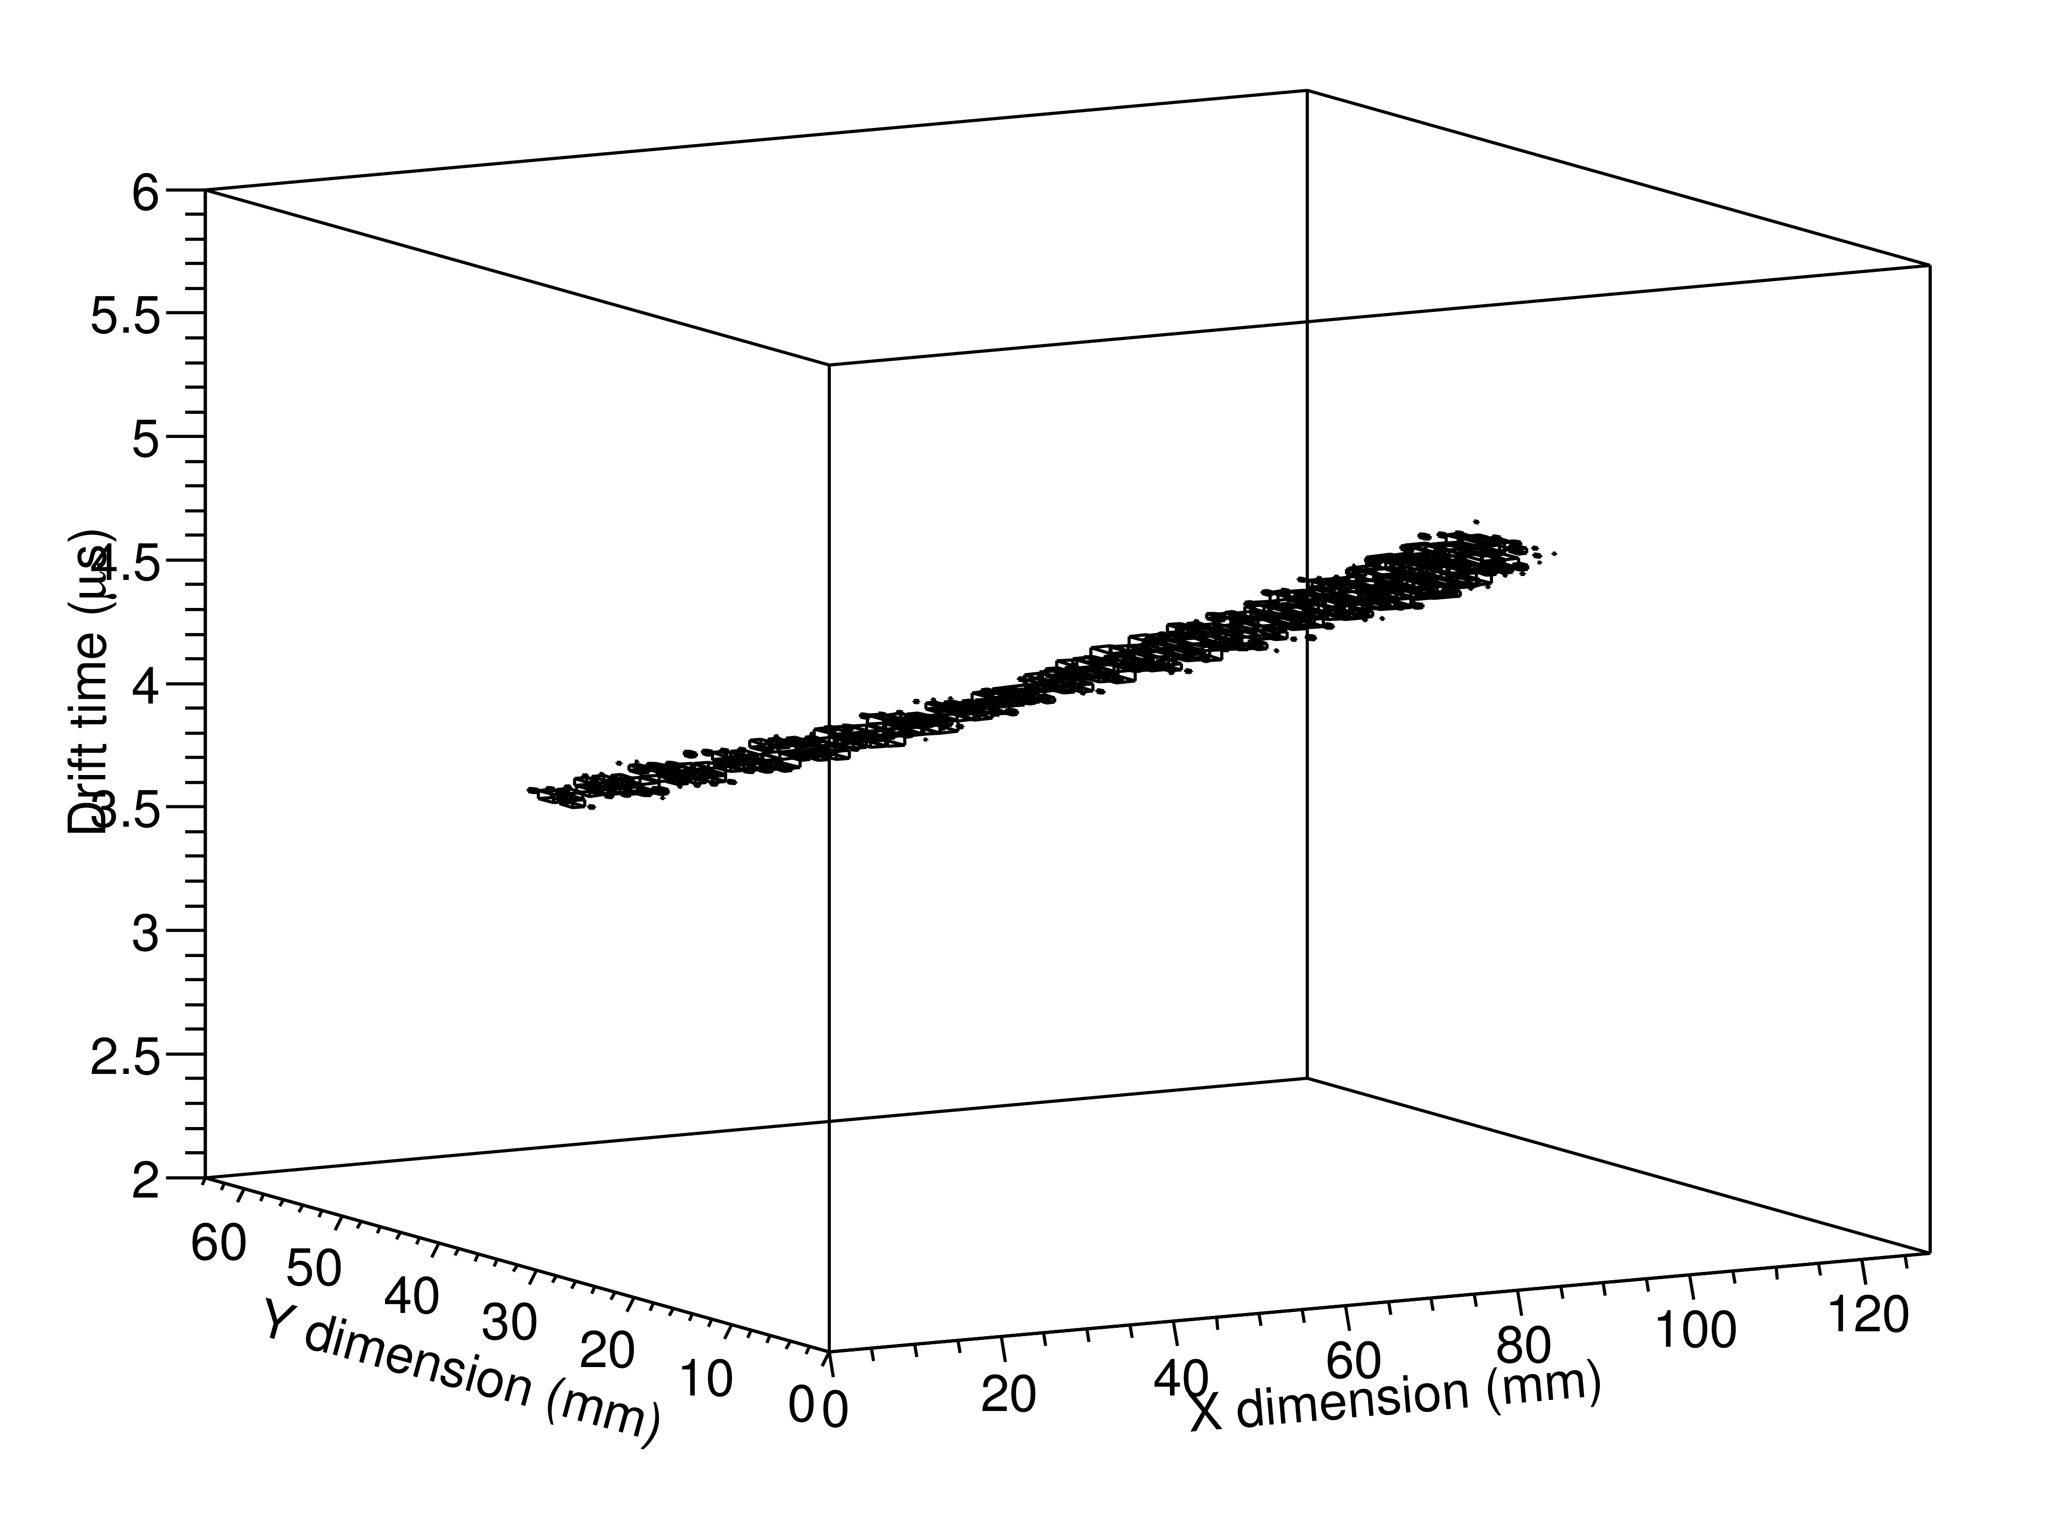
tracks analysis
“standard” analysis
signal amplitude + CFD timing
2D (X,Y) A & T
→ 2 × 16k = 32k data
J. Giovinazzo (LP2iB – CNRS IN2P2 / Univ. Bordeaux)
2025/03 réseau R&D détecteurs à gaz – simulations for ACTAR TPC decay experiments

Slide 26
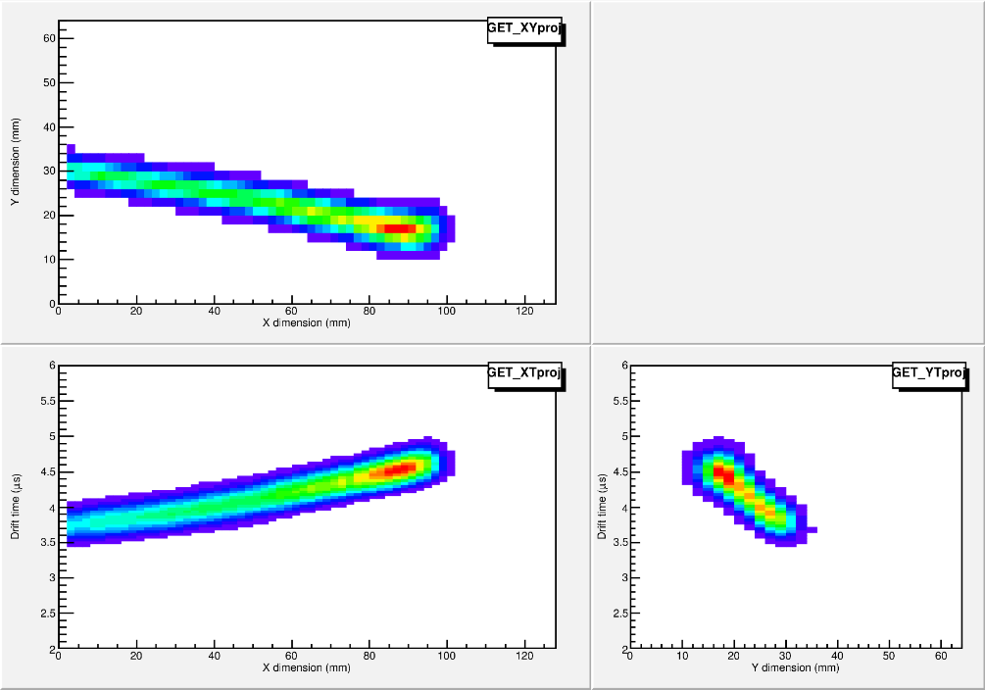
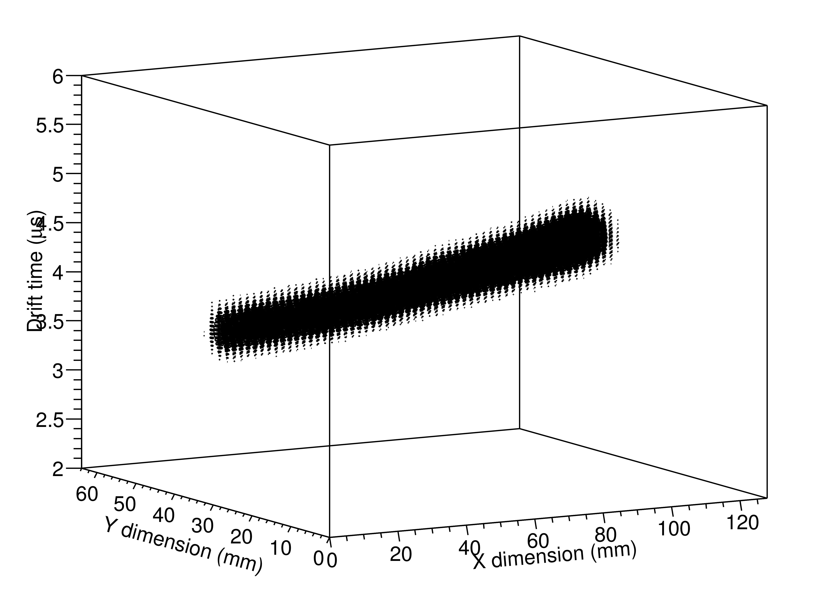
tracks analysis
“standard” analysis
signal amplitude + CFD timing
2D (X,Y) A & T
→ 2 × 16k = 32k data
deconvolution analysis
→ response functions for each channel
full 3D (X,Y,T) signal distribution (from FFT)
→ 512 × 16k = 8000k data
JG, NIM A 2020
J. Giovinazzo (LP2iB – CNRS IN2P2 / Univ. Bordeaux)
2025/03 réseau R&D détecteurs à gaz – simulations for ACTAR TPC decay experiments
analysis / computing cost
×200 !!

Slide 27
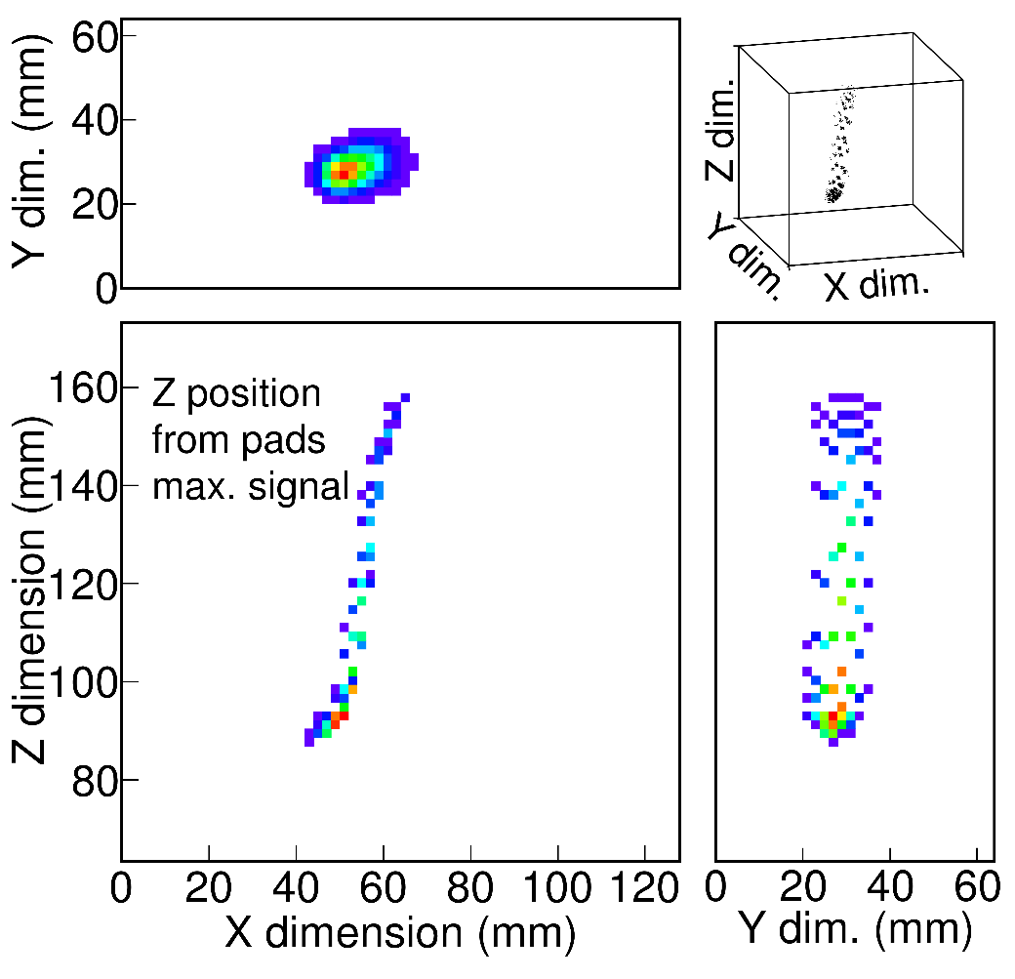
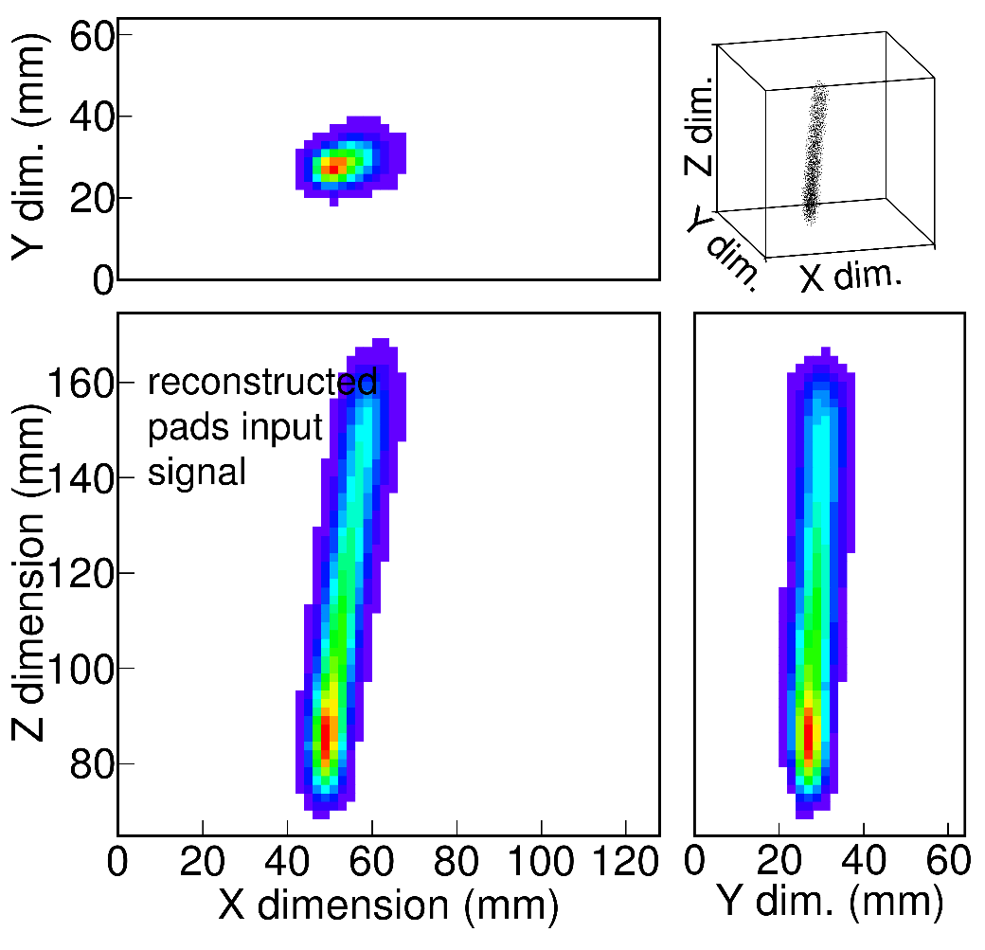
tracks analysis
“standard” analysis
signal amplitude + CFD timing
2D (X,Y) A & T
→ 2 × 16k = 32k data
deconvolution analysis
→ response functions for each channel
full 3D (X,Y,T) signal distribution (from FFT)
→ 512 × 16k = 8000k data
problem at large
vertical angles
JG, NIM A 2020
J. Giovinazzo (LP2iB – CNRS IN2P2 / Univ. Bordeaux)
2025/03 réseau R&D détecteurs à gaz – simulations for ACTAR TPC decay experiments
incorrect
track
length

Slide 28
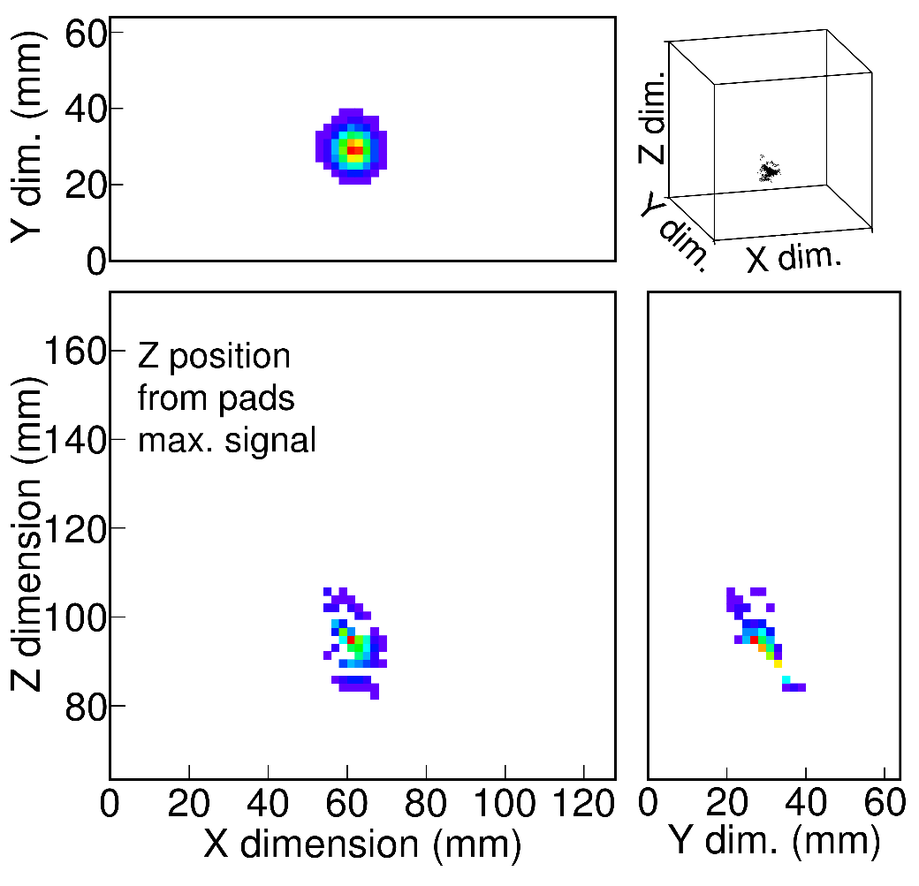

tracks analysis
“standard” analysis
signal amplitude + CFD timing
2D (X,Y) A & T
→ 2 × 16k = 32k data
deconvolution analysis
→ response functions for each channel
full 3D (X,Y,T) signal distribution (from FFT)
→ 512 × 16k = 8000k data
problem at large
vertical angles
JG, NIM A 2020
J. Giovinazzo (LP2iB – CNRS IN2P2 / Univ. Bordeaux)
2025/03 réseau R&D détecteurs à gaz – simulations for ACTAR TPC decay experiments

Slide 29

tracks fitting
  ○ 2D ampl. + time → 2×16k pads (A+T)
  ○ full 3D rec. charge → 512×16k voxels
  (deconvolution from R.F.)
  • trajectory (geometrical) definition
  start and stop 3D points
  (+ additional control points for segments
  or Bézier curves)
  → 3 param. $\left(x,y,t\right)$ per point
J. Giovinazzo (LP2iB – CNRS IN2P2 / Univ. Bordeaux)
2025/03 réseau R&D détecteurs à gaz – simulations for ACTAR TPC decay experiments

Slide 30




tracks fitting
  ○ 2D ampl. + time → 2×16k pads (A+T)
  ○ full 3D rec. charge → 512×16k voxels
  (deconvolution from R.F.)
  • trajectory (geometrical) definition
  start and stop 3D points
  (+ additional control points for segments
  or Bézier curves)
  → 3 param. $\left(x,y,t\right)$ per point
  • Bragg peak model (energy loss)
  projected along the trajectory
  amplitude factor ($A_{B}$) & length fraction ($λ_{B}$)
Geant4
simulation
$$A_{B}$$
J. Giovinazzo (LP2iB – CNRS IN2P2 / Univ. Bordeaux)
2025/03 réseau R&D détecteurs à gaz – simulations for ACTAR TPC decay experiments
$$λ_{B}=\frac{L}{L_{0}}$$

Slide 31

tracks fitting
  ○ 2D ampl. + time → 2×16k pads (A+T)
  ○ full 3D rec. charge → 512×16k voxels
  (deconvolution from R.F.)
  • trajectory (geometrical) definition
  start and stop 3D points
  (+ additional control points for segments
  or Bézier curves)
  → 3 param. $\left(x,y,t\right)$ per point
  • Bragg peak model (energy loss)
  projected along the trajectory
  amplitude factor ($A_{B}$) & length fraction ($λ_{B}$)
  • dispersion along drift
  $σ_{XY/T}\left(t\right)=σ_{0,XY/T}+σ_{1,XY/T}∙\sqrt{z\left(t\right)}$
Geant4
simulation
$$A_{B}$$
J. Giovinazzo (LP2iB – CNRS IN2P2 / Univ. Bordeaux)
2025/03 réseau R&D détecteurs à gaz – simulations for ACTAR TPC decay experiments
$$λ_{B}=\frac{L}{L_{0}}$$

Slide 32


tracks fitting
  ○ 2D ampl. + time → 2×16k pads (A+T)
  ○ full 3D rec. charge → 512×16k voxels
  (deconvolution from R.F.)
  • trajectory (geometrical) definition
  start and stop 3D points
  (+ additional control points for segments
  or Bézier curves)
  → 3 param. $\left(x,y,t\right)$ per point
  • Bragg peak model (energy loss)
  projected along the trajectory
  amplitude factor ($A_{B}$) & length fraction ($λ_{B}$)
  • dispersion along drift
  $σ_{XY/T}\left(t\right)=σ_{0,XY/T}+σ_{1,XY/T}∙\sqrt{z\left(t\right)}$
  → fit signal function $A_{2D}\left(x,y | \vec{a}\right)$, $T_{2D}\left(x,y | \vec{a}\right)$
  or $S_{3D}\left(x,y,t | \vec{a}\right)$
  → comparison to experimental distributions
  from fit: track length (≡ energy), angles (x-p), charge deposit
Geant4
simulation
$$A_{B}$$
J. Giovinazzo (LP2iB – CNRS IN2P2 / Univ. Bordeaux)
2025/03 réseau R&D détecteurs à gaz – simulations for ACTAR TPC decay experiments
$$λ_{B}=\frac{L}{L_{0}}$$

Slide 33




simulation for tracks fit dispersion
  many parameters in fits
  dispersion depends on detector conditions, not from events
  test fit of “point-like” energy deposit
  with $σ_{XY}=σ_{1}∙\sqrt{z}$
  → fixed $σ_{1}$, variation $z$ of position
  → fixed $z$ position, variation of $σ_{1}$
$$σ_{1}^{sim}=0.2$$
(constant)
track fit
Gauss 2D fit
J. Giovinazzo (LP2iB – CNRS IN2P2 / Univ. Bordeaux)
2025/03 réseau R&D détecteurs à gaz – simulations for ACTAR TPC decay experiments
wrong fit output for dispersion parameter !

Slide 34



simulation for tracks fit dispersion
  many parameters in fits
  dispersion depends on detector conditions, not from events
  test fit of “point-like” energy deposit
  with $σ_{XY}=σ_{1}∙\sqrt{z}$
  → fixed $σ_{1}$, variation $z$ of position
  → fixed $z$ position, variation of $σ_{1}$
$$σ_{1}^{sim}=0.2$$
(constant)
track fit
Gauss 2D fit
$$\sqrt{\frac{{σ_{pad}}^{2}}{z}+{S_{XY1}}^{2}}$$
J. Giovinazzo (LP2iB – CNRS IN2P2 / Univ. Bordeaux)
2025/03 réseau R&D détecteurs à gaz – simulations for ACTAR TPC decay experiments
intrinsic dispersion from pad size
$$\frac{σ_{pad}}{\sqrt{z}}=\frac{∆x}{\sqrt{12∙z}}$$
→ matches simple 2D Gauss fit !!!

Slide 35


simulation for tracks fit dispersion
  many parameters in fits
  dispersion depends on detector conditions, not from events
OK down to
low dispersion
(close to pad plane)
  test fit of “point-like” energy deposit
  with $σ_{XY}=σ_{1}∙\sqrt{z}$
  → fixed $σ_{1}$, variation $z$ of position
  → fixed $z$ position, variation of $σ_{1}$
  • $σ_{XY}=\sqrt{{\left(σ_{pad}\right)}^{2}+{\left(σ_{1}∙\sqrt{z}\right)}^{2}}$
J. Giovinazzo (LP2iB – CNRS IN2P2 / Univ. Bordeaux)
2025/03 réseau R&D détecteurs à gaz – simulations for ACTAR TPC decay experiments

Slide 36


simulation for tracks fit dispersion
  many parameters in fits
  dispersion depends on detector conditions, not from events
OK down to
low dispersion
(close to pad plane)
  test fit of “point-like” energy deposit
  with $σ_{XY}=σ_{1}∙\sqrt{z}$
  → fixed $σ_{1}$, variation $z$ of position
  → fixed $z$ position, variation of $σ_{1}$
  • $σ_{XY}=\sqrt{{\left(σ_{pad}\right)}^{2}+{\left(σ_{1}∙\sqrt{z}\right)}^{2}}$
  • reduced threshold
  (cannot be changed in real data !!!)
  • analytical integral over pad signal
  instead of mean/center value
  (4× erf function instead of 1× Gauss
  → 20× slower fit…)
J. Giovinazzo (LP2iB – CNRS IN2P2 / Univ. Bordeaux)
2025/03 réseau R&D détecteurs à gaz – simulations for ACTAR TPC decay experiments
improved but
useless for real data

Slide 37

simulation for effect of recoil nucleus
  energy calibration (track length ↔ energy conversion) based on known (β-)proton transitions
  calibration curve from SRIM at optimal pressure
  recoil nucleus (ion):
  ∼2-3 % of transition energy (1/A)
  very short range
  most likely quenching
  neutralization
  neglected
J. Giovinazzo (LP2iB – CNRS IN2P2 / Univ. Bordeaux)
2025/03 réseau R&D détecteurs à gaz – simulations for ACTAR TPC decay experiments
  Ok for β-p decays
  (same conditions)

Slide 38
simulation for effect of recoil nucleus
  energy calibration (track length ↔ energy conversion) based on known (β-)proton transitions
  calibration curve from SRIM at optimal pressure
  recoil nucleus (ion):
  ∼2-3 % of transition energy (1/A)
  very short range
  most likely quenching
  neutralization
  neglected
J. Giovinazzo (LP2iB – CNRS IN2P2 / Univ. Bordeaux)
2025/03 réseau R&D détecteurs à gaz – simulations for ACTAR TPC decay experiments
  Ok for β-p decays
  (same conditions)
  problem for 2p decays
  measured Q-value lower than previous measurements
  p
  p
  rec
  p
  rec
  p
  momentum conservation
  different contribution of recoil with p-p angle

Slide 39
simulation for effect of recoil nucleus
  energy calibration (track length ↔ energy conversion) based on known (β-)proton transitions
  calibration curve from SRIM at optimal pressure
  recoil nucleus (ion):
  ∼2-3 % of transition energy (1/A)
  very short range
  most likely quenching
  neutralization
  included in fits (param. L_{rec} and f_{Q})
  of simulated events
  (recoil from β neglected)
  dE/dx
J. Giovinazzo (LP2iB – CNRS IN2P2 / Univ. Bordeaux)
2025/03 réseau R&D détecteurs à gaz – simulations for ACTAR TPC decay experiments
  recoil
  proton
  Q_{rec} ∼ f_{Q}·(1/A)·Q_{p}
  Q_{p}
  L_{rec}

Slide 40

simulation for effect of recoil nucleus
  energy calibration (track length ↔ energy conversion) based on known (β-)proton transitions
  calibration curve from SRIM at optimal pressure
  recoil nucleus (ion):
  ∼2-3 % of transition energy (1/A)
  very short range
  most likely quenching
  neutralization
  included in fits (param. L_{rec} and f_{Q})
  of simulated events
  (recoil from β neglected)
  dE/dx
J. Giovinazzo (LP2iB – CNRS IN2P2 / Univ. Bordeaux)
2025/03 réseau R&D détecteurs à gaz – simulations for ACTAR TPC decay experiments
  recoil
  proton
  Q_{rec} ∼ f_{Q}·(1/A)·Q_{p}
  Q_{p}
intrinsic length
dispersion from
simulation
(for information)
  L_{rec}
  3∼5 % length difference
  (fit vs simul. length)

Slide 41

simulation for effect of recoil nucleus
  energy calibration (track length ↔ energy conversion) based on known (β-)proton transitions
  calibration curve from SRIM at optimal pressure
  recoil nucleus (ion):
  ∼2-3 % of transition energy (1/A)
  very short range
  most likely quenching
  neutralization
  included in fits (param. L_{rec} and f_{Q})
  of simulated events
  (recoil from β neglected)
J. Giovinazzo (LP2iB – CNRS IN2P2 / Univ. Bordeaux)
2025/03 réseau R&D détecteurs à gaz – simulations for ACTAR TPC decay experiments
  rec
  p
  p
  p
  p
  rec
  2P decay:
  Q-value from fitted length
  increased by ∼2%

Slide 42
concluding remarks
⬥ simulations needed for ACTAR TPC decay detection efficiency
custom empirical simulation (no need for microscopic description)
parametrization based on experimental data
dominated by systematic uncertainties
slight differences in E690 & E791 procedures
⬥ simulations help tracks analysis and fits
identification of events topology (not discussed here)
control and correction of fit procedure
→ corrected dispersion
→ included recoil signal
⬥ still some work to be done…
sorting of decay events types (for now “artisanal” way…)
improve fits (3D fits extremely slow)
control G4 results (problems…)
J. Giovinazzo (LP2iB – CNRS IN2P2 / Univ. Bordeaux)
2025/03 réseau R&D détecteurs à gaz – simulations for ACTAR TPC decay experiments

Slide 43
concluding remarks
⬥ simulations needed for ACTAR TPC decay detection efficiency
custom empirical simulation (no need for microscopic description)
parametrization based on experimental data
dominated by systematic uncertainties
slight differences in E690 & E791 procedures
⬥ simulations help tracks analysis and fits
identification of events topology (not discussed here)
control and correction of fit procedure
→ corrected dispersion
→ included recoil signal
⬥ still some work to be done…
sorting of decay events types (for now “artisanal” way…)
improve fits (3D fits extremely slow)
control G4 results (problems…)
J. Giovinazzo (LP2iB – CNRS IN2P2 / Univ. Bordeaux)
2025/03 réseau R&D détecteurs à gaz – simulations for ACTAR TPC decay experiments
thank you for your attention !

Slide 44


problems
updated SimRange program for GSimTPC 6.0 (for rocky linux 8)
recomputed Bragg peak histograms (fit pattern) for alpha and protons
in Ar-C4H10 (90%-10%): 50000 events
• 10 MeV protons, P = 5 bar (file proton_10MeV_5bar.root)
• 10 MeV alpha, P = 1 bar (file alpha_20MeV_2bar.root)
20 MeV alpha average energy loss
in Argon-Isobutane (90-10%) gas (P = 2 bar)
J. Giovinazzo (LP2iB – CNRS IN2P2 / Univ. Bordeaux)
2025/03 réseau R&D détecteurs à gaz – simulations for ACTAR TPC decay experiments
G4 10.03.p01
centos 7, g++ 4.8.5
(50000 events)
G4 11.1.2
rocky8, g++ 8.5.0
(5000 events)
???
average of energy deposit along “normalized” track path

