Slide 1
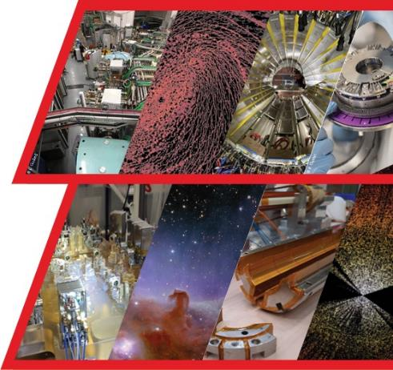
Welcome to IRFU !!!
Institute for Research into the Fundamental
laws of the Universe
Eric Delagnes: Former head of the Department For Electronics, Detectors and computing for Physics

Slide 2
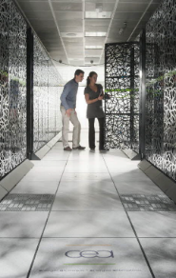
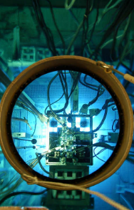
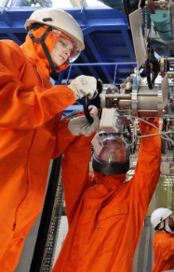





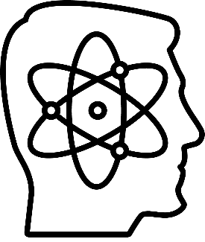


CEA – The French Alternative Energies and Atomic Energy Commission
21000
employees
5.8
billion euros
Defense
Energy
Technology
> 5000
publications
> 450
European projets
Fundamental Research
Institute for Research into the Fundamental Laws of the Universe
Annual Budget : 6.3 Billion Euros

Slide 3
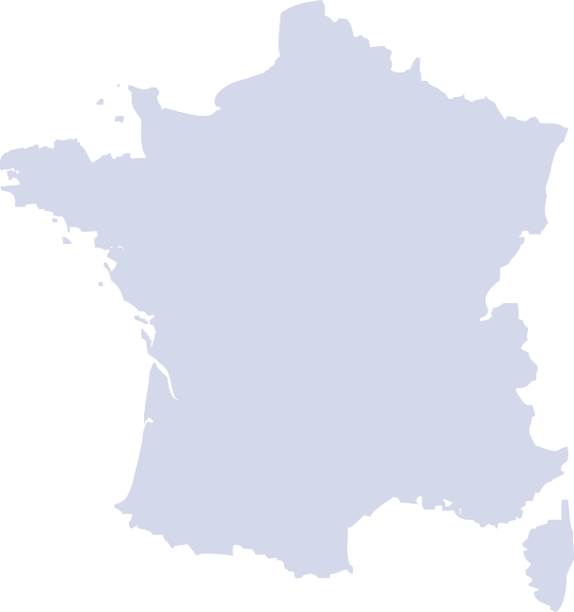
CEA Research Centers in France
Basic Sciences
4
Paris-Saclay
CIVIL CENTERS
5
Microelectronics
DEFENSE CENTERS
8
Bordeaux
Grenoble
Nuclear Energy
Fusion
PLATES-FORMES RÉGIONALES de transfert technologique
Marcoule
Cadarache

Slide 4
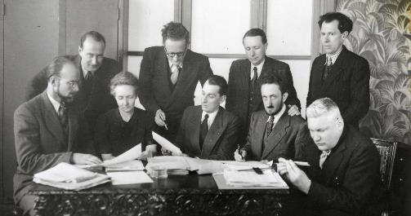
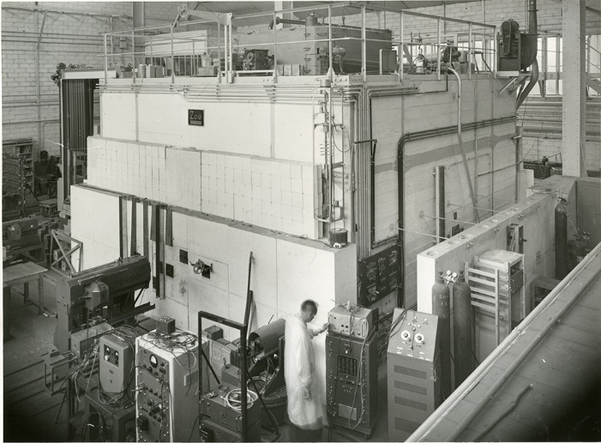
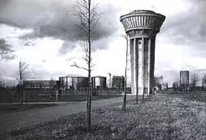
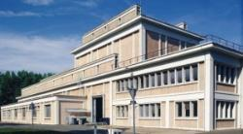
A bit of history : early CEA and Saclay
Jean
Langevin
1945: just after WW2 : creation of CEA with main mission is the development of the use of atomic energy for the domains of science, energy, industry and defense
1948 : divergence of the “Zoe” reactor (Fontenay center now join with Saclay)
1952 : foundation of Saclay’s center : goal was to build a “palace of science” inspired by Versailles and the campus of American Universities.
Pierre
Auger
Irène
Joliot-Curie
Frédéric
Joliot-Curie
Francis
Perrin
First scientific team of CEA (1946)
Saclay in 1950’s with the reactors and the WATER TOWER (historical monument as several buildings of the center, architect A. Perret)
Zoe : first french Nucelar Reactor in Fontenay (near Saclay) 1946)

Slide 5
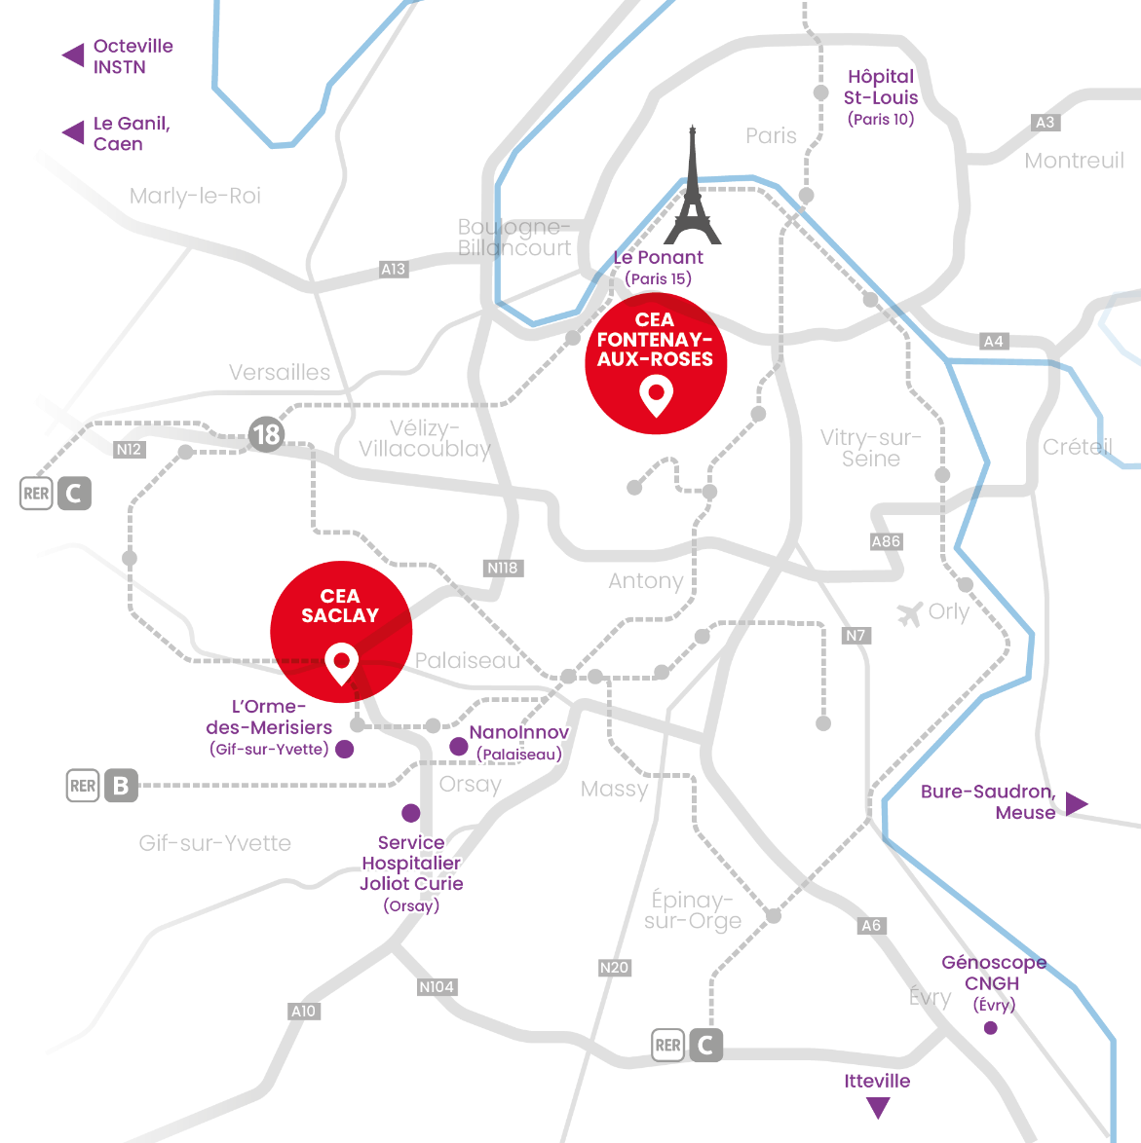
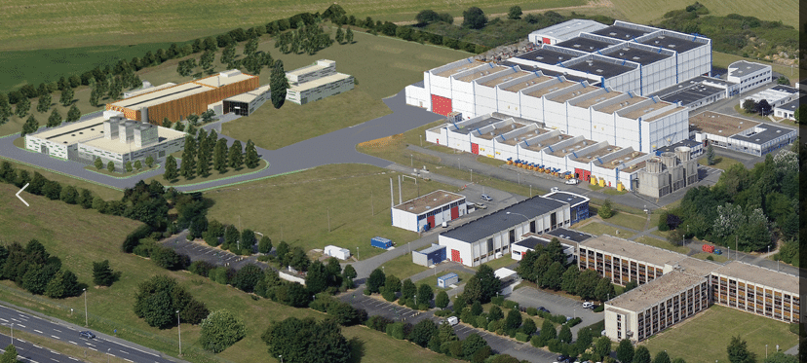
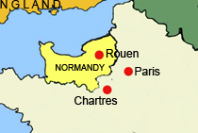
Paris-Saclay center
Hospital
GANIL @ CAEN in Normandy
Main center
14 km
Orme des Merisiers
Basic sciences
(Astro, nuclear, quantum,
Nano and laser physics), climate
Genomic
Hospital
Micro-Nano
electronics

Slide 6
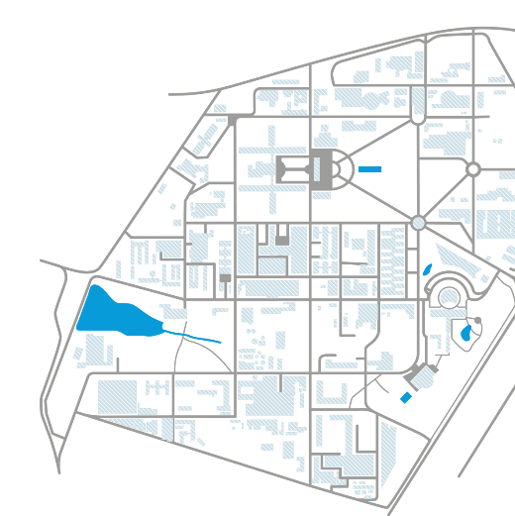



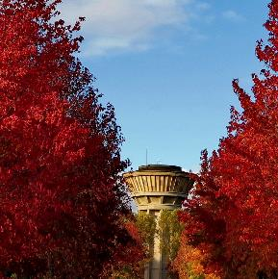
Saclay center in few numbers
Saclay is the largest public research center in UE
Jouy-en-Josas
7 000 People in Saclay
8700 with Fontenay & Evry
Villiers-le-
Bâche
5 600 CEA’s employees
220 hectares for the site of Saclay
6 800 trees over 80 ha of green areas
36 km of roads
4 000 meals served every day
8 research institutes
1 institute for formation (INSTN)
7 nuclear installations
60 installations classified for environment protection
11 11 companies hosted
Saint-Aubin

Slide 7
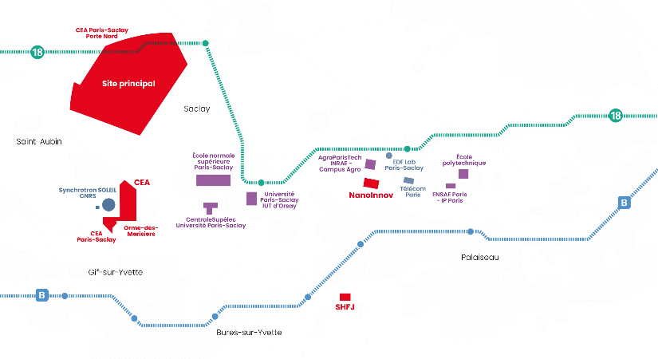

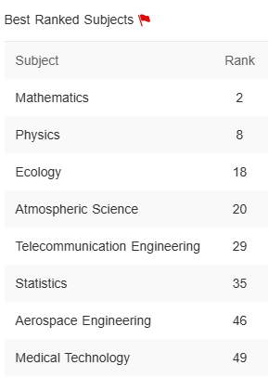
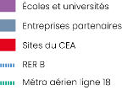
CEA Saclay in the context of Saclay « Plateau »
Largest concentration of scinentific activities in France
Two « universities » : Paris-Saclay University (of which CEA is member) and Institut Polytechnique de Paris
Important place in France for Physics and Mathematics
Largest concentration of french famous engineering schools
Several Labs from private companies
CEA Main
center
PSU:
Shangai
Ranking 2024 : 12
2km
Orsay university
Schools and universities
Lab from private companies
CEA sites
4km

Slide 8
IRFU (Institute for Reasearch on Fondamental Laws of the Universe) in CEA
Direction of military applications
Direction of energies
Direction of basic sciences
Direction of technological research
LETI
LIS
LITEN
Nano sciences
Quantronic
Low temperatures
…
DRF
INAC
BIG
IGE
IRFM
IRAMIS
IRFU
LSCE
IBITEC
…
Physics
Live sciences
Climate
Genomics
Fusion
Condensed matter physics
Laser, nanosciences,
Spintronic/ quantronic…
Astrophysics, High Energy Physics, Nuclear Physics and associated instrumentations
~850
F. Sabatie

Slide 9



Saclay: inter and multiplisciplinary researches
DRF: Basic Research
Dir.
of Energies
Dir. of
Techno.
DDSD
Physics and Instrumentation
Very large Instruments
Energies
Dismantling and Rehabilitation
Climate & Environment
Health and Life sciences
Digital
Teaching and Formation

Slide 10


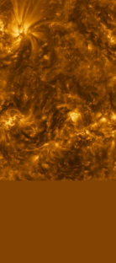
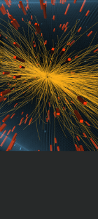
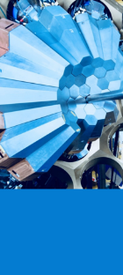
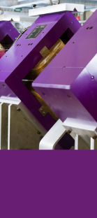
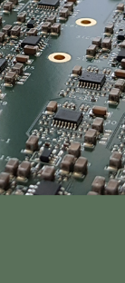
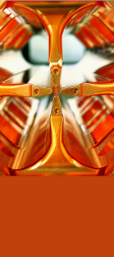
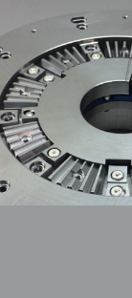




IRFU
Institute for Research into the Fundamental laws of the Universe
Management
Office
DAP
DPHP
DPHN
GANIL
DEDIP
DACM
DIS
Particle
Physics
Nuclear
Physics
Heavy Ion National Accelerator
Detectors
Electronics
Computing
Accelerators
Cryogenic
Magnets
System
Engineering
Astrophysics
671 CDI
268 CDD
111 PhD
23 ERC
(8 ongoing)
1050
111 M€
1000/an

Slide 11
Missions of IRFU
Carry out technological and fundamental research within the framework of CEA's missions, in order to explore the fundamental laws of the universe, from the smallest scales (elementary constituents, nuclear matter) to the largest (energy content and structure of the universe)
Apply our technological innovations to major national or international projects: MRI or fusion magnets, accelerators and neutron sources, medical imaging, etc.
With two specificities due to IRFU’s size and the strong integration of its departments:
Ability to cover the entire research chain
Theory, experiment proposal, simulation, design, construction,
operation, data analysis, phenomenology and communication
Ability to manage large, innovative and complex projects
Accelerators, magnets, detectors
Science
Technologies
Projects

Slide 12
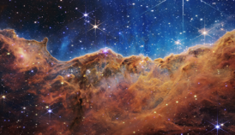
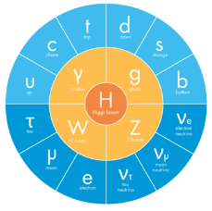
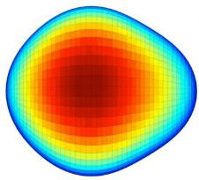
Science
Energy content of the Universe
Formation and evolution of structures, galaxies, stars
Stars and planetary systems
Exploration of the transient Universe
Structure of the Universe
Elementary
constituents,
Fundamental
symmetries
Property of
Nuclear matter
Consistency tests of the standard model
Structural tests of the standard model
Nuclear structure and dynamics
Dynamics of quarks and gluons

Slide 13
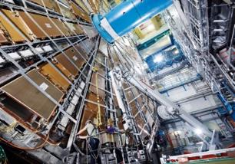
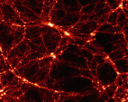
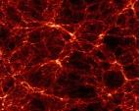
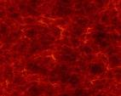
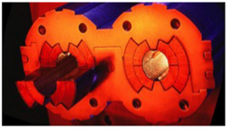
Technologies
Structure of the Universe
Detection
systems
Simulation and
Big data analysis
Infrastructures &
Platforms
Elementary
constituents,
Fundamental
symmetries
Property of
Nuclear matter
Accelerator systems and
cryomagnetism

Slide 14








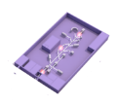
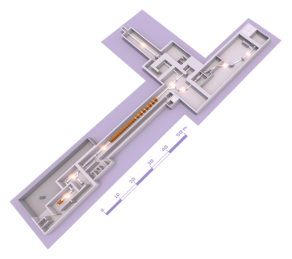
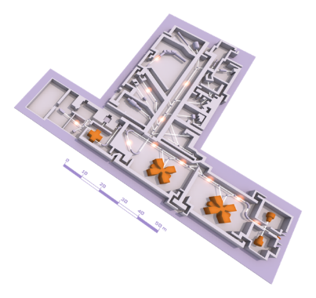



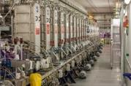


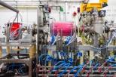



The GANIL infrastructure
Research Infrastructure on the strategic national roadmap, ESFRI landmark since 2016
Multi-disciplinary science: nuclear physics and astrophysics, astro-chemistry, materials under irradiation, nanostructuration, radiobiology, industrial applications, detectors and accelerators R&D
230 permanent staff (half from CEA), ~1000 users, ~100 PhDs ongoing with GANIL data
EXPERIMENTAL ROOM NFS (NEUTRONS FOR SCIENCE)
EXPERIMENTAL ROOM DESIR (Disintegration,
Excitation and Storage of Radioactive Ions)
ACTAR TPC
EXOGAM
Sample holder for irradiation
MUGAST
Convertor room
Time of Flight room
Experimental rooms
AGATA
LISE SPECTROMETER
VAMOS
LINEAR accelerator (LINAC)
EXPERIMENTAL ROOM S3 (SUPER SEPARATOR SPECTROMETER)
GANIL CYCLOTRONS
INDRA + FAZIA
CYCLOTRON
SOURCES
ION SOURCE

Slide 15
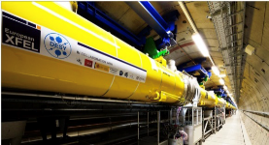
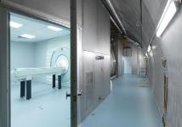
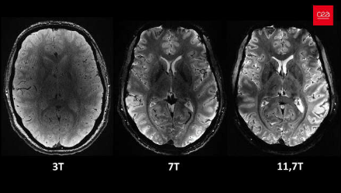

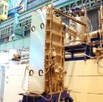
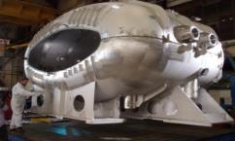
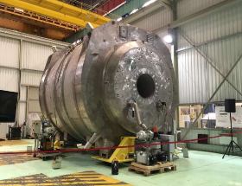
Application of our technologies to large national and international projects
From CERN magnets to Health :
Iseult : MRI with highest field in the world for improved resolution resolution
High Energy/High Lumi accelerators (CERN LHC or post LHC)
Fusion : IFMIF-EVEDA/DONES, JT60-SA
Light sources: SOLEIL, E-XFEL
Neutrons sources: ESS, SARAF, ICONE
Health : TOF-PETMRI (Iseult 11.7T magnet)

Slide 16
Human Resources per scientific field
2017-2022
(w/o GANIL)

Slide 17
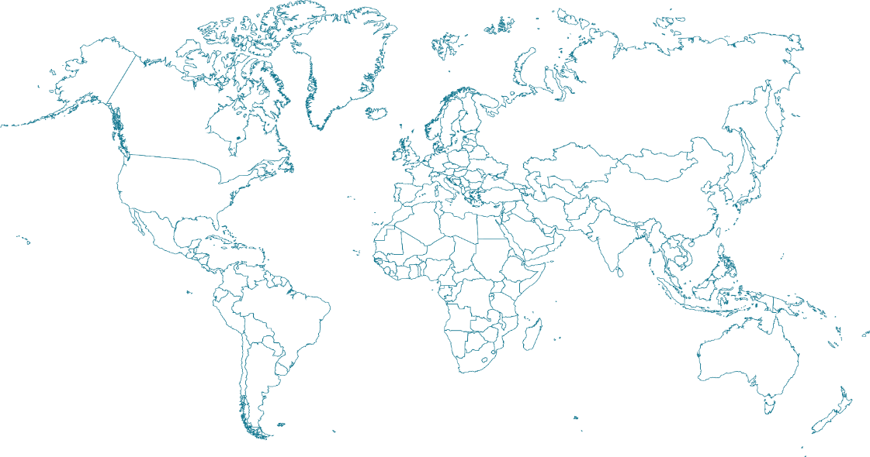




International collaborations
ESS
ESS
DESI
FAIR
PIPII-DUNE
EIC
GANIL
MPI
SVOM
CERN
IFMIF
JLAB
CTA
DONES
T2K
SARAF
MEGACAM
HESS
ELT-ESO
CTA
Astrophysics, astroparticles
SKA
Particle and Nuclear physics
Neutrons Sources, synchrotrons, lasers

Slide 18
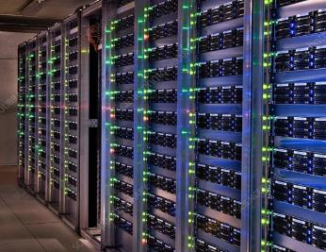
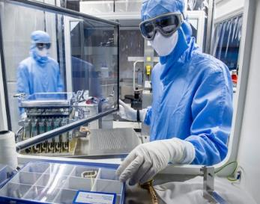
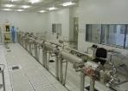
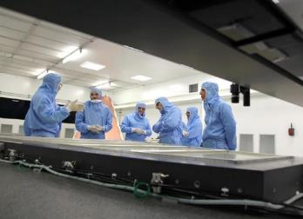
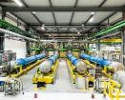

Platforms
COMPUTING
SPACE
3 HPC clusters
13000 cores,
2500 Mh HS06/y
LHC Grid (tier 2)
9000 cores,
500 Mh HS06/y
Clean rooms iso5-8
Instrumentation
Integration and test halls
MAGNETS
ACCELERATORS
DETECTORS
Synergium 25000 m²
Clean rooms iso4-5
Integration halls and test
cryostats
Clean rooms
incl. Ciclad iso7 130m²
and iso5 50m²
Integration and test halls

Slide 19


DEDIP: department for electronics, detectors and computing for Physics
Able to cover the whole detection chains
…or to focus on a part of them
From physics of detector to offline computing
For all the physics of the institute
+ applications for society
From small in-lab devices to large
internationational collaborations
HOME OF THE MICROMEGAS GASEOUS DETECTOR TECHNOLOGY
Ioannis Giomataris:
Inventor of Micromegas

Slide 20








Main technological platforms
Microelectronics lab
+ Micro-assembly
+ associated test equipment
ISO 6,5 60m2 clean room
Halls for integration & test (~2500 m²)
Including a 60 m² temperature-controlled clean room
Ciclad (130m² ISO-6) for large
Detectors integration & test
MIMOSA hall (500m²):
Facilities for Muon tomography
« MPGD » workshop
2 common labs with industry
Computing rooms
Modern mechanical workshop

Slide 21
















Examples of past projects (in operation)
detection
electronics
LHC phase 1
upgrades
computing
Satellite SVOM (gamma ray burst) -2023
FE electronics
On-board computing
Ground Segment (detection & world broadcast of alerts)
CLAS12 (hadronic Physics) @ Jefferson Labs (USA): Micromegas Tracker 30000 channels
ATLAS Calorimeter: 72 Digital Trigger
boards (200Gb/s /board)
Advanced beam diagnostics
High Intensity profile monitors and low energy beam loss monitors
T2K: Micromegas Time projection chambers system Tokai Lab (Japon)
ATLAS NSW: 400m² of Micromegas
detectors
DESI (Dark Energy): the 10 spectrometers installed at Mayal (USA)
ALICE Muon Forward Tracker based on MAPS technology
Upgraded back-end electronics
for the muon arm
Extrem Horizon : 50Mhours computation on TGCC/Joliot Curie

Slide 22















Few examples of on-going projects
EIC EPIC:
CYMBAL Detector
+ Salsa FE chip
+ RO electronics
LHC phase 2
Upgrades (2027)
P2 Basket @Mainz. Micromegas tracker for
Precise measurement of electroweak mixing angle at low pulse transfer
CMS chips for the calorimeters + clock distribution. Extrem radiation hardness.10ps timing precision
Sirius: Silicon detectors used for the focal plane
of S3 @ GANIL/Spiral2
Module assembly and testing. 1/4 of the
Atlas silicon internal Tracker
LISA
NectarCAM camera for the medium size telescopes of CTA (2024-2028)
Digitizers chips, software
Integration and qualification of 9 camera
Mirrors
Hyperkamiokande (Neutrinos, Japon, 2025)
High precision clock distribution system
LISA: gravitational waves (launch in 2032)
Contribution to the LISA optical bench (ground equipment): ultra-stable mechanical structures
Data analysis based on IA technologies

Slide 23








2 joint laboratories with industrial companies
Goals
Transfer of instruments from R&D to industry
Industrial design from the early stages (rapid rise in TRL)
Benefit from industrial technologies to enable innovative R&D
From space instrumentation to nuclear control
From particle physics to Geosciences
Creation of a mosaic of ASICs using the latest 3D+ technology
Transfer and developments for the commercialization of a Gamma Camera.
R&D on high performance detectors with the technological means of the industry.
Transfer and development for the commercialization of muon telescopes.
R&D to optimize the electronics (power supply, control and reading) thanks to IRIS skills.

Slide 24
A very big thanks to all the speakers We wish you an excellent (and sunny) MPGD workshop in Saclay

