Slide 1
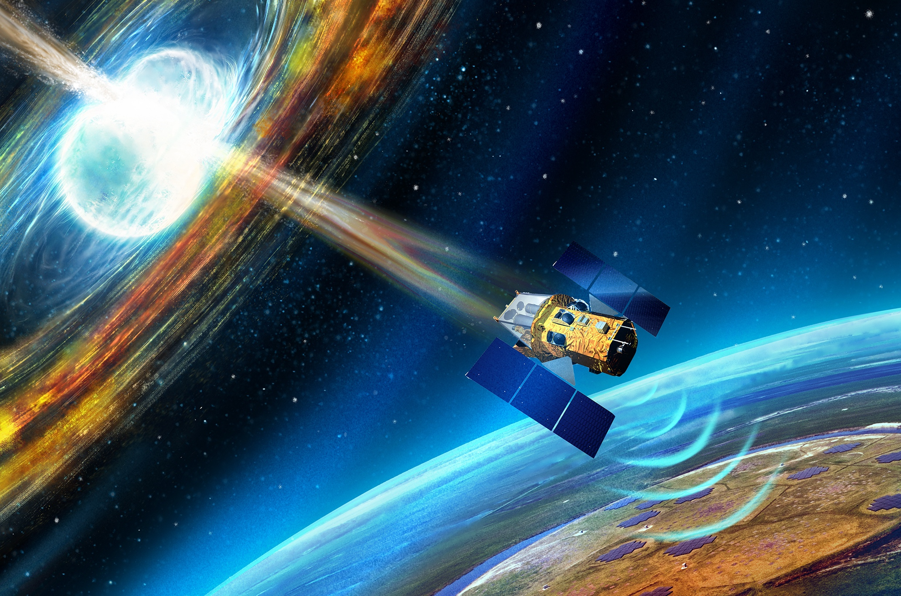




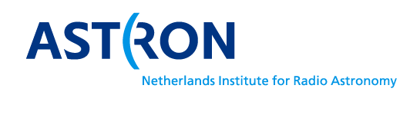
Radio transients:
from LOFAR to SKAO
Antonia Rowlinson
University of Amsterdam & ASTRON
20th October 2025
Image credit:
Danielle Futselaar

Slide 2
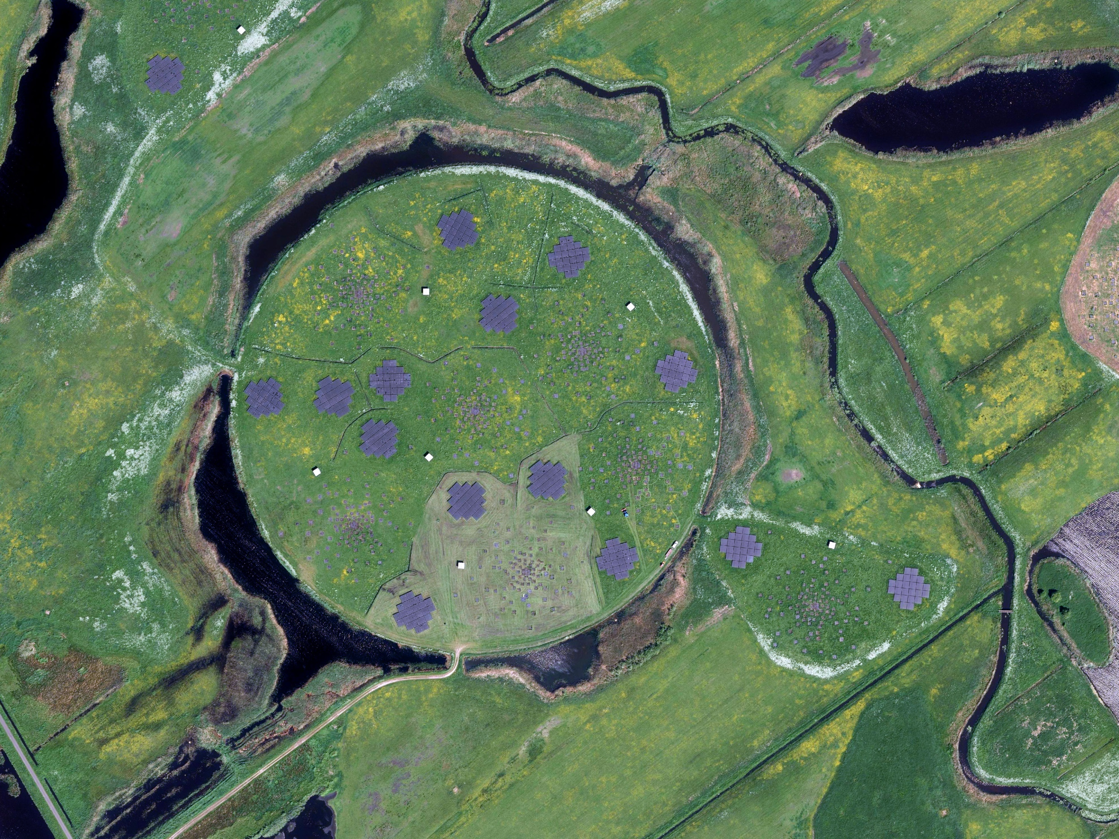
LOFAR

Slide 3
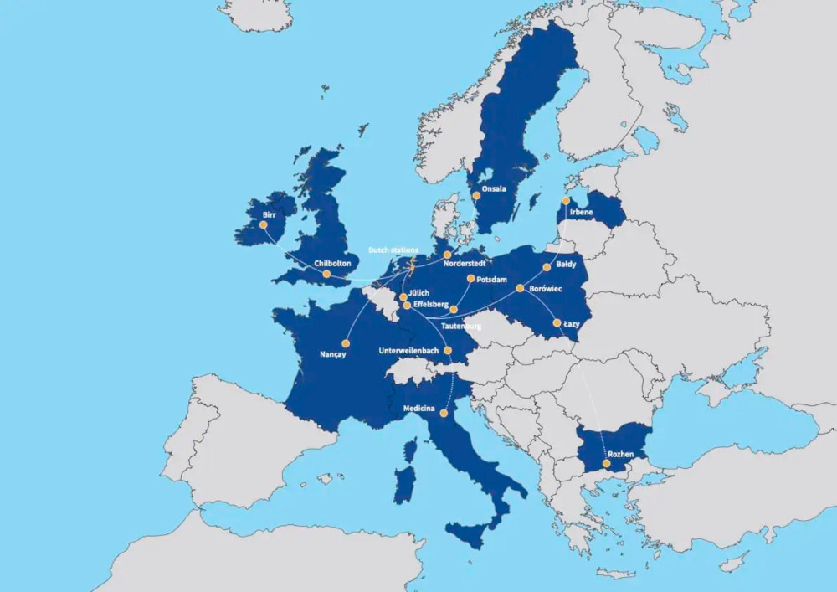

Slide 4
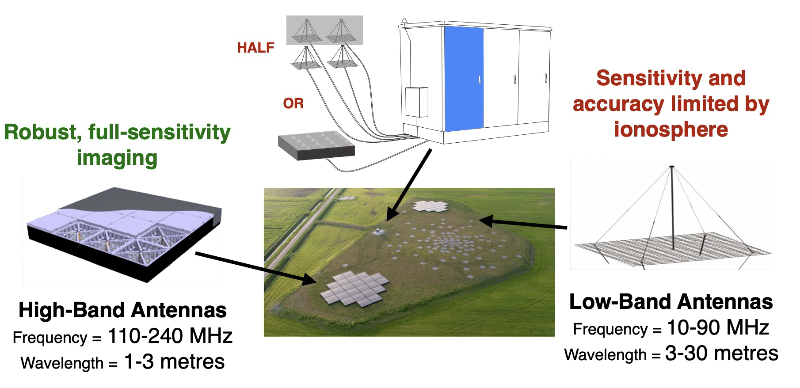
LOFAR
Slide credit: Jason Hessels

Slide 5
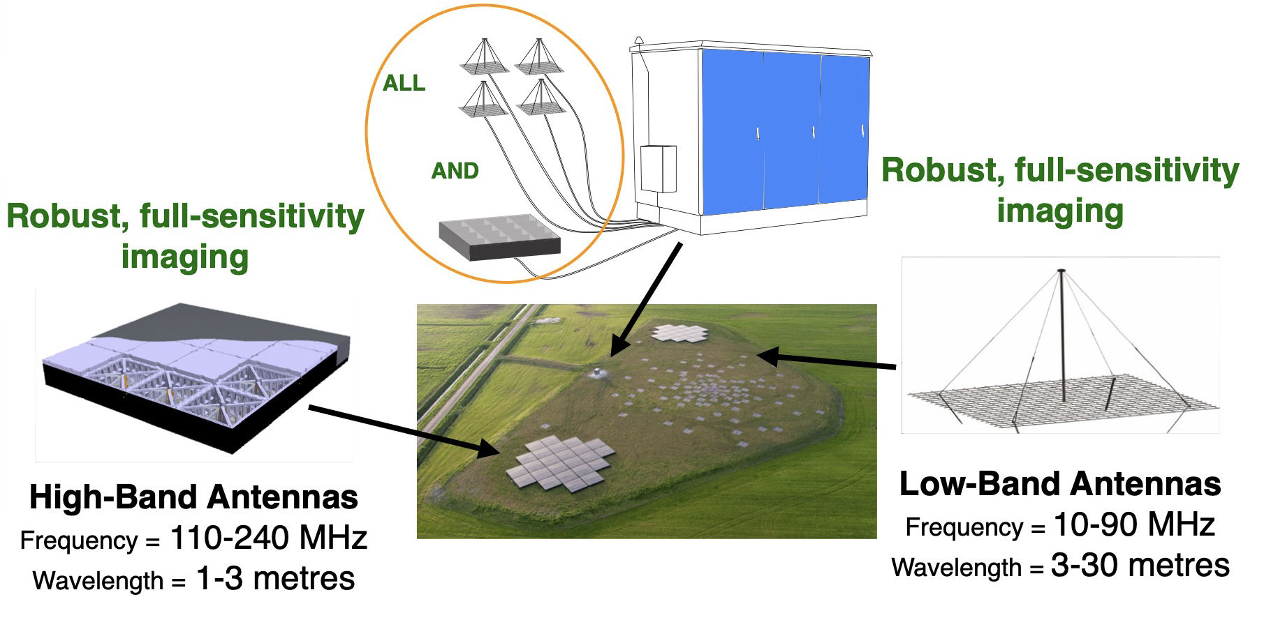
LOFAR 2.0
Faster response time to alerts (goal 1 minute)
Automated pipelines for processing
Online 2026!
Slide credit: Jason Hessels

Slide 6
Unbiased transient surveys

Slide 7
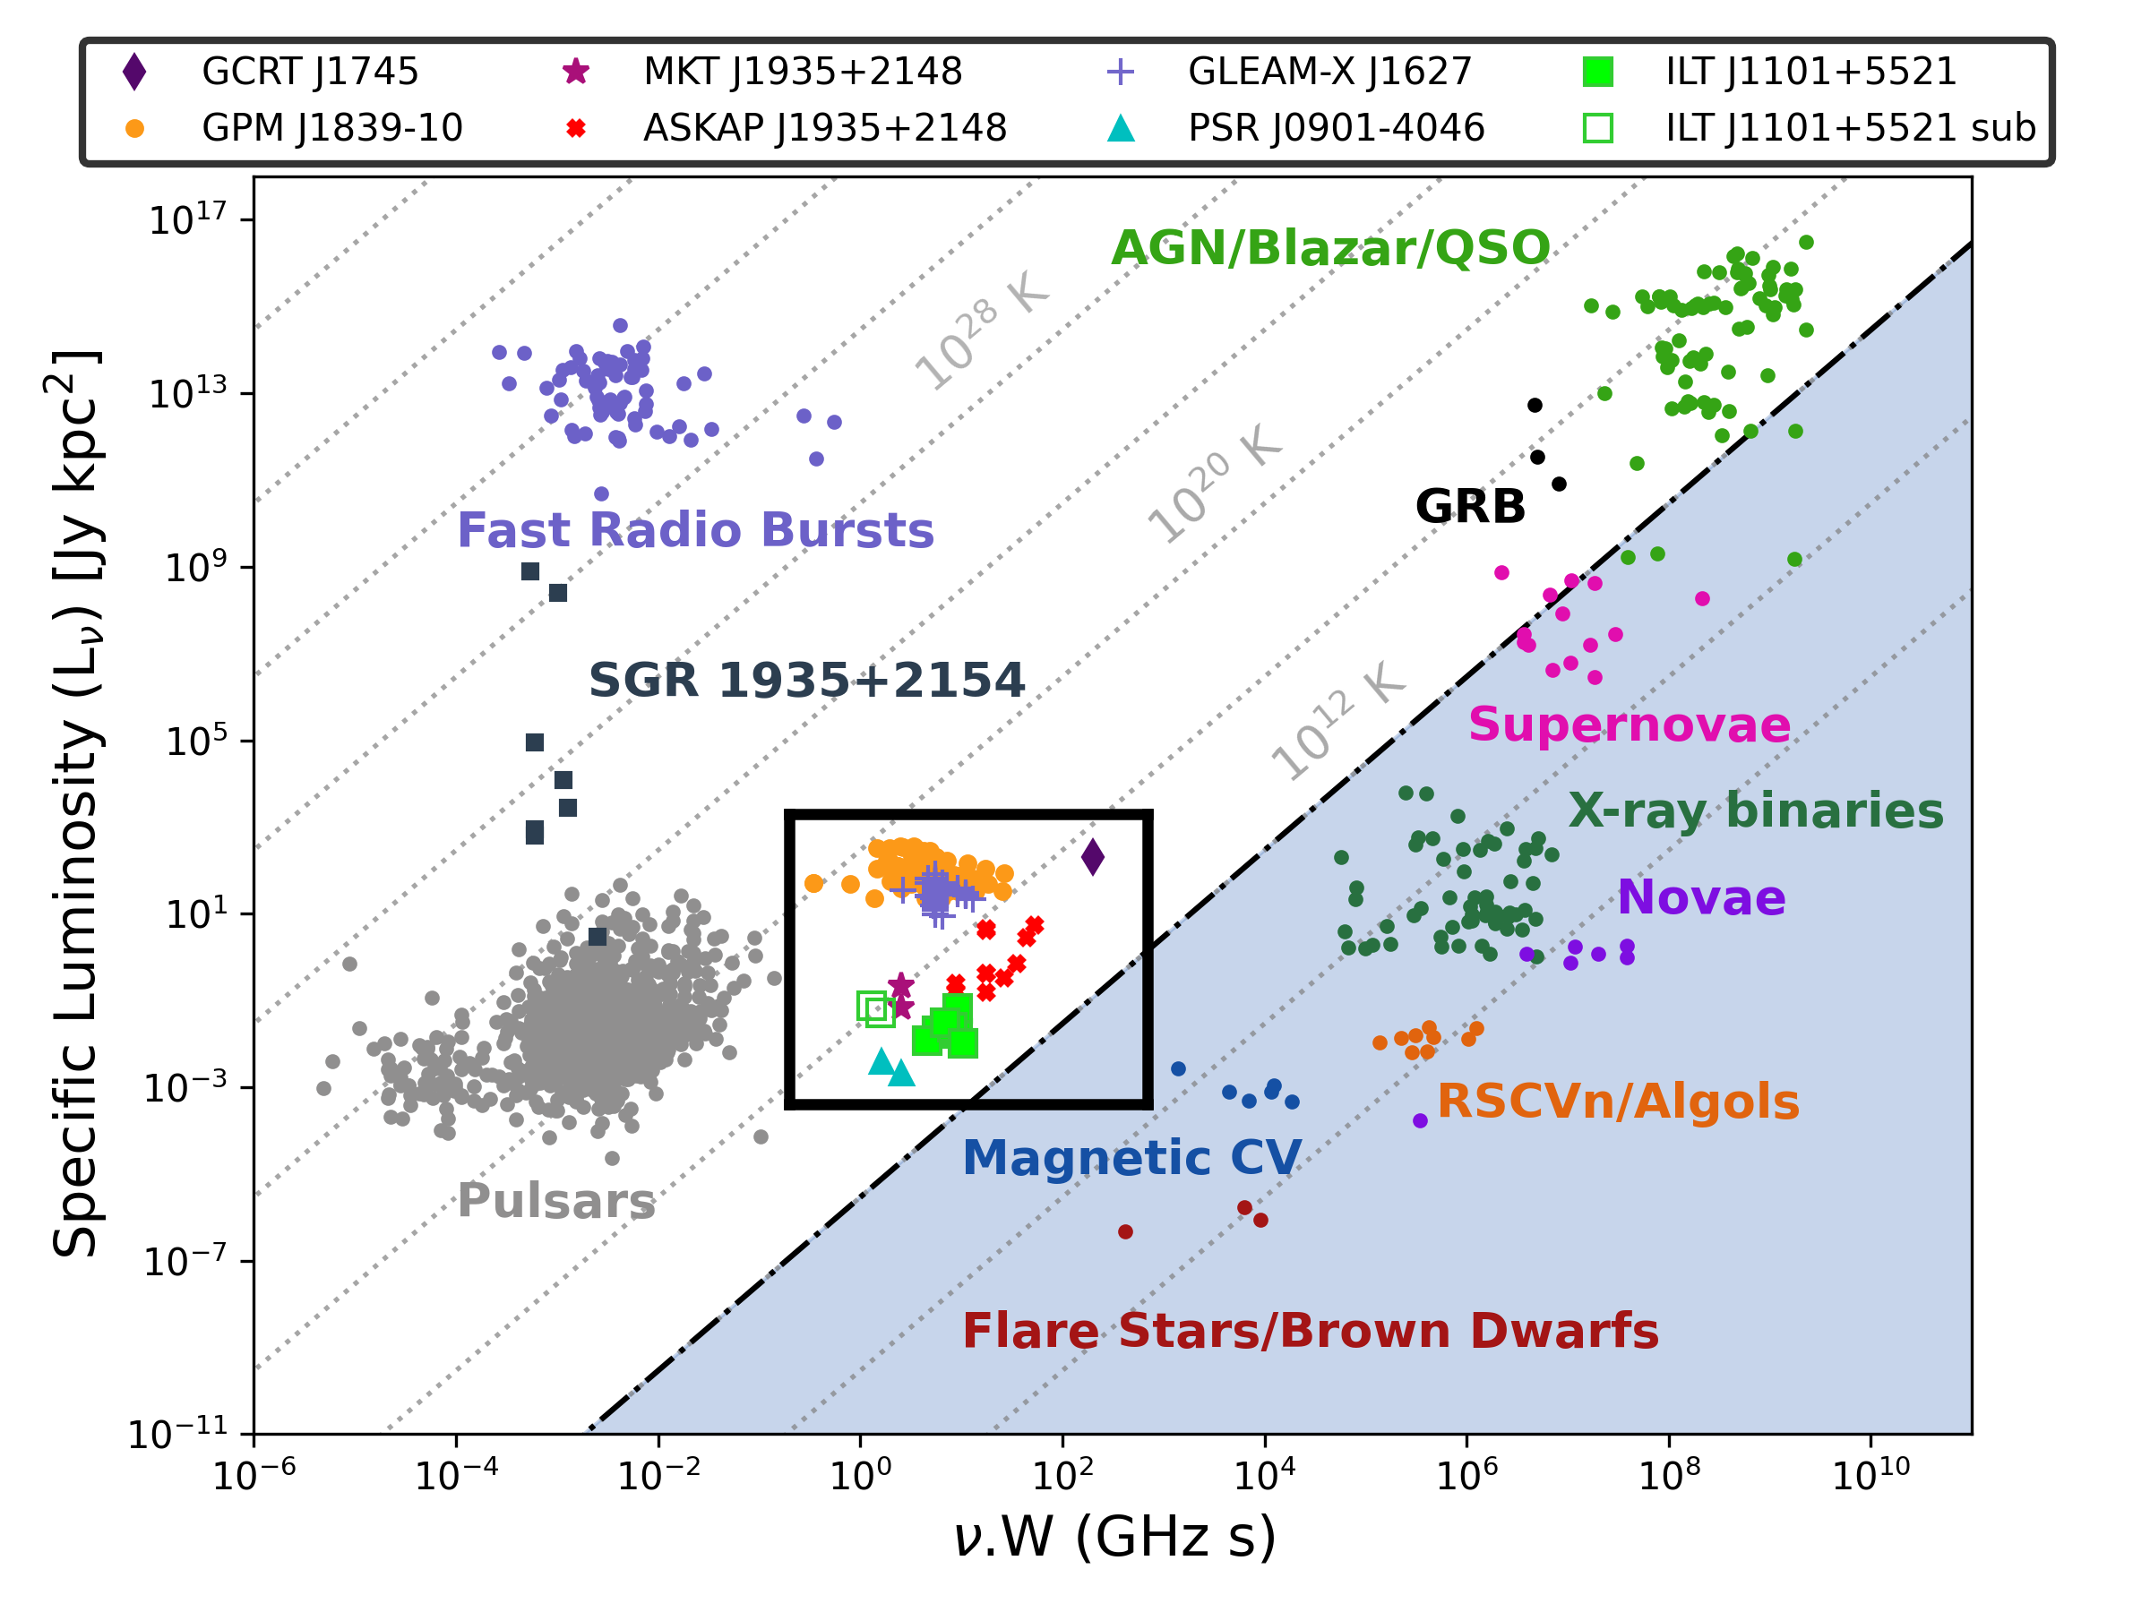
Transient Phase Space
de Ruiter et al. (2025)
LOFAR imaging transient search phase space
Caleb et al. (2024)

Slide 8
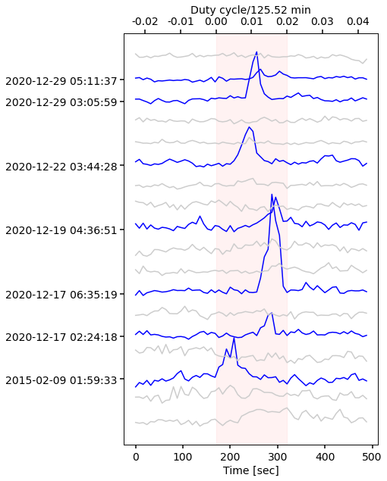
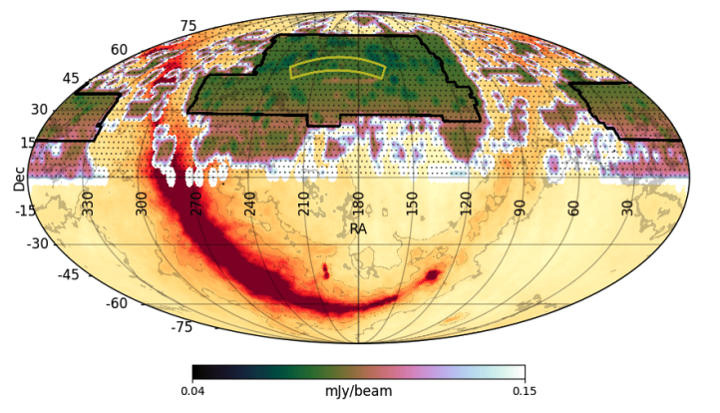






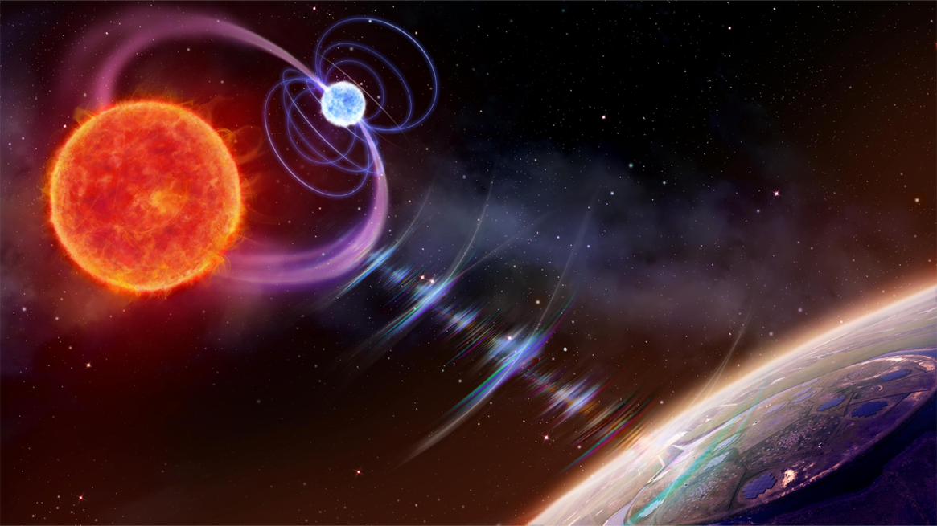
Archival searches: LoTSS
LoTSS (Shimwell et al. 2019, 2022) provides great dataset for short snapshot transient search and yeilding cool results!
Image credit:
Danielle Futselaar
Iris de Ruiter
Jason Hessels
Tim Shimwell
Reshma Anna-Thomas
Sylvain Ranguin
Ines Pastor-Marazuela
De Ruiter et al. (2024)
De Ruiter et al. (2024)
Notes:
Key

Slide 9
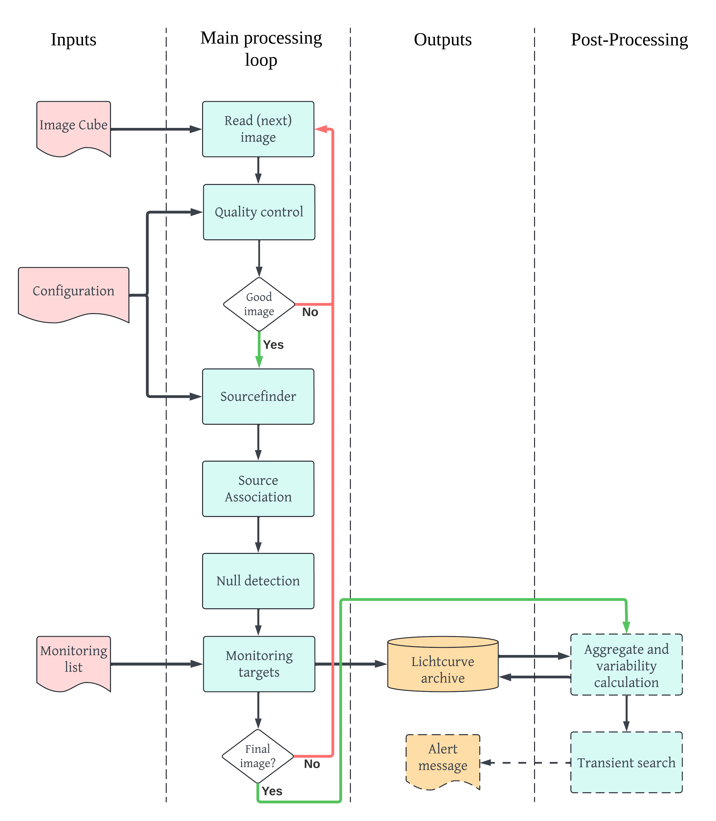

LOFAR2.0: TraP2.0
Major rewrite underway
Methods unchanged, focus on improved performance
TraP will be one of LOFAR2.0 supported pipelines
LINC output image will be automatically ingested by TraP
Pip installable
Timo Millenaar & Team Rapthor
https://transients-pipeline.readthedocs.io/en/latest/

Slide 10

LOFAR2.0: Automated Searches
Direction independent calibration
Publicly available on LOFAR Science Data Centre
Cleaned deep image
Subtract sky model from visibilities
Light curve database
TraP
8 second subtraction images

Slide 11
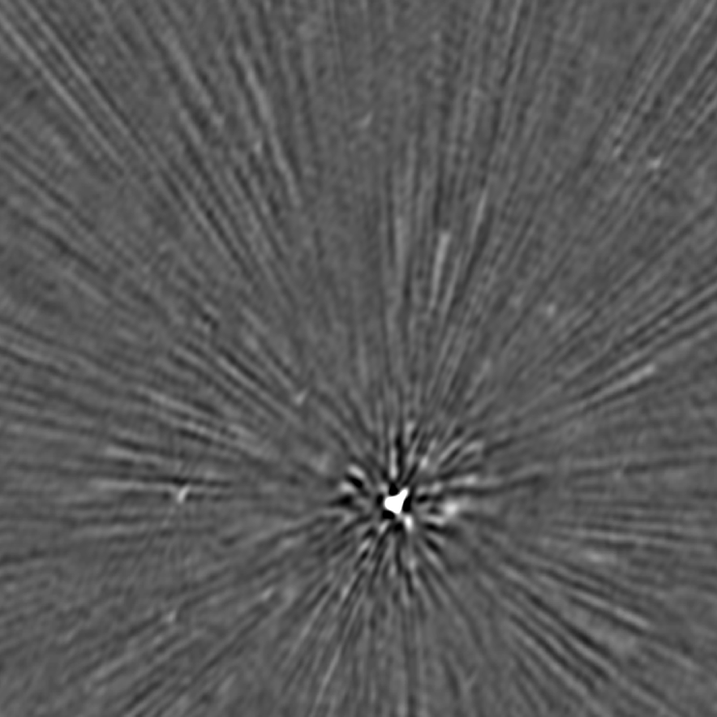
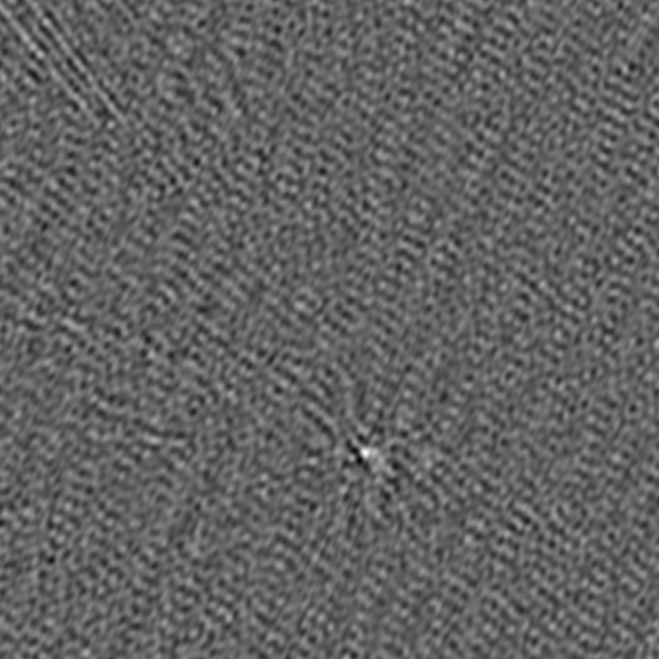
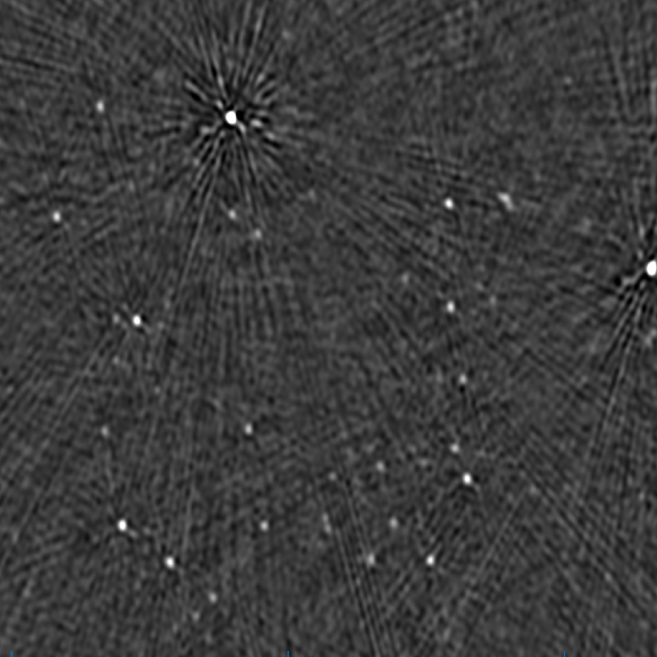

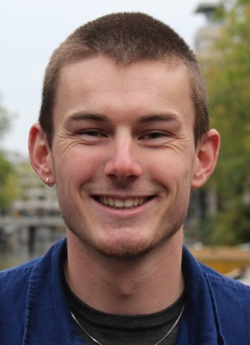
LOFAR2.0: Even faster imaging
P150+30
(41.9 Jy)
Trialled with LoTSS data
8 second images with no Calibration
P164+55
(8.1 Jy)
Subtract consecutive images
Lars Zwaan
Jason Hessels

Slide 12
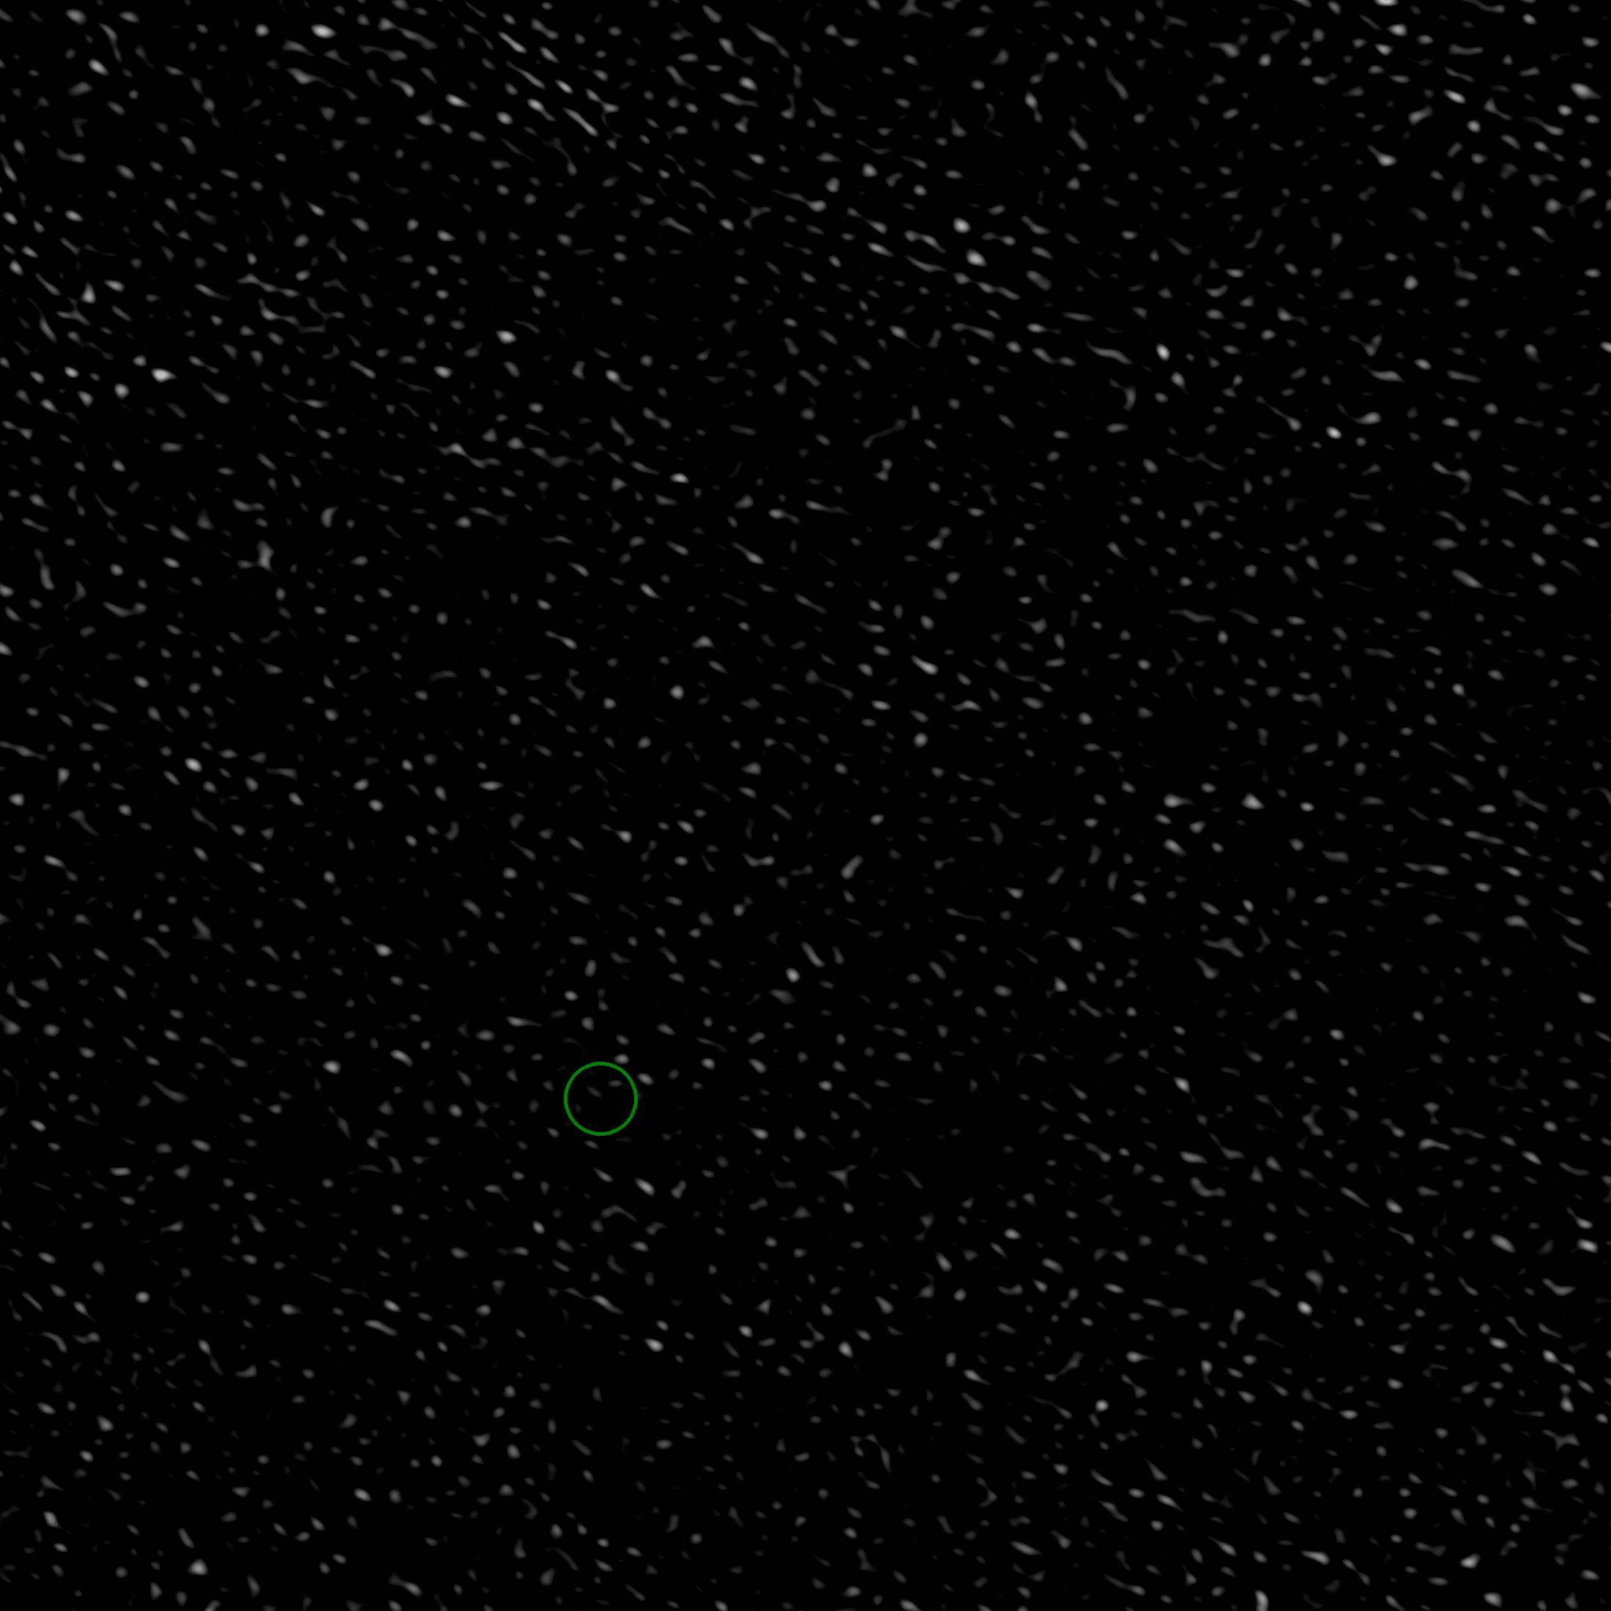
LOFAR2.0: Even faster imaging
Goal:
Run in real time on LOFAR2.0 data
Run on EuroFlash cluster
(PI: Jason Hessels)
First time low frequency radio transients will be detected in real time!
Zwaan et al. (in prep)

Slide 13
Whole radio sky imaging

Slide 14
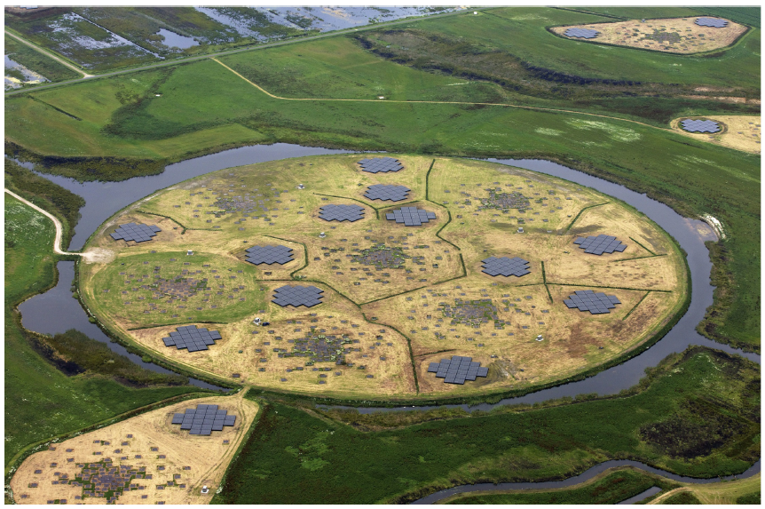
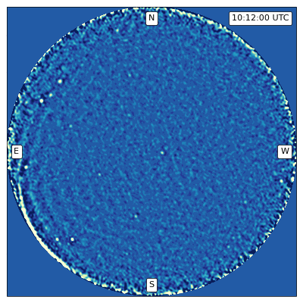

Original AARTFAAC
AARTFAAC used the central 6-12 stations of LOFAR
Saw whole visible sky
1 image per second!
PI: Ralph Wijers
Credit: Mark Kuiack

Slide 15
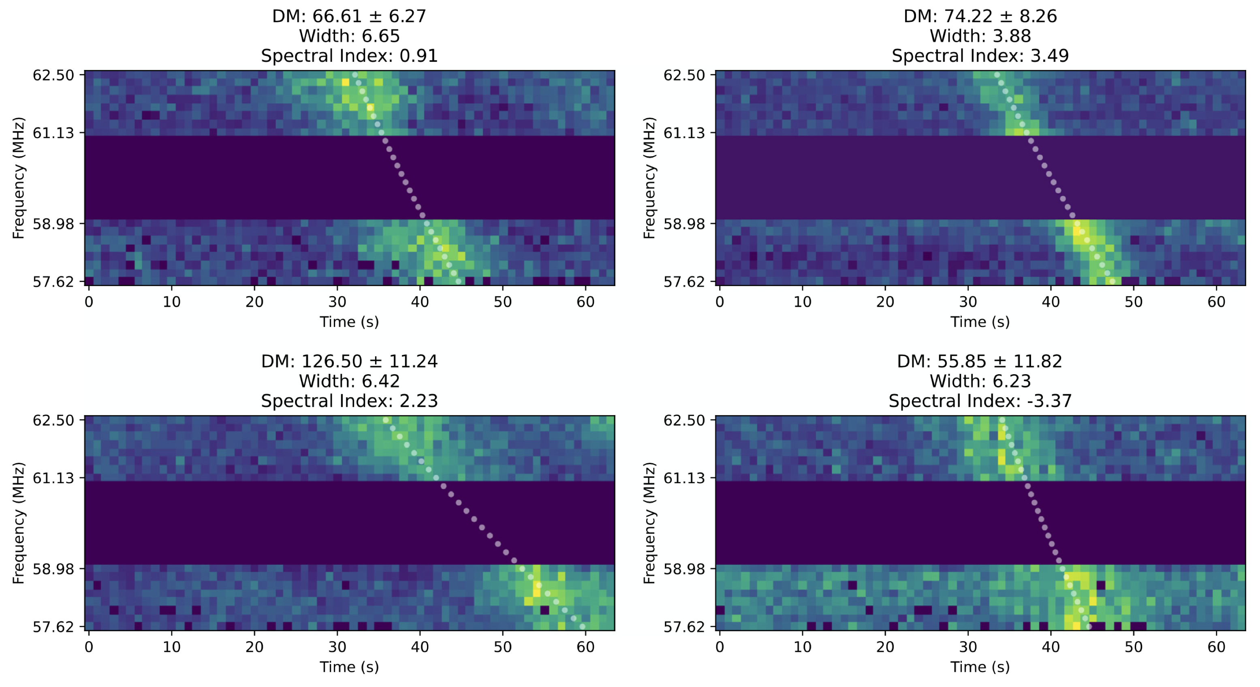
Original AARTFAAC: transients
Kuiack et al. (2021), Ruhe et al. (2021)

Slide 16
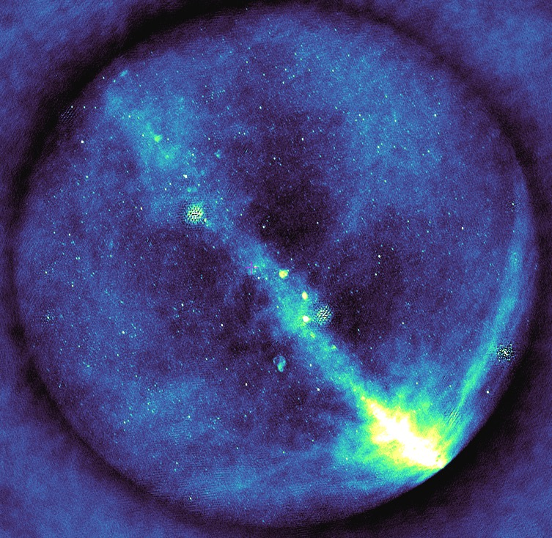

AARTFAAC2.0: Design
30 MHz bandwidth
1 Jy confusion limit
~30’ resolution
12 stations
Operational whenever LOFAR2.0 is turned on
24 hour buffer to save visibilities (200+ TB)
Thanks to:
Arno Schoenmakers and many others at ASTRON
Online 2027!
Credit: Aleksander Shulevski

Slide 17
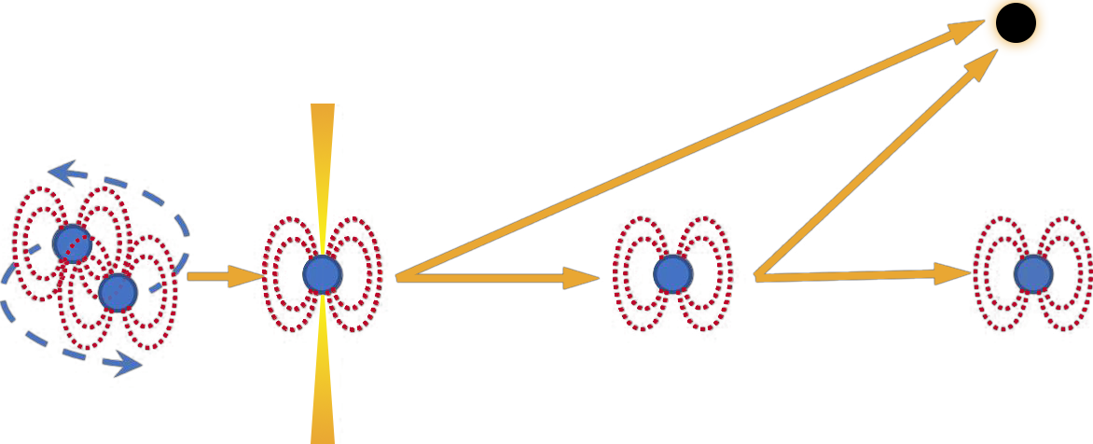
QuickBlitz
Rowlinson & Anderson (2019)
Black hole
Magnetar
Radio Bursts
AARTFAAC2.0 monitoring
LOFAR2.0 triggering

Slide 18
SKA

Slide 19
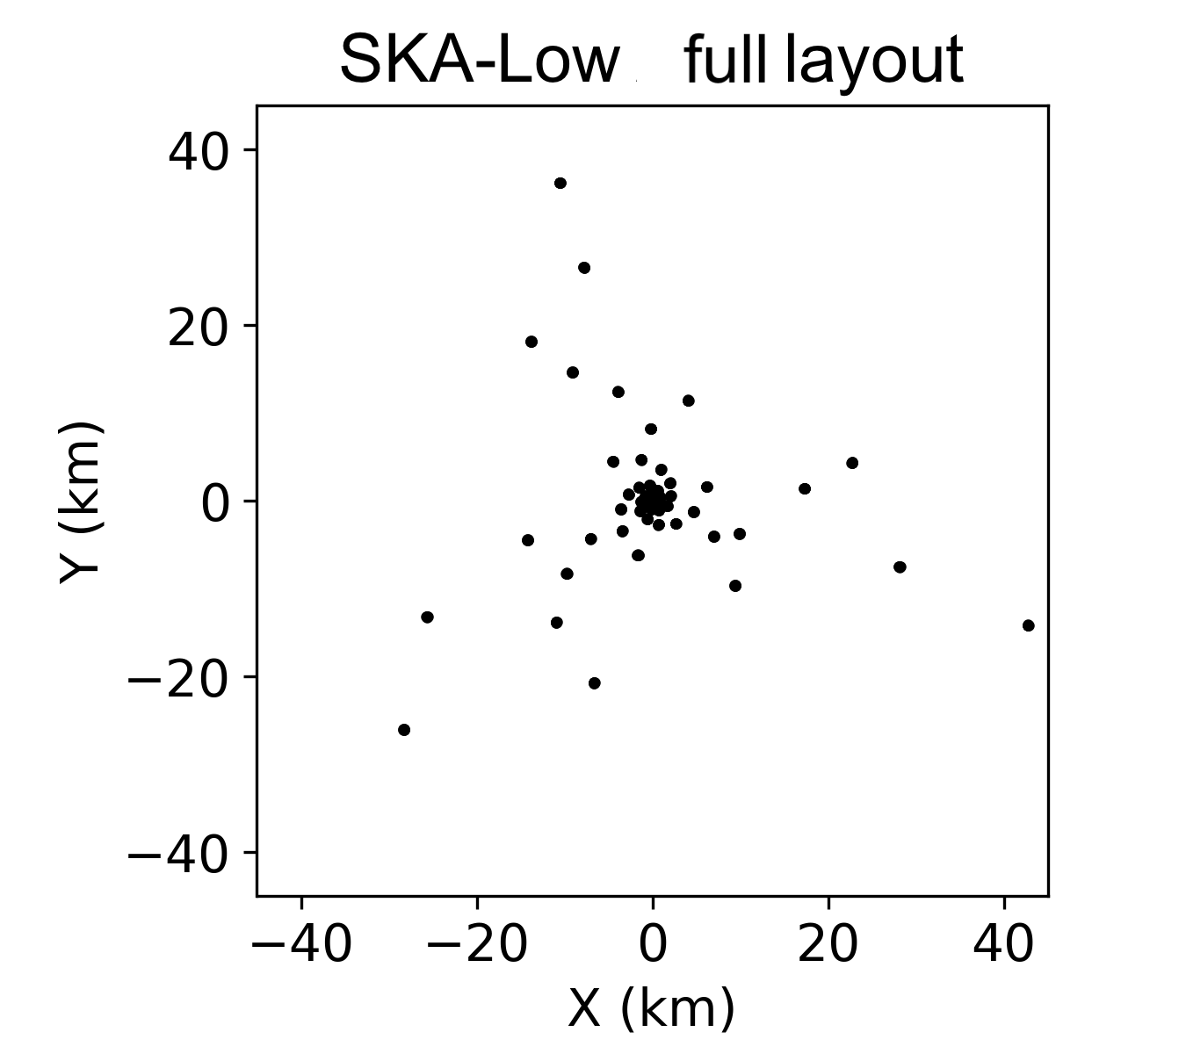
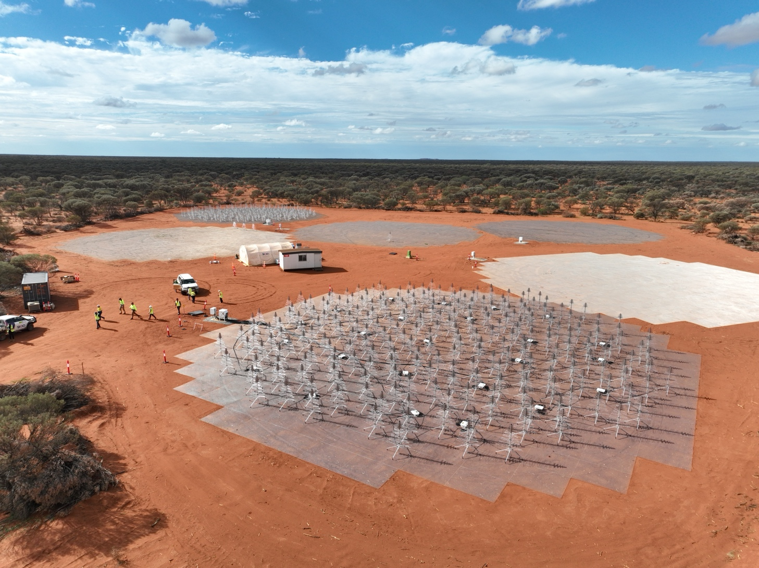
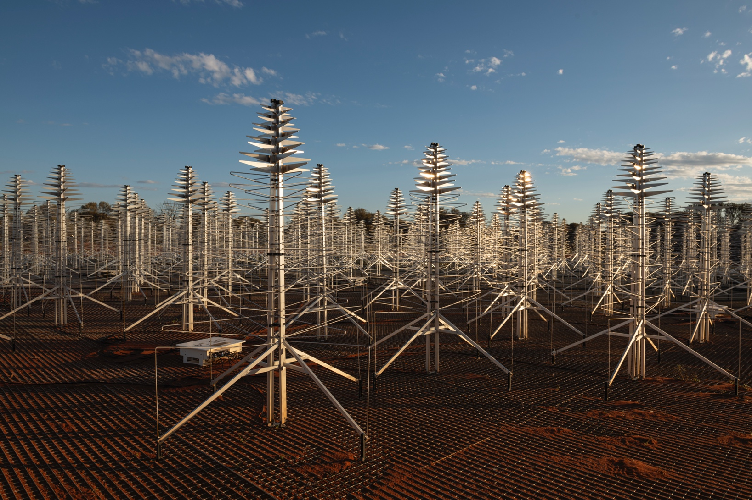
SKA Low (AA*)
50 – 350 MHz
73.4 km
307 stations
Figure credit: SKAO

Slide 20
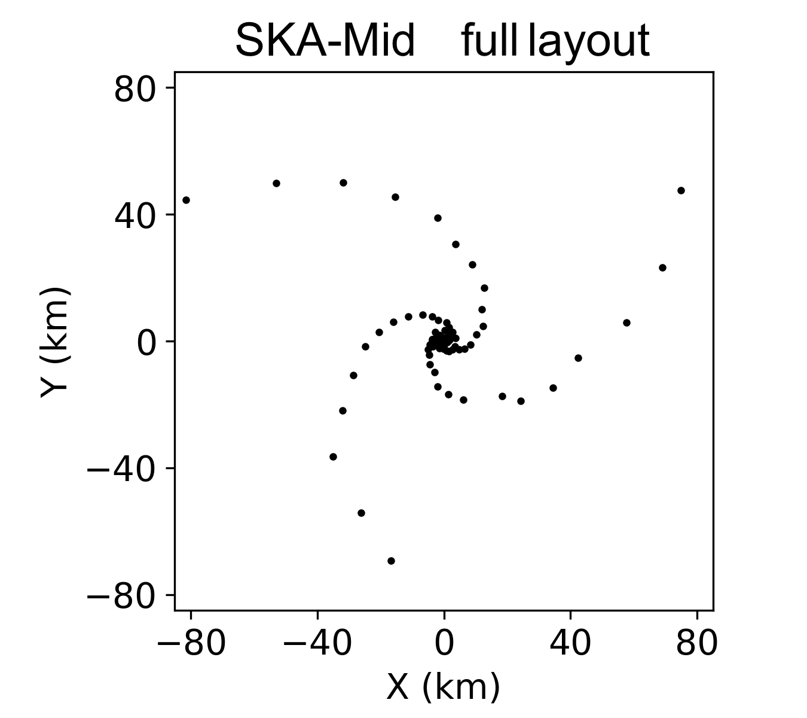
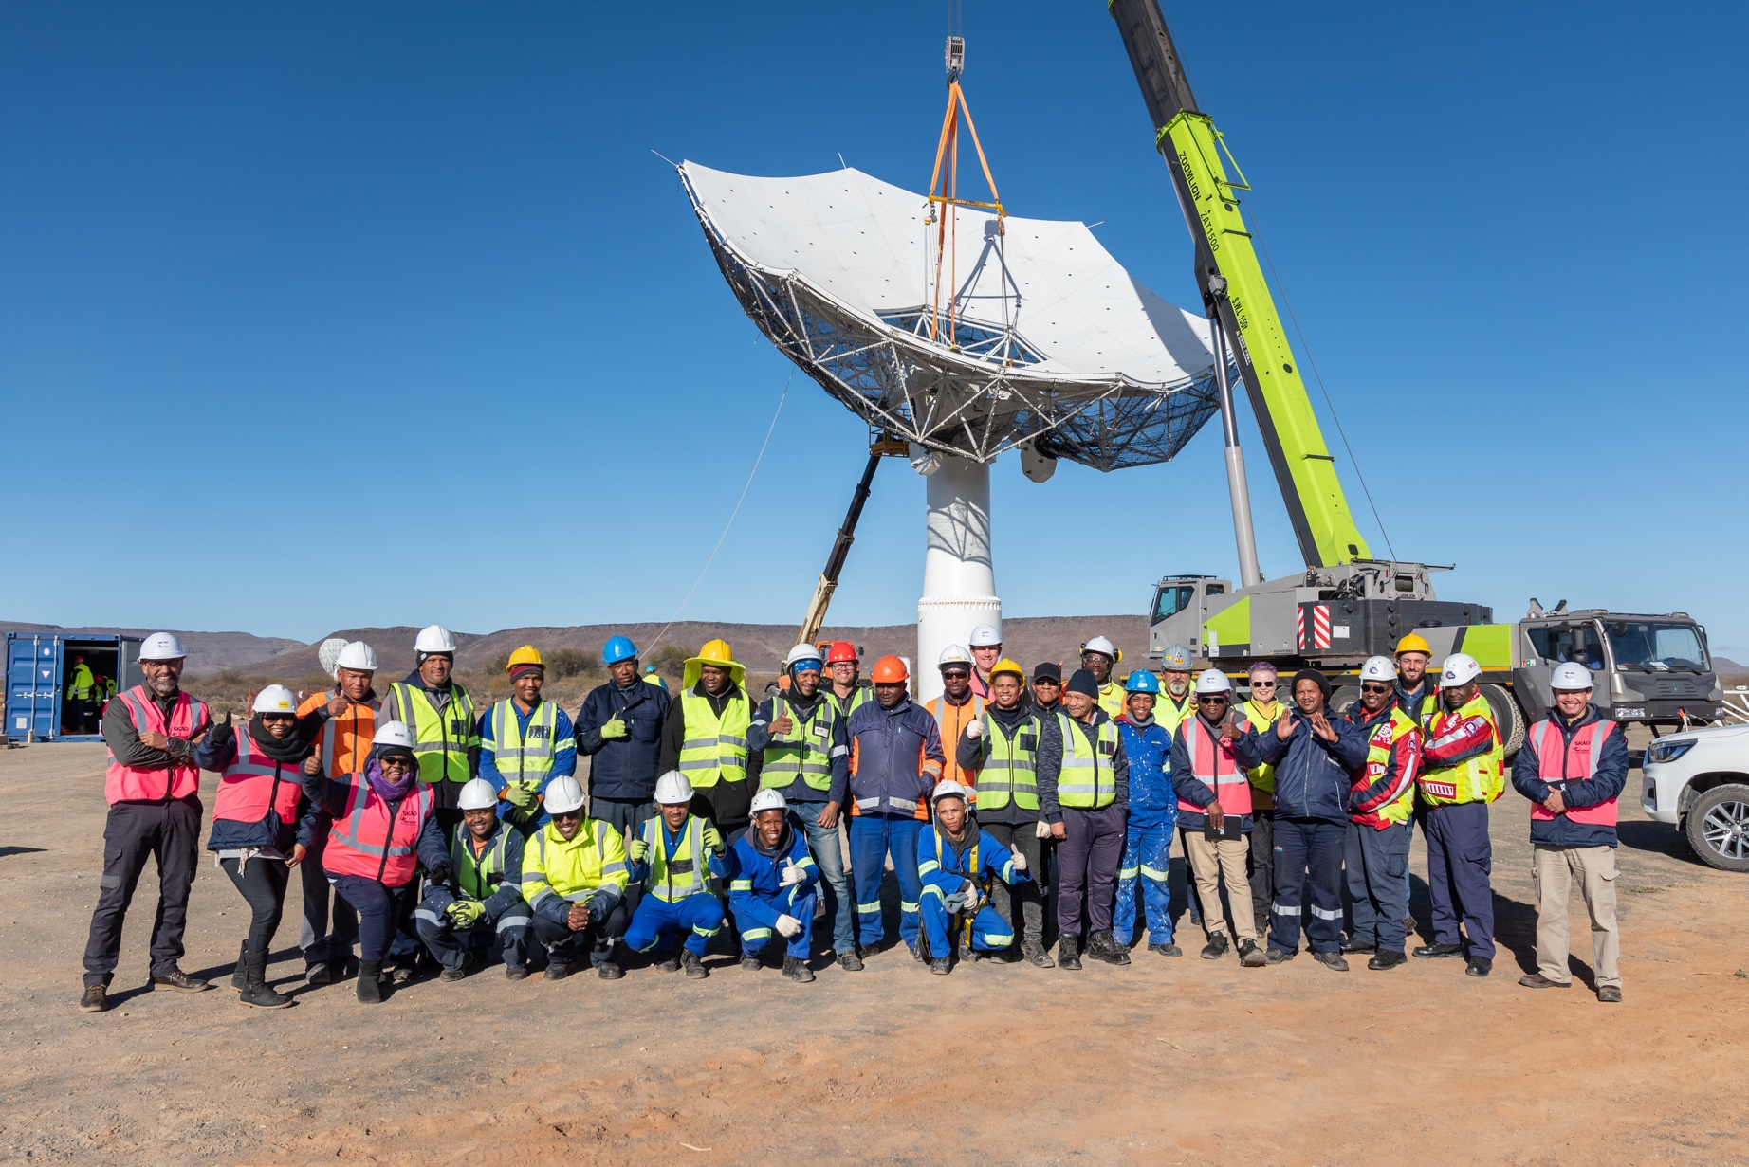
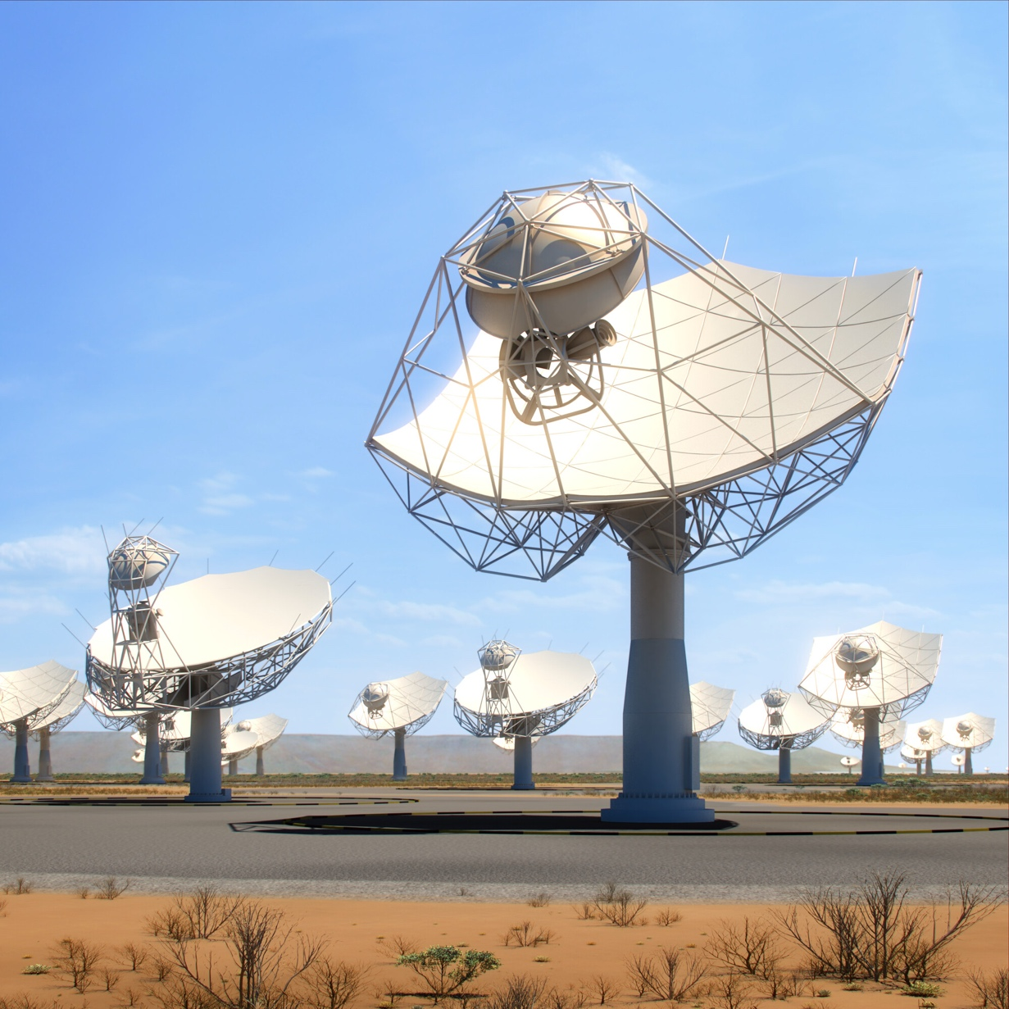
SKA Mid (AA*)
0.35-1.05 GHz, 0.95-1.76 GHz, 4.6-8.5 GHz, 8.3-15.4 GHz
108 km (36 km excluding SKA008)
144 dishes (incl. MeerKAT)

Slide 21
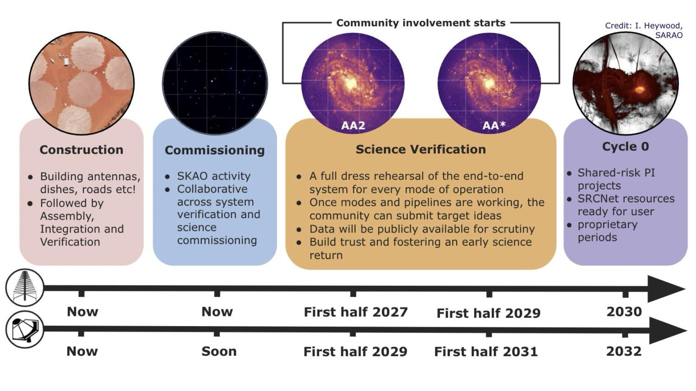
SKA Timeline
https://www.skao.int/en/647/timeline-science
Figure credit: SKAO

Slide 22
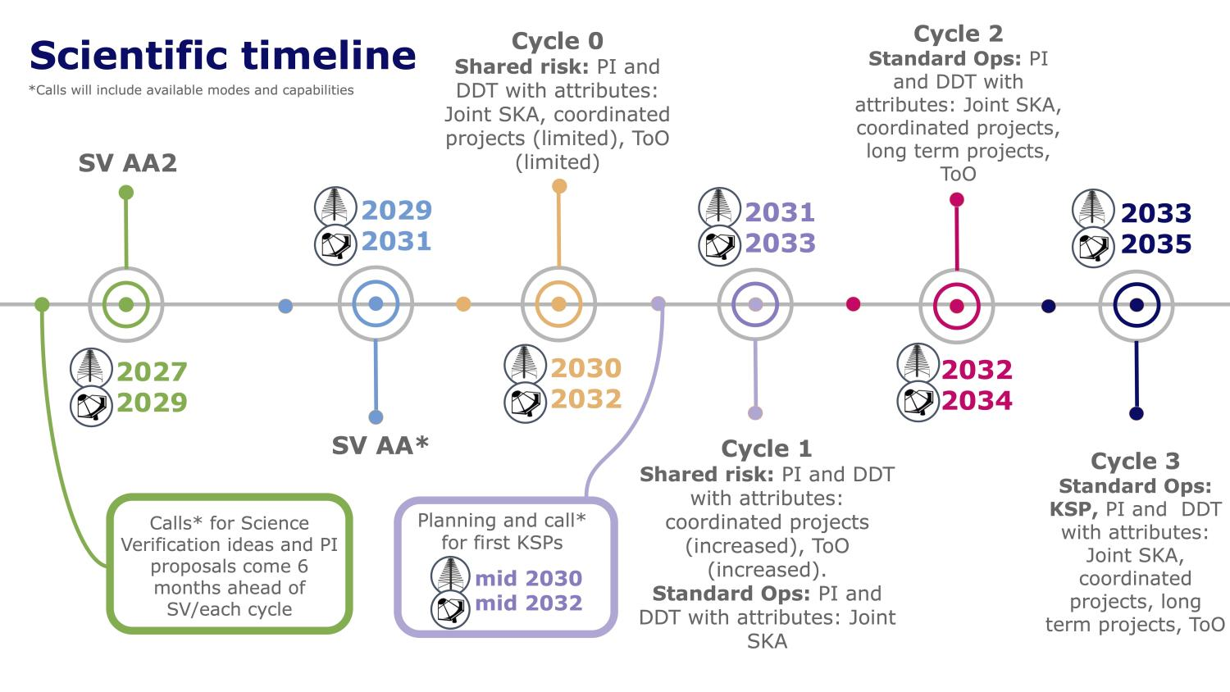
SKA Timeline
https://www.skao.int/en/647/timeline-science
Figure credit: SKAO

