Slide 1
VirtualData

Slide 2
Scientific computing
Computers used to be only for science
Nowadays computers are used for everything
In our labs, it goes from smaller scale to bigger scale: datacenter, supercomputer, grid and.. Cloud

Slide 3
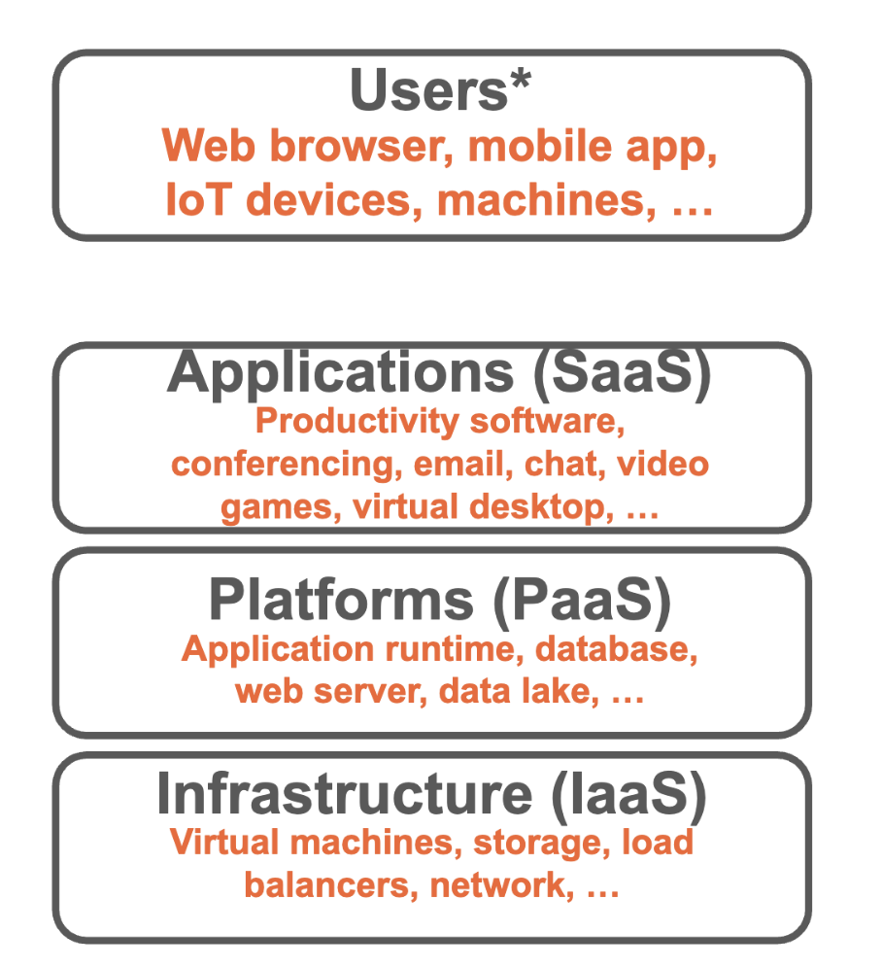
Cloud computing
the practice of using a network of remote servers hosted on the internet to store, manage, and process data, rather than a local server or a personal computer.
Decoupling usage from the rest
3 main layers of interaction
SaaS: Software as a service
Gmail, video game, streaming…
PaaS: Plateform as a Service
Spark, kubernetes, web server, data lake…
IaaS: Infrastructure as a Service
Virtuals servers, storage, network…

Slide 4
Access to cloud
Public cloud
Hosted by commercial compagnies
Pay-as-you-go model
Hybrid cloud (cloud@vd)
Hosted by a partner laboratory accessible by you
You pay for the resources you want to be guaranteed
Private cloud
Hosted and managed by you or your labs
You pay for the hardware and for HR

Slide 5
VirtualData
A datacenter built focusing on energy efficiency to host scientific computing needs
Limit the energy needs to refresh the computer
Open to every university laboratory that wants to have its own resources.
In operation since 2013
a hybrid cloud computing infrastructure built focusing on HR and hardware mutualisation
To be cost efficient
Started in 2010 and based on OpenStack middleware
16 000 vCPU and 2 PB storage
Currently pure x86 cpu but GPU and ARM have been founded for 2025

Slide 6
cloud@vd
Computing infrastructure for various needs
Dynamic resources
You can start a virtual server when you need it
You can have more resources than those garanteed (burst needs)
Storage & compute is decoupled
You can have long time storage life cycle and short time compute life cycle
Total environment control
You are the administrator of your virtual server
Advanced services
A service to start kubernetes environment
A gitlab CI/CD integration for deploying infrastructure

Slide 7
A production cloud
Some critical services hosted on cloud@vd
CNRS video conferencing
Mathrice (national mathematic community services)
Fink a broker for astrophysics
All hardware have a backup electricity supply
But data backup still the responsability of the user

Slide 8
A example: Spark
Service to process and analyse large volumes of data in parallel (MapReduce).
High scalability by adding resources (horizontal scaling).
Based on the Apache Spark framework, highly used in the big data world.
Service potentially open to user groups.
Heavily used in Astronomy/cosmology, especially for the Vera Rubin Observatory. See e.g. https://fink-broker.org
Used to be use for Genomics projects.
Dynamical management of workers is possible (connection with Kubernetes).

Slide 9
Support
IJCLab administrates the cloud, storage and all advanced services
A dedicated helpdesk https://cloud-support.ijclab.in2p3.fr
A documentation https://docs.virtualdata.fr/
University provide user support for moving their application to the cloud
But expertise need to exist in the lab using the resources.

Slide 10
Economic model
The infrastructure is open for all UPSaclay members
Free for a limited (20 vCPUs) resources without guaranteed
Buying the cores that one would like to be guaranteed, but burst needs can be provided free if resources are available
University fund hosting cost for UPSaclay labs

