Slide 1
Storage plateform

Slide 2
Some history
Back in a day where
Storage was disk based : a experience can store all their data in a disk
And after
A disk was not enough, we need a server with a bunch of disk to store data
But now
A entier datacenter is not enough
LHC : 1 000 PB
LSST: 20 TB / day for 10 years
Ska Observatory: 10 PB / day
But also
A long tail of science need a small part need to be addressed

Slide 3
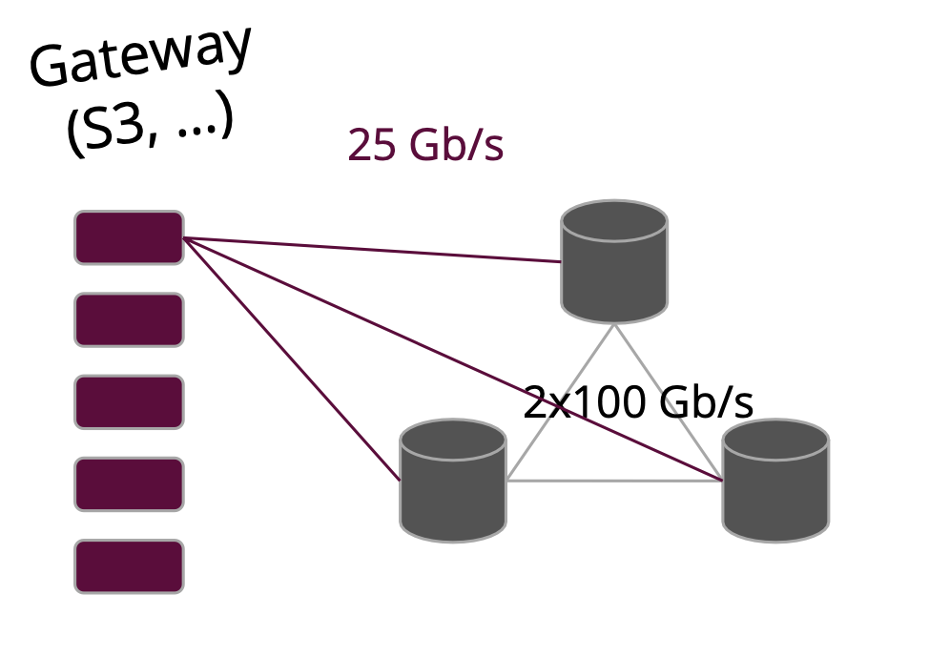
ceph@mésocentre
GOAL to provide a distributed, resilient, and high performance
infrastructure dedicated to scientific data
acces from different computing platform of the mésocentre
standard interfaces (S3, …)
Infrastructure distributed over 3 geographic sites
Fault tolerante
Up to 8 PB of raw data

Slide 4
Adapt for your needs
A storage cloud like service (onedrive, dropbox equivalent)
Based on a high scalable backend
A s3 acces point to storage massive dataset
Accessible from cloud@vd and ruche
Experience based acces, not user based
In progess:
A galaxy of services that can have direct access to data (jupyterhub…)
A part of national storage federation (MesoNet)

Slide 5
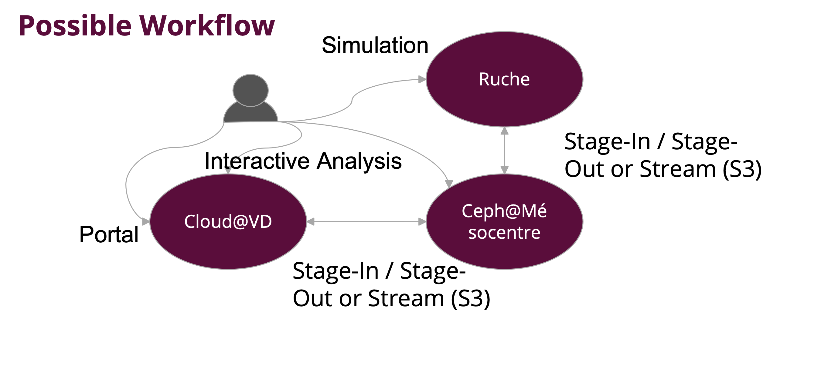
Some possible workflow

Slide 6
Economic model (draft)
A small quota is available freely for experiences
1 TB
After that, experiences must buy the resources they want to have
~ 80 €/TB for 7 years
University pay the hosting for UPSaclay labs
Outside UPSaclay, the hosting is invoiced ~ 15 €/TB/year

