Slide 1

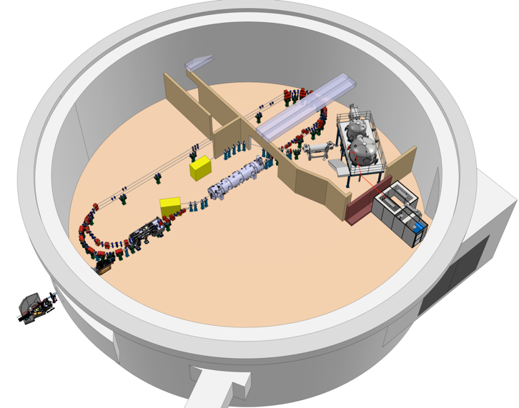
Project Progress Review (PPR) 2-2025
WP05
Présenté par:
Mohammed Ben Abdillah
20 Mars 2025

Slide 2
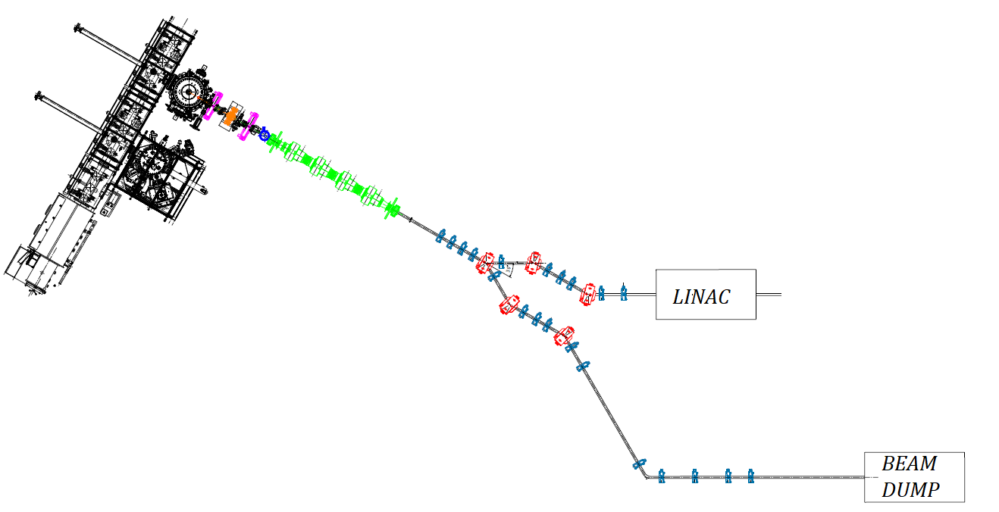
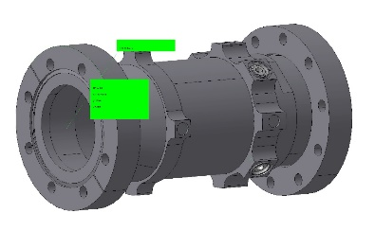
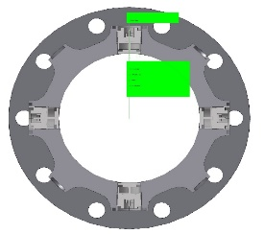
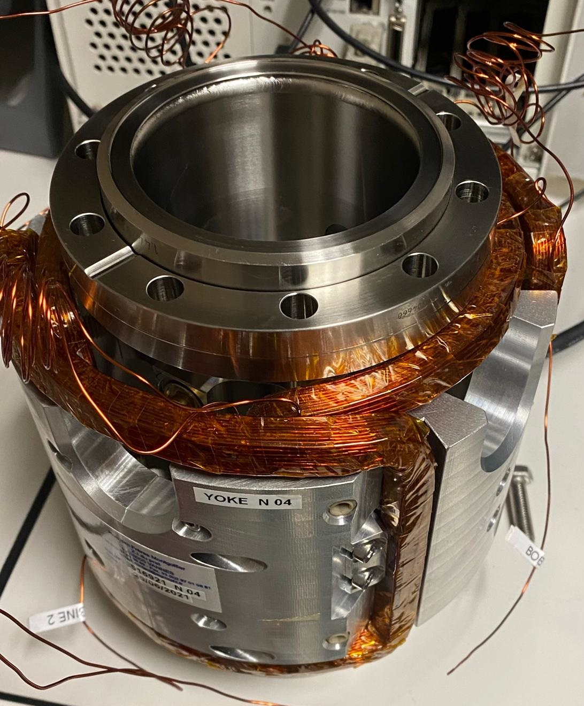
Task 5.1 : BPM; Leader : M. Ben Abdillah
Accomplished:
RI BPM capacitance measurements
RI BPM electrical error measurements
Simulations
Discussion on the use of BPMs for path length monitoring
1st document on acquisition electronics
Planned for next 2 months:
BPM mechanical study to match Merger constraints
Gun BPM cabling specs
Gun BPM calibration (if possible)
Update on path length monitoring
Updated on acquisition electronics
Needs:
Task force for:
Mechanical design
RF front end design
BPM operation for:
Commissioning phase
Beam failure
Buncher
BPMs
Booster
Existing BPMs
Merger
BPMs
Diagnostics Line
BPM

Slide 3
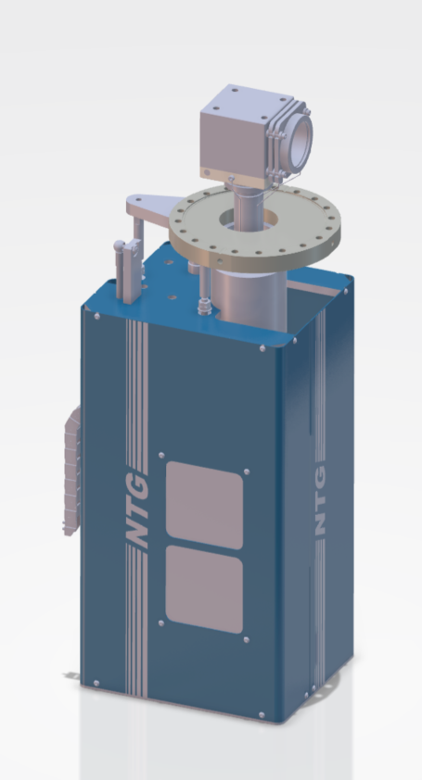
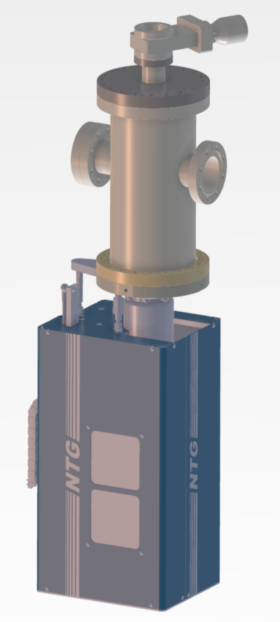
Task 5.2 : BCM; Leaders : M. Ben Abdillah / S. Varnasseri
Accomplished:
Gun Faraday cup
call for quotes
Order
Mechanical drawing received
Discussion on the localization of current transformers on the injector
Planned for next 2 months:
Gun Faraday cup
Confirmation of realization and delivery schedule
Current transformers:
Discussion for a 1st version of specifications document
Needs:
Commissioning schemes
BCM operation in case of Beam failure

Slide 4
Task 5.3 : BLM; Leader : H. Guler
Accomplished:
First loss estimation along the full machine → Lode Internship
https://gitlab.in2p3.fr/perle/beam-losses-and-halo-simulations-studies/beam-loss-figures
Planned for next 2 months:
Get better estimations for BLM location (injector) → BD studies
Estimate use of BLM in MPS and general interlock + see possibilities for causal search for losses.
Study proposal from Libera
Needs:
Timing + C&C : post mortem implementation

Slide 5
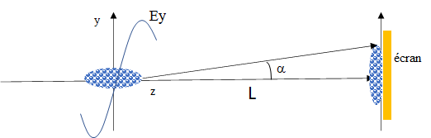
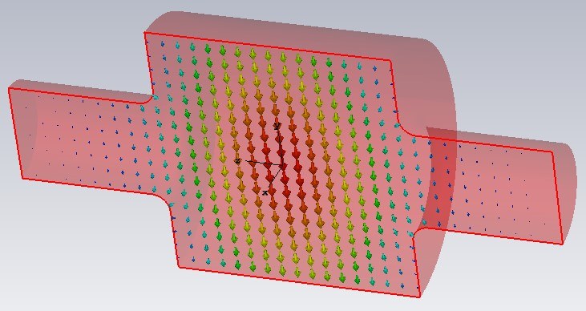
Task 5.6 : Beam Longitudinal length; Leader : R. Roux
Accomplished:
Deflecting Cavity RF design
Planned for next 2 months:
Discussions about:
Mechanical design
RF sources
View Screen
Needs:
Task force for mechanical design
Frequency= 3GHz, pulsed mode
If L = 1 m => E0 = 5,38 MV/m => P = 9,33 kW
If L = 2 m => E0 = 2,69 MV/m => P = 2,3 kW

Slide 6
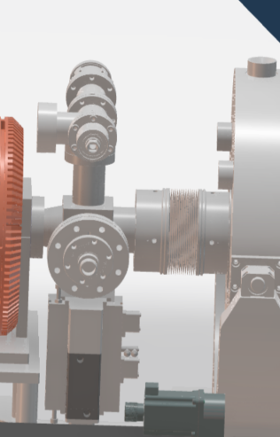
Tasks 5.5 & 5.8 : Energy & View screens; Leader : S.Wallon
Accomplished:
Energy meas: coarse script for energy spread simulations
Requests for two interns to work on mechanical design of the view screen & dipole
Planned for next 2 months:
RI gun’s screen : functioning tests (especially its camera)
Set specs for screens
Needs:
Task force for:
Screen mechanical design
Dipole design
Versatile screen design to allow OTR screen for high energy beam
Feedbacks for expected energy spread

Slide 7
Summary
Points of vigilance:
Inputs: BD, MPS, Mechanics
Task forces: mechanical, electronics, C&C
BLM: No update
TDR: tasks are on different pace and progress, TDR for diagnostics will be filled gradually
Planning:
Gun: planning seems ok, focus on C&C and cabling
Injector & Diagnostics line: planning needs to be consolidated, focus on BPM electronics, BLMs, Mechanics and C&C. Backup solutions are partially addressed.
PERLE 1 turn: BPMs progress pace is OK, BLMs scope to be updated

