Slide 1
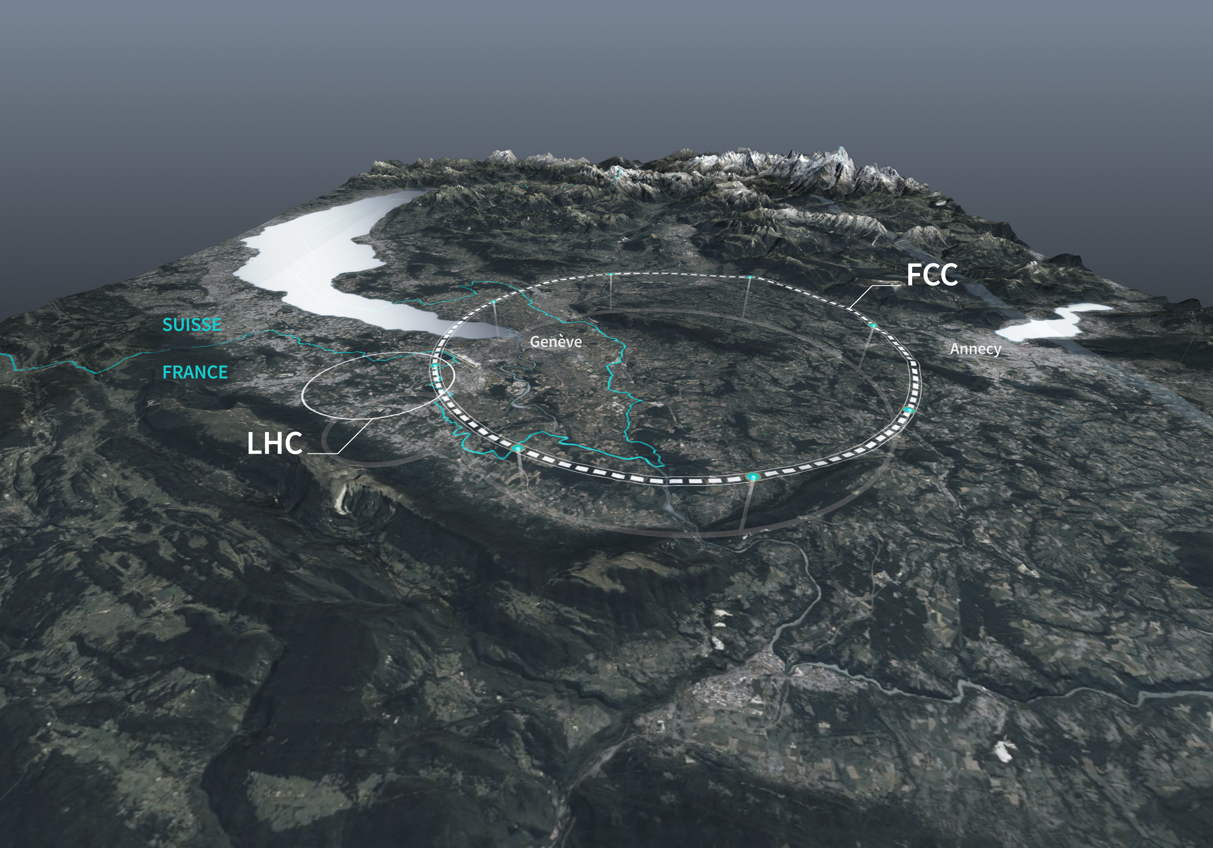
Longitudinal beam dynamics considerations of the FCC-ee high energy booster
Lina Valle*, Ivan Karpov, Rama Calaga, Heiko Damerau and Wolfgang Hofle
Acknowledgements: Birk Karlsen-Bæck, Antoine Chance, Karin Canderan, Elleanor Lamb,, Mariangela Marchi and all FCC-ee colleagues
Journées Accélérateurs, 7-10 octobre 2025, Roscoff, France
*lina.valle@cern.ch

Slide 2
Outline
Introduction
Booster cycles: energy ramps for all physics modes
Power transients at injection: $Z$ mode
Summary and next steps

Slide 3
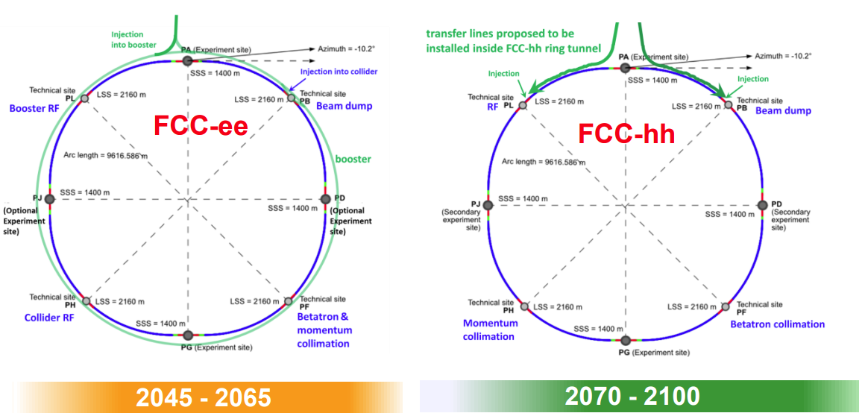

Future Circular Collider project overview
90,7km tunnel to host FCC-ee
then FCC-hh
Stage 1: FCC-ee as a Higgs factory
Four operation energies (per beam):
$Z$ at 45.6 GeV,
$WW$at 80 GeV,
$ZH$ at 115 GeV,
$t\overline{t}$ at 180 GeV
Stage 2: FCC-hh (~100 TeV)
Physics of FCC: https://cds.cern.ch/record/2928193/files/2505.00272.pdf
Michael Benedikt, FCC week 2025, Vienna, Austria

Slide 4
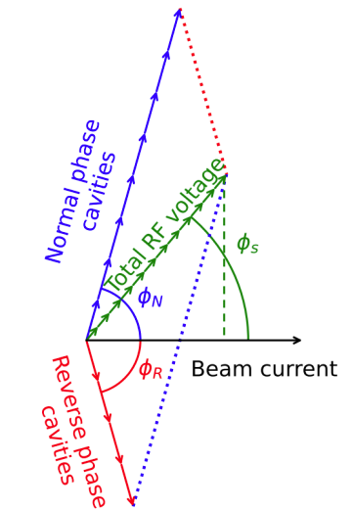



RF requirements for the FCC-ee booster
The RF section of the booster, located in Point L, will be installed in two stages, with additional cavities installed for $t\overline{t}$ operation.
Therefore, the first 112 cavities need to provide a wide range of voltage (from 50 MV to 2 GV), while minimizing RF power requirements and a minimal voltage per cavity of 2 MV.*
Reverse Phase Operation** (or counter-phase***)
Increased voltage per cavity,
Optimal static beam loading compensation,
Homogenized voltage range through all ramps
$$ΔN=16=N_{f}−N_{d}$$
Booster 800 MHz cavities
$ZZ$, $WW$, $ZH$: 112 at 2K in 28 cryomodules (CM)* (4 cavities per CM)
$Q_{0}=3 × {10}^{10}$,
$$Q_{L}=1 × {10}^{7}$$
$t\overline{t}$ : 448 at 2K in 112 cryo-modules (4 cavities per CM)
$$Q_{L}=2.7 × {10}^{7}$$
** Y. Morita et al., SRF, 2009
Experimentally verified in Y. Morita, IPAC, 2010
*** Similar concept used at CERN SPS since the 70s.
I. Karpov, FCC_Week_2025_IK.pdf
*S. Gorgi Zadeh, 800MHz cavity design update, FCC WP1, January 2025

Slide 5
Booster cycles
Energy ramps for all physics modes

Slide 6
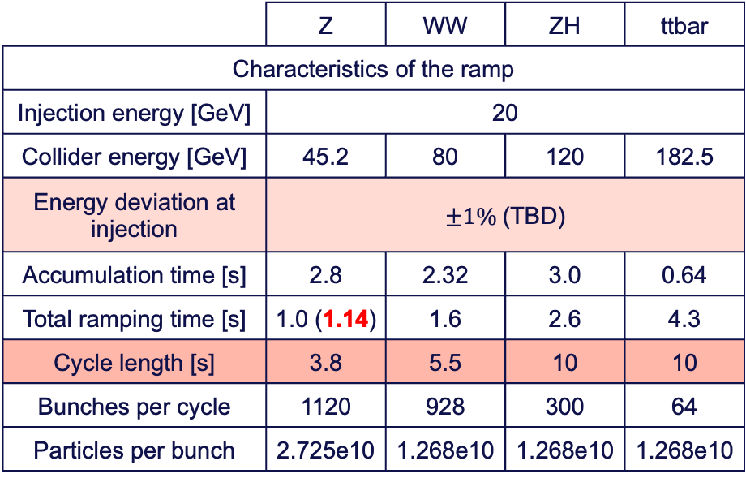
Booster cycles selected parameters
Continuous operation of the booster in parallel to the collider, following three different modes:
Filling mode: to fill the collider from scratch, with maximum bunch intensity.
Top-up mode: top-up the collider bunches with a personalized charge.
Polarized bunches (Z): for precise energy measurement and pilot bunches.
Extraction energy will be varied in the coming weeks, depending on the collider optics and injection scheme.
Booster physics mode selected parameters
 | Z | WW | ZH | ttbar
Characteristics of the ramp
Injection energy [GeV] | 20
Collider energy [GeV] | 45.2 | 80 | 120 | 182.5
Energy deviation at injection | $±1\%$(TBD)
Accumulation time [s] | 2.8 | 2.32 | 3.0 | 0.64
Total ramping time [s] | 1.0 (1.14) | 1.6 | 2.6 | 4.3
Cycle length [s] | 3.8 | 5.5 | 10 | 10
Bunches per cycle | 1120 | 928 | 300 | 64
Particles per bunch | 2.725e10 | 1.268e10 | 1.268e10 | 1.268e10
Changes from FCC week 2025
→ Increased cycle duration for $WW$, $ZH$ and $t\overline{t}$ in filling mode
→ The voltage program will be adjusted to match a variable extraction energy ($±1\%$) and the extraction bunch length

Slide 7
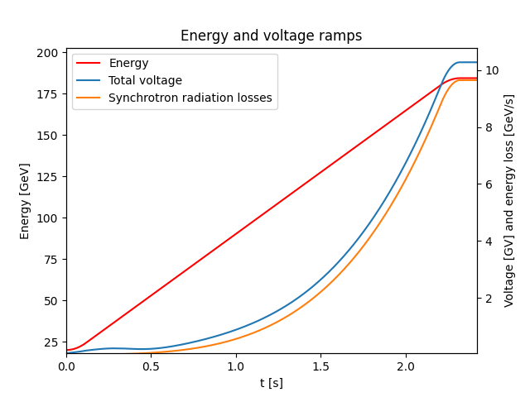
Booster energy ramp analytical computation
Motivation: Optimization the energy and voltage ramps for all four physics modes, all operation modes, including RPO program, homogenize dynamic losses and reduce RF power requirements.
Analytical tools to compute the energy and voltage ramps of the high-energy booster (code on GitLab)
Faster optimization including dynamic effects (power transients, beam loading)
For now, energy ramps for a single bunch, no intensity effects.
Example of 𝑡𝑡 ̅

Slide 8
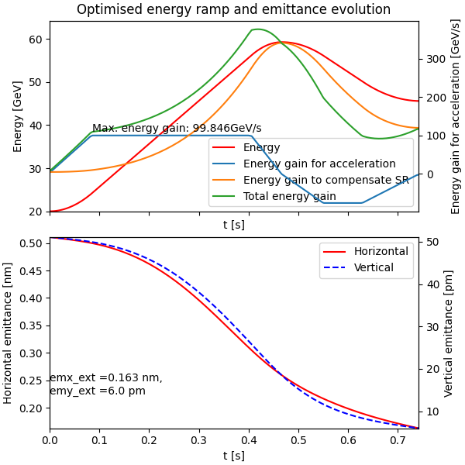
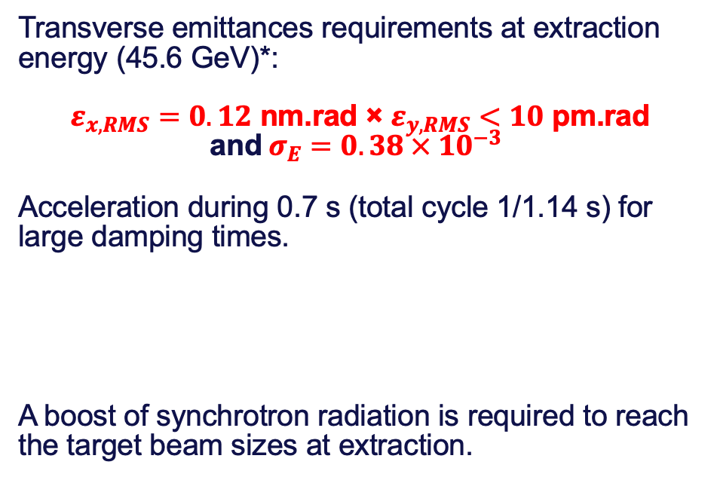
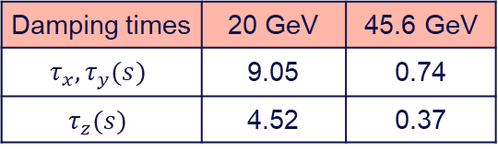
Booster ramping strategies for Z mode
Maximum energy gain: 100 GeV/s
Transverse emittances requirements at extraction energy (45.6 GeV)*:
$ε_{x, RMS}=0.12$ nm.rad × $ε_{y, RMS}<10$ pm.rad and $σ_{E}=0.38 × 10^{−3}$
Acceleration during 0.7 s (total cycle 1/1.14 s) for large damping times.
A boost of synchrotron radiation is required to reach the target beam sizes at extraction.
Damping times | 20 GeV | 45.6 GeV
$$τ_{x}, τ_{y}(s)$$ | 9.05 | 0.74
$$τ_{z}(s)$$ | 4.52 | 0.37
Horizontal emittance remains above requirements.
* Specified by Y. Dutheil, FCCee injectors parameters - Google Sheets and presented in 3rd Meeting of the FCC-ee Layout and Optics Design (30 avril 2025) · Indico
** L.Valle, FCC_WP1_25_03_2025.pdf
Optimized overshoot energy ramp with Particle Swarm Optimization (PSO)**
for lower transverse emittances at extraction

Slide 9
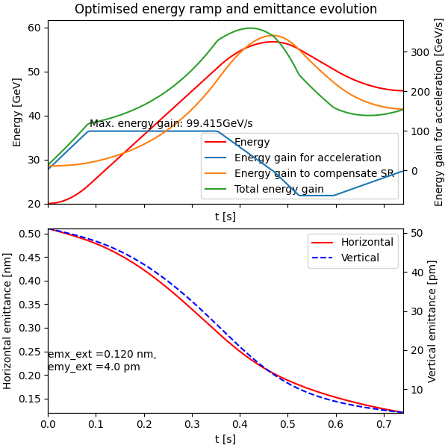
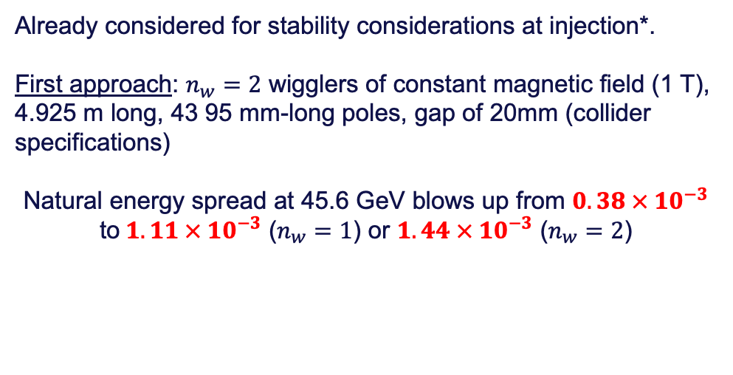
Booster ramping strategies for Z mode
Maximum energy gain: 100 GeV/s
Adding damping wigglers…
Already considered for stability considerations at injection*.
First approach: $n_{w}=2$ wigglers of constant magnetic field (1 T), 4.925 m long, 43 95 mm-long poles, gap of 20mm (collider specifications)
Natural energy spread at 45.6 GeV blows up from $0.38 × 10^{−3}$ to$1.11 × 10^{−3}$ ($n_{w}=1$) or $1.44 × 10^{−3}$ ($n_{w}=2$)
* S. Gorgi Zadeh, FM passband **L.Valle, FCC_WP1_25_03_2025.pdf
Optimized overshoot energy ramp with Particle Swarm Optimization (PSO)**
including two damping wigglers

Slide 10
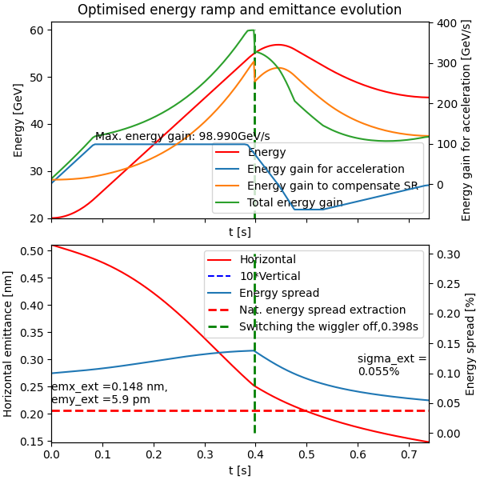
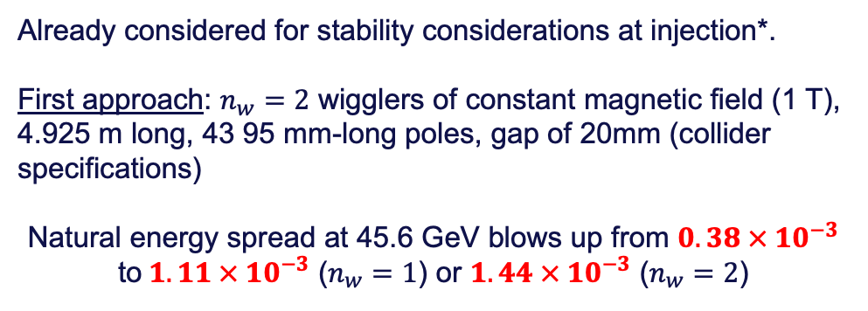
Booster ramping strategies for Z mode
Maximum energy gain: 100 GeV/s
Adding damping wigglers…
Already considered for stability considerations at injection*.
First approach: $n_{w}=2$ wigglers of constant magnetic field (1 T), 4.925 m long, 43 95 mm-long poles, gap of 20mm (collider specifications)
Natural energy spread at 45.6 GeV blows up from $0.38 × 10^{−3}$ to$1.11 × 10^{−3}$ ($n_{w}=1$) or $1.44 × 10^{−3}$ ($n_{w}=2$)
Idea: Switch the wigglers off during the ramp to restore the expected natural energy spread or move the beam away from the wiggler.
Acceleration and deceleration in 1.14 s
Getting closer to the target parameters. Wiggler parameters to be optimized.
Optimized overshoot energy ramp with Particle Swarm Optimization (PSO)**
including two damping wigglers disabled during the ramp
* S. Gorgi Zadeh, FM passband **L.Valle, FCC_WP1_25_03_2025.pdf

Slide 11
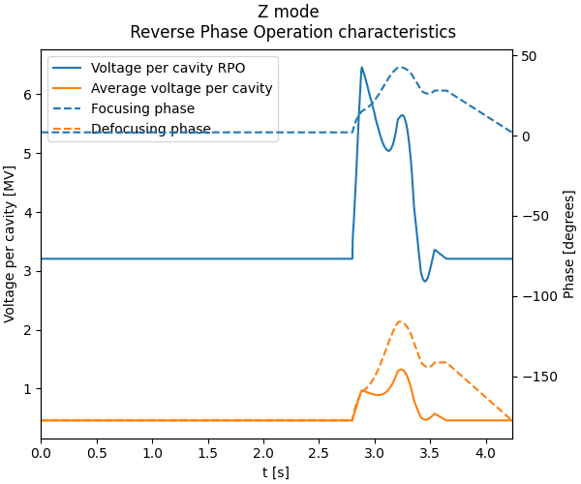
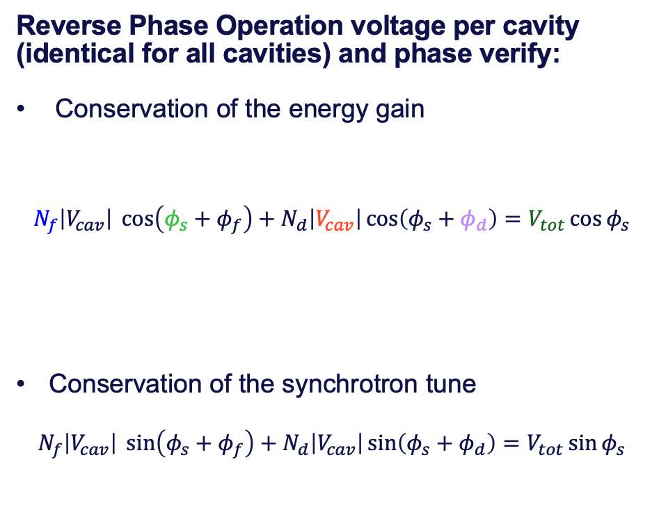
Voltage per cavity program including Reverse Phase Operation
Optimized overshoot, no damping wigglers
Reverse Phase Operation voltage per cavity (identical for all cavities) and phase verify:
Conservation of the energy gain
$$N_{f}\left|V_{cav}\right| \cos\left(φ_{s}+φ_{f}\right)+N_{d}\left|V_{cav}\right|\cos\left(φ_{s}+φ_{d}\right)=V_{tot}\cos{φ_{s}}$$
Conservation of the synchrotron tune
$$N_{f}\left|V_{cav}\right| \sin\left(φ_{s}+φ_{f}\right)+N_{d}\left|V_{cav}\right|\sin\left(φ_{s}+φ_{d}\right)=V_{tot}\sin{φ_{s}}$$
Synchronous phase
Total voltage
Phase reset
Number of focusing cavities
Voltage per cavity
Defocusing cavity phase
Reverse Phase Operation
Accumulation and acceleration
ramp
A. Blednykh et al, https://www.osti.gov/servlets/purl/1888292

Slide 12
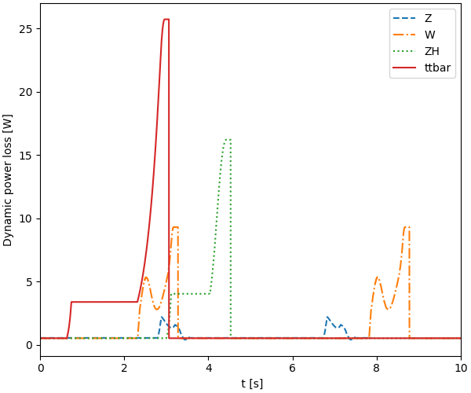
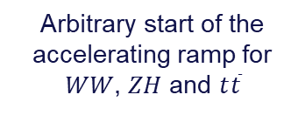
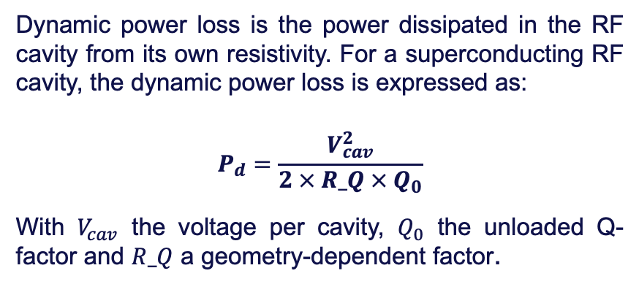
Dynamic power losses in the high-energy booster
Dynamic power loss is the power dissipated in the RF cavity from its own resistivity. For a superconducting RF cavity, the dynamic power loss is expressed as:
$$P_{d}=\frac{V_{cav}^{2}}{2 × R_Q × Q_{0}}$$
With $V_{cav}$ the voltage per cavity, $Q_{0}$ the unloaded Q-factor and $R_Q$ a geometry-dependent factor.
Dynamic power loss during different booster cycles
→ Lower than the static heat loads in all modes
(#350 – 500W) *
* K. Canderan, FCCweek2025_SRF_CM_Design_Evolution.pdf
Duty factor for all physics modes | Z | WW | ZH | ttbar
Peak [W] | 2.21 | 9.30 | 16.2 | 25.7
Average [W] | 0.676 | 1.29 | 1.42 | 2.02
Integrated power [W.s] | 2.66 | 10.1 | 14.2 | 20.2
Duty factor (average/peak) | 0.31 | 0.14 | 0.088 | 0.079
Arbitrary start of the accelerating ramp for $WW$, $ZH$ and $t\overline{t}$

Slide 13
Power transients at injection z mode
Overshoot energy ramp, no damping wigglers.
Results are subjected to large variations depending on the energy ramp strategy and use of damping wigglers throughout the booster cycle.

Slide 14
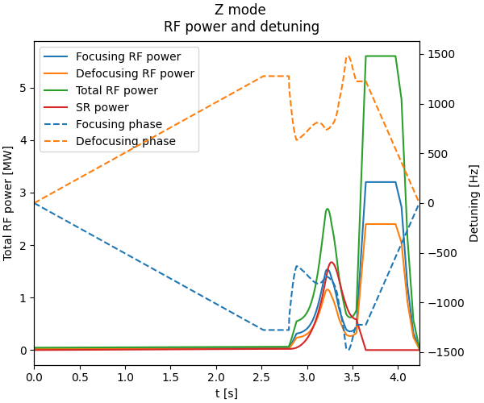
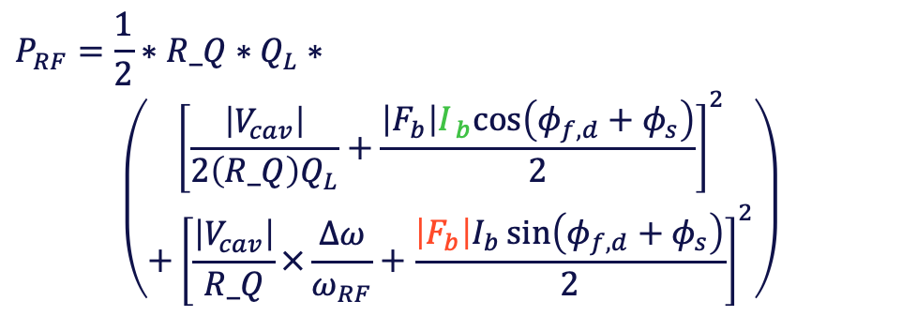

RF power requirements in the booster with optimal detuning
Clamp at 50kW per cavity
(overshot to be verified dynamically)
The power required by the RF cavities can be minimized with the choice of the loaded Q factor and a detuning program Δ𝜔.
In the case of FCC-ee, the cavities are fixed, and identical for 𝑍, 𝑊𝑊 and 𝑍𝐻 modes.
Minimization can therefore only be conducted with detuning of the cavities.
$$P_{RF}=\frac{1}{2}∗R_Q{ ∗Q}_{L}∗$$
$$\left(\begin{aligned}{\left[\frac{\left|V_{cav}\right|}{2\left(R_Q\right)Q_{L}}+\frac{{\left|F_{b}\right|I}_{ b}cos\left(φ_{f,d}+φ_{s}\right)}{2}\right]}^{2} \\ +{\left[\frac{\left|V_{cav}\right|}{R_Q}×\frac{Δω}{ω_{RF}}+\frac{\left|F_{b}\right|I_{b}\sin\left(φ_{f,d}+φ_{s}\right)}{2}\right]}^{2}\end{aligned}\right)$$
Overshoot energy ramp, no wigglers
DC beam current
Form factor
$$\left|F_{b}\right|≈2$$

Slide 15
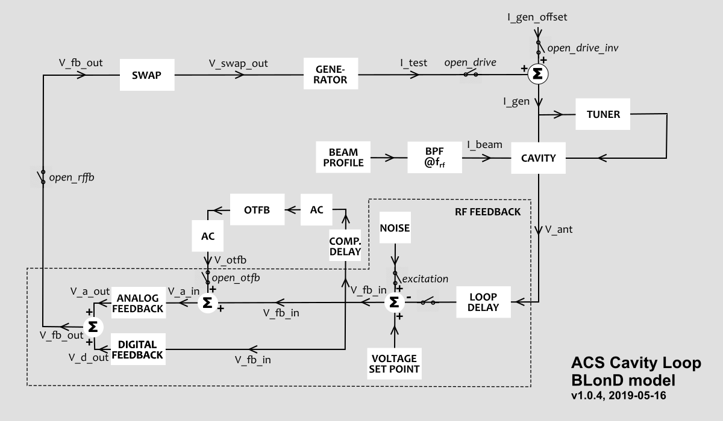
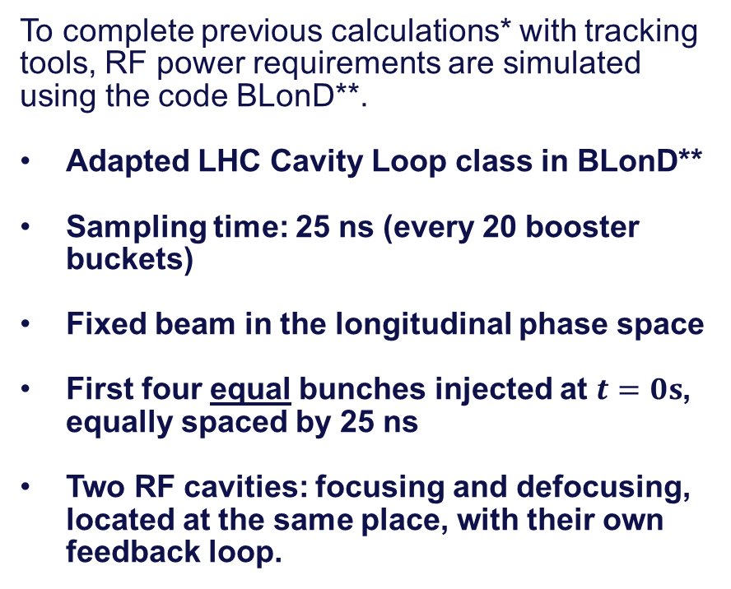
RF power transients at injection using BLonD
To complete previous calculations* with tracking tools, RF power requirements are simulated using the code BLonD**.
Adapted LHC Cavity Loop class in BLonD**
Sampling time: 25 ns (every 20 booster buckets)
Fixed beam in the longitudinal phase space
First four equal bunches injected at $t=0s$, equally spaced by 25 ns
Two RF cavities: focusing and defocusing, located at the same place, with their own feedback loop.
LHC Cavity Feedback loop diagram as implemented in BLonD**
*I. Karpov, FCC_optics_meeting_27022025_IK.pdf
** BLonD, Beam Longitudinal Dynamics simulator, https://blond.web.cern.ch/
*** B.E. Karlsen-Bæck, H. Timko, 2024 JINST 19 T04005

Slide 16
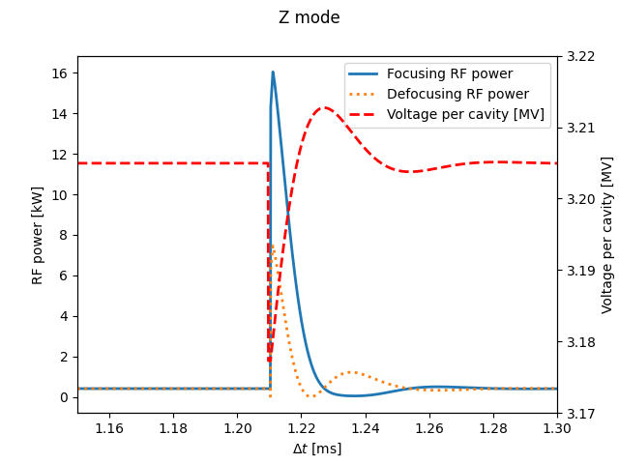
Injecting the four first bunches – Z mode
Injection of the first four bunches from the linac:
2.725e10 particles per bunch,
25 ns bunch spacing,
No intensity nor injection errors,
Fixed beam in the longitudinal phase space in a first approach,
Consistent with expected stabilised value (total 48kW for the first injection)
Averaged at 70kW including transients
RF power transients per cavity at injection in the booster (Z mode, 20 GeV)
Accelerating ramps and voltage programs from FCC_week_2025_valle.pdf

Slide 17

Summary and next steps
Summary
Codes available on GitLab (develop branch)
Energy ramp designing and optimizing functions for all target physics modes
LHC Cavity feedback loop being adapted to the FCC-ee booster for RF power transient calculation
Power transients studied during the first turns after injection in the booster, for Z mode bunches
Next steps
Ongoing optimization of the energy ramps (esp. Z):
Damping wigglers requirements to meet the extraction targets to be determined,
Bunch rotation at flat top to transfer energy spread into bunch length,
Study of booster availability
Trips of RF cavity, redundancy, recovery procedures, …
Full injection scheme (multi-turn injection) in BLonD(3?) in filling and top-up mode:
Booster filling scheme,
Injection mismatches, inhomogeneous bunches,
Coupled-bunch instabilities to be assessed (P. Hickersberger)
BLonD 3 source code at: https://gitlab.cern.ch/blond/BLonD/-/tree/blonder?ref_type=heads

Slide 18
Accelerator Early Career Researchers (AccelECRs)
An accelerator science and technology ECR community is in the pipelines. Our goals:
Build a Europe-wide network of early-career researchers (ECRs) in accelerator science and technology,
Support ECRs with their professional and personal development, career and research opportunities,
Organize topical workshops locally and globally to maximize knowledge sharing and interactions of the community
Get involved in building this community!
How to join:
Simply subscribe to the ‘accelerator-ecr’ e-group mailing list here:
https://e-groups.cern.ch/e-groups/EgroupsSubscription.do?egroupName=accelerator-ecr
For now: CERN-based, we are looking to build antennas in different European labs ☺

Slide 19
Thank you for your attention

Slide 20
Introduction - appendices

Slide 21
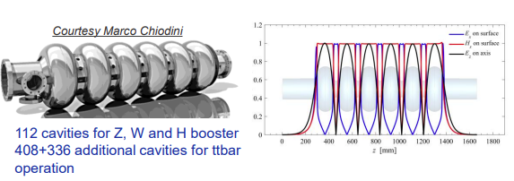
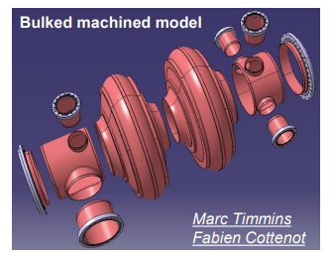
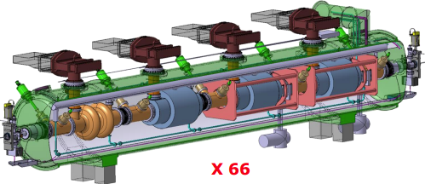
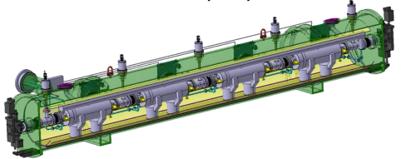

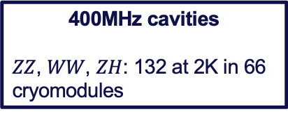
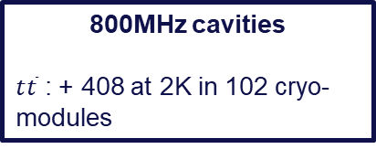
RF operation requirements for FCC-ee and its high-energy booster
800 MHz 6-cell cavity
Compensation of SR losses require many RF cavities
Main challenge: SYNCHROTRON RADIATION LOSSES up to 10 GeV energy loss per turn.
400 MHz 2-cell cavity
Booster
Collider
800MHz cavities
$ZZ$, $WW$, $ZH$: 112 at 2K in 28 cryomodules* (4 cavities per CM)
$Q_{0}=3×{10}^{10}$,
$$Q_{L}=1×{10}^{7}$$
$t\overline{t}$ : 448 at 2K in 112 cryo-modules (4 cavities per CM)
$$Q_{L}=2.7×{10}^{7}$$
400MHz cavities
$ZZ$, $WW$, $ZH$: 132 at 2K in 66 cryomodules
800MHz cavities
$t\overline{t}$ : + 408 at 2K in 102 cryo-modules
800MHz CM
* K. Canderan, FCCweek2025_SRF_CM_Design_Evolution.pdf
** See Ivan’s talks (e.g. FCC_Week_2025_IK.pdf)
400MHz CM
S. Gorgi Zadeh, Accelerating cavities with HOM damping for FCC-ee.pdf

Slide 22
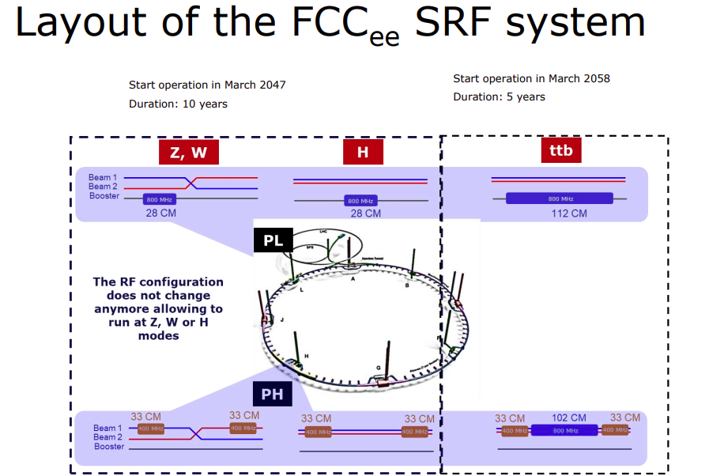
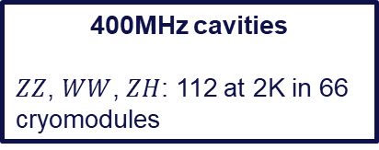
RF operation requirements for FCC-ee and its high-energy booster
Compensation of SR losses require many RF cavities
Main challenge: SYNCHROTRON RADIATION LOSSES up to 10 GeV energy loss per turn.
Booster
Collider
800MHz cavities
$ZZ$, $WW$, $ZH$: 112 at 2K in 28 cryomodules* (4 cavities per CM)
$Q_{0}=3×{10}^{10}$,
$$Q_{L}=1×{10}^{7}$$
$t\overline{t}$ : 448 at 2K in 112 cryo-modules (4 cavities per CM)
$$Q_{L}=2.7×{10}^{7}$$
400MHz cavities
$ZZ$, $WW$, $ZH$: 112 at 2K in 66 cryomodules
800MHz cavities
$t\overline{t}$ : + 408 at 2K in 102 cryo-modules
* K. Canderan, FCCweek2025_SRF_CM_Design_Evolution.pdf
** See Ivan’s talks (e.g. FCC_Week_2025_IK.pdf)
I. Syratchev, FCC_Week_2025_Syratchev.pdf

Slide 23
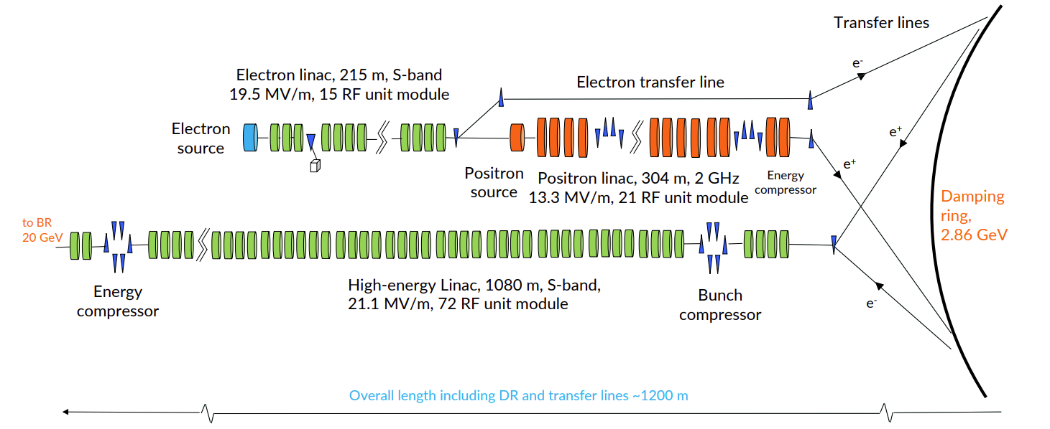
Injection chain into the FCC-ee

Slide 24
Synchrotron radiation in Beam LONgitudinal Dynamics (BLonD)
BLonD* is a CERN simulation suite for longitudinal particle tracking in synchrotrons.
Its latest version includes:
Synchrotron radiation damping and quantum excitation (using synchrotron radiation integrals),
FCCee booster feedback loops adapted from the LHC cavity loops
BLonD3 is a restructuration of BLonD and is under development, and will be adapted to future accelerators (FCCee, muon colliders especially.)
Developer and beginner friendly,
High test coverage and numerous examples (training in preparation),
XSuite wrappers for lattice import,
No backward compatibility with BLonD.
BLonD 3 source code at: https://gitlab.cern.ch/blond/BLonD/-/tree/blonder?ref_type=heads
*BLonD website: https://blond.web.cern.ch/

Slide 25
Energy ramps - appendices

Slide 26
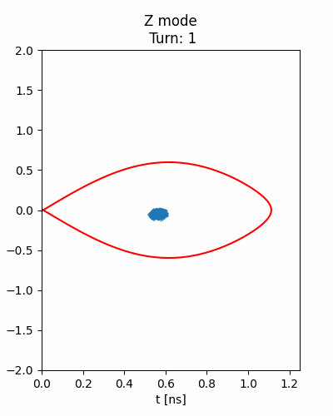
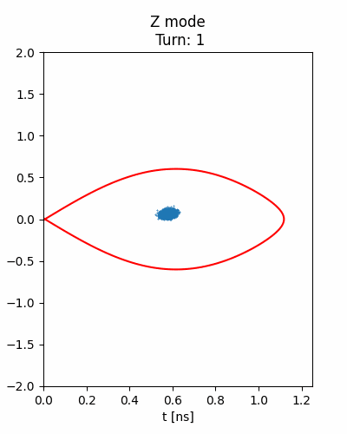
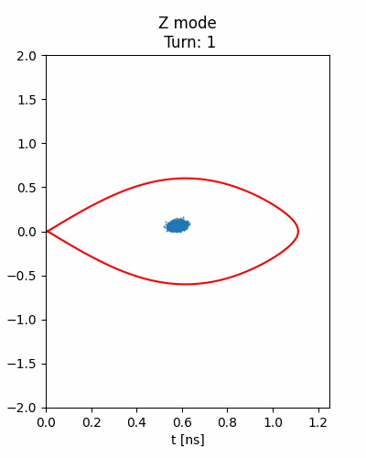
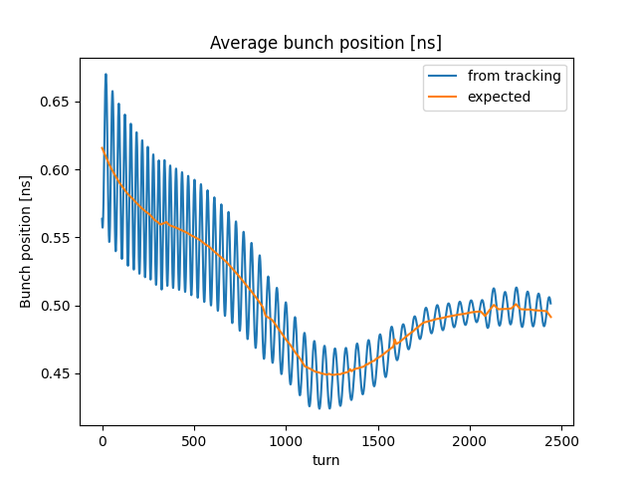
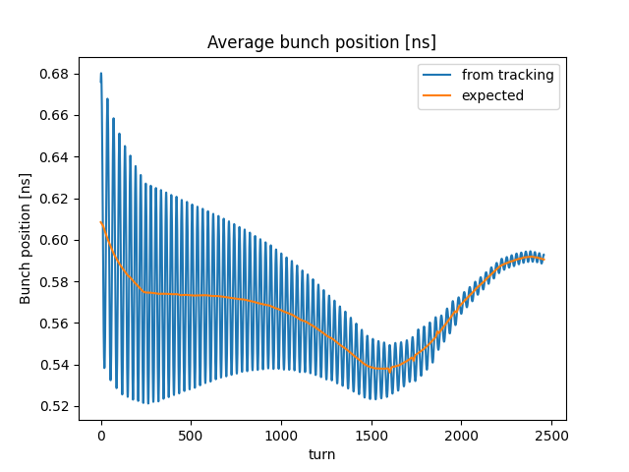
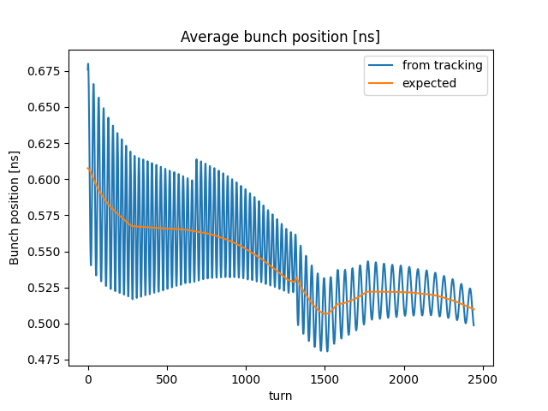




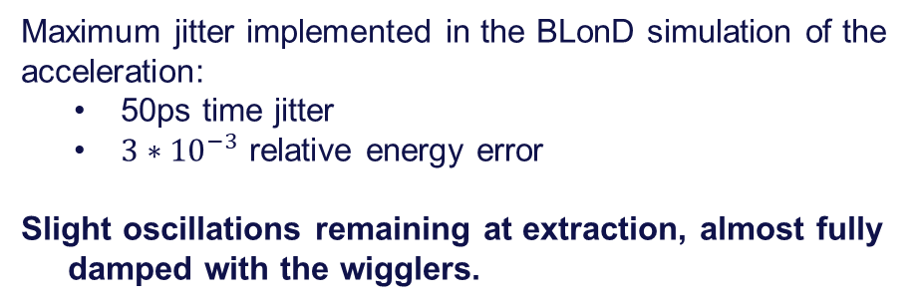
Injection error in the booster: Z ramp
Acceleration of an early-injected bunch
$$n_{w}=0$$
$$n_{w}=2$$
Maximum jitter implemented in the BLonD simulation of the acceleration:
50ps time jitter
$3∗{10}^{−3}$ relative energy error
Slight oscillations remaining at extraction, almost fully damped with the wigglers.
$n_{w}=2$ disabled at t = 0.4s
$$n_{w}=0$$
$$n_{w}=2$$

Slide 27
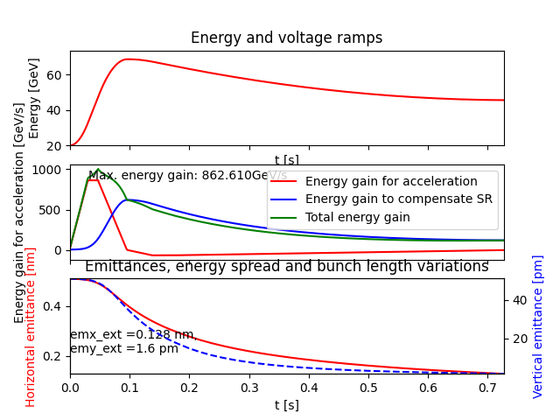
Z mode overshoot
Overshoot energy ramp could meet the requirements on the extraction transverse emittance…
with at least 850 GeV/s energy gain in less than 0.05s!

Slide 28
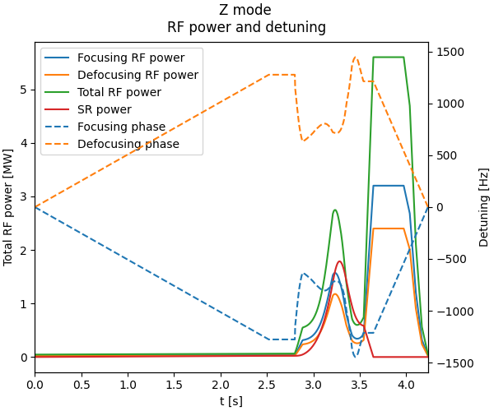
Z voltage per cavity for RPO and RF power
Clamp at 50kW per cavity
(overshot to be verified dynamically)
Optimized overshoot, no wigglers

Slide 29
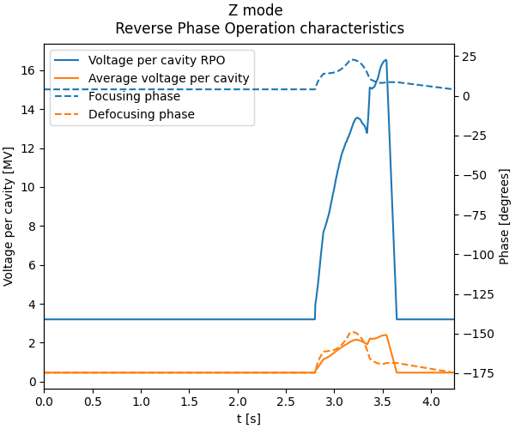
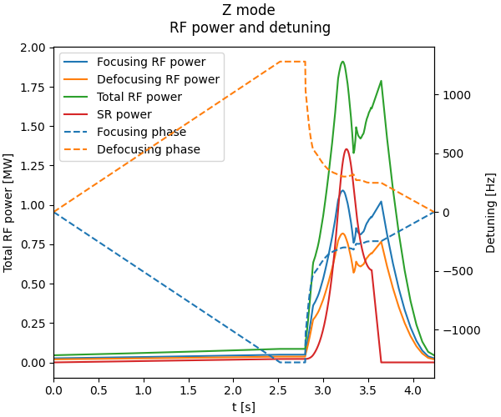
Z voltage per cavity for RPO and RF power
Optimized overshoot, two wigglers

Slide 30
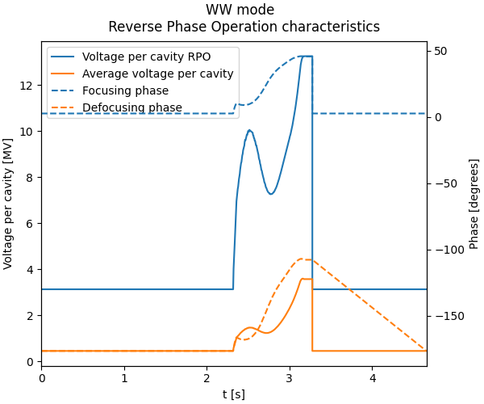
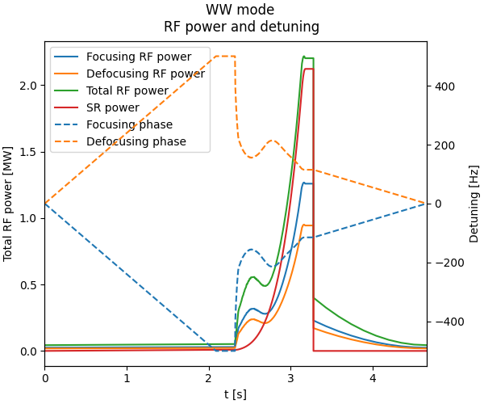
WW voltage per cavity for RPO and RF power
Phase reset
RPO
4.5% RF power overshoot at flat top

Slide 31
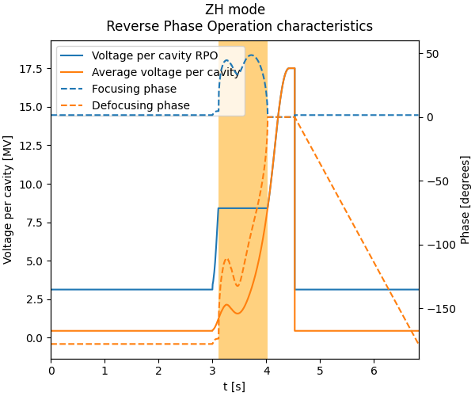
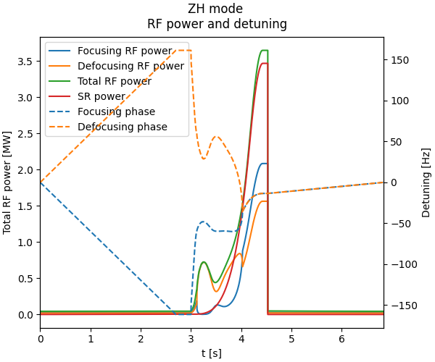
ZH voltage per cavity for RPO and RF power
Phase reset
RPO
Constant voltage
5% RF power overshoot at flat top

Slide 32



$t\overline{t}$ voltage per cavity for RPO and RF power
Constant voltage
Phase reset
RPO
43% RF power overshoot at flat top

Slide 33
Power transients- appendices

Slide 34

RF power transients at injection using BLonD
Adapted LHC Cavity Loop class in BLonD
Sampling time: 25ns
Fixed beam in the longitudinal phase space
Parameters of the FCCee feedback system
Time delays
Loop delay $τ_{loop}$ | 700 ns
Analog feedback delay $τ_{a}$ | 28,3 us
Digital feedback delay $τ_{d}$ | 66,7 us
Gains
Maximum stable analog gain $G_{a}^{max}$ | $$\frac{1}{2 R/Qω_{RF}τ_{loop}}$$
Fraction of maximum gain $a$ | 5
Analog gain $G_{a}$ | $\frac{G_{a}^{max}}{a}$ = 90e-9
Digital gain $G_{d}$ (eff. $G_{a}G_{d}$) | 10
Other parameters
Pre-detuning $Δω/f_{RF}$ | 0 Hz
Sampling time | 25 ns
Pretracking turn number | 50
Phase offset between analog and digital | - 6,7 degrees (foc.)
 | + 6,7 degrees (defoc.)

