Slide 1
Projet de futur collisionneur au CERN et stratégie européenne
G. Arduini – CERN
Acknowledgements: PPG WG on Accelerator Science and Technology, Future Colliders’ project proponents and many other colleagues

Slide 2
European Strategy for
Particle Physics (ESPP)
Cornerstone of Europe’s decision-making process for the long-term future of the field
Formed through a broad consultation of the particle physics community.
In March 2024, the CERN Council launched the process for the third update of the Strategy. The previous ones were completed in 2013 and 2020.

Slide 3
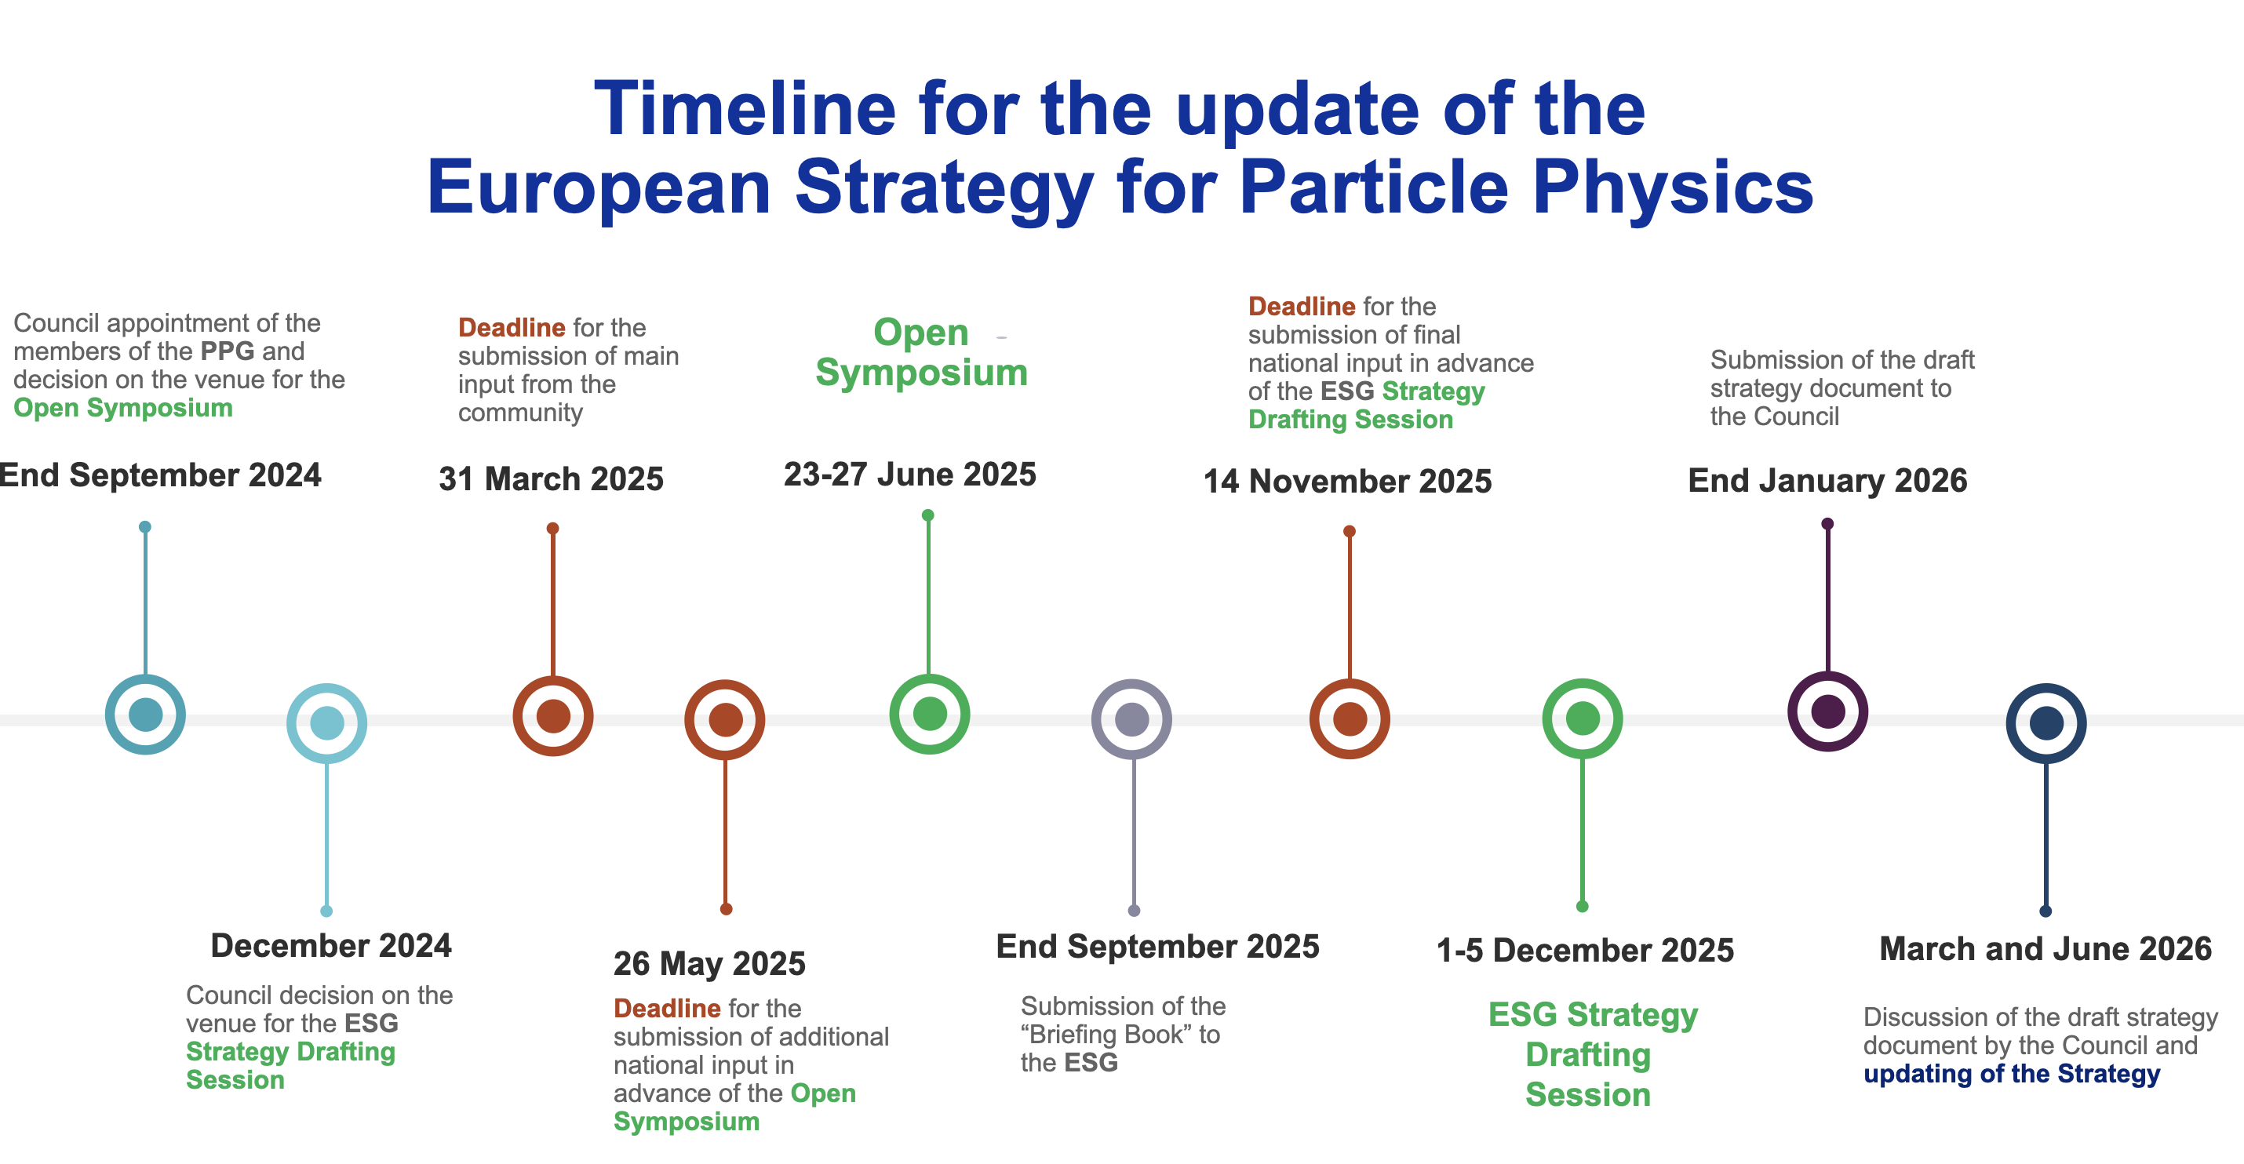
ESPP2026 - Timeline
https://agenda.infn.it/event/44943/overview
https://europeanstrategyupdate.web.cern.ch/node/37
https://europeanstrategyupdate.web.cern.ch/node/37
https://cds.cern.ch/record/2944678

Slide 4

ESPP2020
ESPP2020 – Deliberation document
Europe, together with its international partners, should investigate the technical and financial feasibility of a future hadron collider at CERN with a centre-of-mass energy of at least 100 TeV* and with an electron-positron Higgs and electroweak factory as a possible first stage.
*100 TeV CM energy ~ 10 TeV parton CM energy

Slide 5
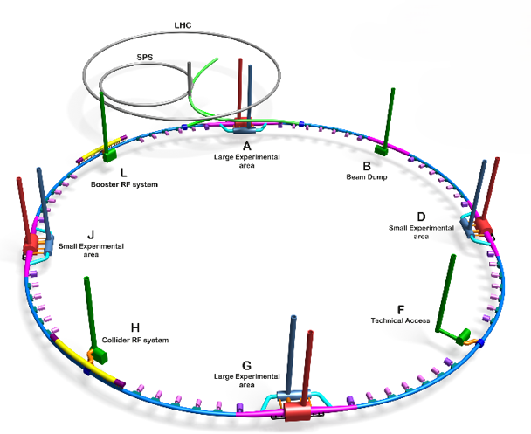
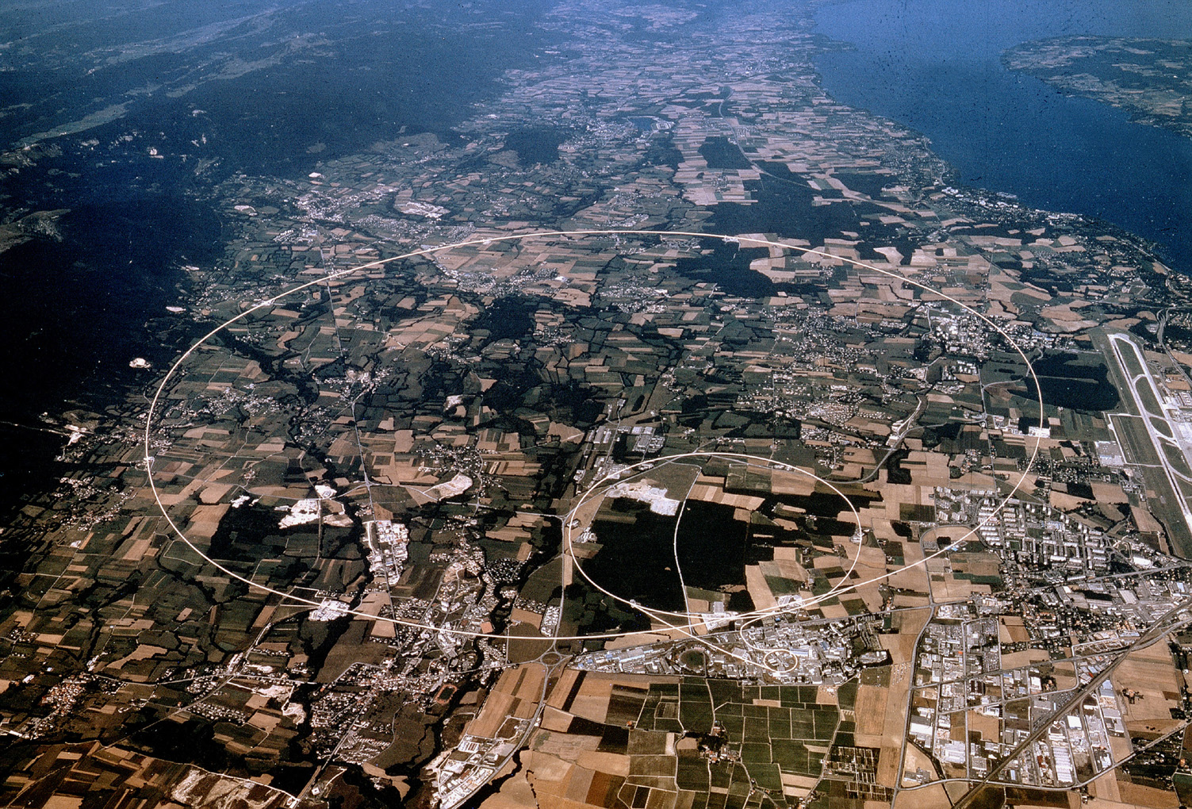
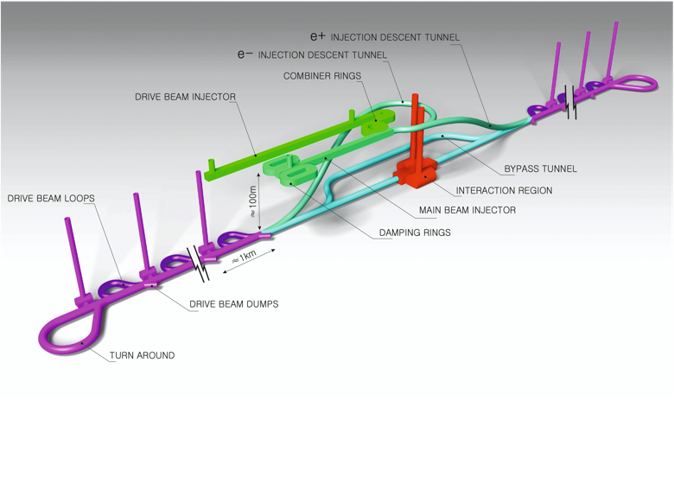
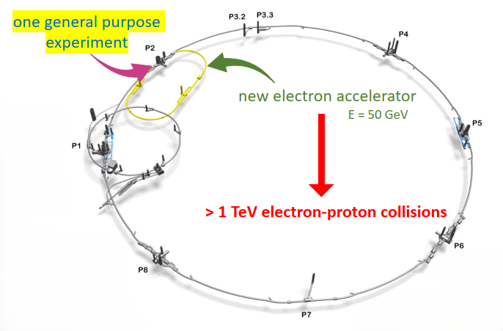
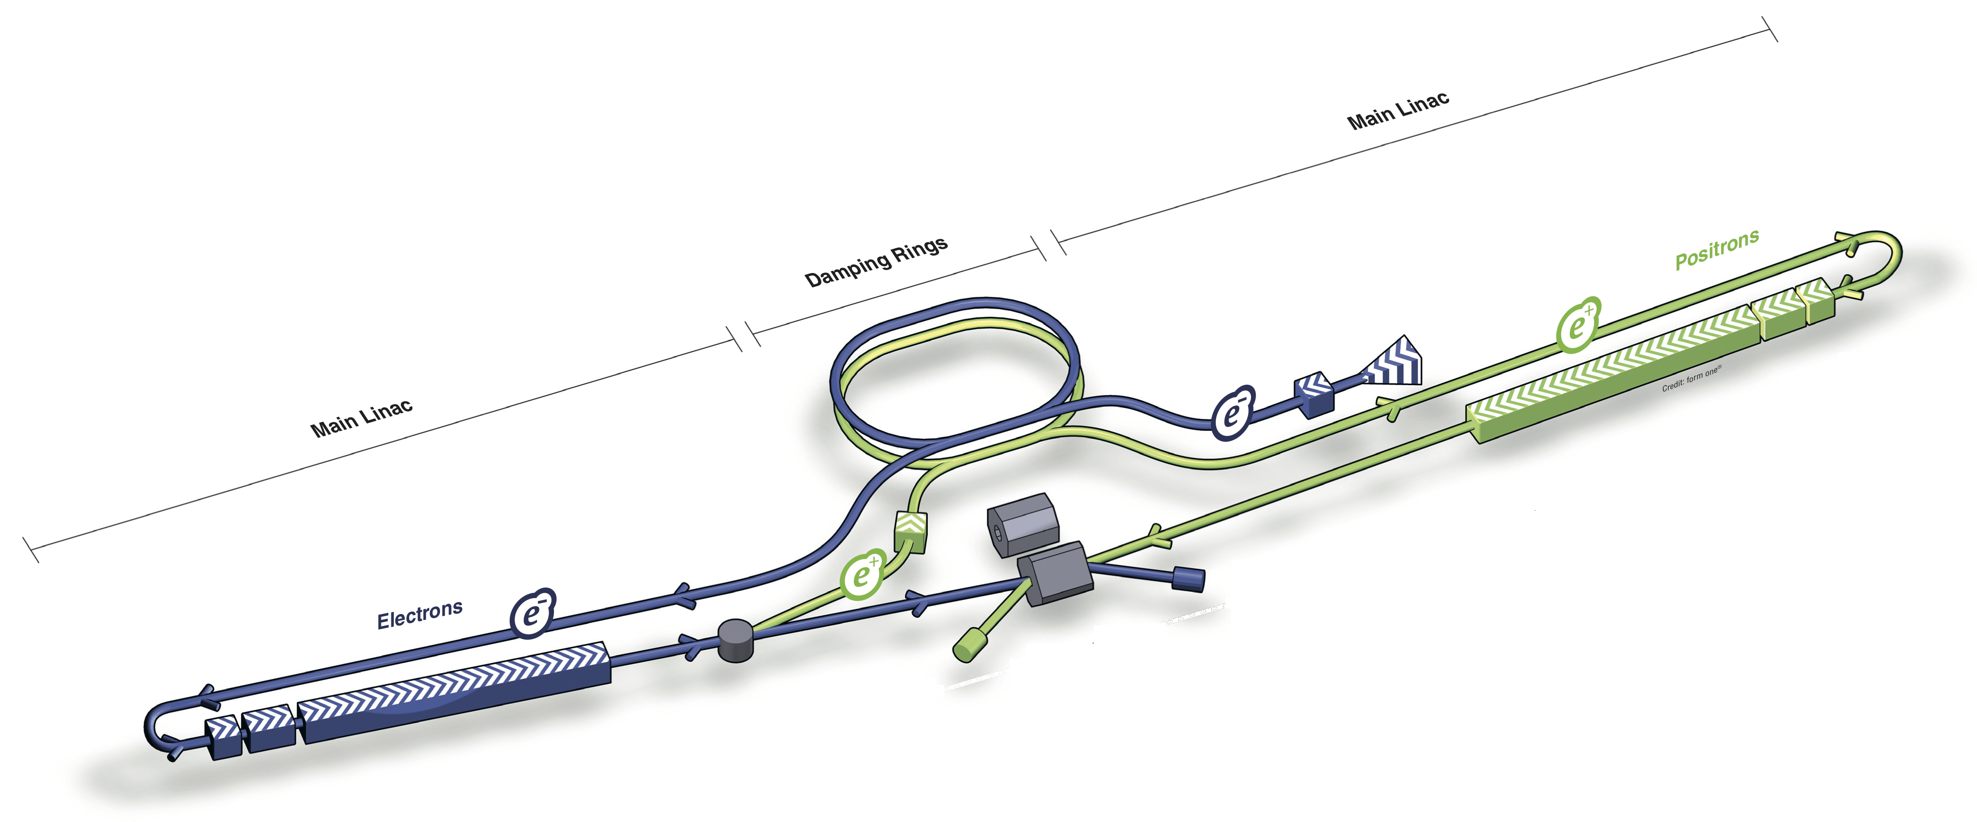
Proposed large-scale projects at CERN
~2045
e⁺ e⁻ Colliders
Re-use of LHC tunnel
LEP3
FCC-ee
CLIC
LCF
LHeC

Slide 6

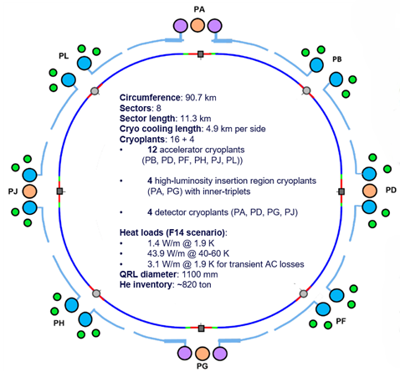
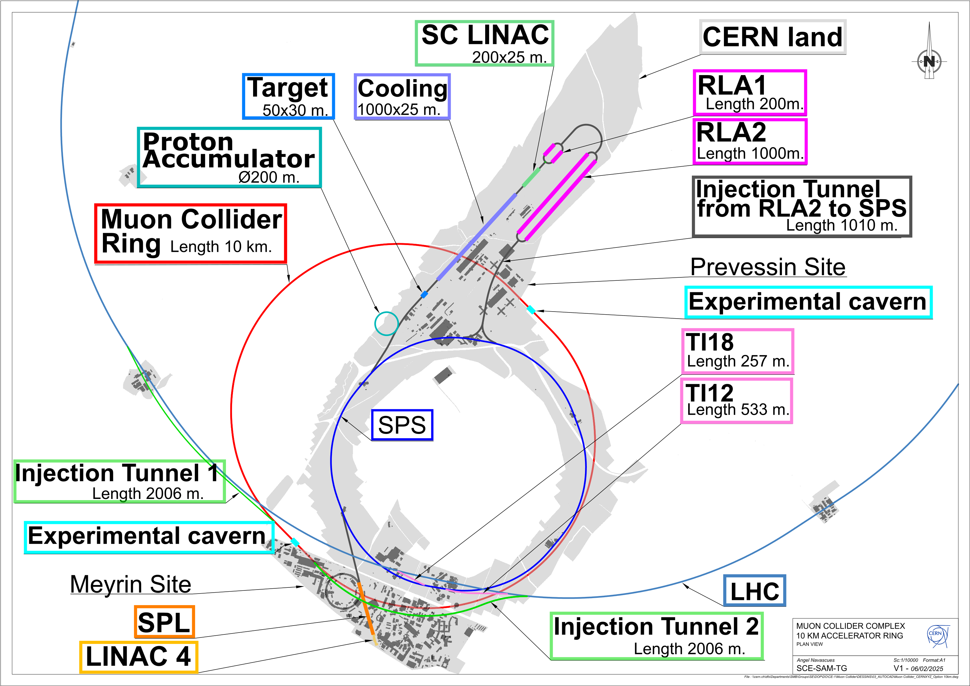
Potential for development towards
10 TeV parton-scale collider
LEP3
CLIC/LCF
FCC-ee
LHeC
Significant R&D required
LC Upgrade
(plasma, HGRF, …)
feasible? timescale?
Muon Collider
FCC-hh

Slide 7
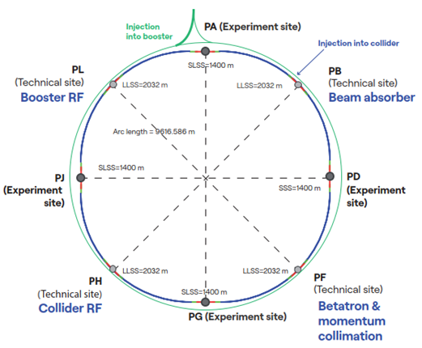
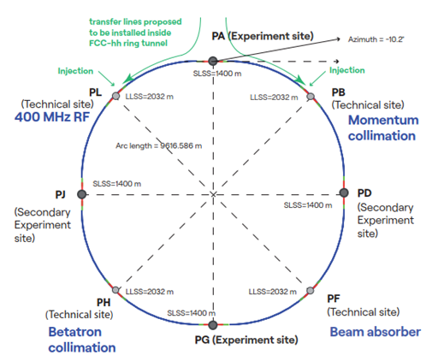
FCC integrated programme
Stage 1: FCC-ee
90 ➔ 365 GeV e⁺e⁻
Stage 2: FCC-hh
(~85 TeV) at energy frontier, pp & AA
2046 - 2065
2070 - 2100
90.7 km circumference
Common civil engineering and technical infrastructures

Slide 8
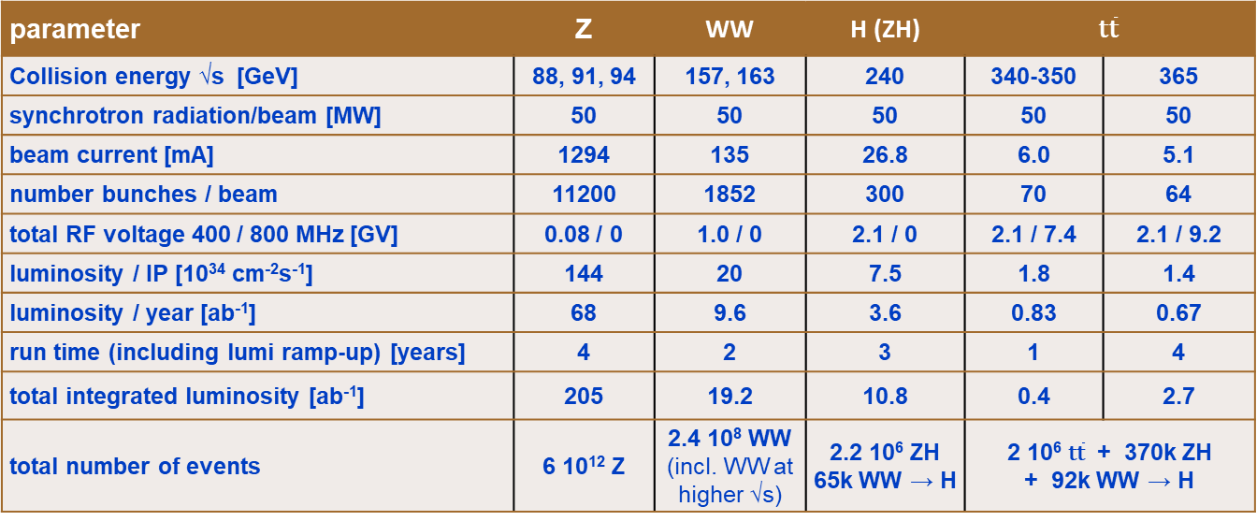

FCC-ee design parameters
$L∝$ $\frac{ρ}{β_{y}^{∗}}\frac{P_{SR}}{γ^{3}}$
parameter | Z | WW | H (ZH) | $$\text{t}\overline{\text{t}}$$
Collision energy √s [GeV] | 88, 91, 94 | 157, 163 | 240 | 340-350 | 365
synchrotron radiation/beam [MW] | 50 | 50 | 50 | 50 | 50
beam current [mA] | 1294 | 135 | 26.8 | 6.0 | 5.1
number bunches / beam | 11200 | 1852 | 300 | 70 | 64
total RF voltage 400 / 800 MHz [GV] | 0.08 / 0 | 1.0 / 0 | 2.1 / 0 | 2.1 / 7.4 | 2.1 / 9.2
luminosity / IP [10³⁴ cm⁻²s⁻¹] | 144 | 20 | 7.5 | 1.8 | 1.4
luminosity / year [ab⁻¹] | 68 | 9.6 | 3.6 | 0.83 | 0.67
run time (including lumi ramp-up) [years] | 4 | 2 | 3 | 1 | 4
total integrated luminosity [ab⁻¹] | 205 | 19.2 | 10.8 | 0.4 | 2.7
total number of events | 6 10¹² Z | 2.4 10⁸ WW (incl. WW at higher √s) | 2.2 10⁶ ZH 65k WW → H | 2 10⁶ $\text{t}\overline{\text{t}}$ + 370k ZH + 92k WW → H
Large energy span at high luminosity
Limited by electricity consumption
Many bunches, high current, like LHC and B factories, different from LEP
Large RF system to compensate for SR loss and cover large intensity/energy range
High luminosity with Crab waist collision scheme demonstrated at DAΦNE and SuperKEKB
Requires top-up injection (SR sources, existing e+/e- colliders) high machine availability/system reliability
Power consumption 250-380 MW
ID233
Notes:
Power consumption ranging from 251 MW to 381 MW

Slide 9
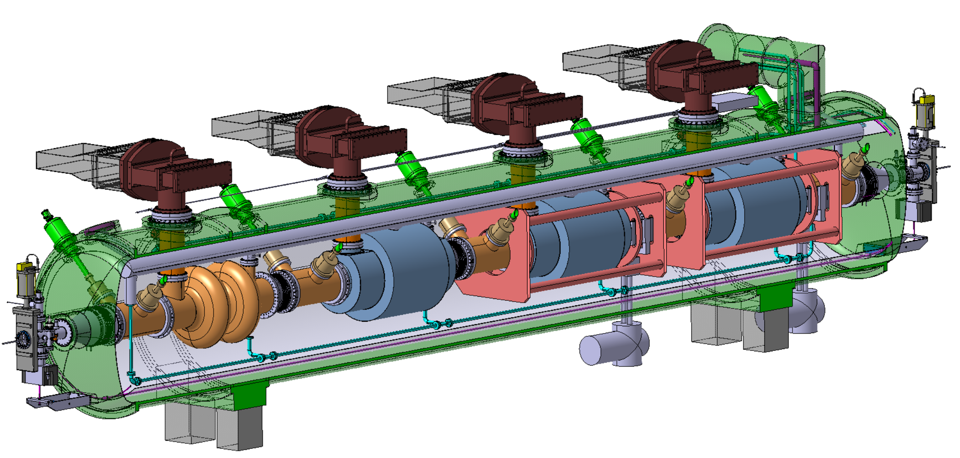
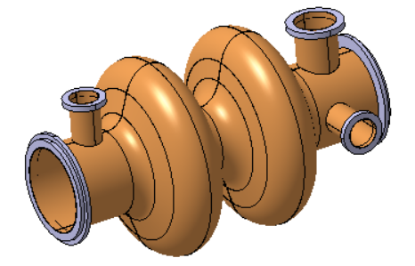
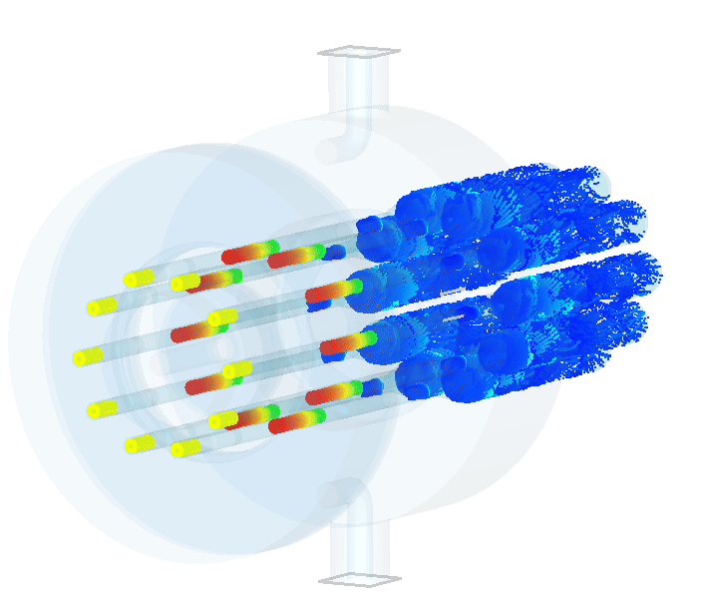
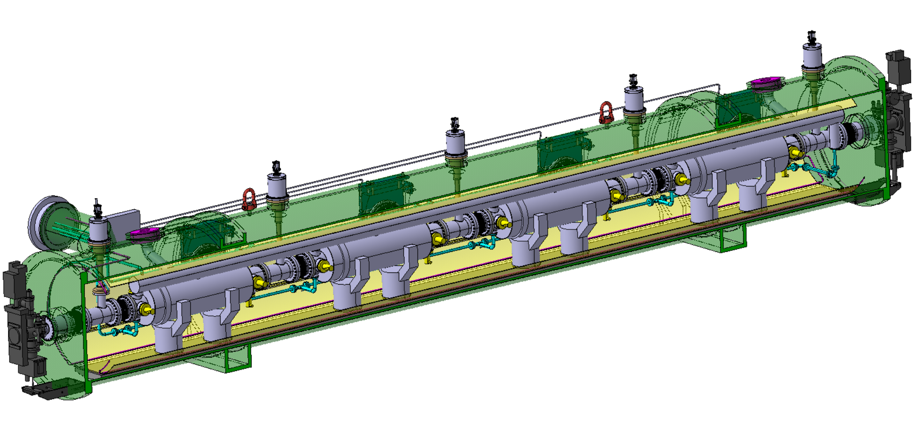
FCC-ee RF
400 MHz Collider
Power source: Multibeam Tristron
Very efficient ~90 % ! <<OPEX
3 m long
50 kV
500 kW, CW
X 264
X 66
Superconducting elliptical cavity
400 MHz, 2-cell, copper Nb coated
1.5 m. long
400 MHz Cryomodule
X 264
800 MHz Collider + Booster
X (408 + 448 booster)
X (102 + 112 booster)
X 204
+ 448 x 10 kW SSA booster
Superconducting elliptical cavity
800 MHz, 6-cell, bulk Nb
Nb₃Sn if R&D is successful
Large SRF Facility being built at CERN
800 MHz Cryomodule

Slide 10
FCC-hh design parameters
parameter | FCC-hh | HL-LHC
collision energy cms [TeV] | 85 | 14
dipole field [T] | 14 | 8.33
circumference [km] | 90.7 | 26.7
beam current [A] | 0.5 | 1.1
synchr. rad. per ring [kW] | 1200 | 7.3
peak luminos. [10³⁴ cm⁻²s⁻¹] | 30 | 5 (lev.)
events/bunch crossing | 1000 | 132
stored energy/beam [GJ] | 6.5 | 0.7
integr. luminosity / IP [fb⁻¹] | 20000 | 3000
Unprecedented energy
High Field SC magnets
LTS/HTS
High SR power intercepted at 40-60 K
“almost” a lepton machine
Challenge for the experiments
Machine protection!
Power consumption 355 MW
ID247

Slide 11
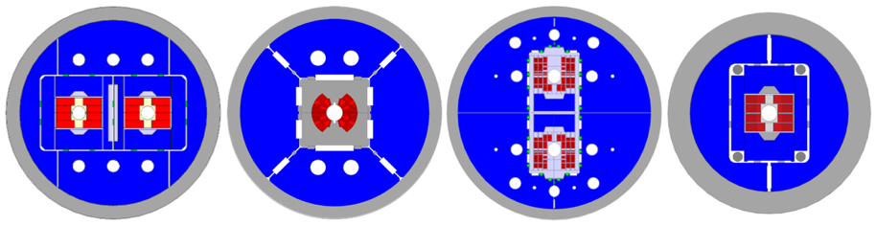
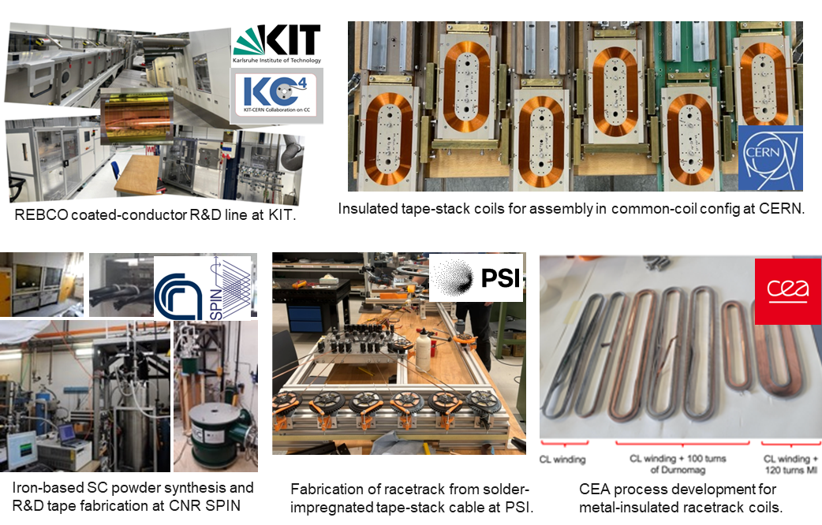


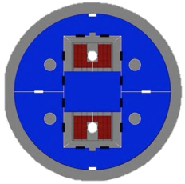



LTS and HTS R&D ongoing
Nb₃Sn:
12- and 14-T short demonstrators
different coil geometries
tests scheduled for 2026
HTS R&D in various domains:
ReBCO and IBS Conductor R&D
racetrack coil developments
Operation at higher field/temperature
E. Todesco, B. Auchmann
Notes:
Rare-earth barium copper oxide
IBS: Iron-based Superconductor

Slide 12
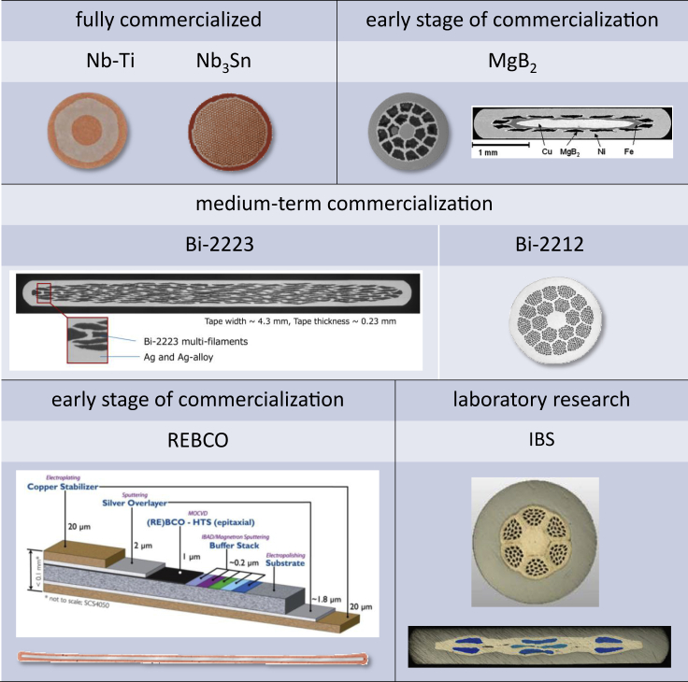
LTS/HTS conductors
ReBCO is produced as a flat tape 4-12 mm wide
Screening currents, which are induced in all types of conductors during a magnet ramp, increase with the major dimension of the superconductor.
Keeping ramp losses low and achieving good, stable, and reproducible field quality during injection, ramp, and physics is more challenging with ReBCO tapes than other conductors with smaller filament sizes (Nb-Ti: 5μm, Nb₃Sn and Bi-2212:50 μm).
Chao Yao and Yanwei Ma, iScience 24, 102541, 2021

Slide 13
Linear Collider Facility (LCF)
Based on Internation Linear Collider design (250 GeV c.o.m. energy) considered for Japan but:
Double repetition rate: 5 ➔ 10 Hz (upgrade option to double number of bunches)
Two separate IPs sharing the available intensity
Longer tunnel (33.5 km) to accommodate extension to 550 GeV
High gradient 1.3 GHz Superconducting RF (31.5 MV/m) with Q₀=2×10¹⁰ (2×ILC specifications) @ 2K
Operational experience at Eu-XFEL, though at <70% of the LCF gradient
ID40 - ID275
33.5 km

Slide 14
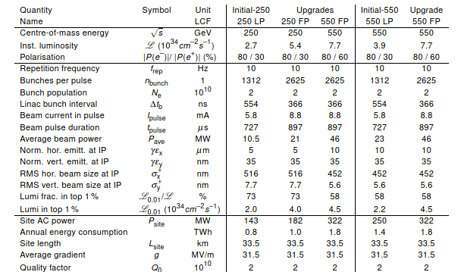

LCF
$$L∝\frac{N_{b}P_{beam}}{γσ_{x}^{∗}σ_{y}^{∗}}H_{D}$$
ID40
Operation at lower energies possible only at lower luminosities
Polarized e⁺/e⁻ beams
Lower rep. rate as compared to circular colliders (kHz)
nm beam size at the IP due to lower repetition frequency
No SR losses but significant beam power continuously damped ➔ e⁺ production, beam dump critical

Slide 15
Compact Linear Collider - 380 GeV
Based on the Two-Beam Acceleration Concept:
12 GHz RF power extracted from High intensity lower energy beam (decelerated) to accelerate lower intensity main beam to high energy ➔ Proof of Concept at CTF3
Higher gradient (70-100 MV/m) ➔ More compact accelerator
Lower current (limited by wakefields, power consumption)
Recent doubling of repetition rate and two IPs sharing the available beam
12.1 km
ID78

Slide 16
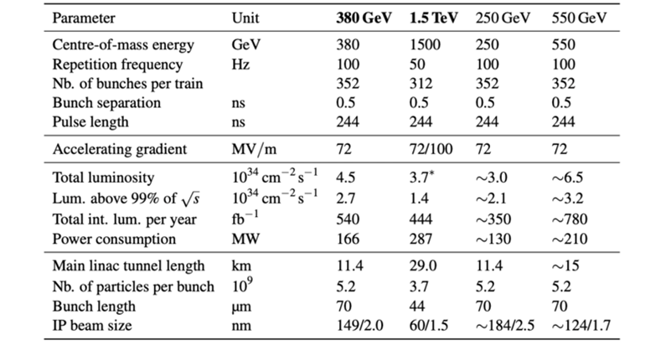
CLIC design parameters
ID78
Possible upgrade to 1.5 TeV ➔ longer tunnel
Operation at lower energies possible only at lower luminosities
Tighter bunch spacing – shorter pulses – bunch-by-bunch IP feedback difficult
Smaller beam size to compensate for lower current
e⁻ beam polarization (±80%)

Slide 17
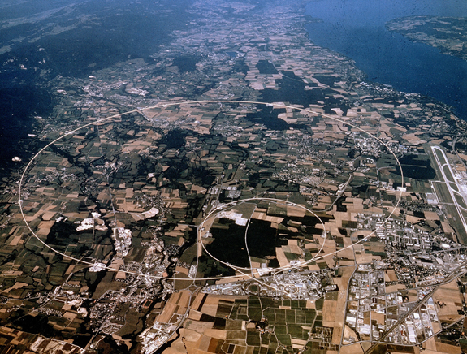
Possible reuse of the LHC tunnel
LEP3
  LEP3:
  Proposal to reuse the existing tunnel ➔ reduced civil engineering
  Constraints on the available space for RF cavities
  Max. synchrotron radiation power = 50 MW/beam
  Scaled design of FCC-ee (including injectors)
  Pre-conceptual design not yet validated by simulation studies to confirm performance (luminosity, power consumption, …)
  Large SC RF system, possible need for SC magnets, and high-energy booster installed in the same tunnel of the collider demand for integration studies to assess extent of the civil engineering

Slide 18
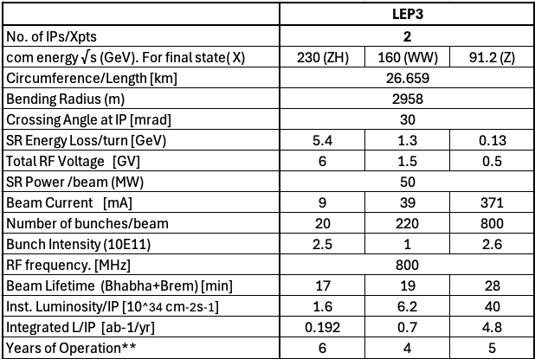
Possible reuse of the LHC tunnel
LEP3
2 experiments as compared to 4 for FCC-ee
Limited to 230 GeV c.o.m. energy
1/3.4 ρ/circumference of FCC-ee
Higher power deposition density
1/3.4 of FCC-ee current
1/5-1/3 of FCC-ee luminosity/IP
Power consumption 200-250 MW
ID188

Slide 19
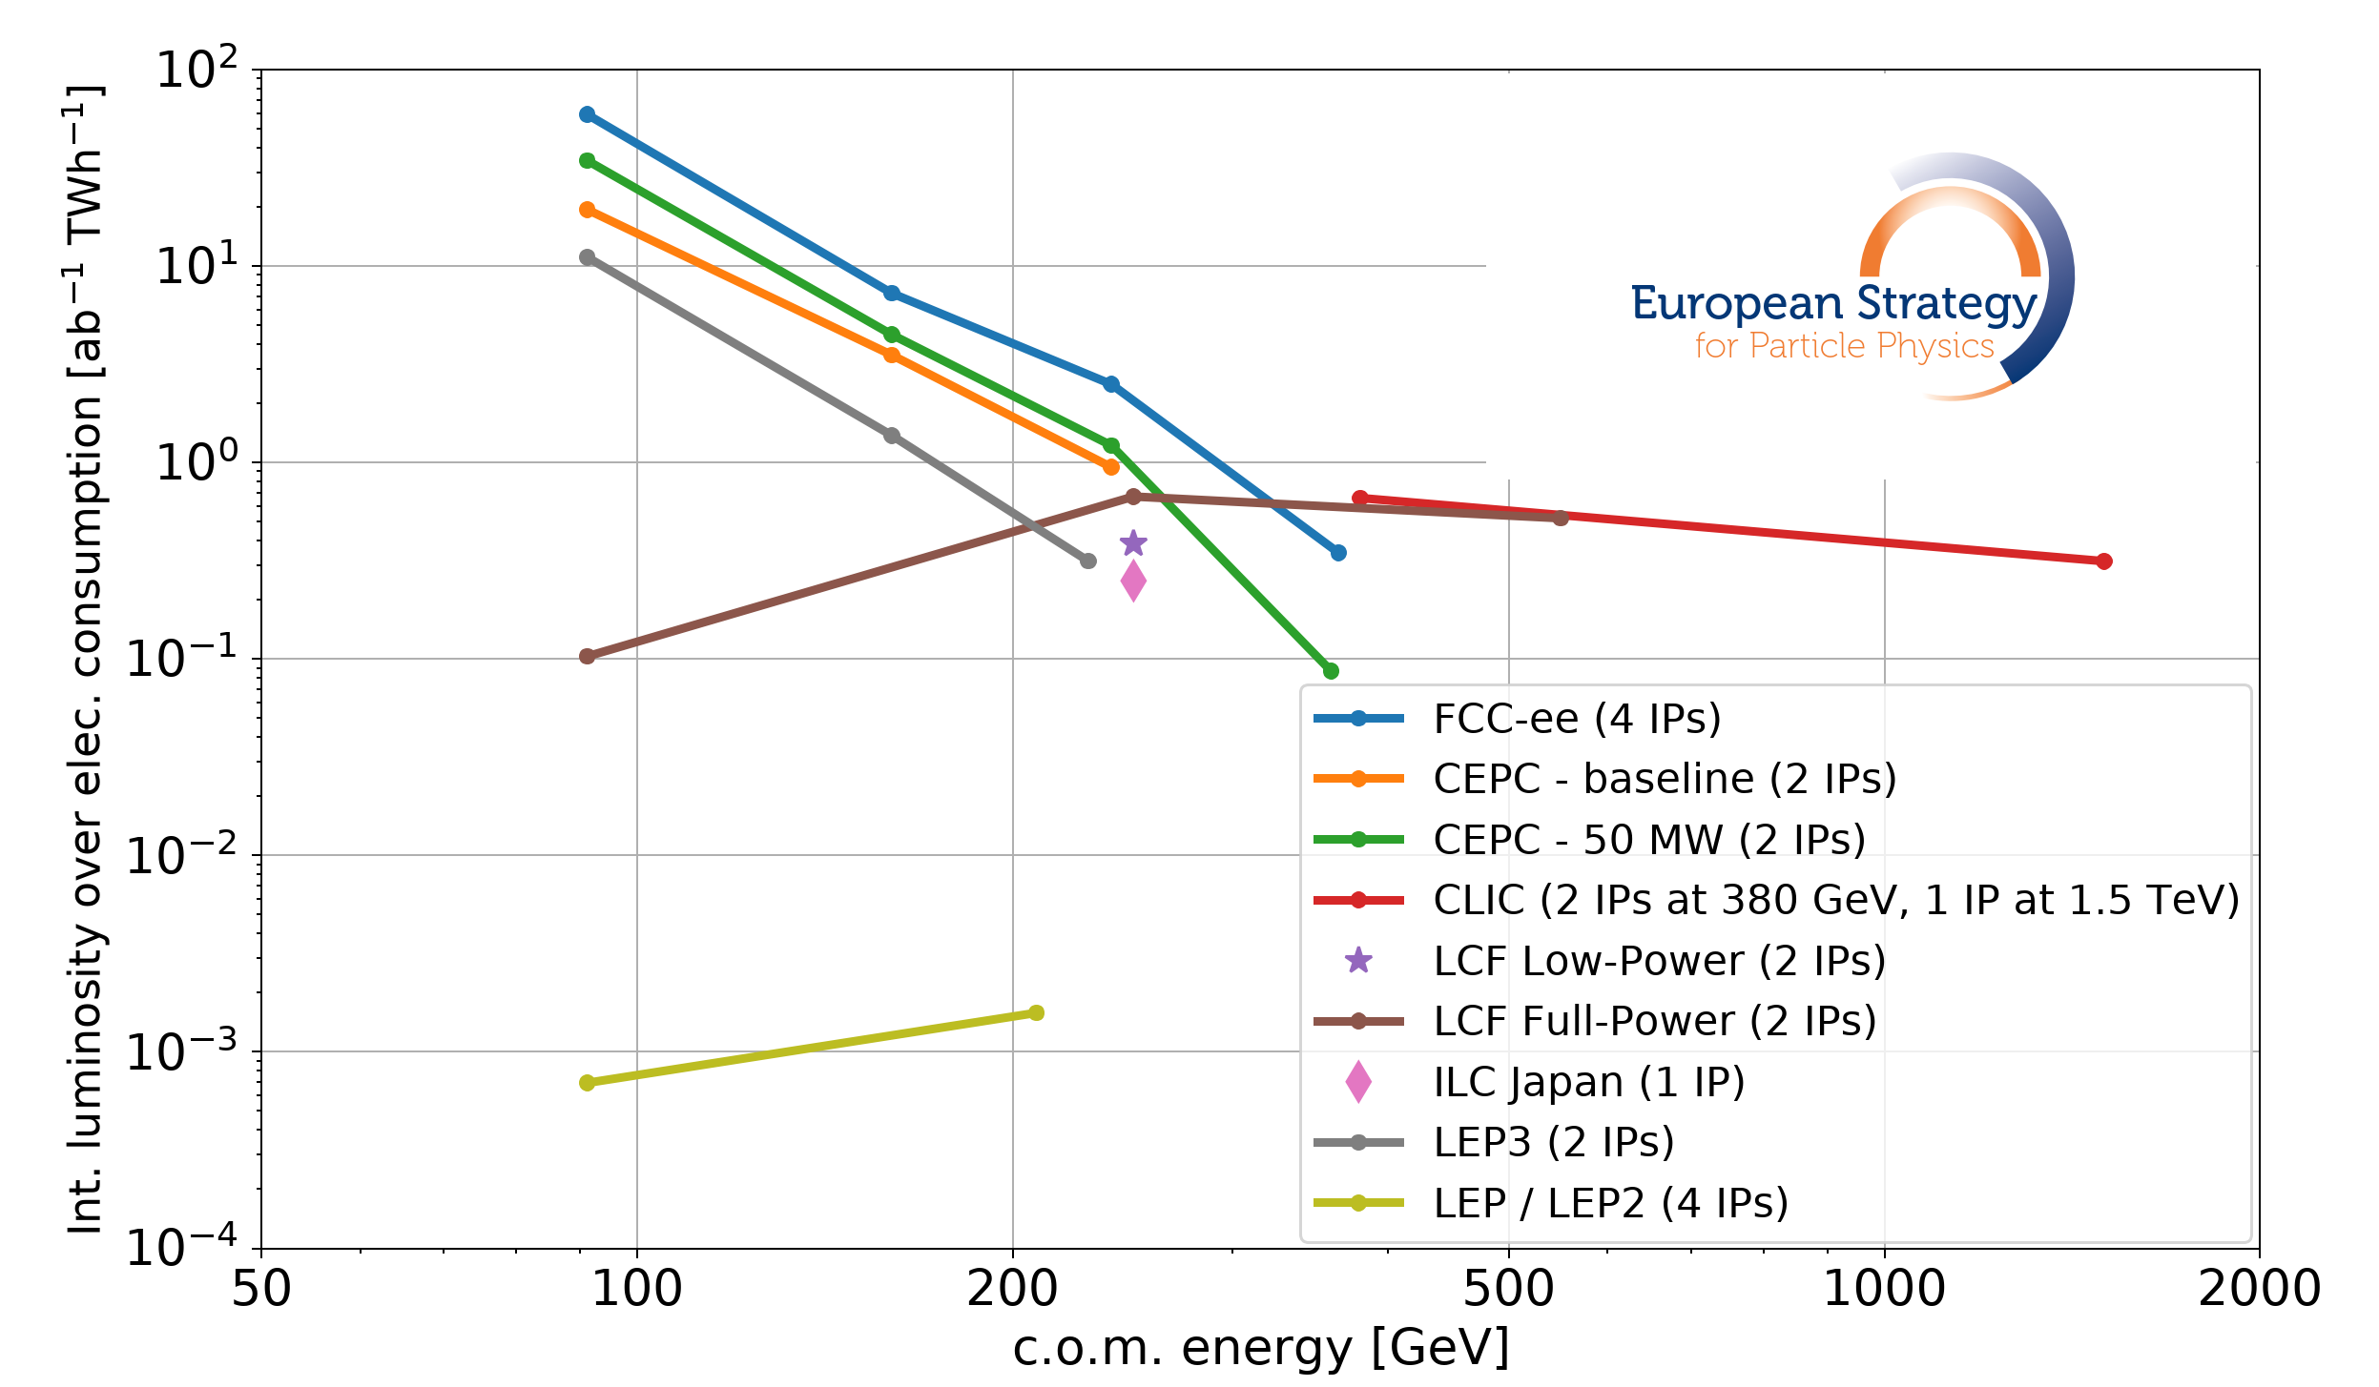
Integrated luminosity/electricity consumption: e⁺/e⁻ colliders
ID281

Slide 20

Possible reuse of the LHC tunnel
LHeC
Schematic view
Beam Energy [GeV]
Luminosity [10³⁴cm⁻²s⁻¹]
Normalized emittance γε_{x,y} [μm]
Beta Function β∗_{x,y} [m]
rms Beam size σ∗_{x,y} [μm]
Beam Current @ IP [mA]
Bunch Spacing @ IP [ns]
Bunch Population [10¹¹]
Bunch charge [nC]
LHeC
p | e⁻
7000 | 50
2.3
2.5 | 20
0.07 | 0.1
4 | 4
1100 | 50
25 | 25
2.2 | 0.078
35 | 1.24
$\sqrt{s}$=1.18 TeV
1/3 LHC circumference
2.5 GW beam power
2.5 GW beam power
HL-LHC proton beam parameters
Very low beta functions at the IP!
50 mA e⁻ current
HL-LHC – 7 TeV

Slide 21
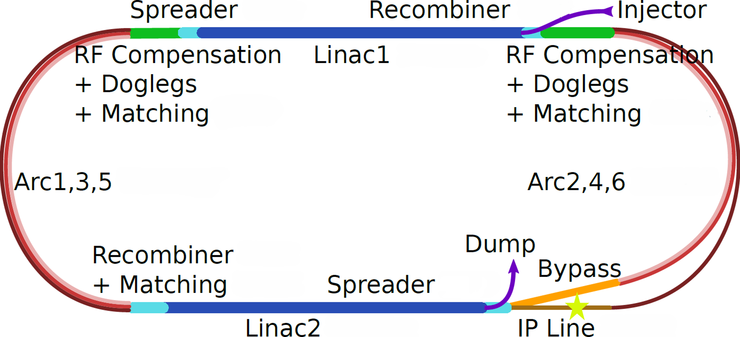
Energy Recovery Linac
50 GeV acceleration with Recirculating Linacs
Three accelerating passes through each of the two ~9 GeV linacs
RF systems (at twice the LINAC frequency) to compensate for the synchrotron radiation loss in the arcs
p
Animation from A. Bogacz (JLab)

Slide 22
Energy Recovery Linac
1/2 RF wave length shift on return arc following the collision
Animation from A. Bogacz (JLab)

Slide 23
Energy Recovery Linac
50 GeV deceleration with Recirculating Linacs
Three decelerating passes through each of the two linacs (energy recovery) ➔ Q₀ > 10¹⁰ for high recovery efficiency and low cryogenic cooling power
Beam dump at injection energy
Circulating bunches = 6 × colliding bunches
Animation from A. Bogacz (JLab)

Slide 24
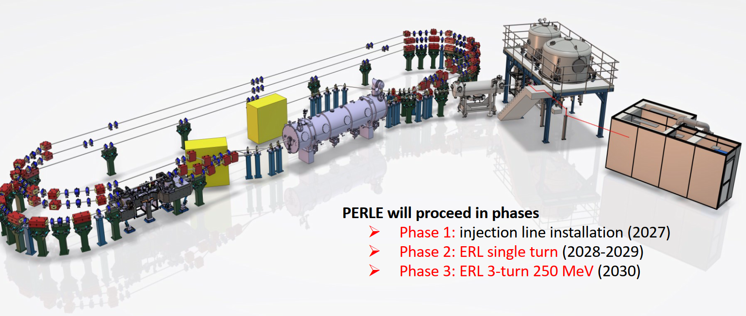
ERL challenges
Multi-pass recirculation and energy recovery at high current and energy (~2.5 GW beam power)
Need demonstrator of this key LHeC element ➔ PERLE (Powerful Energy Recovery Linac for Experiments) being built at IJCLab - Orsay
89 MeV-20 mA
250 MeV – 20 mA

Slide 25
Muon colliders
m_{μ}~200 m_{e}:
lower P_{SR} wrt e⁺e⁻ colliders P_{SR}~ E⁴/m⁴
Beamstrahlung/disruption negligible
One intense bunch per beam with no crossing angle to maximize luminosity at limited total current (μ are difficult to produce!) ➔ k=1, F~1, H_{D}~1
muons decay (104 ms lifetime at 5 TeV ~3000 turns in a 10 km machine)
…need to be replaced rapidly: high repetition rate injector chain f_{inj} (5 Hz)
Small ε* and β* at the IP to compensate for the small number of bunches
Small σ_{z} to minimize hourglass effect ➔ R_{HG} ~1

Slide 26
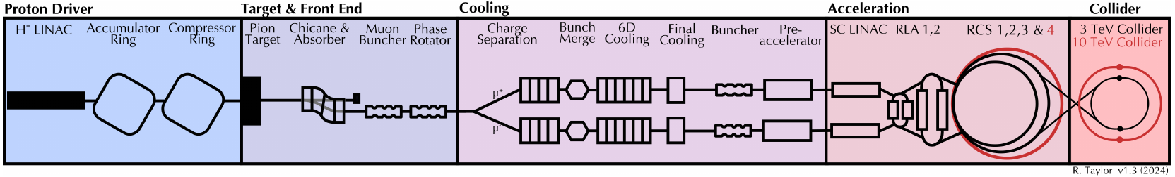
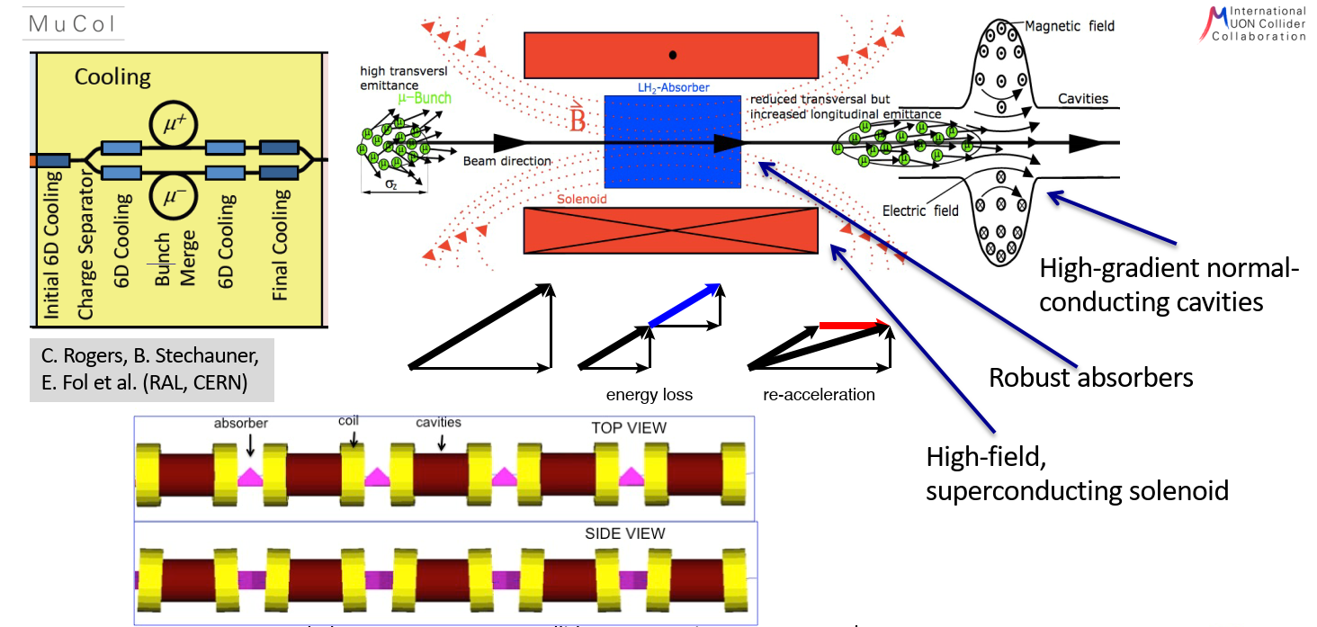
Muon Cooling
High brightness muon beams are difficult to produce:
Tertiary production from a O(MW) proton beam on a target
All beam manipulations required for small longitudinal and transverse emittance must be rapidly carried out
6D Cooling demonstrator is a crucial milestone
Ionization cooling provided by Low-Z wedge absorbers
Solenoid magnets to focus the beam at the absorber location
Warm RF cavities (20-30 MV/m) in strong magnetic field - O(10 T) - to restore the beam longitudinal momentum
O(km) length cooling channel
Quite a number of technological challenges
Notes:
From Interim report: https://arxiv.org/abs/2407.12450

Slide 27
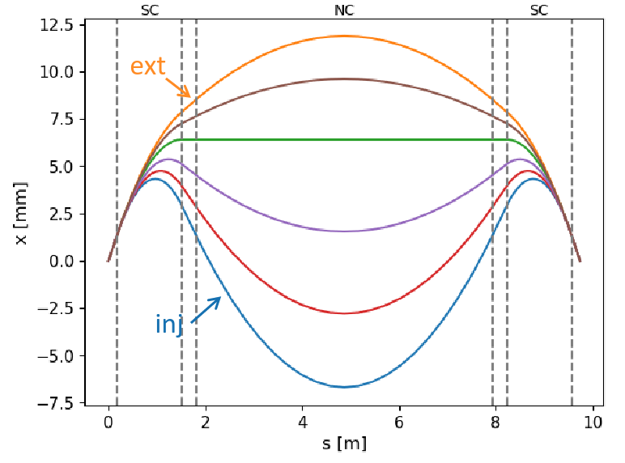
Rapid Cycling Synchrotrons (RCS)
Large RF voltage required to accelerate the beams: many RF cavities in each machine. Up to 90 GV and 3000 cavities
Fast NC ramping magnets are needed (4200 T/s) in RCS 1
Hybrid synchrotrons for higher energy: alternate fixed-field 10 T SC dipoles and pulsed 1.8T NC dipoles to increase the energy swing
  This creates large orbit excursion in the dipole magnets
  No detailed lattice design available yet for CERN implementation
  Unconventional beam dynamics regimes
L. Soubirou
Notes:
Lisa Soubirou annual meeting: https://indico.cern.ch/event/1325963/contributions/5806746/attachments/2817648/4921129/Status_RCS_geometry_LSoubirou.pdf

Slide 28
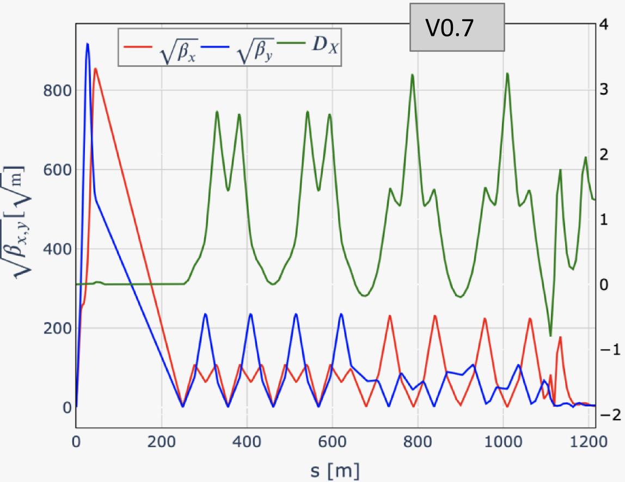
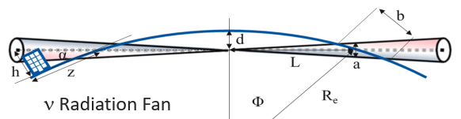
Collider
Achieve high luminosity
  Small β* (1.5 mm), high bunch population (1.8·10¹²)
Challenging lattice design with strong final focus magnets creating large chromatic aberrations and in general sensitivity to errors
Collective and impedance effects are critical
A comprehensive simulation and optimization tool capable of modelling the entire Muon Collider complex is not yet available. Essential to validate performance predictions.
Neutrinos from the muon decays can produce ionizing radiation far from the accelerator complex
K. Skoufaris, M. Vanwelde
Notes:
Marion presentation: https://indico.cern.ch/event/1325963/contributions/5806746/attachments/2817648/4921129/Status_RCS_geometry_LSoubirou.pdf
Kyriacos:

Slide 29
Outlook
Ongoing:
Comparative assessment of submitted proposals (feasibility, cost, timeline, technical readiness, risks….)
Comparative assessment of the physics reach of the proposals
In preparation of the Drafting Session
We are here

