Slide 1
Uncertainties in Nuclear Data
Cyrille De Saint Jean, CEA/DAM/DAN
P(ND)²-3, Perspectives on nuclear data for the next decade
Campus des Cordeliers, Paris 6ème arrondissement, 09-13 March 2026

Slide 2
Uncertainties in Nuclear Data
What are we talking about ?
Next decade challenges
Conclusions

Slide 3
What are we talking about ?
1

Slide 4
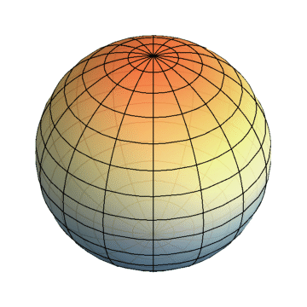
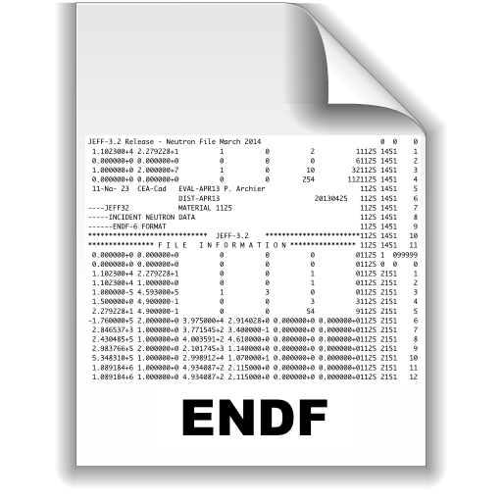

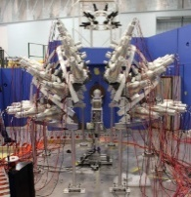

What are we talking about ?
Nuclear reactions
Cross sections
(fission, capture, n2n,…)
Spectra and multiplicities (neutrons, gammas…)
Yields, Branching ratios
Energy balance
Theory
Experiment
Nuclear reactors (conventional or future)
Electronic damage (space)
Radiotherapy
Geology (exploration, etc.)
Non-proliferation and Safegard
Non-destructive testing Fuel cycle,
waste management
Astrophysics, nucleosynthesis…
Providing applications with evaluated nuclear data « constant » *
Precision
Completeness
It's nonsense and an oxymoron
  Their impacts are major….or sometimes equivalent to other contributors
*user perspective ☺

Slide 5
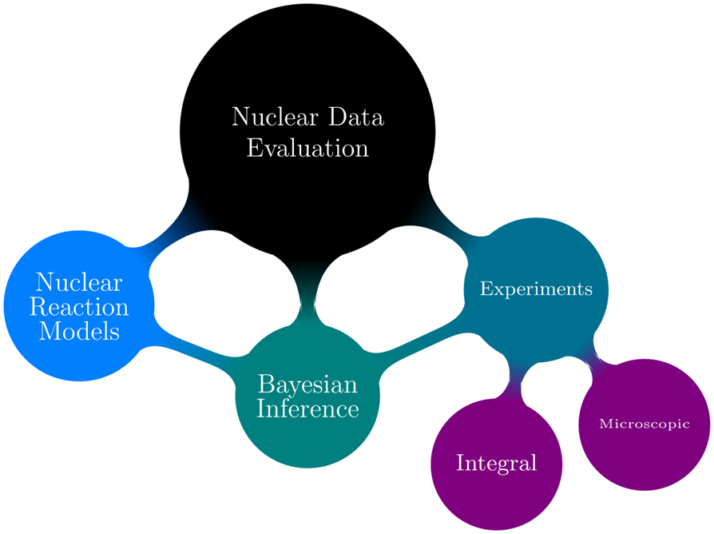
The evaluation of nuclear data
(v±δv) ⇔ the correct numbers of E. Segré
Differential experiments
Very few experiments for some isotopes and some energy domains
Systematic uncertainties
« Old » Experiments
Discrepancies
Phenomenological Models → parameters
« Microscopic » models→ uncertainties/biases ?
Balance prediction/precision
Nuclear Data assimilation
Mathematical framework for C/E comparison
What about prior knowledge ?
Integral Experiments
Nuclear Data correlations/compensations

Slide 6
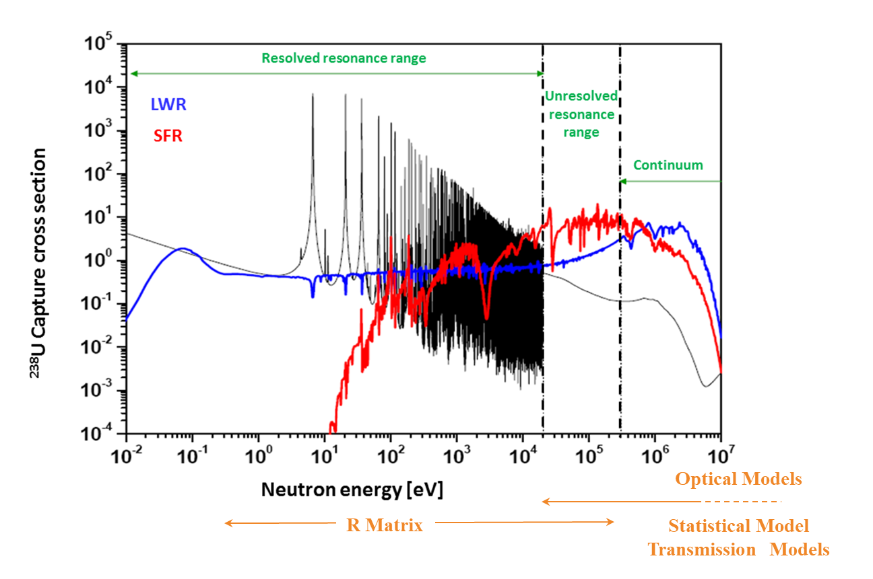
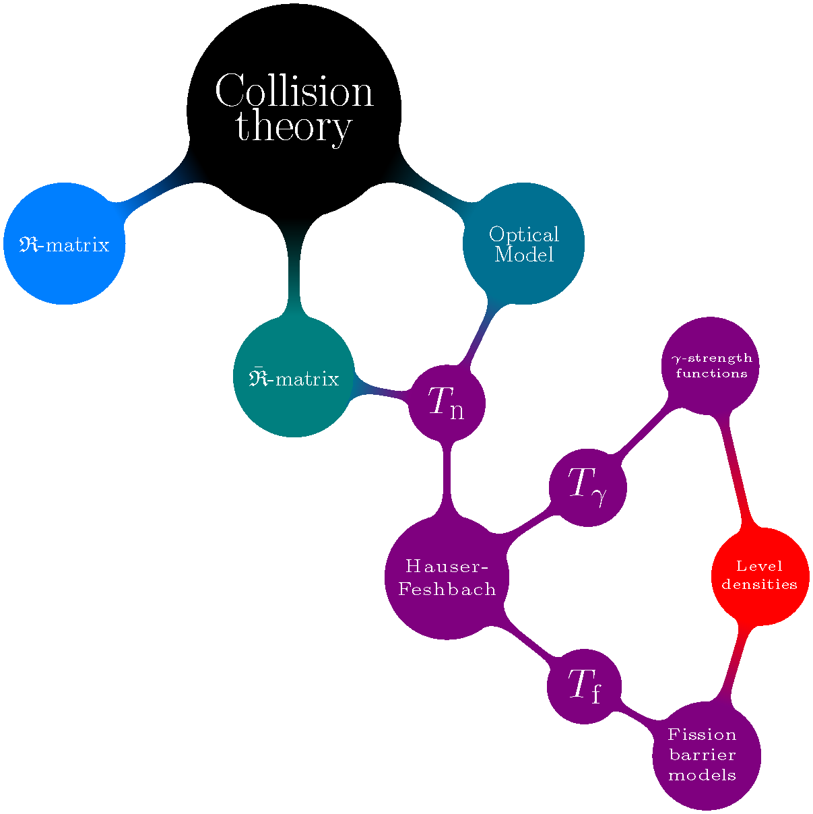
The evaluation of nuclear data
Theoretical models
Microscopic approaches
QRPA/JLM
γ Strength functions
Fission
Level densities
Fusion reactions
Phenomenological models : parameters are vectors of uncertainties

Slide 7
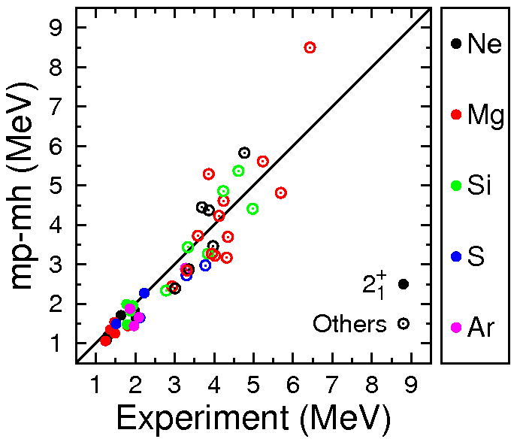
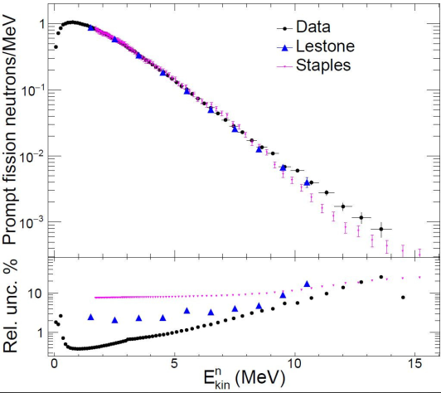
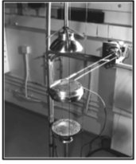
The evaluation of nuclear data
Measurements
Fundamental Observables
« Nuclear data » observables
« Integral » observables
Basic/Universal
Information
Targeted information on an observable of an isotope
Information on several isotopes/observables
Excitation energies
PFNS ^{239,240}Pu and ^{235,238}U
CEA/LANL
Critical S/A ²³⁹Pu, ^{235,238}U … et al.
Evaluation of statistical and systematic uncertainties ; Discrepancies, …

Slide 8
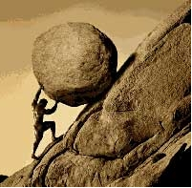
Uncertainties ?
Evaluator‘s perspective
User’s pespective
  Nuclear data are evaluated with models, differential measurements and “validated” on integral experiments (mimic of applications)
  Quantifies the level of knowledge (what we know)
  Quantifies the level of unknown
  It is a commitment ….
  Excellent activity to understand the physics of your model as it relates to reality !
  Applications needs nuclear data and want to asses a level of confidence in their use:
    validation of these ND (C/E of ICSBEP/IRPHEP/… benchmarks)
    Uncertainty evaluated and propagated
  Impact on applications : calculations is mandatory but…difficult…
  What about uncertainties validation ?
Both……
Long standing activity of data assimilation of integral experiment in reactor physics (FR and more recently PWR/BWR)
→high uncertainty reduction for reactors….Questionable…still in debate ; Adjusted ENDF library …in debate as well
→Transposition …. A mock-up or a critical S/A is not a commercial reactor, but, …

Slide 9
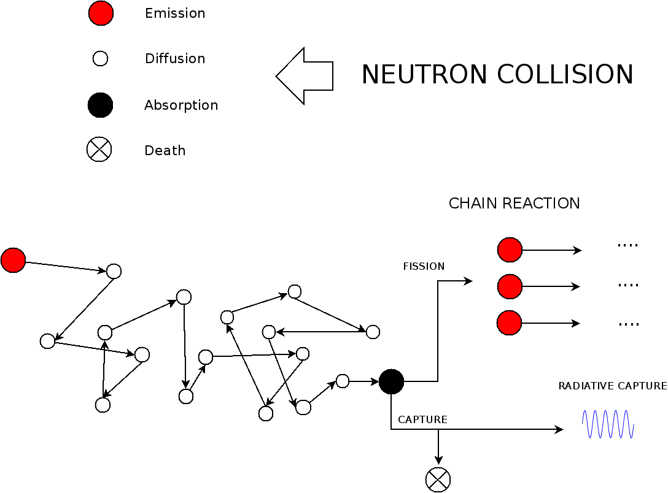

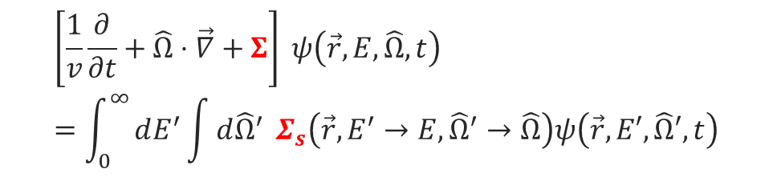
Uncertainties needs ?
Example of neutron transport in matter
Boltzmann equation (one of them…)
The unknown: the neutron flux (n/cm²/s) $ψ\left(\vec{r},E,\hat{Ω},t\right)$
Several types of nuclear data (in red): cross sections, spectra/multiplicities…
+ Evolution of materials under flux + delayed neutrons + …
$$\left[\frac{1}{v}\frac{∂}{∂t}+\hat{Ω}​⋅​\vec{∇}+Σ\right] ψ\left(\vec{r},E,\hat{Ω},t\right)=\int_{0}^{∞}{dE^{′}\int{d\hat{Ω}​^{′}} }Σ_{s}\left(\vec{r},E^{′}→E,\hat{Ω}​^{′}→\hat{Ω}​\right)ψ\left(\vec{r},E′,\hat{Ω}′,t\right)$$
$$+\sum_{x}{\frac{1}{4π}}\int_{0}^{∞}{d}E^{′} {{χ_{x}\left(\vec{r},E^{′}→E\right) ν}_{x}(E^{′},E)Σ}_{f,x}(E′,\vec{r}) φ(\vec{r},E^{′})+S_{ext}(\vec{r},E,\hat{Ω},t)$$
Due to the intensive use of Monte Carlo calculations and the reduction of calculation biases, the final accuracy of neutron calculations depends more and more on the quality of the nuclear data used.

Slide 10
Next decade challenges and questions to be adressed
2
« We choose to go to the Moon. We choose to go to the Moon in this decade and do the other things, not because they are easy, but because they are hard,… » JFK, September 12, 1962
Some of these activities were discussed and looked since a few years

Slide 11
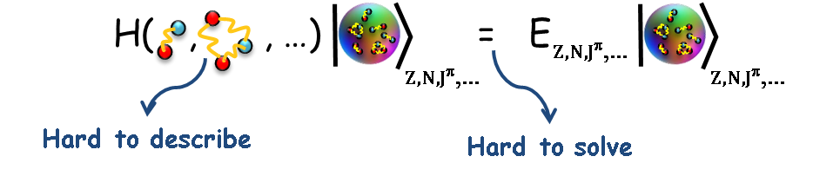
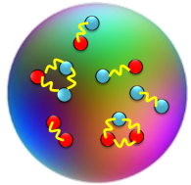
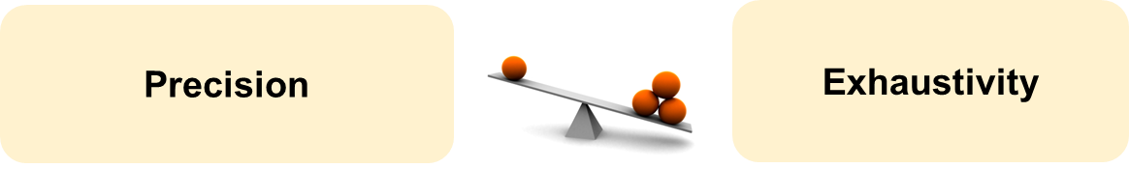
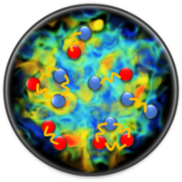
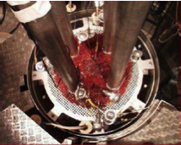
Uncertainty flow in nuclear physics
1
  Nuclear interaction
    Biases and uncertainties
    Power counting
Ab-Initio
Effective Nuclear Interaction
Effective Nuclear Interaction
2
3
  Impact of approximation (HFB, mean-Field, beyond mean-field,….)
  Propagation through HFB et al.
N-body-Nuclear Structure and Reactions
Elemental physical quantities: Energies, masses, Spins,…
  Complementary
  phenomenological models…
  to fit existing data…
5
Phenomenological Models
  HPC, GPU, QC,….
  IA (MetaModel)
4
Macroscopic physical quantities
Transmission, strength functions, fission yields…
Nuclear Data evaluation
Cross sections, angular distributions, spectra/multiplicities, fission yields
Benchmarks (Integral quantities)

Slide 12
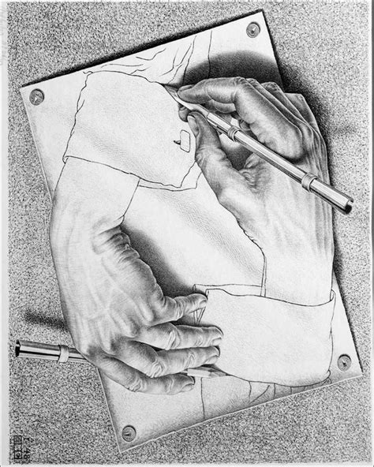
Experimental challenges : knowledge and uncertainties
Precision/Exhaustivity
Audacity/Boldness
1
  Metrology can help basic science
    High precision experiments
  Measurements can highlight new physics (SOFIA) → challenge to theoretician
  Important to propose innovative and out of the scope experiments
    Multi-observable (fission) / Difficult (n,xn)
    Observables for meta-stable/instable isotopes
  Standards*
    Absolute experiments…
3
2
4
5
  IA for experimental design and or analysis
    Smart and innovative integral experiments → reduce compensation / design to tackle one isotope/one energy domain/one reaction
    Smart and innovative differential experiments → IA for data reduction process (Signal/Noise)
*follow the standard, but don’t be the standard !

Slide 13

Evaluation (of uncertainties)
    Old/correlated/broad sensitivities to nd
    Compensation effects
1
  Validation of nuclear data uncertainties
  Mathematical sounded evaluations
  Model defects
  How to add microscopic approaches ?
5
2
  Integral experiments
    Recent advances : Transmission at Geel (CEA/JRC)
    PARADIGM : designed IA based experiments (LANL)
3
4
7
  Deal with discrepancies
    Unconsistent experiments
    Sounded choices can be made
  Transposition to applications
    sensitivities
    similarities
6

Slide 14
Conclusions
4

Slide 15
Nuclear data uncertainties
  Many theoretical and experimental challenges
  Some of them are addressed nowadays (see various P(ND)²-3 talks)
1
From ab-initio to evaluation, a long journey for uncertainties (and for nuclear data…)
2
Experiments as reality constraints
3
IA and particularly NN can be game changers
4
HPC is mandatory for evaluation, propagation or meta-modelization

Slide 16
Considerations for the future
  Needs for the future, mostly driven by the recent « revival of nuclear power »
    Extension of current reactors lifetime
    SMRs
    New reactor concepts proposed by newcomers
    Fusion
    But also radiation protection, radiotherapy, dosimetry, proliferation, monitoring
  A continuous international effort is needed to master the whole chain from the differential measurements to the inclusion of an evaluation into a library:
    Access to experimental infrastructure and investments in upgraded facilities
    Collaboration in theory, modelling and evaluation
    Identifying the nuclei that are critical for the different application communities
    Recommending the most pertinent measurements to improve nuclear data for each nucleus

Slide 17
P(ND)2-3, Perspectives on nuclear data for the next decade ; “Uncertainty” talks
5
  Nuclear Data versus Machine Learning, D. Neudecker
  ND for Reactors: What we need for GIV, for SMR, for all solutions, D. Bernard
  UQ Developments at the IAEA-Nuclear Data Section and Perspectives, G. Schnabel
  Uncertainty Quantification in Optical Potentials, C. Pruit
  What to expect in 2026 from microscopic nuclear modelling for keff calculations, D. Rochmann
  Recent Advances in Experimental Uncertainty Quantification for Fission Yields data, G. Kessedjian
  Innovations in the Surrogate Reactions Method: Integrating Microscopic Theory for Improved Nuclear Data, J. Escher
  Microscopic driven Optical Model Potentials, H. Arellano
  Constraining Direct and Pre-equilibrium Models through Microscopic Approaches, H. Sazaki
  Gogny Forces versus HFB, UQ, N. Pillet
  From nuclear structure to neutron-induced cross-section evaluations, G. Noguere
  A perspective on the role of integral benchmarks for improving nuclear data, S. Van Der Mark
  ….more or less all experimental talks !!!
6
2
3
4
5
2
4
4
4
4
4
4
1
2
4
4
5
1
2
3

Slide 18
It doesn't matter how beautiful your theory is, it doesn't matter how smart you are. If it doesn't agree with experiment, it's wrong.’’
Richard Feynman

Slide 19
Thank you
CEA DAM
cyrille.desaintjean@cea.fr

Slide 20
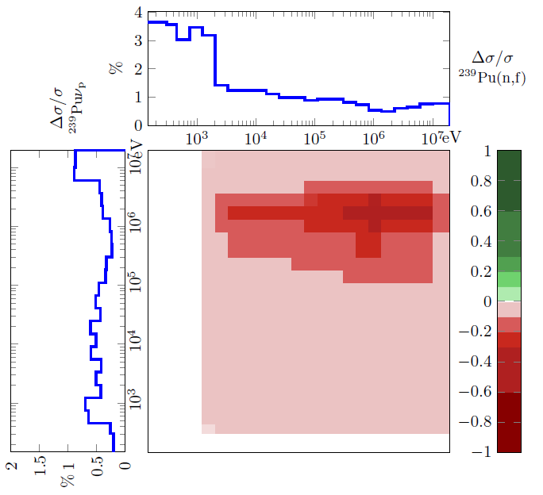
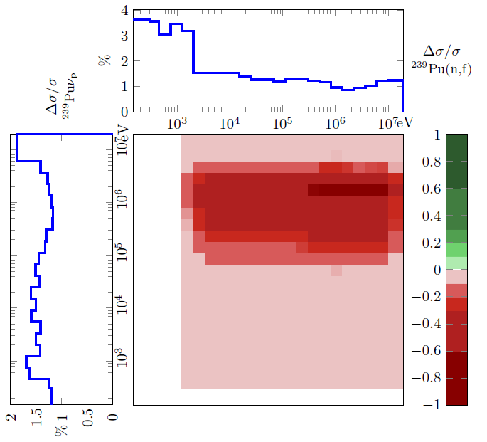
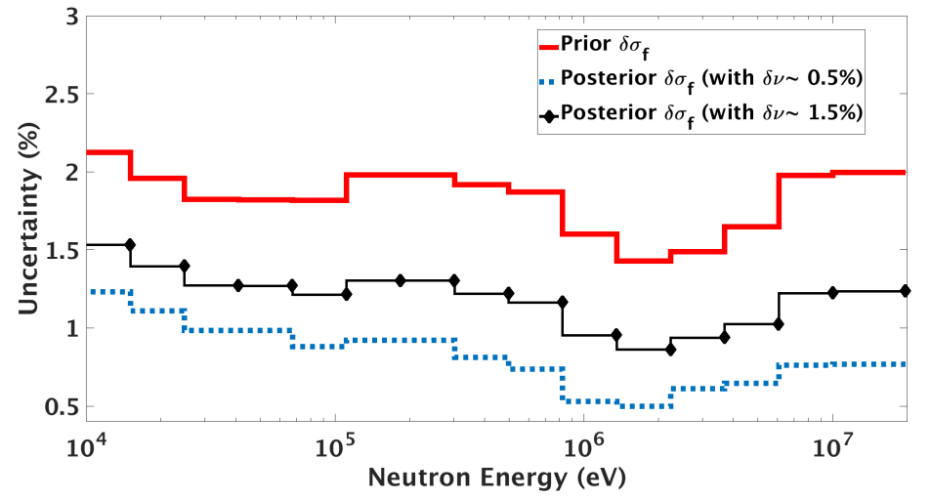
²³⁹Pu ; Integral data assimilation
Compensations~correlations
JEZEBEL
Full nuclear data adjustement (σ, χ, ν)*
Two scenarios:
(1) δν = 0,5% ou (2) δν = 1,5%
(1)
(2)
Sensitivity to “priors”
Correlations between (σ, χ, ν) →ENDF ; GND ?
Drastic uncertainty reduction ~ δI_{JEZEBEL}
(1)
Vital needs for fine diffrential measurements: contraints on « priors »
(2)
nubar measurements very important !!
(1)

