Slide 1

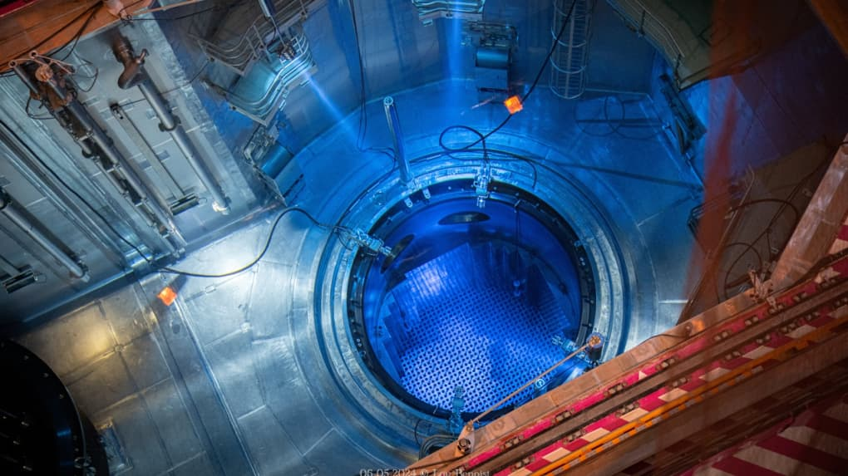
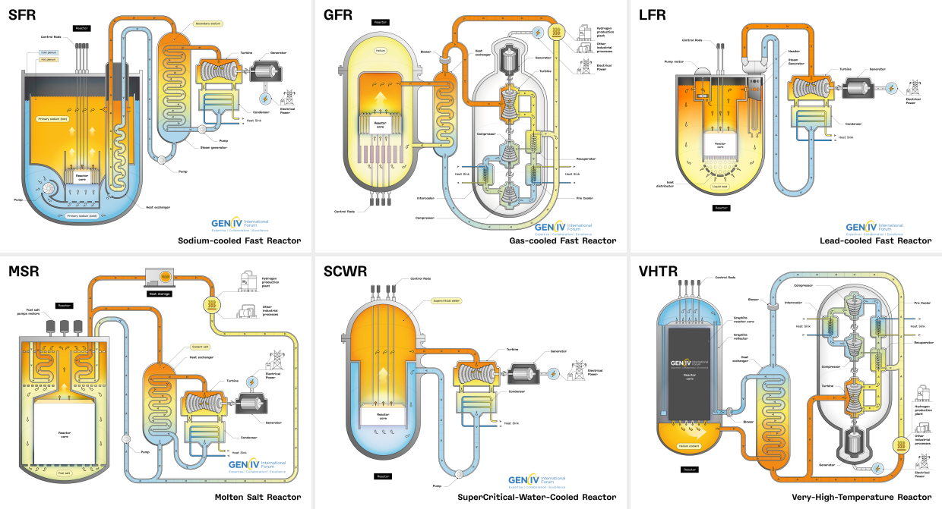
ND for Reactors: “What we need for GEN-III, GEN-IV, for SMR, for all solutions”
D. BERNARD, on behalf of all the « Nuclear Physics & Nuclear Data + applied neutronics & photonics for reactors » group at CEA

Slide 2
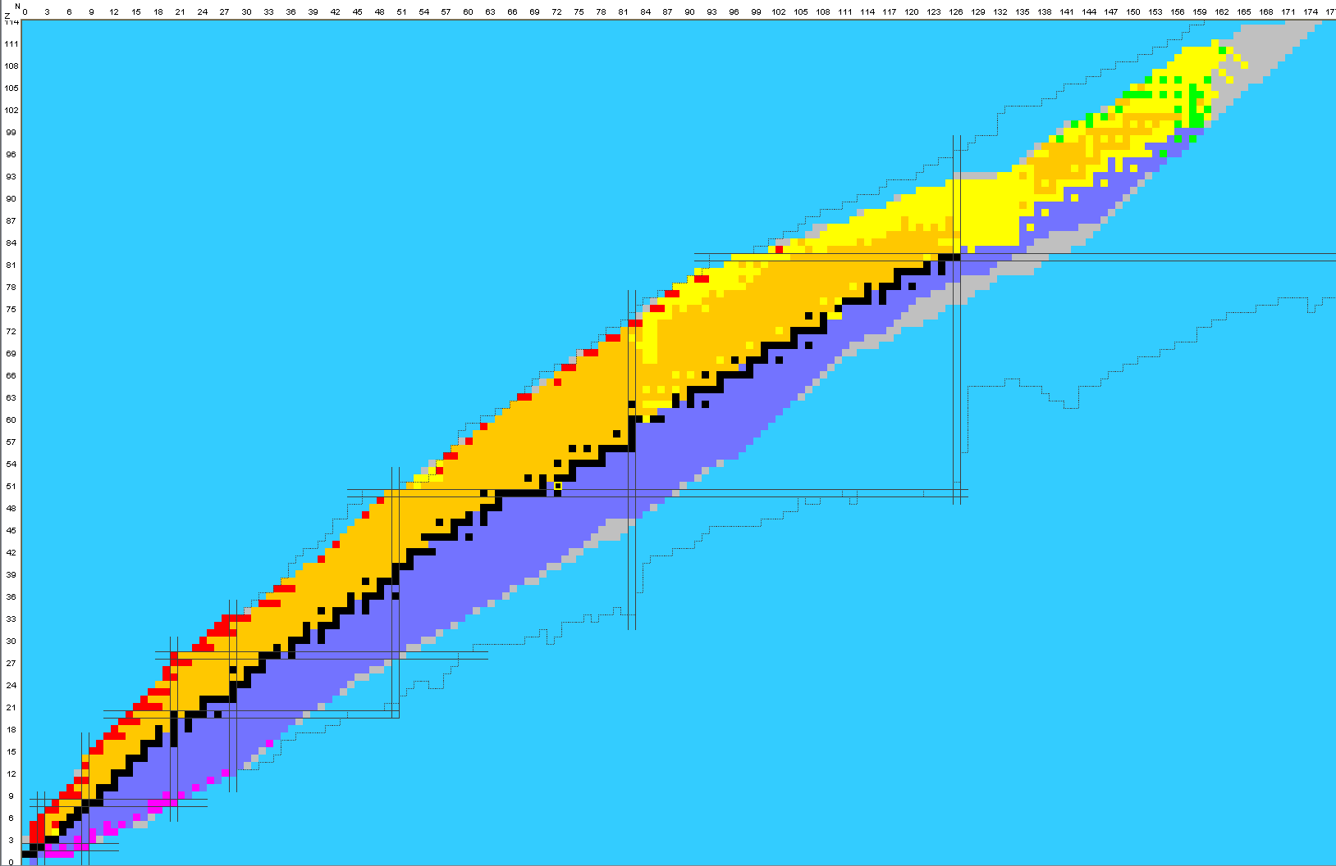
Nuclear (+Atomic) data needs for reactor applications
Application-driven activity :
For reactor physics under operating and accidental conditions, including instrumentation…(static+dynamic physics of neutrons)
For, back-end cycle, radiation exposure…
General goals/objectives: Ensure safety and competitiveness !
Methodology : Industrials have to propose operating realistic margins (safety vs $) to TSOs. In other words, they have to demonstrate the validation of reactor physics codes associated to a given nuclear data library.
Ways to achieve :
compare code&ND calculations to integral measurements or propagate ND prior uncertainty (ND assimilation is according to the desire…)
Select (specific) ND to be measure to reduce the C/E values or uncertainties via, for instance, Target Accuracy Requirement exercices
Short term actions (5-10 years) GEN-II & III
Long term actions (>10 years) GEN-IV, Fusion

Slide 3
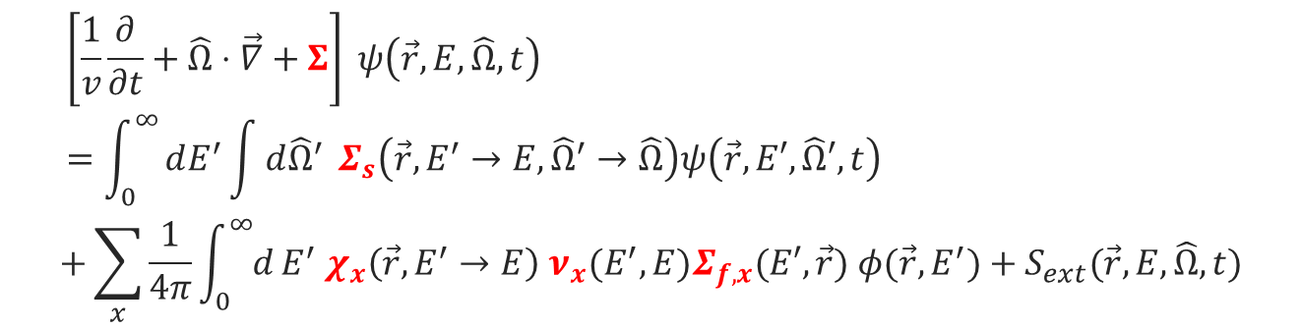
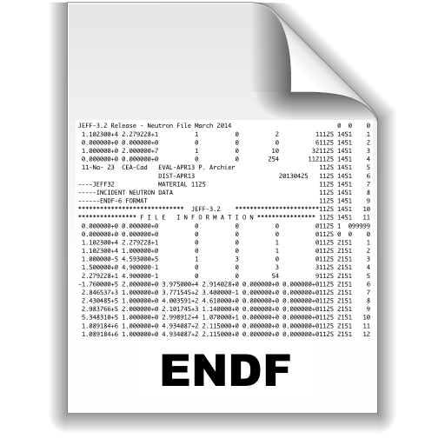
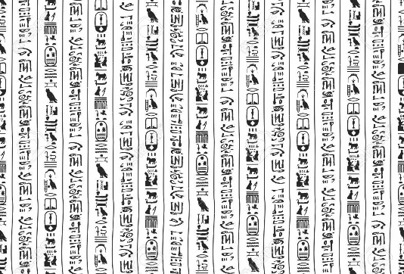
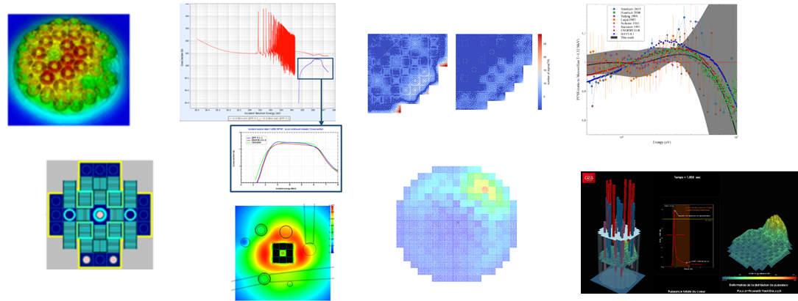
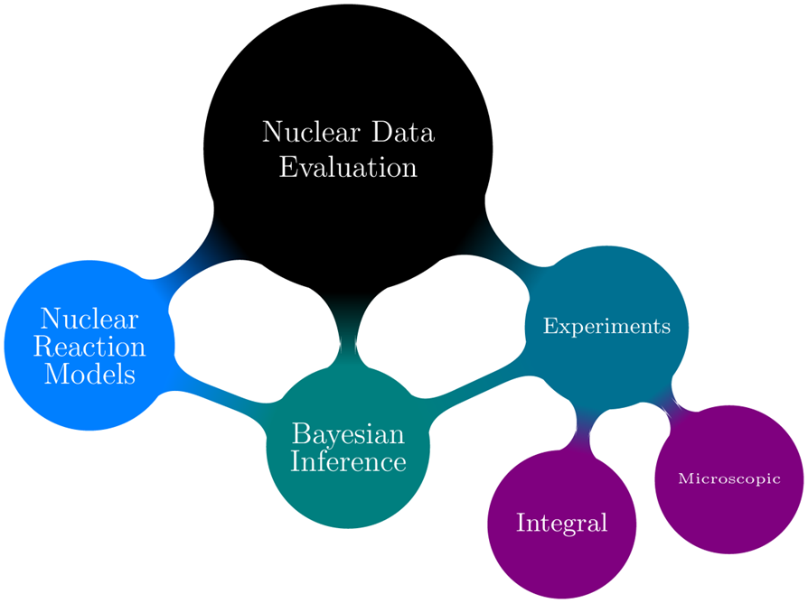
Reactor physics: neutron act as a gas without mutual interactions → Fokker-Planck Boltzmann non-relativistic mesoscopic equation
+ Bateman ODE equations
+ a derivation of both: the in-hour equation.

Slide 4
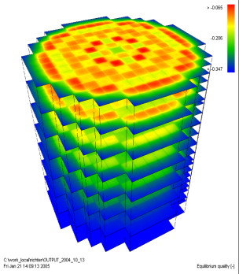
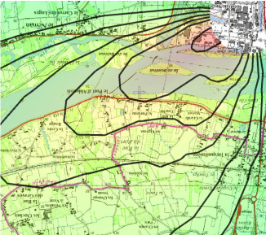
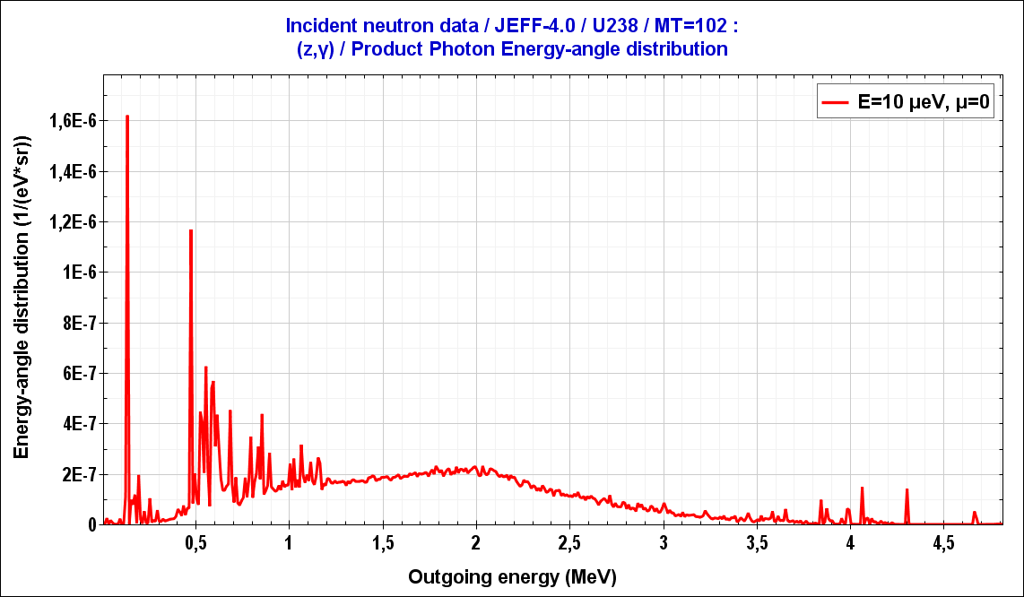
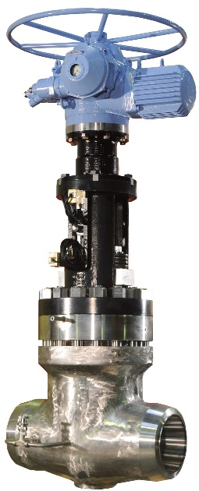
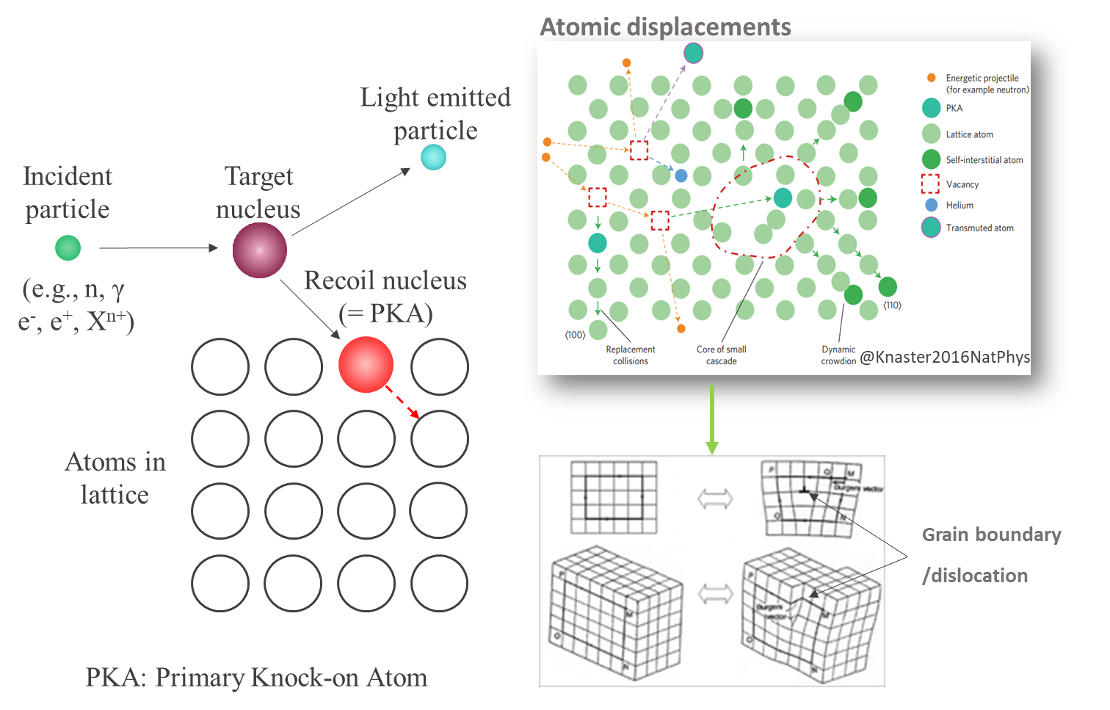
Nuclear Data for GEN-II+III current and actual reactors
12 main parameters:
AND
γ-heating in structural materials (prompts by capture/fission and delayed by activation/fission)
Vessel fluence and DPA (Prompt Neutron Fission Spectra, ⁵⁶Fe(n,n’)SAED)
Power over Activation (P/A) for in-core instrumentation, Self Power Neutron Detectors…
Neutronic emmisivity and spectrum of start-up sources (α,n) XS
Cladding rupture (Fission Gas Released → niFY), some devices are radiosensitives…
Neutron noise to prevent accident and to measure neutron dynamic→P(ν)
Target accuracy on LWR neutronics parameters is about 2 to 5 times lower than the a priori uncertainty (1σ) due to nuclear data.
@Santamarina, ND2007

Slide 5
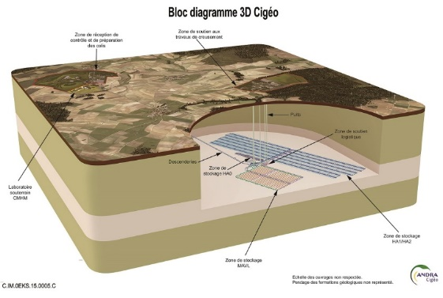
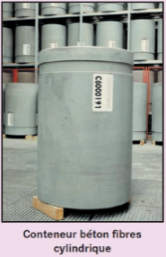
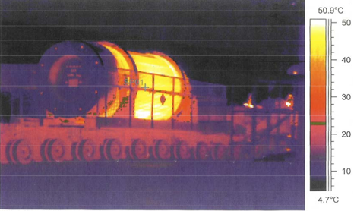
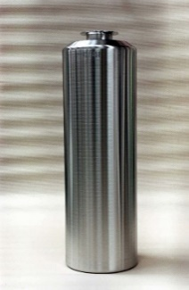
Nuclear Data for GEN-II+III fuel cycle
Gas inducing cladding pressure (fission yields), Tritium production (fuel via ternary fission and primary circuit via ¹⁰B(n_{FAST},t))
Primary circuit corrosion products: (n,lcp) reactions
Spent fuel caracterisation ([²³²U], [²⁴⁴Cm]…) for
radioprotection, Dose, Decay Heat (²⁴¹Am(n_{th-epi},γ)^{242g+m}Am, ²⁴²Pu(n,γ)²⁴³Pu(β⁻)²⁴³Am(n,γ)^{244g+m}Am(β⁻)²⁴⁴Cm)
Neutron rate emission (spontaneous fission and (γ,n)+(α,n))
Non destructive identification of nuclear waste packages/Safeguards and Nuclear Material Management : → (γ,f) Fission Yields

Slide 6
Example #1 of ND needs for GEN-III reactors
Prior uncertainties covariance propagation is about ±5% on radial assembly power maps on large and heterogeneous cores. This is leading to about ±10% on control rod worth !
Usual suspects (for different reactor configurations):
²³⁸U(n_{[2-5]MeV},n’_{cont}) plateau XS.
p(n_{[0.1-5]MeV},p)n : a IAEA standard, but still work to to !
p(n_{th},γ)d, very usefull for Big Bang Nuclear Synthesis, but for LWR aswell ☺
Eigen Value Separation

Slide 7
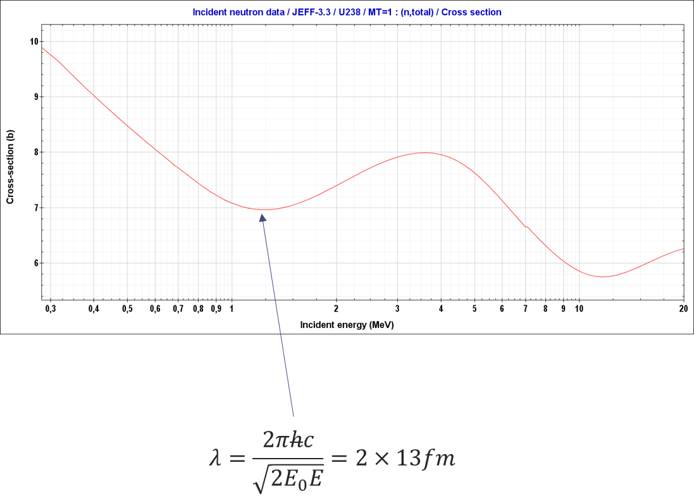
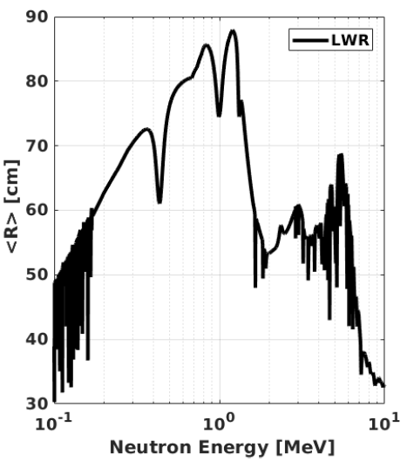
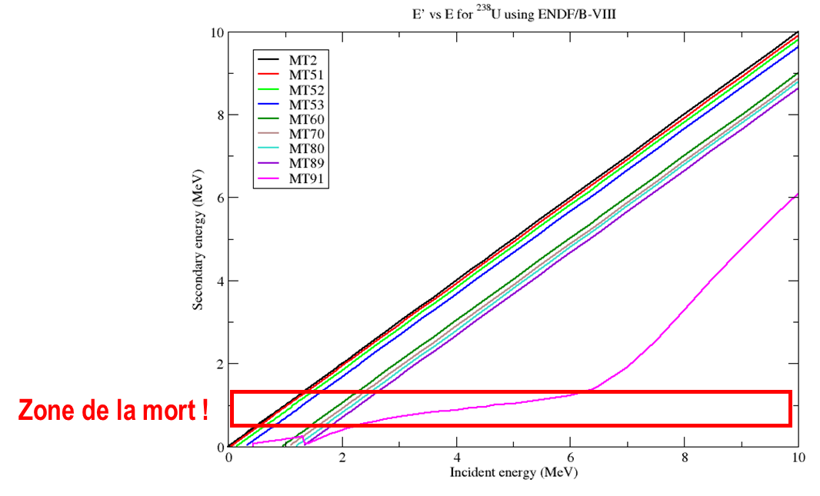

Example #1: ²³⁸U(n _{[2-5]MeV},n’) for almost all reactors
Lower XS value @1MeV because of Ramsauer-Townsend effect:
This gives large migration area to 1 MeV neutrons
This constrains the radial map in large LWR !
These 1 MeV neutrons are coming from ²³⁸U(n_{[2-5]MeV},n_{cont}’) !
Why inelastic from continuum ? Because of secondary K-M angle+energy distributions (MF6/MT91) !
The regime change between discrete and continuum has to be smooth:
TALYS, EMPIRE… : $\frac{∂^{2}σ_{\left(n,n_{i}^{′}\right)}\left(E\right)}{∂E^{′}∂\vec{Ω}}=\frac{∂^{2}σ_{\left(n,n_{cont}^{′}\right)}\left(E\right)}{∂E^{′}∂\vec{Ω}} ???$
Zone of interest

Slide 8
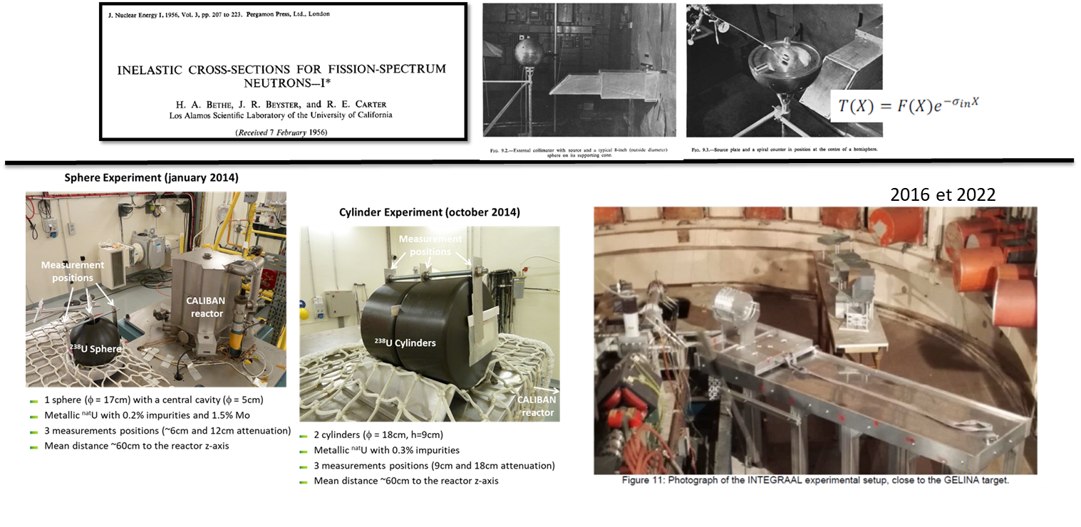
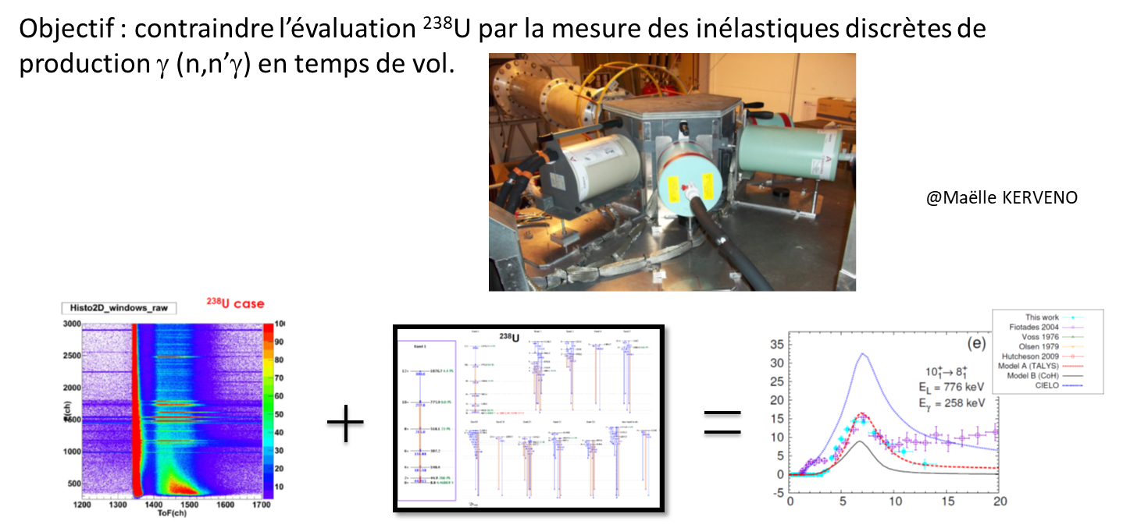
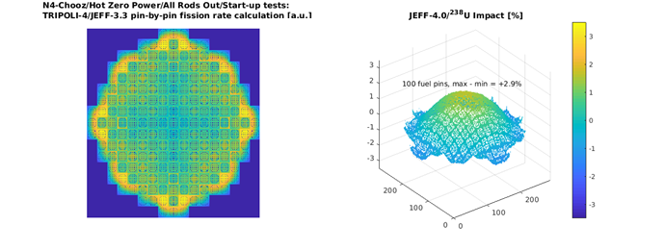
Example #1: ²³⁸U(n_{[2-5]MeV},n’) for almost all reactors
Lot of integral and ToF new experiments:
²³⁸U(n,n’γ) for which nuclear structure data are needed, even for ²³⁸U !!
At the end of the day, JEFF-4.0/²³⁸U+n solves partially the issue…but we still need some associated realistic covariances there…

Slide 9
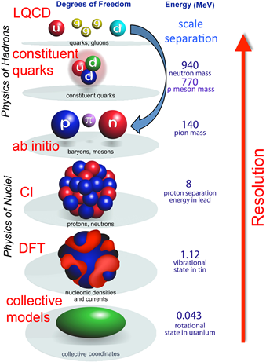

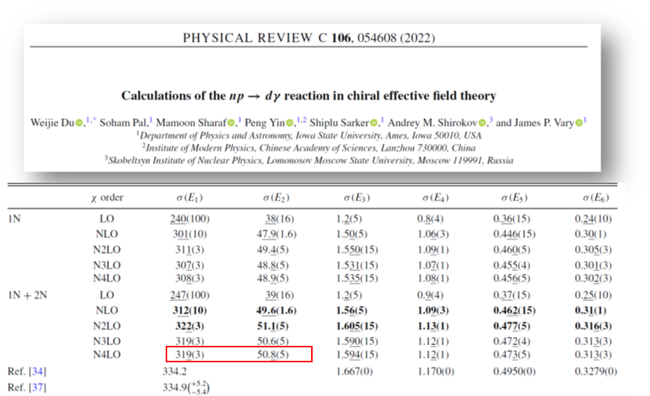
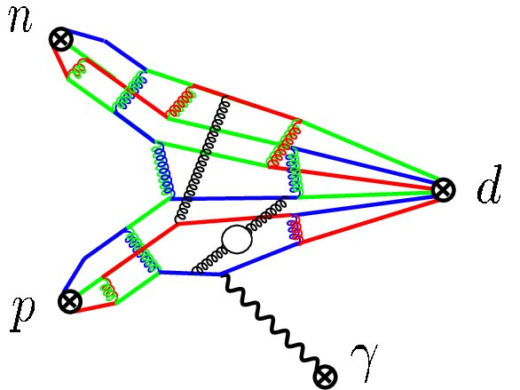
Example #2: ¹H(n_{th},γ) for GEN-III reactors
(n+p) system is evaluated mainly at US/LANL through phenomenological R-Matrix formalism including almost 6000 experiments (direct and inverse d+γ)…More experiments will not help…
Improvements are still needed for LWR temperature coefficients, radial power and reactivity.
My point: nuclear theory is always useful and will become essential ! Choose your dof:
Very encouraging results coming from basic nuclear χEFT theory and LQCD !
ENDF/B-VIII.1 : $σ_{p\left(nth,γ\right)}=\left(332.6±6.9\right) mb$
(C = 317.7 mb)

Slide 10
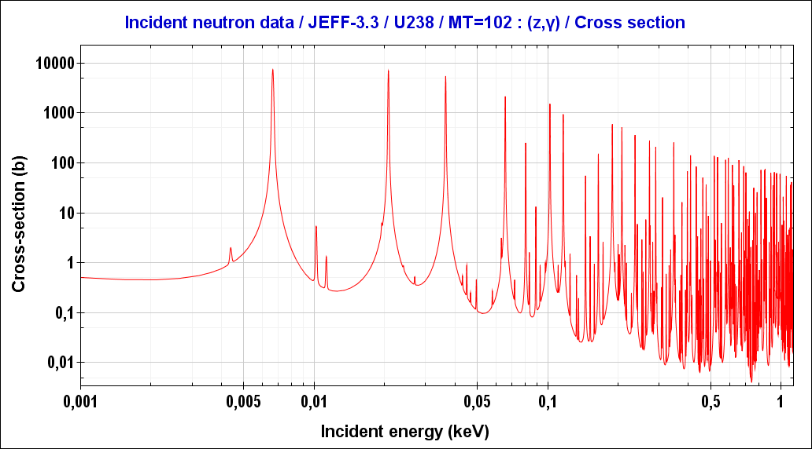
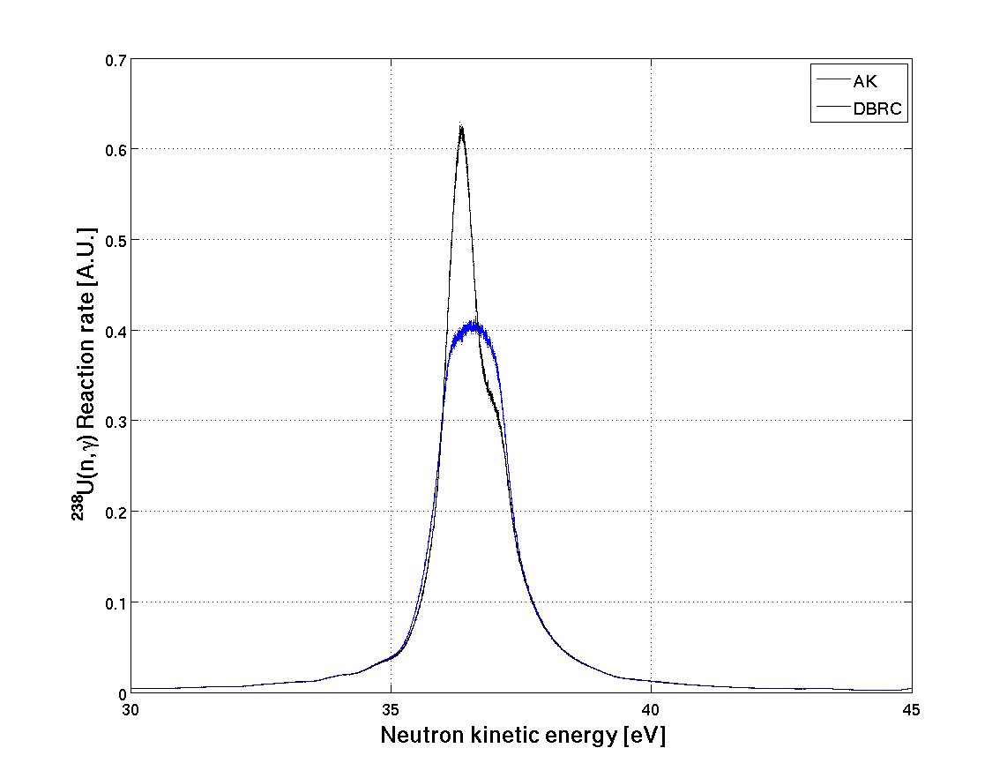
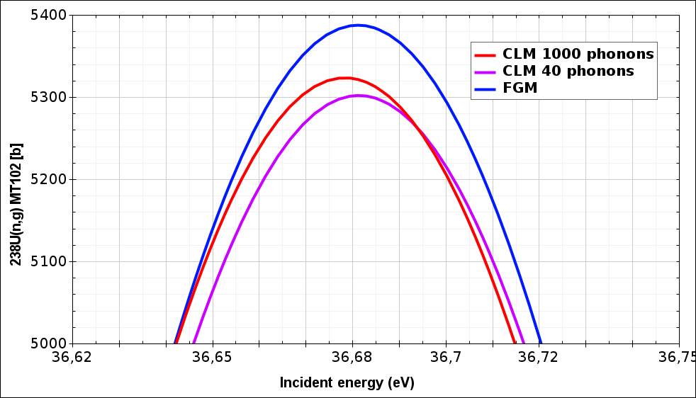
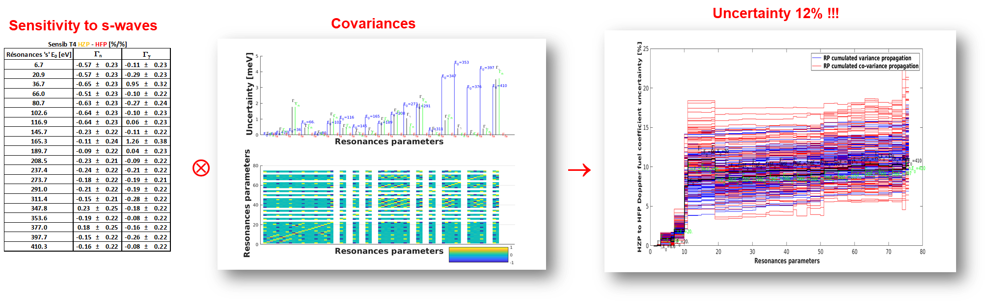
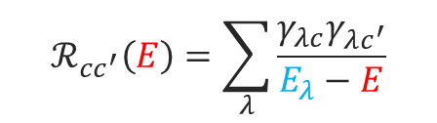
Example #3: ²³⁸U(n_{36eV},γ) for GEN-III reactors
$$\begin{aligned}ℛ_{cc^{′}}\left(E\right)=\sum_{λ}{\frac{γ_{λc}γ_{λc^{′}}}{E_{λ}−E}}\end{aligned}$$
Doppler reactivity coefficient
T=900K
Resonant Up-scattering
Need to reduce the uncertainty of the 36eV resonance parameters and phonon spectra of many molecules

Slide 11
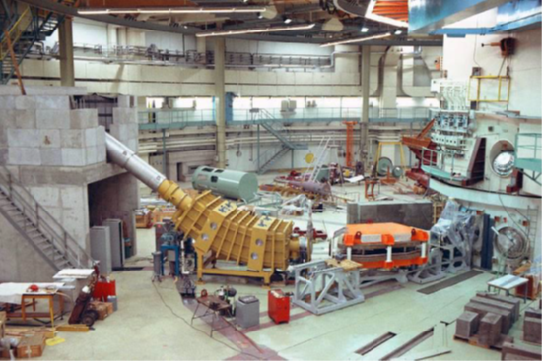
Example #4: neutron induced fission yields for GEN-III reactors
Fuel depletion (Post Irradiation Experiments = radiochemical analyses) and its reactivity, a long standing problem partly solved in JEFF-4.0
²³⁹Pu(n_{th},f)¹⁵³Sm cumulated yield measurement @ILL/Lohengrin to restore the JEFF-3.1.1/LWR reactivity versus burn-up.
+ New JEFF/4.0/¹⁴⁷Pm(n_{th+epi},γ)^{148g+m}Pm…+70pcm…

Slide 12
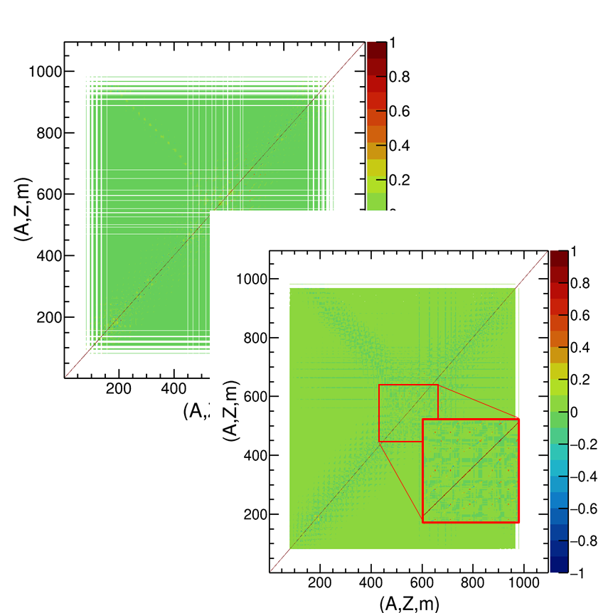
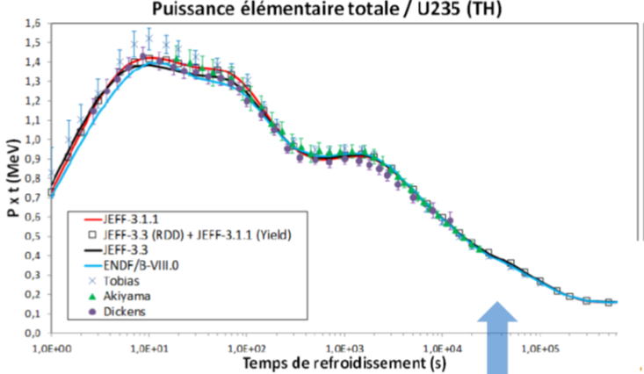
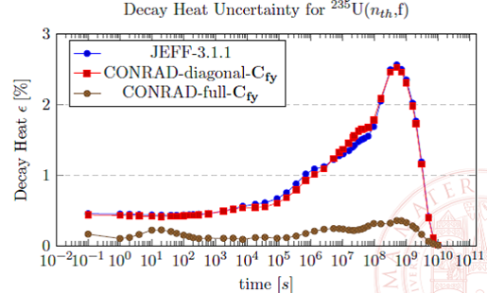
Example #4: neutron induced fission yields for GEN-III reactors
Decay Heat:
Decay heat
N-FY “experimental” covariance : JEFF-4.0 matrices
Cooling time [s]
Experimental correlations and charge invariance lead to decrease prior ND uncertainty

Slide 13
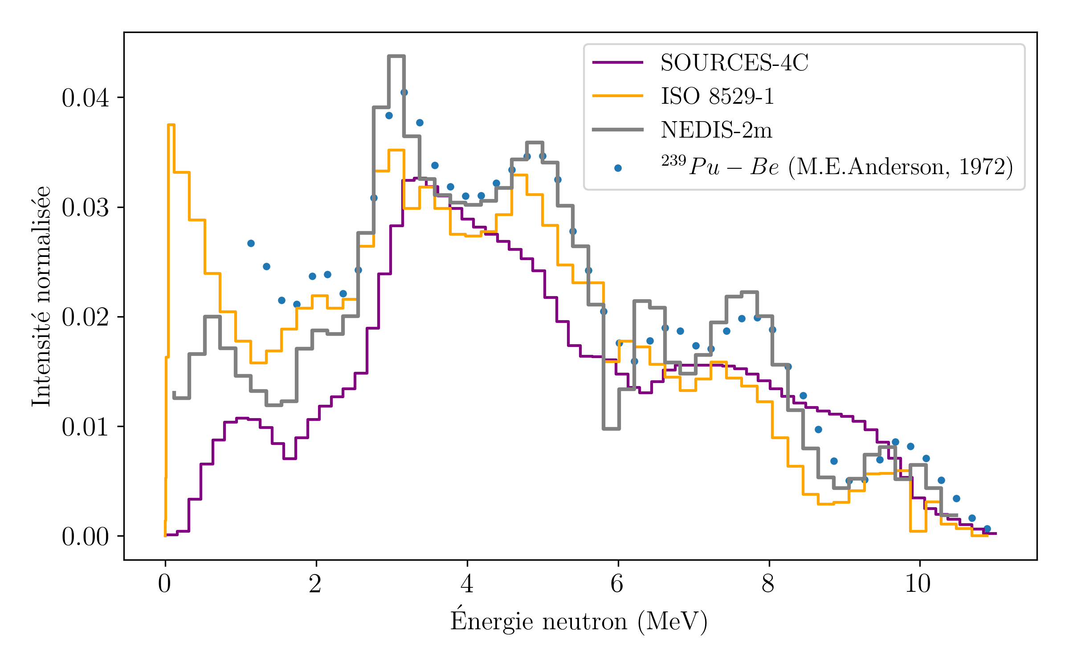
Example #5: neutron start-up sources for almost all reactors
During fuel loading (k_{eff}<1), i.e. subcritical approach, low (<1 MeV) and high (>3 MeV) energy neutrons are crucial for:
their amplification through ²³⁵U(n,f) and ²³⁸U(n,f),
their monitoring by ex-core detectors.
New JEFF-4.0/⁹Be(α,n₀)/SAD during core loading to prevent low reactivity accidents

Slide 14
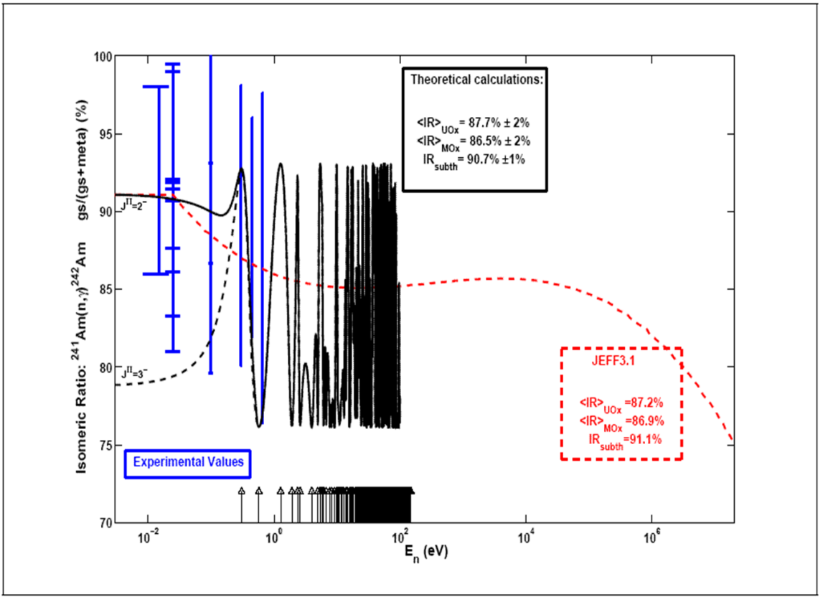
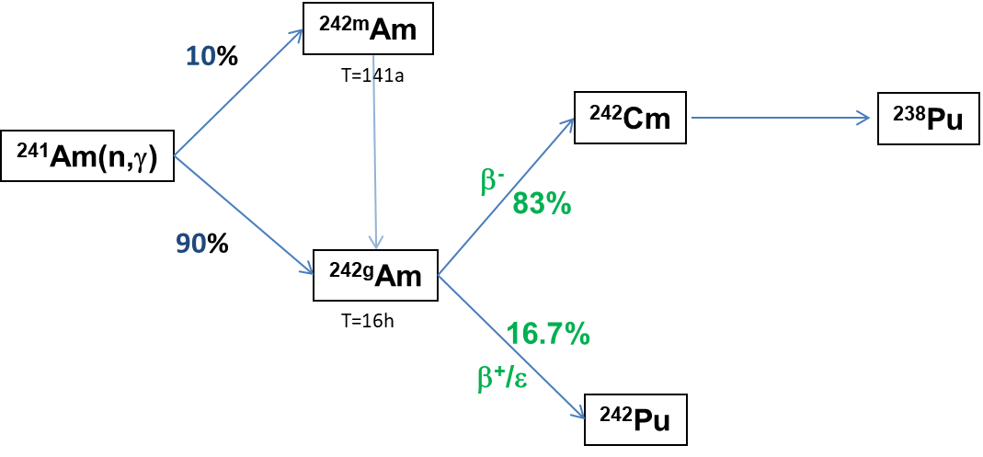
Examples #6 of ND needs for nuclear cycle
Photofission XS+yields for γ-inspection
²³⁷Np(n,2n) and ²⁴¹Am(n,γ) branching ratios resp. for radiotoxicity [²³²U] and decay heat [²⁴²Cm]
FIFRELIN/EM cascade calculations for the 2 J^{π} resonances with different LDM and PSF.

Slide 15
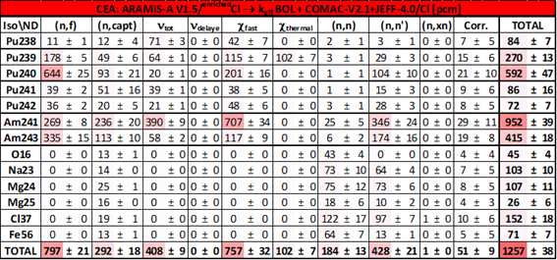
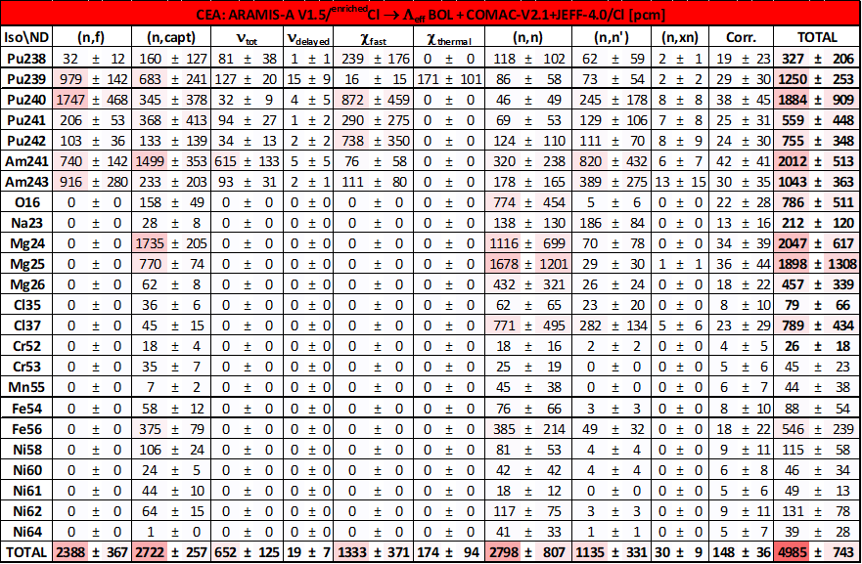
Longer term : GEN-IV reactors
Molten Salt Fast Reactor dedicated to transmute transuranians as an example.
²⁴¹Am(n_{FAST},f)PFNS is mandatory !
k_{eff} uncertainty [pcm]
Λ_{eff} (effective neutron generation time) uncertainty [pcm]

Slide 16
EU/SANDA project (2019-2023), http://www.sanda-nd.eu/
+ ²⁷Al(n,n&n’), ²⁷Al(n,γ), ¹³⁵Xe(n,γ) for JHR studies
+ Chlorine, Calcium, silicium isotopes, for High Level Waste disposal studies
+ Tungstene & Osmium for fusion applications

Slide 17
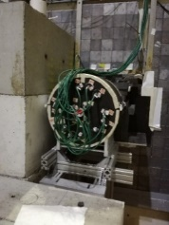
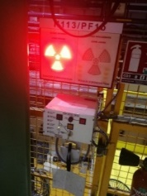
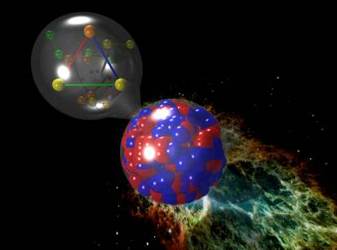
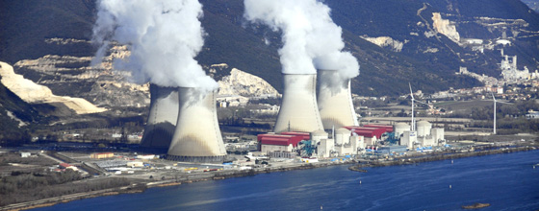
Conclusion
Thanks to HPC, Nuclear Data is now the main source of uncertainty in reactor calculations !
Structure data is mandatory to reduce data from independent FY or (n,n’γ) measurements
Reaction data: Big5 n-XS (^{235,238}U, ²³⁹Pu, ¹H, ¹⁶O)+ structural/absorbing materials, PFNS, SAD, SAED, P(ν), ρ(ω), n+γ induced FY, γ production…
Short lived nuclei XS (IAEA initiative few years ago?): ^{135m}Xe…
Delayed neutron emission (experiments are on going), spectra have to be re-measured or calculated (summation calculations will need to improve P_{xn} in Decay Data files)
SPND (⁵¹V(n,γ), ⁵⁹Co(n,γ), ¹⁰³Rh(n,γ)), dosimetric files…
Decay Data: full covariance is needed (β±/ε,α, γ/ICC, eA, X-rays…)…
Almost all you want to know : see HPRL website https://www.oecd-nea.org/download/wpec/hprl/

Slide 18
Merci ! Questions ?
iresne@cea.fr
Site internet CEA IRESNE
LinkedIn CEA IRESNE
CEA CADARACHE
13115 Saint Paul Lez Durance Cedex
France
david.bernard@cea.fr

