Slide 1
Constraining Neutron-Capture Cross Sections: Recent Results from the Shape and Inverse Oslo Methods
Mathis Wiedeking
Nuclear Science Division
mwiedeking@lbl.gov
https://nuclearscience.lbl.gov/
This material is based upon work supported by the U.S. Department of Energy’s National Nuclear Security Administration, the U.S. Department of Energy, Office of Science, Office of Nuclear Physics under Contracts No. DE-AC02-05CH11231 and the US Nuclear Data Program.

Slide 2
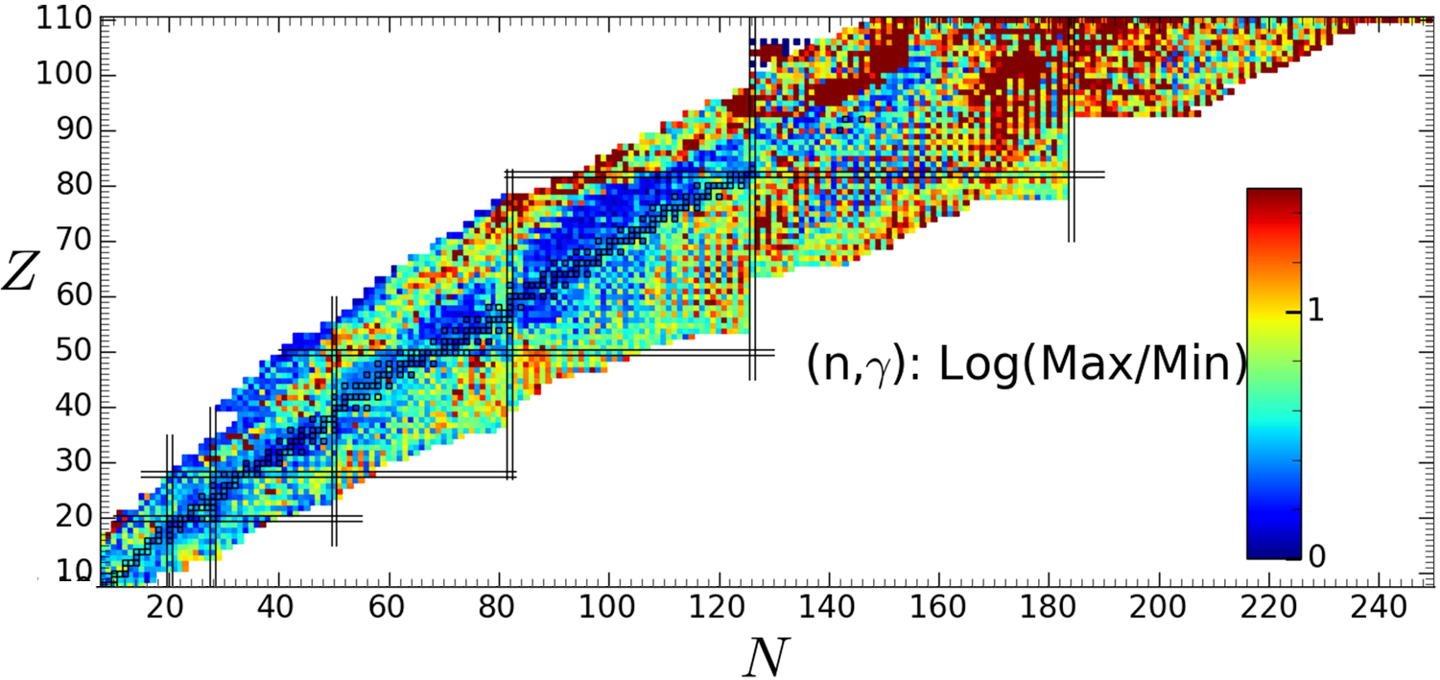
Quasi-continuum data: Outline
PSF/NLD
(n,γ) cross sections
Hauser-Feshbach
Applications
Nucleosynthesis
Wiedeking & Goriely, Phil. Trans. R. Soc. A 382, 20230125 (2024).

Slide 3
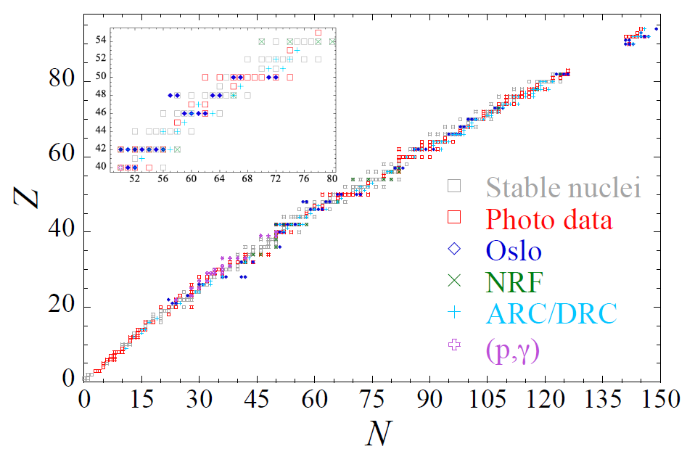
Quasi-continuum data: Outline
PSF/NLD
(n,γ) cross sections
Hauser-Feshbach
Applications
Nucleosynthesis
Wiedeking & Goriely, Phil. Trans. R. Soc. A 382, 20230125 (2024).
New approaches
Talk by Larsen:
Thursday 14:50
Shape Method
Inverse-Oslo Method
β-Oslo Method
S Goriely et al., Eur. Phys. J. A 55, 172 (2019).

Slide 4
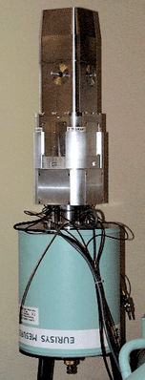
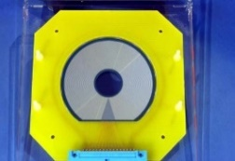
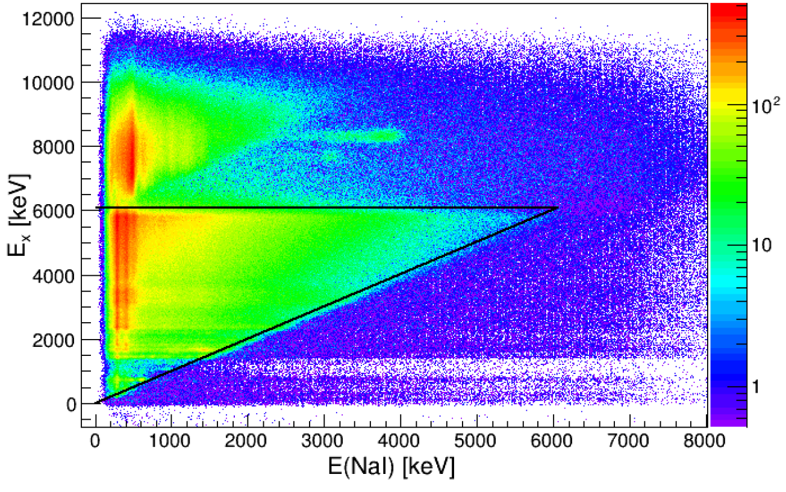
Measuring the PSF and/or NLD
Photonuclear Reactions (>S_{n})
Primaries from n-capture (>S_{n})
Nuclear Resonance Fluorescence (<S_{n})
Two-step cascade, n/p capture (<S_{n})
Inelastic p scattering with polarized beam (<S_{n} and >S_{n})
Primaries from p-capture (>S_{p} and <S_{n})
Primaries from charged particle reactions (<S_{n})
Oslo, β-Oslo, inverse Oslo Methods
Ratio/Shape Methods
α
Si ΔE-E
telescope
beam
Target nucleus

Slide 5
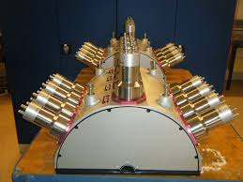
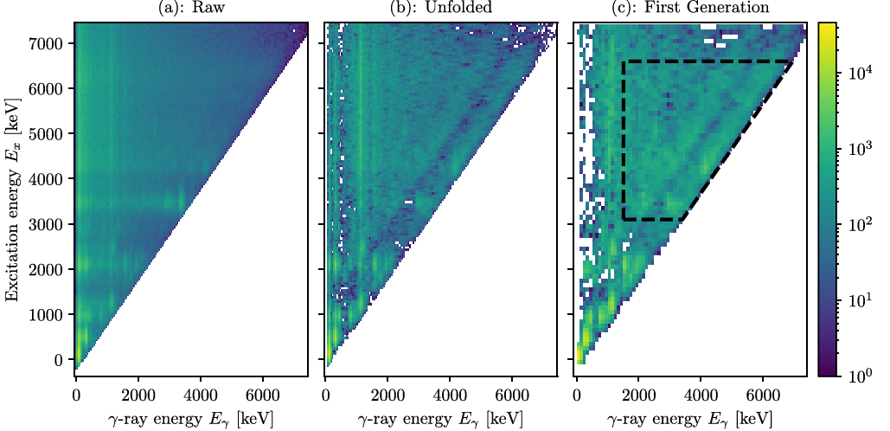
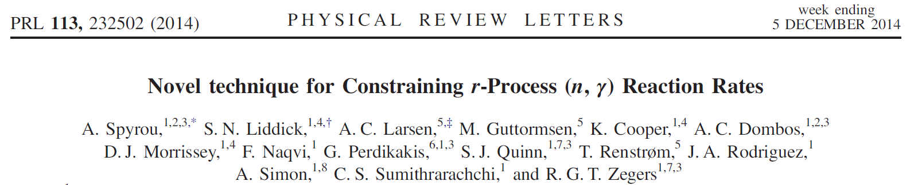
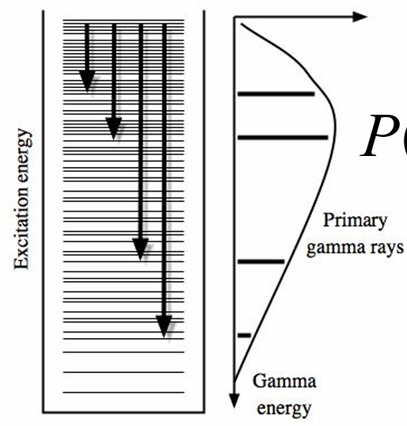
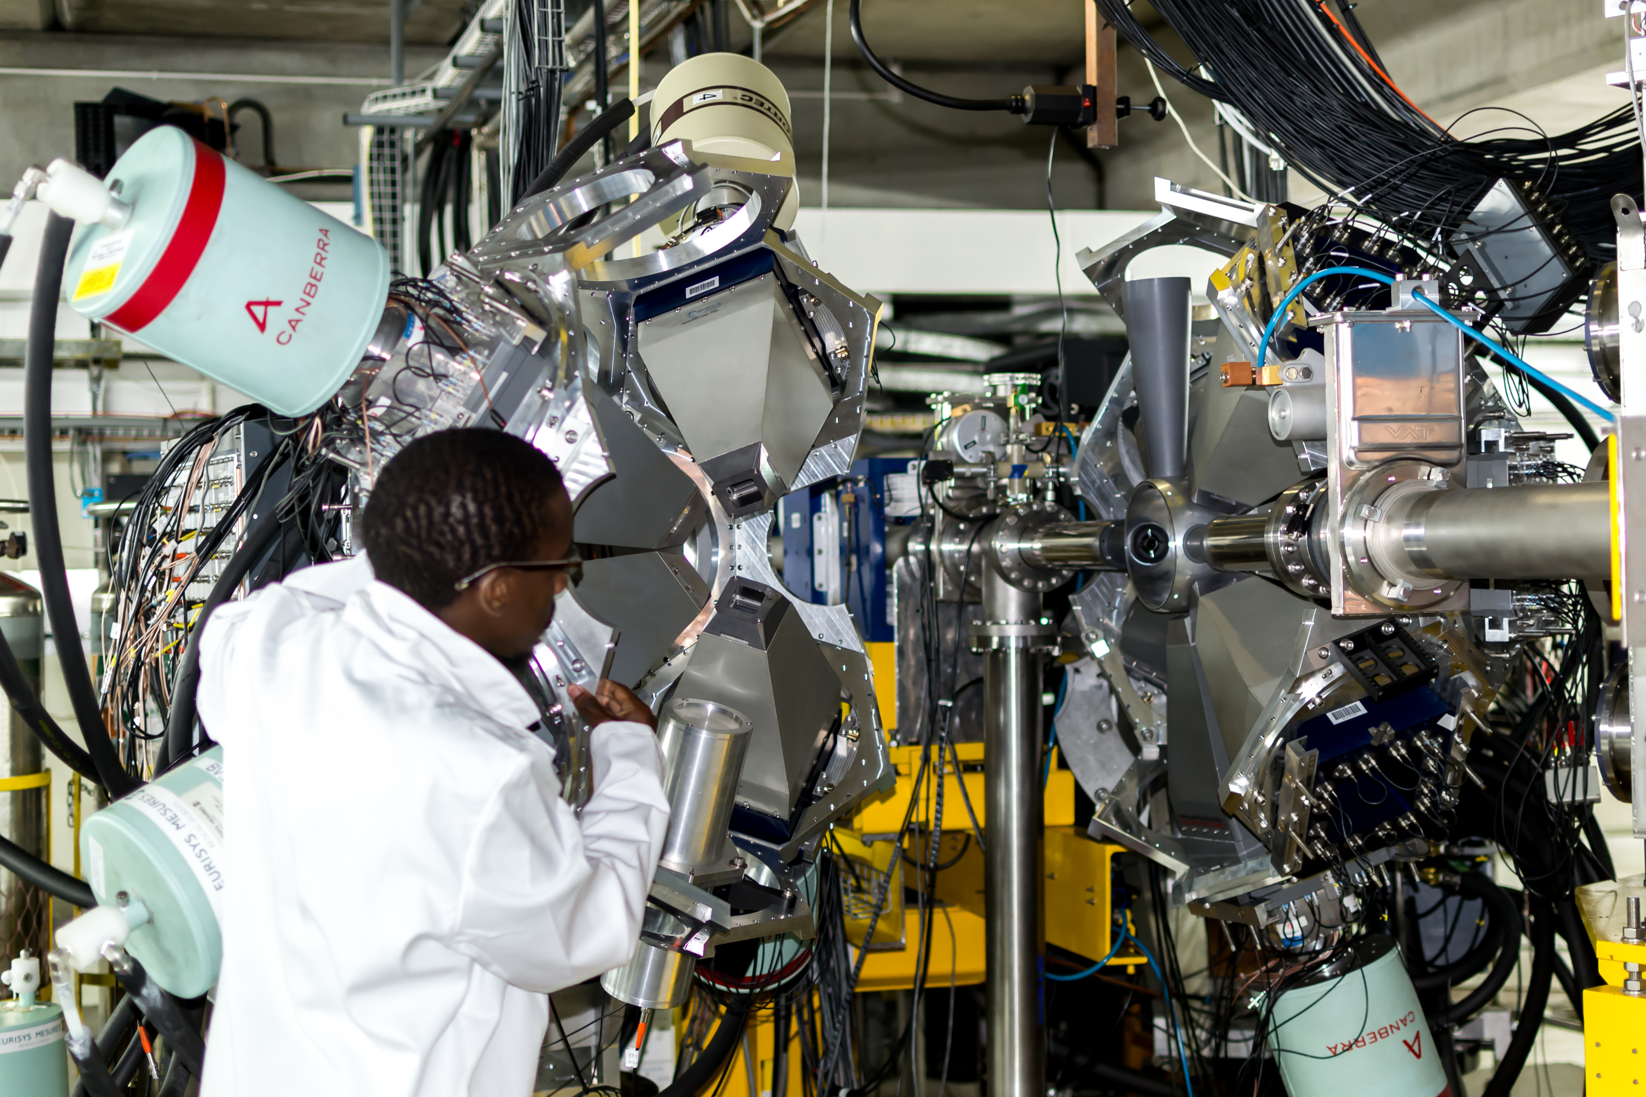
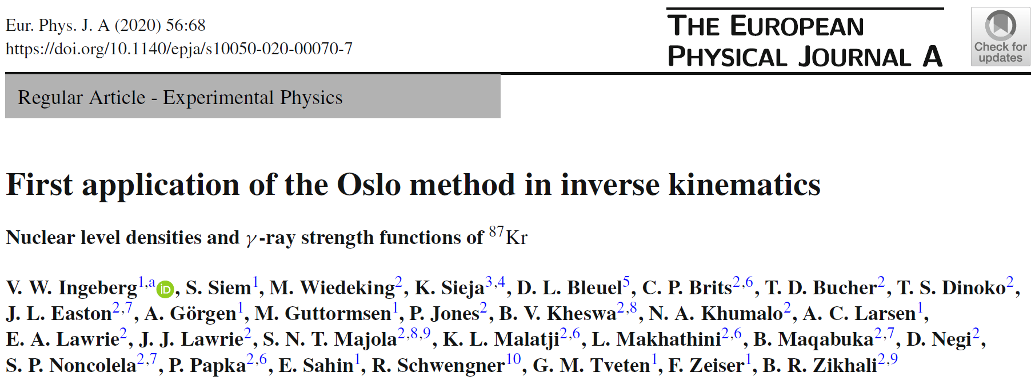

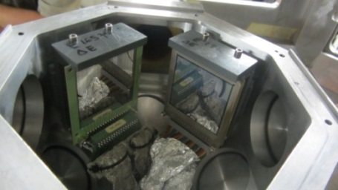
Oslo Methods
“Traditional” Oslo method
Beta-Oslo method
First for NLDs and PSFs to be measured away from stability.
Picture from: https://groups.nscl.msu.edu/SuN/SuN_photos.php
Ingeberg et al., Phys. Rev. C 106 054315 (2022).
Inverse-Oslo method
NLDs and PSFs from inverse-kinematic reactions. Applicable to stable and RIB facilities.
Notes:
The first generation γ-ray distribution (yellow triangle) is given by the product of the level density ρ(Ei − Eγ)andtheγ-ray transmission coefficient Tγ(Eγ).

Slide 6
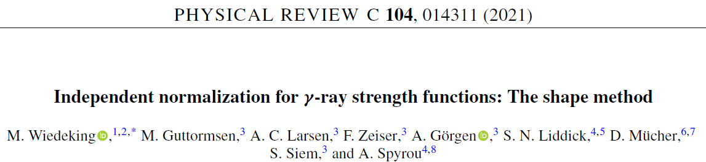
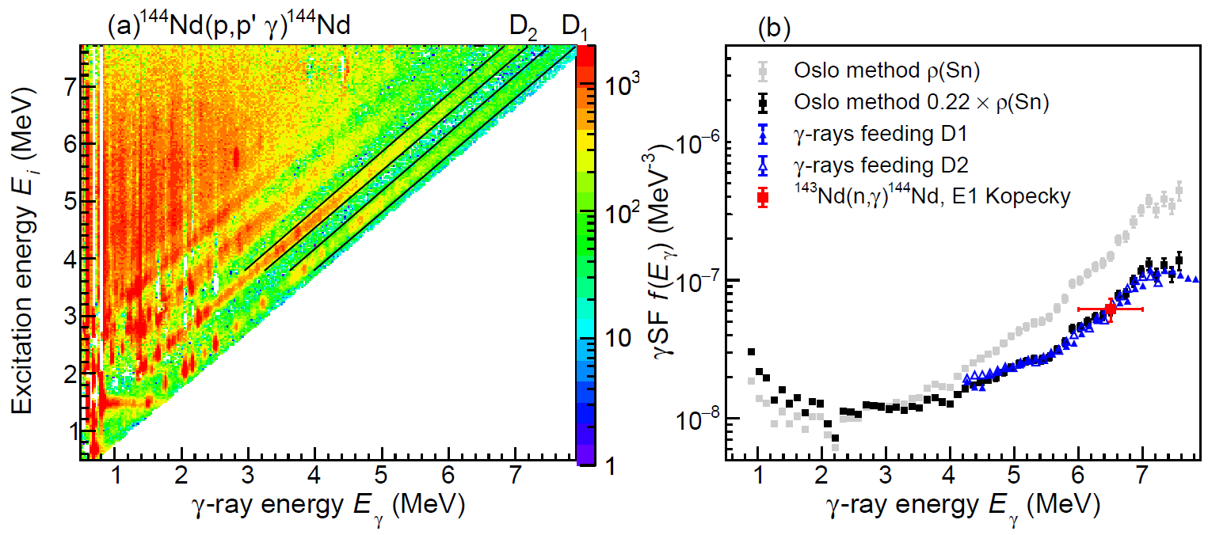
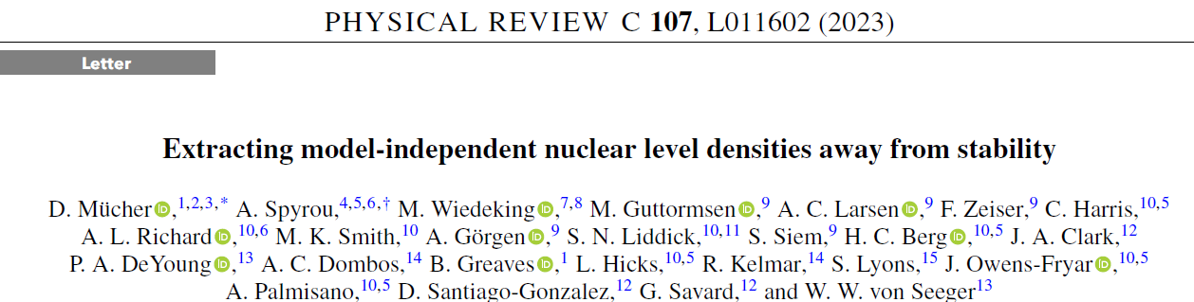
Shape Method
D₀ is not known.
No standard approach in absence of D₀ .
Unambiguous identification of origin and destination of primaries.
Functional form is retained between primaries from same excitation energy bin.
Concepts from Average Resonance Capture, Ratio, and χ² methods.
Guttormsen, Ay, Ozgur et al., Phys. Rev. C 106, 034314 (2022).

Slide 7
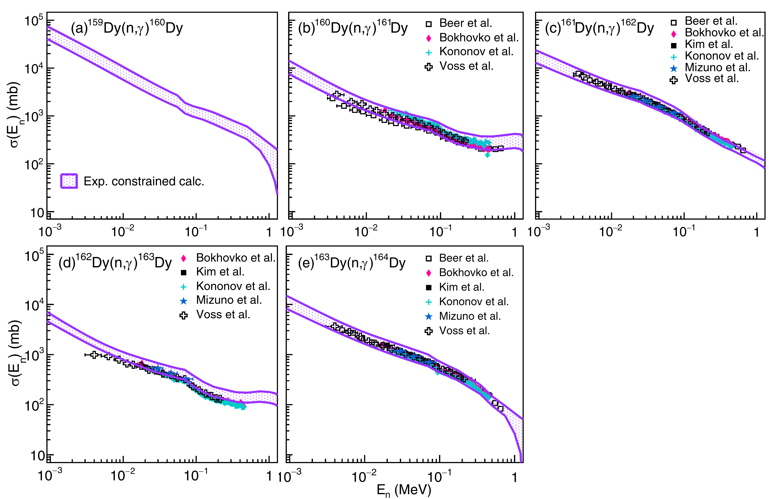
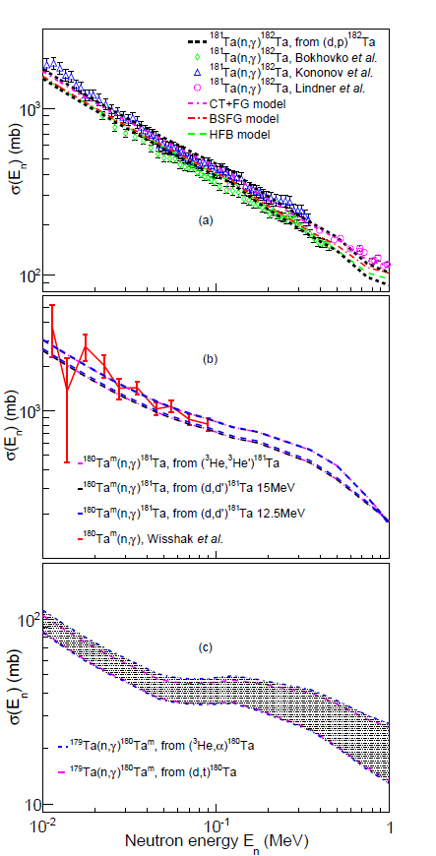
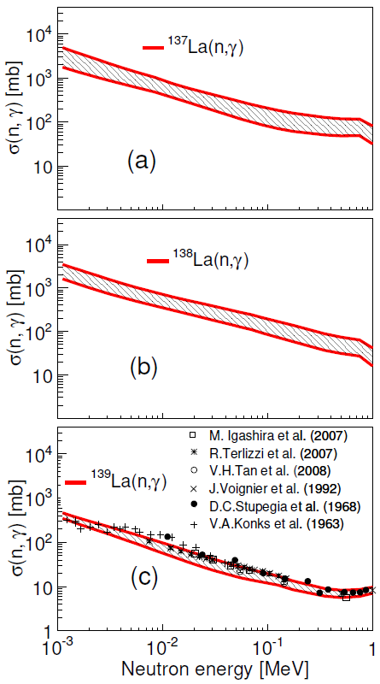

(n,γ) capture cross sections from PSF and NLD
Renstrom et al.,
Phys. Rev. C 98, 054310 (2018).
Satisfying agreement with results from direct cross section measurements.
Kheswa et al, Phys. Lett B 744, 268 (2015).
Kheswa et al, Phys. Rev. C 95, 045805 (2017).
Matatji et al, Phys. Lett. B 791, 403 (2019).
Brits et al., Phys. Rev. C 99, 054330 (2019).

Slide 8
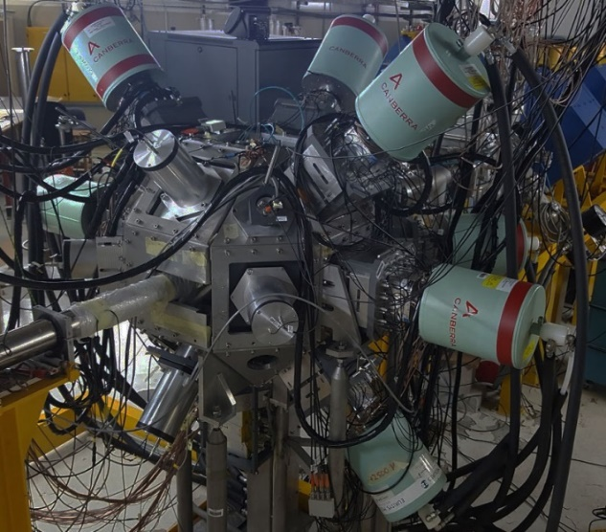
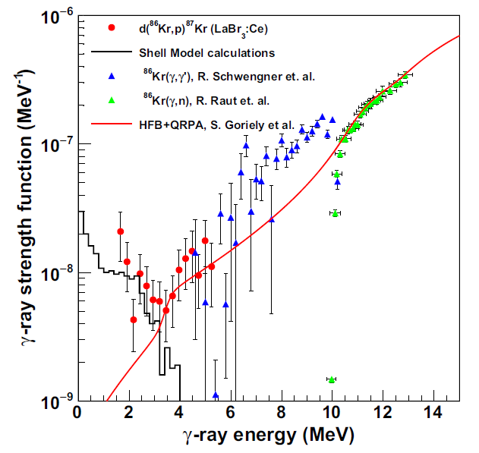
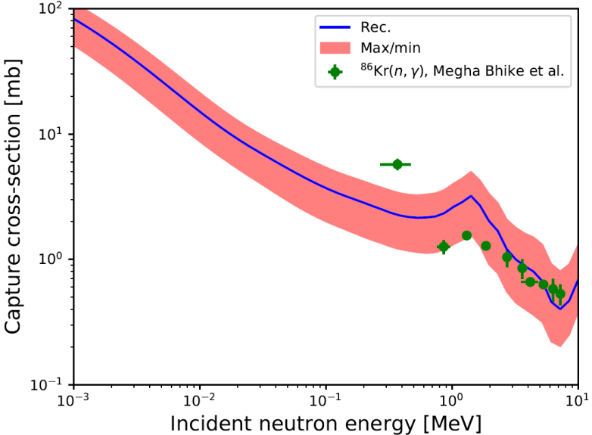
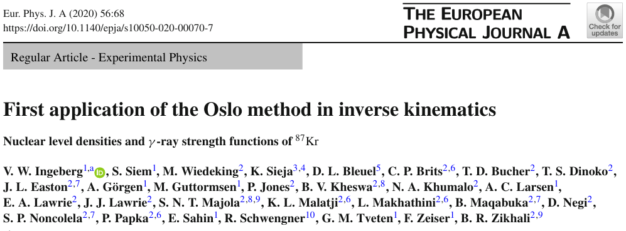

D(⁸⁶Kr,p)⁸⁷Kr - 300 MeV: Inverse-Oslo
300MeV ⁸⁶Kr, CD targets. HPGe + LaBr₃(Ce) + Silicon
First: NLD and PSF from inverse kinematics.
Complementary to Oslo & Beta-Oslo Methods.
Applicable to stable & radioactive beam facilities.
iThemba LABS: ¹³³Xe, ⁸⁵Kr, ⁸⁷Kr
Texas A&M: ⁵⁸Fe
HIE-ISOLDE CERN: ⁶⁷Ni
MSc project
Vetle Ingeberg

Slide 9
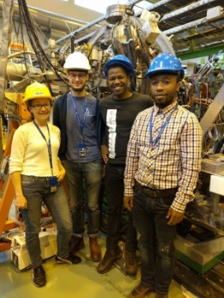
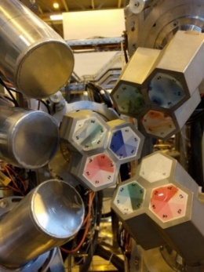
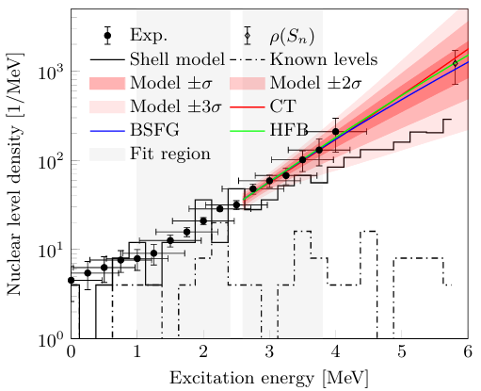
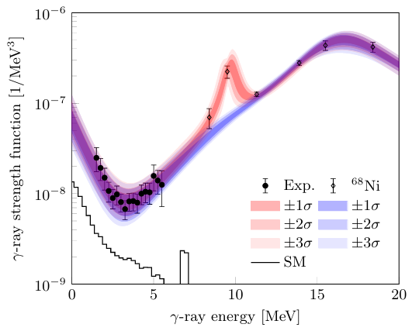
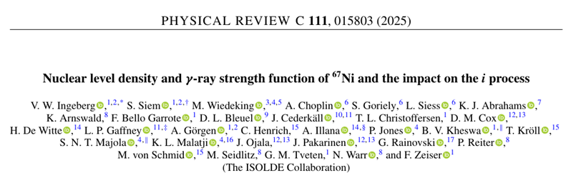
D(⁶⁶Ni,p)⁶⁷Ni - 302 MeV: Inverse Oslo
PhD project
Vetle Ingeberg
d(⁶⁶Ni,p)⁶⁷Ni with 4.5 MeV/u
CD target 0.7mg/cm²
3.5x10⁶ pps for 140 hours
Miniball + LaBr₃(Ce) + C-REX
LaBr: ~320k p-γ, Miniball: ~1.1m p-γ

Slide 10
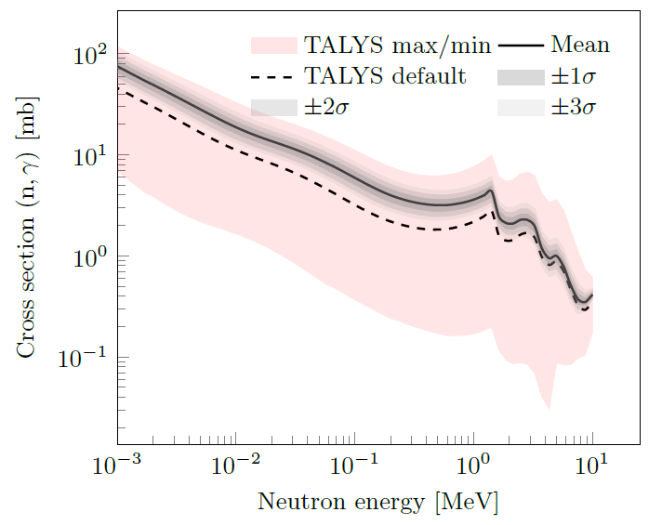
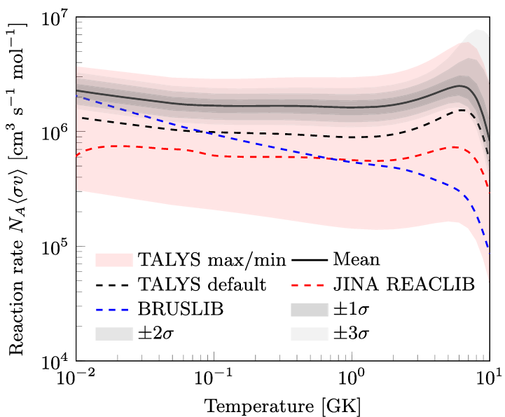
⁶⁶Ni(n,γ)
V. Ingeberg et al, Phys. Rev. C 111, 015803 (2025).

Slide 11
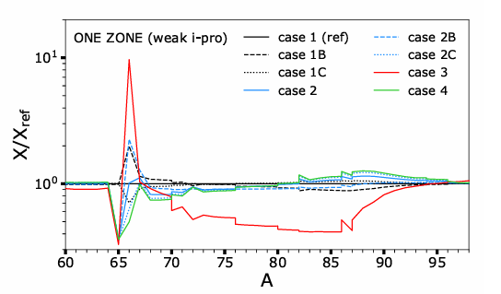
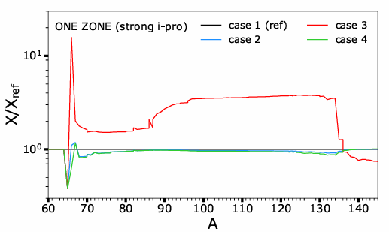
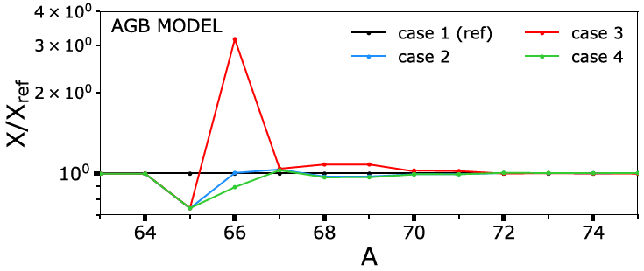
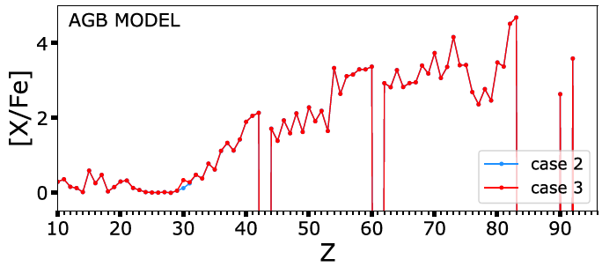
⁶⁶Ni(n,γ) i-process nucleosynthesis
Low-metallicity, low-mass stars during the early thermally pulsating Asymptotic Giant Branch phase.
One zone model:
“The ⁶⁶Ni(n,γ) reaction is found to behave as a major bottleneck for the i-process nucleosynthesis.”
McKay et al., MNRAS 491, 5179 (2020).
Impact is marginal in multi-zone low-mass, low-metallicity AGB stellar models experiencing i-process nucleosynthesis.
V. Ingeberg et al, Phys. Rev. C 111, 015803 (2025).

Slide 12
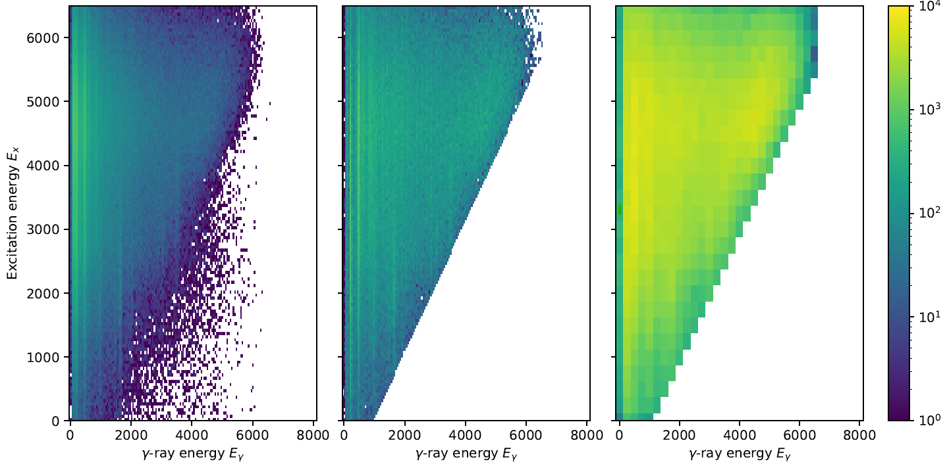
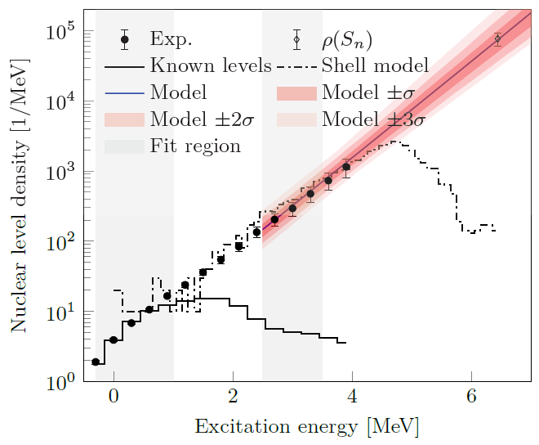
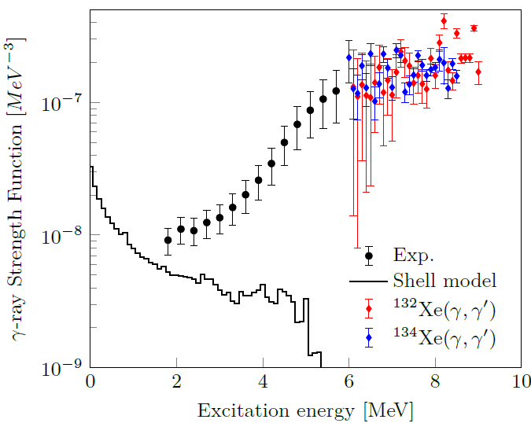
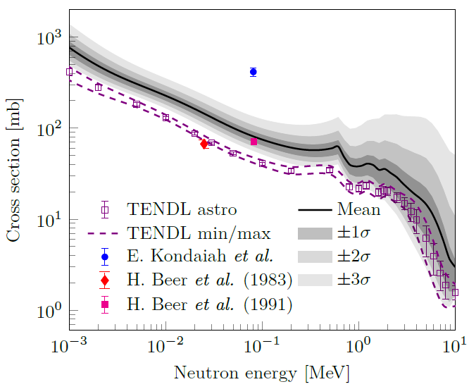

D(¹³²Xe,p)¹³³Xe - 530 MeV: Inverse Oslo
Measurement in support of NIF shots on ¹³²Xe
Annular particle telescope and a scintillator
LaBr3(Ce) and BGO-shielded HPGe Clover detectors.
MSc project
Hannah Berg
H. Berg et al, Submitted to Phys. Rev. C (2026).
Inspired ¹³⁶Xe(p,p’) inverse measurement at Texas A&M 2026.

Slide 13
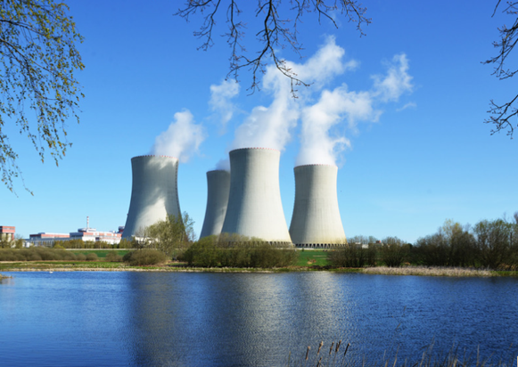
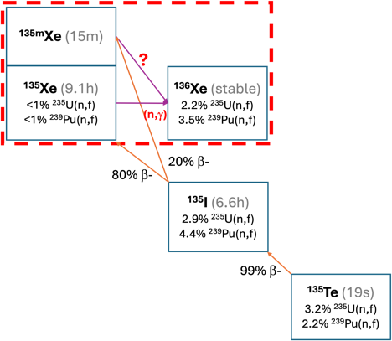
Applications of QC Data: Reactors and Safeguards
¹³⁵Xe is a neutron poison in nuclear reactors.
Knowledge of its burnup rate needed to reactor operation as well as atmospheric monitoring for nuclear safeguards [1].
¹³⁵Xe(n,γ) cross section is unknown at energies higher than thermal.
Gen4
PWR
Yang, Nuclear Engineering and Technology, 44(2), 722 (2012).
[1] J. Carlson,, et al., Progress in Particle and Nuclear Physics 94, 68 (2017)
Slide adapted from D.L. Bleuel

Slide 14
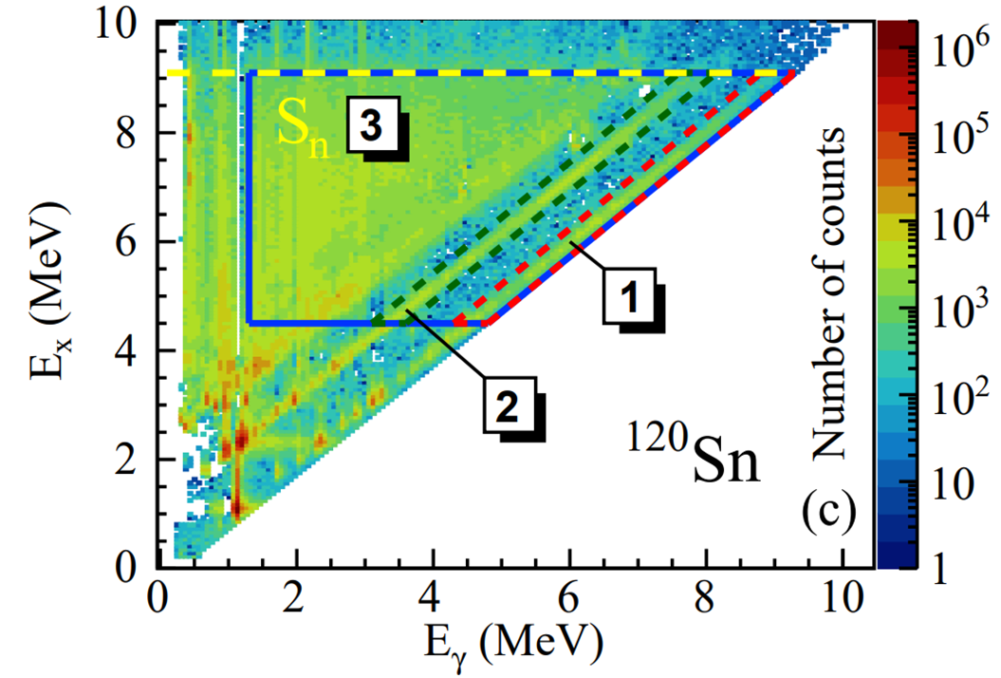
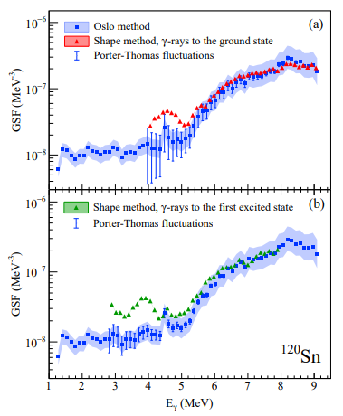
Use of Shape Method
Shape method applied (probably more):
⁹³Sr: Sweet et al., Phys. Rev. C 109, 054305 (2024).
^{144,145,150}Nd: Guttormsen et al., Phys. Rev. C 106, 034314 (2022).
^{120,124}Sn: Markova et al., Phys. Rev. C 106, 034322 (2022).
¹¹²Cd: Goriely et al., Phys Rev C 106, 044315 (2022).
^{96,100}Mo: Larsson, Ph.D. thesis, University Osof lo (2023).
¹⁶⁴Dy, ⁵⁶Fe, ⁹²Zr: Wiedeking et al., Phys Rev C 104, 014311 (2021).
¹⁰⁶Cd: Tsewu, ongoing, Ph.D. University of Johannesburg (2025).
⁷⁶Ge, ⁸⁸Kr: Mücher et al. Phys Rev C 107, L011602 (2023).
⁶³Ni, ⁸⁵Kr: Nkalanga, ongoing, PhD, University of Johannesburg (2025)
¹⁴⁰Ba: Spyrou et al. Phys. Rev. Lett. 132, 202701 (2024).
⁵⁸Fe: Abbott et al., Phys. Rev. C 111, 034322 (2025).
Zr: Larsen et al., ongoing
Ce: Spyrou et al., ongoing
⁷⁰Cu: Ronning et al, in preparation.
……
M. Markova et al., Phys. Rev. C 106, 034322 (2022).
Guttormsen, Ay, Ozgur et al., Phys. Rev. C 106, 034314 (2022).

Slide 15
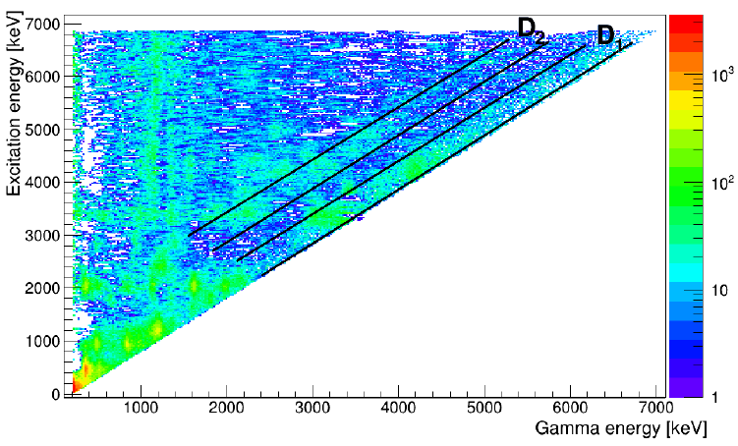
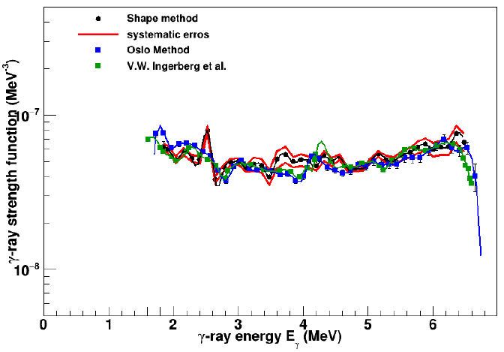
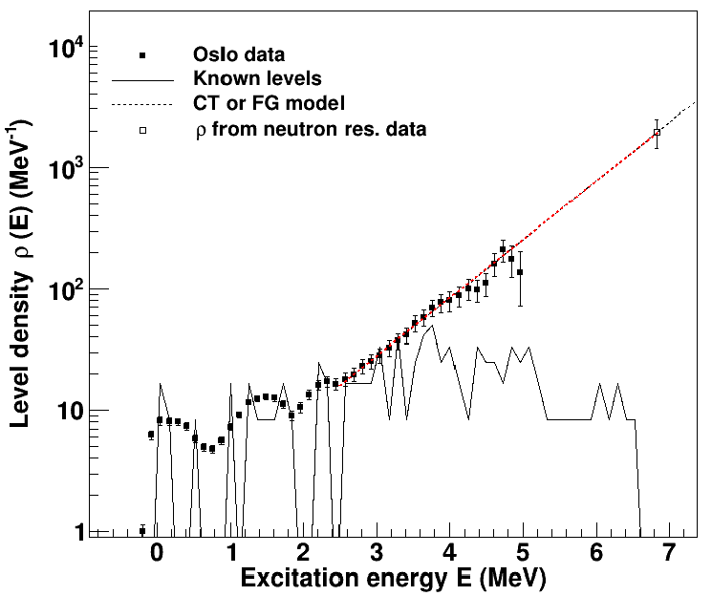

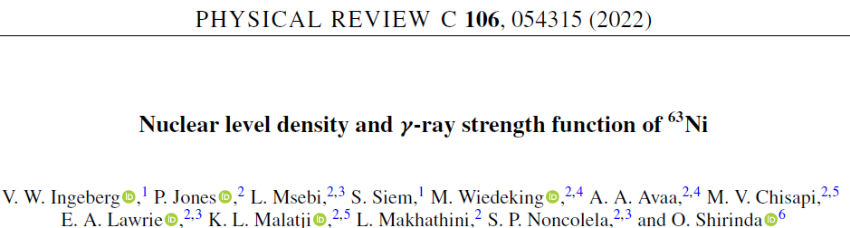
⁶⁴Ni(p,d)⁶³Ni - 27 MeV: Shape Method
Preliminary
PhD
Nkalanga
Mhlangano

Slide 16

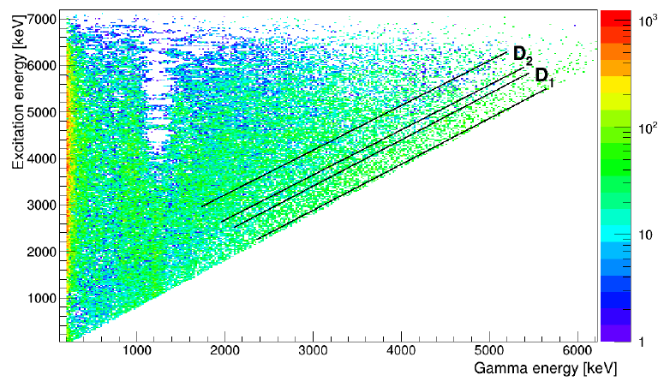
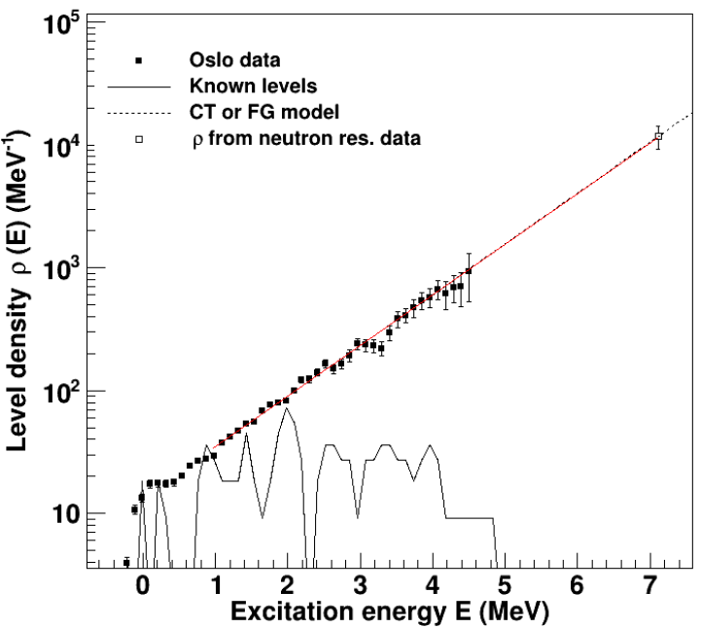
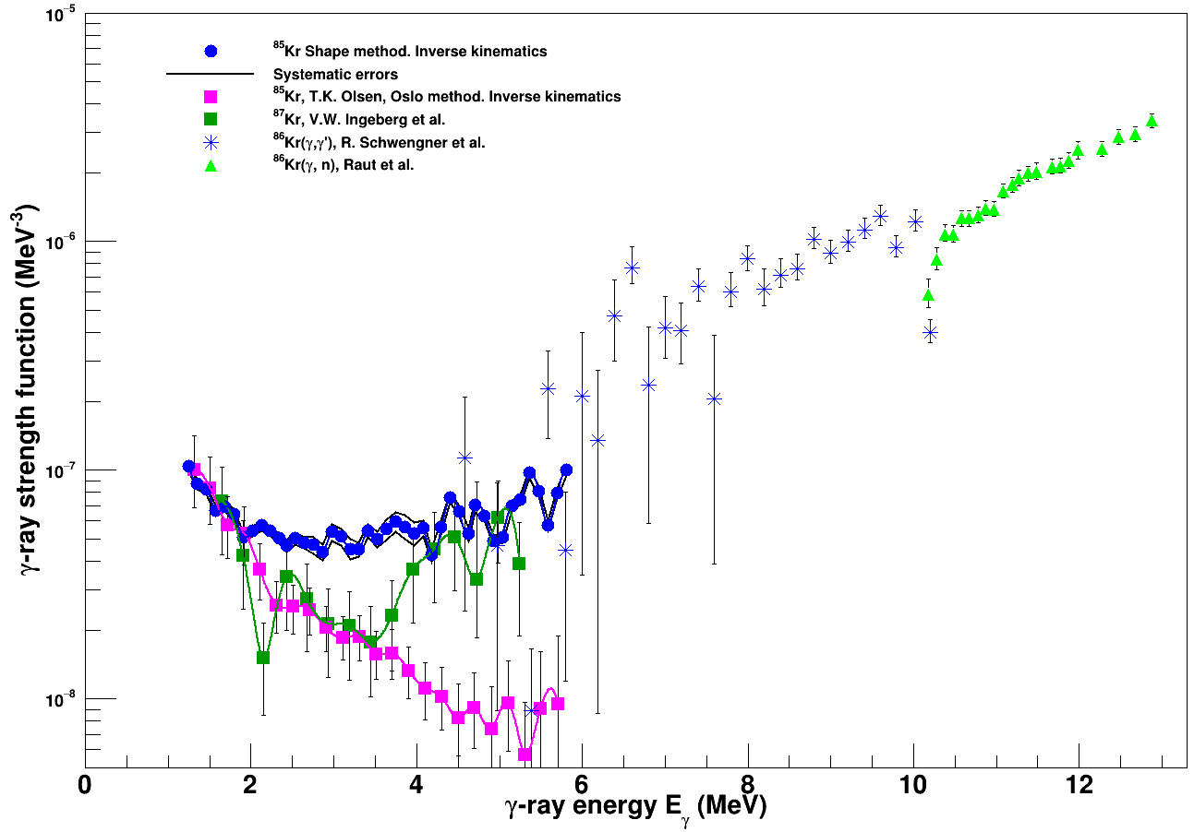
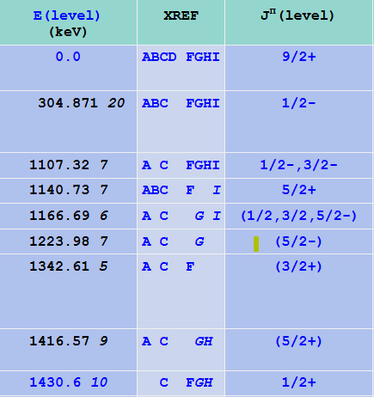
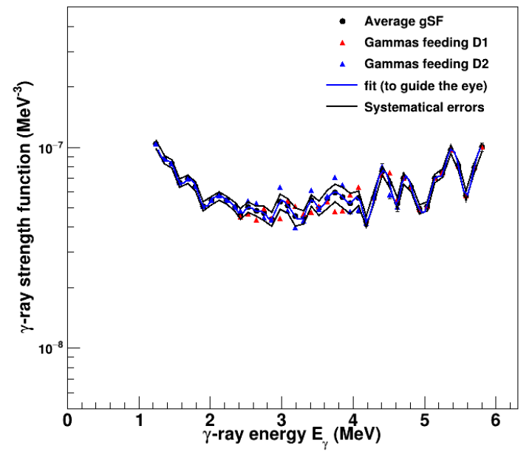
D(⁸⁴Kr,p)⁸⁵Kr - 428 MeV: Inverse Oslo & Shape Method
MSc Trine Olafsen
PhD Nkalanga Mhlangano
Very Preliminary
Singh & Chen, Nucl. Data Sheets 116, 1 (2014)

Slide 17





D(⁵⁷Fe,p)⁵⁸Fe - 428 MeV: Inverse Oslo & Shape methods @ TAMU

Slide 18

Photon Strength Function Database
IAEA Coordinated Research Project on Photonuclear Data and Photon Strength Functions F41032, 2016-2019.
Experimental data: 338 unique nuclides
(1123 data files) for all experimental methods
NRF for 29 nuclei, 47 data files
Oslo method for 113 nuclei, 222 data files
ARC for 54 nuclei, 123 data files
DRC for 52 nuclei, 99 data files
(p,γ) for 22 nuclei, 37 data files
Shape/Ratio method for 13 nuclei, 34 data files
(p,p₀) scattering for 9 nuclei, 55 data files
Photonuclear for 154 nuclei, 337 data files
Absolute Photonuclear for 63 nuclei, 115 files
TC and EGAF for 58 nuclei, 137 data files
Theoretical data:
D1M-QRPA data files
SMLO data file
https://www-nds.iaea.org/PSFdatabase/
2025 update available soon.

Slide 19
Updating/Improving Nuclear Level Densities for Applications
Since 2008: important developments and new information available
Wealth of new experimental information obtained also with new methods
New advanced modelling capabilities for global calculations
Improved fundamental theories to guide the models
New measurements to validate the models
Enhanced dissemination tools: interactive retrieval interfaces, web-based APIs
IAEA CRP started 2025.
Estimated dissemination 2028.

Slide 20
Summary
Tools available to obtain (n,γ) cross sections away from stability.
Inverse Oslo Method
- complementary and potential option when other methods cannot be used.
Shape Method
- normalization when neutron resonance spacing is not available.
Many measurements/analyses underway
Database developments
- PSF annual updates, NLD started

Slide 21
Thank you!
Mathis Wiedeking
Nuclear Science Division
mwiedeking@lbl.gov
https://nuclearscience.lbl.gov/
This material is based upon work supported by the U.S. Department of Energy’s National Nuclear Security Administration, the U.S. Department of Energy, Office of Science, Office of Nuclear Physics under Contracts No. DE-AC02-05CH11231 and the US Nuclear Data Program.

