Slide 1
Fission Studies at LANSCE with the Chi-Nu and VENDETA
M Devlin, P-3,
Los Alamos National Laboratory
March 10, 2026
LA-UR-26-21614

Slide 2
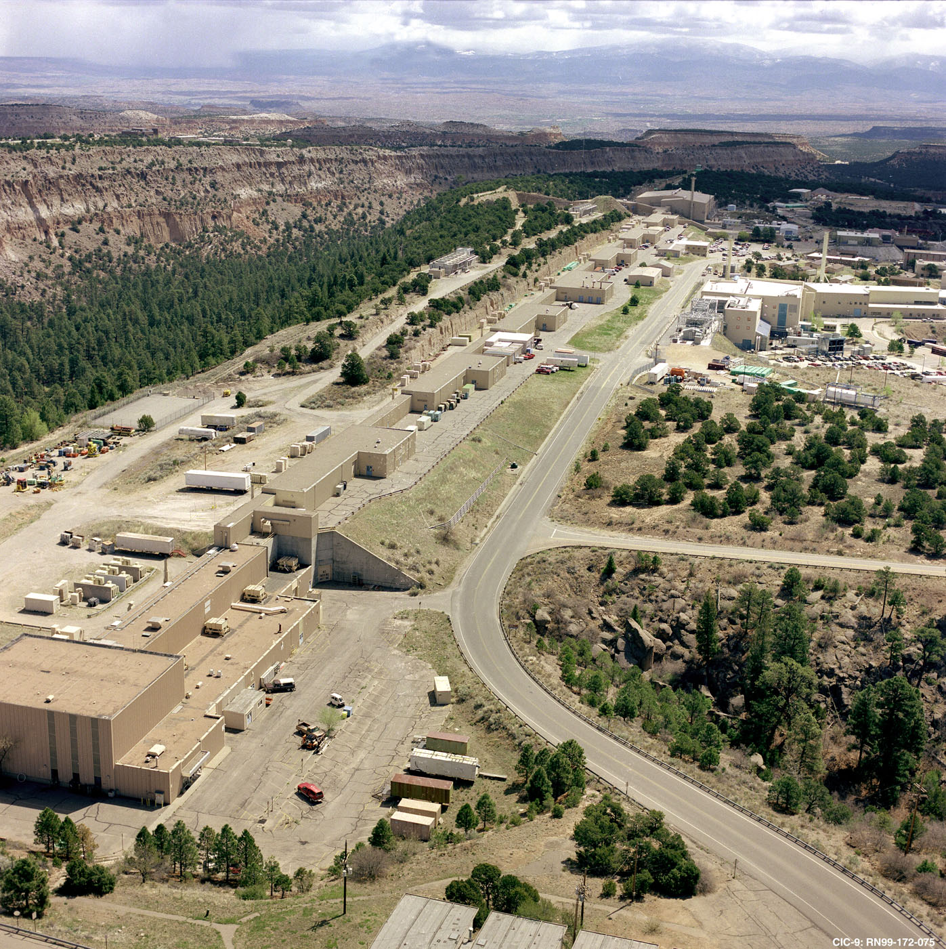
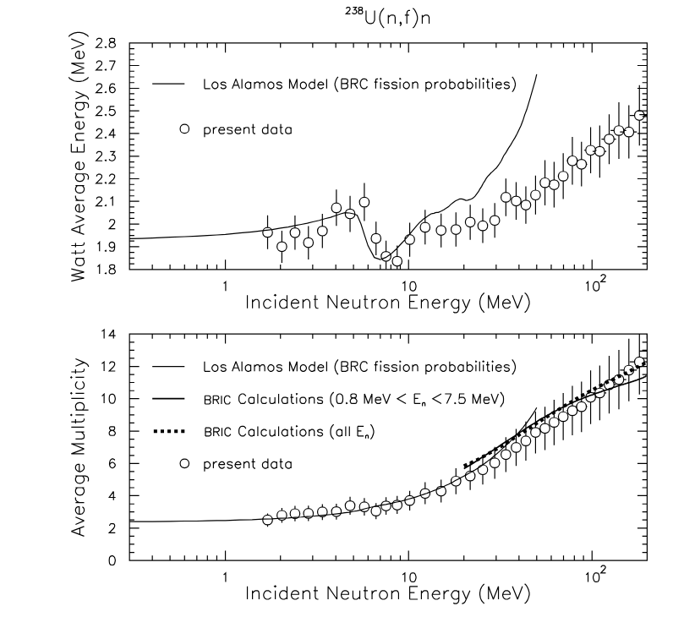
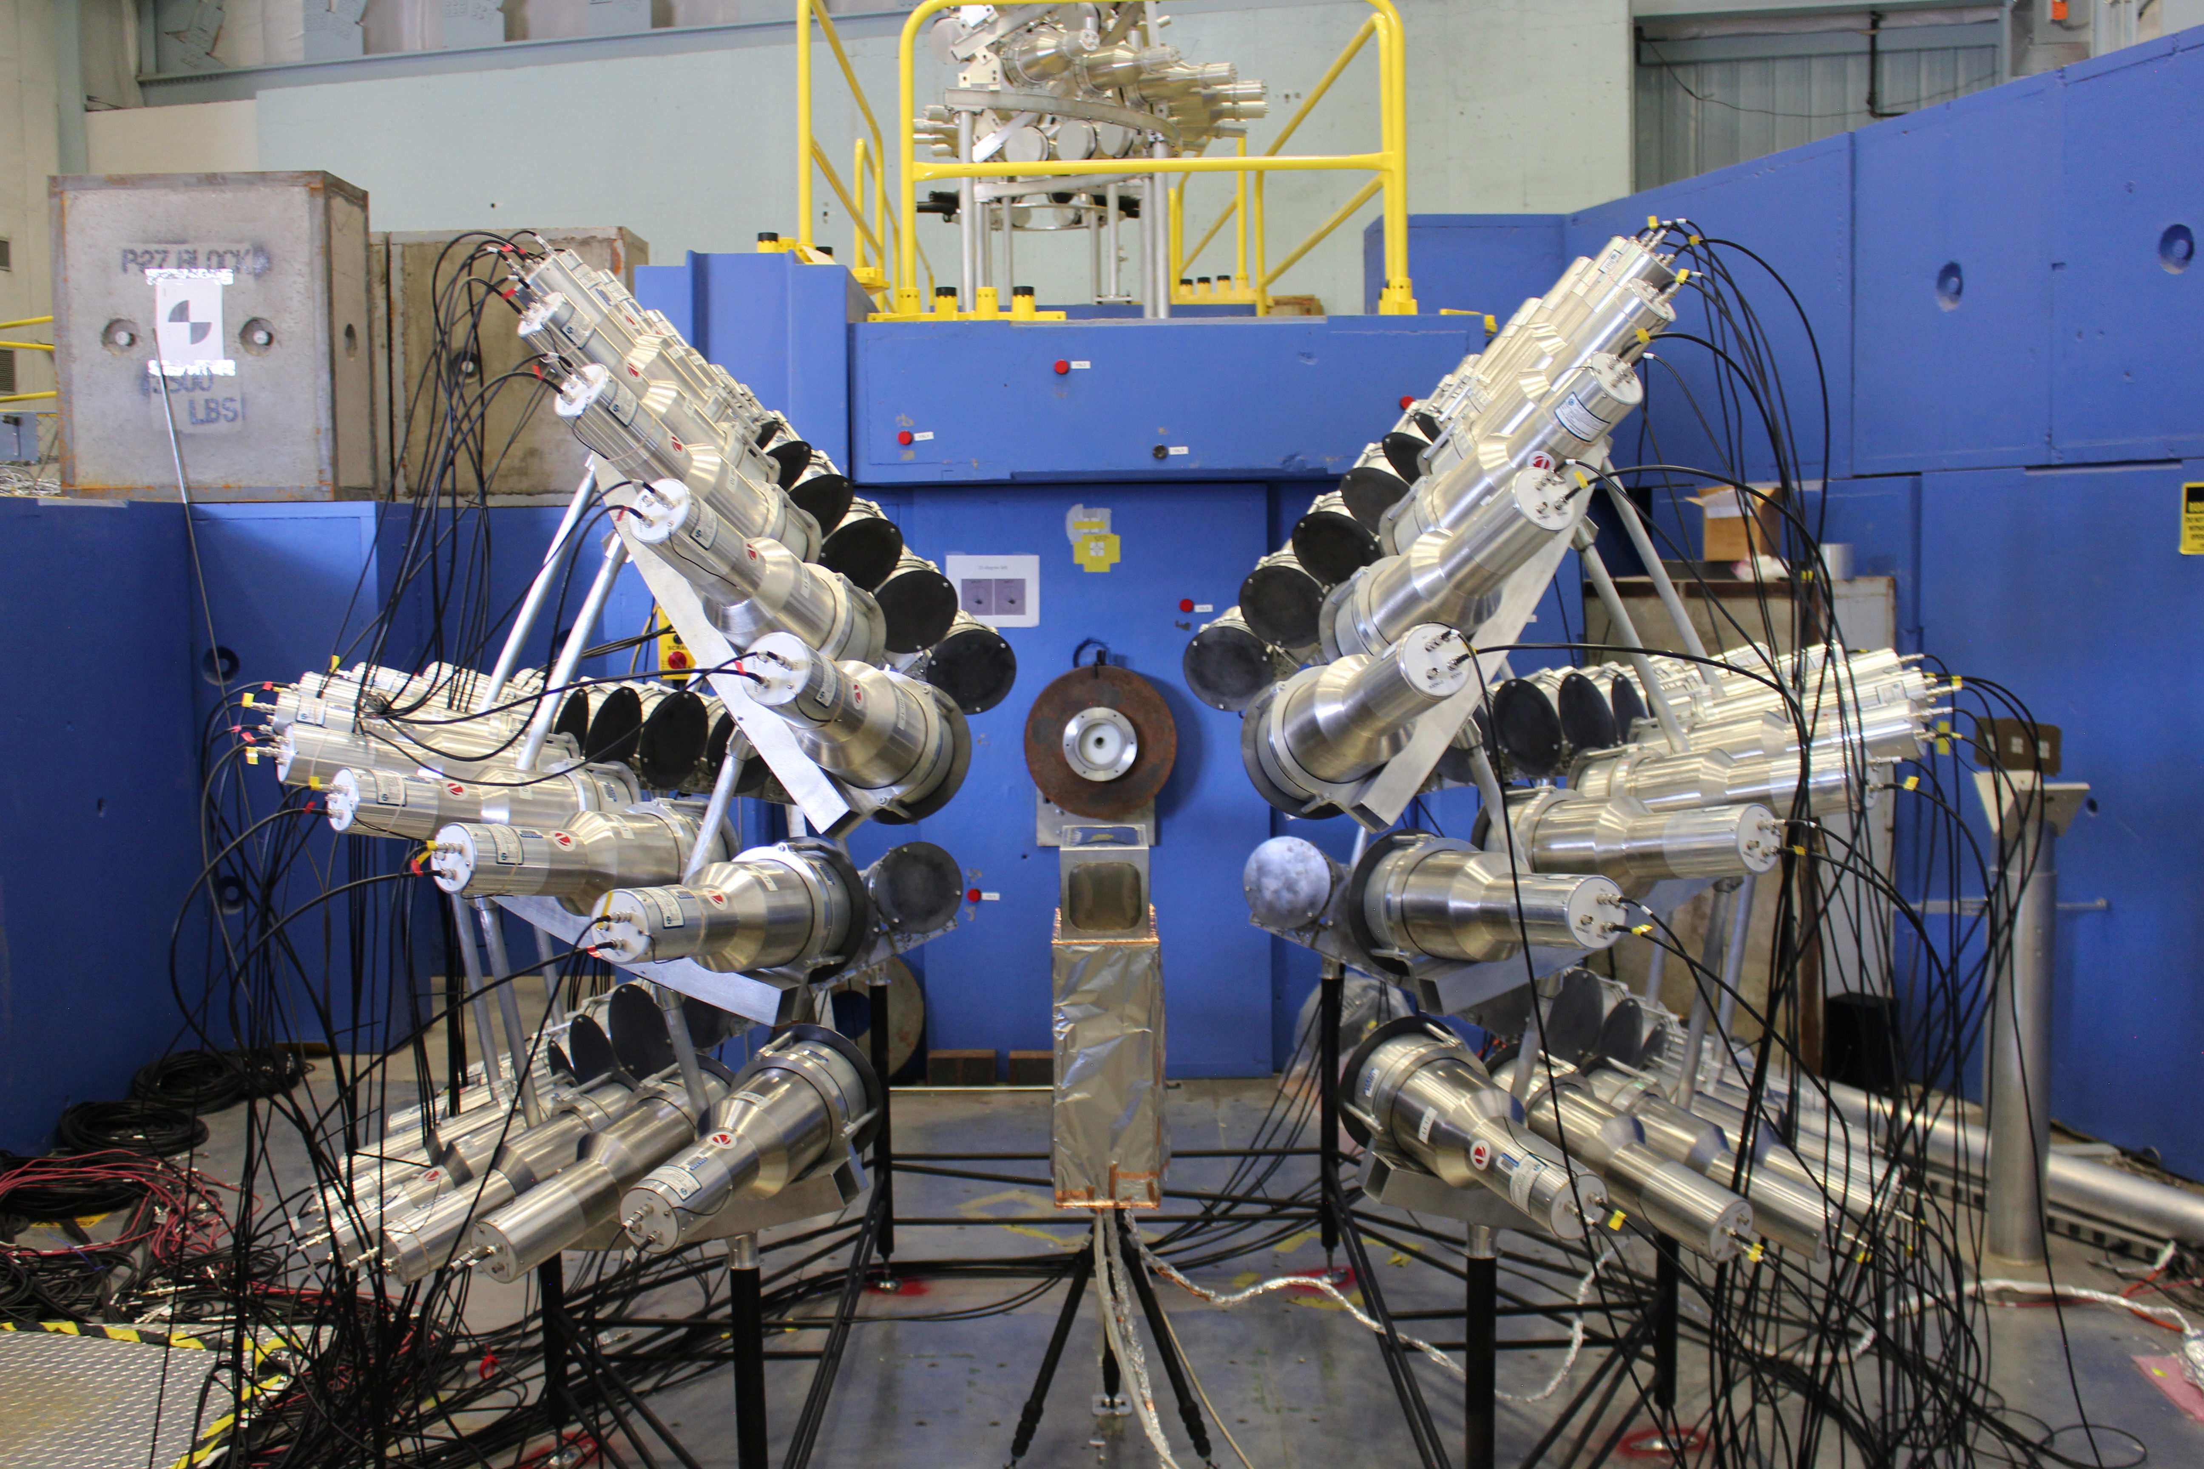
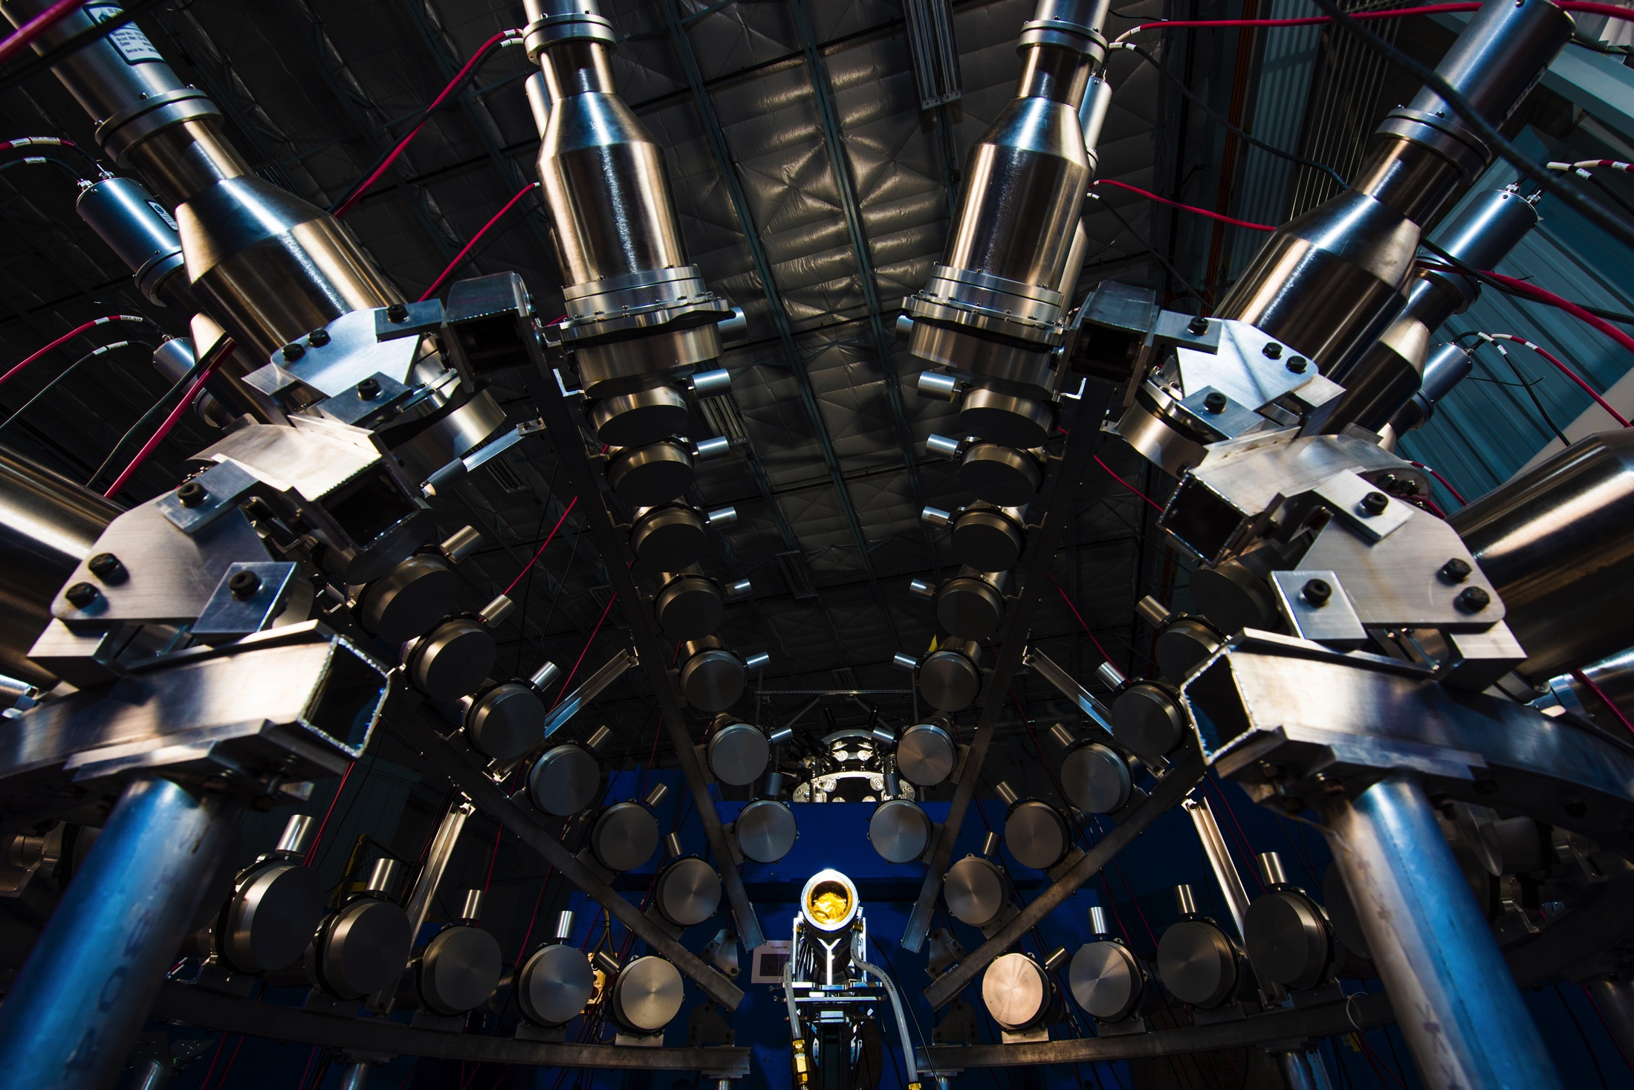
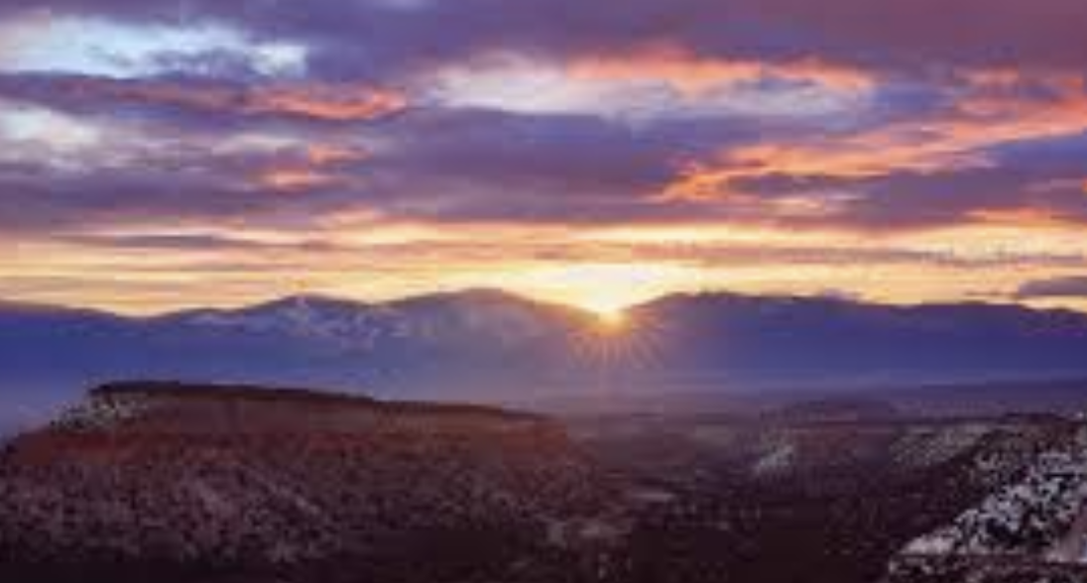
Outline
Intro
Fission Spectra
History
Chi-Nu
VENDETA
What is next?

Slide 3
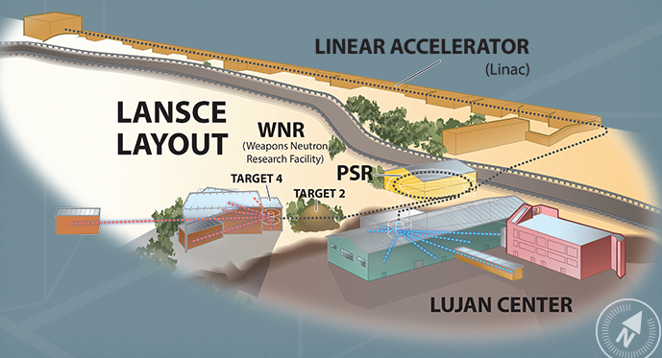
LANSCE: The Los Alamos Neutron Science CEnter
An
An 800 MeV proton LINAC with 5 facilities, two of which are used for nuclear physics measurements, the Lujan Center and WNR

Slide 4
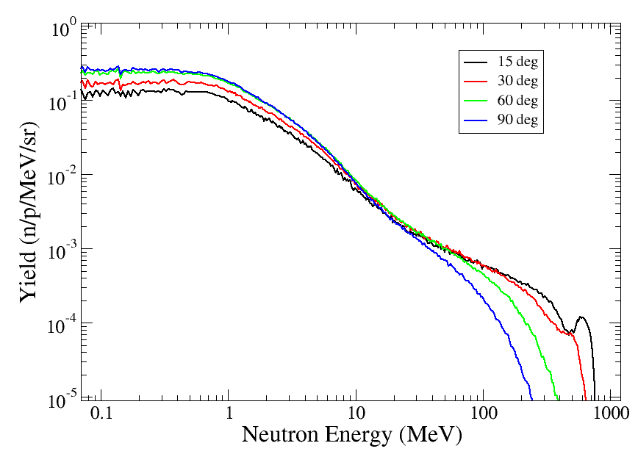
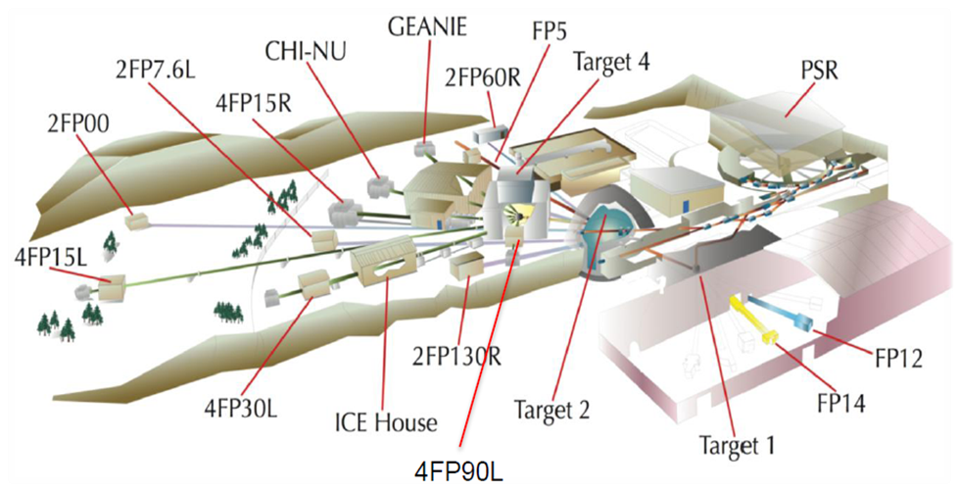
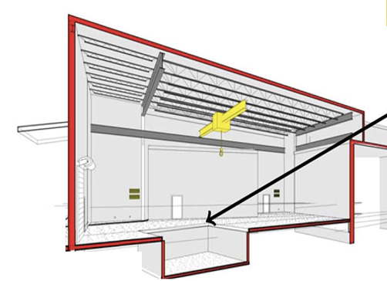
Flightpath 15L at WNR
WNR has 6 flightpaths, and Chi-Nu + VENDETA use 15L
The neutron flux is Highest at a few MeV, but extends from 10 keV to 100s of MeV
15L has a target station at 21.5m, with a false floor and ‘get lost’ pit

Slide 5
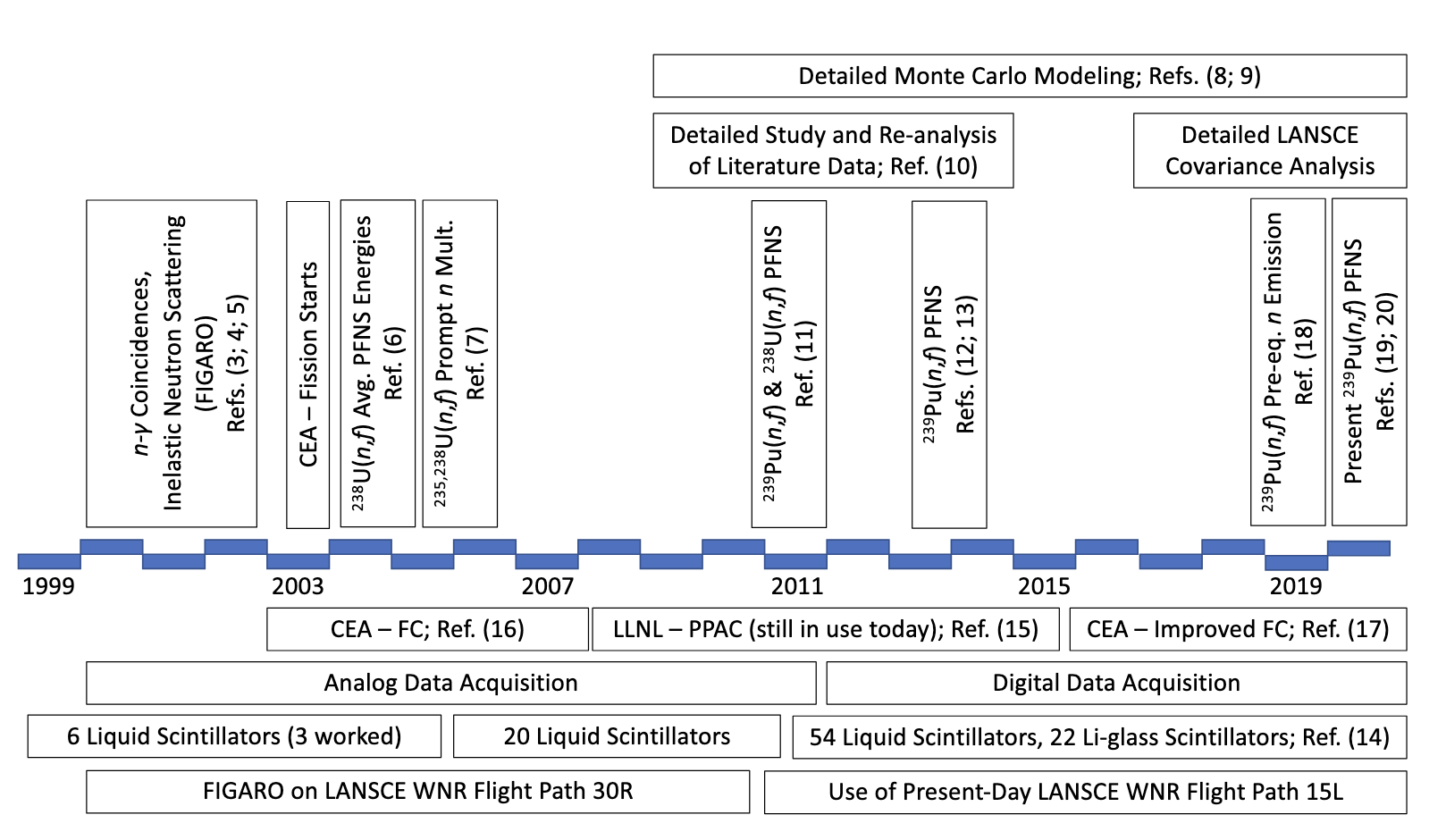
LANL CEA Collaboration
Slide shown by KJ Kelly at a workshop in Santa Fe (2020).

Slide 6
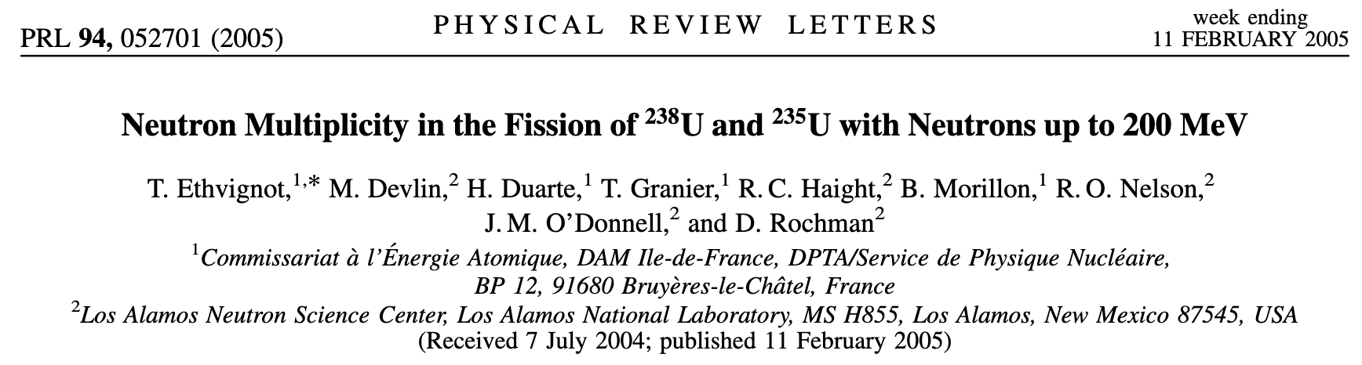
First Prompt Fission Neutron Energy and Multiplicity Measurements
Used the FIGARO detector array, which had 6-8 liquid scintillator detectors, not all of which worked well

Slide 7
Since 2020
CEA/NNSA PFNS results comparison for ²³⁹Pu (KJ Kelly et al., NDS 2021)
²³⁵U(n,f) PFNS (B Mauss et al., PRC 2025)
²⁴⁰Pu(sf) PFNS (O Syrett et al., (tbp)
²³⁹Pu(n,f) PFNS (P Marini et al., PRC 2020)
²³⁹Pu(n,f) nubar (P Marini et al., PLB 2022)
²³⁸U(n,f) PFNS (KJ Kelly et al., PRC 2023)
²⁴⁰Pu(n,f) PFNS (KJ Kelly et al., PRC 2024)
²⁴⁰Pu(n,f) PFNS (tbd)
2020
2022
2024
2026
VENDETA
Chi-Nu

Slide 8
Chi-Nu – Two Neutron Detector Arrays
Neutron detectors:
Li Glass Array
40cm from the target position
22 ⁶Li Glass Scintillators
EJ309 Liquid Scintillator Array
1m from the target position
54 detectors
Fission detector:
10-cell PPAC built at LLNL
for each actinide
Chi-Nu Liquid Scintillator Detector Array

Slide 9
Chi-Nu Prompt Fission Neutron Spectra (PFNS) Measurements
c
LANL+LLNL
²³⁵U(n,f) PRC 105, 044615 (2022)
²³⁹Pu(n,f) PRC 102, 034615 (2020) and PRL 122, 072503 (2019)
²³⁸U(n,f) PRC 108, 024613 (2023)
²⁴⁰Pu(n,f) and ²⁴⁰Pu(sf) PRC 109, 064611 (2024)
²⁴²Pu(sf) to be published
CEA+LANL
²³⁹Pu(n,f) PRC 101, 044614 (2020) and PLB 835, 137513 (2022)
²³⁵U(n,f) PRC 111, 044611 (2025)
²³⁸U(n,f) EPJ WoC 193, 03002 (2018)
²⁴⁰Pu(sf) with VENDETA, to be published

Slide 10
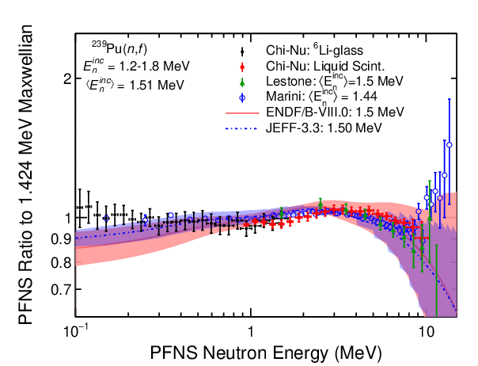
PFNS for ²³⁹Pu(n,f)
LANL+LLNL data in black and red, CEA+LANL data in blue, Lestone (1.5 MeV) in green
Ratio to a Maxwellian
Incident neutron energy spectra range of 1-20 MeV
Compared to ENDF/B-VIII.0 at bin edges

Slide 11
Another View of These Data

Slide 12
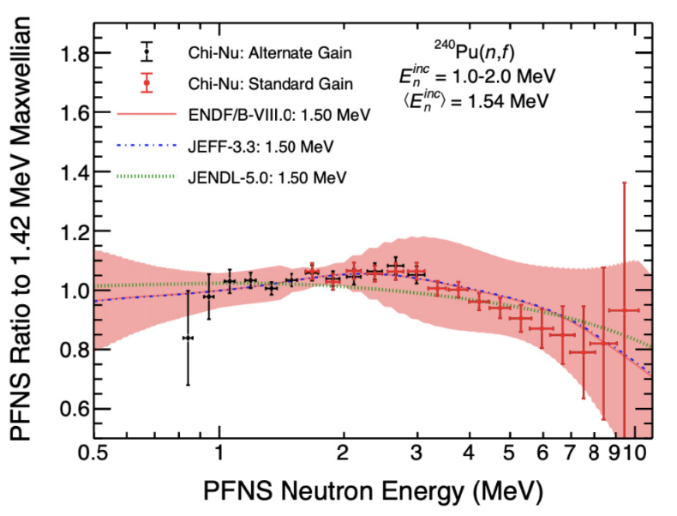
²⁴⁰Pu(n,f) PFNS
First measurement of these PFNS above 0.85 MeV
Used a 12-cell Parallel Plate Avalanche Counter from LLNL for fission detection
Incident neutron energies up to 20 MeV
Uncertainties are limited by the α background beneath the fission trigger

Slide 13
VENDETA
72 liquid scintillators, slightly smaller than the Chi-Nu detectors
1m from the target position
Improved photocathode for higher output
Improved timing

Slide 14
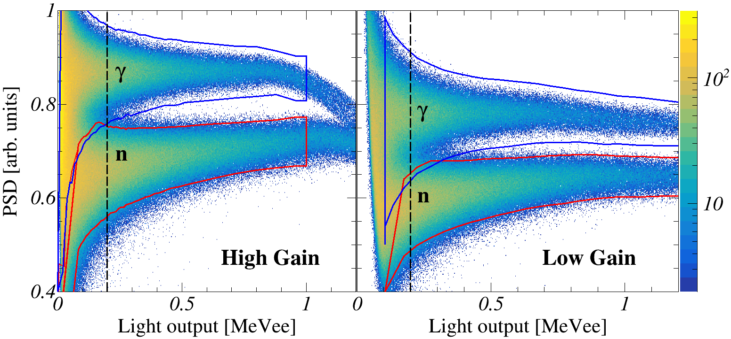
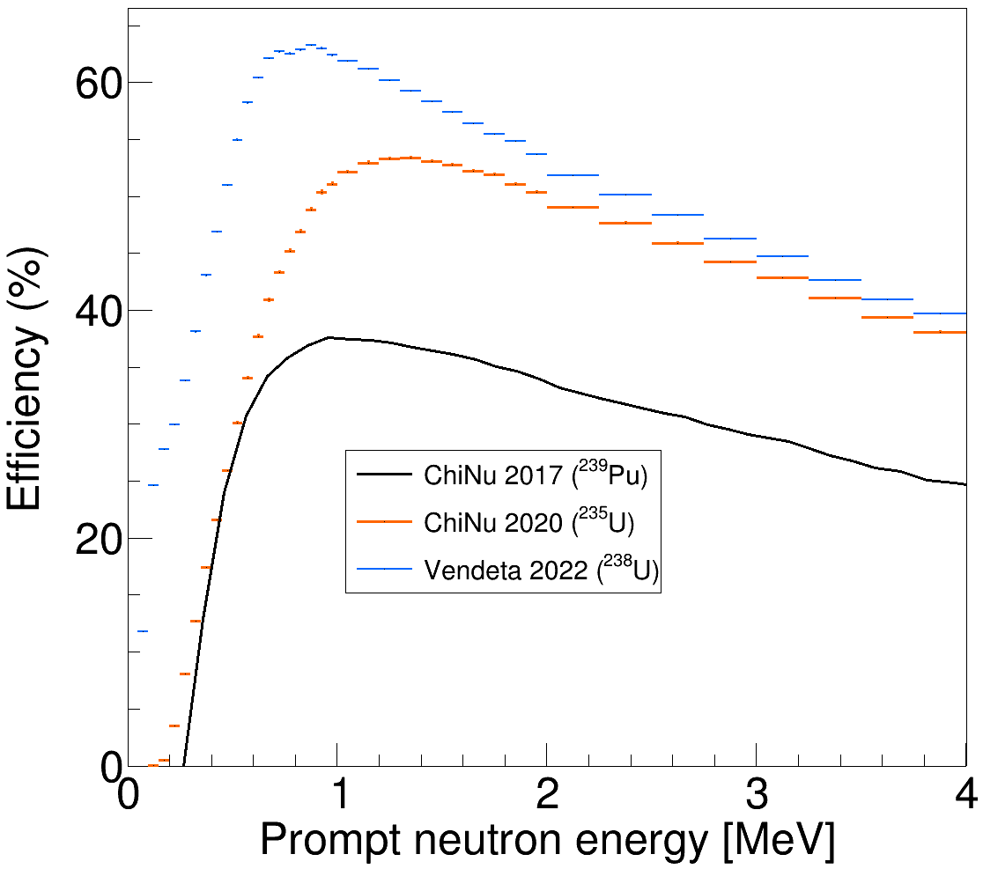
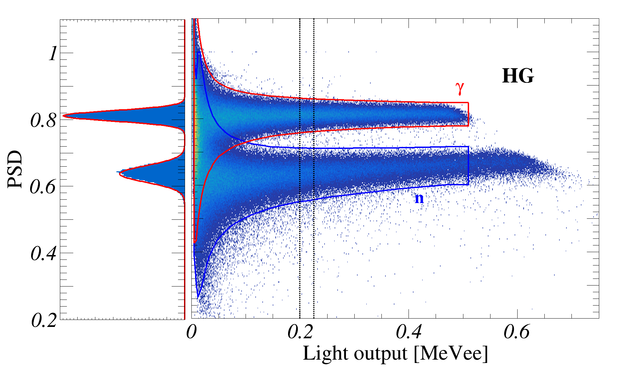
VENDETA compared to Chi-Nu
Efficiency
Chi-Nu
PSD
VENDETA

Slide 15
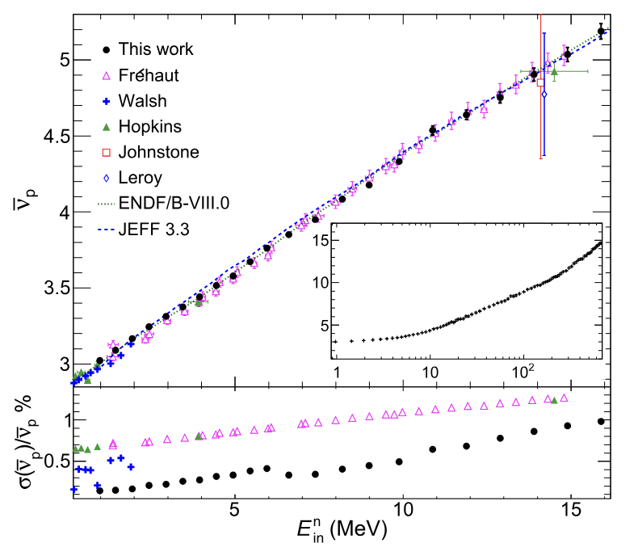
²³⁹Pu(n,f) nubar Measurement
Unfolding the number of neutrons detected following a fission event can produce a neutron number distribution
With the Chi-Nu efficiency, ~10%, the resulting distribution is well enough constrained to produce an average neutron number, nubar

Slide 16
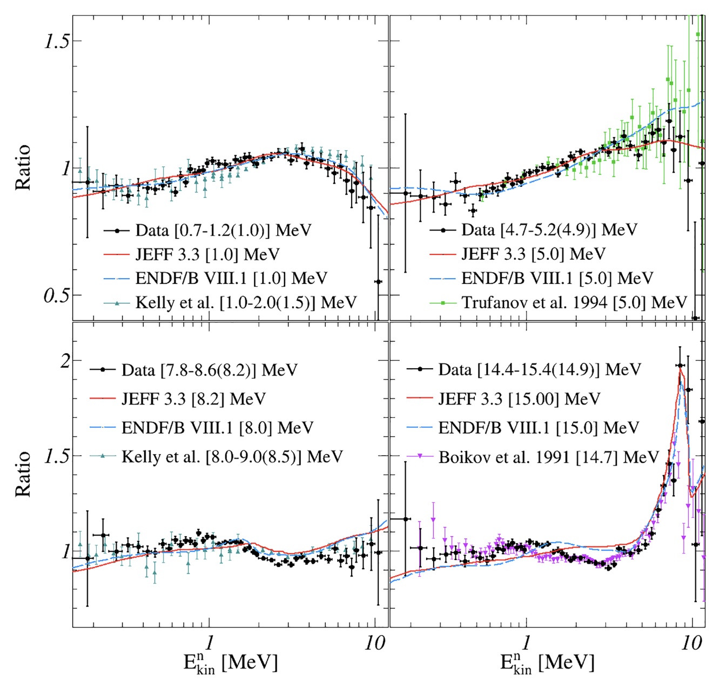
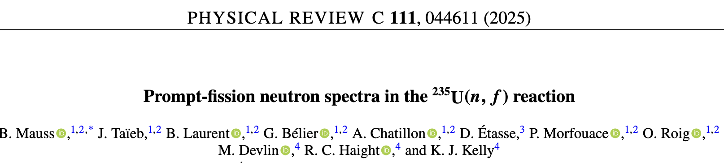
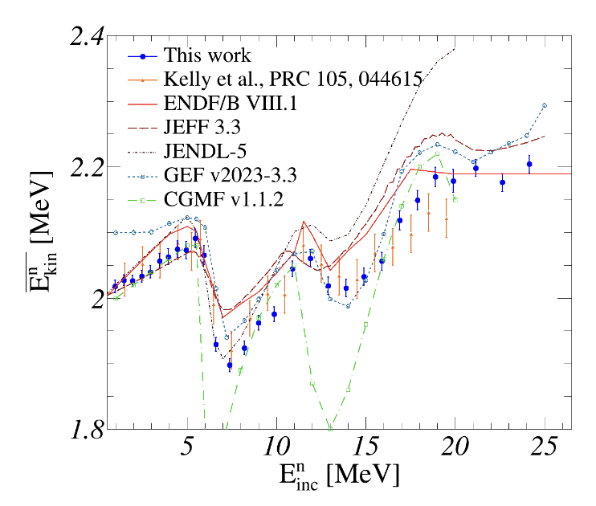
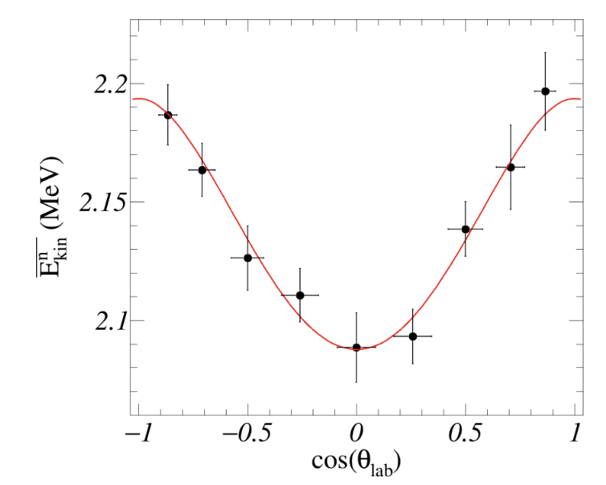
²³⁵U(n,f) PFNS recently published
Used Chi-Nu + CEA fission chamber and daq

Slide 17
²⁴⁰Pu(sf) PFNS with VENDETA
O. Syrett et al., to be published
Measurement performed at LANSCE over about 8 months, using VENDETA and a CEA fission chamber
The planned in-beam ²⁴⁰Pu(n,f) PFNS measurement did not run due to the lack of LANSCE beam
VENDETA now returning to CEA
²⁴⁰Pu(sf) | nubar | E_{ave}
Gerasimenko | - | 2.044(36) MeV
Evaluation | 2.154(5) | -
New results | 2.139(2) | 2.005(2) MeV

Slide 18
What’s next?
²³³U(n,f) PFNS with Chi-Nu (2026 – delayed from 2024)
²⁴⁰Pu(n,f) PFNS with VENDETA, when LANSCE beam improves

Slide 19
What’s next?
²³⁷Np(n,f) and ²⁴²Pu(n,f) PFNS have been mentioned, but no support yet
Neutron scattering, etc [Inelastic, elastic, (n,2n),…]
Other suggestions?

Slide 20
Collaboration
LANL
Keegan Kelly
John O'Donnell
Denise Neudecker
Bob Haight
Pat Copp
Jason Surbrook
LLNL
Ching-Yen Wu
Roger Henderson
CEA
Julien Taieb
Benoit Mauss
Audrey Chatillon
Pierre Mourfouace
Owen Syrett
David Etasse

