Slide 1
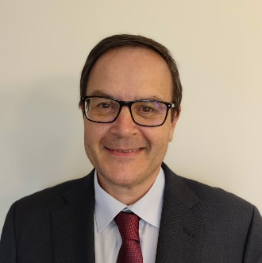
UPM Activities in Nuclear Data
Third International Workshop on Nuclear Data for the Next Decade (P(ND)²-3), March 9-13, 2026
Prof. Oscar Cabellos
oscar.cabellos@upm.es
Technical University of Madrid
1

Slide 2
Contents
The Speaker
UPM Activities and Programs in ND
Activities in EU/APRENDE Project
Future and Challenges in JEFF-4.1
Conclusion… final reflections
courtesy by A.Plompen (ND2025)
2

Slide 3

1. The Speaker
I am Oscar Cabellos, full professor in nuclear engineering at the Polytechnic University of Madrid (UPM)
I am coordinator of UPM courses on “Introduction on Nuclear Technology”, “Simulation of Nuclear Power Plants” and “Design and Simulation of PWRs” which is one of the UPM coursed based on the CDIO (Conceive, Design, Implement and Operate) initiative
My background is reactor physicist, specifically in PWR (Pressure Water Reactors) simulations where I did my PhD in 1998
Since 2005 I have been involved in EU projects working on nuclear data activities: EUROTRANS (2005-2010), ANDES(2010-2013), CHANDA(2013-2018), SANDA (2019-2023), APRENDE (2024-2028)
In 2014-2017, I moved to OECD/Nuclear Energy Agency (NEA)/Data Bank as Nuclear Data Scientist working in the development of EXFOR and JEFF databases, and JANIS and NDaST web-tools
Currently, I am actively working in the JEFF (Joint Evaluation Fission and Fusion) project and WPEC (Working Party on International Nuclear Data Evaluation and Cooperation) activities of the OECD/NEA
Member of the JEFF-Coordination Group, WPEC (co-coordinator WPEC/SG46 and monitor of WPEC/SG47) and WPNCS (Working Party on Nuclear Criticality and Safety)
Member of the OECD/NEA/NSC – (Nuclear Science Committee) and OECD/NEA/MBDAV – (Management Board for the Development, Application and Validation of Nuclear Data and Codes)
Member of the IAEA - International Nuclear Data Committee (INDC)
Oscar Cabellos (UPM)
oscar.cabellos@upm.es
3

Slide 4
2. UPM Activities and Projects in ND
Processing and verification: NJOY – PREPRO – AMPX – FRENDY
  1.1 OECD/NEA/DB/CPS: Processed Libraries – JEFF-3.1, JEFF-3.1.1, JEFF-3.3
  1.2 Formats: PENDF, GENDF, HENDF/JANIS, WIMSD, ACE, AMPX/CE, …, COVERX, BOXER,…
Benchmarking: ICSBEP/Mosteller – IRPhEP – SINBAD – SFCOMPO – CONDERc
  2.1 The Mosteller Suite, … SINBAD/Oktavian, FNS, …, LLNL/PS…
Validation: BUC/Benchmarks – NNPP/Almaraz – Advanced Reactors Design & SMRs
  3.1 TMI Pin-cell Burnup Benchmark (WPRS/UAM-2012)
Sensitivity Analysis: TSUNAMI, MCNP/PERT/KSEN, … perturbation techniques,…
  4.1 Sensitivity profiles: SMRs, Advanced Reactors Designs, PWRs, … LLNL pulsed spheres,…
  4.2 Supporting evaluators with NDAST calculation: Perturbation analysis, …
Uncertainty Quantification (UQ): Criticality (+NNPP values), decay heat, isotopic inventory, ... due to uncertainties in cross-sections, angular distributions, TSLs, fission yields, …
  5.1 Necessity of credible ND uncertainties: processing ND Cov, FYs correlations, Angular distributions,…
  5.2 UQ: Overview of UQ in ICSBEP using NDAST tool
  5.3 TAR Exercise (WPEC/SG46) for HPRL
4

Slide 5
2. UPM Activities and Projects in ND
EUROTRANS
(NUDATRA-DM5)
Nudatra: nuclear data for transmutation (2005-2010)
Accurate Nuclear Data for nuclear Energy Sustainability (ANDES)
FP7-Fission-2009 –249671
(2010-2013)
Solving Challenges in Nuclear Data
(CHANDA)
FP7-605203. 8
(2013-2018)
Supplying Accurate Nuclear Data for Energy and non-Energy Applications (SANDA)
EU Project No. 847552.
(2019-2023)
“Addressing PRiorities of Evaluated Nuclear Data in Europe (APRENDE)
EU Project No. 101164596.
(2024-2027)
2006 | 2008 | 2010 | 2012 | 2014 | 2016 | 2018 | 2020 | 2022 | 2024 | 2026 | 2028
JEFF-4.0 (2025)
JEFF-3.1 (2005)
JEFF-3.1.1
(2009)
JEFF-3.1.2
(2011)
JEFF-3.2 (2014)
JEFF-3.3
(2017)
ENDF/B-VIII.0 (2018)
ENDF/B-VIII.1
(2024)
“Graduate and Executive Nuclear Training and Lifelong Education” (GENTLE),
FP7- 323304.
(2013-2016)
GREaT-PIONEeR – Graduate Education Alliance for Teaching the Physics and safety of Nuclear Reactors
(2020-2023)
GREaT-PIONEeR (2)
(2025-2028)
5

Slide 6
2. UPM Activities and Projects in ND
courtesy by G. Nobre
(CSEWG Meeting - November 5-7, 2024)
2006 | 2008 | 2010 | 2012 | 2014 | 2016 | 2018 | 2020 | 2022 | 2024 | 2026 | 2028
JEFF-3.3 (2017)
JEFF-4.0 (2025)
JEFF-3.1 (2005)
JEFF-3.1.1 (2009)
JEFF-3.1.2 (2011)
JEFF-3.2 (2014)
ENDF/B-VIII.0 (2018)
ENDF/B-VIII.1 (2024)
6

Slide 7
2. UPM Activities and Projects in ND
Jefdoc-2421
courtesy by A. Plopem
(ND2025, June 22-27, 2025)
2006 | 2008 | 2010 | 2012 | 2014 | 2016 | 2018 | 2020 | 2022 | 2024 | 2026 | 2028
JEFF-3.3 (2017)
JEFF-4.0 (2025)
JEFF-3.1 (2005)
JEFF-3.1.1 (2009)
JEFF-3.1.2 (2011)
JEFF-3.2 (2014)
ENDF/B-VIII.0 (2018)
ENDF/B-VIII.1 (2024)
7

Slide 8
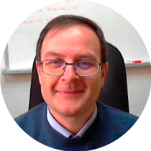



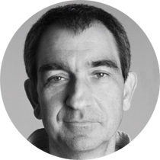
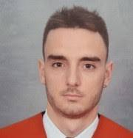

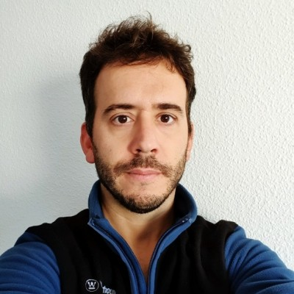
3. UPM Activities in EU/APRENDE
Oscar Cabellos
Nuria García-Herranz
Diana Cuervo
Emilio Castro
Gonzalo F. Garcia-Fernández
Alejandro Marro
Iñigo Gayo
Ismael Manzano
8

Slide 9
3. UPM Activities in EU/APRENDE
WP | Task | Subtask | Milestone | Leader-UPM | Milestones | Deliverables
WP6. Communication, transnational access, education & training, dissemination & exploitation | Task 6.4 Training of early-stage researchers and scientific visits (M1-M48) Task leader: HZDR. Other participants: USE, UPM, CIEMAT |  | The objective is to organize 15 scientific visits for early-stage researchers and external senior experts up to 8 weeks length. (D6.5) | O. Cabellos
 | Task 6.5 Organisation of two summer schools (M1-M48) Task leader: USE Other participants: USE, UPM, ESS, HZDR |  | Summer School “Nuclear data: The path from the detector to the reactor calculation” (UPM, D6.7) To be held in June 2027 at UPM , Madrid (Spain) | O. Cabellos |  | D6.7 Report on the theoretical school in Madrid (Lead by UPM) (M48)
9

Slide 10
3. UPM Activities in EU/APRENDE
WP | Task | Subtask | Milestone | Leader-UPM | Milestones | Deliverable
WP4. Nuclear Data Evaluation | Task 4.3 Fission yield evaluation Task leader: CEA Other participants: CEA, UPM, CNRS, SCK, IRSN | Subtask 4.3.2 Fission yield benchmarking. Partners: UPM, CEA, CNRS, SCK, IRSN | ENDF-6 evaluated files for the actinides and energies defined in subtask 4.3.1 must be validated on quantities of interest for the user community. The impact of the thermal neutron-induced fission yields evaluations of 233,235U and 239,241Pu will be quantified on reactor observables, based on the expertise of the CEA, UPM and IRSN (MS4.1). | O. Cabellos | MS4.1 Presentation on the validation of the fission yield libraries (M36) | D4.6 Report on the validation of the fission yield libraries (thermal and fast): MYRRHA-like fast systems and thermal systems for decay heat (Lead by CEA) (M42)
 | Task 4.4 Cross section evaluation Task leader: CEA Other participants: DES, CEA DAM, NRG, PSI, JSI, EPFL, JRC-Geel, CIEMAT, UU, UPM, SCK, KIT, UBU | Subtask 4.4.2 File processing and cross section benchmarking | JSI, SCK and EPFL will perform a series of benchmarks on the reactivity dependence on the burnup for PWR assemblies | O. Cabellos | MS4.3 Presentation of various benchmarks based on new evaluations (M36) | D4.13 Performance report of the pre-release JEFF-4 library (Lead by EPFL) (M46)
 |  | Subtask 4.4.2 File processing and cross section benchmarking | UPM will be processing the complete pre-release of the JEFF-4 library and convert it to standard formats used in simulation codes (MCNP, SCALE, SERPENT) and deliver them to the NEA databank. | O. Cabellos
 |  |  | UPM will make recommendations of reliable benchmarks for validating structural and shielding materials (Cu, Fe).
 |  |  | For the benchmarking step, different expertise will be applied, taking advantage of the specialization of the different institutes
10

Slide 11
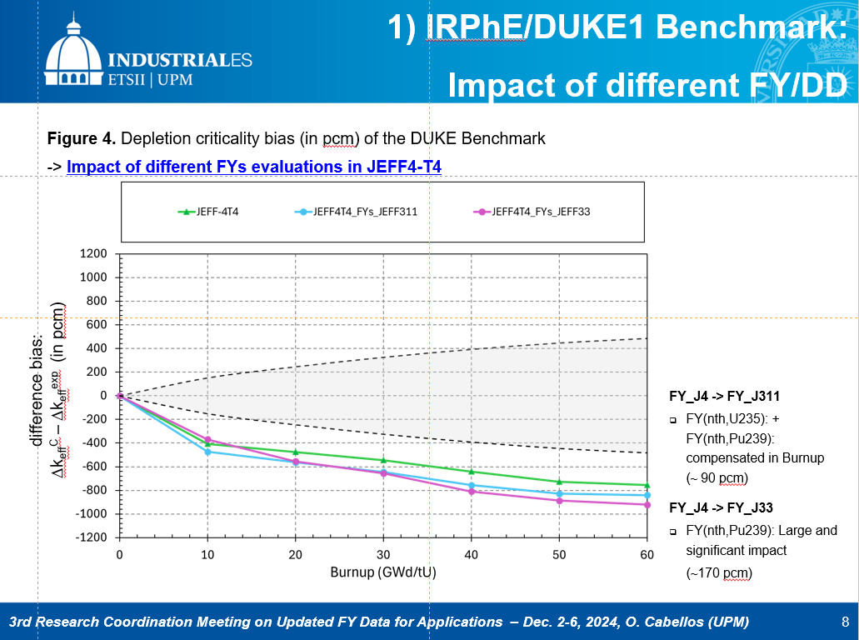
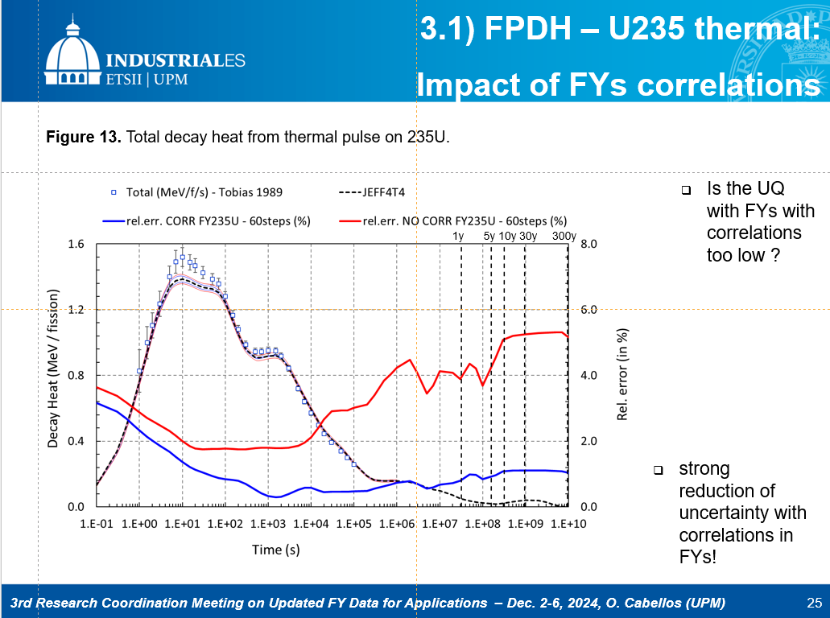
3. UPM Activities in EU/APRENDE
WP | Task | Subtask | Milestone
WP4. Nuclear Data Evaluation | Task 4.3 Fission yield evaluation | Subtask 4.3.2 Fission yield benchmarking. | ENDF-6 evaluated files for the actinides and energies defined in subtask 4.3.1 must be validated on quantities of interest for the user community. The impact of the thermal neutron-induced fission yields evaluations of 233,235U and 239,241Pu will be quantified on reactor observables, based on the expertise of the CEA, UPM and IRSN (MS4.1).
11

Slide 12
3. UPM Activities in EU/APRENDE
WP | Task | Subtask | Milestone | Leader-UPM | Milestones | Deliverables
WP5. Nuclear data validation, sensitivity analyses and impact studies | Task 5.1. Sensitivity analyses, uncertainty quantification, impact studies. Task leader: CIEMAT Other participants: SCK, STUBA, UPM, UMAR, CNRS, JSI, UKAEA | Subtask 5.1.1. Sensitivity analyses and priorities for nuclear data improvements | CIEMAT, UPM, STUBA and CNRS will calculate sensitivity profiles of quantities such as reactivity, Doppler coefficient, spectral indices, dose rates, inventories, decay heat, neutrino emissions and eventually others, to nuclear data for a variety of core models, ranking nuclear data by the importance of the uncertainty contribution. Systems of interest include LWRs with accident tolerant fuels, SFR, GFR, AMR (fast SMR), ADS, MSFR. The focus will be on steady-state equilibrium operating conditions, accounting for fuel depletion | N. García-Herranz, E. Castro | MS5.1 Calculation of sensitivity profiles for ADS, MSR, LWRs, GFR and SFR (M24) | D5.1 Sensitivity analyses and priorities for ND improvements (Lead by CIEMAT) (M48)
 |  |  | UPM SA will address a non-energy application: neutron activation of concrete shields of proton therapy centres (PTC) (MS5.1 and D5.1). | Gonzalo F. García
 |  | Subtask 5.1.2. Nuclear data uncertainty propagation in reactor and shielding applications | For power transients, the calculations will use coupled neutronics-thermal hydraulics models to propagate nuclear data uncertainties to power and temperature distributions, reactivity, etc., while accounting for feedback effects and time-dependent phenomena. | Diana Cuervo |  | D5.2 ND uncertainty propagation in reactor, shielding and advanced fuels (Lead by CIEMAT) (M48)
12

Slide 13
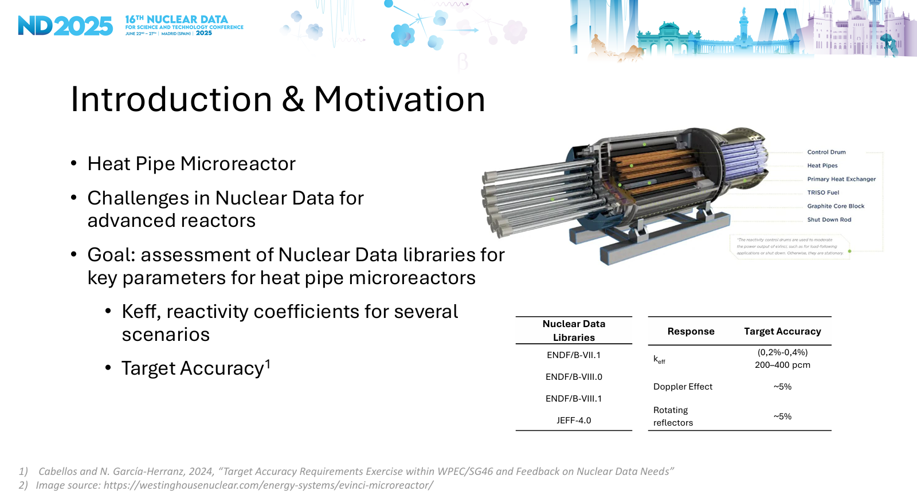
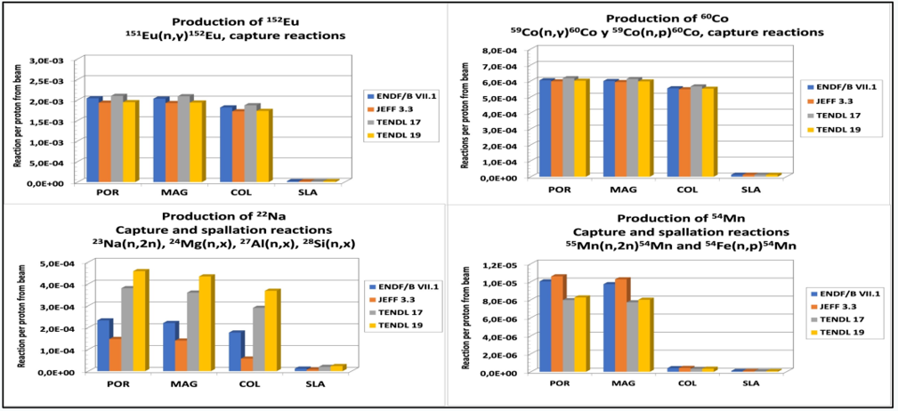
3. UPM Activities in EU/APRENDE
WP | Task | Subtask | Milestone
WP5. Nuclear data validation, sensitivity analyses and impact studies | Task 5.1. Sensitivity analyses, uncertainty quantification, impact studies. | Subtask 5.1.1. Sensitivity analyses and priorities for nuclear data improvements | CIEMAT, UPM, STUBA and CNRS will calculate sensitivity profiles of quantities such as reactivity, Doppler coefficient, spectral indices, dose rates, inventories, decay heat, neutrino emissions and eventually others, to nuclear data for a variety of core models, ranking nuclear data by the importance of the uncertainty contribution. Systems of interest include LWRs with accident tolerant fuels, SFR, GFR, AMR (fast SMR), ADS, MSFR. The focus will be on steady-state equilibrium operating conditions, accounting for fuel depletion
 |  |  | UPM SA will address a non-energy application: neutron activation of concrete shields of proton therapy centres (PTC) (MS5.1 and D5.1).
Nuclear Data Sensitivity Analysis of Key Parameters for eVinci-like Heat Pipes Nuclear Microreactors
Activation in proton therapy centers depending on type of concrete and nuclear data
13

Slide 14
3. UPM Activities in EU/APRENDE
WP | Task | Subtask | Milestone | Leader-UPM | Milestones | Deliverables
WP5. Nuclear data validation, sensitivity analyses and impact studies | Task 5.2: Analysis of experiments, validation, and data assimilation. Task leader: UPM Other participants: EPFL, UMAR, IRSN, UU, SCK, CEA, STUBA, UKAEA, CIEMAT | Subtask 5.2.1 Analyses of integral measurements, reactor data | Integral measurements such as ex-core calculations in SINBAD benchmark H.B. Robinson-2 for comparison of computed neutron spectrum, fast neutron fluence and iron dpa (UPM) | N. García-Herranz | MS 5.3 Results of nuclear data impact studies | D5.3 Analyses of integral measurements, reactor data and correlations between integral data (Lead by UPM) (M48)
 |  | Subtask 5.2.2. Correlations between integral data | Consistency between the data assimilation results using different choices of integral benchmarks (ICSBEP, IRPhEP and SEFOR experiments) and experimental data (k_eff, spectral indices and reactivity coefficients such as coolant voiding, Doppler broadening, or reflector-worth values) will be studied (UPM) | N. García-Herranz
 |  | Subtask 5.2.3. Assimilation using group-averaged data, derivation of JEFF4 trends | In addition, one outcome of these techniques will be the prioritization of new experiments which will be added to the HPRL with the corresponding Target Accuracy Requirement (TAR) calculations (UPM, SCK) (D5.4). | O. Cabellos |  | D5.4 Assimilation techniques for the derivation of ND trends (Lead by UPM) (M48)
14

Slide 15
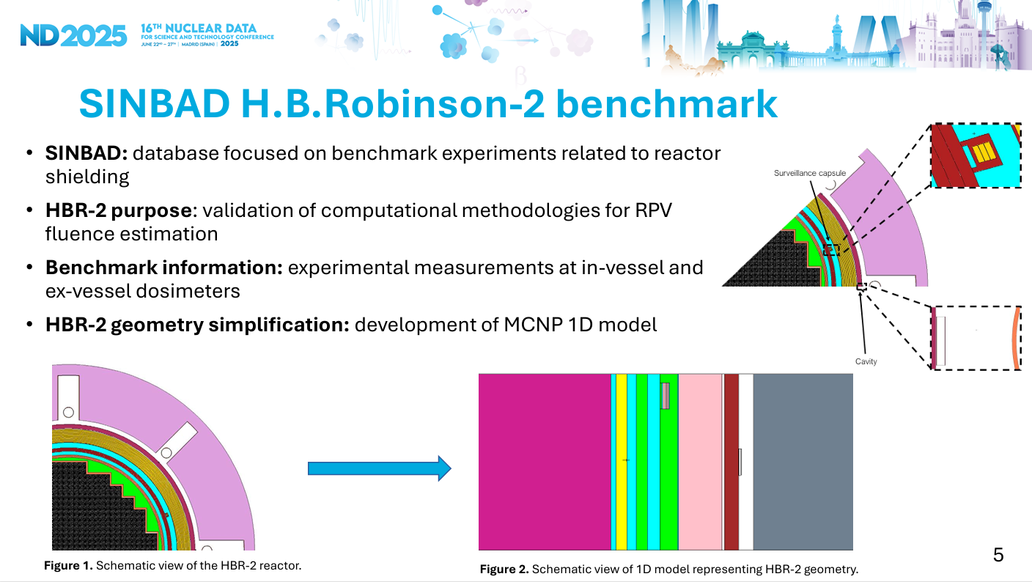
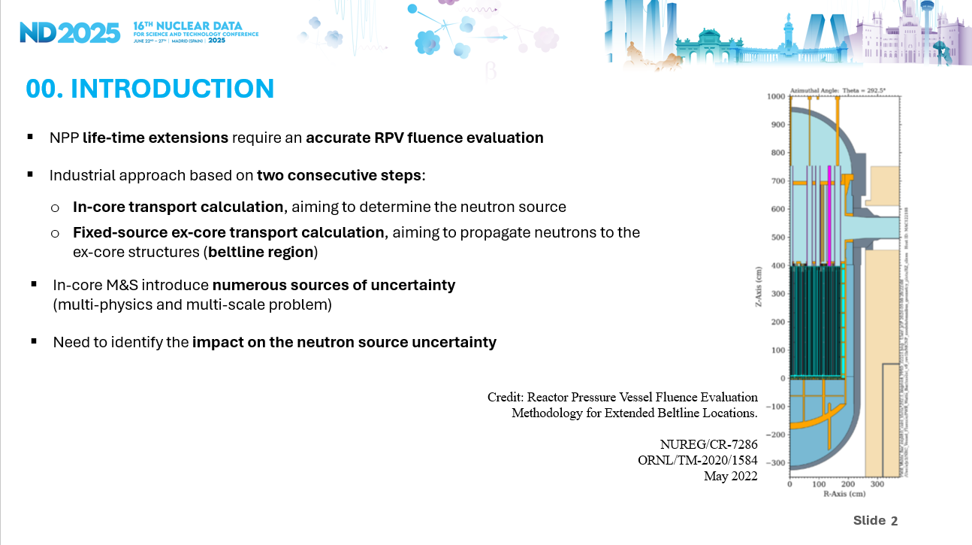
3. UPM Activities in EU/APRENDE
WP | Task | Subtask | Milestone
WP5. Nuclear data validation, sensitivity analyses and impact studies | Task 5.2: Analysis of experiments, validation, and data assimilation. | Subtask 5.2.1 Analyses of integral measurements, reactor data | Integral measurements such as ex-core calculations in SINBAD benchmark H.B. Robinson-2 for comparison of computed neutron spectrum, fast neutron fluence and iron dpa (UPM)
On the potential of H.B. Robinson-2 benchmark for nuclear data validation
Nuclear Data Validation Using LWR Measurements: Insights from the OECD/NEA TVA-WB1 Benchmark
15

Slide 16
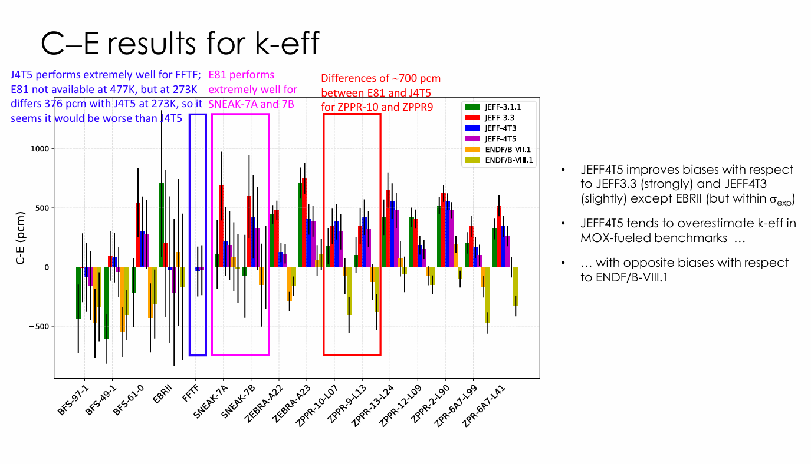
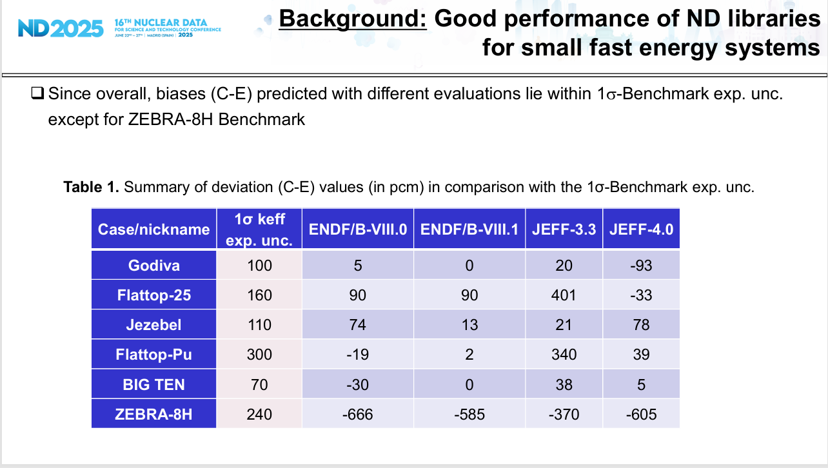
3. UPM Activities in EU/APRENDE
WP | Task | Subtask | Milestone
WP5. Nuclear data validation, sensitivity analyses and impact studies | Task 5.2: Analysis of experiments, validation, and data assimilation. | Subtask 5.2.2. Correlations between integral data | Consistency between the data assimilation results using different choices of integral benchmarks (ICSBEP, IRPhEP and SEFOR experiments) and experimental data (k_eff, spectral indices and reactivity coefficients such as coolant voiding, Doppler broadening, or reflector-worth values) will be studied (UPM)
Evaluating JEFF4T5 for the modelling and simulation of liquid metal fast reactors, JEFDOC-2433
Analysing Differences of Evaluated ND for 235U, 238U, and 239Pu in the Fast Energy Region with a Focus on Angular Distributions
JEFF Nuclear Data Week, 14-19 April 2025, JEFDOC-2433
16

Slide 17
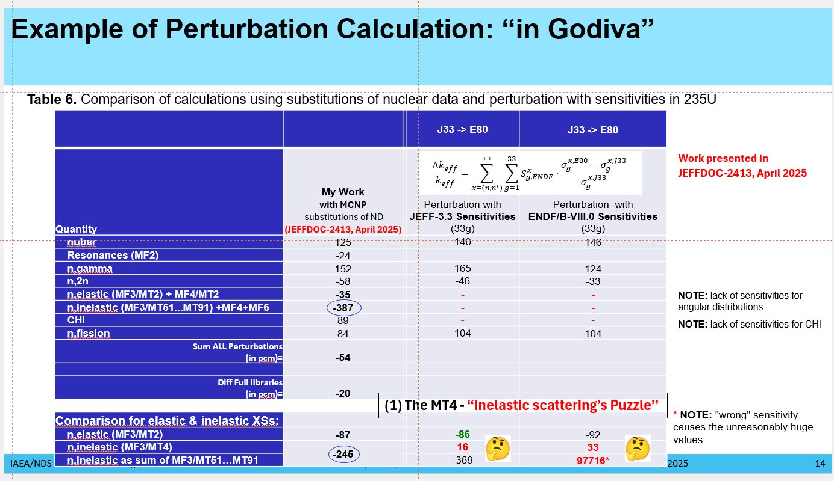
3. UPM Activities in EU/APRENDE
Analysing Differences of Evaluated ND for 235U, 238U, and 239Pu in the Fast Energy Region with a Focus on Angular Distributions
ND-2025, INDEN/ACT-2025 and PHYSOR-2026
(1) The MT4 – “inelastic scattering’s Puzzle” in Godiva for 235U …. it is solved using SED (secondary energy distributions) !
17

Slide 18
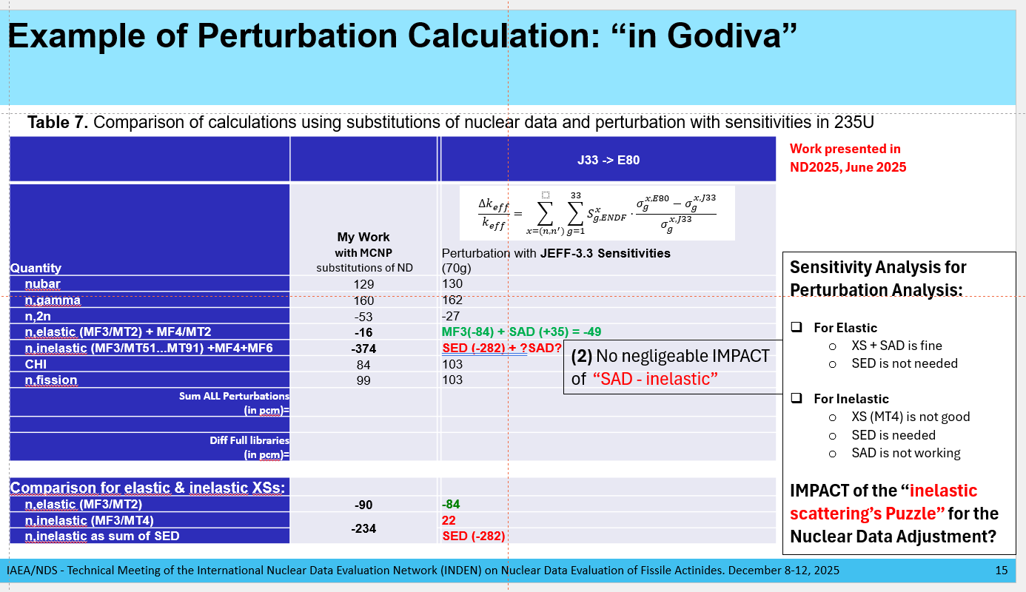
3. UPM Activities in EU/APRENDE
Analysing Differences of Evaluated ND for 235U, 238U, and 239Pu in the Fast Energy Region with a Focus on Angular Distributions
ND-2025, INDEN/ACT-2025 and PHYSOR-2026
(2) No negligeable IMPACT of SAD (secondary angular distributions) in inelastic in Godiva for 235U
18

Slide 19
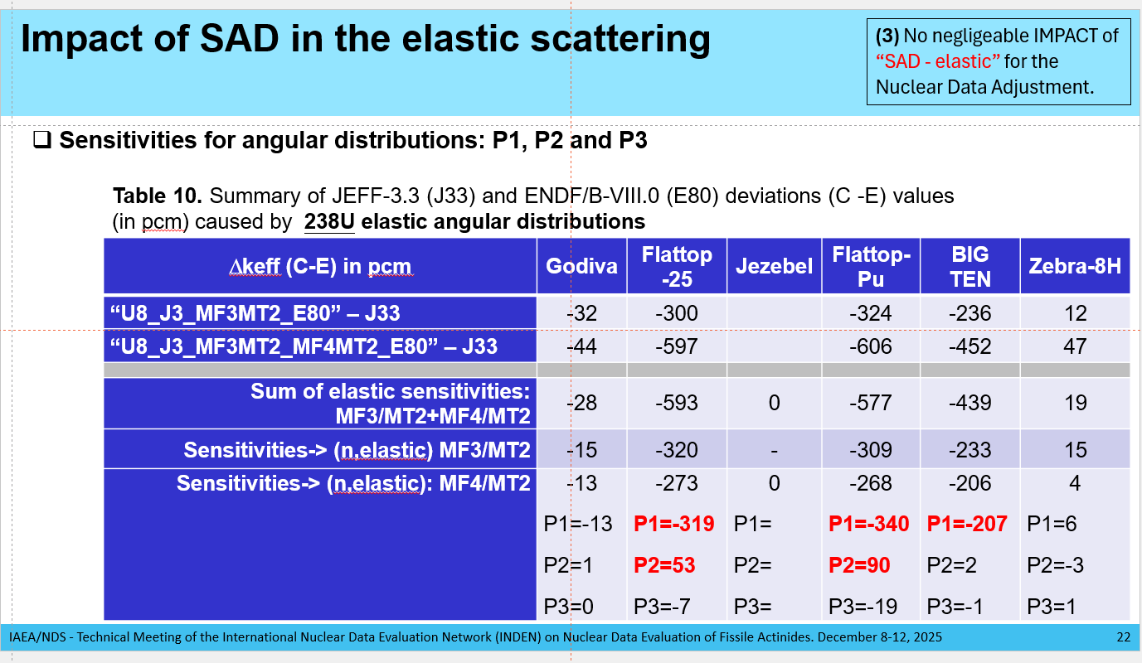
3. UPM Activities in EU/APRENDE
Analysing Differences of Evaluated ND for 235U, 238U, and 239Pu in the Fast Energy Region with a Focus on Angular Distributions
ND-2025, INDEN/ACT-2025 and PHYSOR-2026
(3) No negligeable IMPACT of SAD in elastic in Godiva for 238U
19

Slide 20
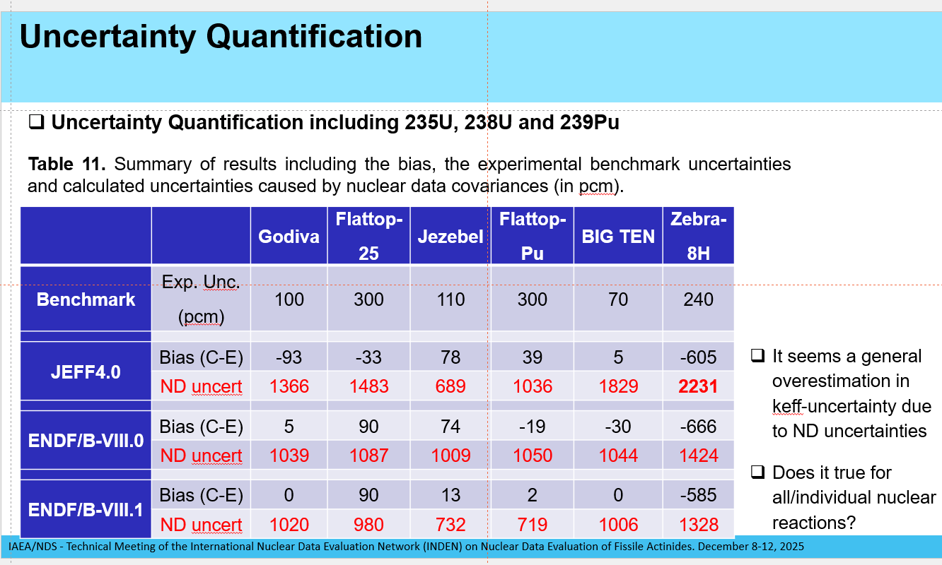
3. UPM Activities in EU/APRENDE
Analysing Differences of Evaluated ND for 235U, 238U, and 239Pu in the Fast Energy Region with a Focus on Angular Distributions
ND-2025, INDEN/ACT-2025 and PHYSOR-2026
(4) Uncertainty Quantification: For some reactions, the deviations in the evaluations are larger than the associated uncertainties
Table. Main contributions (> 100 pcm) to the JEFF-3.3 (“J33”) vs ENDF/B-VIII.0 (“E80”) multiplication factor deviations in pcm.
Comparison with uncertainties from the nuclear covariance data (values in pcm)
Case | Main contributor | E80/J33* Substitution MF/MT | E80/J33 Perturbation S/A | JEF-3.3 =JEFF-4.0 uncertainty | ENDF/B-VIII.0 uncertainty | ENDF/B-VIII.1 uncertainty
Godiva | U235(n,n’) | -234 | 22 | 695 | 236 | 236
Flattop-25 | U238(n,n’) | 430 | 440 | 444 | 282 | 282
 | U238(n,n) | -300 | -320 | 141 | 354 | 354
 | U235(n,n’) | -255 | -49 | 324 | 100 | 100
 | U238(n,gamma) | -182 | -198 | 129 | 80 | 80
Jezebel | Pu239(n,n’) | 742 | 773 | 131 | 679 | 578
 | Pu239(n,n) | -339 | -337 | 101 | 528 | 393
 | Pu239(n,chi) | 189 | 189 | 509 | 217 | 95
Flattop-Pu | U238(n,n’) | 349 | 382 | 453 | 266 | 266
 | U238(n,n) | -324 | -309 | 125 | 342 | 342
 | Pu239(n,n’) | 254 | 274 | 43 | 236 | 191
 | Pu239(n,chi) | 199 | 180 | 553 | 232 | 100
 | U238(n,gamma) | -157 | -166 | 110 | 67 | 67
 | Pu239(n,n) | -141 | -128 | 35 | 201 | 156
BigTen | U238(n,gamma) | -970 | -985 | 614 | 396 | 396
 | U238(n,n’) | 490 | 501 | 506 | 267 | 267
 | U238(n,n) | -236 | -233 | 126 | 262 | 262
 | U238(n,fission) | 211 | 216 | 390 | 178 | 178
ZEBRA-8H | U238(n,gamma) | -1463 | -1456 | 860 | 583 | 582
 | U235(n,gamma) | 327 | 320 | 446 | 299 | 299
 | U238(n,fission) | 207 | 229 | 394 | 182 | 182
 | U235(n,n’) | 127 | 38 | 136 | 43 | 43
 | U238(n,n’) | -39 | -207 | 1326 | 786 | 786
20

Slide 21
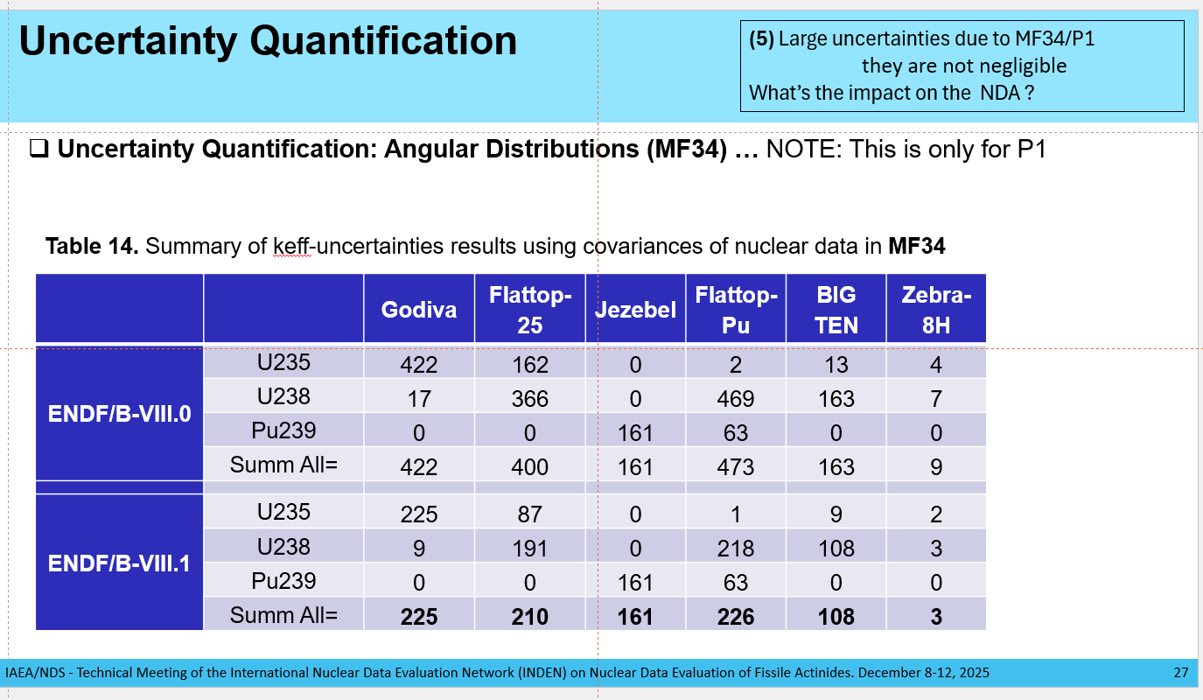
3. UPM Activities in EU/APRENDE
Analysing Differences of Evaluated ND for 235U, 238U, and 239Pu in the Fast Energy Region with a Focus on Angular Distributions
ND-2025, INDEN/ACT-2025 and PHYSOR-2026
(5) Large uncertainties due to MF34/P1 they are not negligible. What’s the impact on the NDA if it is neglected?
21

Slide 22
4. Future and Challenges in JEFF-4.1
See F. Michel-Sendis talk in P(ND)²-2, 2014
(https://www.oecd-nea.org/science/meetings/pnd22/presentations/2-MICHEL-SENDIS.pdf)
Motivations for “JEFF-4”
JEFF-4 (4Cs?): Completeness, Consistency, Covariance and Credibility (by R. Jacqmin)
“Next decade” : JEFF-4 after 2020 ?
Leap forward warrants a change : JEFF “Business as usual” practices will not meet the qualitative leap needed.
Motivations for “JEFF-4.1” … evolving the 4Cs toward 2030-2035
An example, to supporting SMR deployment
Completeness→ Application-Relevant Completeness
Coverage focused on what matters most for advanced reactor applications
Consistency → Integral-Consistent Evaluation
Data that are physically coherent and reproduce relevant integral benchmarks
Covariance → Decision-Ready Covariance
    Uncertainty information that directly supports reliable design decisions
Credibility → Licensing-Oriented Confidence
    Demonstrated performance in benchmarks representative of target systems
22

Slide 23
5. Conclusion… final reflections
How do we learn from the past activities?
  CASE1: Pu-239 evaluation at thermal energies in JEFF-3.3 - hidden issues emerging from PST-034 benchmarking… we need AI/ML!
  CASE 2: Burnup issue in JEFF-3.3 - hidden issues from TMI pin-cell burnup… we need expert judgment (by e-mail A. Santamarina , 2016)!
  CASE 3: How to improve discussions between evaluators (CIELO/SG40, INDEN, …) and users (WPEC/SG39, SG46,…- Nuclear data adjustment) for improvement of nuclear data files – WPEC/SG52?
Other issues that may affect future nuclear data evaluations, of course, my personal view…
  A risk is the low compilation rate of experimental data in EXFOR… see following websites
      https://nds.iaea.org/exfor-master/x4compil/exfor_input.htm: The table shows updated EXFOR entries per year
      https://nds.iaea.org/nrdc/alloc/: The table at the top shows EXFOR entries since the last NRDC meeting
  Some final reflections:
      The era of AI/ML … how do we integrate these tools into the evaluation of nuclear data?
      The era of Open Science… how do we promote transparency while preserving strategic autonomy in codes and data?
      The era of global collaboration …. are we losing dedicated technical spaces for nuclear data discussion & dissemination?
23

Slide 24
Thank you !
24

Slide 25
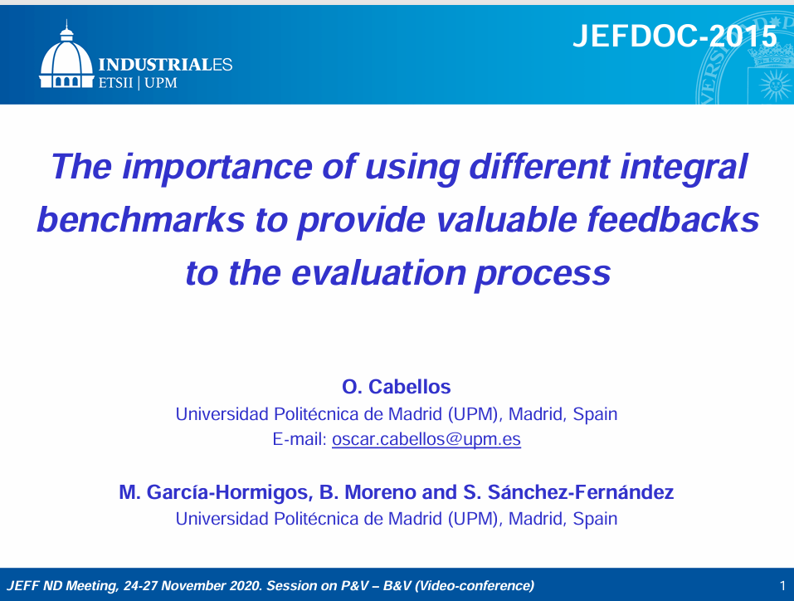
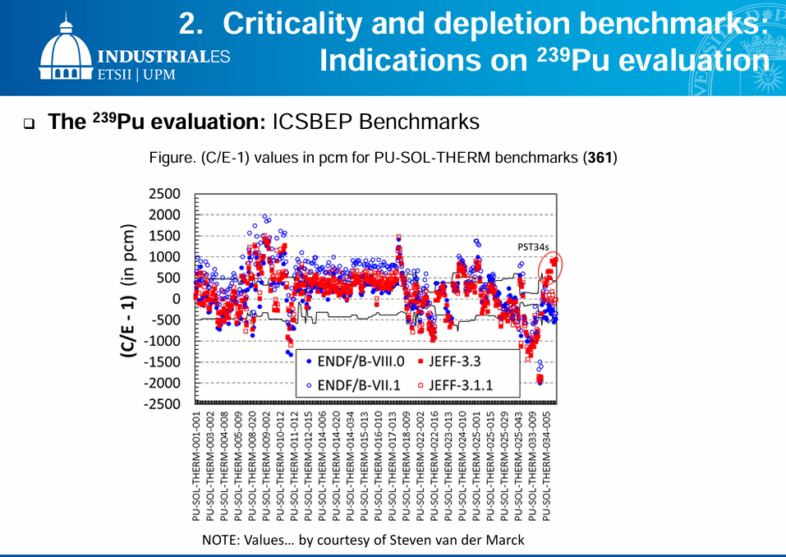
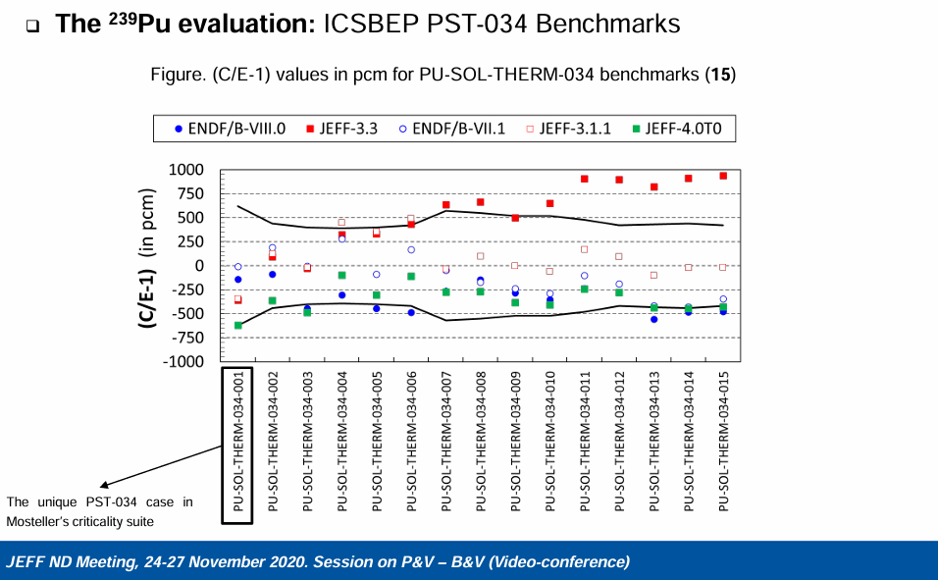
ANNEX I: “Pu-239 evaluation at thermal energy in JEFF-3.3”
  CASE1: “Pu-239 evaluation at thermal energy in JEFF-3.3”…hidden issues within PSTs benchmarking … we need help provided by AI/ML!
25

Slide 26
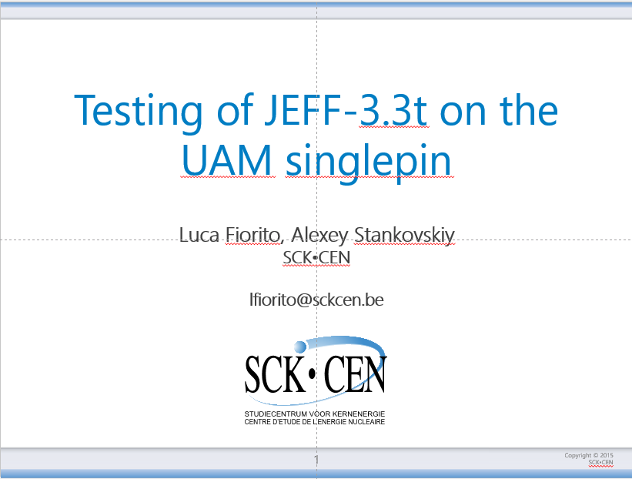
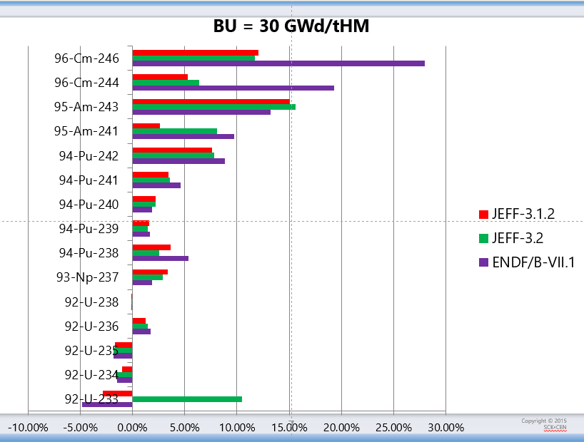
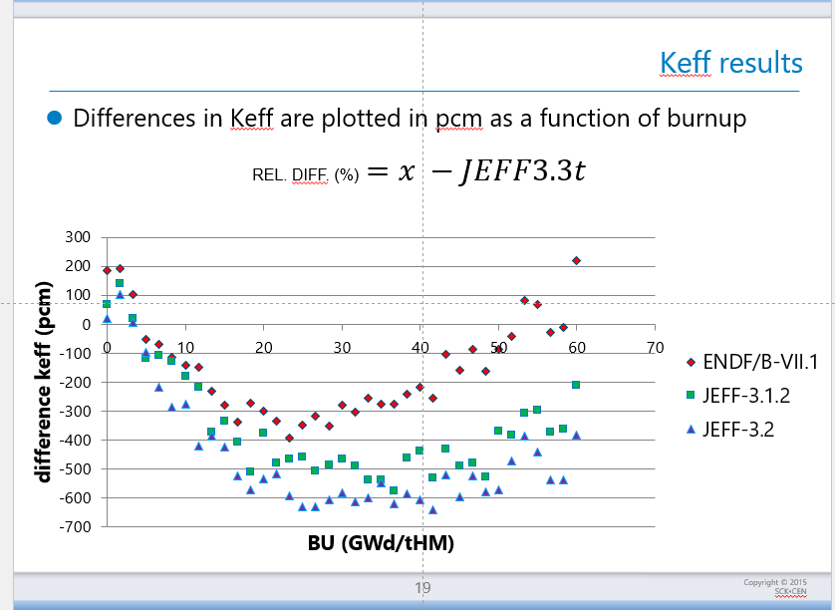

ANNEX II: “Burnup issue in JEFF-3.3”
REL. DIFF. (%)$=\frac{x −JEFF3.3t}{JEFF3.3t}$
27 April 2016 … (JEFF-3.3 is released in Nov 2027)
Lack of JEFF partners working in burnup, only SCK·CEN
B&V work mainly devoted to criticality in ICSBEP
Significant changes in major isotopes in the last JEFF-3.3T versions
  CASE 2: “Burnup issue in JEFF-3.3”… we need expert judgment !
26

Slide 27
ANNEX II: “Burnup issue in JEFF-3.3”
-----Message d'origine-----
De : Oscar.Cabellos@oecd.org [mailto:Oscar.Cabellos@oecd.org] Envoyé : vendredi 29 avril 2016 12:08 À : SANTAMARINA Alain 081917 Objet : RE: Burnup calculations with JEFF33T1
Dear Alain
Thanks a lot for your comments on this presentation. I have included your comments in the session of JEFF/CG and they are appreciated very much your comments.
Most of the times the impact on burnup calculations is forgotten in the Benchmarking phase before release a new library. From my point of view, these calculations are important to complete the general performance of the library.
Thanks again!! I will keep you informed on new steps in the benchmarking of JEFF-3.3T2.
My best regards
Oscar Cabellos, Ph.D.
Nuclear Data Scientist, NEA Data Bank
-----Original Message-----
From: SANTAMARINA Alain 081917 [mailto:alain.santamarina@cea.fr]
Sent: 28 April 2016 11:44 AM
To: CABELLOS Oscar, NEA/DB
Subject: RE: Burnup calculations with JEFF33T1
Dear Oscar,
This actinide build-up with burnup in JEFF3.3T is fully wrong in my opinion : From all the French PIEs, it is clear that the current Pu isotopic content is correct with JEFF3.1.1 (or JEFF3.1.2).
On the contrary, Pu238 is in the wrong direction for JEFF33, and all the other Pu isotopes are clearly underestimated (as well as U236) for current LWR burnups in this presentation
Kind regards
Alain
-----Message d'origine-----
De : Oscar.Cabellos@oecd.org [mailto:Oscar.Cabellos@oecd.org] Envoyé : mercredi 27 avril 2016 08:27 À : SANTAMARINA Alain 081917 Objet : Burnup calculations with JEFF33T1
Dear Alain
Sorry for disturb you, I need your advice and comments about the attached presentation.
We are in the JEFF meeting, and your comments will be very much appreciated.
Could you conclude something from the new JEFF33T1 library comparing the data from other evaluations?
My best regards
Oscar Cabellos
NEA Data Bank
27

Slide 28


Acknowledgments
This work is part of the APRENDE project (Addressing PRiorities of Evaluated Nuclear Data in Europe) that has received funding from the European Union’s HORIZON-EURATOM
under grant agreement No. 101164596
28

Slide 29
ANNEX III: UPM Activities in EU/APRENDE
October 2024 – March 2026
CSEWG
[1] O. Cabellos, “ENDF/B-VIII.1 Covariance Testing”, CSEWG Meeting November 4-8, 2024
IAEA
[2] O. Cabellos, “Some User' Feedbacks and Potential new Demands”, IAEA TM on Nuclear Data Retrieval, Dissemination, and Data Portals – November 11-5, 2024
[5] O. Cabellos, “Benchmarking and validation of 235U(nth,f) and 239Pu(nth,f) JEFF-4 fission yield evaluations. Uncertainty quantification using new correlation matrices”, 3rd Research Coordination Meeting on Updated FY Data for Applications – December. 2-6, 2024
[6] O. Cabellos, “Benchmark of evaluation changes in 232Th, 233U, 235U and 239Pu”, Technical Meeting of INDEN on ND Evaluation of Fissile Actinides – December 9-13, 2024
JEFF Meetings
[3] O. Cabellos, “Assessing the Impact of JEFF-4T4 FY (Correlations) in Depletion Calculations”, JEF/DOC-2373, JEFF November Meeting “Fission Observables Session” – November 25-28, 2024
[4] O. Cabellos, N. Otsuka, L. leal, “A Tentative Evaluation of 233U Neutron Capture Cross-Section in keV Energy Region”, JEF/DOC-2377, JEFF November Meeting “Evaluation Session” – November 25-28, 2024
[7] O. Cabellos, I. Kodeli, W. Zwermann, I. Hill, N. Garcia-Herranz, “Review on Compensating Effects in keff: The Importance of the Sensitivities to the Secondary Energy Distributions of the Inelastic Scattering”, JEF/DOC-2413, JEFF Nuclear Data Week - Evaluation Session, April 15, 2025
[8] O. Cabellos, “Feedbacks on Processing and Benchmarking for JEFF4-T5 (official release February 27th, 2025)”, JEF/DOC-2421, JEFF Nuclear Data Week - Evaluation Session, April 14-18, 2025
[9] N. García-Herranz, O. Cabellos, A. Jiménez-Carrascosa, W. Zwermann, Evaluating JEFF4T5 for the modelling and simulation of liquid metal fast reactors (updating JEFDOC-2352), JEFF Nuclear Data Week, 14-19 April 2025, JEFDOC-2433
29

Slide 30
ANNEX III: UPM Activities in EU/APRENDE
16th Nuclear Data for Science and Technology Conference (ND2025), Madrid, (Spain), June 22-27, 2025.
[10] G. F. Garcia-Fernández, N. García-Herranz, O. Cabellos, “Activation in proton therapy centers depending on type of concrete and nuclear data”
[11] O. Cabellos, M. Cotelo, D. Cuervo, G.F. García, N. García-Herranz, E. Oliva, “Nuclear data Education and Training at the Universidad Politécnica de Madrid: The CDIO/INGENIA-NUCLEAR Experience and the Active Learning/GreatPioneer Project”
[12] O. Cabellos, I. Kodeli, W. Zwermann, I. Hill, N. Garcia-Herranz, “Analysing Differences of Evaluated Nuclear Data for 235U, 238U, and 239Pu in the Fast Energy Region with a Focus on Angular Distributions”
[13] Nuria García-Herranz, Oscar Cabellos, Emilio Castro, Ian Hill, David Sauvan, “Towards establishing experimental correlations among criticality experiments for reliable data assimilation studies”
[14] Alejandro Marro, Nuria García-Herranz, Emilio Castro, Oscar Cabellos, Kostadin Ivanov, “On the potential of H.B. Robinson-2 benchmark for nuclear data validation”
[15] Ismael Manzano, Nuria García-Herranz, Oscar Cabellos, Emilio Castro , “Nuclear Data Sensitivity Analysis of Key Parameters for eVinci-like Heat Pipes Nuclear Microreactors”
[16] Iñigo Gayo, Emilio Castro, Oscar Cabellos, Nuria García-Herranz, Diana Cuervo, Kostadin Ivanov, “Nuclear Data Validation Using LWR Measurements: Insights from the OECD/NEA TVA-WB1 Benchmark”
NRDC-2025
[17] O. Cabellos, “Some User' Feedbacks and Potential new Demands”, NRDC-2025 Meeting, Madrid (Spain) June 19, 2025.
PHYSOR-2026
[18] O. Cabellos, N. García-Herranz, I. Hill, I. Kodeli, W. Zwermann, “Impact of Nuclear Data Uncertainties of 235U, 238U, and 239Pu in Benchmarks Representative of Small Fast Reactors”, PHYSOR 2026 - The International Conference on Physics of Reactors · Torino, Italy · April 19 – 23, 2026
SNE-2025
[19] D. Cuervo, M.N. Avramova M.N., A. Abarca A.SEFOR experiment case modelling: first step to S/U in SFR transient analysis using CTF at the APRENDE project, SNE 2025.reunión Annual Sociedad Nuclear Española, Cáceres España. September 25, 2025
30

