Slide 1
A perspective on the role of integral benchmarks for improving nuclear data
Steven van der Marck
P(ND)²-3, Paris, 9–13 March 2026

Slide 2
A (selective) look back at 20 or 10 years ago
Now
Possibilities for the near future

Slide 3
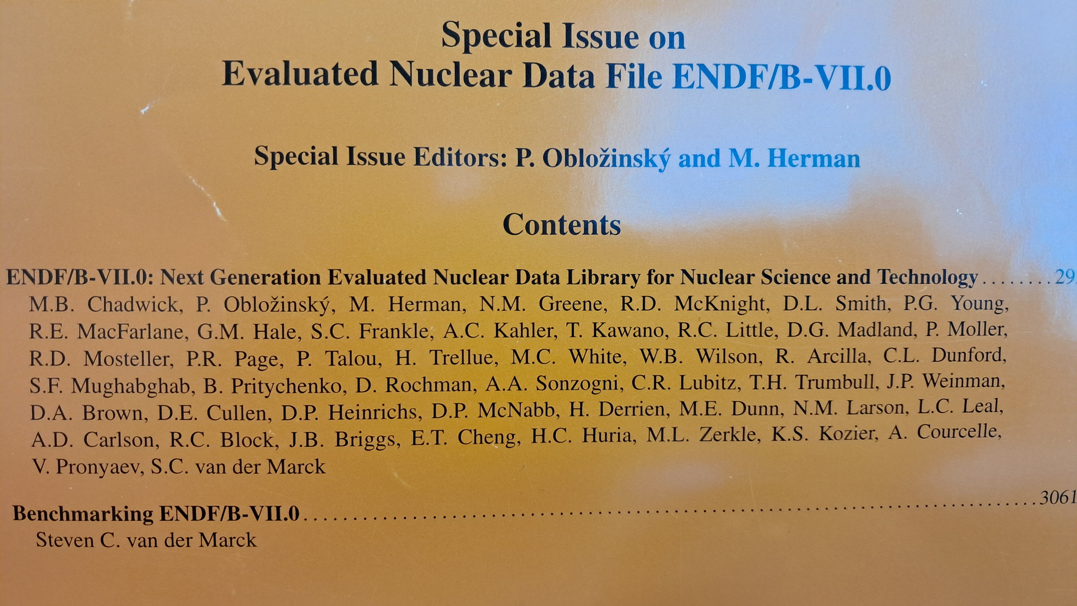
20 years ago – Bird’s eye view
2002 JEFF-3.0 released
2005 JEFF Report 19: The JEFF-3.0 Nuclear Data Library
2006 ENDF/B-VII.0 NDS special issue
796 criticality safety benchmarks
Shielding, mostly fusion (FNS, LLNL spheres, Oktavian)
Delayed neutron (20 β_{eff}, 11 Rossi-α)
JEFF Report: fission products and ²⁴¹Pu

Slide 4
10 years ago – Bird’s eye view
2017 JEFF-3.3 released
2018 ENDF/B-VII.0 NDS special issue
2020 EPJ paper on JEFF-3.3
796 → 2530 criticality safety benchmarks; plots per category; results ‘per institute’
Shielding: Fusion source: + FNG, IPPE, Rez; Fission source: Aspis-Fe88, Tiara
Delayed neutron
Reaction rates (Godiva, BigTen, ….)
Boron concentration burnup (up to 11.4 GWd/tHM)
Decay heat
MACS

Slide 5
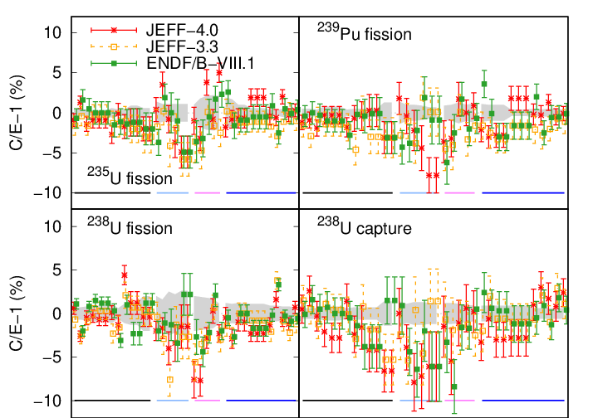
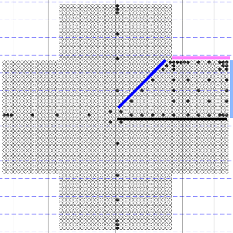
Now – Bird’s eye view
2024 ENDF/B-VIII.1 released
2025 JEFF-4.0 released
2026? NDS special issue ENDF/B-VIII.1
2027? EPJ paper on JEFF-3.3
2530 → 3192 criticality safety benchmarks; independent of code, processing, institute
Shielding: Fission source: + PCA Replica, ORNL PCA
Delayed neutron → kinetic parameters
Reaction rates: + FCA (fast) and Venus-F, Dimple (thermal)
Power maps (Watts Bar benchmark, NPPs)
Critical measurements and boron concentration (NPPs Sizewell B, Tihange, Doel)
Depletion (Duke benchmark, NPPs Fessenheim, Almaraz-2, Turkey Point-3)
Decay heat
MACS
Gamma production

Slide 6
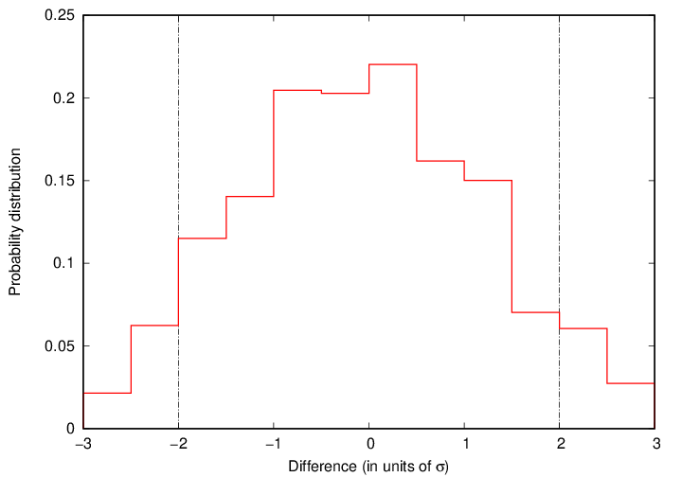
Criticality safety: code & processing independence
MORET-6 and NJOY2016.78 (IRSN)
MONK-12B and NJOY2016.30 (Amentum)
Serpent-2.2.1 and NJOY2016.78 (NEA Data Bank)
MCNP-6.2 and NJOY2016.78 (PSI and NRG Pallas)
Number of cases with good agreement:
Moret-6 and MCNP-6.2: 900
Serpent-2.2.1 and MCNP-6.2: 650
MONK-12B and MCNP-6.2: 600

Slide 7
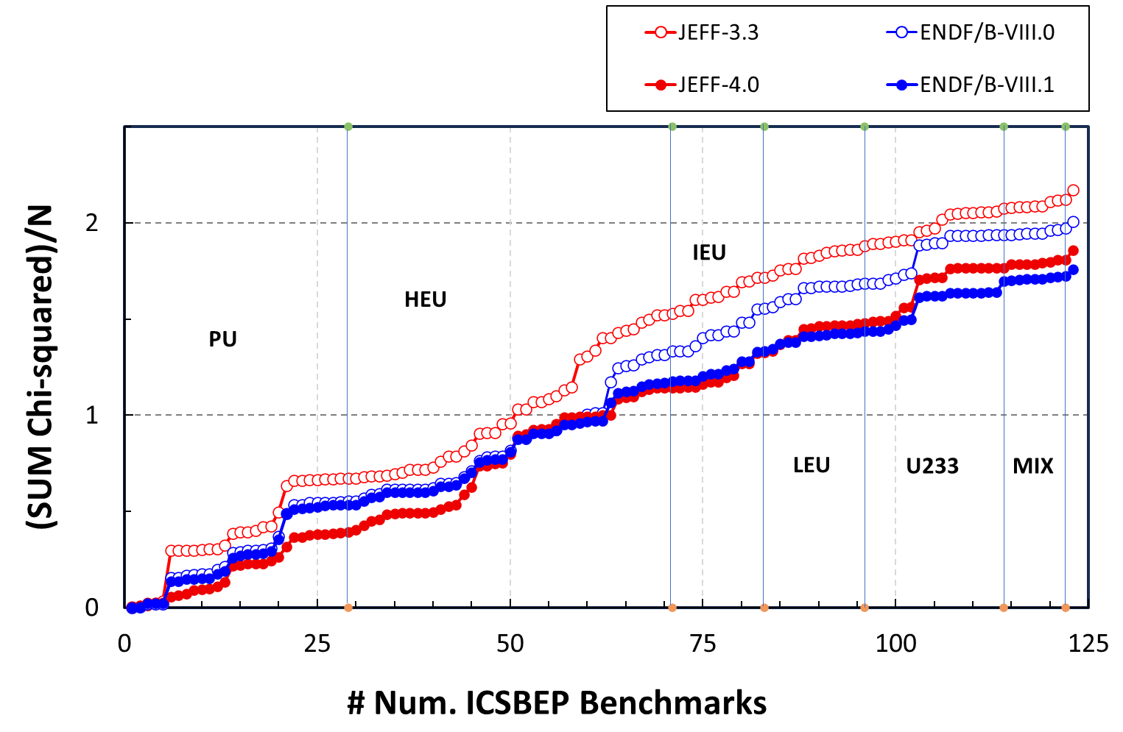
χ² for Mosteller suite
123 cases

Slide 8
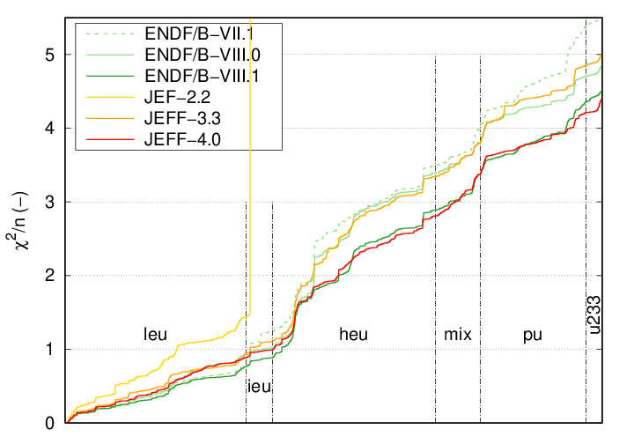
χ² for 3857 cases

Slide 9
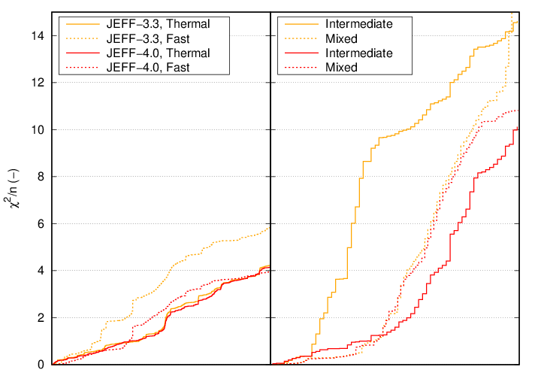
χ² per spectrum category

Slide 10
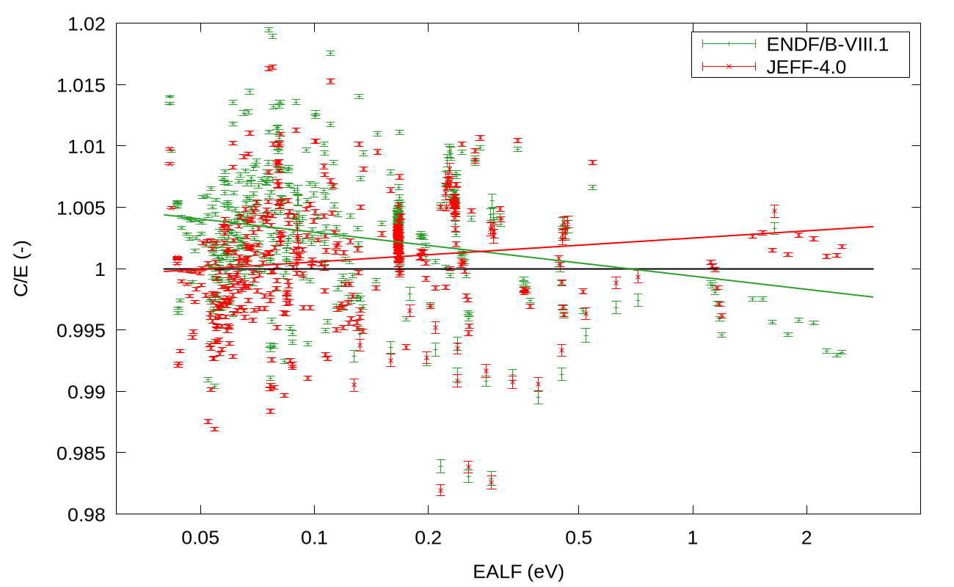
Pu-sol-therm vs EALF

Slide 11
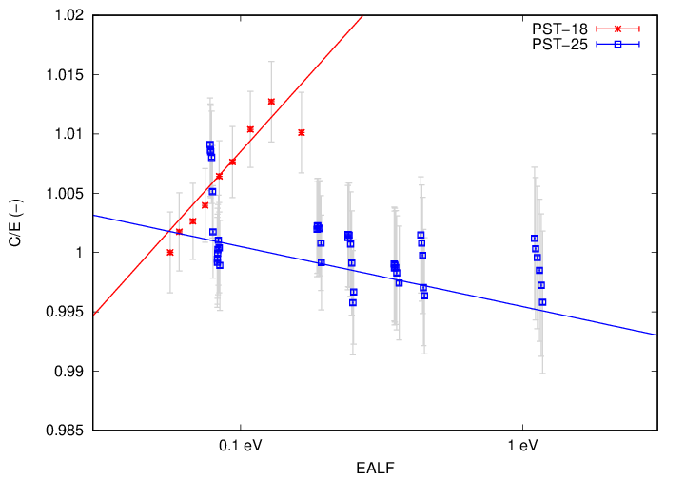
Pu-sol-therm: conflicting information?
pst-1 | 5.02e-03
pst-2 | 1.09e-02
pst-3 | 1.42e-02
pst-4 | 9.99e-04
pst-5 | 2.15e-02
pst-6 | 2.34e-02
pst-7 | 6.97e-03
pst-8 | −1.87e-03
pst-9 | 9.99e-04
pst-10 | 1.85e-02
pst-11 | 5.01e-02
pst-12 | 5.27e-03
pst-13 | 1.00e-03
pst-14 | 1.00e-03
pst-15 | 1.00e-03
pst-16 | 7.77e-04
pst-18 | 1.15e-02
pst-20 | −2.27e-03
pst-21 | 1.15e-03
pst-22 | 9.99e-04
pst-23 | −2.33e-02
pst-25 | −2.20e-03
pst-28 | −1.58e-03
pst-30 | −4.40e-03
pst-32 | −7.88e-03
pst-34 | −2.31e-04
pst-38 | 2.15e-02
pst-41 | −1.74e-04
PST-25
PST-18

Slide 12
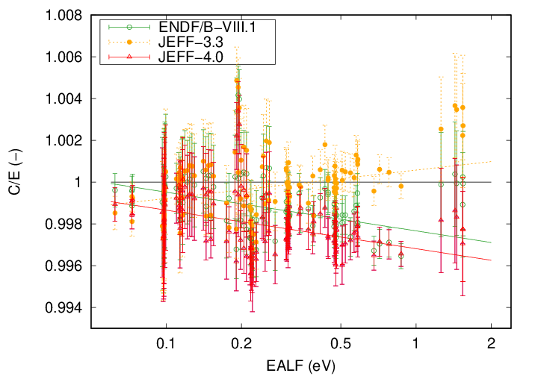
Basic fuel array lattices vs EALF

Slide 13
Possibilities for improvement
Sensitivity profiles – do we use their full potential?
One element at a time
Benchmarks: case by case
Benchmark selection
Adjustment

Slide 14
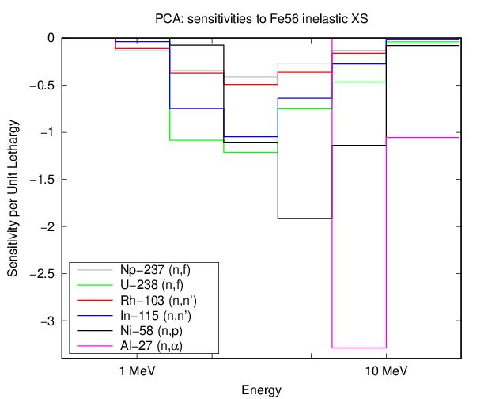
Sensitivity profiles – do we use their full potential?
Based on Fe shielding benchmarks (Asips-Fe88, ORNL PCA, PCA Replica):
Fe has improved significantly
Some difficulties in intermediate energy range
There are many reaction rate measurements at many distances → many sensitivity profiles

Slide 15
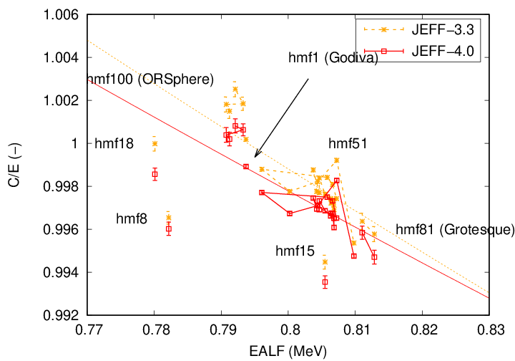
One element at a time?
First have a look at benchmarks with HEU (almost) only

Slide 16
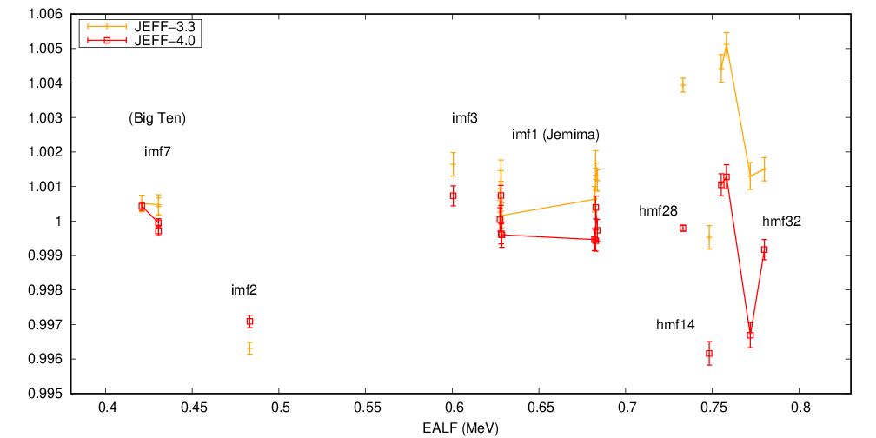
One element at a time?
Then with IEU … and with U-nat or U-dep reflectors

Slide 17
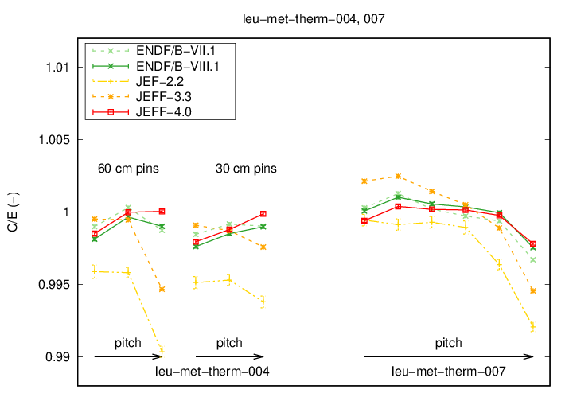
One element at a time?
Then add water
… then e.g. Al, or Fe … etc.

Slide 18
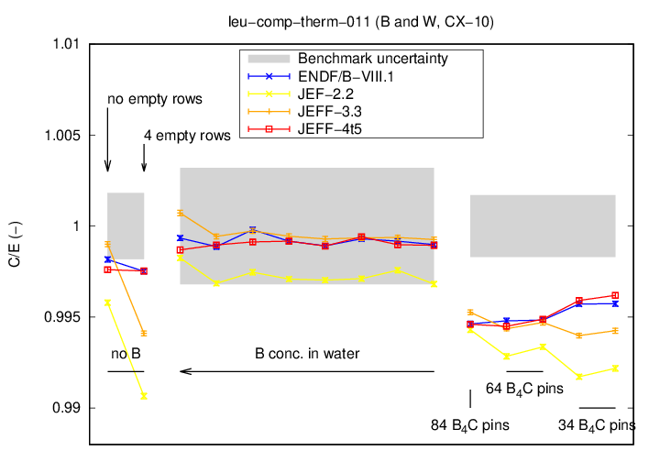
Benchmarks case by case? (see also appendix)
Often, the configurations of different cases of the same benchmark series have been selected carefully. Comparison between selected cases can reveal information.
Spectrum variation
Reflector thickness
Absorber concentration
…

Slide 19
Benchmark selection?
Results for various pu-sol-therm benchmarks seem to contradict each other.
Should we rank benchmarks? Or, perhaps even better, select some and not use others?
One possibility (JEFDOC-2485, Carmen Sánchez Martín, Mariya Brovchenko, ASNR):
Choose various experimental data sets
Use an automated ND adjustment procedure to quantify the impact of individual data sets
If one data set worsens the performance for other benchmarks, then consider dropping it.
ND parameters
“Experimental” benchmarks
ND adjustment
Feedback on the ND parameters
Feedback on the benchmarks (consistency analysis)
Towards a more reliable benchmark database

Slide 20
Adjustment?
JEFF-4.0 and ENDF/B-VIII.1 have been developed while looking closely at the impact on integral benchmarks.
One could, for specific purposes, adjust the library to improve its performance for that purpose.
These days it should be possible to do this while respecting microscopic data.
Recent examples
JEFDOC-2380 (Mathieu Hursin) asymptotic GLLS to adjust Pu evaluations
EFFDOC-1553 (Mathieu Hursin) W-183 data assimilation with TMC & the Petten method

Slide 21
Conclusion
The use of integral benchmarks for testing and/or improving nuclear data has increased significantly over the years.
There is room for further improvement, by
Perhaps not using all available benchmarks
Looking at the details of benchmark cases
Creating a (automatic) feedback loop, through sensitivities or perturbations

Slide 22
Acknowledgment This work is part of the APRENDE project (Addressing PRiorities of Evaluated Nuclear Data in Europe) that has received funding from the European Union’s Horizon/Euratom under grant agreement No. 101164596

Slide 23
EU DuC = X This document may contain information that may be subject to European and/or national export authorization. Any transfer or disclosure of the information contained in this document which requires an export license will not be made without the authority of an export license demanded by the competent authorities. The exporter is responsible for obtaining the export license. No rights may be derived from the (absence of an) EU DuC.
^{Disclaimer}

Slide 24
Appendix
Criticality safety benchmark cases
Basic fuel rod lattices
Spectrum variation
Strong absorbers (mostly B, Gd)
Reflectors
Plutonium solutions
Special element: F
Miscellaneous

Slide 25
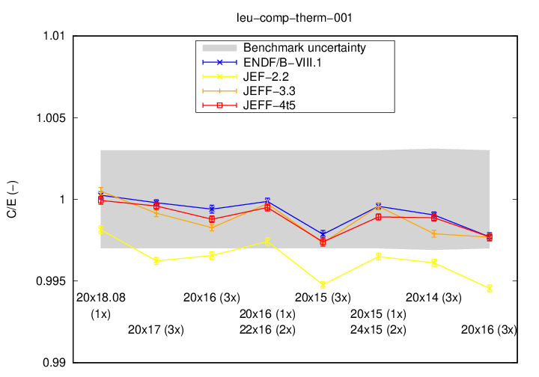
Basic fuel rod lattices

Slide 26
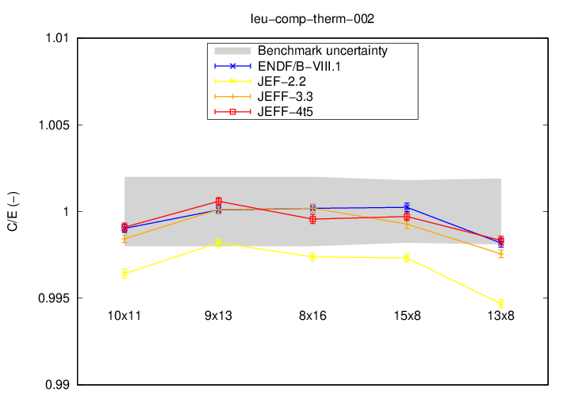
Basic fuel rod lattices

Slide 27
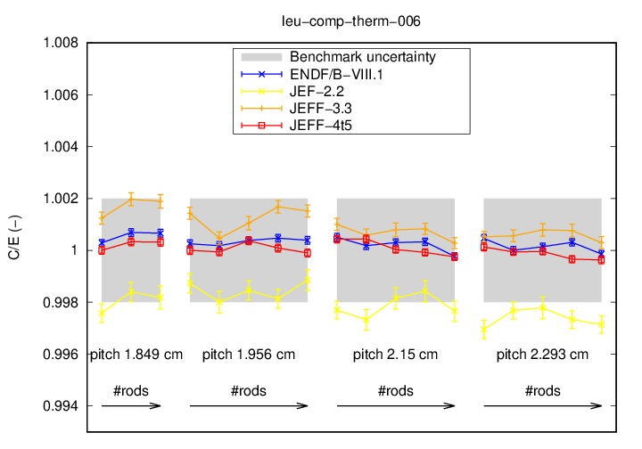
Basic fuel rod lattices

Slide 28
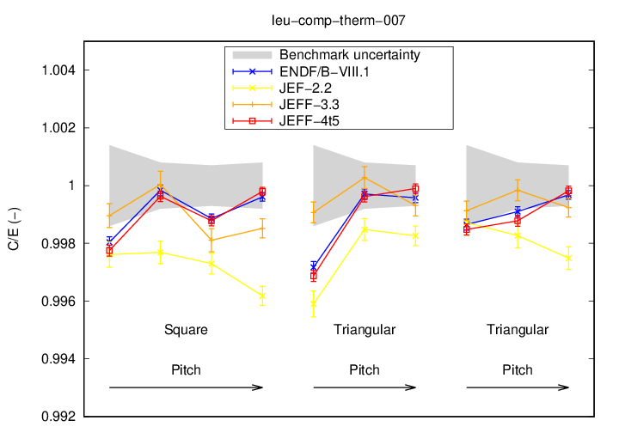
Basic fuel rod lattices

Slide 29
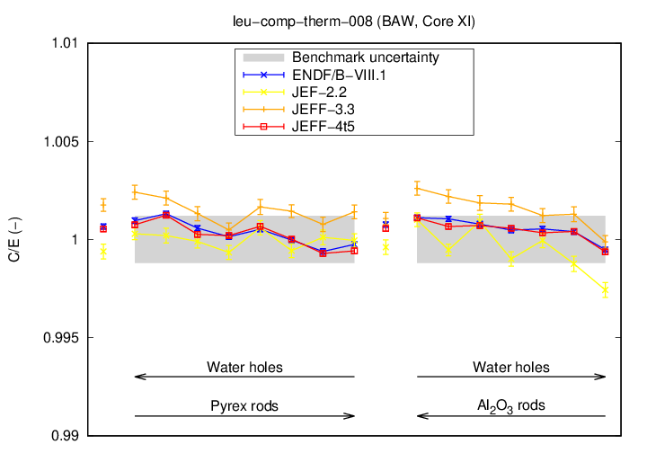
Basic fuel rod lattices

Slide 30
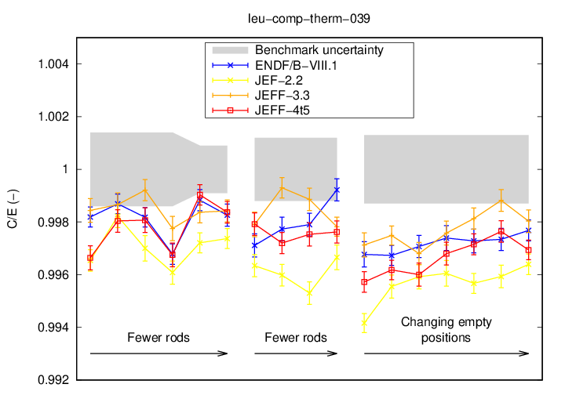
Basic fuel rod lattices

Slide 31
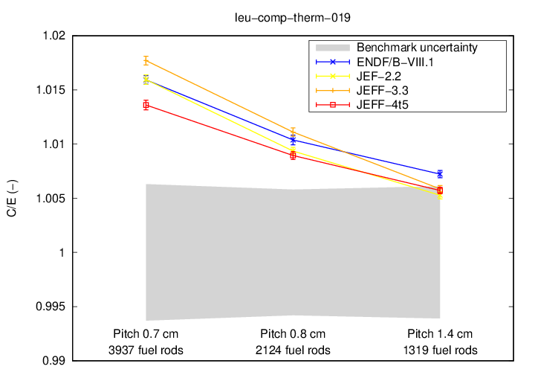
Basic fuel rod lattices

Slide 32
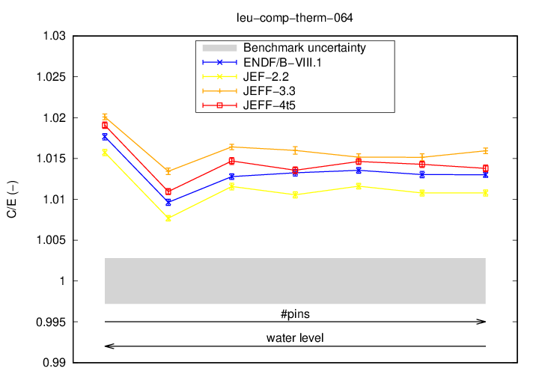
Basic fuel rod lattices

Slide 33
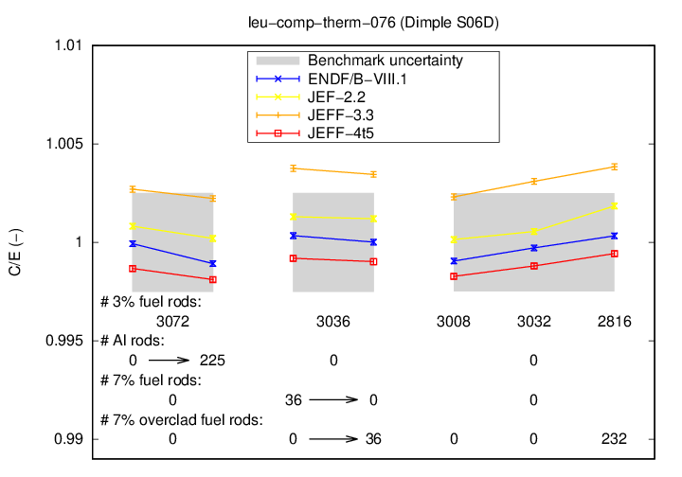
Basic fuel rod lattices

Slide 34
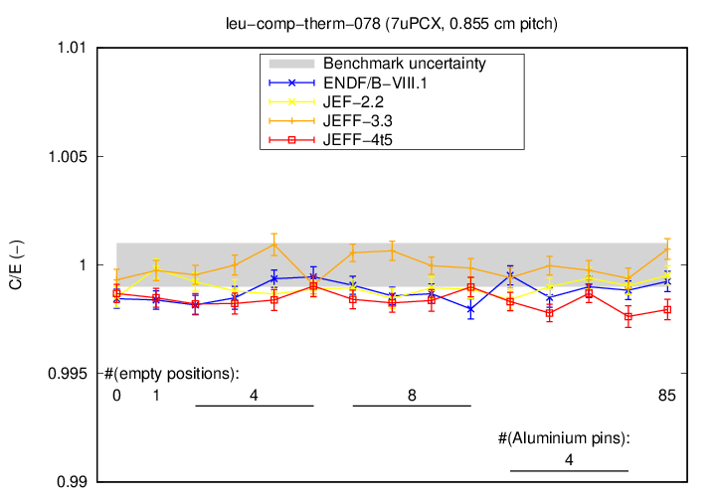
7% UO2 pin lattices (7uPCX)

Slide 35
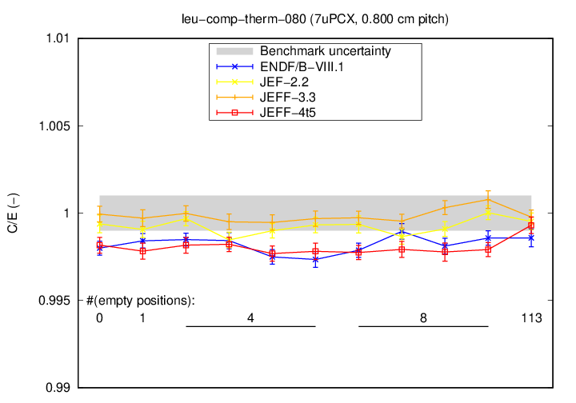
7% UO2 pin lattices (7uPCX)

Slide 36
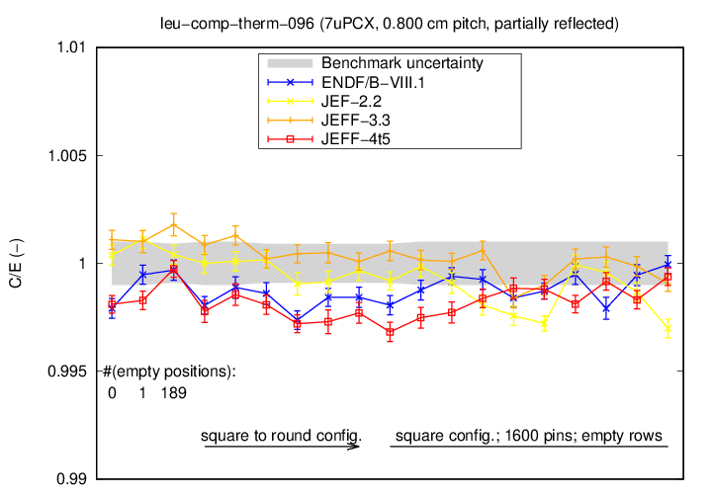
7% UO2 pin lattices (7uPCX)

Slide 37
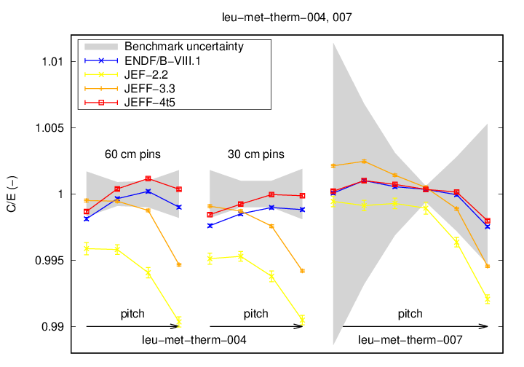
Spectrum variation

Slide 38
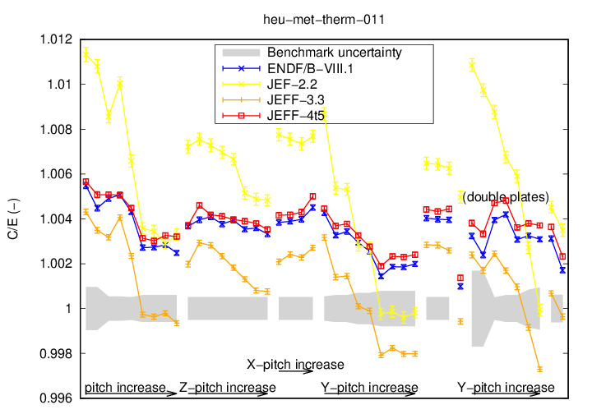
Spectrum variation

Slide 39
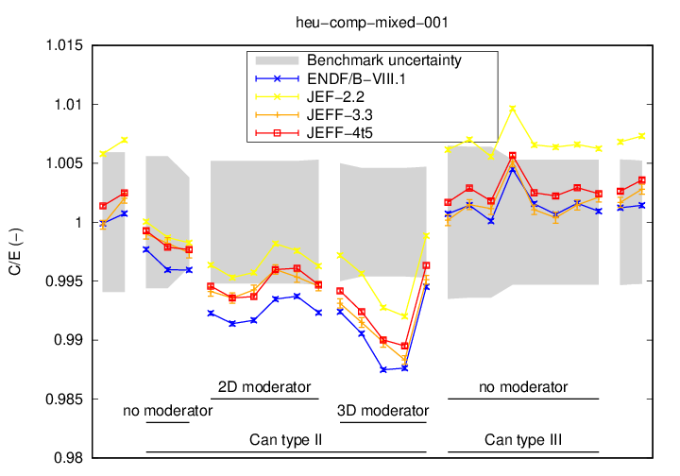
Spectrum variation

Slide 40
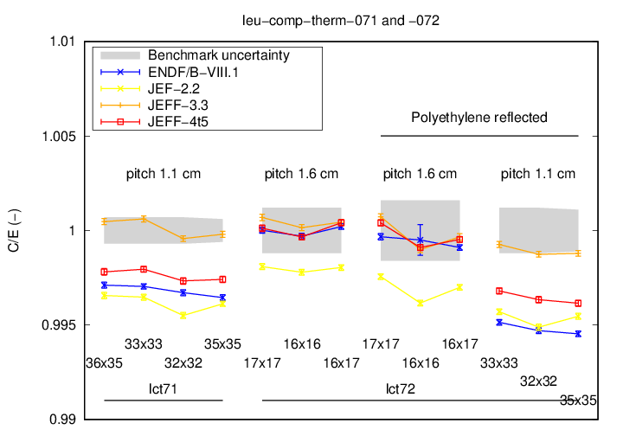
Spectrum variation

Slide 41
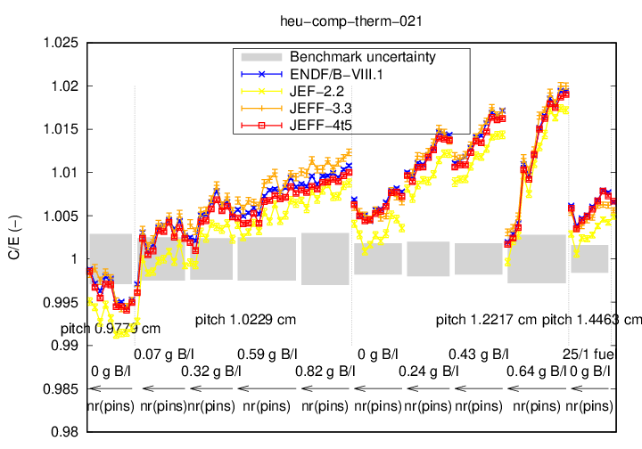
Strong absorbers: B

Slide 42
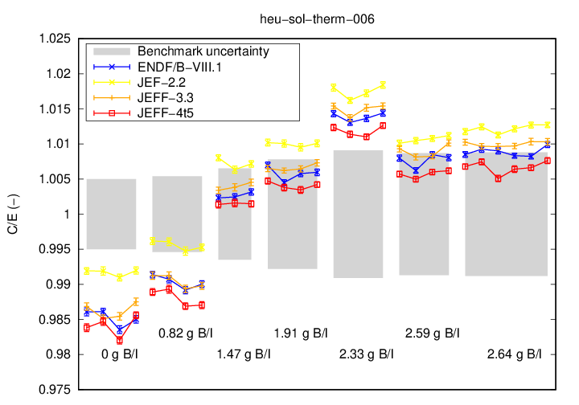
Strong absorbers: B

Slide 43
Strong absorbers: B

Slide 44
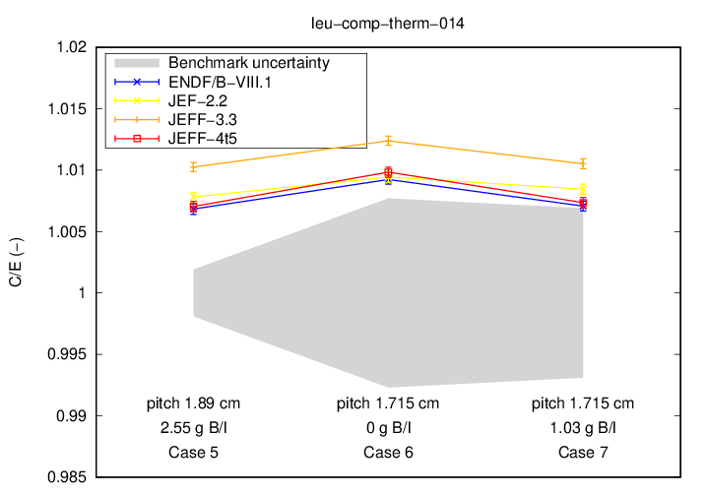
Strong absorbers: B

Slide 45
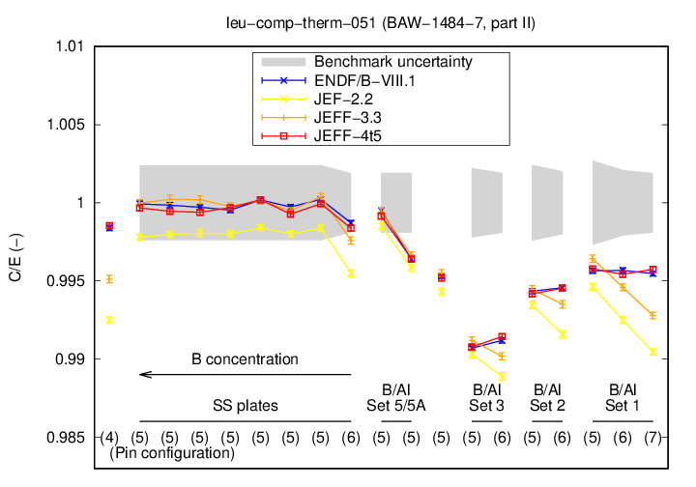
Strong absorbers: B

Slide 46
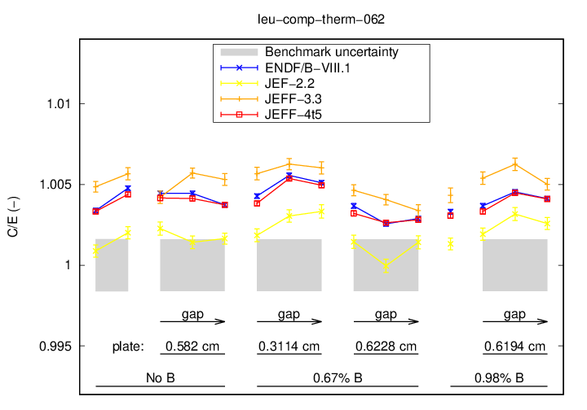
Strong absorbers: B

Slide 47
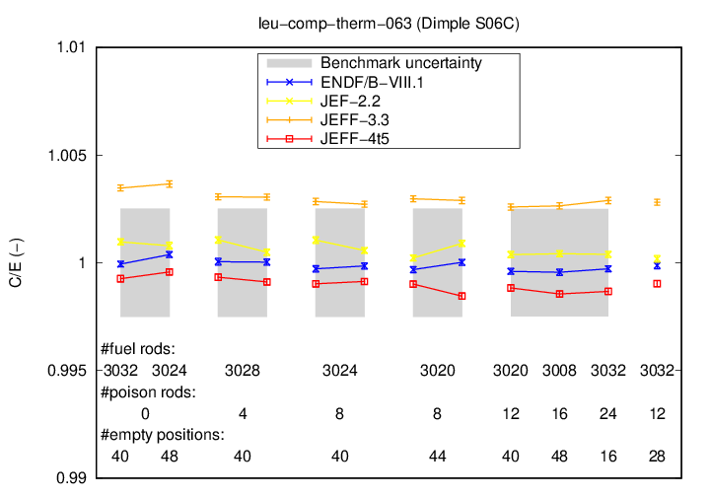
Strong absorber: B (borosilicate)

Slide 48
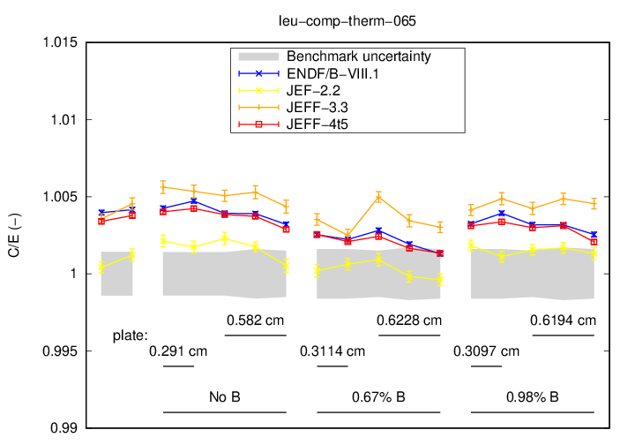
Strong absorbers: B

Slide 49
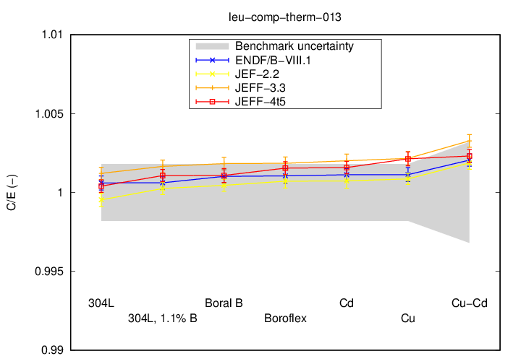
Strong absorbers: B, Gd, Cu

Slide 50
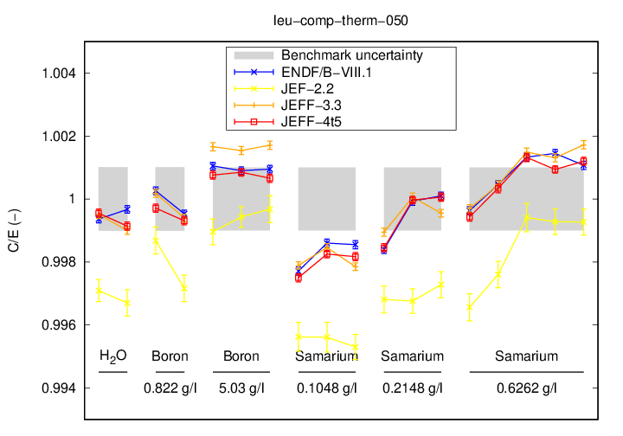
Strong absorbers: B, Sm

Slide 51
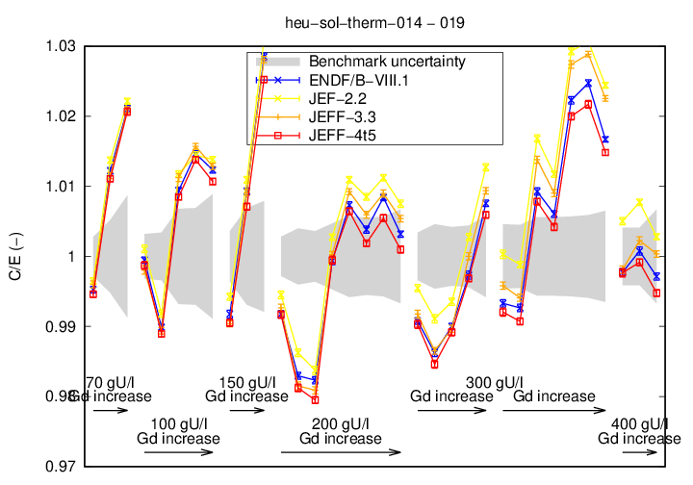
Strong absorbers: Gd

Slide 52
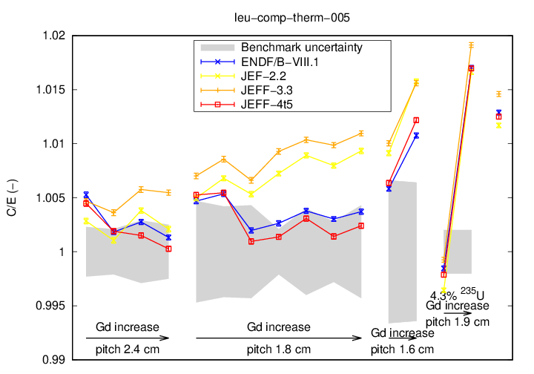
Strong absorbers: Gd

Slide 53
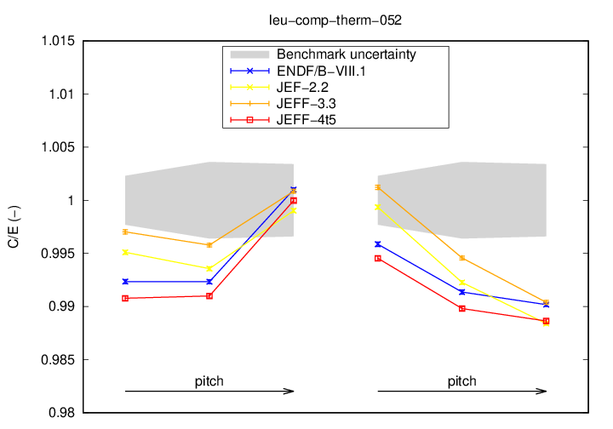
Strong absorbers: Gd

Slide 54
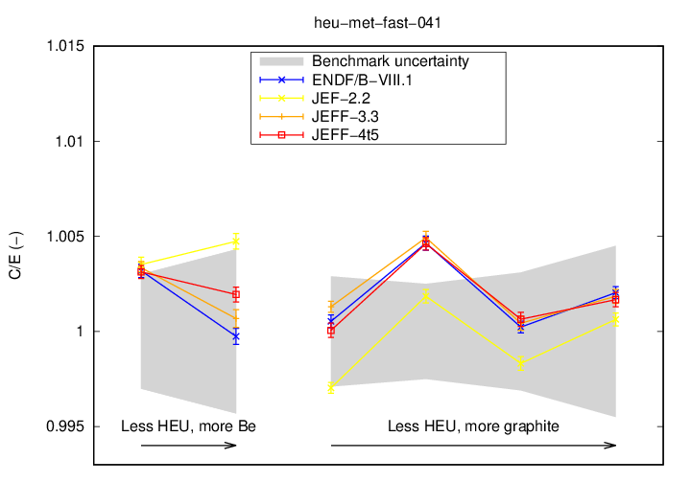
Reflectors: Be, graphite

Slide 55
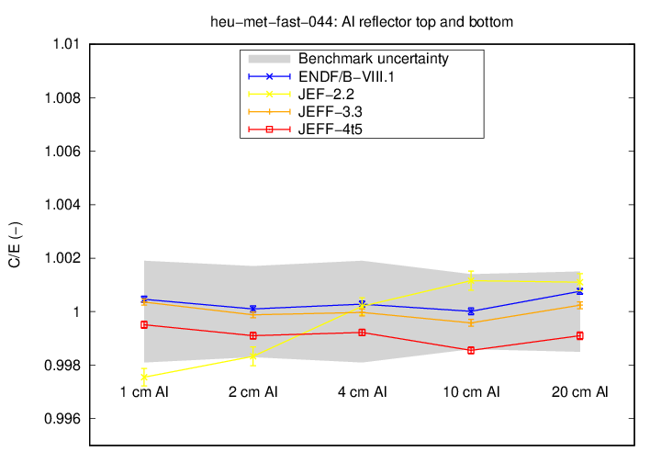
Reflectors: Al

Slide 56
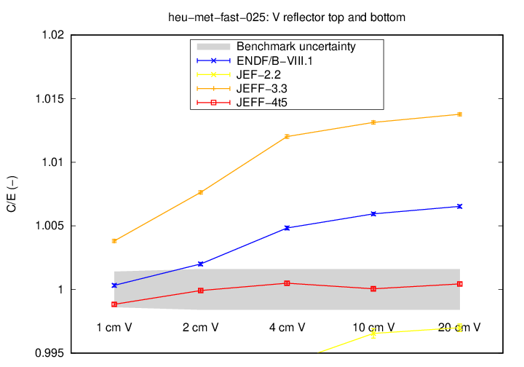
Reflectors: V

Slide 57
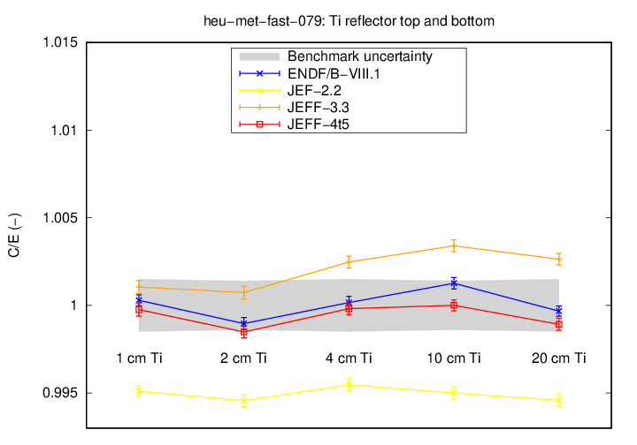
Reflectors: Ti

Slide 58
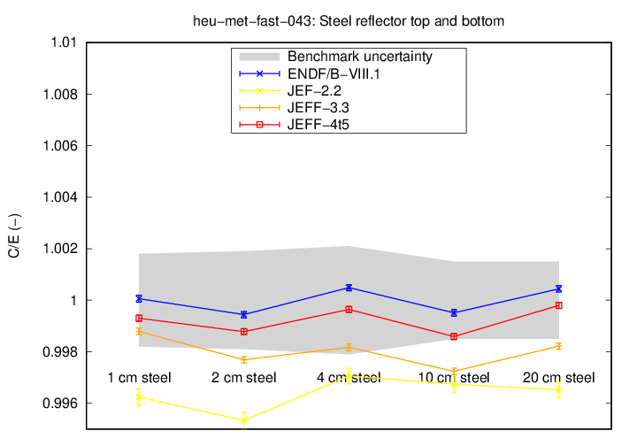
Reflectors: Steel

Slide 59
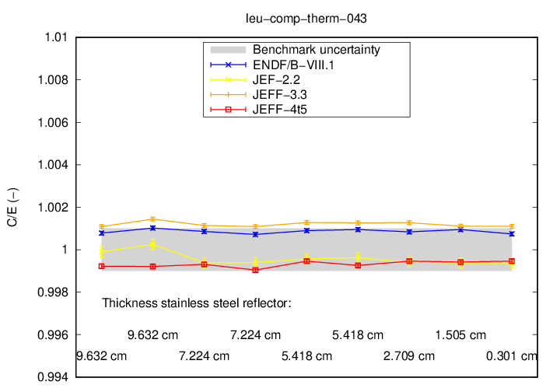
Reflectors: Steel

Slide 60
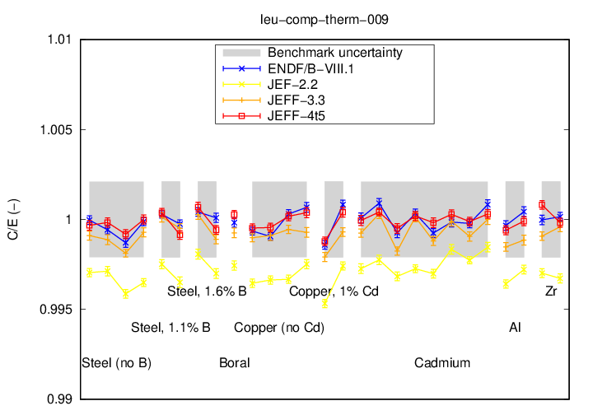
Reflectors: Steel, Cu, B, Zr, Al

Slide 61

Reflectors: Steel, Boral, Cu, Cd, Al, Zr

Slide 62

Reflectors: Steel, Ni

Slide 63

Reflectors: Hf

Slide 64

Reflectors: Pb

Slide 65

Reflectors: Pb

Slide 66

Reflectors: Pb, U, Steel

Slide 67

Reflectors: Pb, U, Steel

Slide 68

Reflectors: U-dep, W-C, Ni

Slide 69

Reflectors: …

Slide 70

Reflectors: Cu, Fe, Ni-Cu-Zn, Th, W

Slide 71

Plutonium solutions

Slide 72

Plutonium solutions

Slide 73

Plutonium solutions

Slide 74

Plutonium solutions

Slide 75

Plutonium solutions

Slide 76

Plutonium solutions

Slide 77

Plutonium solutions

Slide 78

Plutonium solutions

Slide 79

Plutonium solutions

Slide 80

Plutonium solutions

Slide 81

Plutonium solutions

Slide 82

Plutonium solutions

Slide 83

Plutonium solutions

Slide 84

Plutonium solutions

Slide 85

Plutonium solutions

Slide 86

Plutonium solutions

Slide 87

Plutonium solutions

Slide 88

Plutonium solutions

Slide 89

Plutonium solutions

Slide 90

Plutonium solutions

Slide 91

Plutonium solutions

Slide 92

Plutonium solutions

Slide 93

Plutonium solutions

Slide 94

Special element: F

Slide 95

Special element: F

Slide 96

Special element: F

Slide 97

Special element: F

Slide 98

Special element: F

Slide 99

Special element: F

Slide 100

Special element: F

Slide 101

Special element: F

Slide 102

Miscellaneous

Slide 103

Miscellaneous

Slide 104

Miscellaneous

Slide 105

Miscellaneous

Slide 106

Miscellaneous

Slide 107

Miscellaneous

Slide 108

Miscellaneous

Slide 109

Miscellaneous

Slide 110

Miscellaneous

