Slide 1
Perspectives on Nuclear Data for the Next Decade
Integral
^
Presented at the 3rd P(ND)² Meeting
March 13, 2026
Catherine Percher
ICSBEP Chair
Lawrence Livermore National Laboratory, USA

Slide 2
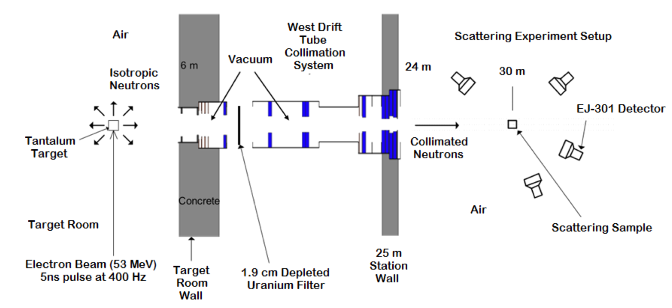
Measurements Form the Basis for Nuclear Data
Differential Measurements
  Measurements of a single (ideally) reaction of a particle and a nucleus at a specific energy
  Example: Neutron Scattering Experiments
Picture from D. Smith, NNL Measurements at the RPI LINAC, National Nuclear Data Week 2018, New York.

Slide 3
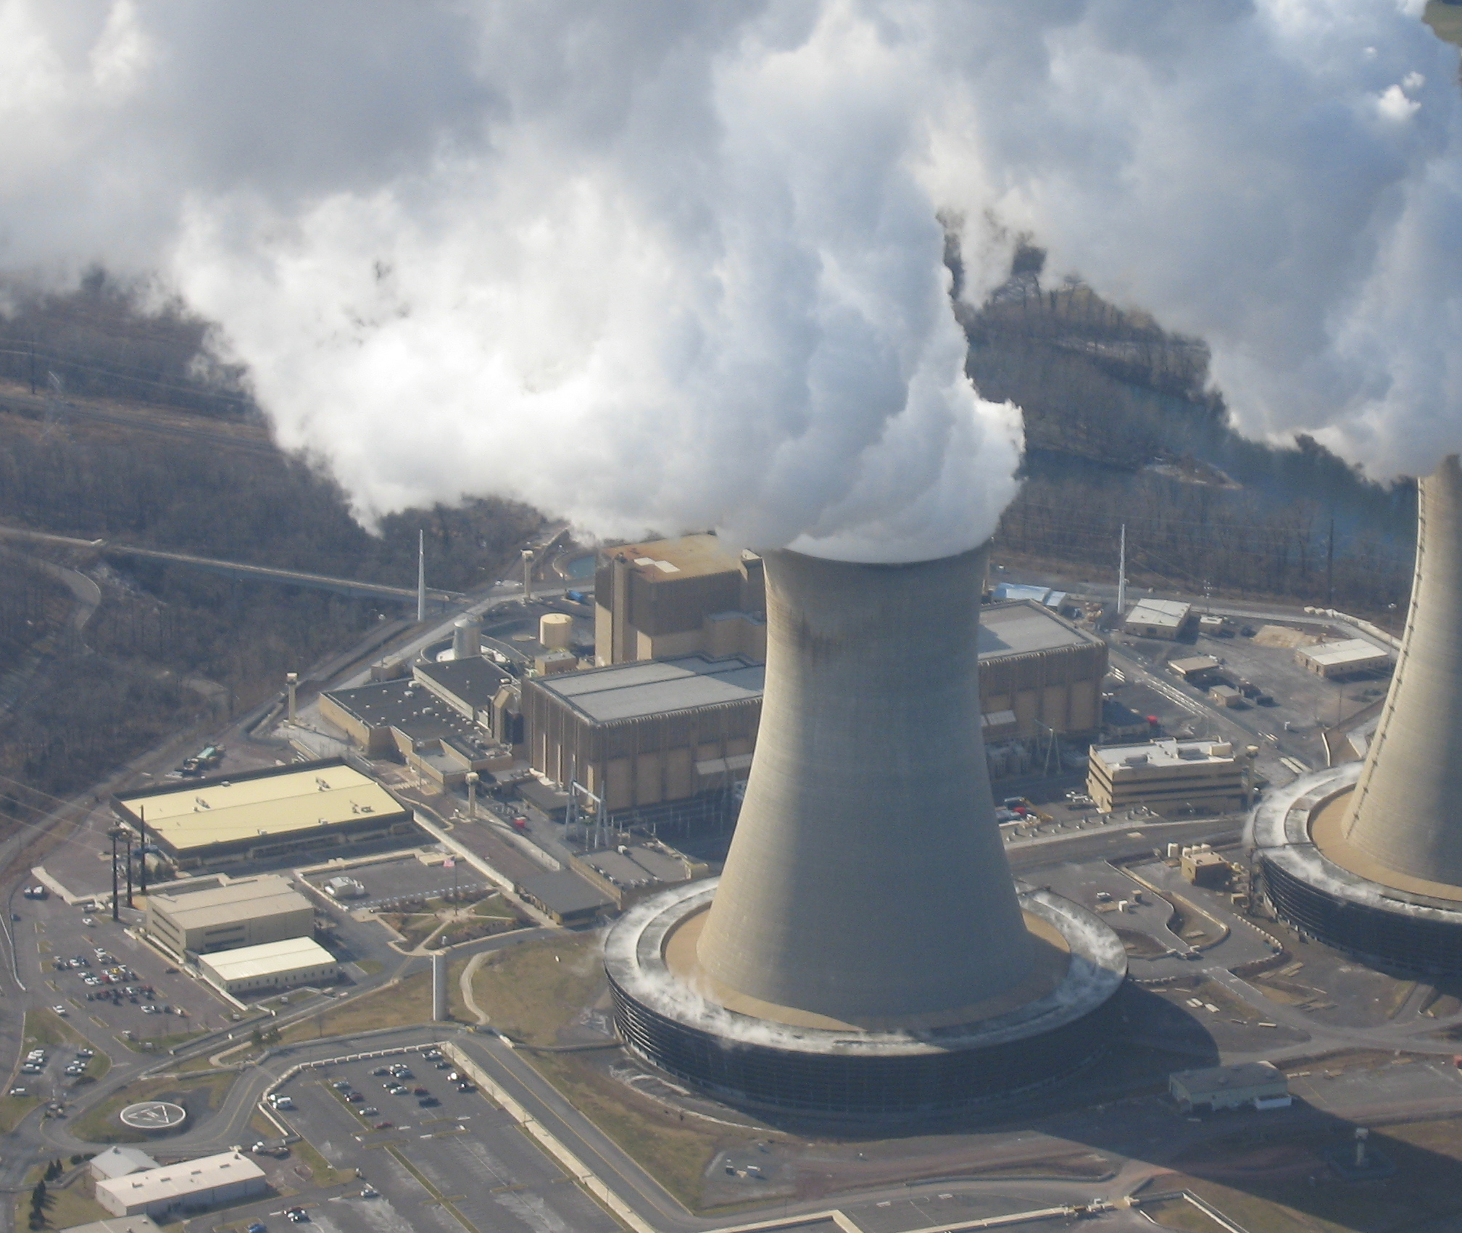
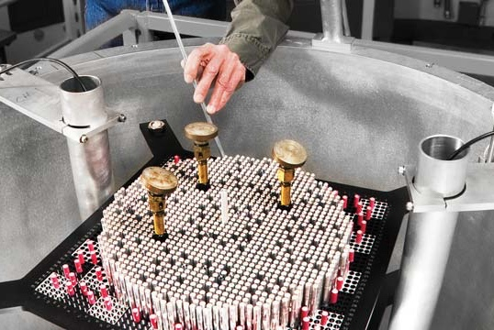
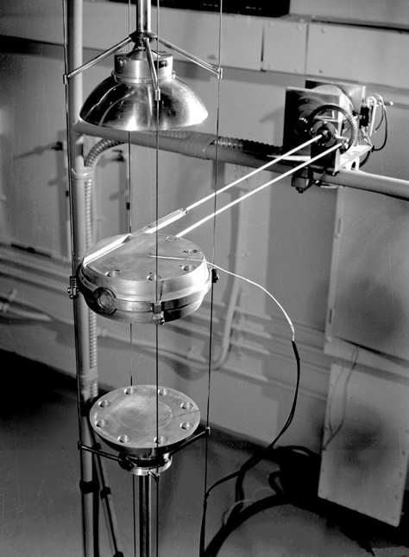
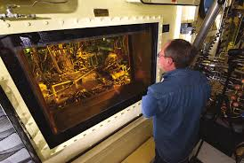
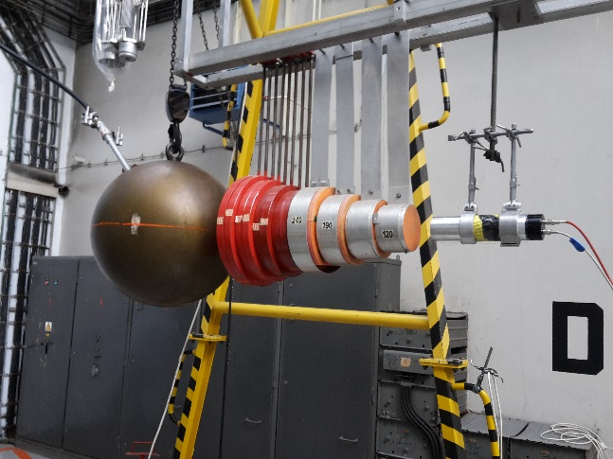
Measurements Form the Basis for Nuclear Data
Integral Measurements
  Measurements of a system that is dependent on multiple data (isotopes, reactions, energies) at once
  May be designed to be particularly sensitive to one piece of data
Examples:
  Critical assemblies
  Subcritical assemblies
  Reactor startup experiments
  Reactor operation data
  Shielding Experiments
  Transmission Experiments
  Activation Experiments
  Post Irradiation Examination

Slide 4
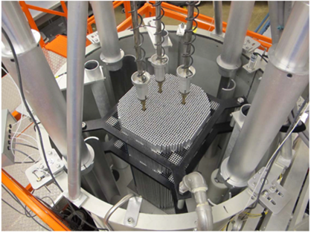
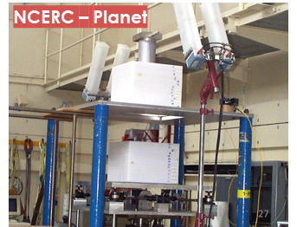
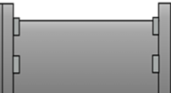
Benchmarking: Comparison to Experimental Truth
Validation that analytical method adequately represents reality for a given application
Integrated test of:
Evaluated nuclear data
Nuclear data processing codes
Transport codes
Sensitivity (/Uncertainty) Study
Experiment
Theory & Evaluation
Data Processing
Transport Codes
Benchmarking
User

Slide 5
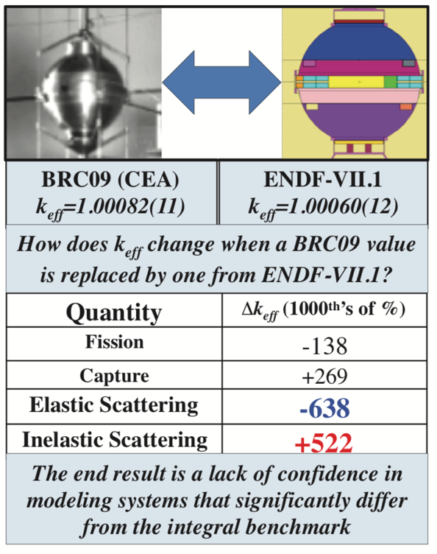
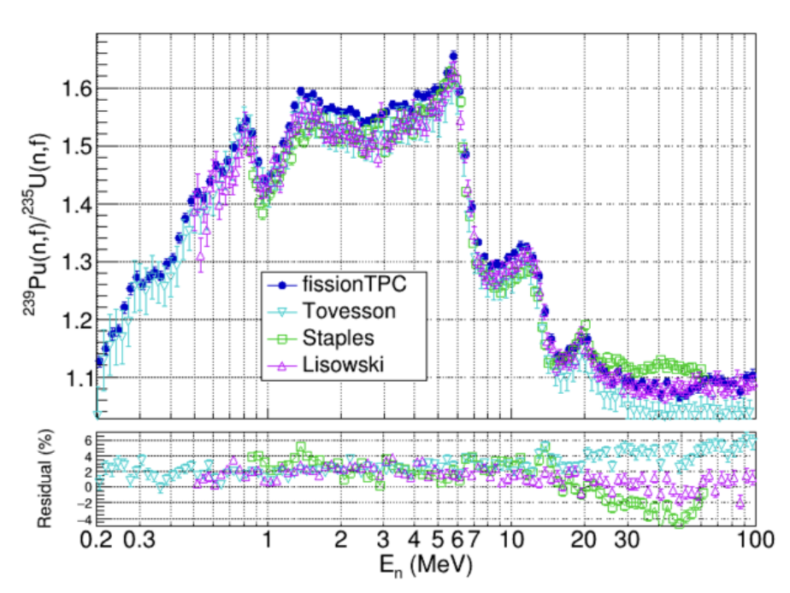
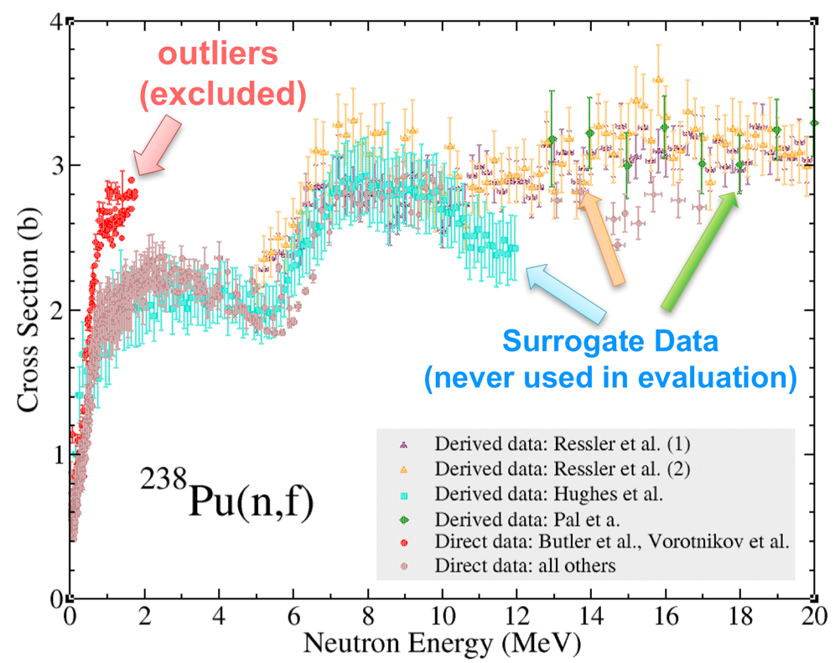
Data Adjustment: When Integral Experiments Are Used During Nuclear Data Evaluation
Differential data often disagrees, so evaluators use integral data (how well the cross section predicts integral experiments) to determine which data to believe
  Major cross sections are “tuned” to certain critical experiments
L. Snyder, et al, Nuclear Data Sheets 178, 2021
E. Bauge, et al, Eur. Phys. J. A 48, 113, 2012

Slide 6
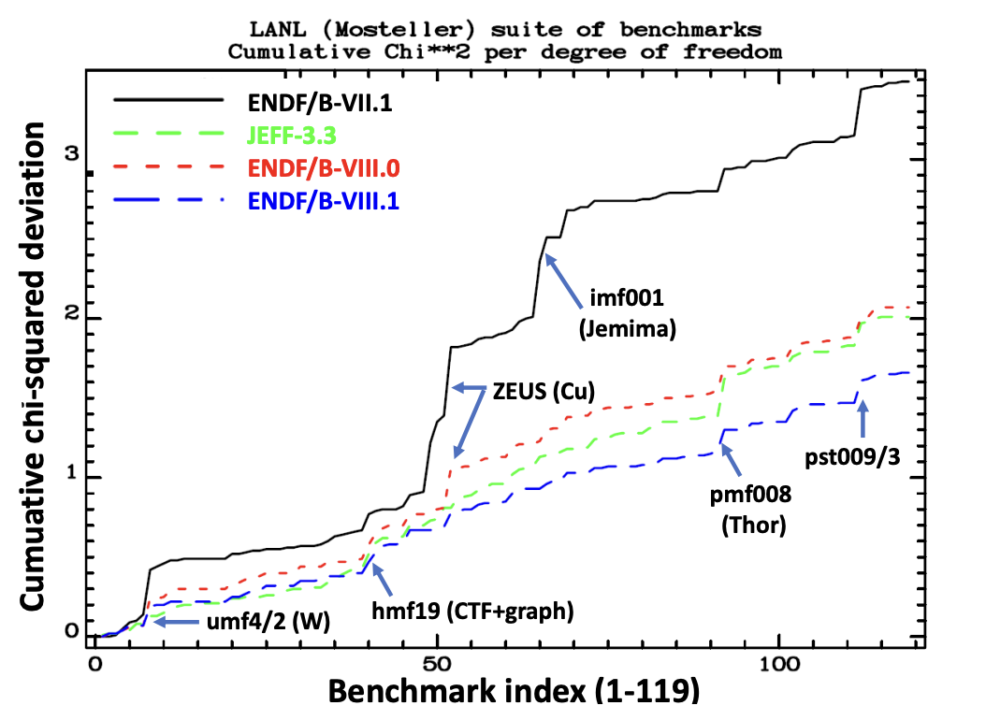
Data Validation: Nuclear Data Libraries are Judged by How Well They Predict Integral Experiments
Ultimate goal is to improve evaluated nuclear data for applications
Suite of benchmarks to validate evaluated nuclear data
Provides feedback to measurement and evaluation community
  Currently dominated by critical benchmarks, NEED representation from other applications
Drives improvements in evaluated nuclear data
Provides end-users confidence they can use codes and nuclear data for their applications
Figure from Nobre, et al. ENDF/B-VIII.1: Updated Nuclear Reaction Data Library for Science and Applications. 5 Nov 2025. arXiv:2511.03564

Slide 7
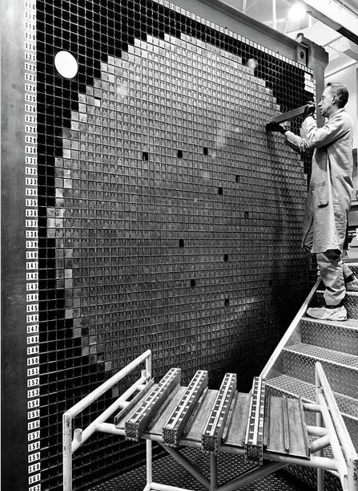
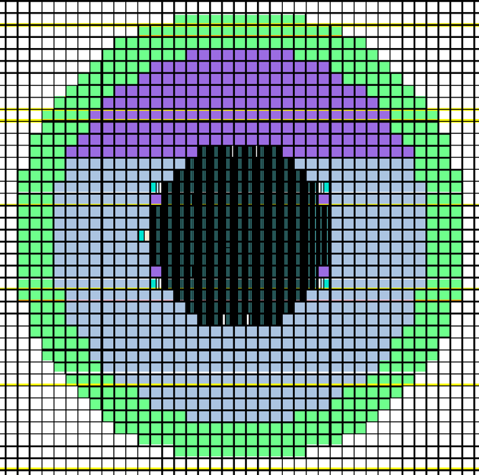
Benchmarks Are Evaluated Integral Experiments
Well characterized experiments
Evaluate all benchmark uncertainty effects on measured quantity, driven by:
  Uncertain measurements
  Missing data
Bias and uncertainty for model simplifications
  Geometry simplifications
  Room return
  Material impurities
Describe benchmark model
Sample calculation results
Disseminate for broader use

Slide 8
Sources of Benchmark Uncertainty
Experimental: How certain are the experimenters of the data reported?
    Uncertainty in measurement technique, reproducibility measurements, etc
    Small contribution for k_{eff} and reactivity worth
    Larger contribution for direct radiation measurements
Benchmark Model Uncertainties: How certain are the evaluators of the benchmark model? Model vs. Reality
    Mass (are all masses or densities well known?)
    Dimensions (were all parts measured? How do they fit together?)
    Composition (what are the constituents of all parts, including impurities?)
    Other Factors (Temperature, irradiation history, etc)

Slide 9
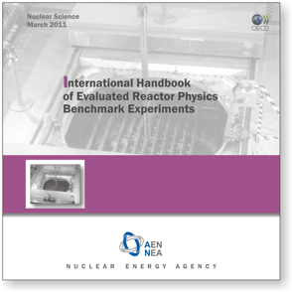
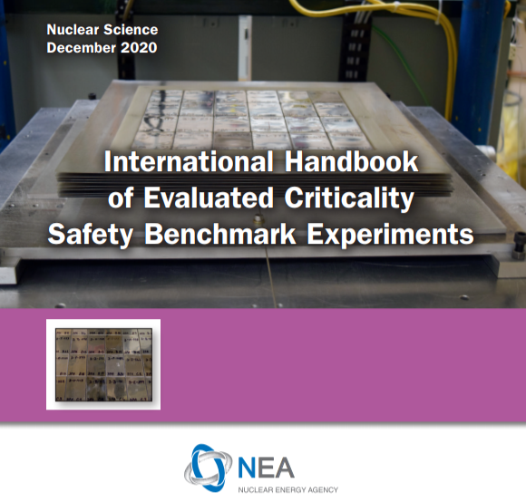
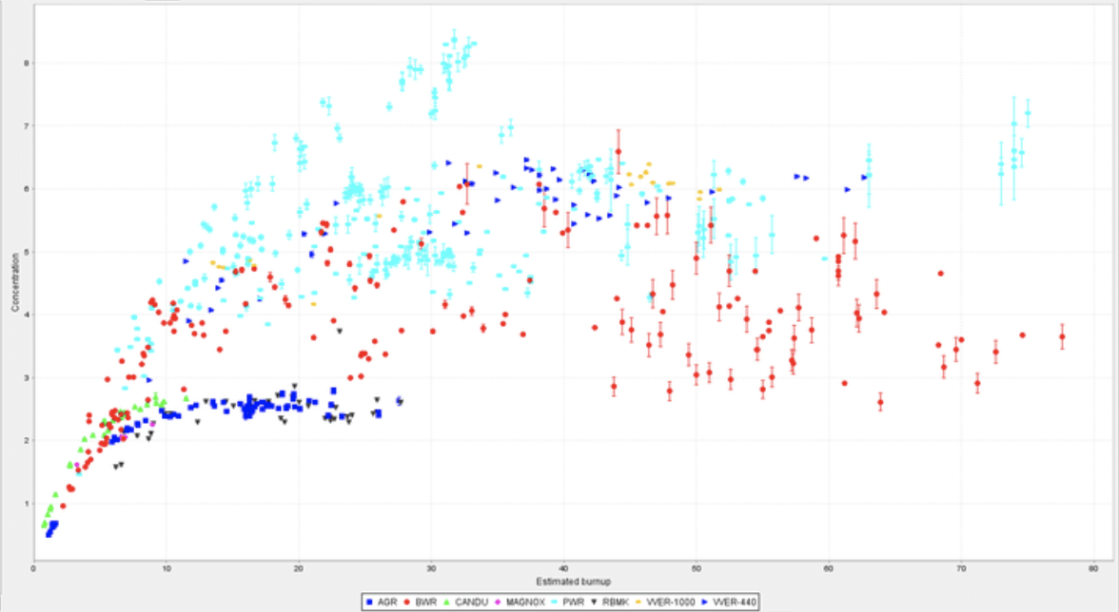
Established Integral Benchmark Handbooks and Databases
International Criticality Safety Benchmark Evaluation Project (ICSBEP)
  >5000 Critical, subcritical, shielding and physics configurations
International Reactor Physics Evaluation Project (IRPhEP)
  200 Reactor benchmarks
  200 Spectra benchmarks
Shielding Integral Benchmark Database (SINBAD)
  Reactor shielding (46)
  Fusion neutronics shielding (31)
  Accelerator shielding (23)
Spent Fuel Composition (SFCompo)
  700 Samples

Slide 10

International Criticality Safety Benchmark Evaluation Project (ICSBEP)
Official activity of the Organization for Economic Cooperation and Development’s (OECD) Nuclear Energy Agency since 1995 under Working Party for Nuclear Criticality Safety (WPNCS)
Main Goal: Provide standardized benchmarks for criticality safety validation
Updated handbook with new evaluations released regularly- 2025 edition released Feb 2026
ICSBEP Type | Description | Configurations
PU | Plutonium | 810
HEU | Highly Enriched Uranium | 1461
IEU | Intermediate Enriched Uranium | 278
LEU | Low Enriched Uranium | 1829
U233 | Uranium 233 | 244
MIX | Mixed Material Systems | 536
SPEC | Other Actinides | 20
ALARM | Shielding and Criticality Accident Alarm Placement | 53
FUND | Fundamental Physics Measurements | 250
 | Handbook Total | 5481

Slide 11
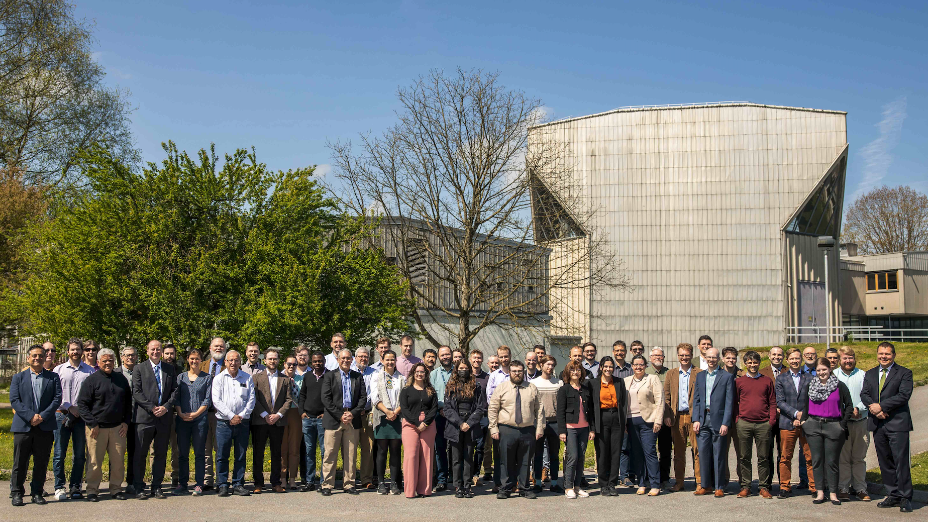
Extensive International Review Process
Many Experts Involved
Evaluator(s) – primary assessment of the benchmark
Internal Reviewer(s) – in-house verification of the analysis, same access to information
Independent Reviewer(s) – external verification of the analysis and modeling
Technical Review Group (TRG) Meeting – annual international effort and panel review
ICSBEP is the “Gold Standard” of Integral Data
Used by the nuclear data, code developer, and nuclear criticality safety communities
Critical benchmarks do not provide a good test of all parts of an isotope’s nuclear data
One number (k_{eff}) is susceptible to compensating errors
ICSBEP standards and rigor have evolved over time

Slide 12
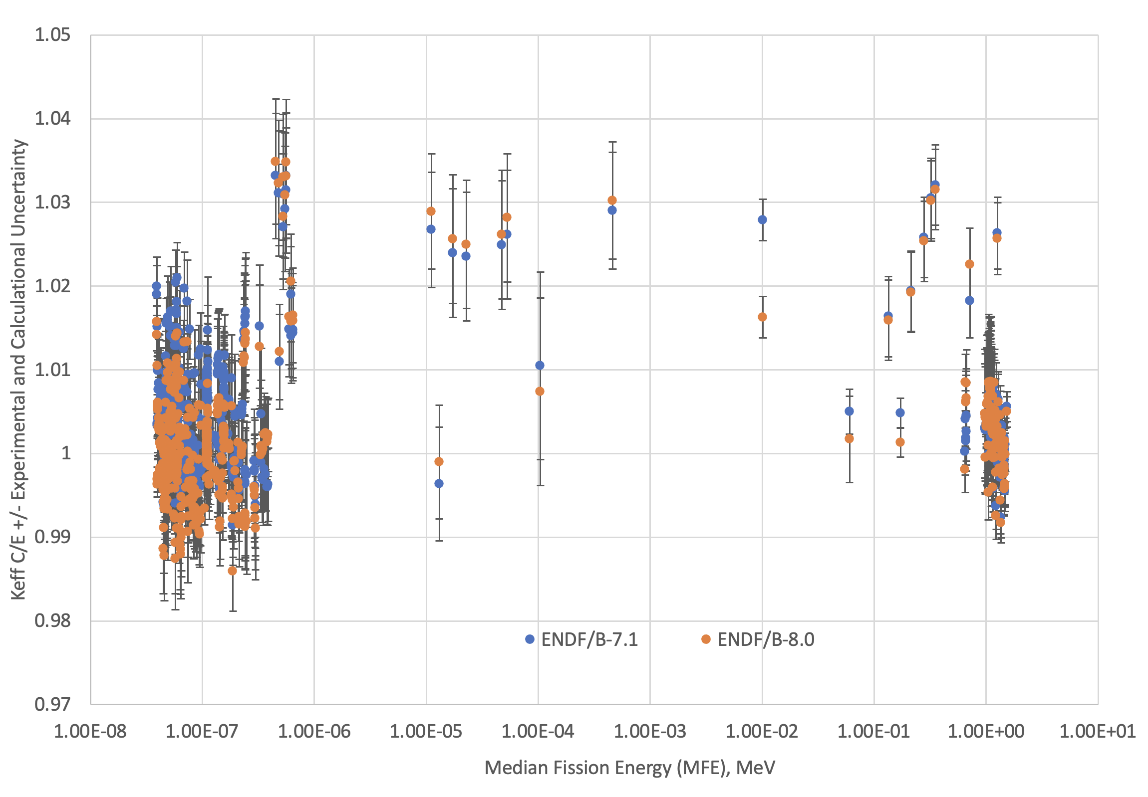
ICSBEP- Plutonium Benchmarks Circa 2015 (748 Cases)

Slide 13
ICSBEP- Plutonium Benchmarks Circa 2015 (748 Cases)
Thermal
589 Cases
3% Spread
43 Intermediate/Mixed
4% Spread- Very Sparse Coverage
Fast
116 Cases
4% Spread

Slide 14
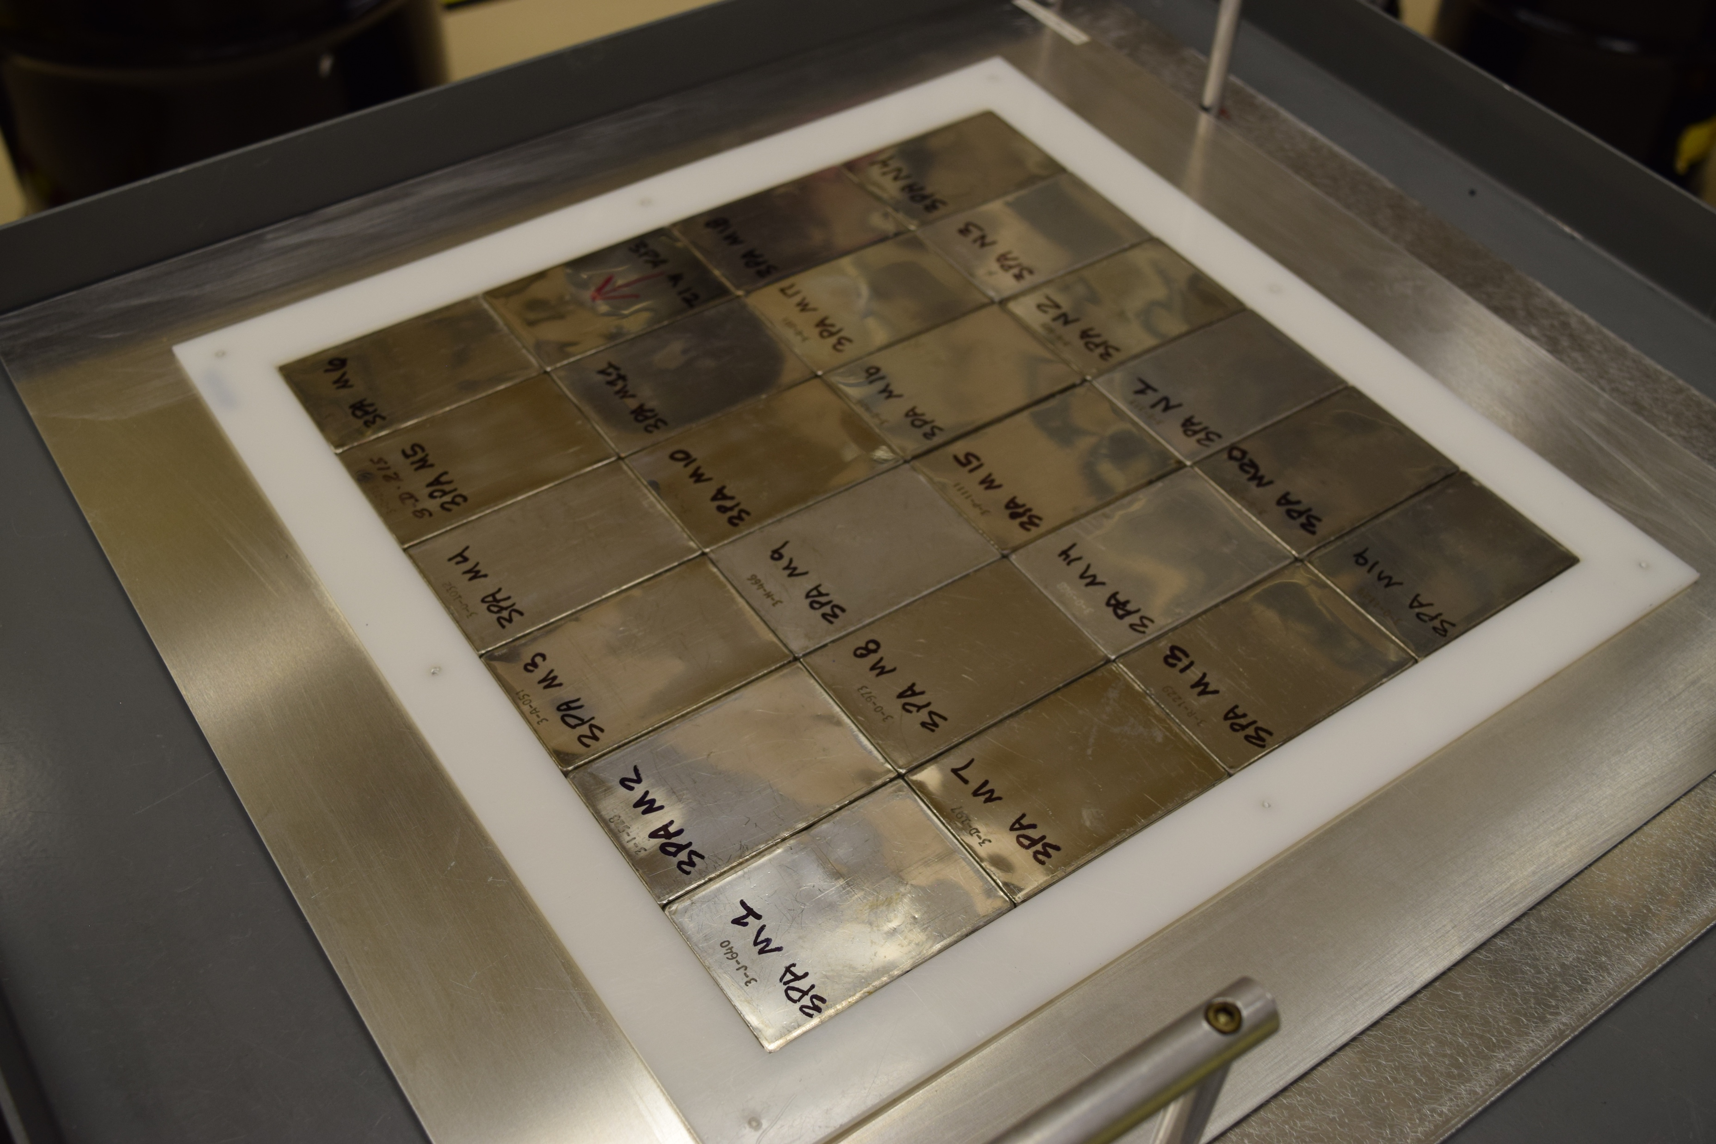
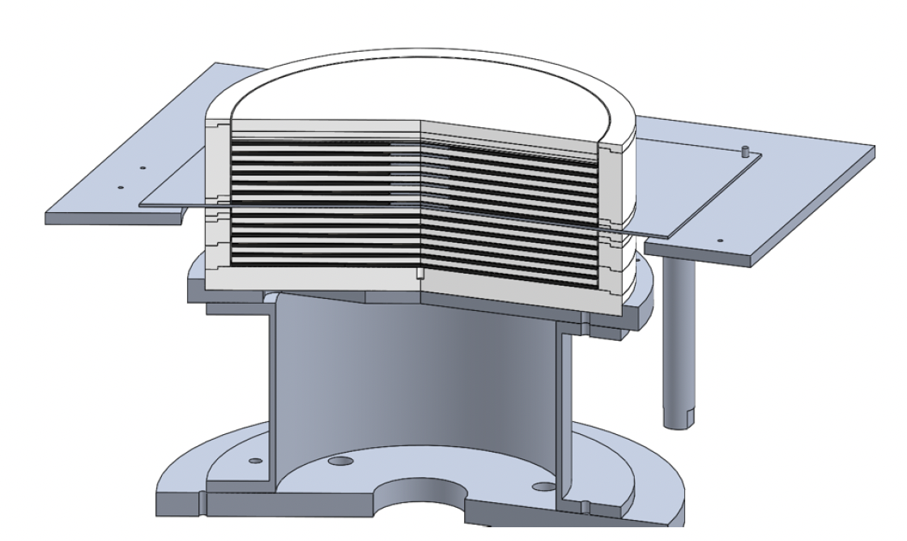
Thermal/Epithermal eXperiments (TEX)
LLNL/LANL collaboration funded by the US DOE Nuclear Criticality Safety Program (NCSP) to produce new critical benchmarks to address the nuclear data and validation needs for criticality safety
Two test bed assemblies (Pu and HEU)
  Plutonium fueled with plutonium/aluminum Zero Power Physics Reactor (ZPPR) plates arranged in 30 cm by 30 cm layers
  HEU fueled with Jemima plates (48 cm OD)
  Minimum of materials
  Designed to span multiple neutron fission energy spectra (fast through thermal) using polyethylene moderator
  Assembly designed to be easily modified to test materials of interest

Slide 15
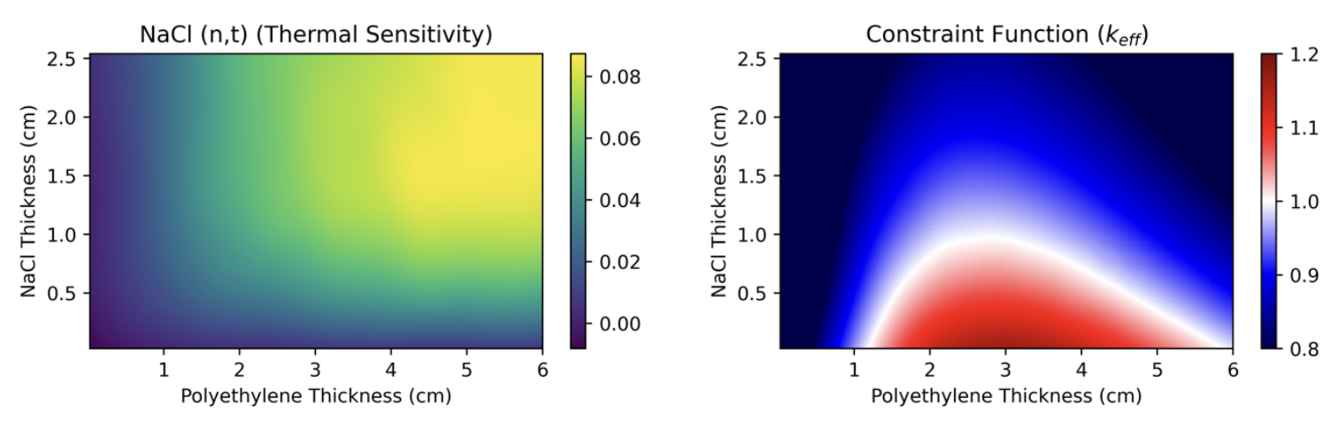
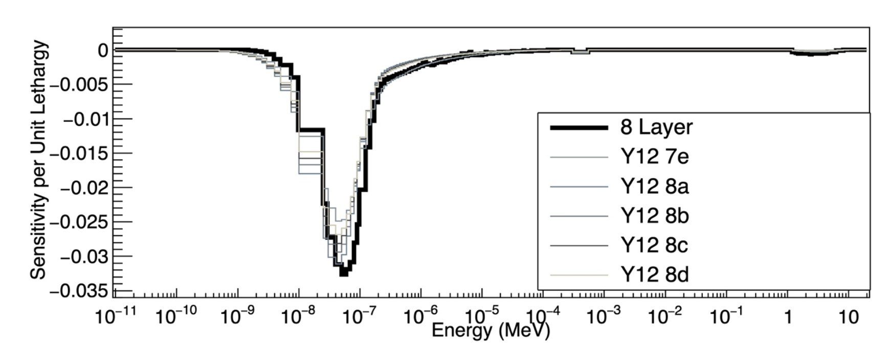
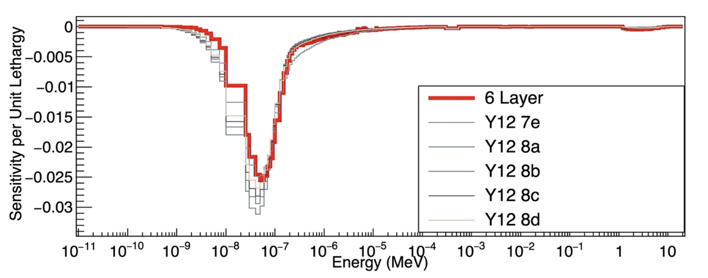
Designing Modern Critical Experiments
Optimize experiment design to provide the best possible test of some variable
  Targeting averaging neutron energy of a system
  Sensitivity to specific reaction of specific nuclide at a specific energy
  Representativity of application
    ML example of TEX-Cl to electrorefining operational criticality upset conditions

Slide 16
Six TEX Benchmarks Published
TEX-PU
  PU-MET-MIXED-002- TEX Plutonium Baseline Assemblies: Plutonium-Aluminum Metal Alloy Plates with Varying Thicknesses of Polyethylene Moderator and a Thin Polyethylene Reflector
  PU-MET-MIXED-003- TEX Plutonium Assemblies with Tantalum: Plutonium-Aluminum Metal Alloy Plates with Varying Thicknesses of Polyethylene Moderator, Interstitial Tantalum, and a Thin Polyethylene Reflector
  PU-MET-THERM-004- TEX Plutonium Thermal Assemblies: Plutonium-Aluminum Metal Alloy Plates with Thick Polyethylene or Polymethyl Methacrylate (Lucite) Moderators
TEX-HEU
  HEU-MET-MIXED-021- TEX-HEU Baseline Assemblies: Highly Enriched Uranium Plates with Polyethylene Moderator and Polyethylene Reflector
  HEU-MET-INTER-013- TEX-Hf Assemblies: Highly Enriched Uranium Plates with Hafnium Using Polyethylene Moderator and Polyethylene Reflector
  HEU-MET-THERM-038- TEX-Chlorine Assemblies: Highly Enriched Uranium Plates with Sodium Chloride Absorbers Using Polyethylene Moderator and Polyethylene Reflector

Slide 17
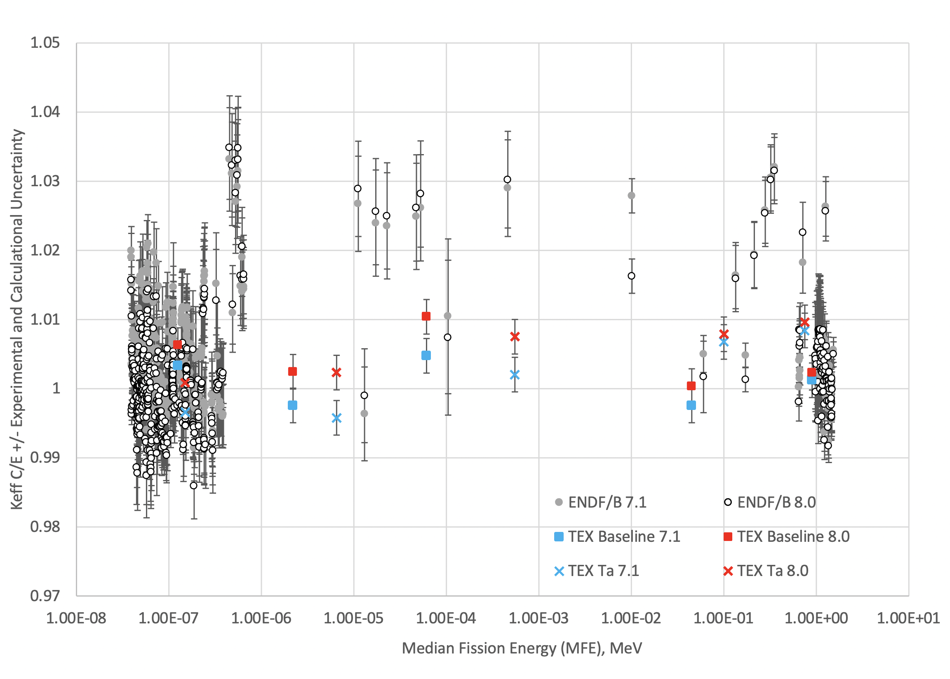
PMM-002 and PMM-003 (with Ta) Results, MCNP6.1, Compared with other Pu Benchmarks
3
4
2
1
5

Slide 18
Additional Work for TEX
TEX-Pu
Experimental campaign completed in November 2025 at NCERC for configurations using an iron diluent in thermal spectra
Additional variants designed to investigate ²⁴⁰Pu and Mn and additional baseline experiments targeting intermediate energy regime
Design work ongoing for Ni and Cr variants
TEX-HEU
Additional, intermediate and fast configurations with chlorine, more targeted at molten salt reactors, completed in February 2026 at NCERC
Low Temperature experiments at -40 °C (-40 °F) with HEU to address transportation and unheated facility validation needs with the UK’s NNL, planned for FY26
Additional variants designed to investigate ⁶Li neutron absorption in thermal/epithermal spectrum

Slide 19
The Good News
The ICSBEP is healthy at the moment
  Active international participation in yearly TRG meetings (50-100 people)
  Pace of approximately 20 new benchmark configurations published each year
  Many new experiments are being designed to fill validation gaps and target novel materials or neutron spectra
    Epithermal/Intermediate neutron energies
    Cl, Hf, Ta, Cu
  Many of the new benchmarks are being evaluated soon after the experiment was conducted, with active participation from knowledgeable experimenters (better benchmarks!)
New benchmark experiment capacity added with Japan’s STACY facility and LLNL Pulsed Neutron Die Away experiment

Slide 20
The Not-So-Good News
  Overall integral experimental facility numbers have been declining for decades
  The other benchmark and integral experiment projects have been struggling
    IRPhEP has not released new evaluations since 2021
    SINBAD is undergoing a reimagining and reinvigoration after about a decade of stagnation
    SFCompo currently working on few evaluations
  High quality benchmarking is expensive, time-consuming, and difficult
    Many historical benchmarks should probably be re-evaluated, but might lack enough information to evaluate to a modern standard
    Even though we conduct nuclear experiments everyday, sponsors aren’t usually willing to pay the high cost of benchmarking an experiment

Slide 21
Perspective on the Next Decade in Integral Data
  More, and different kinds, of benchmarks are needed
  Not all benchmarks are good for nuclear data validation- should be curated
  Advanced reactor designs (both fission and fusion based) use novel materials and a variety of neutron energy spectra
    Not well represented by current integral data
    Need targeted, well-designed integral experiments that are sensitive to specific reactions that are important for these applications
    Sensitivity studies needed to design and prioritize experiments
  Pilot facilities are being built and planned and could be a good source of new integral data
    Advanced fission reactor data could suffer from being proprietary, not aid the general library validation
    Brighter fusion sources can result in more relevant experiments, but source characterization will be important for benchmarks

Slide 22
Questions/Discussion

Slide 23
Backup Slides

Slide 24
Evolution of ICSBEP Uncertainty Assessment Methodology
Historically (pre ~2010)- More than 90% of the benchmarks
  Some uncertainties experimentally measured- e.g. remeasure outside to account for room return
  Some deterministic or Monte Carlo calculations, generally with 100 pcm (0.001 in k_{eff}) calculation uncertainty for “most important” uncertainties
  Simply assert some uncertainties are “negligible” with a threshold of 100 pcm (0.001 in k_{eff})
  Ignore some uncertainties completely due to lack of data (impurities?)
  Many of the historical benchmarks were evaluated in the 1990s/2000s for experiments that were conducted decades earlier without involvement or input from the experimenters
Modern method
  Run dozens or hundreds of perturbation calculations with Monte Carlo, uncertainties approaching 1 pcm
  Use sensitivity analysis for mass and composition uncertainties
  Threshold for negligible approaching 1 pcm
  Account for stack heights, real as-built measurements (not just drawings), real compositions including impurities
  Many modern benchmarks are completed soon after the experiments are conducted with active input from the experimenters

Slide 25
New Content for the 2025 Edition of the ICSBEP Handbook
8 new evaluations with 19 critical configurations, 4 fundamental physics configurations, and 2 alarm/shielding configurations
  Volume I (PU): Two new fast Pu evaluations
  Volume II (HEU): One new fast HEU, one intermediate HEU, and one thermal HEU evaluations
  Volume IV (LEU): One new thermal LEU evaluation
  Volume VII (ALARM): Two new ²⁵²Cf source shielding evaluations
  Volume IX (FUND): One new pulsed neutron die-away evaluation

Slide 26
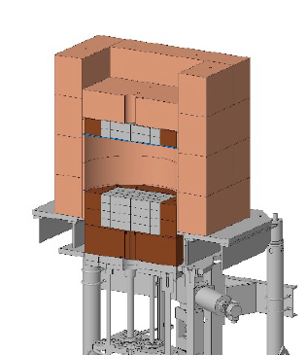
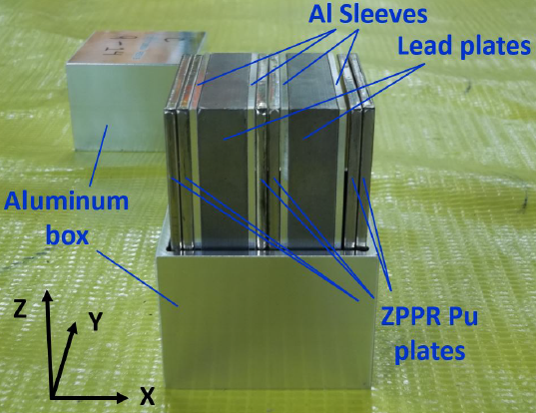
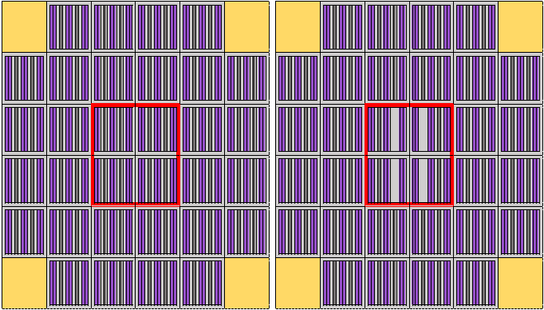
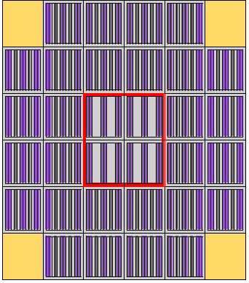
New Evaluation 1 and 2:
PU-MET-FAST-047 and PU-MET-FAST-050
The Jupiter Experiments: Plutonium Metal Plates Separated by Lead and Reflected by Copper
  Comet Assembly Machine at NCERC, USA
  Collaboration between LANL and the Japan Atomic Energy Agency (JAEA) for fast reactor lead void reactivity studies
  Plutonium Zero Power Physics Reactor (ZPPR) plates mixed with lead plates and ZEUS copper reflector
  3 cases in PU-MET-FAST-047 with increasing central lead void
  2 cases in PU-MET-FAST-050 with higher ²⁴⁰Pu content ZPPR plates

Slide 27
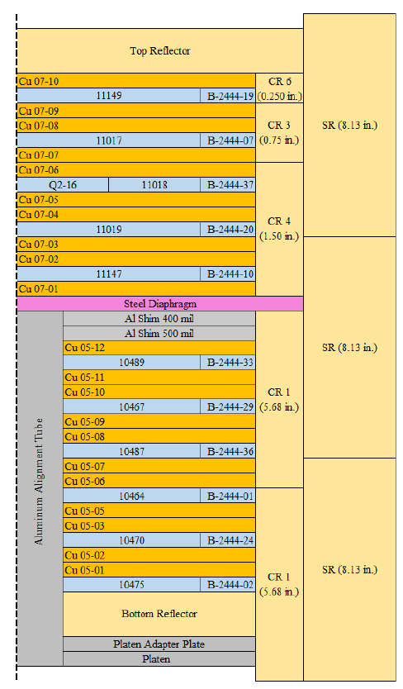
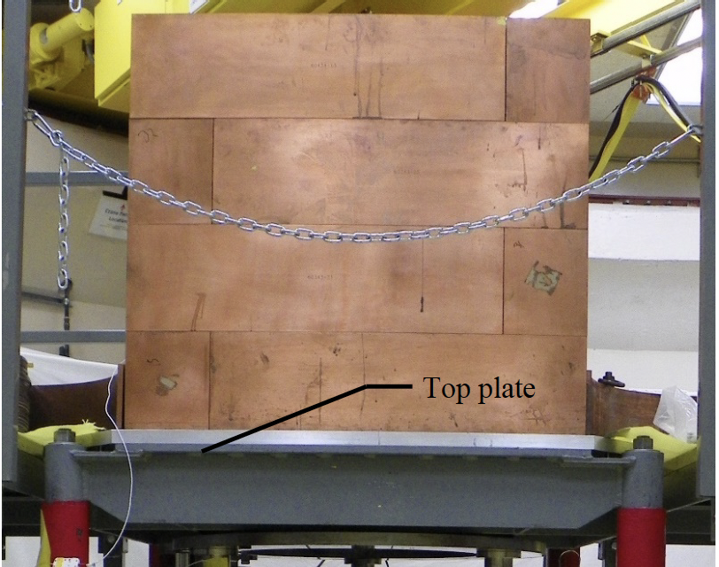
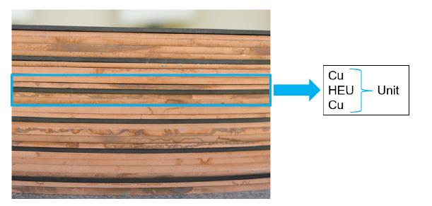
New Evaluation 3:
HEU-MET-FAST-106
CERBERUS: A Zeus Configuration with HEU and Copper Reflected by Copper
  Comet Assembly Machine at NCERC, USA
  Zeus Copper Reflector and HEU Jemima Plates
  3 cases with increasing thicknesses of interstitial copper plates
  In combination with other Zeus experiments, goal is to provide a holistic test of copper nuclear data

Slide 28
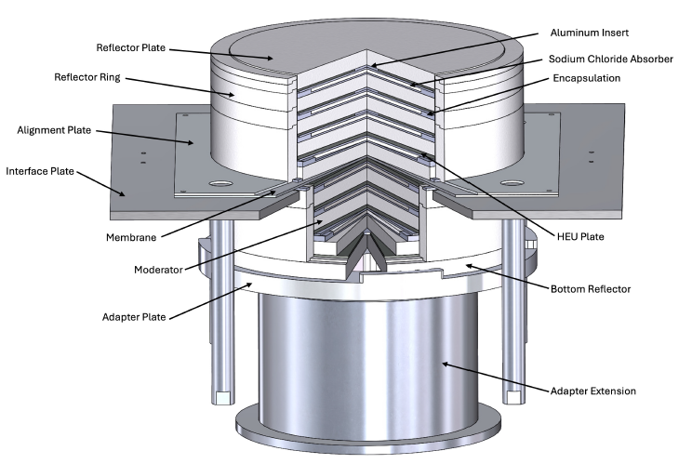
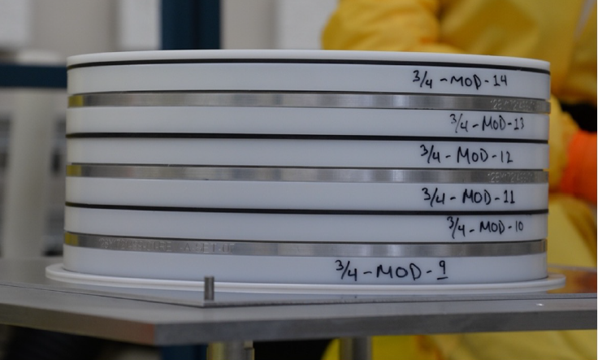
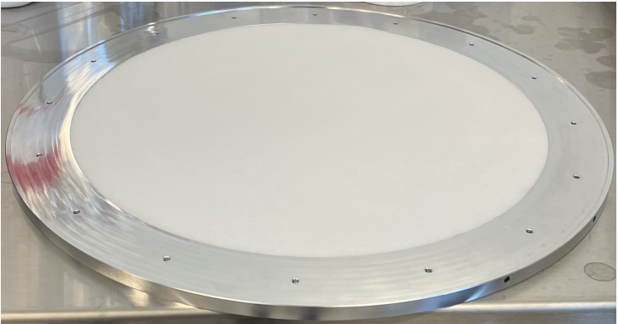
New Evaluation 4:
HEU-MET-THERM-038
TEX-Chlorine Assemblies: Highly Enriched Uranium Plates with Sodium Chloride Absorbers Using Polyethylene Moderator and Polyethylene Reflector
  Comet Assembly with HEU Jemima Plates at NCERC/NNSS
  Varied polyethylene moderator thickness to adjust neutron spectra
  Included vibro-packed sodium chloride absorber plates between layers
  3 Cases, 2 thermal and 1 intermediate
  Provide test of chlorine absorption for criticality safety validation cases for electrorefining and molten salt fuel fabrication

Slide 29
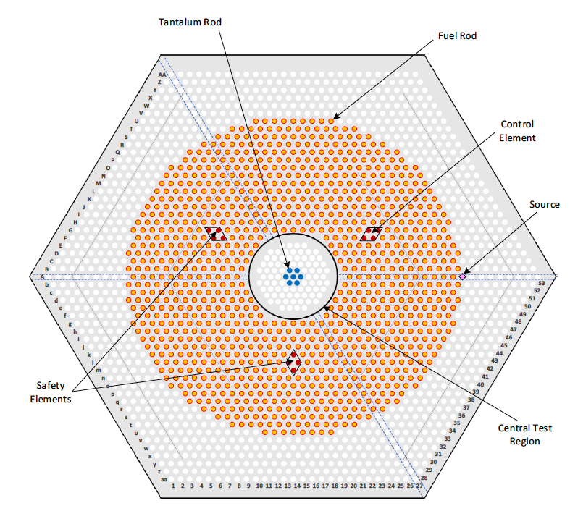
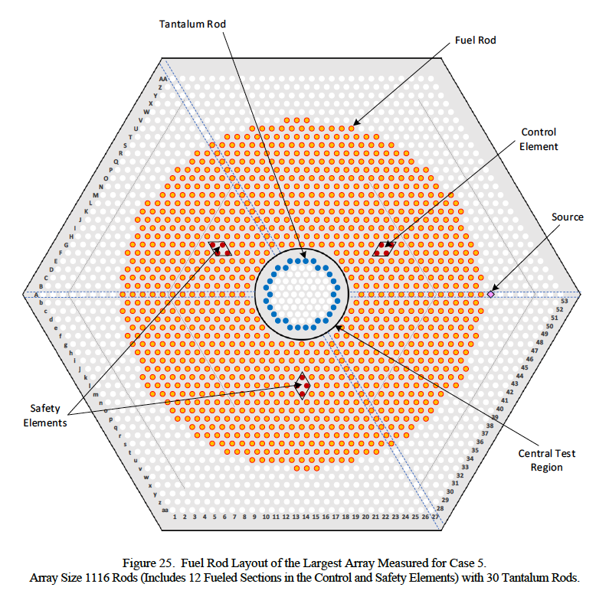
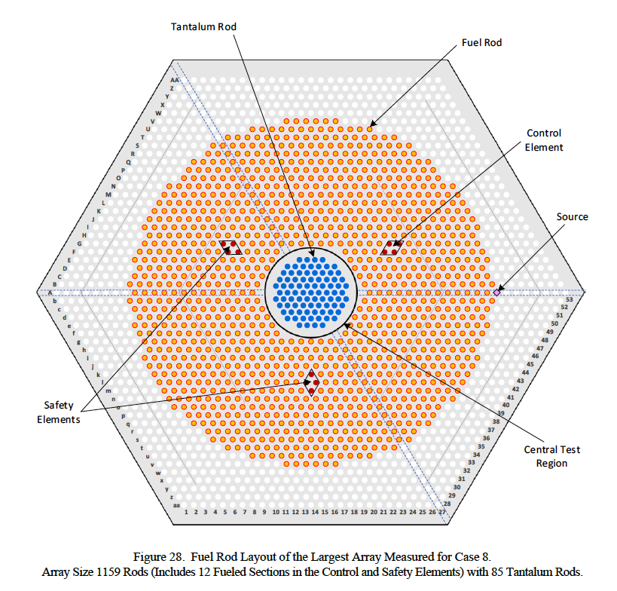
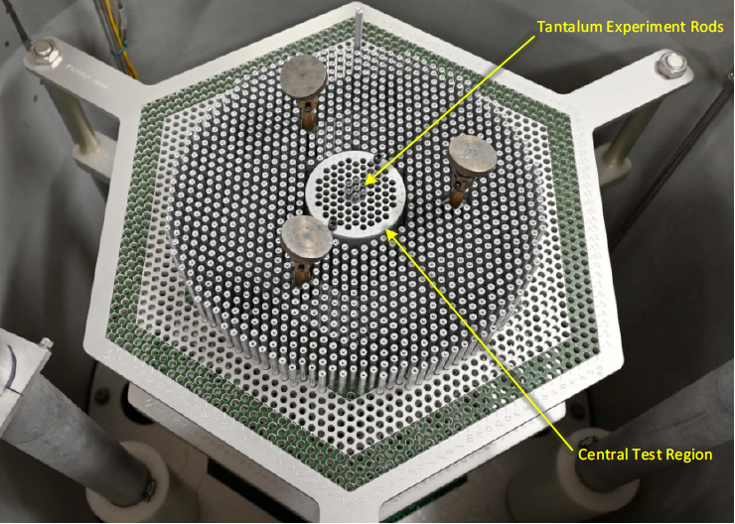
New Evaluation 5:
LEU-COMP-THERM-112
Case 2
Case 5
Case 8
Tantalum Experiments in Fully-Reflected Water-Moderated Triangular-Pitched U(6.90)O₂ Fuel Rod Lattices (1.02 cm Pitch)
  Sandia Critical Experiments Facility (SCXF) with 7uP fuel
  Purpose of the experiment was to measure the effects of Ta in epithermal systems
  Fuel arranged around a central test region lined with Cd to absorb thermal neutrons and provide harder spectrum to the Ta rods
  8 cases with varying configurations of Ta rods within the test region

Slide 30
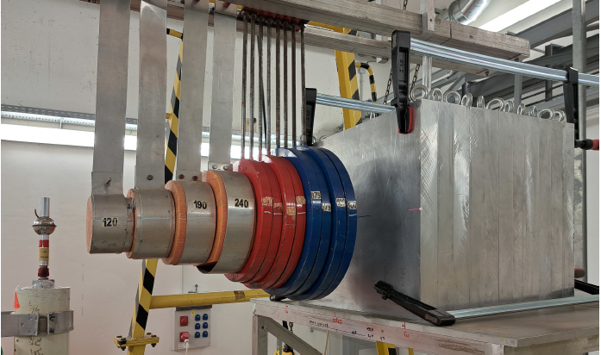
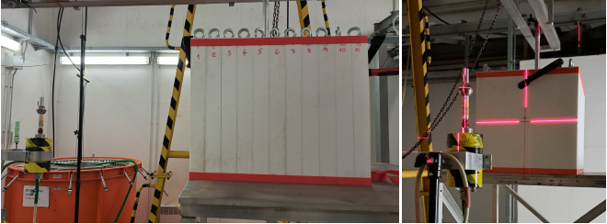
New Evaluation 6 and 7:
ALARM-CF-PTFE-SHIELD-001 and ALARM-CF-AL-SHIELD-001
Fast Neutron Leakage and Spatial Distribution of Activation Foils from an Polytetrafluoroethylene (PTFE) [or Aluminum] Block with a ²⁵²Cf Source in the Center
  Performed at Research Center Řež (RCR), Czechia
  Measured proton recoil method to obtain neutron leakage spectrum
  Activation foils placed within and outside the block
  Useful to test the validity of neutron cross section data, very sensitive to scattering
    ¹⁹F scattering (PTFE)
    Aluminum scattering

Slide 31
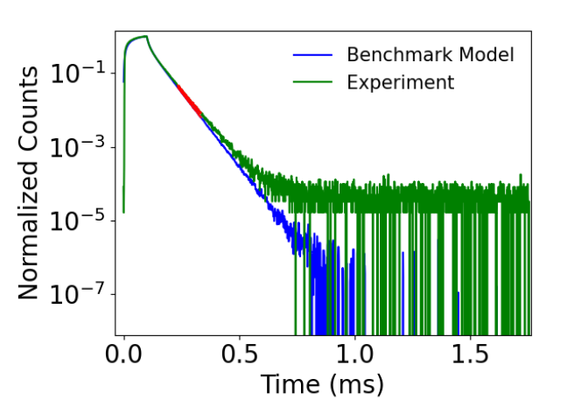
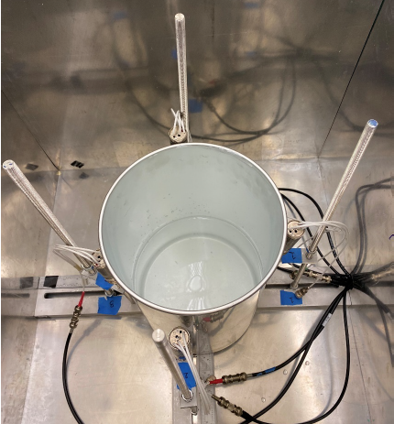
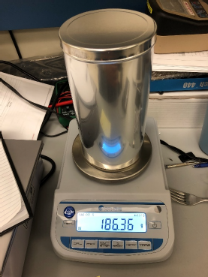
New Evaluation 8:
FUND-LLNL-DT-H2O-PNDA-001
Pulsed-Neutron Die-Away Response of H₂O Targets to a D-T Neutron Generator Pulse
  LLNL, USA
  Four different target sizes of water
  Benchmark quantity is characteristic exponential decay eigenvalue, ⍺
  Useful to test thermal scattering law data
    Smaller targets- more sensitive to scattering
    Larger targets- more sensitive to absorption

Slide 32
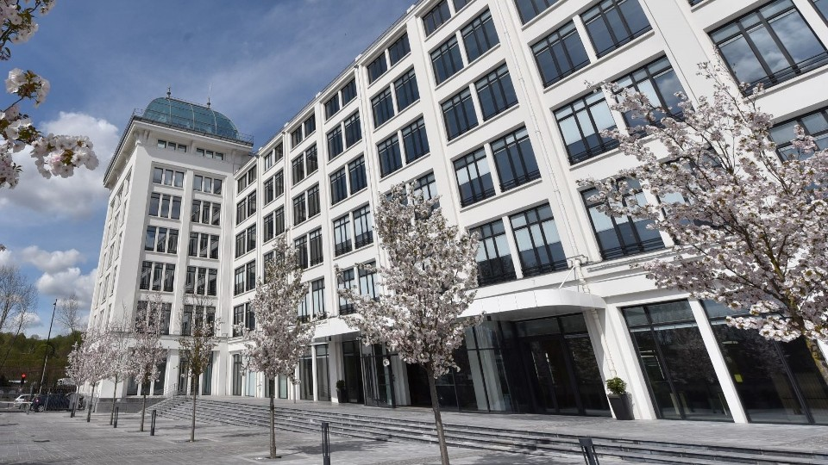
Next ICSBEP TRG Meeting
OECD/NEA Headquarters, Boulogne Billancourt, France
April 13-16, 2026 (M-Th)
International Reactor Physics Evaluation Project (IRPhEP) will meet April 17

Slide 33
Benchmarks Currently Expected at Next Meeting
Autorité de Sûreté Nucléaire et de Radioprotection (France) – Apparatus B Salt Water Configurations
Centrum Výzkumu Řež (Czechia) – Fast Neutron Leakage and Activation from a C₂Cl₄ Sphere with a ²⁵²Cf Source
Idaho National Laboratory (USA) – PROTEUS Critical Configurations with TRISO Fuel
Instituto de Pesquisas Energéticas e Nucleares (Brazil) – IPEN/MB-01 New Core Evaluation with U₃Si₂-Al, 19.75% enriched in U-235 Plate Type Fuel
Lawrence Livermore National Laboratory (USA) – Pulsed-Neutron Die-Away Experiments with Oil Targets (FUND)
Los Alamos National Laboratory (USA) – HEU-MET-FAST-086: Godiva IV Benchmark Revision
Los Alamos National Laboratory (USA) – Prompt Fission Uranium Neutron Spectrum (PFUNS) Critical Experiments
Los Alamos National Laboratory (USA) – MUSIC: Bare Highly-Enriched Uranium Shells Subcritical Measurements (FUND)
Los Alamos National Laboratory (USA) – Deimos: HALEU as Tri-structural isotropic (TRISO) Kernels Reflected by Graphite and Beryllium
Rensselaer Polytechnic Institute (USA) – Standard Core Critical Configurations of the Walthousen Reactor Critical Facility

