Slide 1

The JEFF‑4.0 Nuclear Data Library: Status and Perspectives
Nuclear Data for the Next Decade
12 March 2026
JEFF Chair: Arjan Plompen
Antonio Jiménez-Carrascosa*
Anastasia Georgiadou
OECD/NEA Data Bank, JEFF Secretariat
3rd International Workshop on Nuclear Data for the Next Decade, 12 March 2026

Slide 2
Contents
JEFF-4.0 library contents
JEFF-4.0 benchmarking
NEA Data Bank infrastructure
Next steps

Slide 3
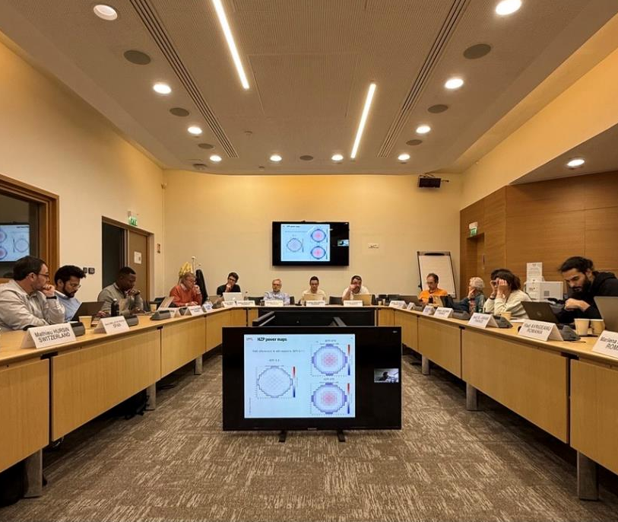
JEFF-4.0 nuclear data library
JEFF-4.0 was released in June 2025 with new:
Neutron induced cross section evaluations
Thermal fission yields (U-233, U-235, Pu-239, Pu-241)
Thermal scattering law (TSL) libraries
Major contributions from TENDL-2023 (++)
A selection of proton-induced transport data
New TAGS data on top of JEFF-3.3 decay data
Data publicly available at the NEA Data Bank website:
Joint Evaluated Fission and Fusion (JEFF) Library version 4.0 - NEA Data Bank GitLab platform
JEFF Nuclear Data Week April 2025

Slide 4
JEFF-4.0 nuclear data library - contents
Neutron-induced cross sections
Thermal Scattering Law
123 files covering 24 elements and 60 compounds
Fission yields sub-library
Decay data
JEFF-3.3 data
New TAGS data for 8 radionuclides
Transport subset: 593 files
Full set: 2855 files
New evaluations for reactor materials (UO2, PuO2, ThO2, Zy4)
Large integration of nCrystal and ENDF/B-VIII.1 TSLs
Proton-induced cross sections
Evaluations for 288 naturally abundant nuclides (TENDL-2023, JENDL-5, ENDF/B-VIII.1)
JEFF-3.3
New nth + U-233, U-235, Pu-239, Pu-241
Corrected files for 2 radionuclides
Transport subset: 288 files
Full set: 2855 files
g, d, t, h, a-induced cross sections
g: 2825 files
d: 2850 files
t: 2865 files
h: 2821 files
a: 2835 files
TENDL-2023 data
Updated correlation matrices

Slide 5
JEFF-4.0 nuclear data library - contents
Neutron-induced cross sections
New major actinides U-235, U-238, Pu-239:
Resolved resonance region.
Fast and unresolved resonance region based on new models.
New minor actinides U-236, Np-237/238, Pu-238/240/241/242, Am-241/243, Cm-244/246.
New C-12, O-16, Gd-155/156/158/160.
Modifications on Bi-209, U-234, Np-239 (JENDL-5), Hf-176/178, U-237; delayed neutron groups and gamma-emission.
TENDL-2023 (updates in August 2024 and February 2025).
2855 files (full set).
Removal of legacy (single-purpose) JEFF-3.3 files in favour of TENDL.
Fission product updates via TENDL.
INDEN: B-10/11, O-18, F-19, Si-28/29/30, Cr-50/52/53/54, Mn-55, Fe-54/56/57, Co-59, Cu-63/65, Th-232, U-233.
JENDL-5: H-1, In-113/115, Pa-232, U-232, Np-235/236/239, Pu-236, Am-242/242m/244/244m, Cf-249/254, Es-253/255, Fm-255.
ENDF/B-VIII.0: He-4, Li-6/7, C-13, W-180/182/183/184/186, Ta-181 (ENDF/B-IX-beta1)

Slide 6
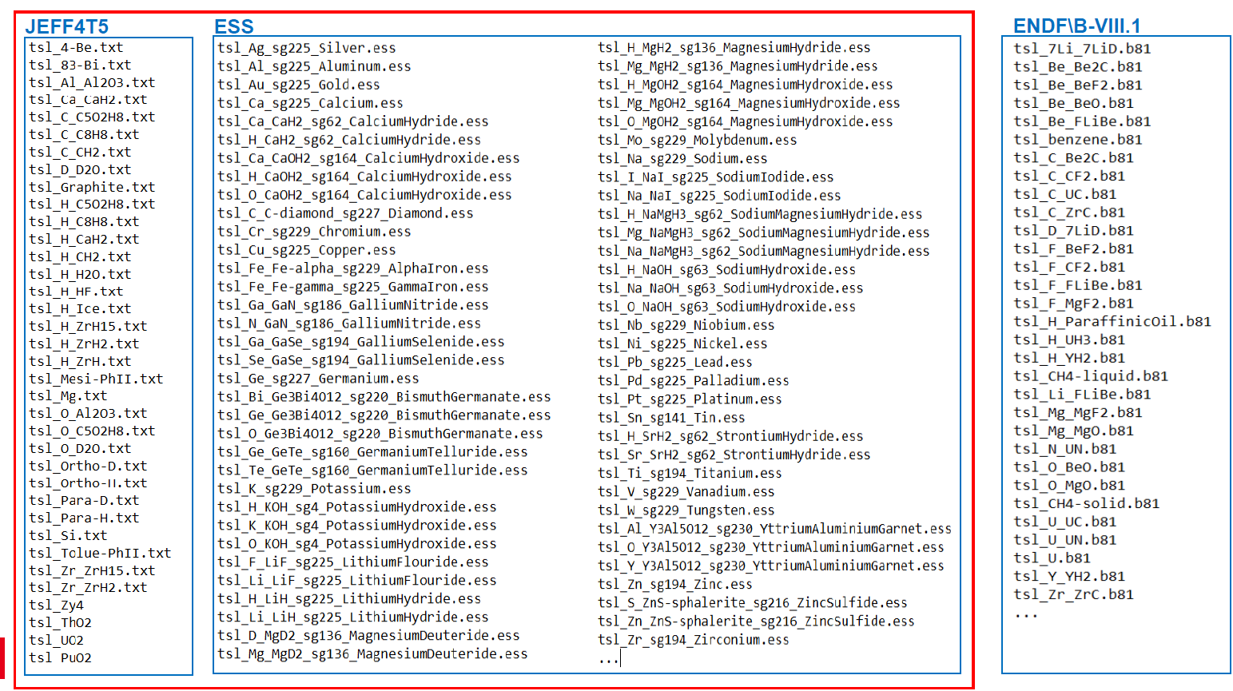
JEFF-4.0 nuclear data library - contents
Thermal scattering law sub-library
JEFF-3.3 with 16 new files, 6 modified files, new H in H2O evaluation, ESS (nCrystal) and ENDF/B contributions.
132 files for 84 materials (24 elements, 60 compounds).

Slide 7
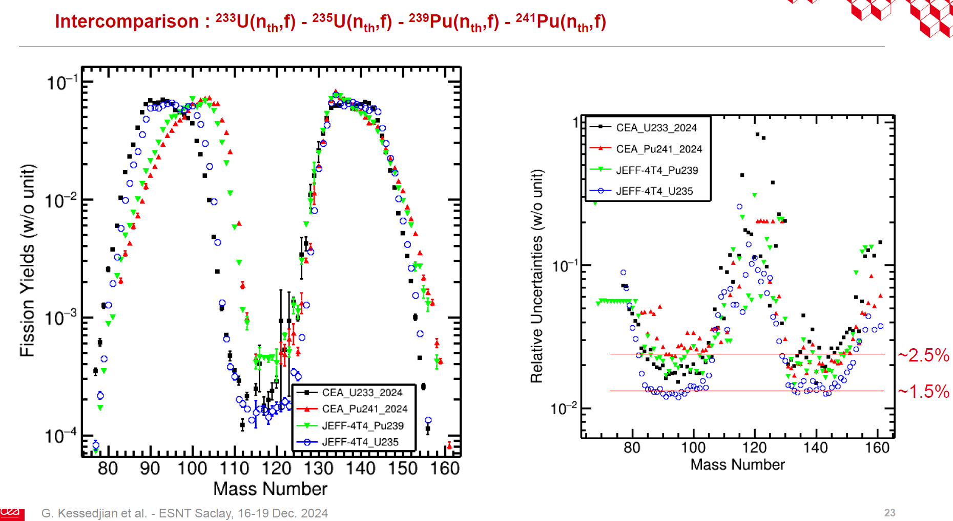
JEFF-4.0 nuclear data library - contents
Fission product yields sub-library
JEFF-3.3 data with new thermal neutron-induced U-235, Pu-239, U-233, Pu-241.
New methodology at CEA, carefully using all experimental data and new ILL data.
Correlation matrices have been produced for the four new evaluations and are publicly available.

Slide 8
JEFF-4.0 nuclear data library - contents
Decay data sub-library
JEFF-3.3 sub-library with new TAGS data for 8 radionuclides (Rb-93, Y-96, Y-96m, Y-99, Tc-103, Tc-108, I-138, Cs-142.
Tc-99 Q-value update.
Am-242 EC/B- branching and decay radiation.

Slide 9
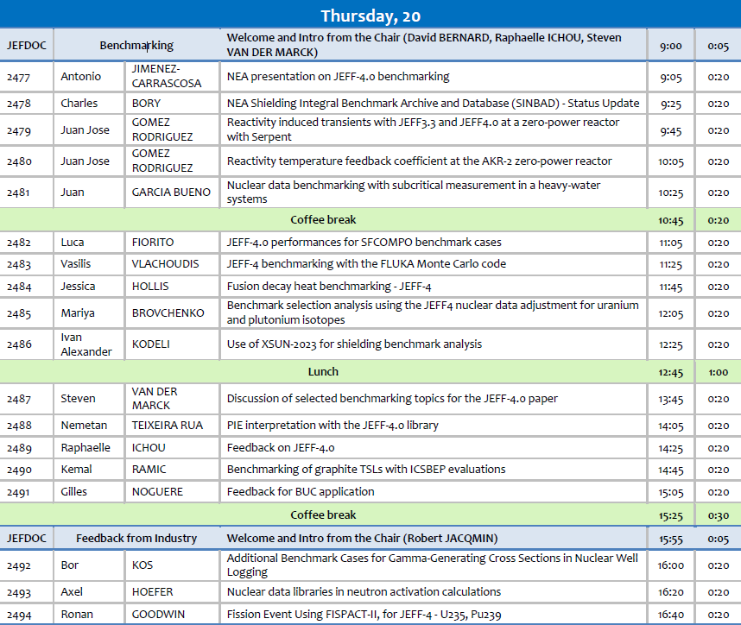
JEFF-4.0 nuclear data library - benchmarking
Extensive feedback on JEFF-4.0 was provided at the latest JEFF Nuclear Data Week, November 2025.
Criticality benchmarking looks consistent.
Corrected reactivity vs. burnup.
Improved inventory estimations due to FP updates.
Improvements on fission and fusion decay heat.

Slide 10
JEFF-4.0 nuclear data library - benchmarking
Criticality benchmarking for 3191 cases shows a clear improvement compared to JEFF-3.3.
Similar performance as ENDF/B-VIII.1.
S. van der Marck, Discussion of selected benchmarking topics for the JEFF-4.0 paper, JEFDOC-2487, November 2025.

Slide 11
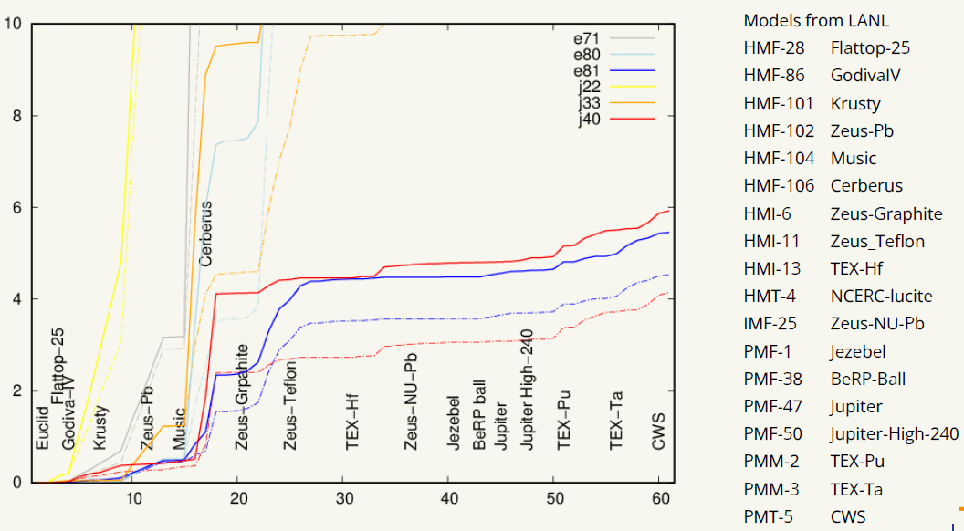
JEFF-4.0 nuclear data library - benchmarking
Criticality benchmarking for 3191 cases shows a clear improvement compared to JEFF-3.3.
Similar performance as ENDF/B-VIII.1.
Modern validation suite with quite similar behavior between JEFF-4.0 and ENDF/B-VIII.1.
S. van der Marck, Discussion of selected benchmarking topics for the JEFF-4.0 paper, JEFDOC-2487, November 2025.

Slide 12
JEFF-4.0 nuclear data library - benchmarking
Criticality benchmarking for 3191 cases shows a clear improvement compared to JEFF-3.3.
Similar performance as ENDF/B-VIII.1.
Modern validation suite with quite similar behavior between JEFF-4.0 and ENDF/B-VIII.1.
Reactivity curve was finally corrected, where JEFF-4.0 and ENDF/B-VIII.1 perform similarly.
R. Ichou, Feedback on JEFF-4.0, JEFDOC-2489, November 2025.

Slide 13
JEFF-4.0 nuclear data library - benchmarking
Criticality benchmarking for 3191 cases shows a clear improvement compared to JEFF-3.3.
Similar performance as ENDF/B-VIII.1.
Modern validation suite with quite similar behavior between JEFF-4.0 and ENDF/B-VIII.1.
Reactivity curve was finally corrected, where JEFF-4.0 and ENDF/B-VIII.1 perform similarly.
Improved inventory estimation due to updates on fission products.
G. Noguere, Feedback for BUC application, JEFDOC-2491, November 2025.

Slide 14
JEFF-4.0 nuclear data library - benchmarking
Criticality benchmarking for 3191 cases shows a clear improvement compared to JEFF-3.3.
Similar performance as ENDF/B-VIII.1.
Modern validation suite with quite similar behavior between JEFF-4.0 and ENDF/B-VIII.1.
Reactivity curve was finally corrected, where JEFF-4.0 and ENDF/B-VIII.1 perform similarly.
Improved inventory estimation due to updates on fission products.
Fusion decay heat shows improvements.
J. Hollis, Fusion decay heat benchmarking - JEFF-4, JEFDOC-2484, November 2025.

Slide 15
JEFF-4.0 nuclear data library - benchmarking
Criticality benchmarking for 3191 cases shows a clear improvement compared to JEFF-3.3.
Similar performance as ENDF/B-VIII.1.
Modern validation suite with quite similar behavior between JEFF-4.0 and ENDF/B-VIII.1.
Reactivity curve was finally corrected, where JEFF-4.0 and ENDF/B-VIII.1 perform similarly.
Improved inventory estimation due to updates on fission products.
Fusion decay heat shows improvements.
Enhanced RPV shielding results.
S. van der Marck, Discussion of selected benchmarking topics for the JEFF-4.0 paper, JEFDOC-2487, November 2025.

Slide 16
NEA Data Bank infrastructure
The JEFF project is supported by the NEA Data Bank, which aims at improving the infrastructure development for data management and code pipelines.
JEFF library developments are coordinated through a collaborative GitLab repository.
Tested nuclear data ready for use with software:
Complete, reproducible pipelines.
Reference calculation results.
Packaged within containers ready to be published.
Access to repository (restricted to JEFF community at the moment): https://git.oecd-nea.org/databank/nds/jeff

Slide 17
NEA Data Bank infrastructure – processing pipeline
We use GitLab CI/CD infrastructure to:
Version-controlled updates on evaluated files.
Perform evaluated files consistency checks.
Process to different formats (with input templates for auto-generation):
ENDF utilities
NJOY (ACE format)
FUDGE (GNDS format)
PREPRO
AMPX
OpenMC
Track issues related to specific files (access to JEFF issue board).
Run verification suites (checks if the data is usable by the software).
Run validation suites (measures the quality of the data to predict a quantity of interest):
Criticality safety, reactor physics, spent fuel, others.

Slide 18
NEA Data Bank infrastructure – processing pipeline

Slide 19
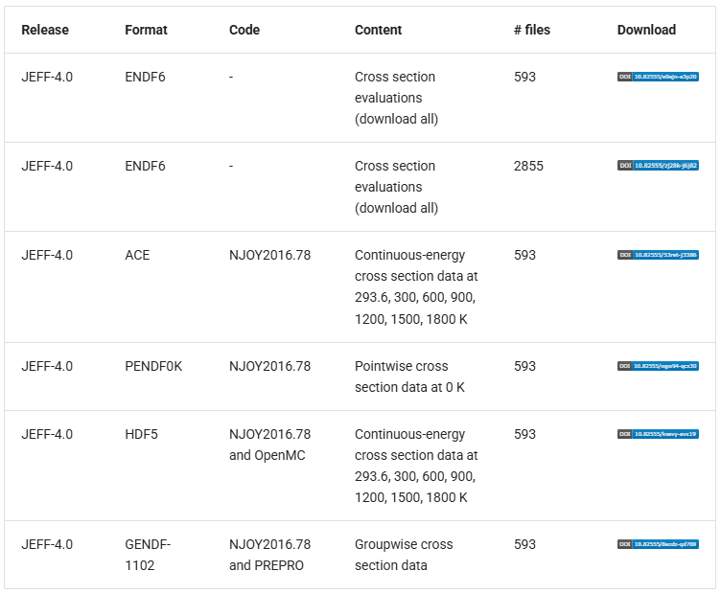
NEA Data Bank infrastructure – JEFF-4.0 products
Data publicly available at the NEA Data Bank website:
Joint Evaluated Fission and Fusion (JEFF) Library version 4.0 - NEA Data Bank GitLab platform
ACE files for multiple temperature points (cross sections and TSLs) for Monte Carlo transport codes.
PENDF 0K (e.g., for FLUKA code).
HENDF resources (for JANIS).
GENDF and SSF resources (for FISPACT).
HDF-5 files (for OpenMC).
Enhanced record registration and metadata.
More to be released shortly (SCALE resources, GNDS format,…).
A set of resources are available for testing.

Slide 20
NEA Data Bank infrastructure – next steps
We aim at expanding the capabilities of the processing pipeline:
Work on GNDS translation of JEFF-4.0 library.
Include covariance testing and verification (NJOY, AMPX).
Compare JEFF performance with ENDF and JENDL in an automatic way.
Add more formats to meet the user’s community requirements
Open to suggestions (and specific users’ needs) here ☺
Add more downstream testing products:
OpenMC
Serpent
SCALE
Beyond criticality,…
Add nuclear data adjustment tools to produce application-oriented libraries (in cooperation with WPEC/SG-52).

Slide 21
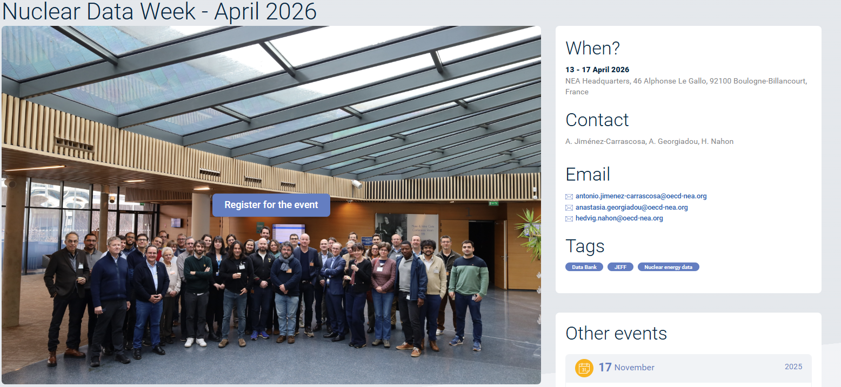
Next steps for JEFF-4 project
JEFF-4.0 main paper and associated topic collection under preparation.
JEFF Nuclear Data Week scheduled on 13-17 April 2026 (jointly with APRENDE project and ICSBEP).
Enhanced collaboration with experimentalists towards a more efficient interaction (JEFF Nuclear Data Week November 2025).
Stakeholders’ meeting postponed to fall 2026, dates to be announced.

Slide 22
Thank you for your attention

Slide 23
JANIS
"Freeze but maintain" - maintain ability to update (e.g. for hotfixes) but freeze active development
Release jars via pipeline process on GitLab
Release JANIS processing pipeline (open source) + documentation
Release all existing JANIS datasets on https://data.oecd-nea.org
Open-source the full JANIS code and decommission related web services due to "Critical" cybersecurity vulnerabilities in legacy Java code

