Slide 1
Modernizing Experimental Nuclear Data Access: The IAEA Nuclear Reaction Data Explorer (…and Beyond)
P(ND)²-3
3rd Conference of Perspectives for Nuclear Date for the Next Decade
March 11, 2026
Shin Okumura
Nuclear Data Section, Division of Physical and Chemical Sciences, Department of Nuclear Sciences and Applications, International Atomic Energy Agency

Slide 2
Nuclear Data Formats
EXFOR: Experimental Nuclear Reaction Database
ENDF-6: Evaluated Nuclear Data Library
ENTRY C 41553 20240709 41553000 1
SUBENT C 41553001 20240709 41553001 1
BIB 10 21 41553001 2
TITLE Angular distribution gamma-rays emitted during the 41553001 3
inelastic scattering of fast neutrons from a reactor by41553001 4
114, 116Cd 41553001 5
AUTHOR (A.M.Demidov,L.I.Govor,O.K.Zhuravlev,M.M.Komkov, 41553001 6
I.B.Shchukalov) 41553001 7
REFERENCE (J,BAS,40,(6),119,1976) Engl.translation of IZV,40,157 41553001 8
(J,IZV,40,1241,1976) Issue 6 41553001 9
ENDSUBENT 28 0 4155300199999
SUBENT C 41553002 20240709 41553002 1
BIB 6 14 41553002 2
REACTION ((48-CD-114(N,INL)48-CD-114,,SPC/DA,,FST)// 41553002 3
(48-CD-114(N,INL)48-CD-114,,SPC/DA,,FST)) 41553002 4
ENDBIB 14 0 41553002 17
DATA 8 56 41553002 23
E-NM E-NM-ERR DATA DATA-ERR LVL-INI LVL-INI-ER 41553002 24
LVL-FIN MISC 41553002 25
KEV KEV NO-DIM NO-DIM KEV KEV 41553002 26
KEV NO-DIM 41553002 27
367.7 0.6 0.62 E-2 0.06 E-2 1732.2 0.4 41553002 28
1364.0 4.8 E-2 41553002 29
448.3 0.8 0.35 E-2 0.09 E-2 1732.2 0.4 41553002 30
33 103 42 02725 1451 907
33 104 26 02725 1451 908
33 105 16 02725 1451 909
33 106 9 02725 1451 910
33 107 49 02725 1451 911
33 111 8 02725 1451 912
33 112 13 02725 1451 913
34 2 63 02725 1451 914
2725 1 099999
2725 0 0 0
2.705900+4 5.842693+1 0 0 1 02725 2151 1
2.705900+4 1.000000+0 0 0 1 02725 2151 2
1.000000-5 1.000000+5 1 3 0 12725 2151 3
3.500000+0 6.672000-1 0 0 2 32725 2151 4
5.842690+1 6.672000-1 0 0 600 1002725 2151 5
-5.000000+3 3.000000+0 5.576800+2 9.215100+0 0.000000+0 0.000000+02725 2151 6
-5.000000+3 4.000000+0 1.898100+2 1.868200-1 0.000000+0 0.000000+02725 2151 7
-4.767000+2 4.000000+0 1.949000-2 2.148900+0 0.000000+0 0.000000+02725 2151 8
-2.258800+2 3.000000+0 8.910000+0 5.940000-2 0.000000+0 0.000000+02725 2151 9
1.320000+2 4.000000+0 5.270100+0 4.700000-1 0.000000+0 0.000000+02725 2151 10
4.323100+3 4.000000+0 1.041400+2 4.173700-1 0.000000+0 0.000000+02725 2151 11
5.016000+3 3.000000+0 6.789600+2 1.332200+0 0.000000+0 0.000000+02725 2151 12
6.389700+3 4.000000+0 1.681100+0 3.155600-1 0.000000+0 0.000000+02725 2151 13​
8.061900+3 3.000000+0 4.083300+1 4.078000-1 0.000000+0 0.000000+02725 2151 14​
EXFOR example
Line numbers
n+⁵⁹Co example
Line numbers
These formats are still actively used today, but they inherit several constraints from the Fortran era (punch-card legacy):
incompatibility with modern data tools
limited metadata and contextual information
lack of human readability and semantic clarity

Slide 3
Challenges and Needs in Nuclear Data Usage
Traditional (Legacy) nuclear data formats
Fixed-width text formats (EXFOR, ENDF-6, XUNDL, ENSDF)
Limited metadata and poor machine readability
Require format expertise and preprocessing before use
Impact
High entry barrier for newcomers
Not all nuclear physicists are nuclear data format specialists
What researchers (not format expert) need
Easy access to EXFOR and evaluated (ENDF-6) data and self-explanatory metadata
Compatibility with modern data science and AI/ML tools

Slide 4



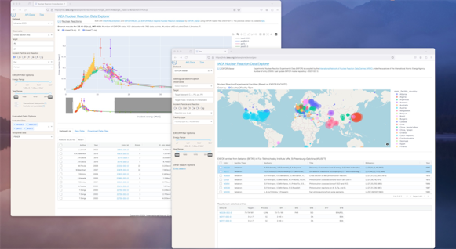
IAEA Nuclear Reaction Data Explorer
Developed in 2021, renewed in 2024, will be renewed in 2026 (soon)
https://nds.iaea.org/dataexplorer
Reaction based data plotter
Input target and reaction to get evaluated and experimental datasets
Cross section
Thermal neutron cross section
Residual production cross section
Fission yield
Python 3 based, Open source project
EXFOR entry viewer
Easy access without understanding of EXFOR format
Search by reactions
Entry viewer
Geographical analysis
Web APIs
Easy computational access
Reaction, EXFOR entry and definition of EXFOR keywords, RIPL-3 levels

Slide 5












Dataflow: Experimental (EXFOR) and Evaluated (ENDF-6) Data
Experimental Data (EXFOR)
Backend Data Flow for EXFOR files
Parsing
Transformation
Mapping
Tabulation
APIs
Trans files →
EXFOR_Master
Original files
EXFOR_parser
EXFOR_JSON
exfortables_py
Interface
RIPL-3 Discrete levels Parser
EXFOR Dictionary Parser
RIPL3_JSON
Intermediate
files
exfor_dictionary
Evaluated Data
Backend Data Flow for ENDF-6 files
Latest ENDF-6 libraries
SQL
IAEA
Nuclear Reaction
Data Explorer
Processing
PENDF
Tabulation
Backend
System
(NJOY/PREPRO)

Slide 6
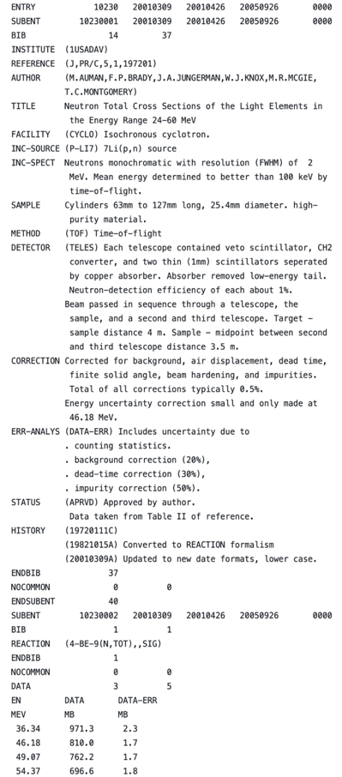
EXFOR Parsing: General Format Parsing into JSON
Block Parsing
Pseudo-document oriented database format.
Based on tagged, nested blocks.
Raw Input Block | Parsed JSON Fragment
ENTRY – ENDENTRY | "entry": "D1036", "last_updated": ...
SUBENT – ENDSUBENT | "subentry": "D1036001", "date": ...
BIB – ENDBIB | "bib_record": { "title": "...", ... }
DATA - ENDDATA | "data": { “head": [...], “unit”:[], “data”*[]... }

Slide 7
EXFOR Parsing: EXFOR Code and Free Text Separation
Block → Key-Value Parsing → JSON → SQL Table
Step 1: Separation of dictionary-defined codes (in parentheses) from free-text descriptions + JSON conversion
Step 2: SQL Representation
"facilities": [
{ "x4_code": "(CYCLO,3POLIPJ)", "free_txt": ["C-30 cyclotron"],
"facility_type": "(CYCLO)", "institute": "(3POLIPJ)"}
],
"sample": [
{ "x4_code": null, "free_txt": ["Enriched metallic 112Sn", "(20.6 mg, 5 mm diam., 0.2 mm thick)"]},
{ "x4_code": "(50-SN-112,ENR=0.84)", "free_txt": [] },
{ "x4_code": "(50-SN-114,ENR=0.13)", "free_txt": [] }
],
"detector": [
{ “x4_code”: “(HPGE)”, "free_txt": [ " 1 HPGe detector (1.8 keV resoluation at", " 1332 keV) for 114m2In” ...]}
]
FACILITY (CYCLO,3POLIPJ) C-30 cyclotron
SAMPLE Enriched metallic 112Sn
(20.6 mg, 5 mm diam., 0.2 mm thick)
(50-SN-112,ENR=0.84)
(50-SN-114,ENR=0.13)
DETECTOR (HPGE) 1 HPGe detector (1.8 keV resoluation at
1332 keV) for 114m2In measurement, and 2 HPGe
detectors (2.0 keV resolution at 1332 keV and 1.1 keV
resolution at 122 keV)
Key | Value | Free text
SAMPLE |  | Enriched metallic 112Sn (20.6 mg, 5 mm diam., 0.2 mm thick)
SAMPLE | (50-SN-112,ENR=0.84)
SAMPLE | (50-SN-114,ENR=0.13)
METHOD | (ACTIV) | Irradiated for 5 min at 27nA or 1 hr at 3.5 nA
INC-SPECT |  | The proton energy beam was determined by detection of elastically scattered proton on polyethylene foil by a Si(Li) telescope.
DETECTOR | (HPGE) | 1 HPGe detector (1.8 keV resoluation at 1332 keV) for 114m2In measurement, and 2 HPGe detectors (2.0 keV resolution at 1332 keV and 1.1 keV resolution at 122 keV)

Slide 8
EXFOR Parsing: Data Table Parsing and Unit Unification
Clear alignment of values with headers and units.
Handles missing values (null) and multi-row cleanly.
Original Expression
JSON Structured Form
Fixed width, multiple columns (>6) with line breaks.
Parsed each row block by column headers, units, and flattened the structure into JSON arrays.
DATA 8 19
ELEMENT MASS ISOMER MASS-MIN MASS-MAX DATA
DATA-MIN FLAG
NO-DIM NO-DIM NO-DIM NO-DIM NO-DIM MB
MB NO-DIM
82. 203. 26.
81. 202. 3.
81. 201. 20.
81. 200. 12.
81. 199. 27.
81. 198. 15.
66. 149. 153.
0.62 1.
:
ENDDATA
{
"data": {
"heads": ["ELEMENT", "MASS", "ISOMER", "MASS-MIN", "MASS-MAX", "DATA", "DATA-MIN", "FLAG"],
"units": ["NO-DIM", "NO-DIM", "NO-DIM", "NO-DIM", "NO-DIM", "MB", "MB", "NO-DIM"],
"data": [
[82.0, 81.0, 81.0, 81.0, 81.0, 81.0, 66.0, 66.0, 65.0, 56.0, 56.0, 56.0, 38.0, 38.0, 35.0, 35.0, 32.0, 32.0, 32.0],
[203.0, 202.0, 201.0, 200.0, 199.0, 198.0, null, null, 149.0, 131.0, 129.0, 128.0, 91.0, 89.0, 82.0, 80.0, 75.0, 69.0, 66.0],
[null, null, null, null, null, null, null, null, null, null, null, null, null, null, null, 1.0, null, null, null],
[null, null, null, null, null, null, 149.0, 149.0, null, null, null, null, null, null, null, null, null, null, null],
[null, null, null, null, null, null, 153.0, 153.0, null, null, null, null, null, null, null, null, null, null, null],
[26.0, 3.0, 20.0, 12.0, 27.0, 15.0, null, null, null, 5.5, 1.9, 4.3, 0.48, 1.4, 0.22, 0.07, 0.53, 0.65, 0.17],
[null, null, null, null, null, null, 0.62, 1.77, 0.95, null, null, null, null, null, null, null, null, null, null],
[null, null, null, null, null, null, 1.0, 1.0, 1.0, null, null, null, null, null, null, null, null, null, null]
]
}
}

Slide 9
EXFOR Parsing: Handling Reaction Expressions
{
"type": "Ratio",
"numerator": "...",
"denominator": "..."
}
Re-Structuring EXFOR’s Reaction Math Expressions for Better Usability
Clear Operation
JSON-Friendly
Original Expression | Structured Form
(92-U-235(N,F),,SIG) | N/A
((9-F-19(N,G)9-F-20,,RI)//(9-F-19(N,G)9-F-20,,SIG)) | ['Ratio', '(9-F-19(N,G)9-F-20,,RI)', '(9-F-19(N,G)9-F-20,,SIG)']
((94-PU-239(N,F),DL/GRP,NU)/(94-PU-239(N,F),DL,NU)) | ['Divide', '(94-PU-239(N,F),DL/GRP,NU)', '(94-PU-239(N,F),DL,NU)']
(((92-U-238(N,F)ELEM/MASS,CUM,FY)/ (92-U-238(N,F)43-TC-99,CUM,FY))// ((92-U-235(N,F)ELEM/MASS,CUM,FY,,MXW)/ (92-U-235(N,F)43-TC-99,CUM,FY,,MXW))) | [’Ratio’, [’Divide’, ’(92-U-238(N,F)ELEM/MASS,CUM,FY)’, ’(92-U-238(N,F)43-TC-99,CUM,FY)’], [’Divide’, ’(92-U-235(N,F)ELEM/MASS,CUM,FY,,MXW)’, ’(92-U-235(N,F)43-TC-99,CUM,FY,,MXW)’]]

Slide 10
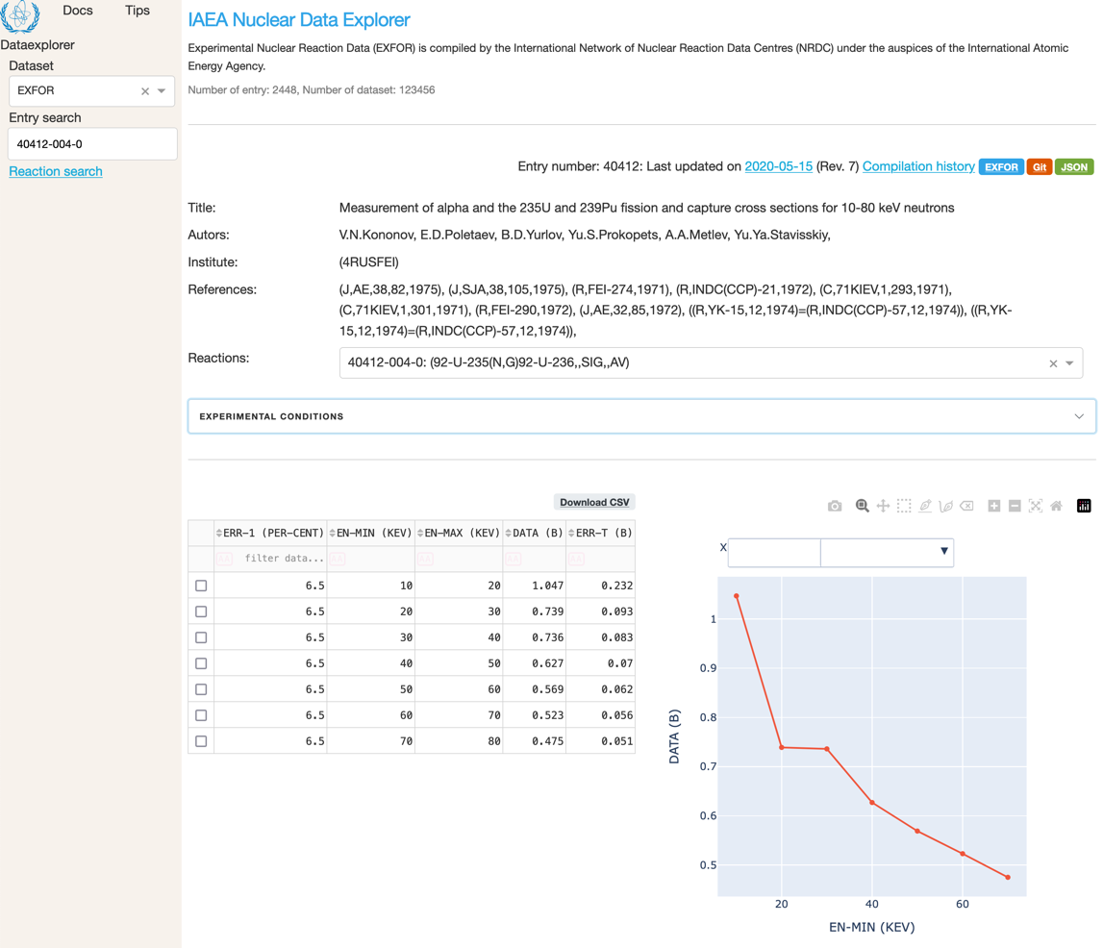
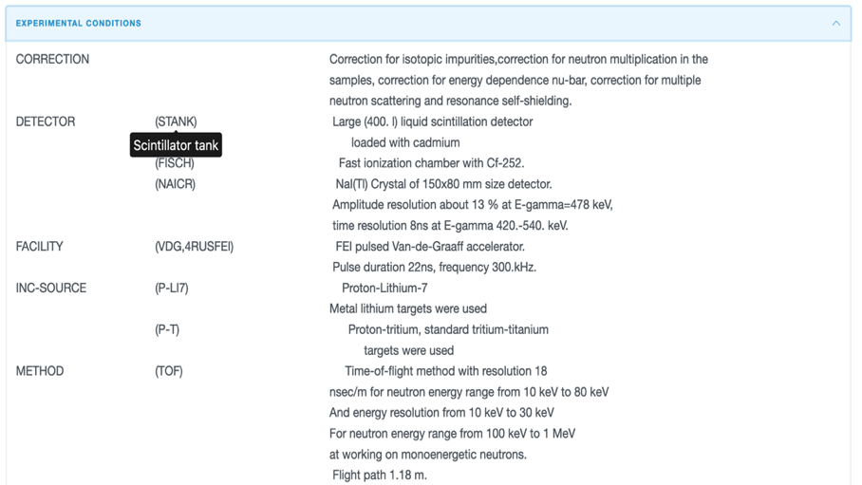
The EXFOR Entry Viewer
Example: https://nds.iaea.org/dataexplorer/exfor/entry/40412
ENTRY 40412 20200318 20200515 20200514 4186
SUBENT 40412001 20200318 20200515 20200514 4186
BIB 13 76
INSTITUTE (4RUSFEI)
REFERENCE (J,AE,38,82,1975) Issue 2.
(J,SJA,38,105,1975) Engl.translation of AE,38,82,1975.
#doi:10.1007/BF01208866
(R,FEI-274,1971)
(R,INDC(CCP)-21,1972) Engl.translation of R,FEI-274.
(C,71KIEV,1,293,1971) Graphs of Alpha value.
(C,71KIEV,1,301,1971) Exp.method.
(R,FEI-290,1972) Facility details.
(J,AE,32,85,1972) Issue 1. Graphs of Alpha value.
(J,SJA,32,95,1972) Engl.translation of AE,32,85,1972
#doi:10.1007/BF01261042
((R,YK-15,12,1974)=
(R,INDC(CCP)-57,12,1974))
Even at NDS web-site in this INDC(CCP)-57 pdf these pag
are absent.
AUTHOR (V.N.Kononov, E.D.Poletaev,B.D.Yurlov, Yu.S.Prokopets,
A.A.Metlev, Yu.Ya.Stavisskiy)
TITLE Measurement of alpha and the 235U and 239Pu fission and
capture cross sections for 10-80 keV neutrons
FACILITY (VDG,4RUSFEI) FEI pulsed Van-de-Graaff accelerator.
Pulse duration 22ns, frequency 300.kHz.
INC-SOURCE (P-LI7) Proton-Lithium-7
Metal lithium targets were used
(P-T) Proton-tritium, standard tritium-titanium
targets were used
SAMPLE Four metal Pu-239 discs of 40 mm diameter, 2.9E-03
nuclei/b thickness. Total weight 14.5 g.
Pu-240 content in the sample - 0.2%.
Triuranium octoxide U3O8 (90.3 percents of U-235)
Sample of 4.1E-3 U-235-nuclei/b thickness in aluminum
shell of 40 mm Diameter and 0.5mm wall thickness.
U3O8 weight - 24.4g.
Background measurements equivalent scattering samples
of carbon and lead were used
METHOD (TOF) Time-of-flight method with resolution 18
nsec/m for neutron energy range from 10 keV to 80 keV
And energy resolution from 10 keV to 30 keV
For neutron energy range from 100 keV to 1 MeV
at working on monoenergetic neutrons.
Flight path 1.18 m.
DETECTOR (STANK) Large (400. l) liquid scintillation detector
loaded with cadmium
(FISCH) Fast ionization chamber with Cf-252.
(NAICR) NaI(Tl) Crystal of 150x80 mm size detector.
Amplitude resolution about 13 % at E-gamma=478 keV,
time resolution 8ns at E-gamma 420.-540. keV.
MONITOR Measurement of the capture-to-fission cross-section
ratios (ALFA) was absolute
The fission cross-sections have been measured using
energy dependence of B-10(n,alpha-gamma) reaction as
given by Sowerby M.G. et al, 70HELSINKI,1,161 and
Macklin P.L. et al, Phys.Rev., 165, 1147, 1968.
Normalization of fission cross-section was made over
energy region 30-40 keV to evaluated data by Sowerby
et al, Ann. Of Sci. and Eng., V1,No.718,1974.
CORRECTION Correction for isotopic impurities,correction for
neutron multiplication in the samples, correction for
energy dependence nu-bar, correction for multiple
neutron scattering and resonance self-shielding.
HISTORY (19770110C)
(19791211U)
(19840227U) Reaction formalism introduced
(20070924A) M.M.Dates were corrected for 4-digits year.
BIB information was added.
(20140325U) Ref. J,SJA,38,105,1975 was added.
Minor corrections of BIB information.
AV was added in SF8 in Subents 003-004,006-008.
(20191209A) Correction of ERR-ANALYS in Subents
003,004,006,007
(20200318U) ref. R,INDC(CCP)-57,12,1974 was added, even
at NDS web-site in this INDC(CCP)-57 pdf these pages
are absent.
ENDBIB 76
NOCOMMON 0 0
ENDSUBENT 79
SUBENT 40412004 20191209 20200217 20200217 4185
BIB 4 11
REACTION (92-U-235(N,G)92-U-236,,SIG,,AV)
ANALYSIS Capture CS was determined from ALF and fission CS.
ERR-ANALYS (ERR-T) Errors shown on the data are total error
which includes error of alpha and fission cross-section
data
(ERR-1) Uncertainty of fission C-S.
.See also uncertainties in Subents 002,003.
STATUS (TABLE) Revised by author data of Table 1 of
J.At.Energ.,v.38,is.2,p.82,1975
(DEP,40412002) ALFA
(DEP,40412003) Fission cross section
ENDBIB 11
COMMON 1 3
ERR-1
PER-CENT
6.5
ENDCOMMON 3
DATA 4 7
EN-MIN EN-MAX DATA ERR-T
KEV KEV B B
1.0000E+01 2.0000E+01 1.0470E+00 2.3200E-01
2.0000E+01 3.0000E+01 7.3900E-01 9.3000E-02
3.0000E+01 4.0000E+01 7.3600E-01 8.3000E-02
4.0000E+01 5.0000E+01 6.2700E-01 7.0000E-02
5.0000E+01 6.0000E+01 5.6900E-01 6.2000E-02
6.0000E+01 7.0000E+01 5.2300E-01 5.6000E-02
7.0000E+01 8.0000E+01 4.7500E-01 5.1000E-02
ENDDATA 9
ENDSUBENT 29
← Simplified bibliographic info
← Reactions in ENTRY
←Measurement info
↓Tooltip from the EXFOR dictionary
Data download in csv↓
Direct data plot
Entry with original EXFOR format
Separate code and free text→

Slide 11
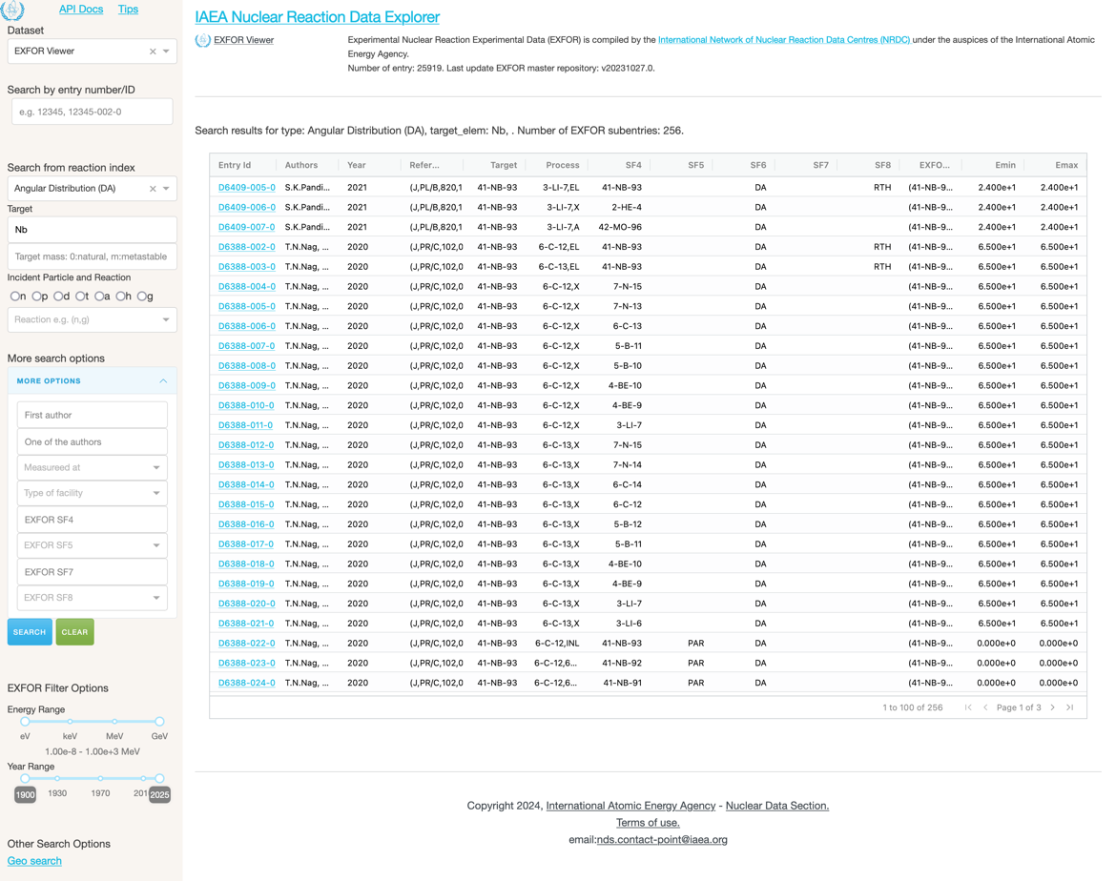
Search EXFOR Entry
Example:https://nds.iaea.org/dataexplorer/exfor/search?type=DA&target_elem=Nb&target_mass=93

Slide 12
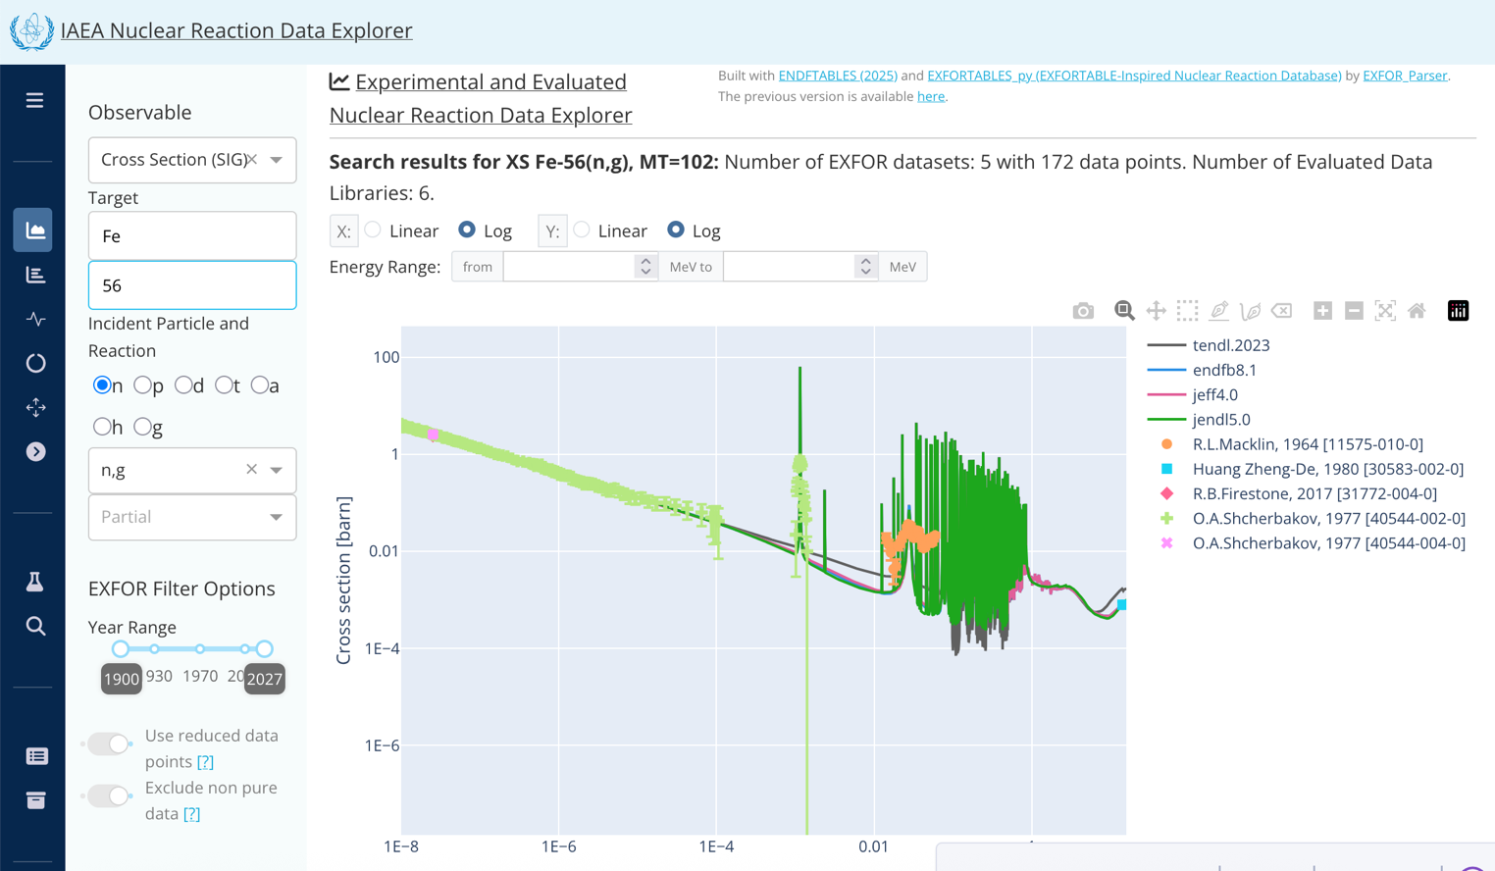
Fe56(n,g) Cross Section Plot
Example:https://nds.iaea.org/dataexplorer/reactions/xs?target_elem=Fe&target_mass=56&reaction=n%2Cg
Preview of the upcoming interface

Slide 13
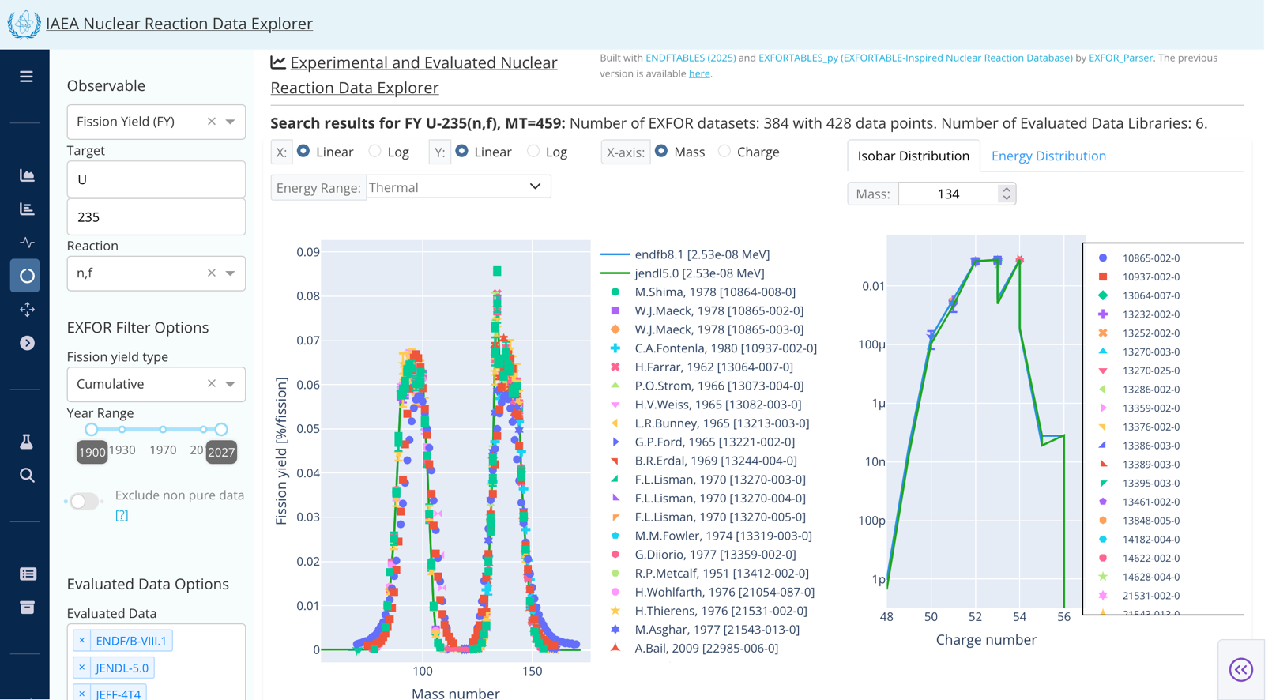
Fission Product Yield Plot
Example:https://nds.iaea.org/dataexplorer/reactions/fy?&target_elem=U&target_mass=235&reaction=n,f&fy_type=Cumulative
Preview of the upcoming interface

Slide 14
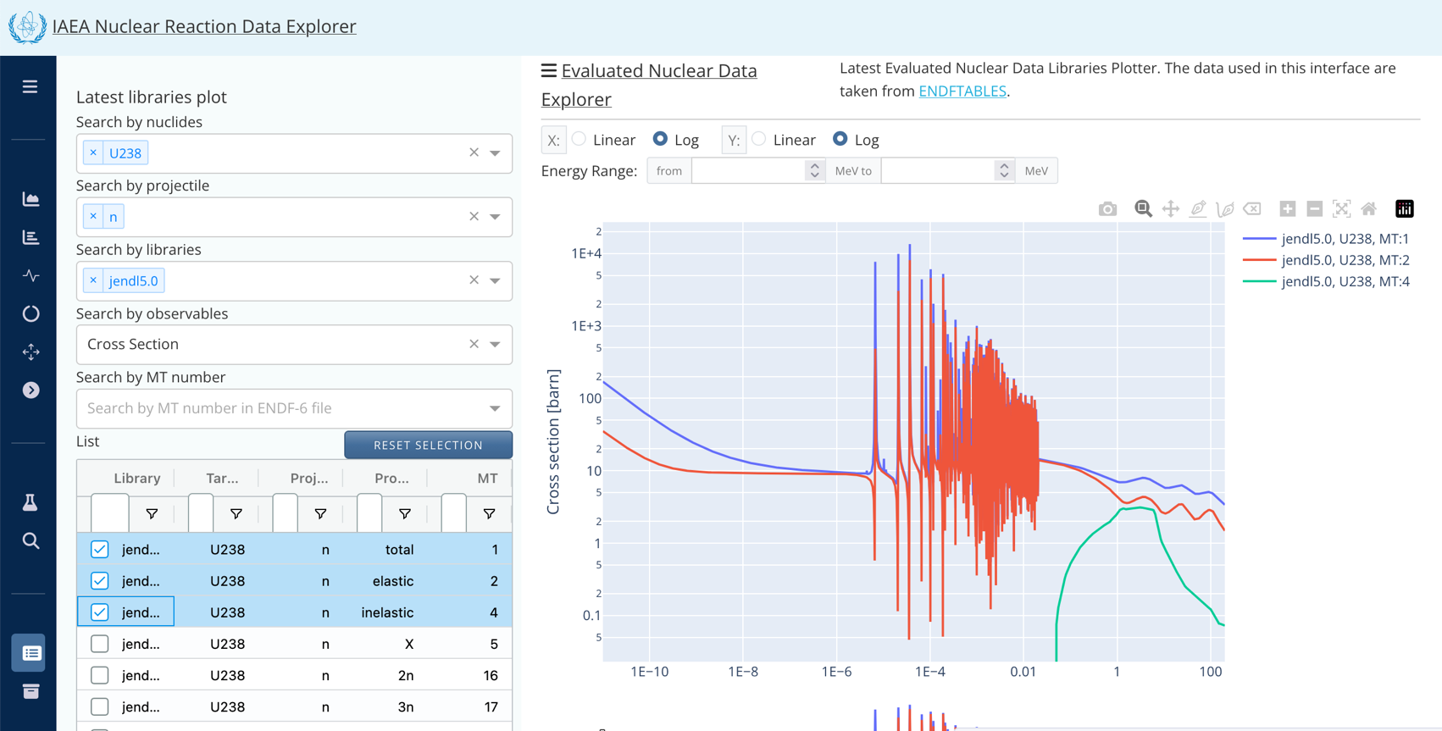
Library Comparison
Preview of the upcoming interface

Slide 15

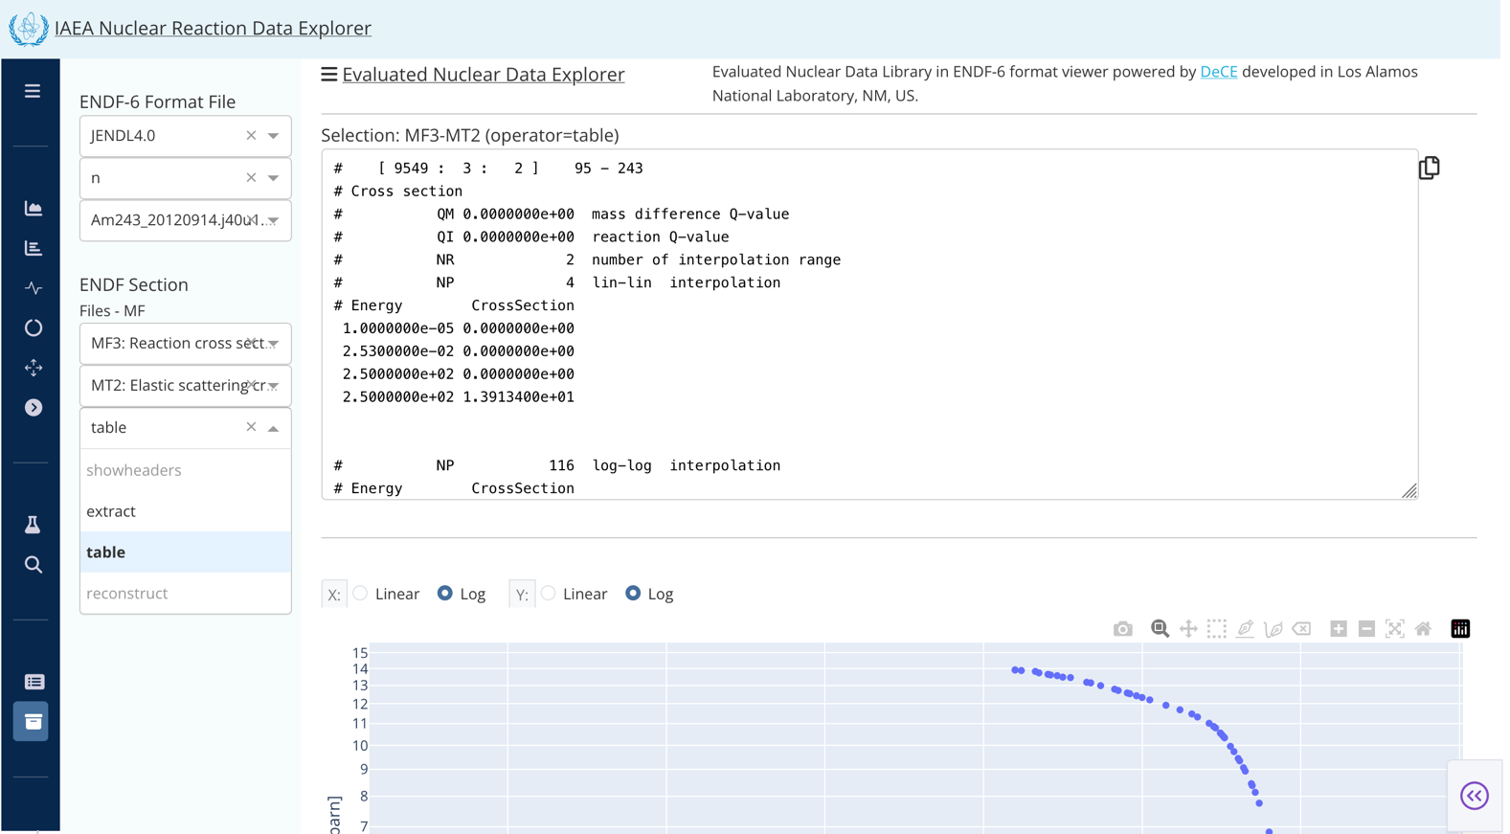
Library Archive Access (powered by DeCE)
[1] Developped by T. Kawano (LANL), https://github.com/toshihikokawano/DeCE
ENDF-6 content viewer powered by DeCE^{[1]}
showheaders: print parameters in header MF1 MT 451
extract: print section in ENDF-6 format
table: print section in tabulated table format
reconstruct: cross section from resonance parameters
Preview of the upcoming interface

Slide 16






Scenario in Next Few Years
Leading to the IAEA Nuclear Data Portal project
I want to share recently measured data as soon as possible with collaborators and others. I cannot wait for the EXFOR compilation.
Is there a place to upload data for sharing?
(Ideally with a persistent identifier like a DOI.)
experimentalists
I want to preserve the datasets and methods (metadata) used to produce evaluated library data.
I want to share the theoretical calculation results published in a paper so that other scientists can easily access and reuse them.
evaluators
theoreticians
I have corrected an EXFOR entry data. The original entry contained a compilation mistake.
any data user

Slide 17
Ideas for the Next Decade – Nuclear Reaction Data Portal
Consolidating these scenario into practical implementation needs leads:
Format-Independent Data Access
Access nuclear data without requiring expertise in formats such as EXFOR or ENDF-6.
Rich Metadata & Contextual Relationships
Link between datasets, experiments, and evaluations for clear context.
Accelerated Data Availability
User submissions + automatic extraction from publications for rapid updates.
Community-Driven Contributions
Curated, corrected, theoretical, or experimental data with provenance tracking.
Transparent and Reproducible Evaluations (≒WPEC SG54)
Trace ENDF evaluations back to experimental and corrected data.
Future-Ready Infrastructure and Modern Data Management
Scalable, version-controlled, FAIR-compliant system ready for AI and new data types.

Slide 18















Next Step: Expand the Data Explorer into a Data Portal
EXFOR compilation
IAEA Nuclear Reaction Data Portal and APIs
EXFOR
Experimental Data
Library evaluation
More findable and accessible in a easy way (UI and REST API)
ENDF-6
Evaluated Data
Converted data
Curated Data
Rapid dissemination, availability, visualization options of data
All Users:
Contributors from the entire community
Theoretical Data
Enhance more data usage for AI and ML models
User’s data
Processed Libraries
Mobile access
* We won’t force users to submit data, it’ll be a new choice. The current EXFOR data compilation process remains the same.
Analytical Data
Original data
IAEA
Nuclear Reaction
Data Lake

Slide 19
Data Portal Project Goals
Goal 1: Integrate diverse nuclear data into unified data models
Scalable, version-controlled, AI-ready infrastructure.
Convert legacy nuclear data formats into machine-readable JSON and/or SQL models.
Support modern scientific data management practices.
Goal 2: Ensure data quality, provenance, and reproducibility
Track data provenance and processing history.
Maintain explicit links between evaluated values and experimental / curated data.
Goal 3: Enable open and FAIR data access
Align with FAIR principles (Findable, Accessible, Interoperable, Reusable).
Provide APIs and bulk data access for collaborating institutes.
Use standardized identifiers:
Institutes → ROR, Authors → ORCID, Publications → DOI
Goal 4: Support community contributions
Allow submission of curated, corrected, collected, theoretical, or experimental data.
Support rapid updates and dissemination via automatic extraction and user submissions.

Slide 20
Challenges on Data Mapping
Parsers have been developed, but
Interpreters are still required, as only experts know how to compare data.
ENDF-6
EXFOR
13-AL-27(N,TOT),,SIG
40-ZR-90(N,INL)40-ZR-90,PAR,SIG
26-FE-56(A,X)1-H-1,,DA/DE
3-LI-6(HE3,P)4-BE-8,PAR,DA
92-U-238(N,F),PR,NU/DE
92-U-235(N,F)0-G-0,PR,FY/DE
92-U-235(N,F)42-MO-99,CUM,FY
92-U-233(N,F),,AKE,LF+HF
94-PU-239(N,F),PR,NU
MF 3 MT 1
MF 3 MT 51-89
MF 4 MT 601
MF 6 MT none
MF 5 MT 18
MF 15 MT 18 x MF 12 MT 18
MF 8 MT 459
MF none MT none
MF 1 MT 456
Evaluation into ENDF-6 format
EXFOR compilation
Nuclear Reaction Physics
EXFOR Parser
+
Interpreters
Cross sections
• Cumulative: total, elastic, non-elastic
• Exclusive: (n,n’), (n,2n), (n,g), (n,f), n,p),….
• Discrete level: (n,n’_1), (n,n’_2),…(n,p_0),….
• Particle production: (n,xn), (n,xp),….
• Residual production: (n,x), (p,x),….
Angular distributions
• Elastic
• Inelastic
Single-differential emission spectra (energy)
Double-differential emission spectra (energy-angle)
Gamma-ray production cross sections
Fission yields
Fission neutron
ENDF Processing Code and Parser
+
Interpreters
NJOY
PREPRO
FRENDY
DeCE
ENDFtk
endf-parsepy+endf-userpy
exforparser
x4i

Slide 21
Summary
The IAEA Nuclear Reaction Data Explorer has been developed since 2021, was renewed in March 2024, and will be renewed in 2026 with the following updates:
New interface, latest datasets
Additional observables: Resonance Parameters, Transmission
New function: Library archive access using DeCE as an EDNF-6 parser
Towards a new era of nuclear data management and utilization, developments of IAEA Nuclear Reaction Data Portal has been initiated.
Existing data formats and processes will remain unchanged for the official community.
Nuclear Reaction Data Portal will provide new options to explore and analyse data using modern mechanisms with new transparent data pipelines.
Timeline will be announced within 2026.
Any comments and requests from Nuclear Data for the Next Decade community are appreciated.
Feedback: nds.contact-point@iaea.org or s.okumura@iaea.org

Slide 22
Thank you for your attention!
Collaborators:
Arjan Koning (IAEA)
Jean-Christophe Sublet (UKAEA)
Georg Schnabel (IAEA)
Alejandra Martinez (IAEA)
Toshihiko Kawano (LANL)
Julia Sprenger (OECD/NEA)
As well as many scientists who provided suggestions and feedback.
Feedback: nds.contact-point@iaea.org
s.okumura@iaea.org

Slide 23
Useful Resources around EXFOR
Area | Name | Purpose | GitHub Repository
EXFOR | EXFOR Master Files | Preservations of all historical changes on EXFOR entries | https://github.com/IAEA-NDS/exfor_master
 | EXFOR in JSON | All EXFOR entries converted into JSON | https://github.com/IAEA-NDS/exfor_json
 | EXFOR Dictionary in JSON | All EXFOR entries converted into JSON | https://github.com/IAEA-NDS/exfor_dictionary
 | EXFOR Parser | Program to Parse EXFOR and convert into JSON and create tabulated table | https://github.com/IAEA-NDS/exforparser
 | EXFORTABLES_py | EXFOR data in tabulated format similar to EXFORTABLES | https://github.com/shinokumura/exfortables_py
 | RIPL-3 Discrete Levels in JSON | All discrete levels converted into JSON | https://github.com/shinokumura/ripl3_json
 | Thermal Cross Section | Extracted thermal cross section from EXFOR | https://github.com/shinokumura/thermaldata
 | Resonance Parameters | Extracted resonance parameters from EXFOR | https://github.com/shinokumura/resonance_data
 | More DOIs for EXFOR Entries | DOIs for REFERENCE, REL-REF and MONIT-REF in EXFOR entries | https://github.com/shinokumura/exfor_entry_doi

Slide 24
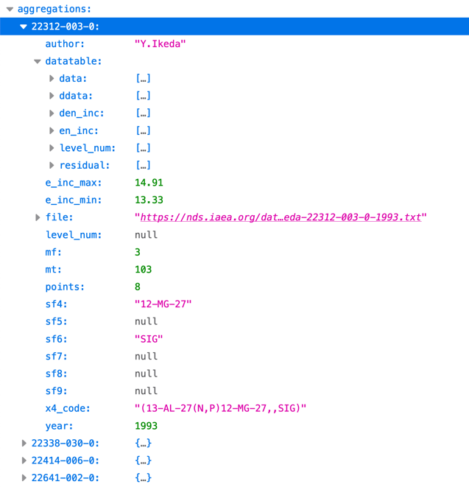
Reactions API
/dataexplorer/api/reactions/{type}
GET
Example:https://nds.iaea.org/dataexplorer/api/reactions/xs?target_elem=Al&target_mass=27&reaction=n%2Cp&table=True&page=1
Name | Data Type | Required | Description
type | string |  | xs: Cross section residual: Residula production cross sections thermal: Thermal neutron cross sections fy: fission yields
General search parameters
Name | Data Type | Required | Description
target_elem | string |  | e.g. Al
target_mass | number |  | e.g. 27
reaction | string |  | e.g. n,g
rp_elem | string | optional | Element name of the residual product
rp_mass | number | optional | Mass number of the residual product
fy_type | string | optional | Cumulative, Independent, Primary for FPY
table | boolen | optional | Default: False, True to include data table in the return
page | number |  | Default: 1, page number of pageing. 100 datasets in one page are returned.

Slide 25
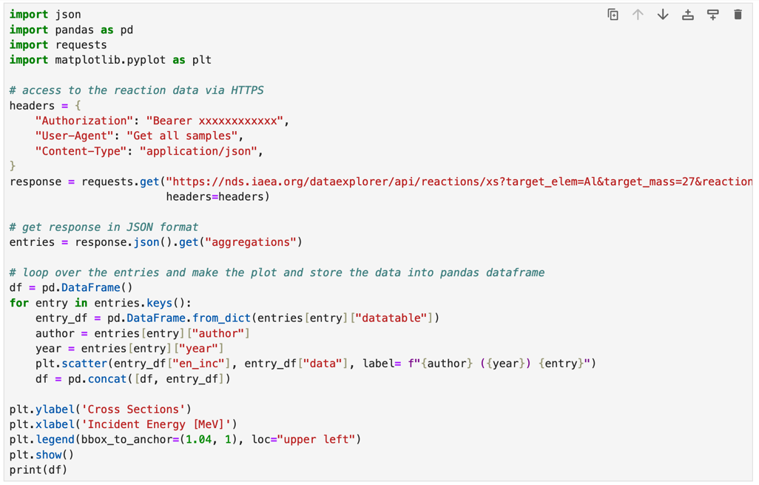
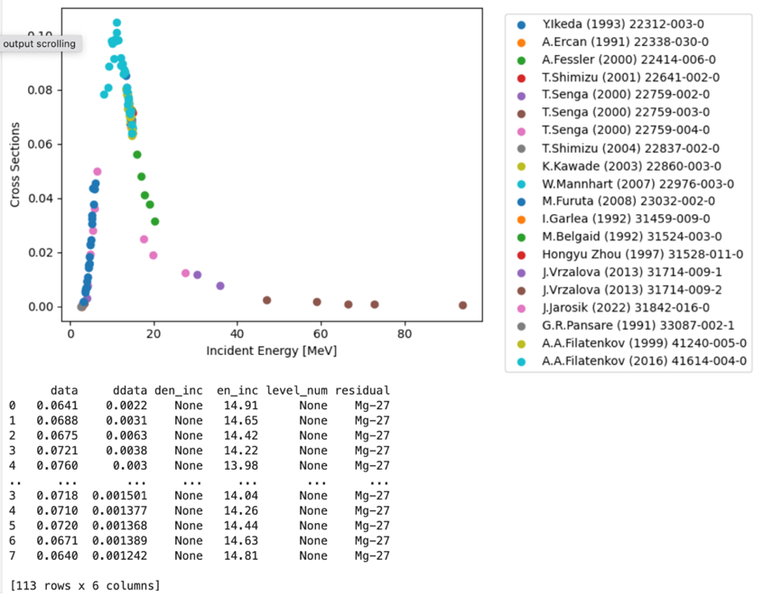
Simple Use Case of Reactions API

Slide 26
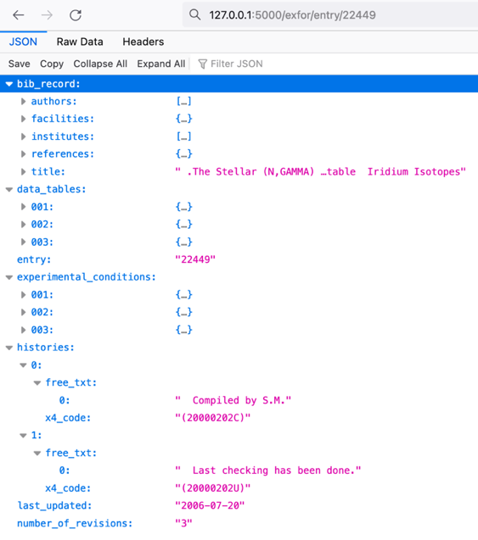
EXFOR Entry API
Example:https://nds.iaea.org/dataexplorer/api/exfor/entry/31558
/dataexplorer/api/exfor/entry/{entry_id}/{subent_id}
GET
Name | Data Type | Required | Description
entry_id | string |  | EXFOR entry number
subent_id | string | optional | Subentry number
/dataexplorer/api/exfor/entry/{entry_id}/{section}
GET
Name | Data Type | Required | Description
section | string | optional | bib: return bibliographic data data: return datatable experiment: return experimental conditions histories: return entry history

Slide 27
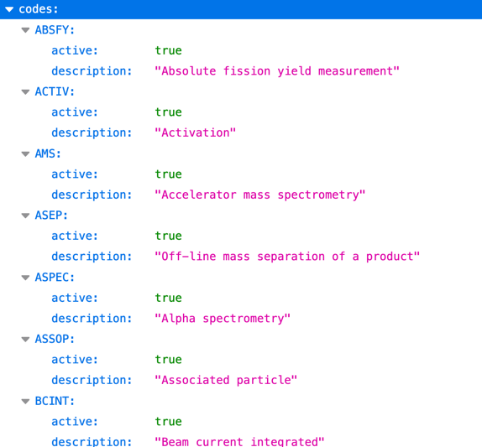

EXFOR Dictionary API
/dataexplorer/api/exfor/dict/{field}/{name}
GET
Name | Data Type | Required | Description
field | string |  | institute: used in INSTITUTE field facility: used in FACILITY field method: used in METHOD field detector: used in DETECTOR field
name | string | optional
Example: https://nds.iaea.org/dataexplorer/api/exfor/dict/method
http://nds.iaea.org/dataexplorer/api/exfor/dict/institute/1CANALA
https://nds.iaea.org/dataexplorer/api/exfor/dict/facility/accel
http://nds.iaea.org/dataexplorer/api/exfor/dict/method/activ
http://nds.iaea.org/dataexplorer/api/exfor/dict/detector/hpge

Slide 28
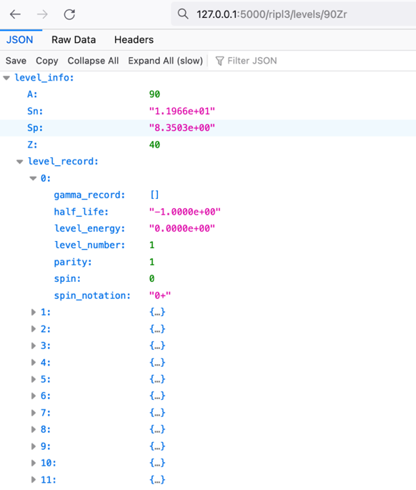
RIPL-3 discrete level API
Example: http://nds.iaea.org/dataexplorer/api/ripl3/levels/90Zr
/dataexplorer/api/exfor/ripl3/{field}/{nuclide}
GET
Name | Data Type | Required | Description
field | string |  | levels: discrete level information
nuclide | string |  | Name of nuclide with ‘235U’ format

