Slide 1


GOVERNING BOARD MEETING Peter McIntosh, Chairperson Padova meeting, March 13, 2025
Funded by the European Union. Views and opinions expressed are however those of the authors only and do not necessarily reflect those of the European Union or the European Commission. Neither the European Union nor the granting authority can be held responsible for them.
All information contained in this presentation and any accompanying documents is for iSAS project only, and must be treated as strictly confidential. Any dissemination, distribution or other use of this information without the consent of its owner is prohibited.

Slide 2
Agenda
Agenda items
Formal recognition of GB recent changes
Discussion about communication lines
Review of the financial status of the project
Review of CA v2 & NDA
Setting of the next Governing Board meeting date
AOB
Notes will be found in the iSAS project Indico page

Slide 3
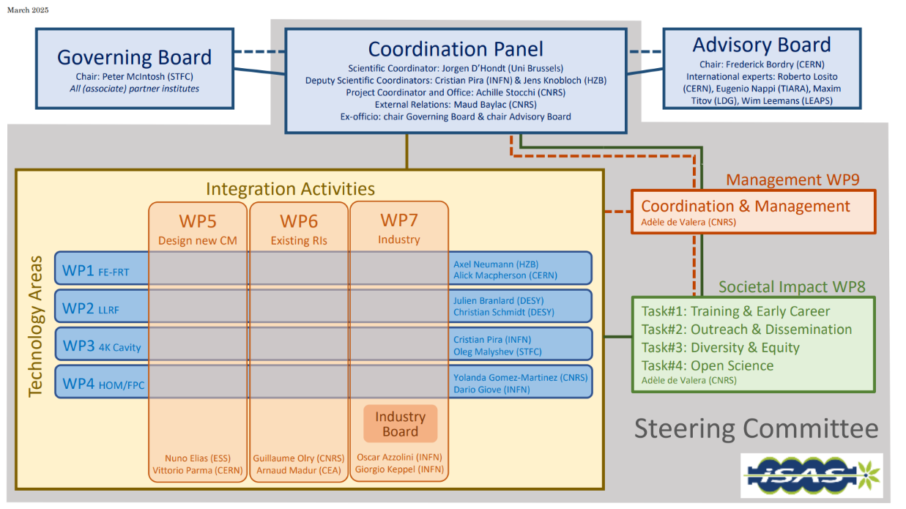
Instances (as formalised in the CA)
Governing Board & Advisory Board Chairs ex-officio members of Coordination panel to better communication between instances
Advisory Board reports back to the Coordination panel for yearly project meetings and upon ad hoc request in counsel
Coordination panel becomes Steering Committee every other meeting to allow for scientific cross-coordination between Coordination & WP Leaders as well as between WPs
Industry Board including WP Leaders to enable co-development

Slide 4
Governing Board
Beneficiaries: Peter McIntosh (Chairperson)
Jérôme Schwindling (CEA)
Vittorio Parma (CERN)
Achille Stocchi (CNRS)
Hans Weise (DESY)
Nuno Elias (ESS)
Jens Knobloch (HZB)
Attilio Sequi (INFN)
Michael Tytgat (VUB)
Associated partners: Oleg Malyshev (UKRI)
Graeme Burt (University of Lancaster)
Mike Seidel (EPFL)
Jorgen D'Hondt (Nikhef)
Tomas Junquera (ACS)
Birger Nordmann (Cryoelectra)
Alexei Kanareykin (Euclid Techlabs)
Filippo Casazza (Plasmatherm)
Alexander Navitski (Research Instruments)
Ambra Gresele (Zanon)
Coordination panel
Mandated: Achille Stocchi (Chairperson)
Jorgen D'Hondt (Scientific Coordinator)
Cristian Pira (Deputy Scientific Coordinator)
Jens Knobloch (Deputy Scientific Coordinator)
Maud Baylac (External Relations)
Peter McIntosh (Ex-officio)
Frederick Bordry (Ex-officio)
Steering committee
Mandated: Coordination panel (Ex-officio)
Axel Neumann & Alick MacPherson (WP1)
Julien Branlard & Christian Schmidt (WP2)
Cristian Pira & Oleg Malyshev (WP3)
Yolanda Gomez-Martinez & Dario Giove (WP4)
Nuno Elias & Vittorio Parma (WP5)
Guillaume Olry & Arnaud Madur (WP6)
Oscar Azzolini & Giorgio Keppel (WP7)
Adèle de Valera (WP8)
Adèle de Valera (WP9)
Advisory Board
Mandated: Frederick Bordry (Chairperson)
Roberto Losito (CERN)
Eugenio Nappi (TIARA)
Maxim Titov (LDG)
Wim Leemans (LEAPS)

Slide 5
Industry Board
Industry Board members: Oscar Azzolini (Chairperson)
WP Leaders (Ex-officio)
Mandated by companies: Arthur Iziquel (Accelerators and Cryogenic Systems)
Alexei Kanareykin (Euclid Techlabs)
Alexander Navitski (Research Instruments)
Ambra Gresele (Zanon Research & Innovation)
Birger Nordmann (Cryoelectra)
Filippo Casazza (Plasmatherm)

Slide 6
Digital spaces opened
iSAS Website to showcase the project to wider audiences
Can be found following this link
Where to announce job postings & new hires linked to iSAS, e.g. Lode Vanhecke on WP5 at EPFL
Project Indico page to meet
Can be found following this link
Where to find upcoming project meetings and presentations
Project data repository to share project documents
Can be found following this link
Where Conference Coordinator Nicholas Shipman collects conferences presentations & where to submit abstracts
If you encounter any technical difficulties, please contact Joseph Diakun

Slide 7
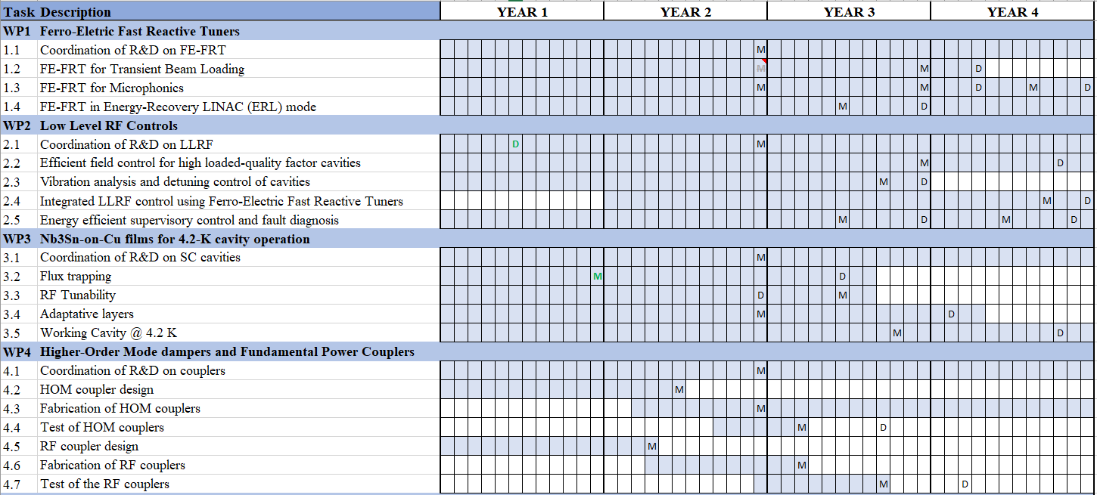

Slide 8
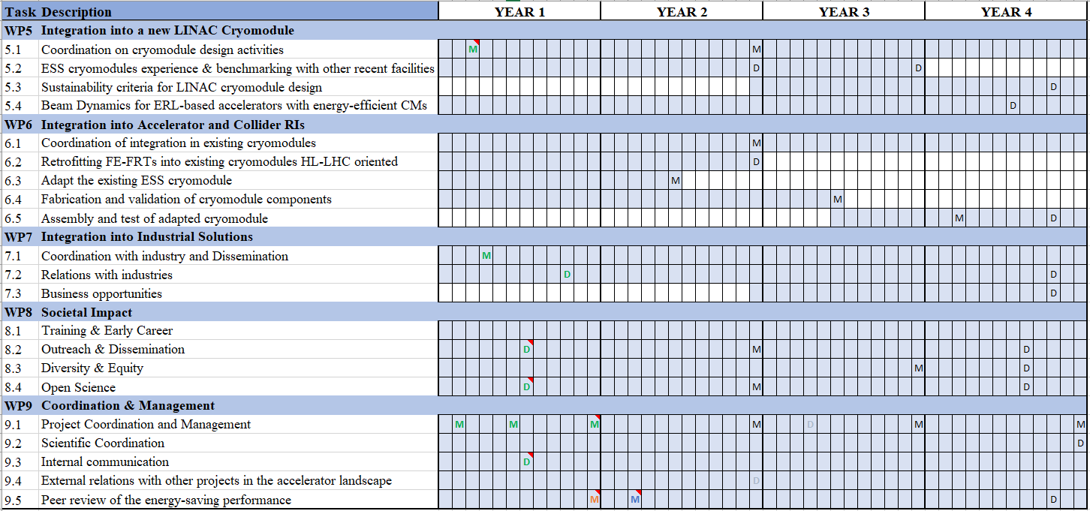

Slide 9
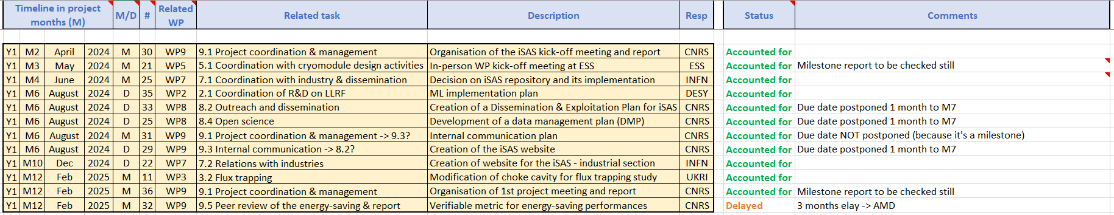
Work plan
Up to date with Milestones & Deliverables status by timeline for the 1st project year closed:

Slide 10
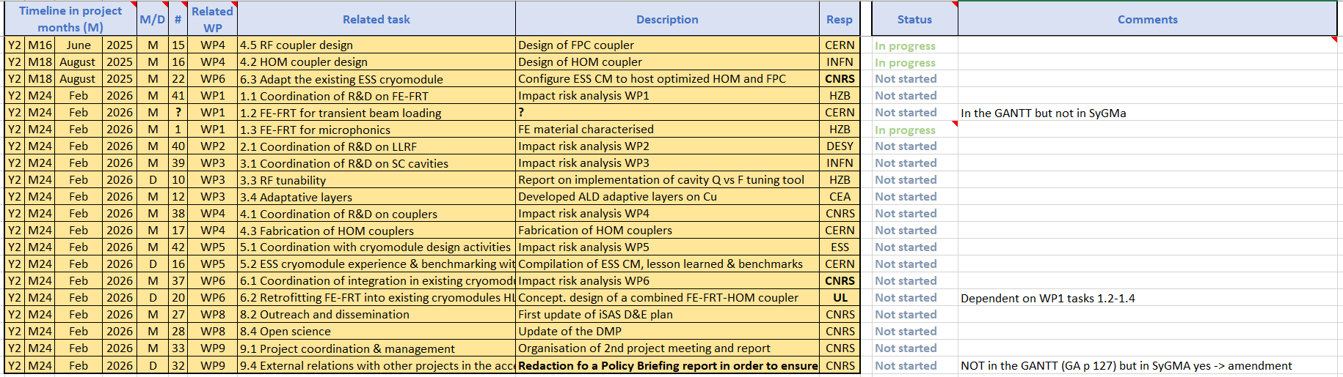
Work plan
Up to date with Milestones & Deliverables status by timeline for the 2nd project year opening up:

Slide 11
Work plan
Up to date with Milestones & Deliverables status by timeline for the 2nd project year opening up:
3 for WP4 & WP6 in project months 16-18, June-August 2025
17 in project month 24, Feb 2026, including 6 impact risk analyses for WP1-6, the update of D&E and DMP
End of the 1st reporting period (RP) M24: periodic report expected 60 days after end of RP

Slide 12
Financial status
Up to date for the 1st project year:
No deviations, except for WP4 on changes made to the design of FPCs
Risk for WP1, more in kind might be needed to prepare cavities

Slide 13
WP1 – FE-FRT: financial status
Financial status
In WP 1 funding was officially only for CERN and HZB as beneficiaries with about 50% of matching funds for personnel and invest/consumables
So far only smaller spendings happened for invest/consumables
Of the two positions, one is filled at HZB since beginning of iSAS, CERN is still working on filling their position
We still need to make a full funding analysis, which requires input from the lab’s administrations, which takes time
Deviations
So far not identified, but there might be more in kind budget needed at HZB to prepare cavities for the FE-FRT tests

Slide 14
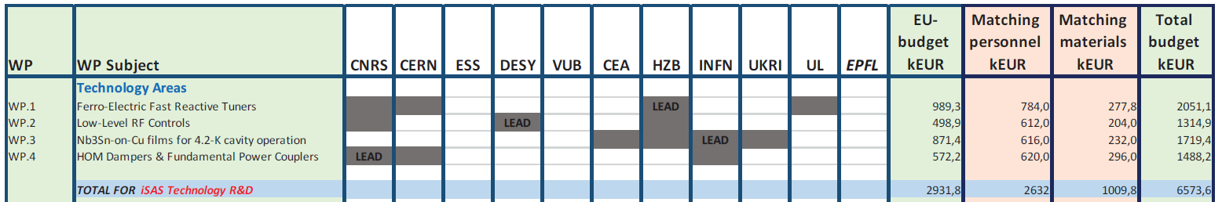
WP2 – LLRF: financial status
Financial status
Funds engaged in the WP by institute to date, differentiating EU-budget from matching funds
With highlight of staff dedicating time on the iSAS project, to date & projections if possible
Deviations? → I think still on track
WP 2 | EU-Budget | Matching funds
2024 | 7,050.55 | 111,687.13
2025 | 2,147.25 | 5,862.23
Total | 9,197.80 | 117,549.36
Most of the budget is foreseen to hire personnel.
iSAS position to be released this month + advertised on iSAS
Money already spent was to pay personnel to bridge the gap

Slide 15
WP3 Nb₃Sn on Cu: financial status
Budget expenses are on track
Partner | Budget
 | EU total contribution | EU Budget spent | Matching Funds
CEA | 100 | dedicated CEA staff | consumables
HZB | 200 | 1 post-doc hired | dedicated HZB staff
INFN | 200 | 1 post-doc hired + dedicated LNL staff | 1.3 GHz coating system upgrade
UKRI | 200 | 1 student grant at UKRI | Dedicated UKRI Staff

Slide 16
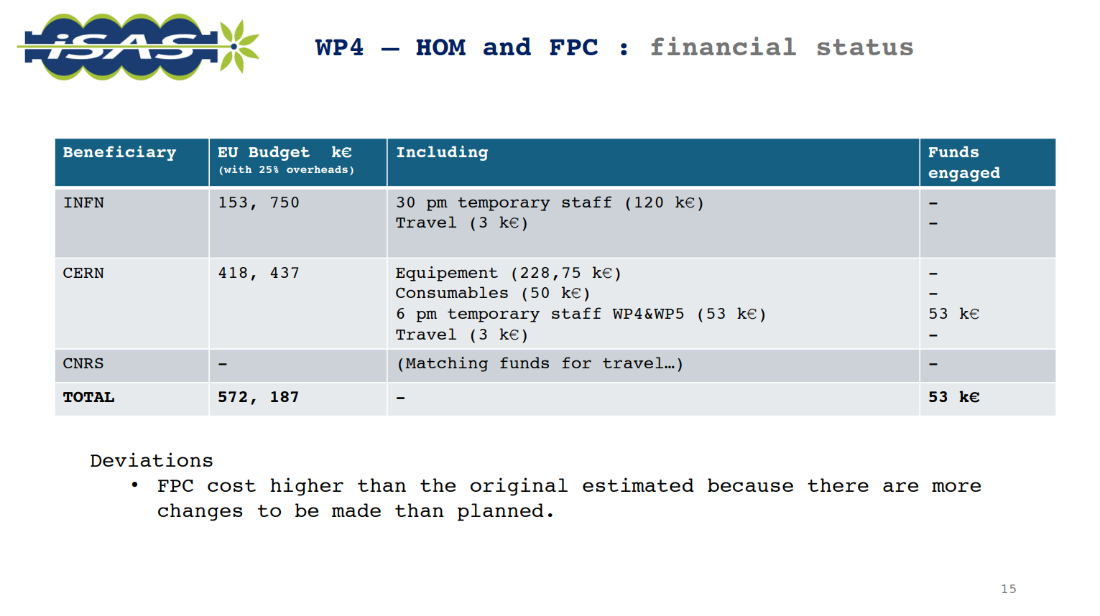

Slide 17
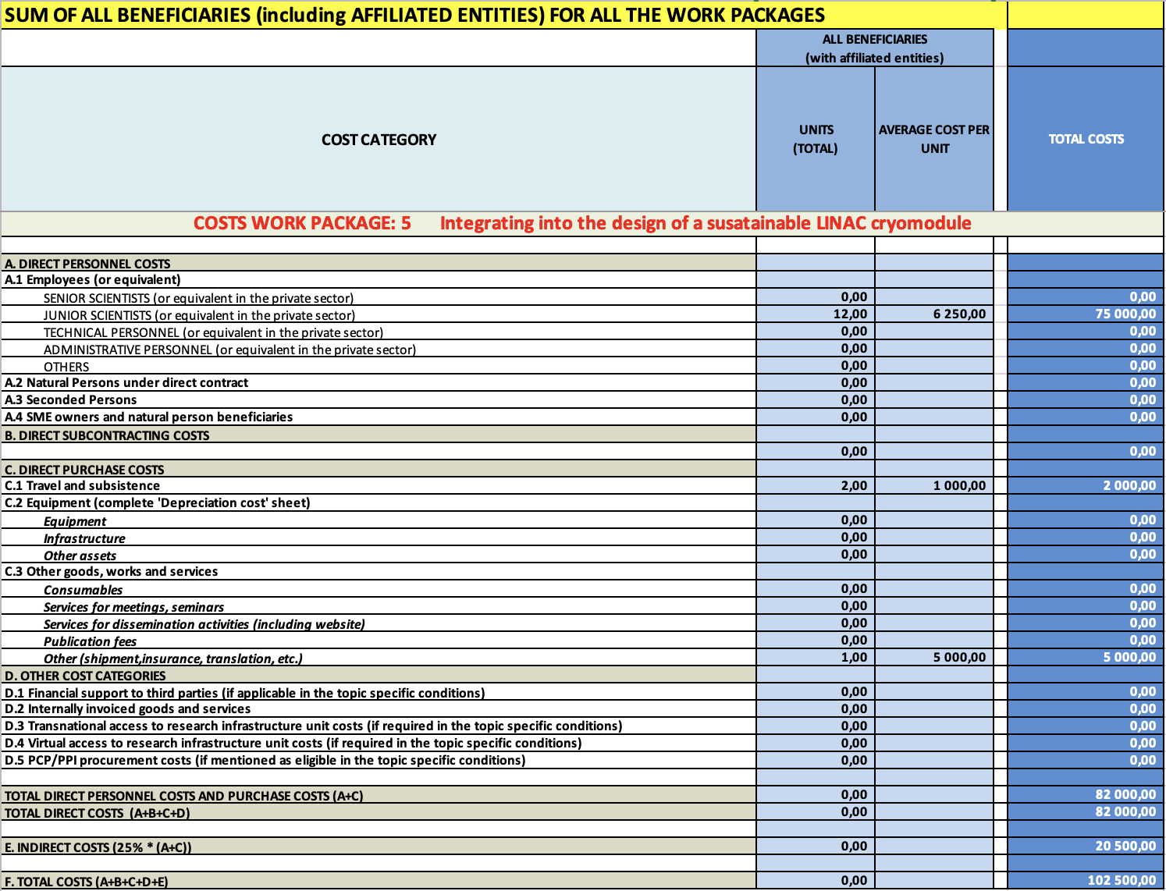
WP5 – Title: financial status
Financial status : no deviations on projections
Funds engaged in the WP by institute to date, differentiating EU-budget from matching funds
With highlight of staff dedicating time on the iSAS project, to date & projections if possible
The PhD student for Task 5.4 is not on the EU budget but is a budget directly from EPFL
Junior Scientist [ESS] WP5 (12m) + WP6 (12m) ; Recruitment starting soon + extension to be analysed*
Deviations?
No Deviations
ESS:
8K (travels for meetings on CM developments) + 3K (Licenses) + 2K (Workshop organization)
CERN:
2K (travels to collaborating institutes)

Slide 18
WP6: financial status
Financial status
Material
iSAS Funds engaged by CNRS: purchasing of the Niobium material for 5cell cavities (“few” hundreds of k€)
iSAS + matching funds to be engaged in 2025 by CNRS: purchasing of the 5cell cavities + (if possible) magnetic shields.
Human resources
No staff hired with iSAS funds in WP6
Deviations
No

Slide 19
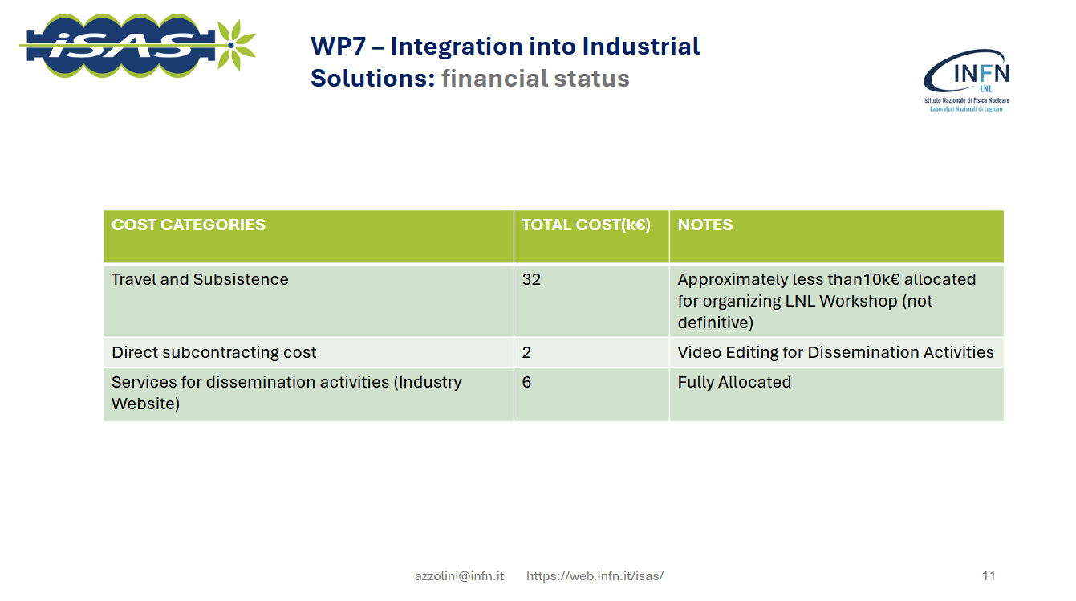

Slide 20
WP8 – Societal impact: financial status
Financial status
Funds engaged in the WP by institute to date, differentiating EU-budget from matching funds
With highlight of staff dedicating time on the iSAS project, to date & projections if possible
CNRS
Funds not engaged yet: neither travel nor publication fees
Deviations?
No Deviations

Slide 21
WP9 – Management & Coordination: financial status
Financial status
Funds engaged in the WP by institute to date, differentiating EU-budget from matching funds
With highlight of staff dedicating time on the iSAS project, to date & projections if possible
CNRS
HR funds engaged for iSAS project manager, 100K€
Travel funds are starting to be used for Padova meeting, not totalized yet
Other costs not engaged yet (publication fees, shipment, etc.)
VUB
Travel funds used for Kick-off & Padova meetings, less than 5k€
Deviations?
No Deviations

Slide 22
Consortium Agreement, shared NDA, amendment
Consortium Agreement (CA)
CA v2 sent by Julie Gendron-Brundu on March 7 for review before signature process
Comments expected until March 28
Shared NDA
For industrial partners, sent by Julie Gendron-Brundu on Feb 19, comments sent until Feb 26
Signatures phase has opened
Amendment (AMD) to the Grant Agreement - 1st trimester 2025 or 2nd trimester 2025
To welcome Nikhef to the project
To adjust to minor changes

Slide 23
Upcoming Governing Board meetings
The Governing Board meeting is held twice a year, once during the yearly iSAS project meeting in early spring, and once remotely in autumn
Indico page for Governing Board meetings
Governing Board meeting - March 13, 17:35-18:35 pm CET
Governing Board meeting – Oct 1 at 02:00-3:00 pm CET

Slide 24
Thank you!

