Slide 1


GOVERNING BOARD MEETING Peter McIntosh, Chairperson Online meeting, Oct 1st, 2025
Funded by the European Union. Views and opinions expressed are however those of the authors only and do not necessarily reflect those of the European Union or the European Commission. Neither the European Union nor the granting authority can be held responsible for them.
All information contained in this presentation and any accompanying documents is for iSAS project only, and must be treated as strictly confidential. Any dissemination, distribution or other use of this information without the consent of its owner is prohibited.

Slide 2
Agenda
Agenda items
Consortium agreement v3, shared NDA & amendment update
Discussion with a perspective to close the loop if consensus can be reached among partners
AOB
Notes will be found in the iSAS project Indico page

Slide 3
Consortium Agreement, shared NDA, amendment
Consortium Agreement (CA)
v3 sent with Sept 29 due date for last review before signature process:
Background missing for DESY
CERN, EPFL & HZB asked for opposite modifications on 5.2 on contractual liability & gross negligence
Provisional CA v4 available to negotiate w/ HZB & EPFL
Note: GB not allowed to interfere with this negotiation process.
Shared NDA
For industrial partners
Signed by ACS, Euclid & Zanon
Cryoelectra, Plasmatherm missing the legal entity, non-responsive
RI willing to sign
Does GB agree to exclude any partner who has not signed the NDA, until a suitable resolution is achieved?
Amendment (AMD) to the Grant Agreement
Nikhef will not join the consortium formally
Other modifications to be included in RP1 report, tbc by PO (new PO: Sotirios Kakarantzas)

Slide 4
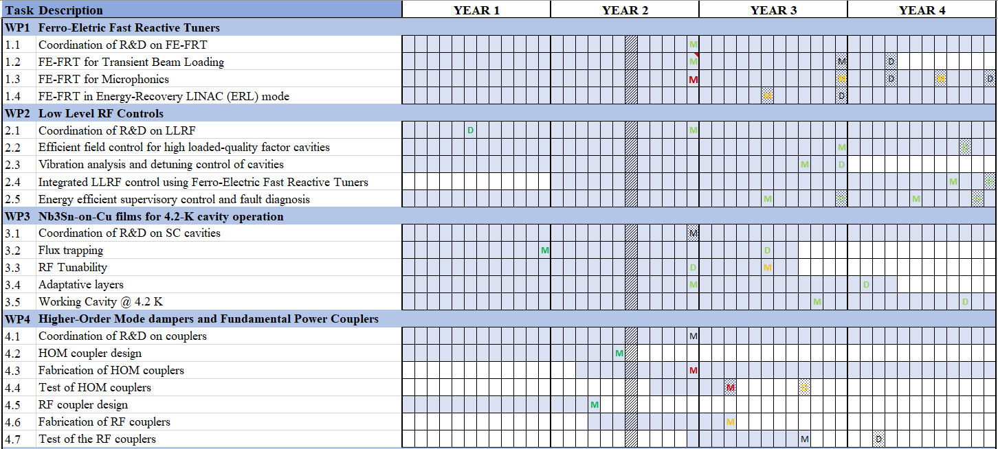

Slide 5
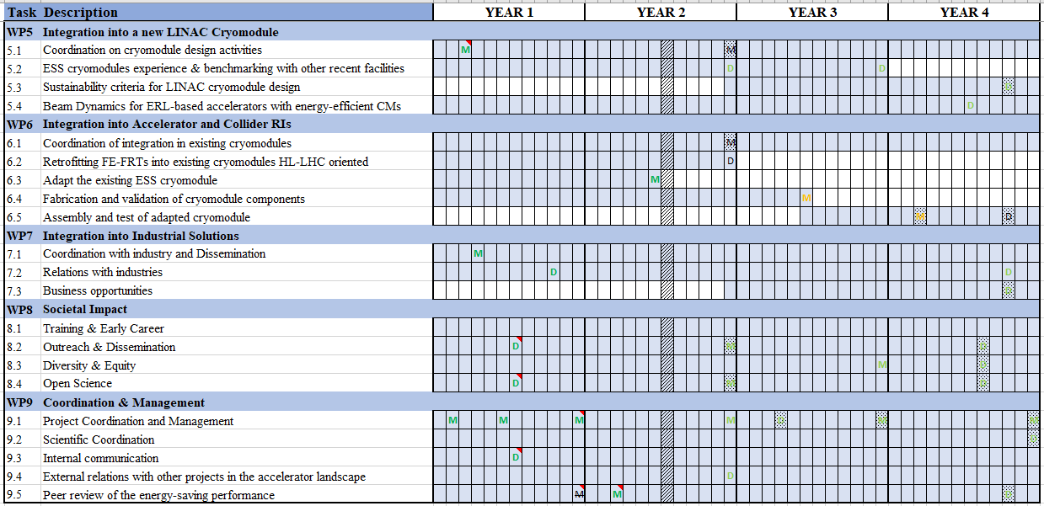

Slide 6
Upcoming project meetings
Mid-term Advisory Board meeting
Online, Oct 7 at 9:30 am CET
2nd yearly project meeting
Hosted by HZB in Berlin (w/ online connection as well), April 22-24, 2026
Including Governing Board in-person meeting w/ online option (exact time tbd soon)
Coordination panel & Steering committee meetings
Steering committee – Nov 4 at 10 am CET
Coordination panel - Dec 16 at 10 am CET
Steering committee – Jan 27 at 10 am CET
Coordination panel – March 10 at 10 am CET
Steering committee – April 21 at 10 am CET
Coordination panel – June 2 at 10 am CET

Slide 7
Upcoming Governing Board meetings
The Governing Board meeting is held twice a year, once during the yearly iSAS project meeting in early spring, and once remotely in autumn
Indico page for Governing Board meetings
Governing Board meeting - April 22-24, during annual project meting (exact time tbd)
Governing Board meeting – Oct 2026 (exact time tbd)

Slide 8
Thank you!

Slide 9
Back up

Slide 10
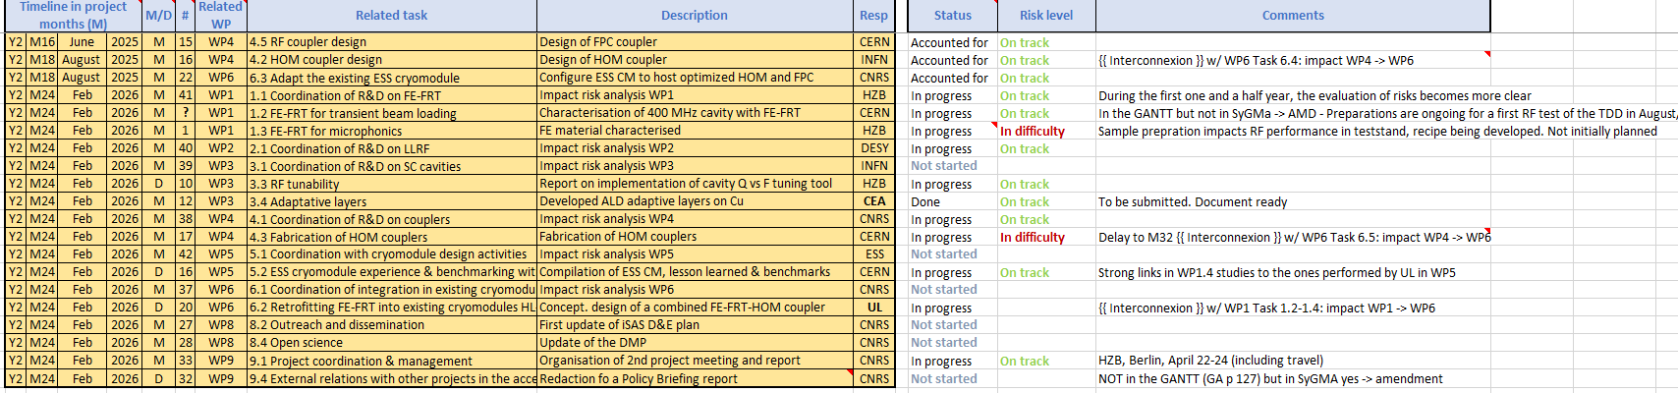
iSAS work plan
Milestones & Deliverables status by timeline:
3 milestones of summer accounted for, 17 to go all in Feb + end of RP1 report

Slide 13
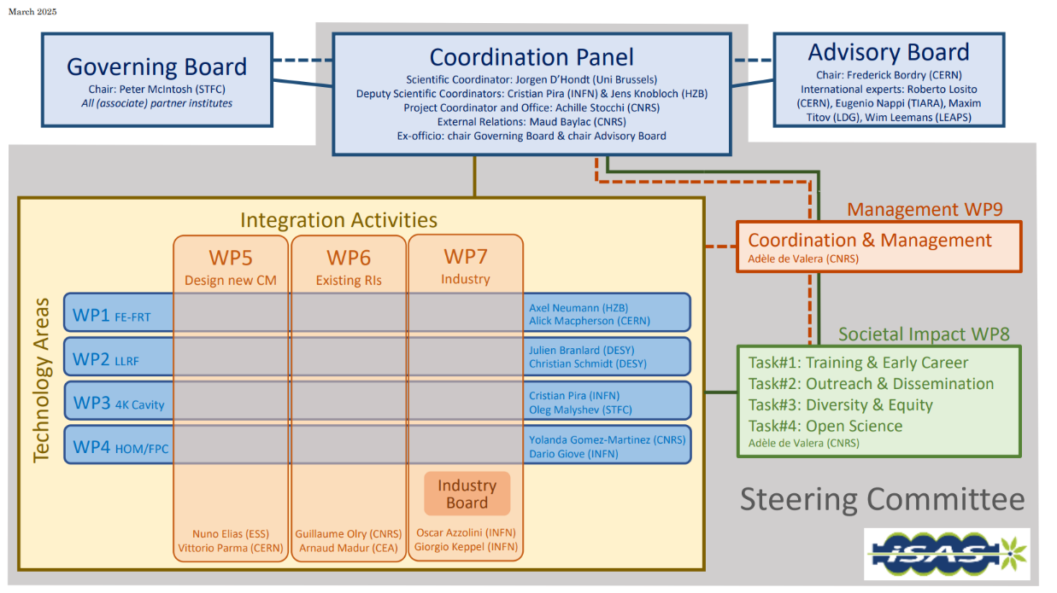
Instances (as formalised in the CA)
Governing Board & Advisory Board Chairs ex-officio members of Coordination panel to better communication between instances
Advisory Board reports back to the Coordination panel for yearly project meetings and upon ad hoc request in counsel
Coordination panel becomes Steering Committee every other meeting to allow for scientific cross-coordination between Coordination & WP Leaders as well as between WPs
Industry Board including WP Leaders to enable co-development

Slide 14
Governing Board
Beneficiaries: Peter McIntosh (Chairperson)
Jérôme Schwindling (CEA)
Vittorio Parma (CERN)
Achille Stocchi (CNRS)
Hans Weise (DESY)
Nuno Elias (ESS)
Jens Knobloch (HZB)
Attilio Sequi (INFN)
Michael Tytgat (VUB)
Associated partners: Oleg Malyshev (UKRI)
Graeme Burt (University of Lancaster)
Mike Seidel (EPFL)
Jorgen D'Hondt (Nikhef)
Tomas Junquera (ACS)
Birger Nordmann (Cryoelectra)
Alexei Kanareykin (Euclid Techlabs)
Filippo Casazza (Plasmatherm)
Alexander Navitski (Research Instruments)
Ambra Gresele (Zanon)
Coordination panel
Mandated: Achille Stocchi (Chairperson)
Jorgen D'Hondt (Scientific Coordinator)
Cristian Pira (Deputy Scientific Coordinator)
Jens Knobloch (Deputy Scientific Coordinator)
Maud Baylac (External Relations)
Peter McIntosh (Ex-officio)
Frederick Bordry (Ex-officio)
Steering committee
Mandated: Coordination panel (Ex-officio)
Axel Neumann & Alick MacPherson (WP1)
Julien Branlard & Christian Schmidt (WP2)
Cristian Pira & Oleg Malyshev (WP3)
Yolanda Gomez-Martinez & Dario Giove (WP4)
Nuno Elias & Vittorio Parma (WP5)
Guillaume Olry & Arnaud Madur (WP6)
Oscar Azzolini & Giorgio Keppel (WP7)
Adèle de Valera (WP8)
Adèle de Valera (WP9)
Advisory Board
Mandated: Frederick Bordry (Chairperson)
Roberto Losito (CERN)
Eugenio Nappi (TIARA)
Maxim Titov (LDG)
Wim Leemans (LEAPS)

Slide 15
Industry Board
Industry Board members: Oscar Azzolini (Chairperson)
WP Leaders (Ex-officio)
Mandated by companies: Arthur Iziquel (Accelerators and Cryogenic Systems)
Alexei Kanareykin (Euclid Techlabs)
Alexander Navitski (Research Instruments)
Ambra Gresele (Zanon Research & Innovation)
Birger Nordmann (Cryoelectra)
Filippo Casazza (Plasmatherm)

