Slide 1
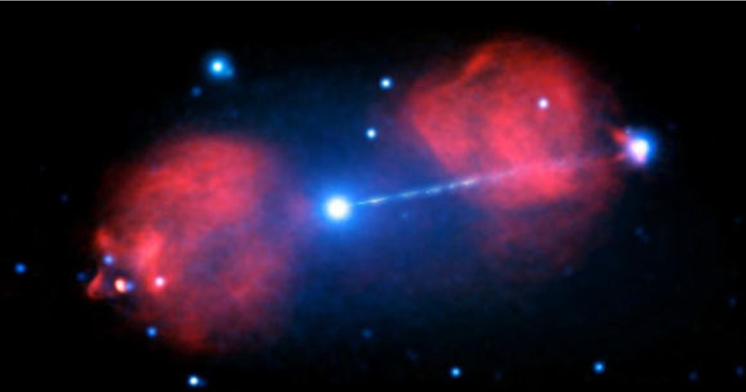
The radiogalaxy Pictor A
Radioastronomy of AGN jets
Hélène Sol
CNRS, Observatoire de Paris

Slide 2
Photo gallery and AGN radio jets in a nutshell
A closer look to nuclear VLBI jets
Links between radio, optical and gamma rays: individual source approach and population studies
Combining radio VLBI with optical Gaia data

Slide 3
Photo gallery and AGN radio jets in a nutshell
A closer look to nuclear VLBI jets
Links between radio, optical and gamma rays: individual source approach and population studies
Combining radio VLBI with optical Gaia data

Slide 4
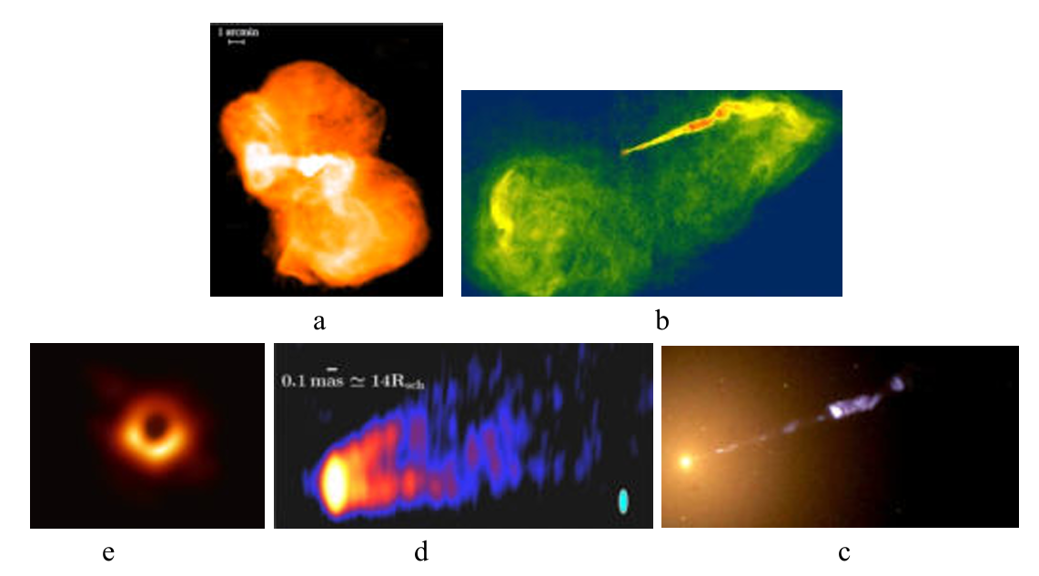
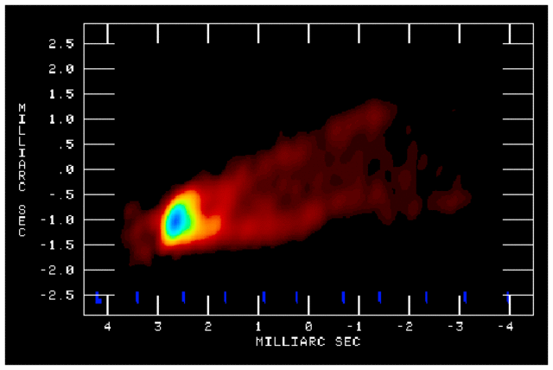
kpc and Mpc-scales
Large scale radio jets and lobes
M87
sub-pc scale and below
= sub milliarcsec (mas) scale
Nuclear VLBI radio jets
structures,
sizes (z),
speeds,
shocks,
turbulence

Slide 5

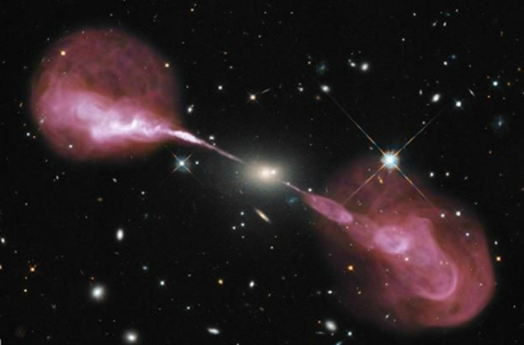
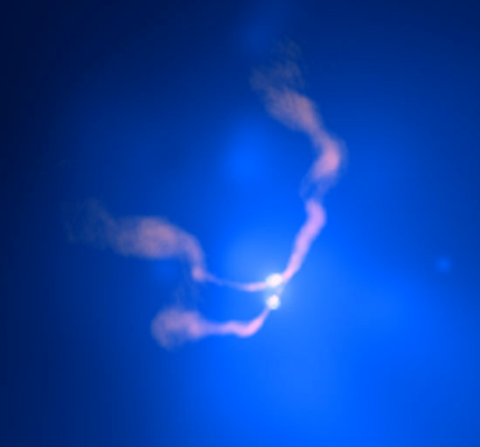
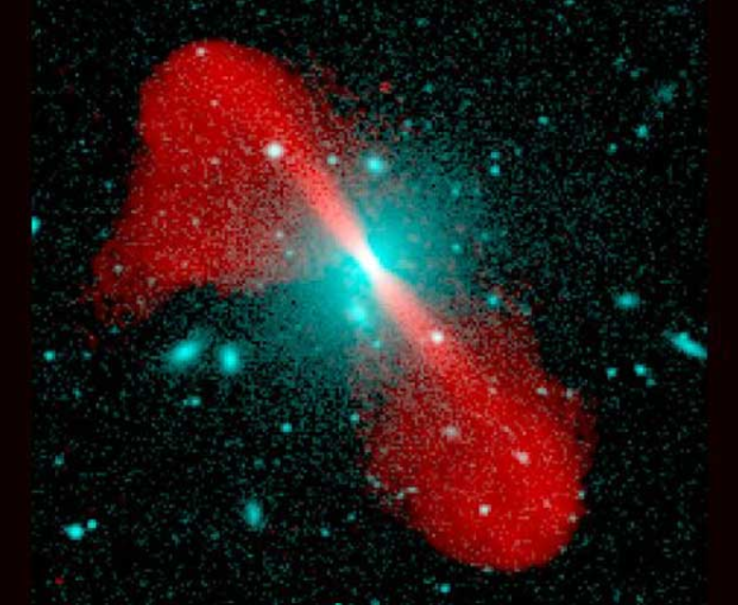
FR II
Large scale jets
Hercules A
Cygnus A
3C 296
FR I
3C 75
NRAO

Slide 6
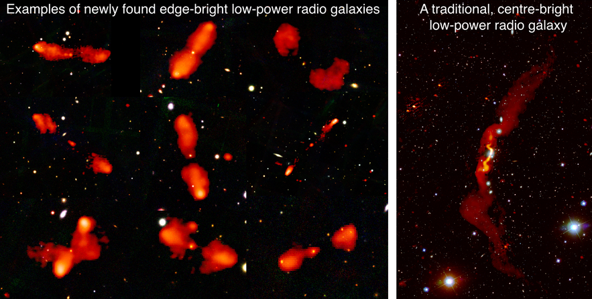
LOFAR, 2020
A new population of low-power jets with an edge-bright appearance
revealed by LOFAR
- Smaller and less dense host galaxies, less disturbed during propagation
- New light on BH/jet/host galaxy mutual influence and interaction

Slide 7
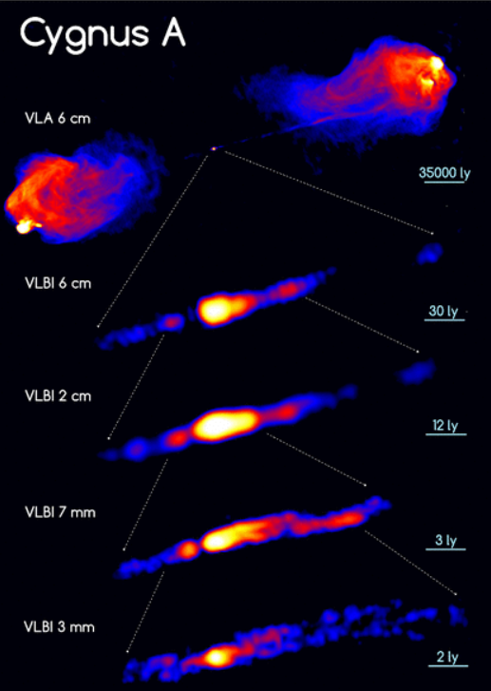
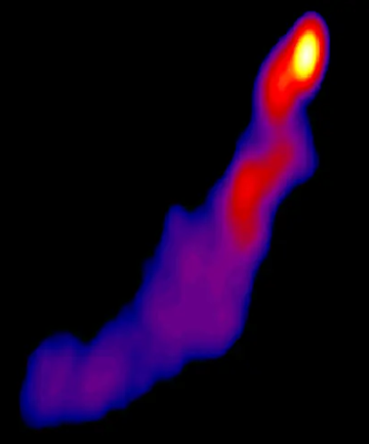
Nuclear VLBI jets
Base of extended radio sources
with large scale radio jets or lobes
CTA 102
Helical
feature?
(MPIfR)
(MOJAVE)

Slide 8
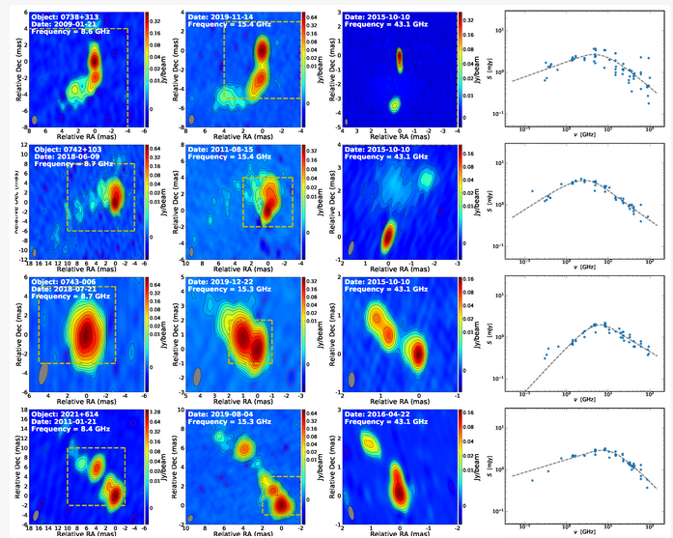
Nuclear VLBI sources
Compact radio sources (< 1 kpc): Compact Symmetric Objects (CSO), Compact Steep Spectrum (CSS), GHz Peaked Spectrum (GPS), Jetted Subgalactic-Size (JSS) …
Early stages of of FRI/FRII radio sources evolution - or ‘frustrated’ jet sources, or mergers,
or short-lived jets?
8.6 GHz 15.4 GHz 43 GHz
Often with 2 or 3 bright
components on VLBI maps
Radio core location?
(Cheng et al, 2023)

Slide 9
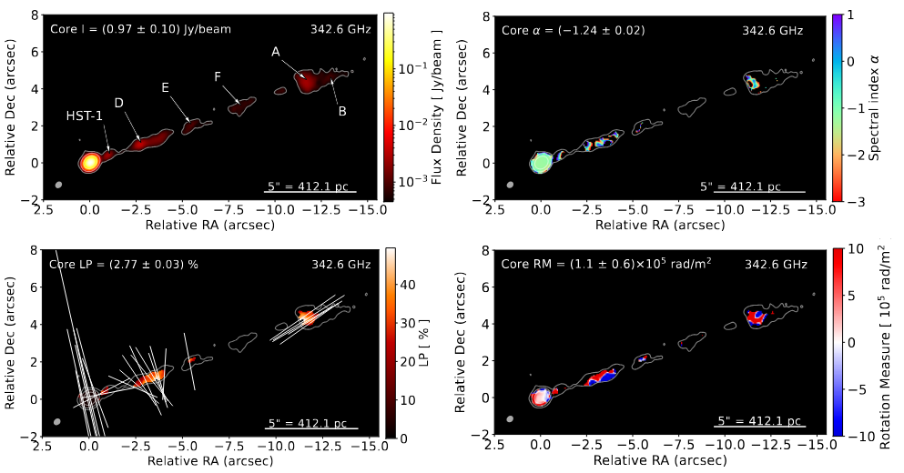
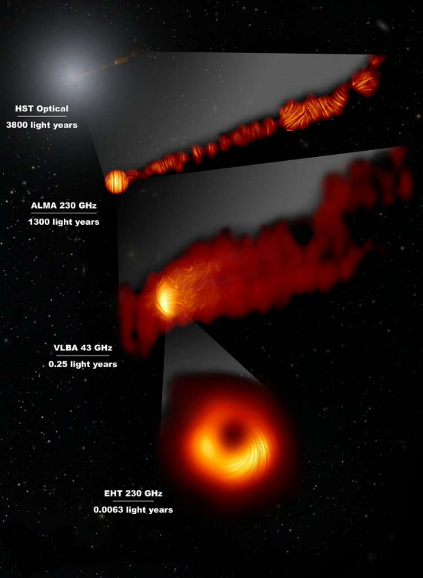
M87 large scale jet
Polarisation images at 0.87 mm and 345 GHz
total intensity
spectral index
% linear polarization
Faraday rotation measure
(Goddi et al, 2025)
Spectral and polarisation
properties:
→ magnetic field,
synchrotron emission,
densities,
particle distribution function,
energy budget (incomplet!)
M87 nuclear jet
10% linear polarisation
B // rotation axis near disk
EHT, 2021

Slide 10
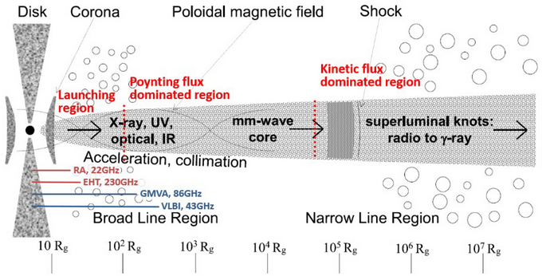
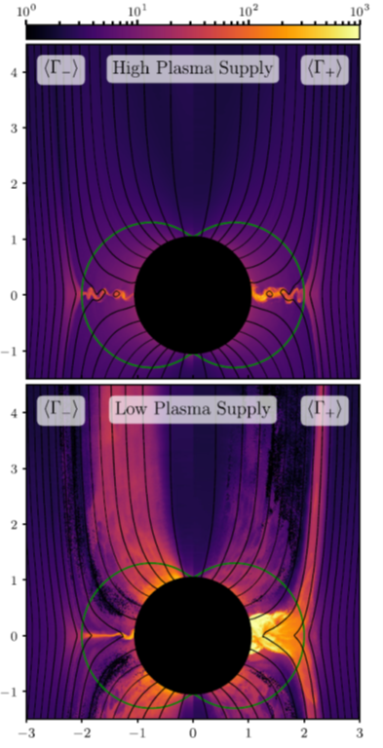
Standard sketch for innermost regions of radio-loud AGN,
with typical resolution in radio expected for AGN at low z
(Venturi et al, VLBI20-30, 2020)
An entire field of research, observation, modeling and simulation at work to clarify, consolidate and improve these descriptions!
- Jet formation (Blandford-Znajek # Blandford-Payne process?...)
- Dichotomy radio-loud/radio-quiet AGN ; gamma-loudness
- Black holes and host galaxies co-evolution ; mergers
- Origins of variabilities
- Origin(s) of γ-ray emission, location of γ-ray emitting zone(s)
- Particle acceleration mechanisms …
(Parfrey et al, 2019)
(R_{s} = 2GM/c² ~ 10⁻⁵ M₈ pc ~ 3 x 10¹³ M₈ cm)

Slide 11
Photo gallery and AGN radio jets in a nutshell
A closer look to nuclear VLBI jets
Links between radio, optical and gamma rays: individual source approach and population studies
Combining radio VLBI with optical Gaia data

Slide 12
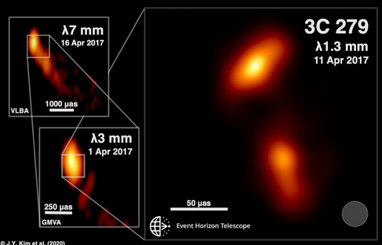
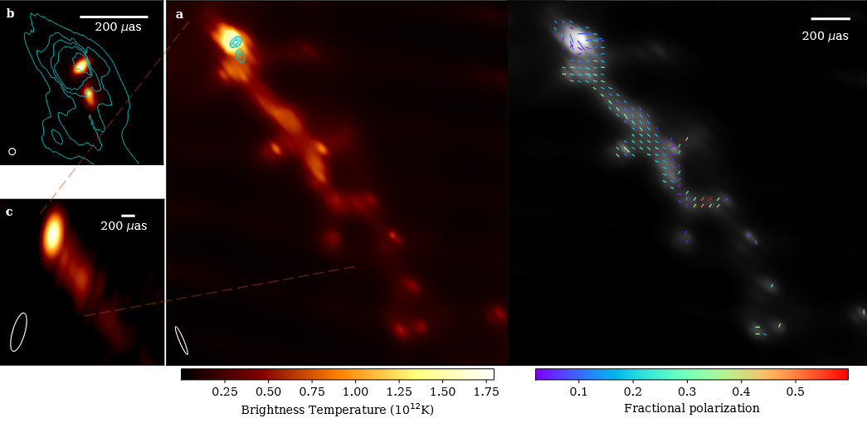
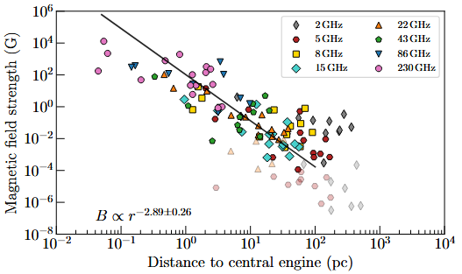
Event Horizon Telescope: explores BH vicinity and jet formation zone
3C 279
Radioastron 22GHz
(Kim et al, 2020; Toscano et al, 2025)
EHT data for 16 AGN sub-pc jets:
---> main parameters : core size, T_{B}, B as f(r)
Variation along jet different from standard
relativistic jet model (Blandford, Königl, 1979)
Complex B configuration
Acceleration of jet closer to BH than expected?
Different regimes of stationary states?
(Röder et al, 2025)

Slide 13
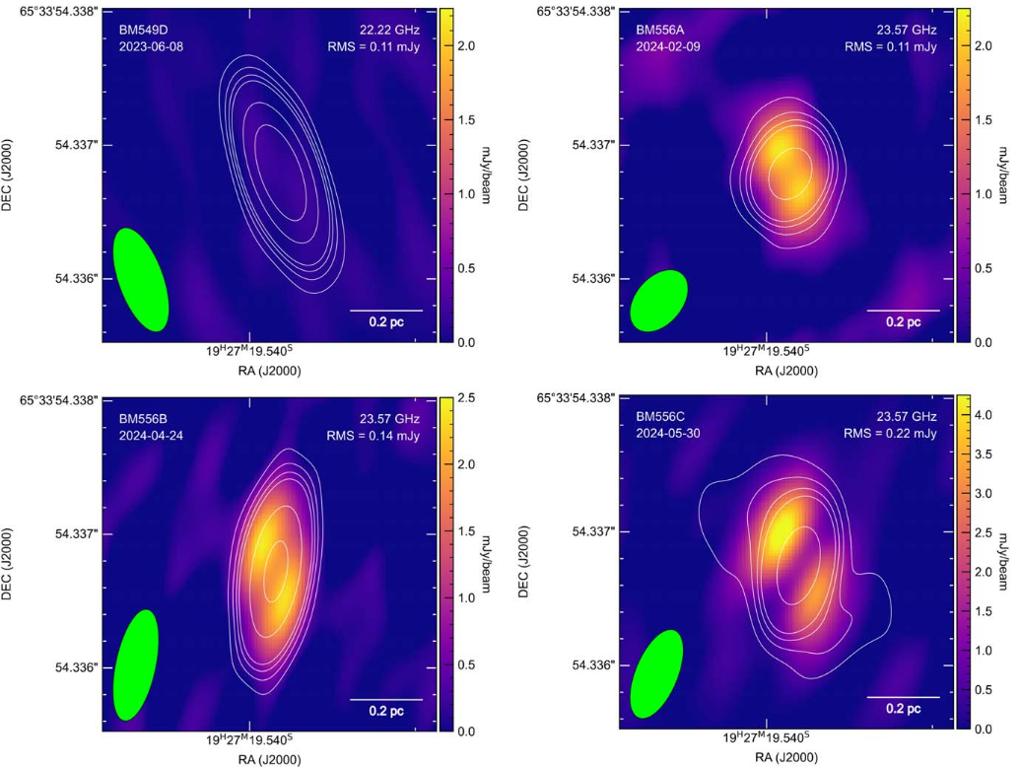
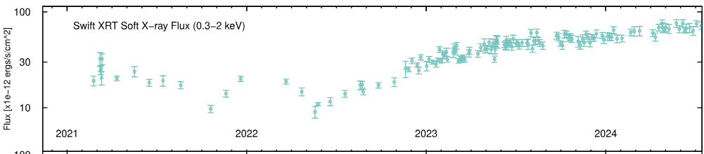
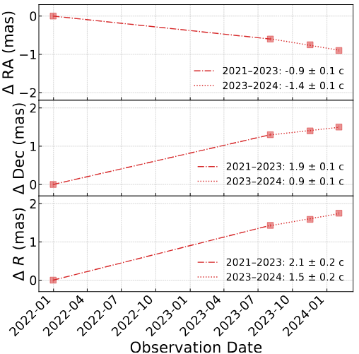
From radio-quiet to radio-loud …
06/2023
02/2024
- Jet launch in changing-look AGN
1ES 1927+654, after some activities
Radio-quiet before 2023
(Meyer et al, 2025)
- Relativistic ‘jet’ found in a ‘radio-quiet’ Seyfert NLS1 Mrk 110
One single component: from 3.6 c-2.1 c then deceleration to 1.5 c at 1.1 pc (Wang et al, 2025)
Transient jet phases? Depending on different accretion regimes?
X-rays
04/2024
05/2024

Slide 14
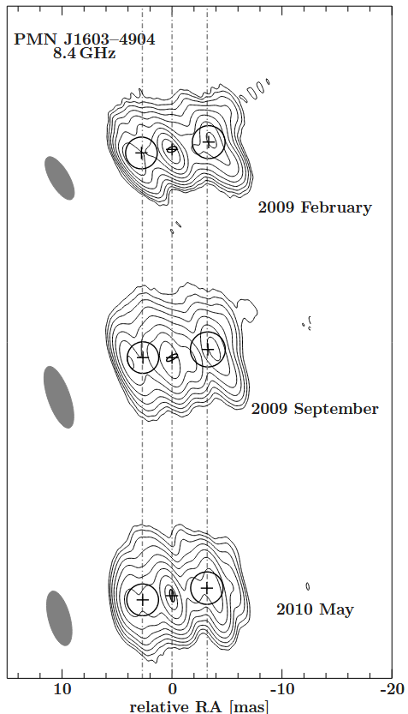
PMN J1603-4904
Fermi/LAT AGN
Detected by HESS (2025)
Previously classified as a BL Lac but gamma-ray detection and VLBI map now identify it as a CSO
Powered by a LINER/Seyfert nucleus (Goldoni et al, 2016)
Continued monitoring by MeerKAT, NuSTAR, HESS
– Fermi/LAT detected new activity
Gamma-ray data decisive for a better understanding of the source
(Müller et al, 2014)

Slide 15
Photo gallery and AGN radio jets in a nutshell
A closer look to nuclear VLBI jets
Links between radio, optical and gamma rays:
individual source approach and population studies
Combining radio VLBI with optical Gaia data

Slide 16
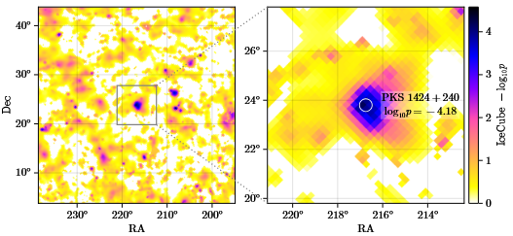
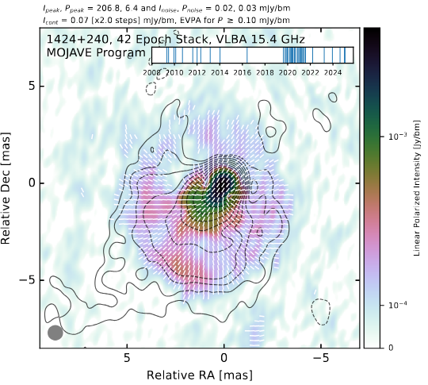
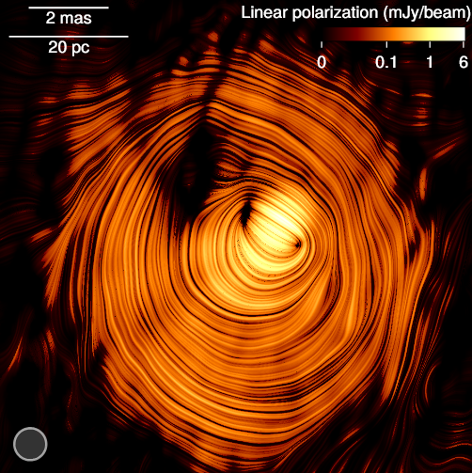
IceCube
PKS 1424+240
Strong in VHE + 9 year IceCube peak
« The eye of Sauron »
Stacking 42 VLBA images 2009-2025
Viewing angle < 0.6°, Doppler factor ~ 30
Toroidal B around jet ---> current-carrying jet flowing almost directly towards us!
Could solve the ‘Doppler factor crisis’
Neutrinos from pγ mechanism…
(Kovalev et al, 2025)

Slide 17
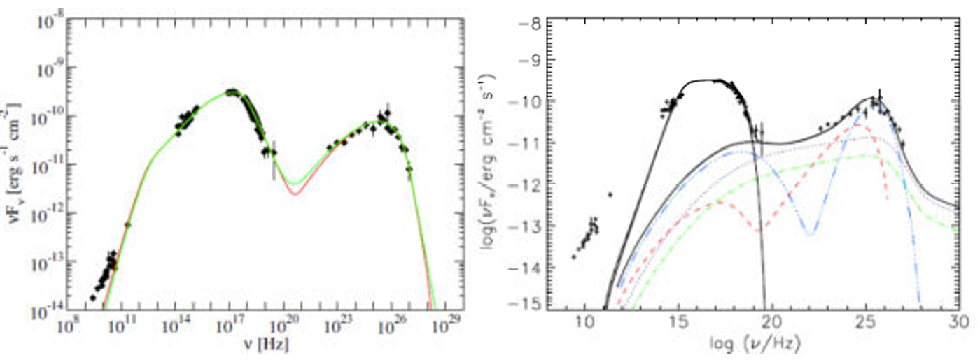
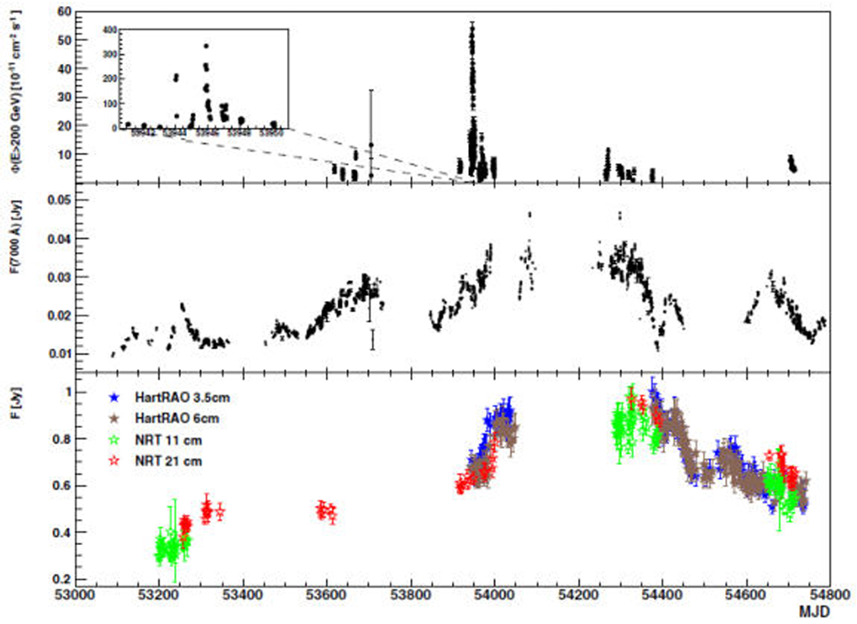
Mrk 421
SSC
hadronic
(Abdo et al, 2011)
Extended radio emission at low frequencies:
expected less variable, somewhat different
emitting particle population, signal delayed
after HE flares
However leptonic scenarios of gamma-ray
emission, and some hadronic ones, include
a counterpart of radio and optical emission
associated to the HE and VHE ---> correlation
can be expected, although possibly hidden
PKS 2155-304
(Abramowski et al, 2012)

Slide 18
Growing evidences for correlation between some HE and VHE flares and events seen by VLBI: radio core flux variations, appearance of new knots at jet base, appearance of stationary features (Akiyama et al, 2012; Jorstad, Marscher, 2018; Rani et al, 2018; Larionov et al, 2020; Kim et al, 2020; Lico et al, 2022)
Now several confirmed emergences of new superluminal knot associated with some γ-ray flares ---> See Reshmi’s talk
Long term joint VLBI-Fermi monitoring of 331 AGN (Kramarenko et al, 2022). Strong correlation between Fermi LAT flux and
(1) radio flux from the radio core, delayed by 3-5 months in observer’s frame, (2) radio flux from radio jet without the core, delayed by 5-9 months
Several authors mention temporal correlation between optical-X-gamma-ray correlation. Quasi-periodicities with various MWL correlation found in a few AGN (ex: Otero-Santos, 2020, 2022)
Correlation between optical and gamma-ray lightcurves (1093 blazars; 4LAC + ZTF survey) “supporting scenarios with a common origin”
---> See poster at this meeting by Julian Hamo et al

Slide 19
Photo gallery and AGN radio jets in a nutshell
A closer look to nuclear VLBI jets
Links between radio, optical and gamma rays:
individual source approach and population studies
Combining radio VLBI with optical Gaia data

Slide 20
Analysis of VLBI-Gaia offsets over last years:
Optical centroid preferably in the jet direction (Kovalev et al. 2017, Petrov et al. 2018, Lambert et al. 2021)
Coincidence of some optical centroids with VLBI knots often stationary and with high linear polarization, up to 20% (Kovalev et al. 2020, Lambert et al. 2021)
Identification of the optical emission detected by Gaia with radio structures in parsec-scale AGN jets (Lambert, HS, Pierron, 2024)
Following SSC scenario, and most leptonic or hadronic ones, non-thermal (NT) optical emission at mas scale could provide indications on the location of the compact γ-ray emission zone(s) of blazars

Slide 21
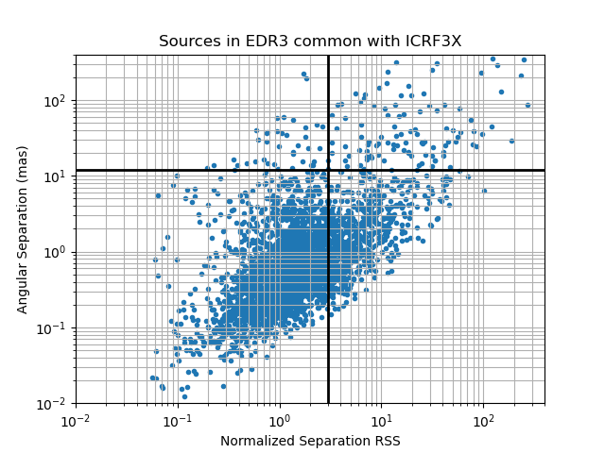
ICRF3, International Celestial Reference Frame : Absolute sub-mas VLBI astrometry, at 3 radio frequencies (4536 radio-loud AGN entries at 8.4 GHz)
Gaia Data release (EDR3) : > 3500 cross-id sources
ICRF and Gaia astrometric precisions are comparable: ~ 0.1 mas
Positional differences reveal some significant offsets between radio and optical centroids at the mas level
MOJAVE modelfit at 15 GHz (Lister et al, 2019) : sample of 422 common AGN, mostly blazars, to further explore the relative positioning of optical and radio structures
Conservative approach : locate the geodetic VLBI reference point onto the centroid of the MOJAVE radio map (Lambert, HS, Pierron, 2024)

Slide 22
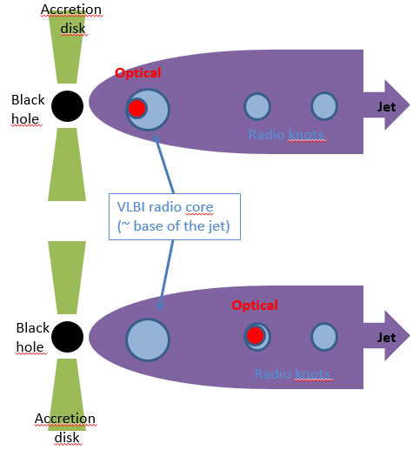

Slide 23
Optical centroid
related to disk or
to radio jet?
(some indication
from Gaia
color index)

Slide 24
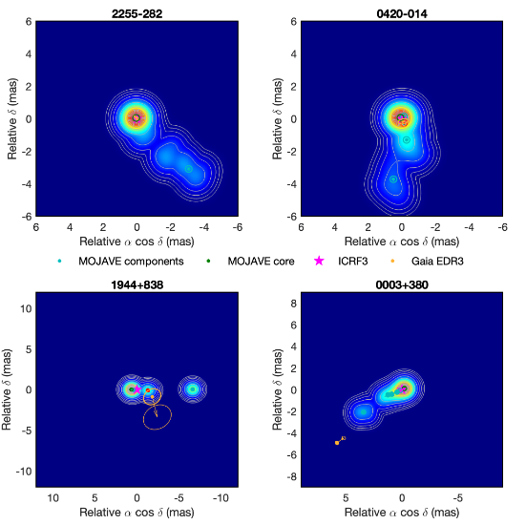
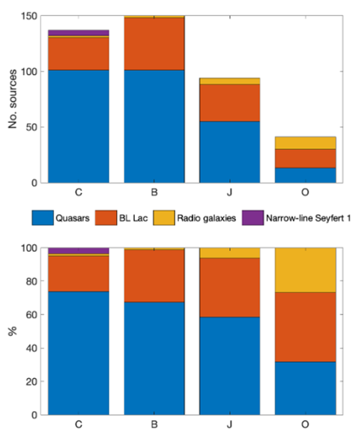
4 categories of sources
C: optical centroid associated with MOJAVE radio core 32%
B: optical centroid associated with radio jet base 36%
J: optical centroid associated with a MOJAVE radio knot 22%
O: no identification with MOJAVE radio structures 10%
C
B
AGN types in each category
J
O
RG
BLL
FSRQ
(Lambert, HS, Pierron, A&A, 2024)

Slide 25
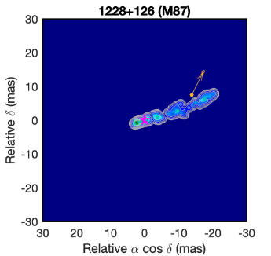
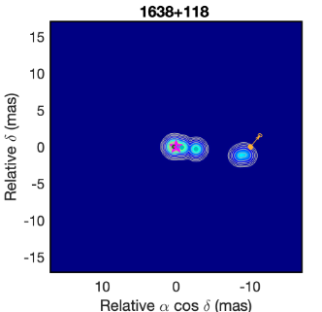
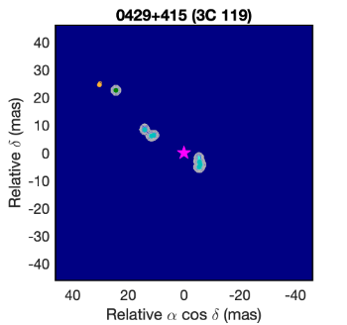

C category, slightly bluer (probable accretion disk influence; cf Plavin et al, 2019)
B+J categories: 58% of optical centroids associated with jet components → NT?
O category, most often still linked to global jet structure, as follows:
O
O: mostly radiogalaxies and BL Lacs at low z
Various effects can affect the relative location of the observed optical Gaia centroid:
Significant proper motion (often V_{Gaia} > V_{MOJAVE})
Non-simultaneous observations
Influence of host galaxy, gaseous or stellar halos
Dust and obscuration effects
Star-jet and gas-jet interactions
A few CSS, Compact Steep Spectrum sources.
Complex VLBI structures, often « double », with ‘VLBI centroid’ different from the standard ‘radio core’ of core-dominated sources.
(Lambert, HS, Pierron, A&A, 2024)

Slide 26
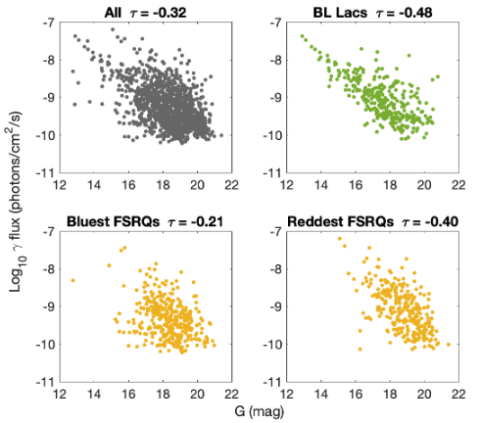
First sample and positions from:
- VLBI reference point from ICRF3 at 8.4 GHz (Charlot et al, 2020)
- Optical centroid from Gaia DR3 (Gaia collaboration et al, 2023)
1-100 GeV γ fluxes: Fermi-LAT 4FGL-DR4 (Abdollahi et al, 2022; Ballet et al, 2023)
New sample with 1233 AGN:
649 FSRQs, 319 BL Lacs, 211 blazars (uncertain type), 26 radiogalaxies
+ 5 CSS, 5 Seyfert 1, 4 AGN, 3 SSRQ, 11 unknown type (Lambert, HS, 2025, to be submitted)
Significant correlation between γ fluxes
and optical Gaia magnitudes
especially for BL Lacs and reddest FSRQ.
Similar trends of correlations for fractional
variabilities in γ-rays and in optical
Part of the optical emission at mas scale
related to γ -ray emission.
Correlations less important for bluest FSRQ
due to contamination by bright thermal disk
in the optical range.

Slide 27
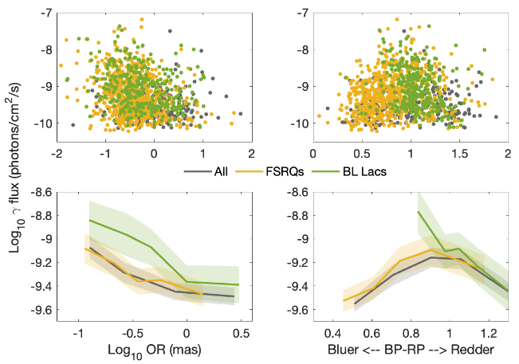
F_{γ}
OR separation between
VLBI and Gaia positions
Gaia color index
F_{γ} decreases with increasing OR separation
BL Lacs redder than FSRQ, average F_{γ} higher for the bluest BL Lacs (NT optical)
2 types of FSRQ are identified: bluest (BP-RP < 0.8) with disk-dominated optical emission, and reddest ones, with jet-dominated optical emission
Color index becomes redder with increasing OR separation (mostly along jets)
in progress…
(Lambert, HS, 2025, to be submitted)

Slide 28
Back to gamma-rays …
Possibly new types of AGN for next generation of γ-rays instruments
γ-ray data can be decisive for understanding some sources (ex : CSO)
Confirmed association of some γ-ray flares with emergence of radio knots from radio core
Growing evidences for correlation between γ-ray flares and optical high states in blazars
Combining astrometric VLBI and Gaia data with MOJAVE data for 422 AGN, mostly blazars: 58% of Gaia centroids are associated with a jet component, and 32% with the active nucleus. Other 10% mostly along the jet.
Optical Gaia centroids: an interesting ‘proxy’ to identify the γ-ray emitting site in BL Lacs and red FSRQ (i.e. not disk-dominated in the optical range).
Several indications for the existence of γ-ray flares due to a plasma blob flowing along the jet and passing through a stationary nodule (recollimation shock...).

Slide 29
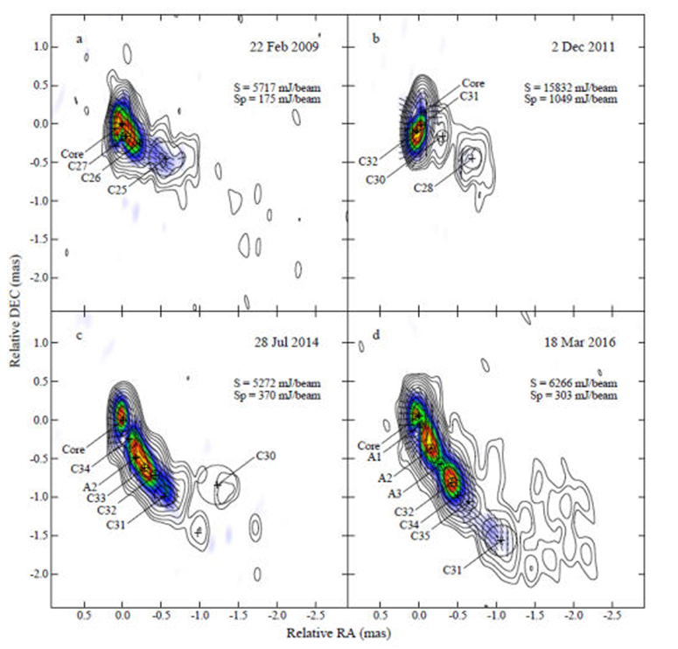
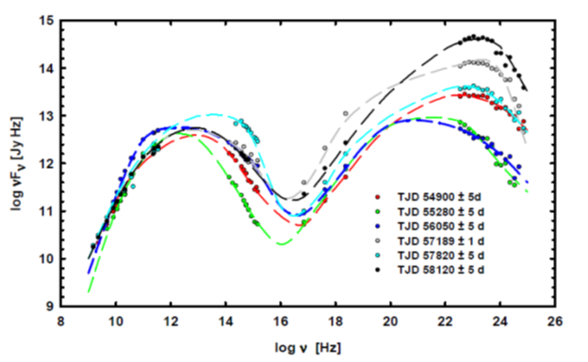
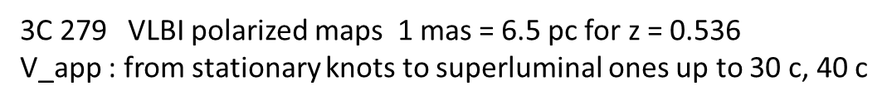
Complements
Evolution of the SED of 3C 279
(Larionov et al. 2020)

Slide 30
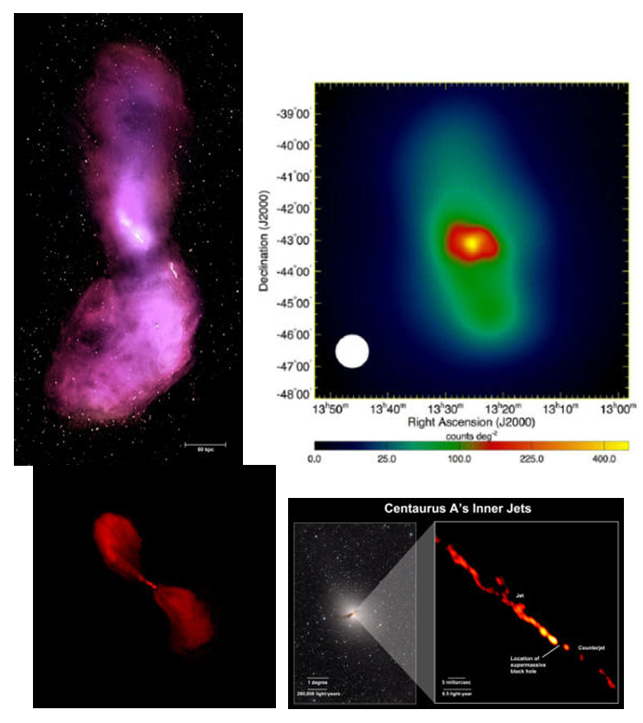

Slide 31
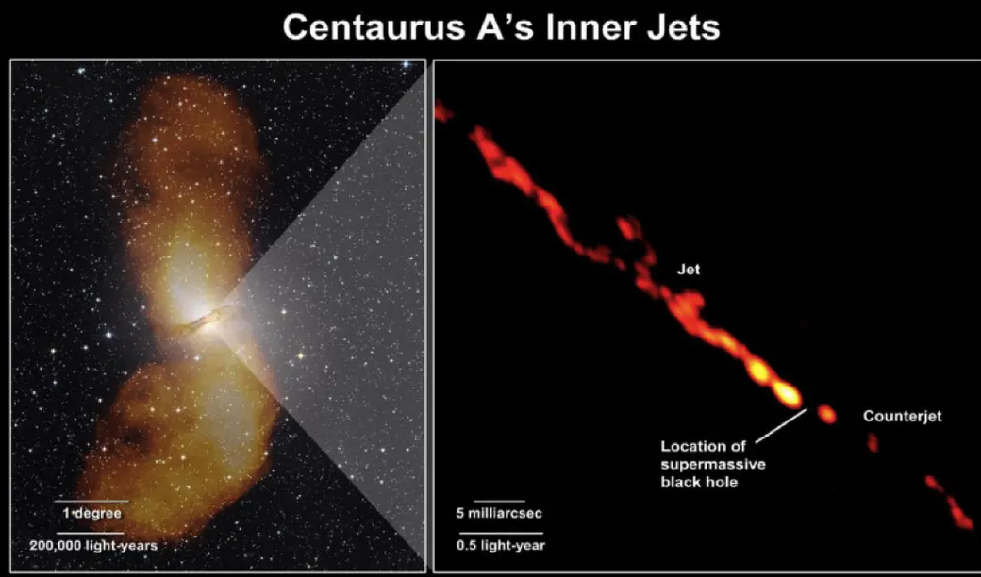
(Tatami)
(Tanami))

Slide 32
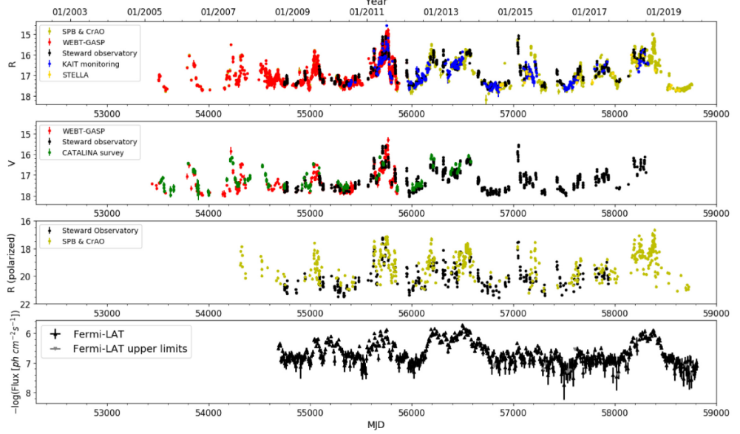
(Otero-Santos et al, 2020)

Slide 33
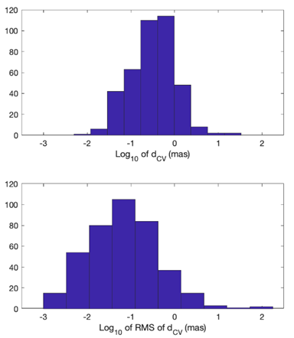
Complements
Distance between MOJAVE radio core and centroid of MOJAVE radio map
(Lambert, HS, Pierron, 2024)

