Slide 1
Radiative corrections in Starobinsky inflation
Wenqi Ke
University of Minnesota
Based on 2510.15137
with J. Ellis, T. Gherghetta,
K. Kaneta, K. Olive
Astroparticle Symposium 2025

Slide 2

Two related topics:
I – Inflation is fine-tuned
How much fine-tuning is allowed?
II – Inflation gets radiative corrections
What’s the constraint on the couplings?
See Keith’s talk
This talk

Slide 3
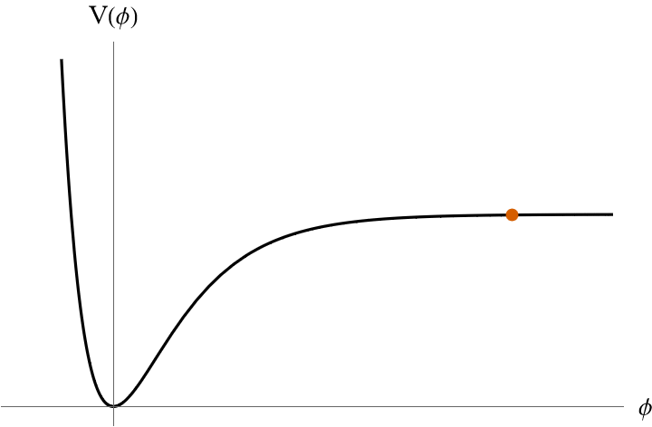




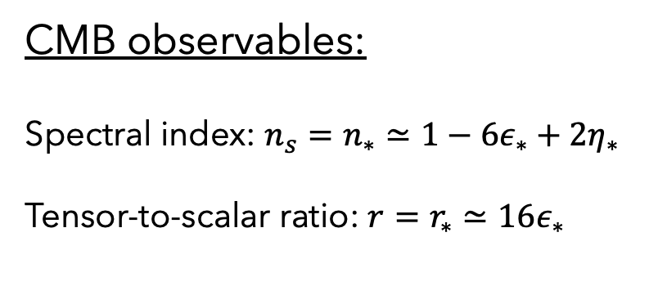

Single-field inflation
CMB observables:
Spectral index: $n_{s}=n_{∗}≃1−6ε_{∗}+2η_{∗}$
Tensor-to-scalar ratio: $r=r_{∗}≃16ε_{∗}$
Slow-roll inflation
Universe in exponential expansion
$$a∼e^{Ht}$$
at the pivot scale
Reheating
Inflaton oscillations
+ Particle production

Slide 4
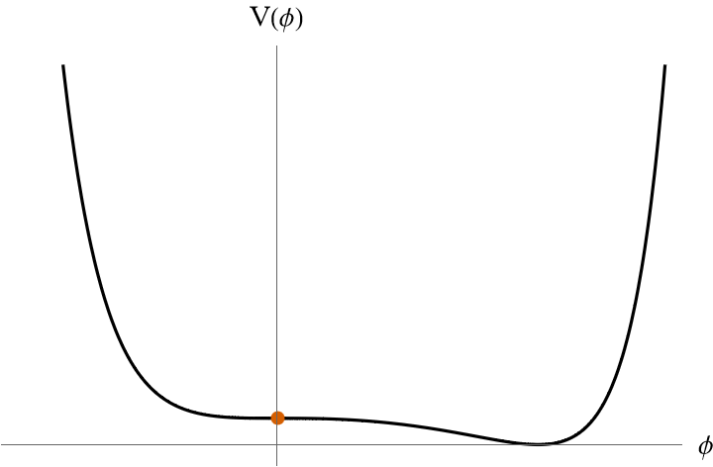
Inflation is fine-tuned, for example:
The inflaton
should sit at the
right place initially
The potential has to
be flat enough
Many ways to deform the potential:
Higher dimensional operators
A tiny change of the coupling
Radiative corrections …

Slide 5
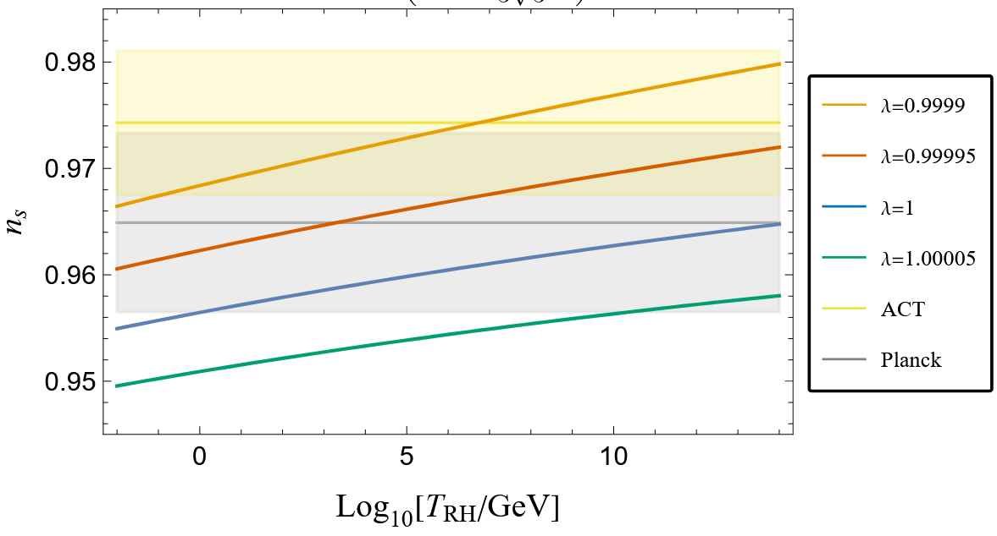
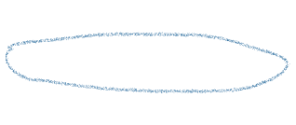
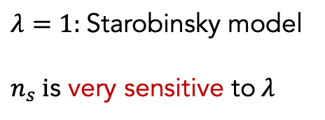
Inflation is fine-tuned, for example:
The inflaton
should sit at the
right place initially
$λ=1:$Starobinsky model
$n_{s} i$s very sensitive to$λ$
The potential has to
be flat enough
Many ways to deform the potential:
Higher dimensional operators
A tiny change of the coupling
Radiative corrections …

Slide 6
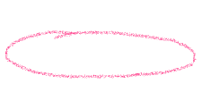
Inflation is fine-tuned, for example:
The inflaton
should sit at the
right place initially
The potential has to
be flat enough
Many ways to deform the potential:
Higher dimensional operators
A tiny change of the coupling
Radiative corrections …
Assuming they are under control/tuned
How do they affect inflation?

Slide 7

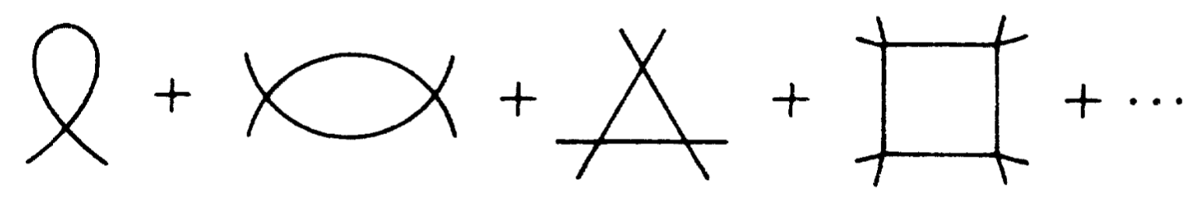
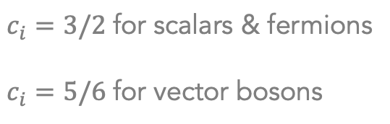
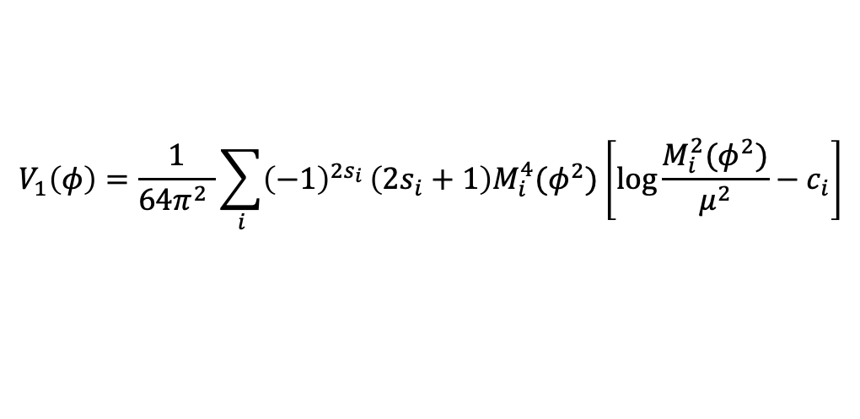
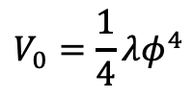
Radiative corrections
The effective scalar potential
e.g.
$$V_{0}=\frac{1}{4}λφ^{4}$$
Tree-level:
One-loop:
Summing up one-particle-irreducible diagrams
More generally, if the scalar couples to other fields. We have:
$$V_{1}\left(φ\right)=\frac{1}{64π^{2} }\sum_{i}{{\left(−1\right)}^{2s_{i}}}\left(2s_{i}+1\right)M_{i}^{4}(φ^{2})\left[\log{\frac{M_{i}^{2}(φ^{2})}{μ^{2}}}−c_{i}\right]$$
$c_{i}=3/2$ for scalars & fermions
$c_{i}=5/6$ for vector bosons
$M_{i}^{2}(φ^{2})$: the field-dependent mass of the particle $i$

Slide 8
Radiative corrections
The effective scalar potential
e.g.
$$V_{0}=\frac{1}{4}λφ^{4}$$
Tree-level:
One-loop:
Summing up one-particle-irreducible diagrams
More generally, if the scalar couples to other fields. We have:
$$V_{1}\left(φ\right)=\frac{1}{64π^{2} }\sum_{i}{{\left(−1\right)}^{2s_{i}}}\left(2s_{i}+1\right)M_{i}^{4}(φ^{2})\left[\log{\frac{M_{i}^{2}(φ^{2})}{μ^{2}}}−c_{i}\right]$$
$c_{i}=3/2$ for scalars & fermions
$c_{i}=5/6$ for vector bosons
$M_{i}^{2}(φ^{2})$: the field-dependent mass of the particle $i$
Radiative corrections are always there: from the self coupling, or coupling to other fields

Slide 9
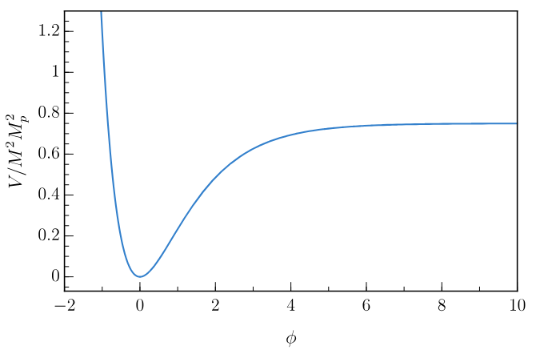


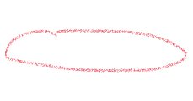
Two subtleties in inflation
$≈$de Sitter
Inflation happens in curved spacetime
CMB observables
What changes in the one loop potential?
#1: The effective mass.
#2: An extra curvature-dependent piece.
Markkanen, Nurmi, Rajantie, Stopyra [1804.02020]

Slide 10
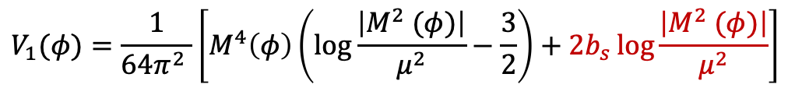
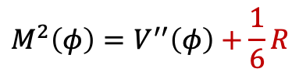
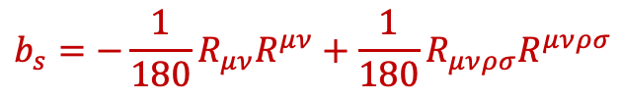
Two subtleties in inflation
$≈$de Sitter
Inflation happens in curved spacetime
CMB observables
What changes in the one loop potential?
#1: The effective mass.
#2: An extra curvature-dependent piece.
e.g. Self-interacting scalar
$$M^{2}\left(φ\right)=V^{′′}\left(φ\right)+\frac{1}{6}R$$
$$V_{1}(φ)=\frac{1}{64π^{2} }\left[M^{4}\left(φ\right)\left(\log{\frac{\left|M^{2} (φ)\right|}{μ^{2}}}−\frac{3}{2}\right)+2b_{s}\log{\frac{\left|M^{2} (φ)\right|}{μ^{2}}}\right]$$
$$b_{s}=−\frac{1}{180}R_{μν}R^{μν}+\frac{1}{180}R_{μνρσ}R^{μνρσ}$$
Markkanen, Nurmi, Rajantie, Stopyra [1804.02020]

Slide 11


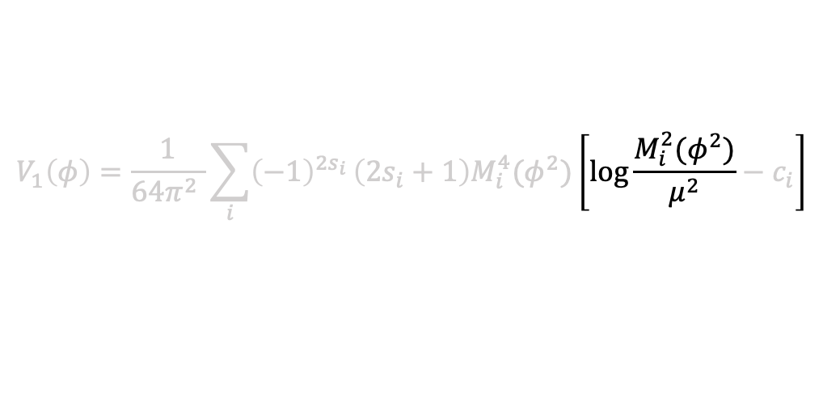


Two subtleties in inflation
The effective mass evolves with time
e.g. $yφ(t)\overline{f}f$
can vary from ${y M}_{P}$ to 0
$$V_{1}\left(φ\right)=\frac{1}{64π^{2} }\sum_{i}{{\left(−1\right)}^{2s_{i}}}\left(2s_{i}+1\right)M_{i}^{4}(φ^{2})\left[\log{\frac{M_{i}^{2}(φ^{2})}{μ^{2}}}−c_{i}\right]$$
Avoid large log’s!

Slide 12
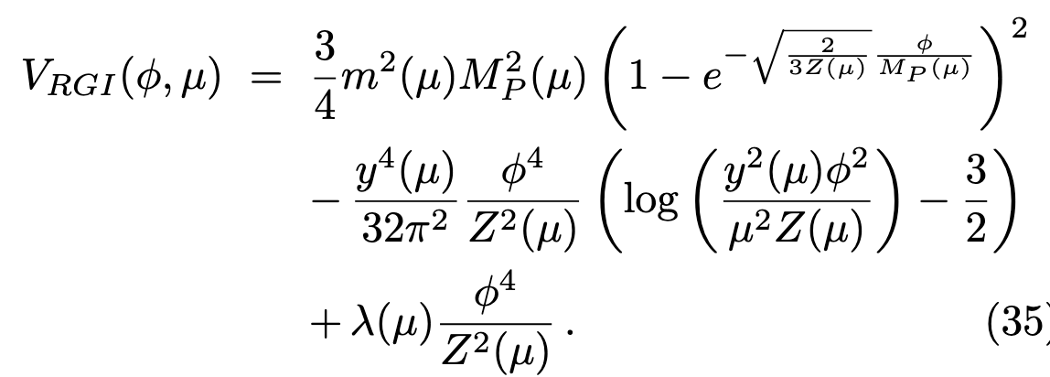
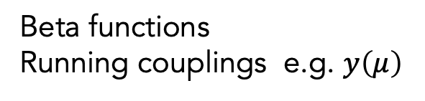
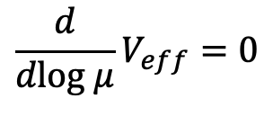
Two subtleties in inflation
The effective mass evolves with time
$$V_{1}\left(φ\right)=\frac{1}{64π^{2} }\sum_{i}{{\left(−1\right)}^{2s_{i}}}\left(2s_{i}+1\right)M_{i}^{4}(φ^{2})\left[\log{\frac{M_{i}^{2}(φ^{2})}{μ^{2}}}−c_{i}\right]$$
Avoid large log’s!
RG-improve the scalar potential:
$$\frac{d}{dlog μ}V_{eff}=0$$
Beta functions
Running couplings e.g. $y\left(μ\right)$
The RG-improved potential has minimal $μ$ dependence (up to higher loops)

Slide 13
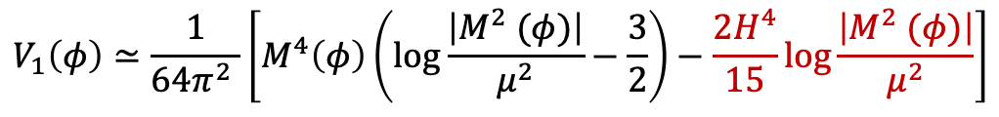
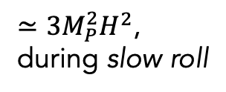
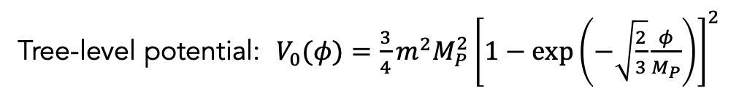
Radiative corrections in Starobinsky
J. Ellis, T. Gherghetta, K. Kaneta, WK, K. Olive [2510.15137]
Tree-level potential: $V_{0}(φ)=\frac{3}{4}m^{2}M_{P}^{2}{\left[1−\exp\left(−\sqrt{\frac{2}{3}}\frac{φ}{M_{P}}\right)\right]}^{2}$
$≃3M_{P}^{2}H^{2}$,
during slow roll
(1) Inflaton self-coupling
$M^{2}\left(φ\right)≃V^{′′}\left(φ\right)−2H^{2}$ ($R≃−12H^{2}$ during inflation)
$$V_{1}\left(φ\right)≃\frac{1}{64π^{2} }\left[M^{4}\left(φ\right)\left(\log{\frac{\left|M^{2} (φ)\right|}{μ^{2}}}−\frac{3}{2}\right)−\frac{2H^{4}}{15}\log{\frac{\left|M^{2} (φ)\right|}{μ^{2}}}\right]$$

Slide 14




Radiative corrections in Starobinsky
J. Ellis, T. Gherghetta, K. Kaneta, WK, K. Olive [2510.15137]
Tree-level potential: $V_{0}(φ)=\frac{3}{4}m^{2}M_{P}^{2}{\left[1−\exp\left(−\sqrt{\frac{2}{3}}\frac{φ}{M_{P}}\right)\right]}^{2}$
$≃3M_{P}^{2}H^{2}$,
during slow roll
(1) Inflaton self-coupling
$M^{2}\left(φ\right)≃V^{′′}\left(φ\right)−2H^{2}$ ($R≃−12H^{2}$ during inflation)
Dominated by Hubble, during slow roll
$$V_{1}\left(φ\right)≃\frac{1}{64π^{2} }\left[M^{4}\left(φ\right)\left(\log{\frac{\left|M^{2} (φ)\right|}{μ^{2}}}−\frac{3}{2}\right)−\frac{2H^{4}}{15}\log{\frac{\left|M^{2} (φ)\right|}{μ^{2}}}\right]$$
$$∼H^{4}$$
$$∼H^{4}$$
$${(V}_{1}∼H^{4})≪(V_{0}∼M_{P}^{2}H^{2})$$
The one-loop correction from inflaton self-coupling is negligible

Slide 15
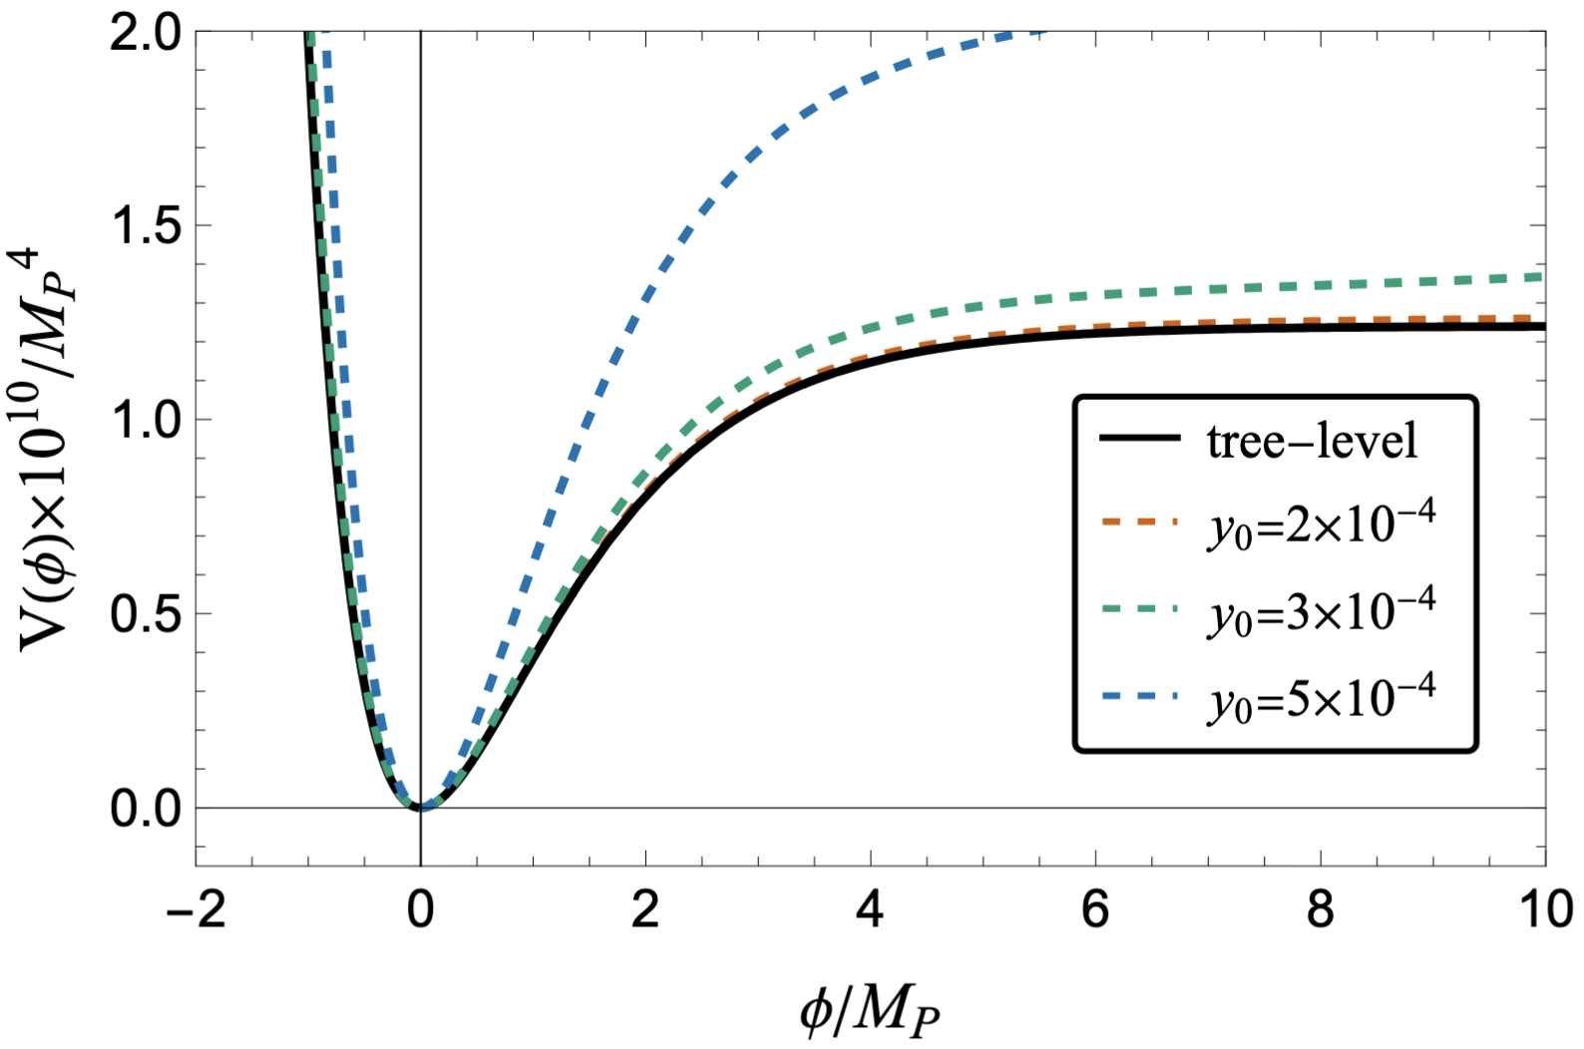
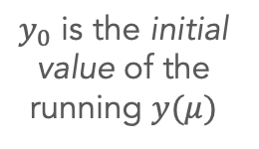
(2) Yukawa coupling $yφ{\overline{f}}^{c}f/2$ ($f$ is massless & Majorana)
Tree-level
vs.
One-loop corrected potential
$y_{0}$ is the initial value of the running $y(μ)$

Slide 16
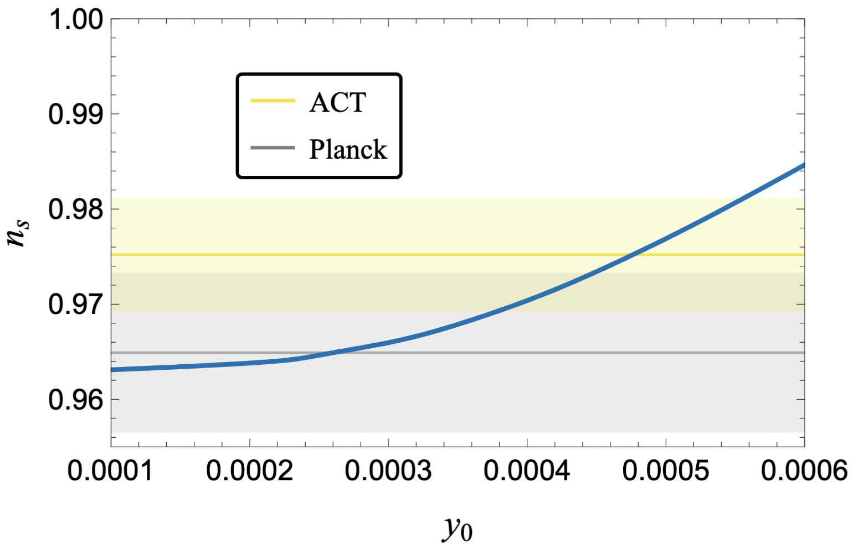

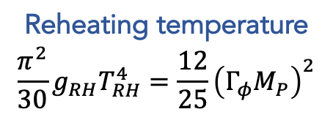

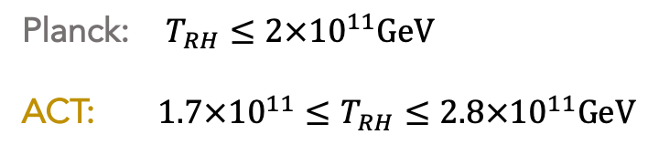
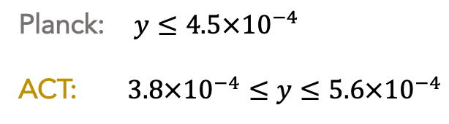
(2) Yukawa coupling $yφ{\overline{f}}^{c}f/2$ ($f$ is massless & Majorana)
Constraint on ns
||
Bound on y
||
Bound on TRH
$$±2σ$$
$$±2σ$$
Reheating temperature
$$\frac{π^{2}}{30}g_{RH}T_{RH}^{4}=\frac{12}{25}{\left(Γ_{φ}M_{P}\right)}^{2}$$
Planck: $y≤4.5×{10}^{−4}$
ACT: $3.8×{10}^{−4}≤y≤5.6×{10}^{−4}$
Planck: $T_{RH}≤2×{10}^{11}GeV$
ACT: $1.7×{10}^{11}≤T_{RH}≤2.8×{10}^{11}GeV$

Slide 17
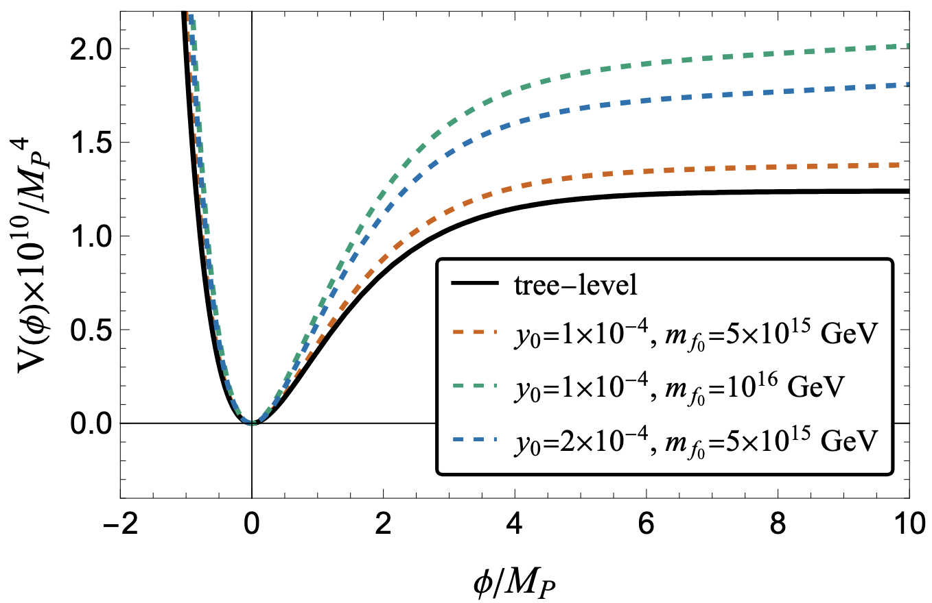
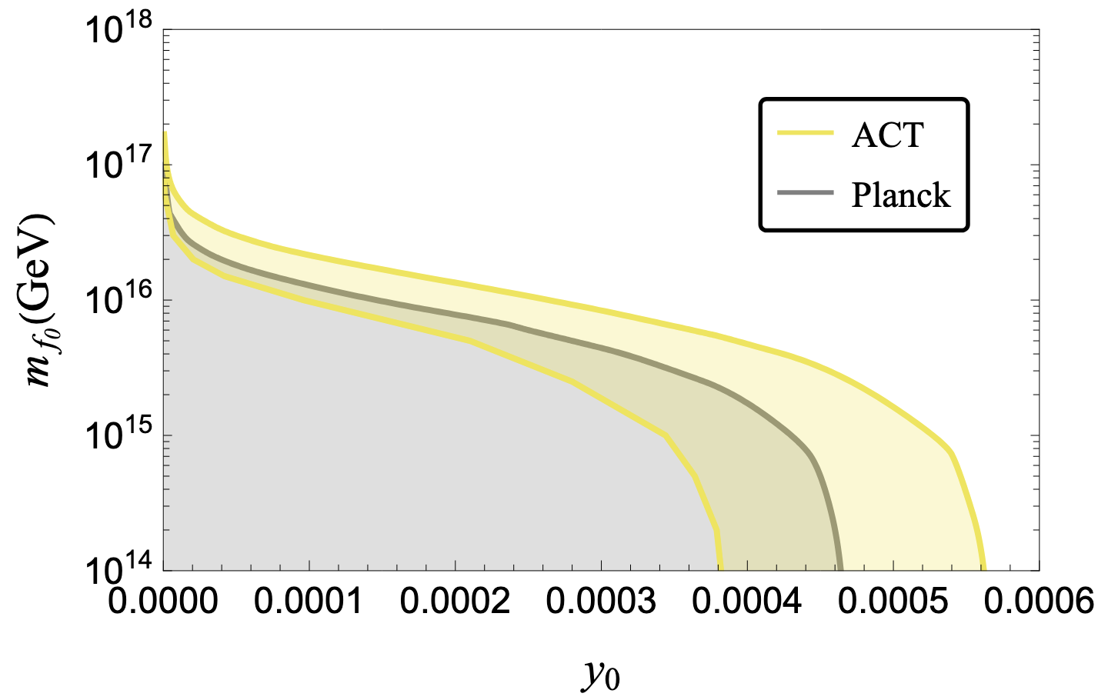
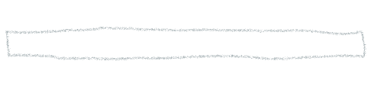
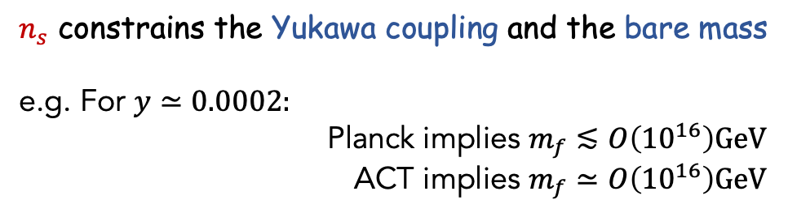
(3) Yukawa coupling with massive fermion $yφ{\overline{f}}^{c}f/2$ $+m_{f}{\overline{f}}^{c}f/2$
$n_{s}$ constrains the Yukawa coupling and the bare mass
e.g. For $y≃0.0002:$
Planck implies $m_{f}≲O\left({10}^{16}\right)GeV$
ACT implies $m_{f}≃O\left({10}^{16}\right)GeV$

Slide 18
(3) Yukawa coupling with massive fermion $yφ{\overline{f}}^{c}f/2$ $+m_{f}{\overline{f}}^{c}f/2$
And similar analyses for inflaton coupling to a scalar …
See our 2510.15137
$n_{s}$ constrains the Yukawa coupling and the bare mass
e.g. For $y≃0.0002:$
Planck implies $m_{f}≲O\left({10}^{16}\right)GeV$
ACT implies $m_{f}≃O\left({10}^{16}\right)GeV$

Slide 19
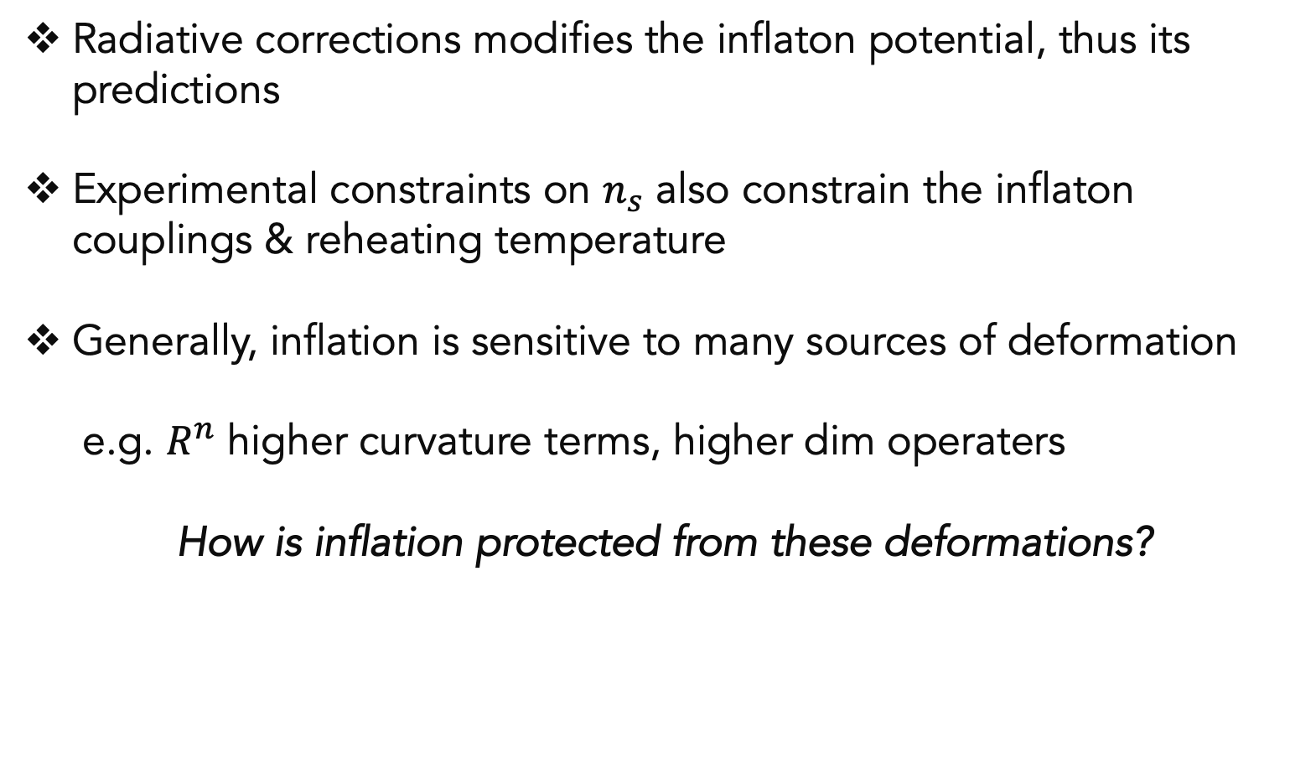
Summary
Radiative corrections modifies the inflaton potential, thus its predictions
Experimental constraints on $n_{s}$ also constrain the inflaton couplings & reheating temperature
Generally, inflation is sensitive to many sources of deformation
e.g. $R^{n}$ higher curvature terms, higher dim operaters
How is inflation protected from these deformations?
Bottom-up: constrain these operators using experiments
Top-down: any symmetries constraining these operators?

