Slide 1




Ab Initio Study of Antiproton-Nucleus Systems at Low Energies
Alireza Dehghani
Supervisors: Dr. Guillaume Hupin
Prof. Ubirajara van Kolck
Collaborators
Dr. Jaume Carbonell (IJCLab, Orsay)
Prof. Slawomyr Wycech (NCNR, Warsaw)

Slide 2
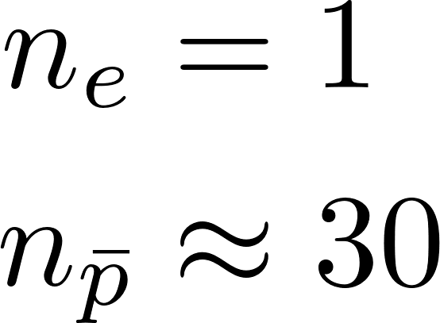



Antiproton’s annihilation at low energy
Antiprotons are slowed down in the target
They are captured by the atom at very high orbit, while ejecting the orbiting electron
They start cascading down on their atomic levels by emitting X-rays
Coulomb+Nuclear
Shifted and broadened levels
Coulomb
When they reach lowest orbits, the strong interaction between antiproton and nucleus shifts the energy levels and broadens the width, the latter leading to annihilation

Slide 3
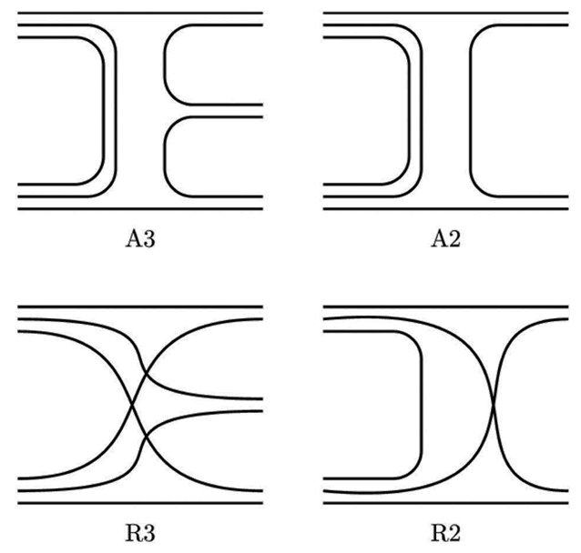
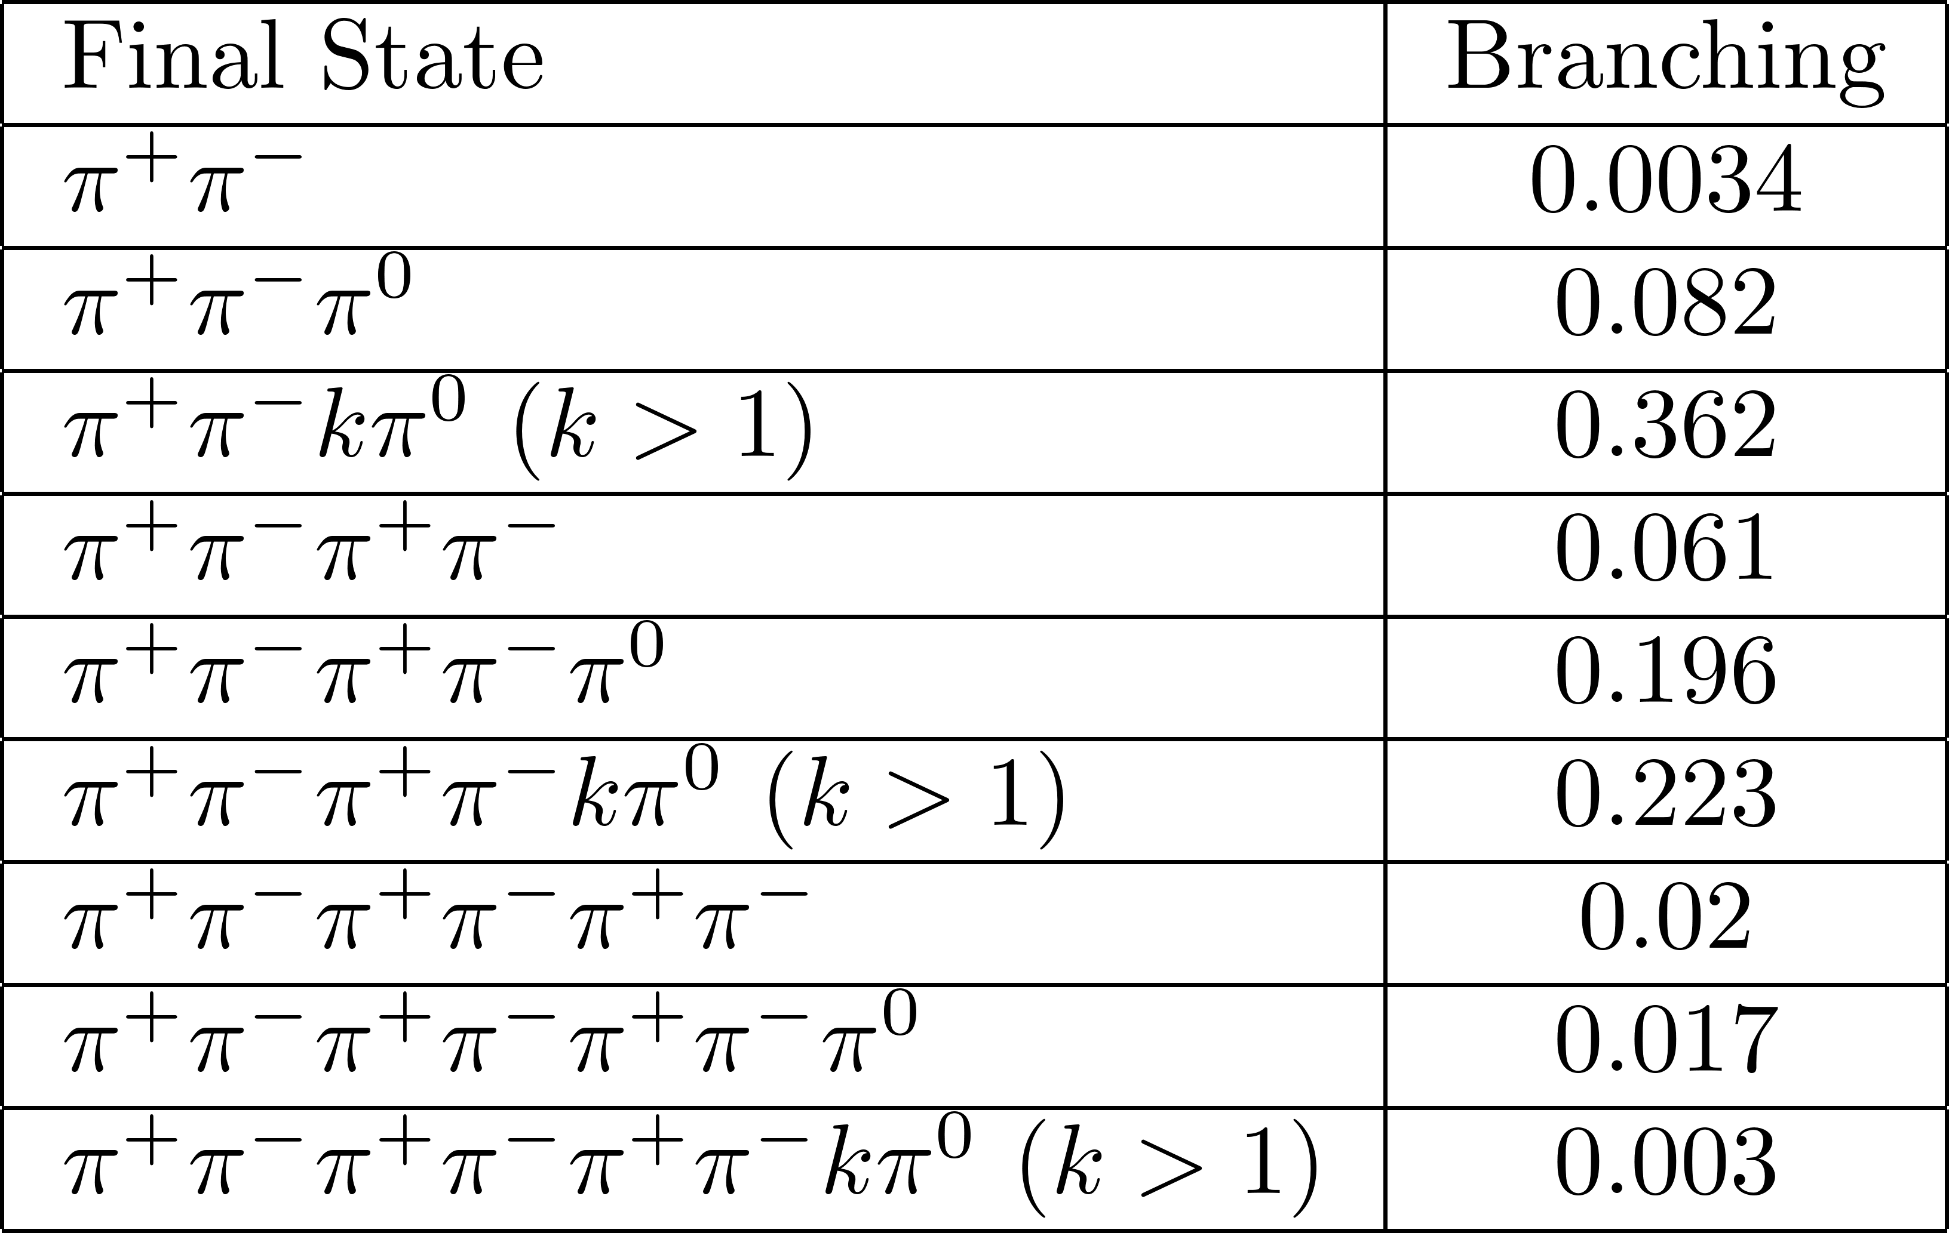
Annihilation into mesons
Richard, J. M. (2020). Antiproton physics. Frontiers in Physics, 8, 6.
Orfanidis, S. J., & Rittenberg, V. (1973). Nuclear Physics B, 59(2), 570-582.

Slide 4
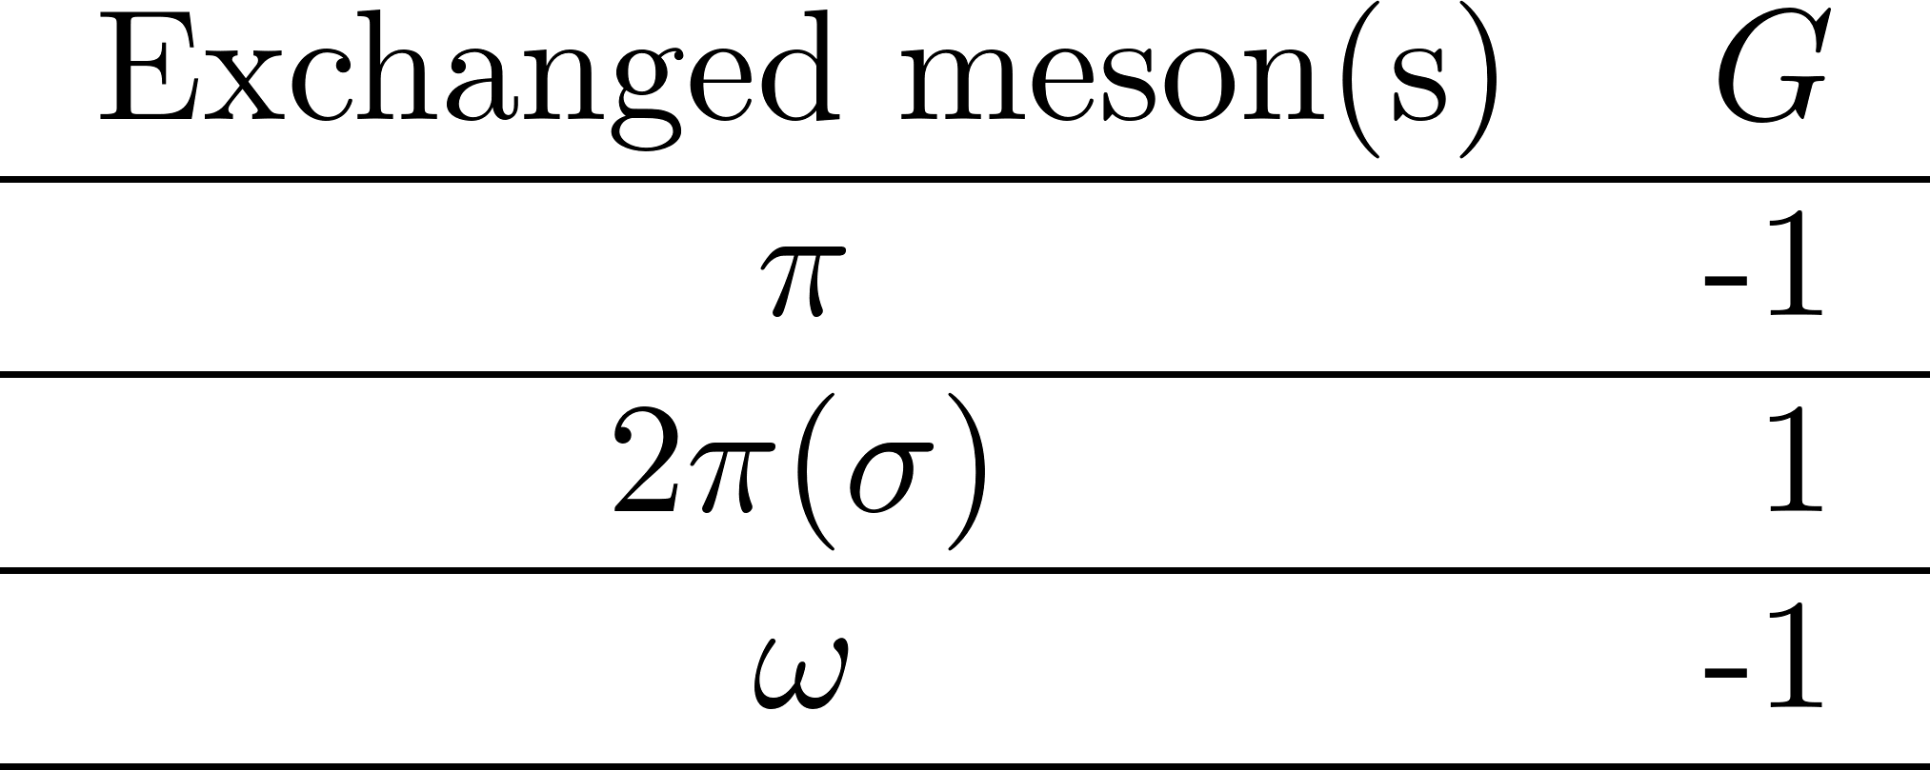
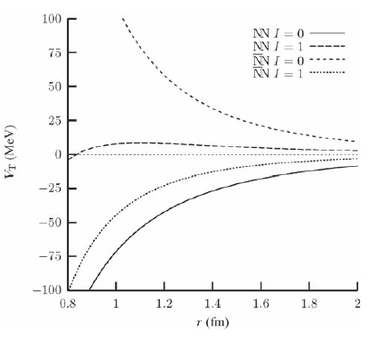
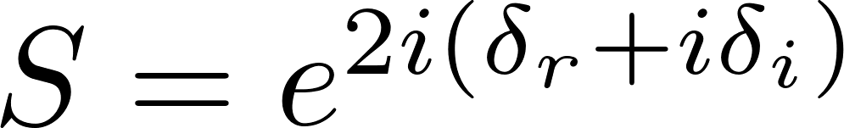
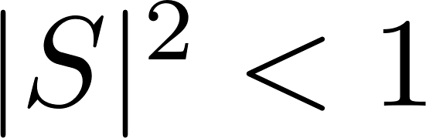

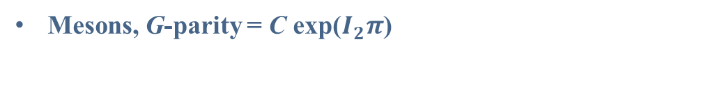
Nucleon-Antinucleon Interaction
Mesons, G-parity = C exp($I_{2}π$)
Comparison of tensor part of Paris potentials
for nucleon-nucleon and nucleon-antinucleon
Annihilation: Complex optical potential
$$V=U+iW$$
Optical Potential
Annihilation
Meson Exchange
Non-unitary
S-matrix
Klempt, E., Bradamante, F., Martin, A., & Richard, J. M. (2002).
Physics Reports, 368(2-3), 119-316.

Slide 5
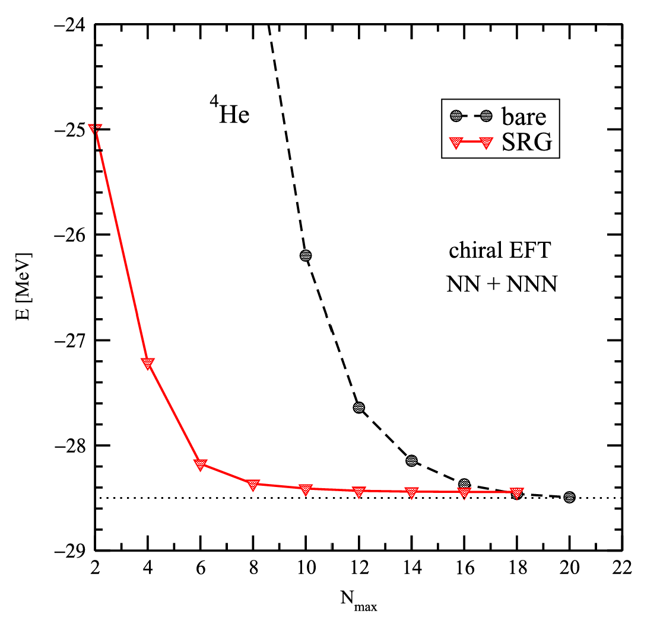
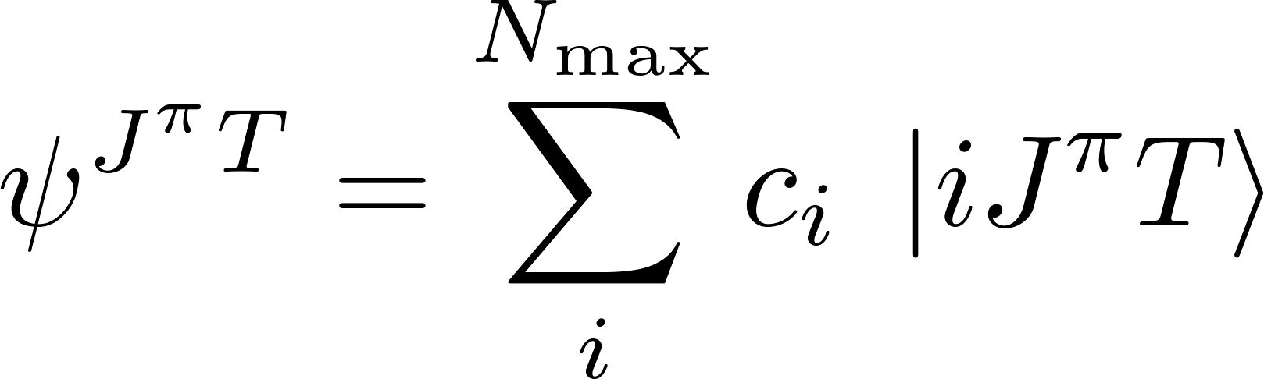
Ab Initio No-Core Shell Model (NCSM)
⁴He ground state energy as a function of N_{max}
Truncation point
HO basis
Total wave function
Expansion coefficients
Barrett, B. R., Navrátil, P., & Vary, J. P. (2013). Ab initio no core shell model. Progress in Particle and Nuclear Physics, 69, 131-181.

Slide 6
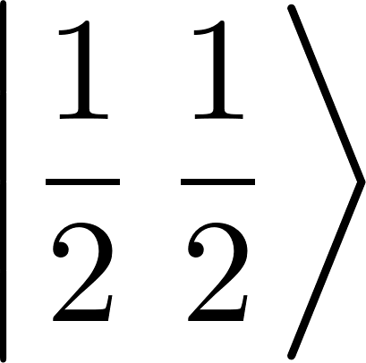
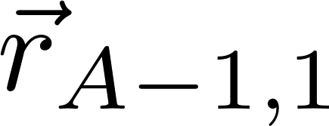
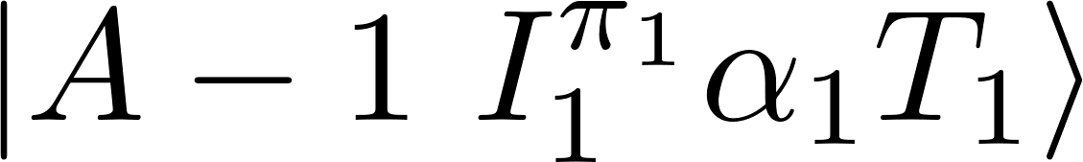






NCSM + Resonating Group Method (NCSM/RGM)
RGM can be used for studying nuclear reaction as well as nuclear structure.
The A-body system is considered as two clusters, i.e., projectile and target.

Slide 7
Results
Antiprotonic Deuteron
Antiprotonic Triton & Helium-3
Antiprotonic Helium-4

Slide 8
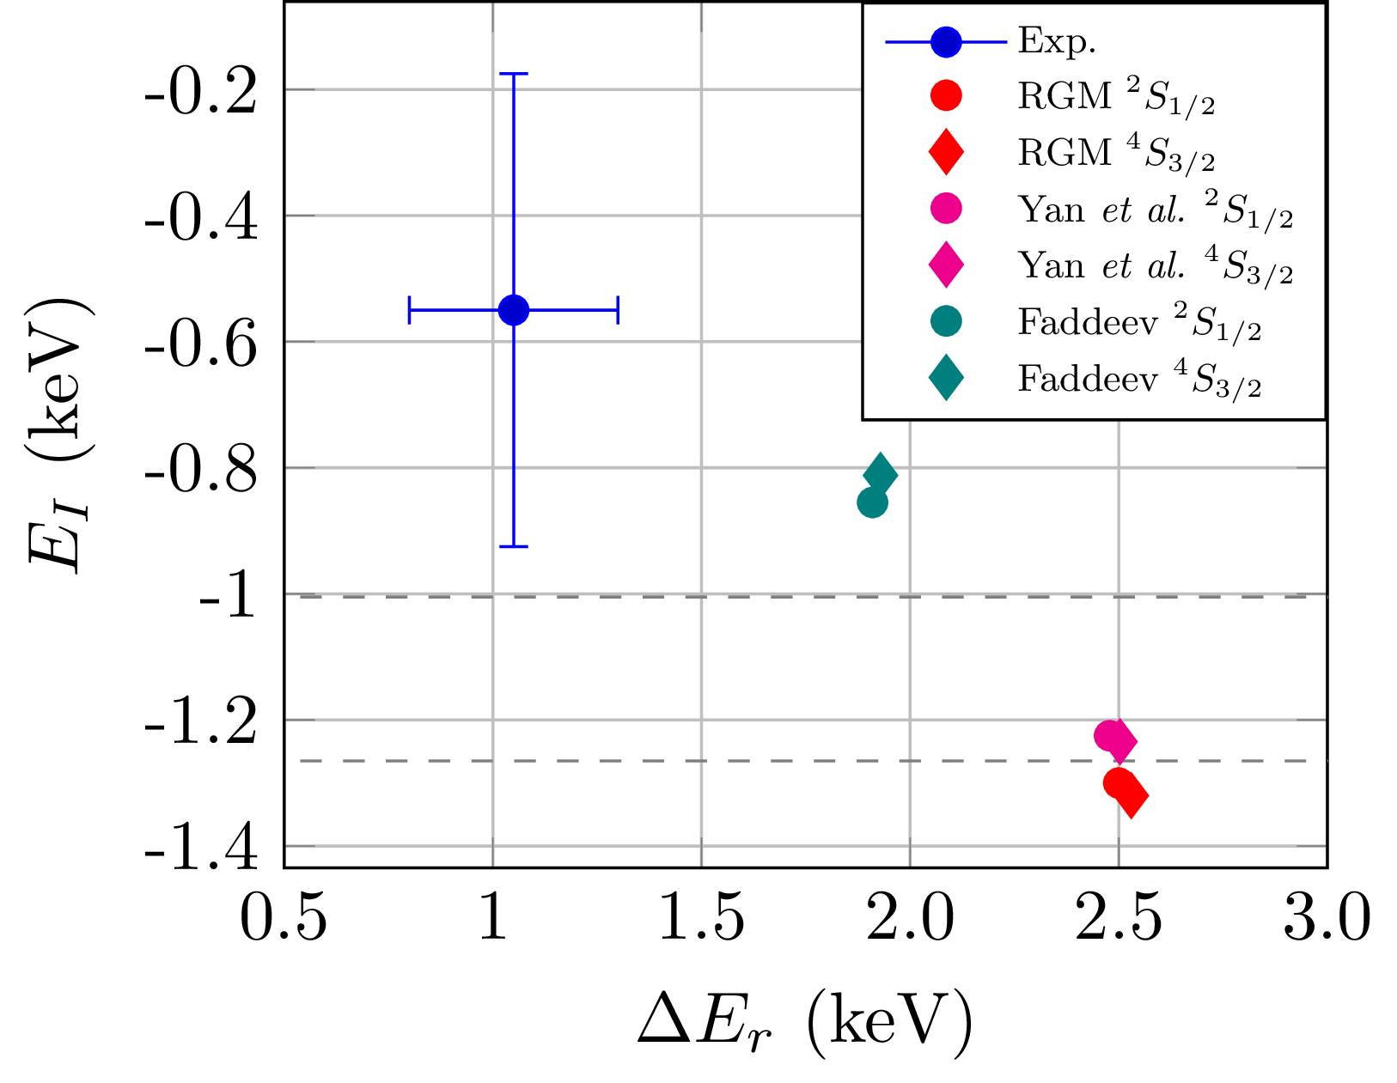
Atomic Level Shift and Width

Slide 9
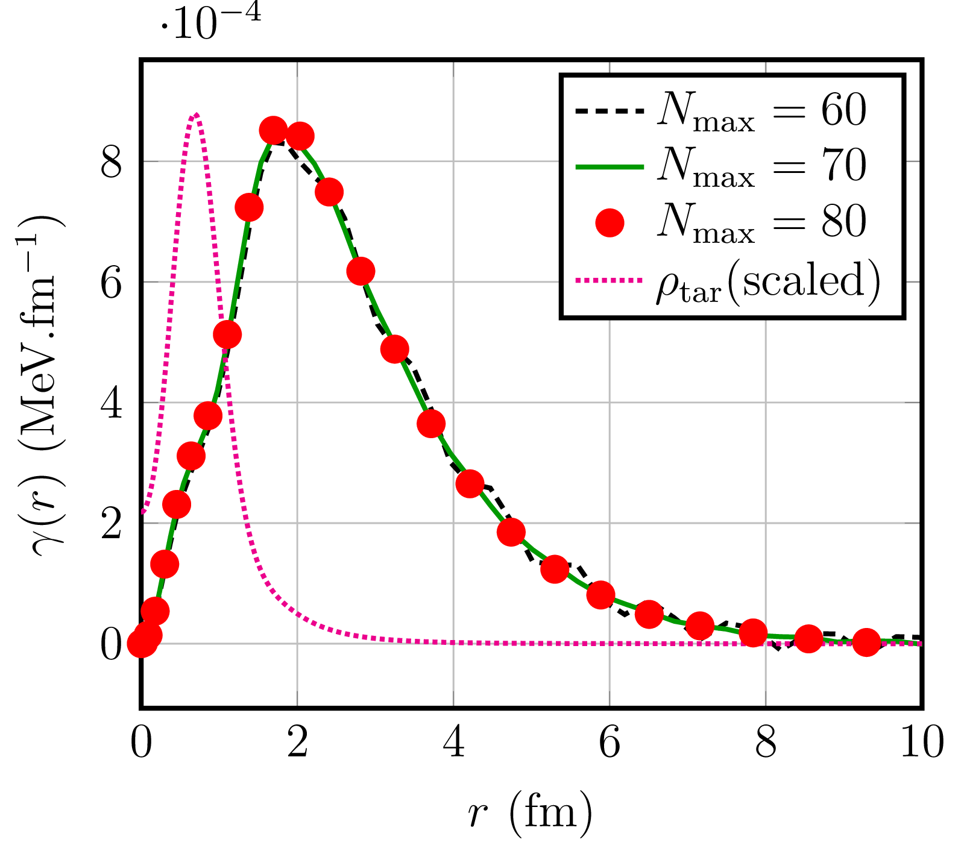
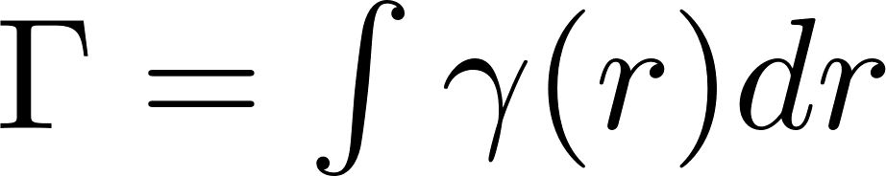
Annihilation Density
Atomic Width
Annihilation density

Slide 10
Results
Antiprotonic Deuteron
Antiprotonic Triton & Helium-3
Antiprotonic Helium-4

Slide 11
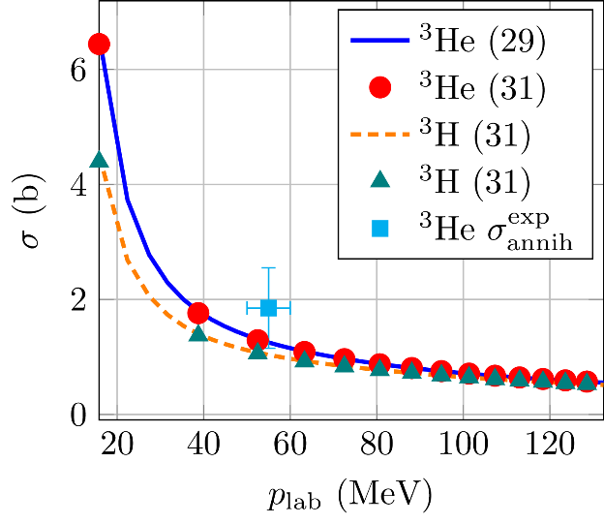
Reaction Cross Section
11

Slide 12
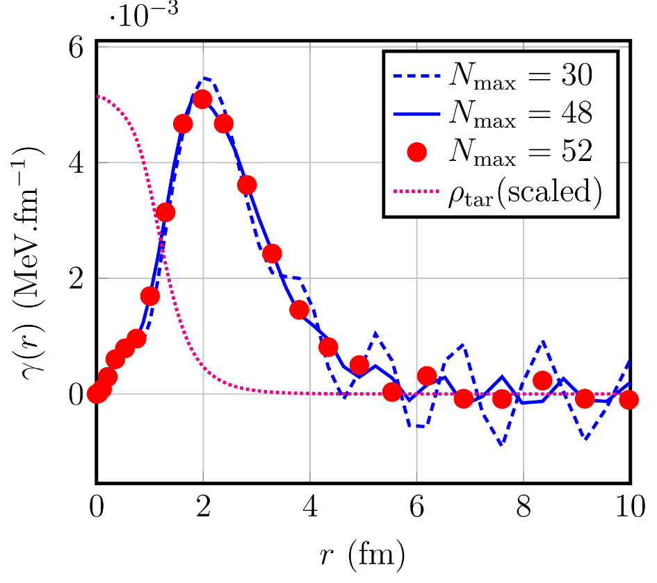
Annihilation Density
12

Slide 13
Selected Results
Antiprotonic Deuteron
Antiprotonic Triton & Helium-3
Antiprotonic Helium-4

Slide 14
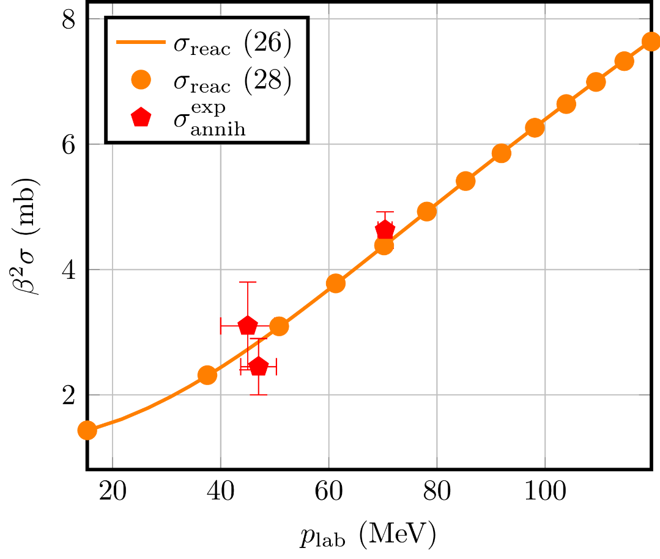
Reaction Cross Section

Slide 15
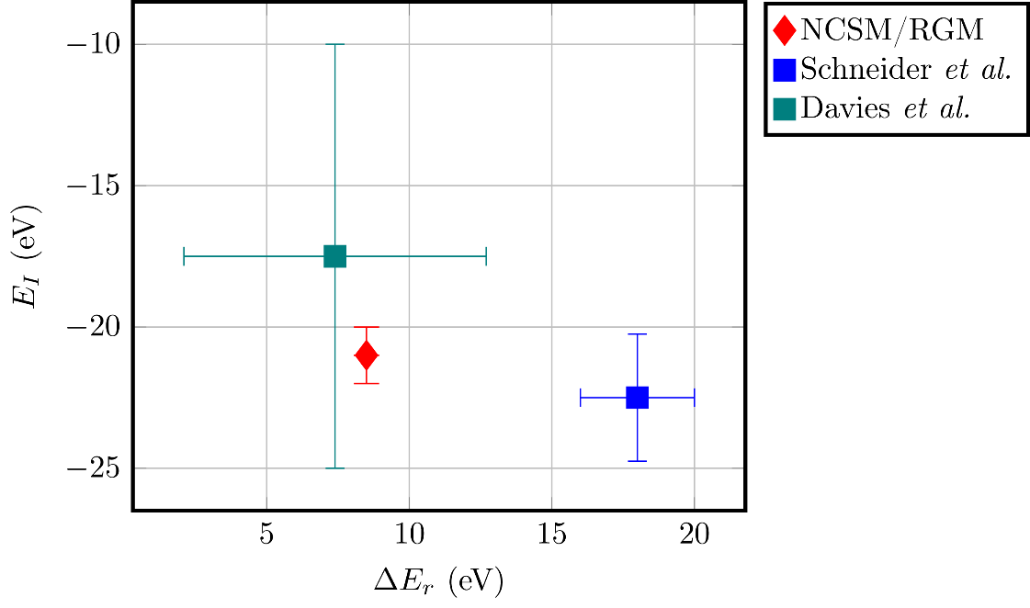
Atomic Level Shift and Width

Slide 16
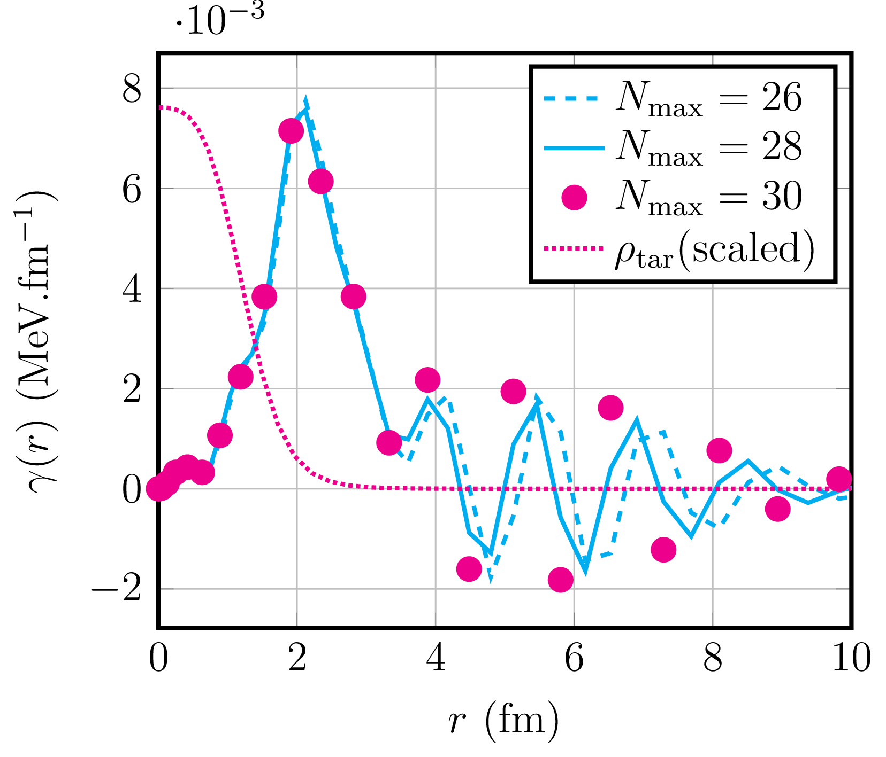
Annihilation Density

Slide 17
Thank you!

