Slide 1
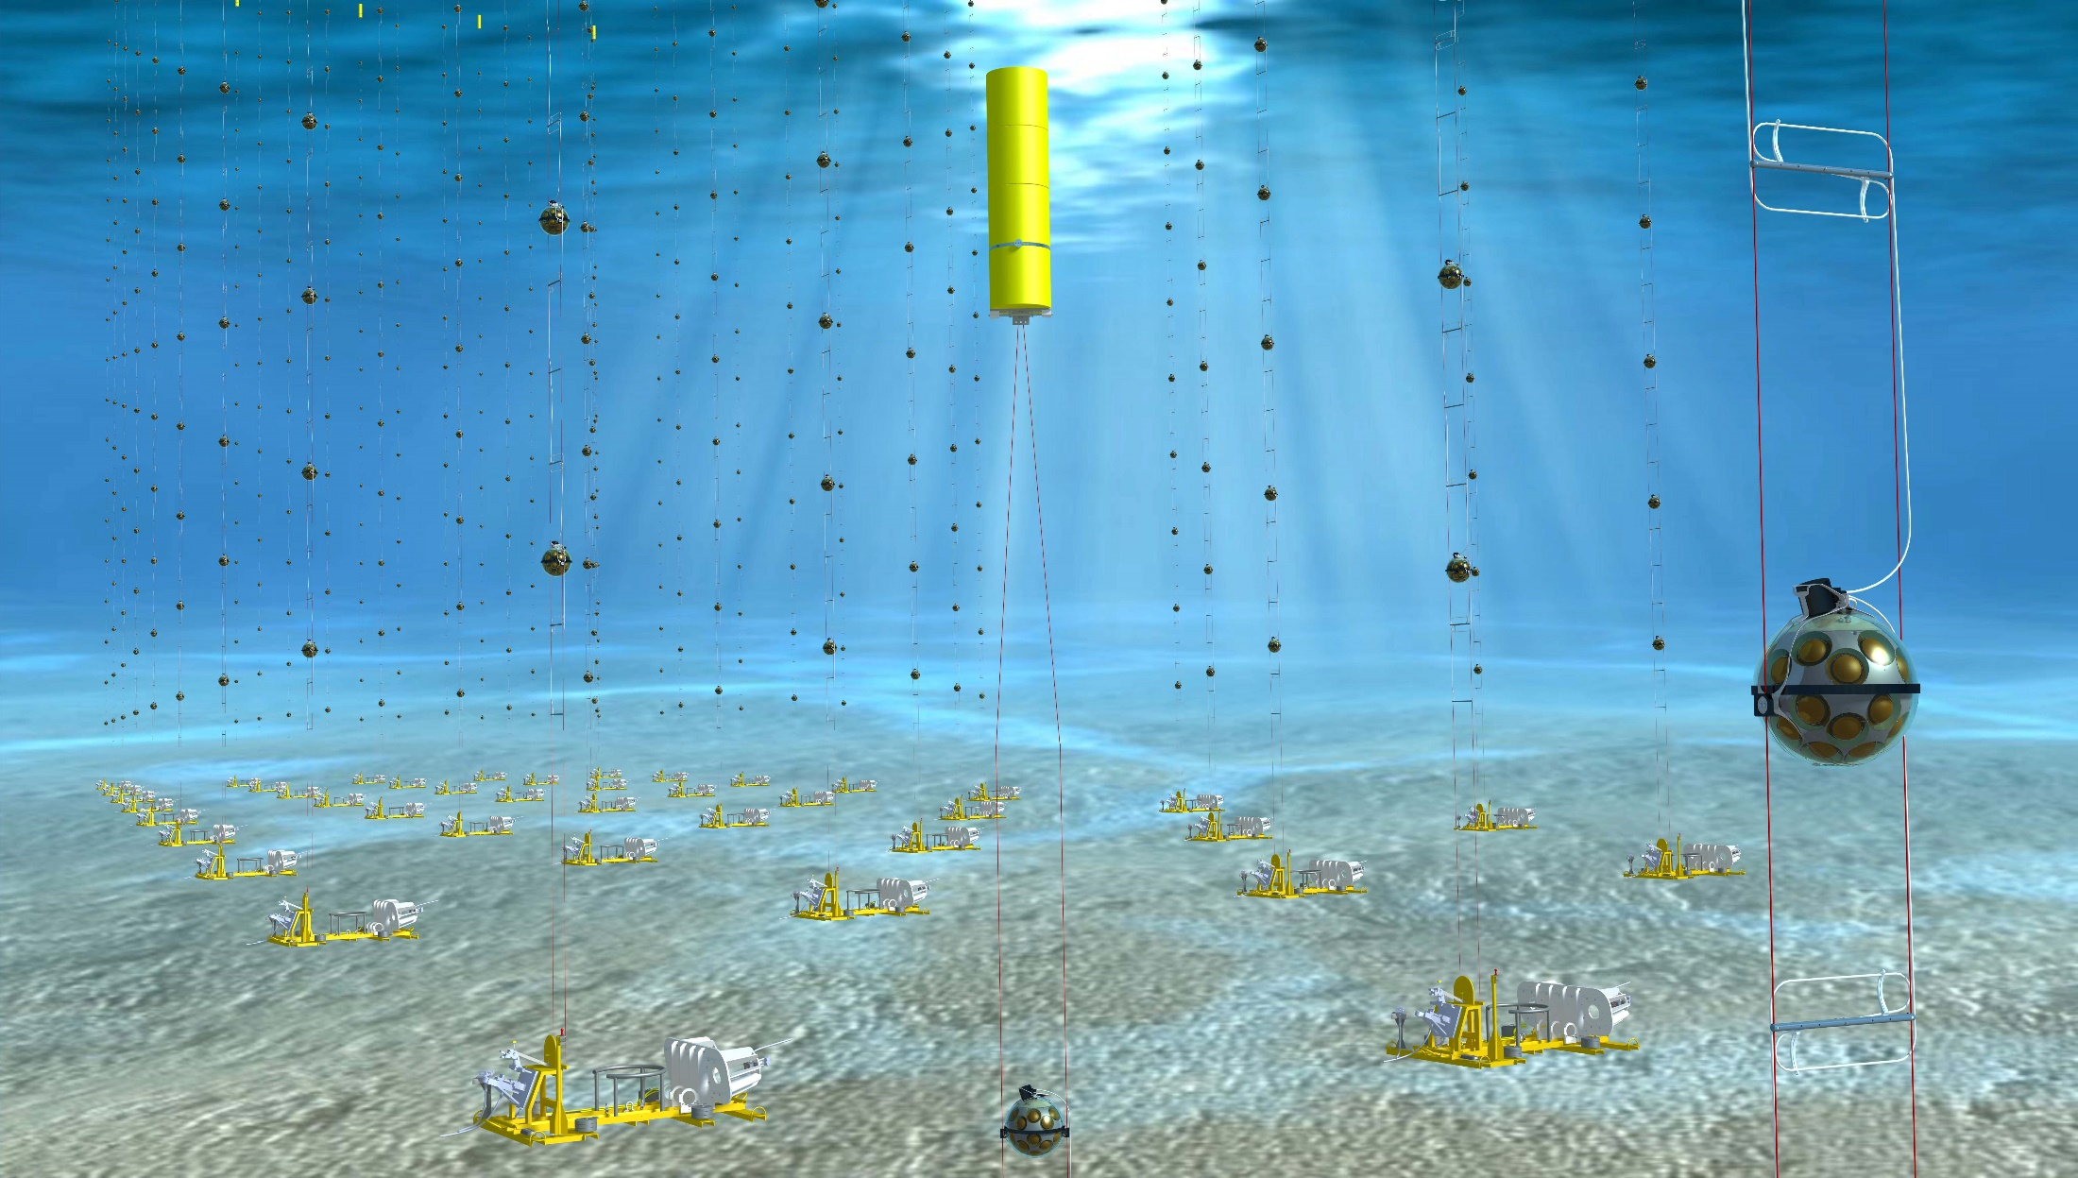
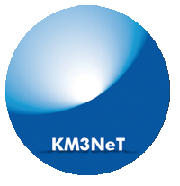


Latest results from KM3NeT
João Coelho
for the KM3NeT Collaboration
28 April 2025

Slide 2
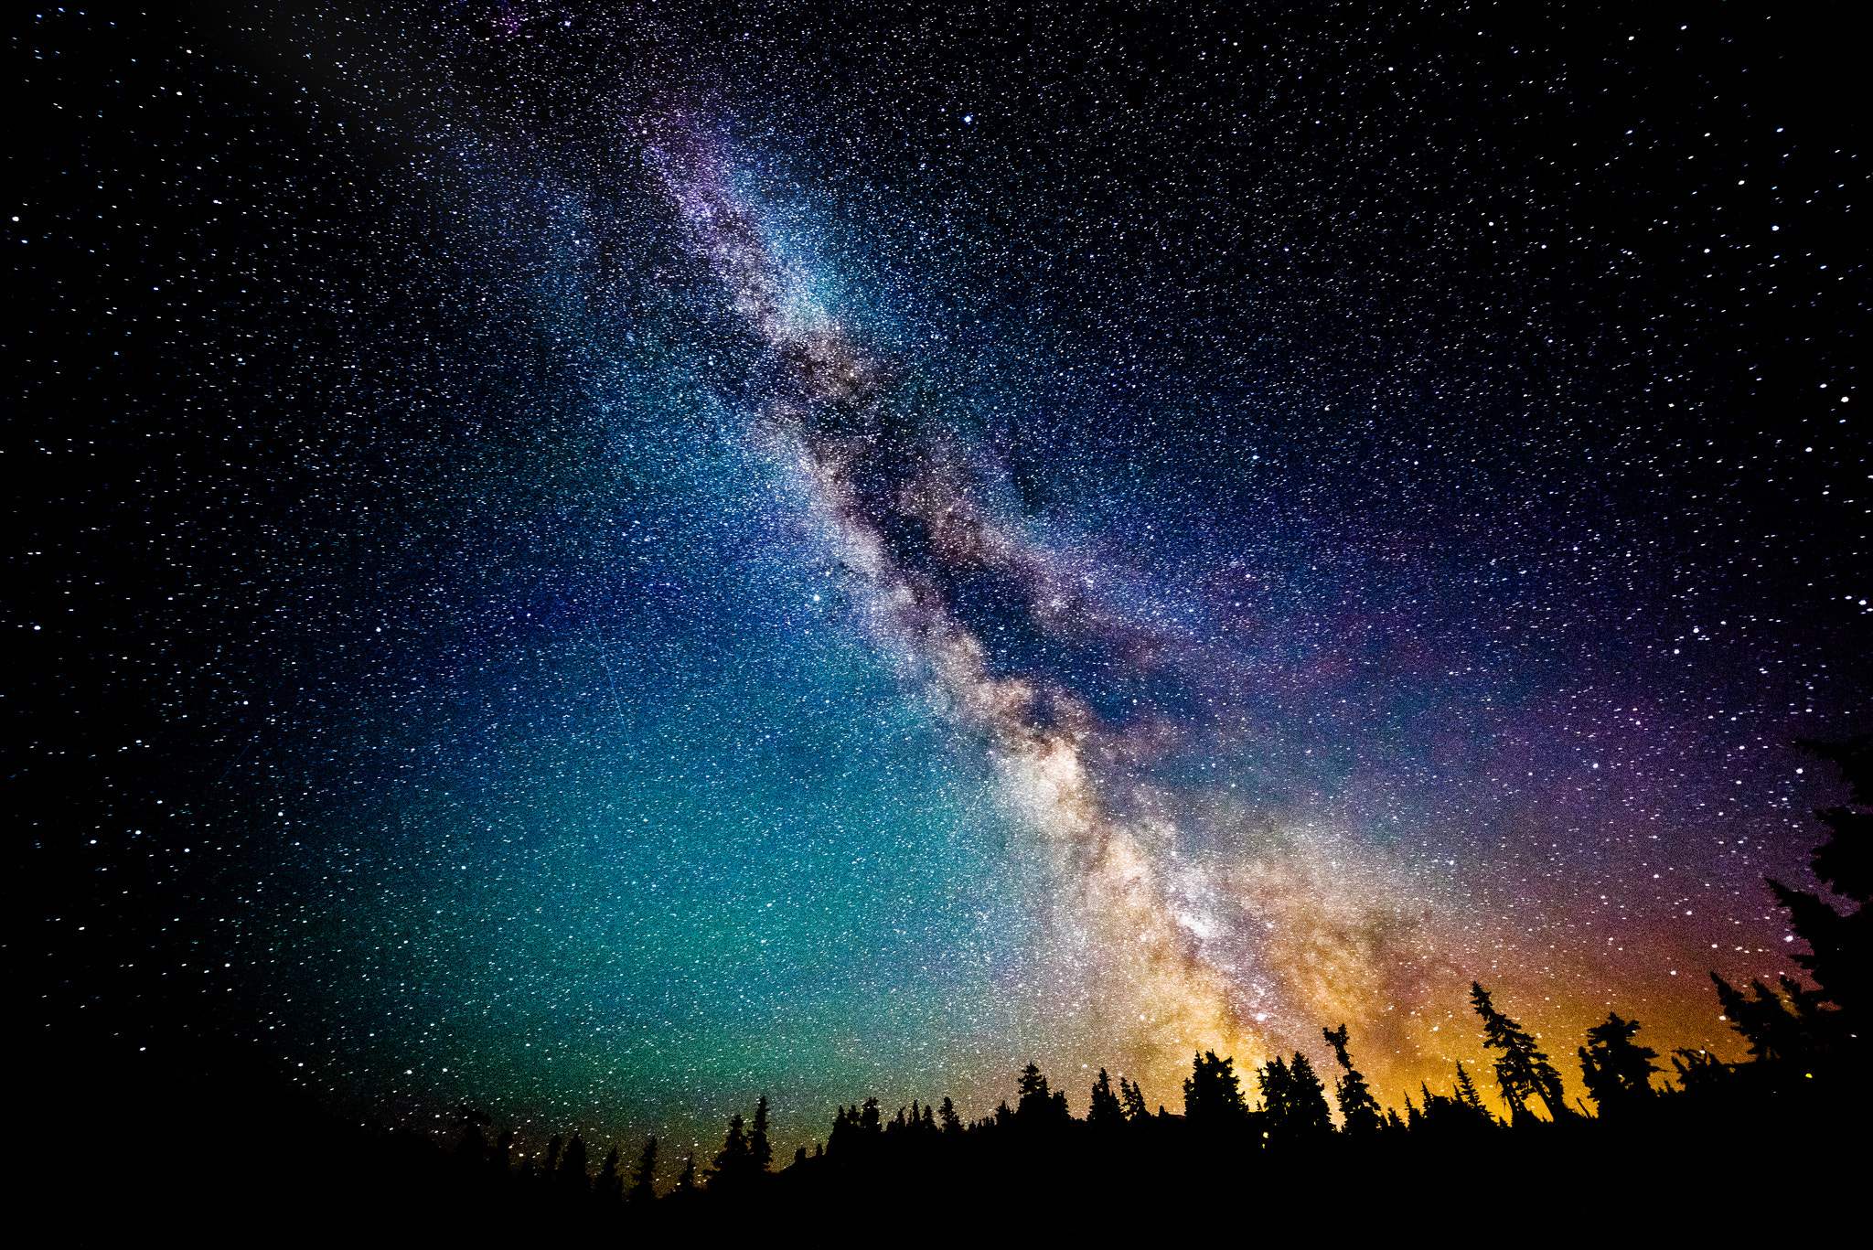
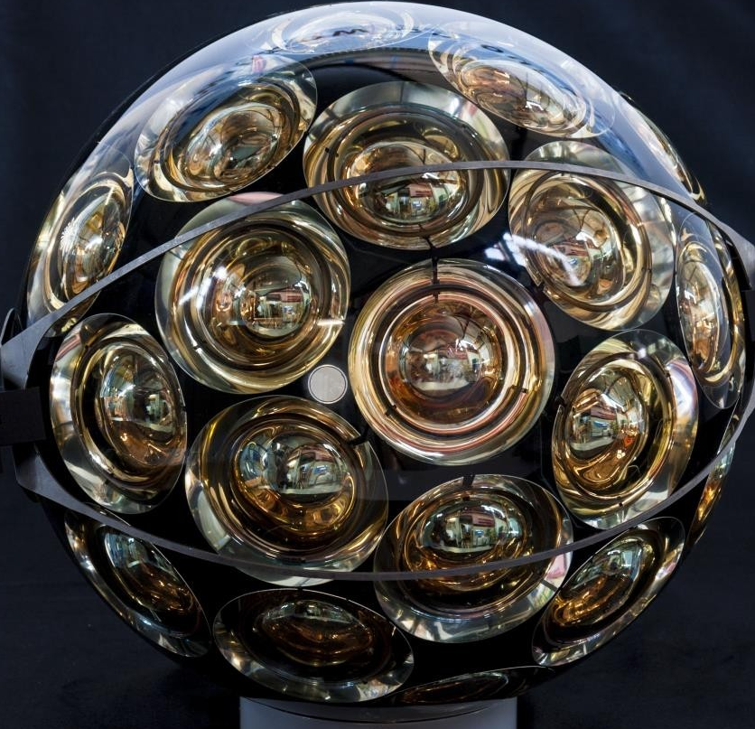
The KM3NeT Eyes
KM3NeT is building a series of neutrino telescopes in the Mediterranean Sea
The KM3NeT DOMs are the eyes of the experiment observing the light around it

Slide 3
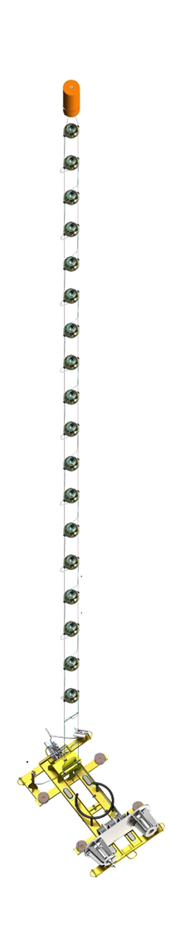
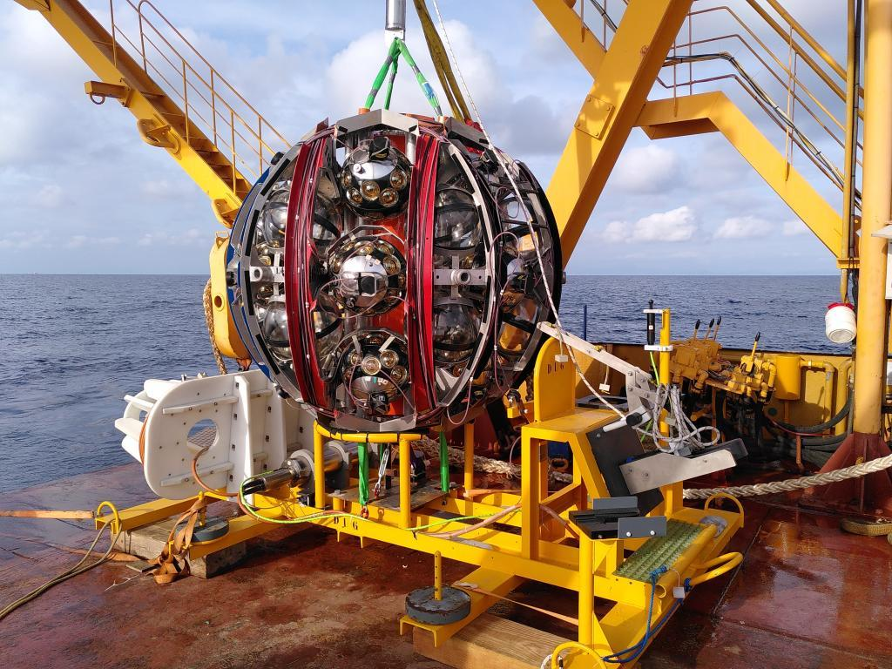
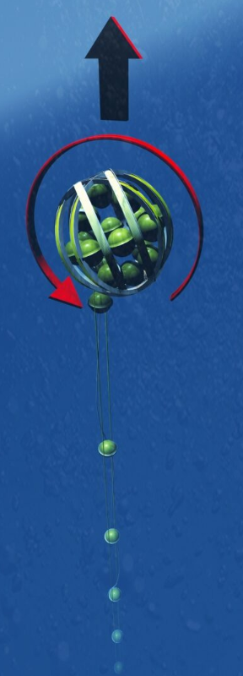
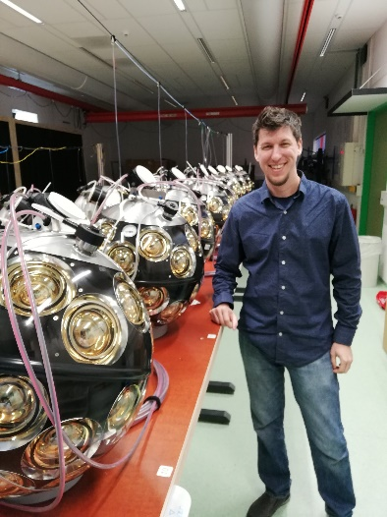
The KM3NeT DU
18 KM3NeT DOMs are joined together in a chain to form a Detection Unit (DU)
DUs are rolled up into a Launcher of Optical Modules (LOM) for deployment at sea
Once at the bottom, LOM is released and unrolls the DUs into its final vertical position

Slide 4
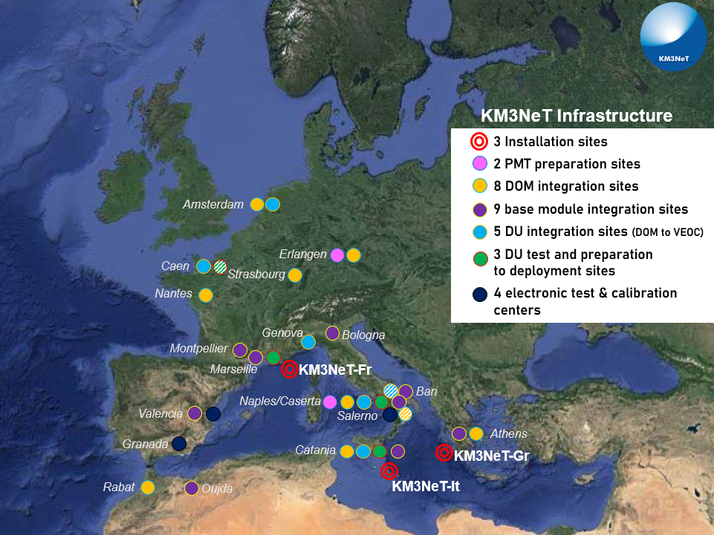
Construction Ongoing
Multiple integration sites across the world
More than 1600 DOMs already integrated

Slide 5
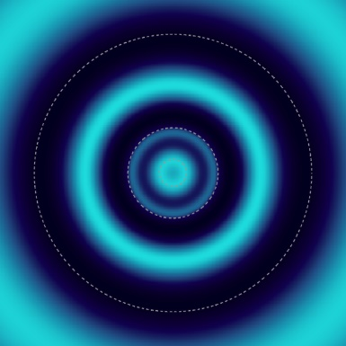
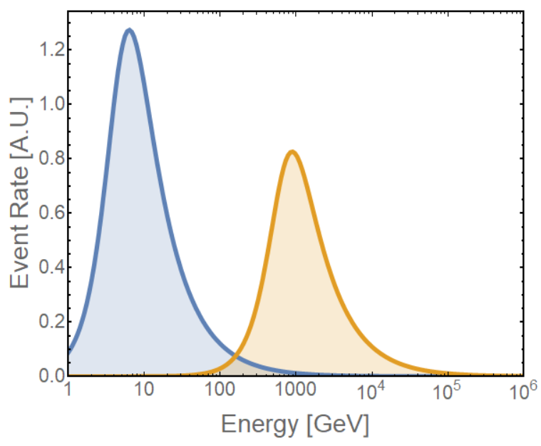
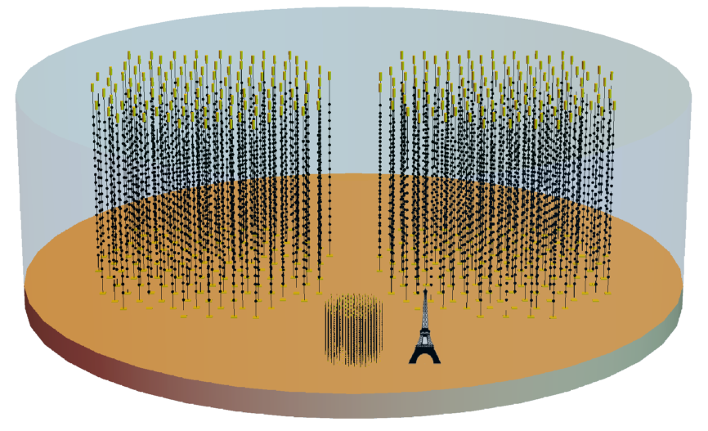
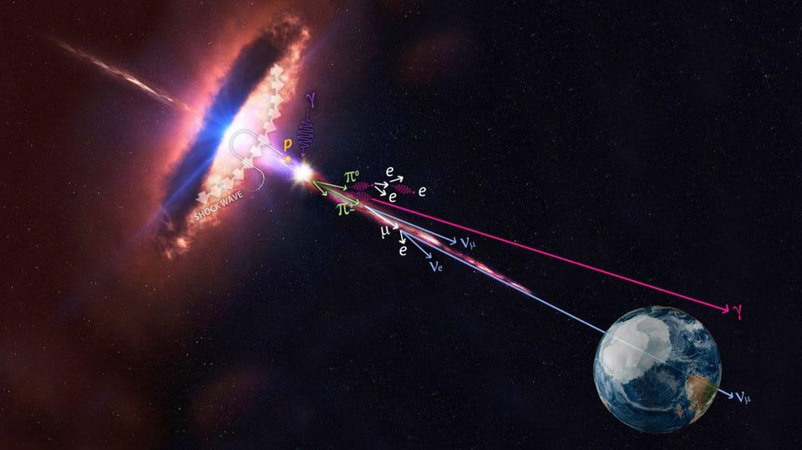
Two Detector Scales
36m vert. x 90m horiz. spacing
TeV - PeV
ARCA BB1
ARCA BB2
ORCA
ARCA
ORCA
9m vert. x 20m horiz. spacing
GeV - TeV

Slide 6
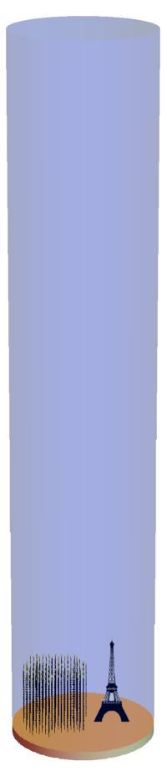

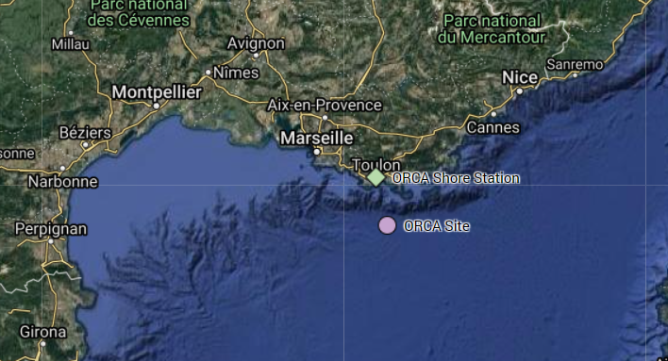
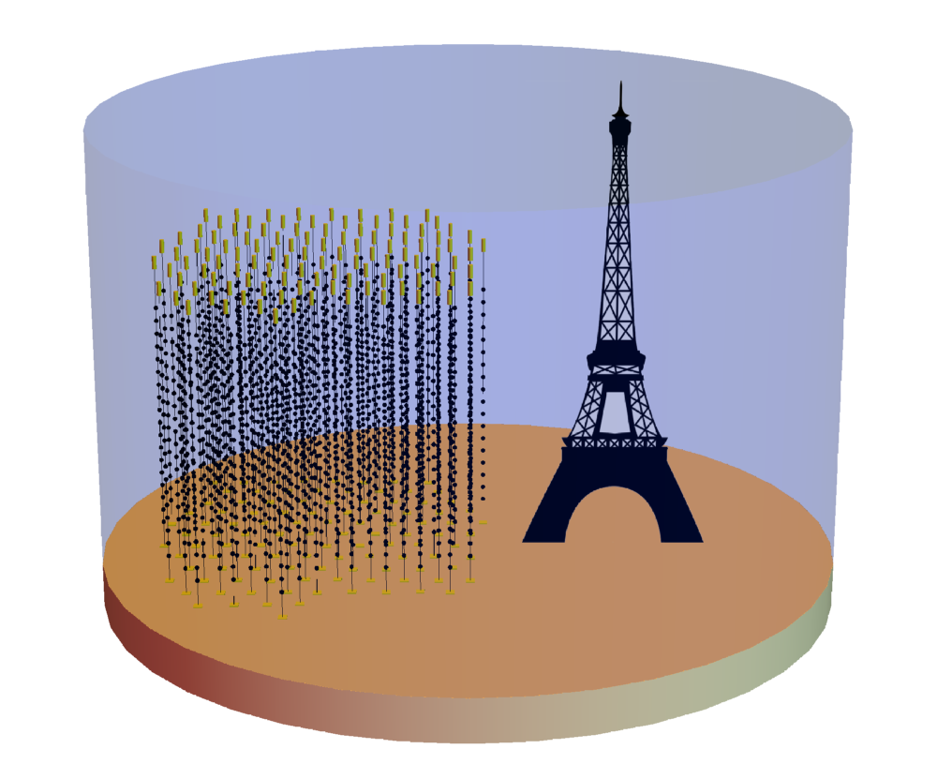
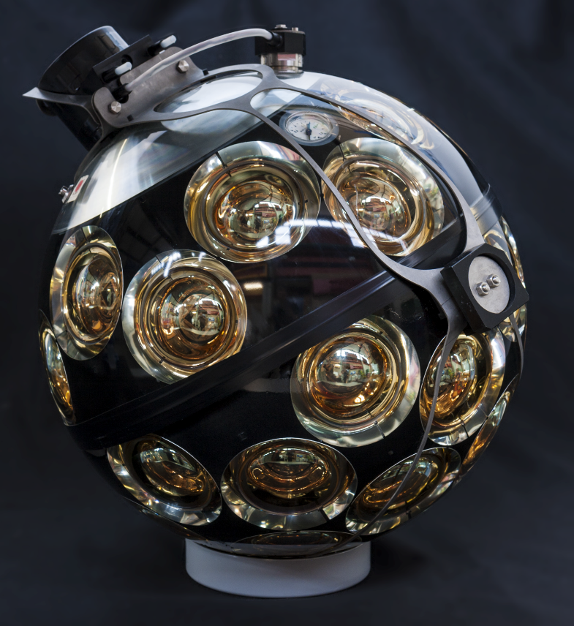
24 DUs Deployed
KM3NeT/ORCA
2450 m
115 Detection Units
18 DOMs / DU
31x 3’’ PMTs
200 m
7 Mton detector
43 cm

Slide 7
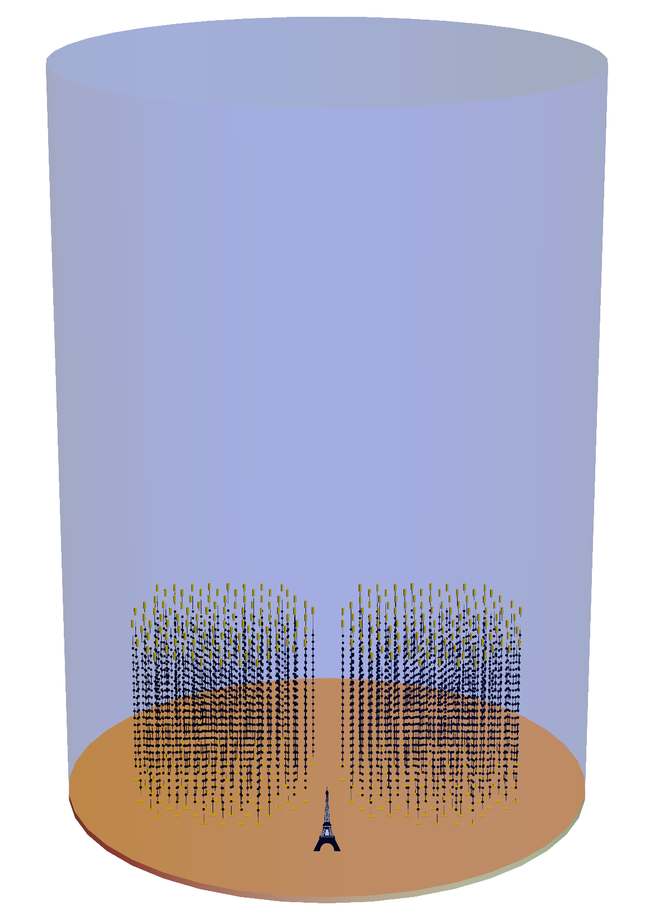
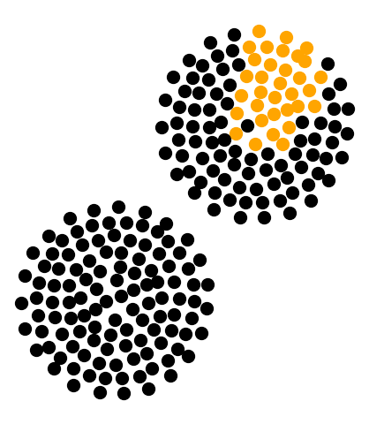
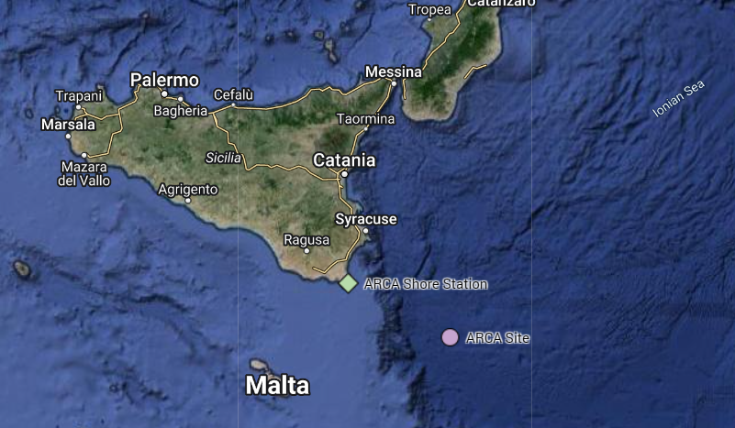
KM3NeT/ARCA
33 DUs Deployed
3500 m
230 Detection Units
18 DOMs / DU
31x 3’’ PMTs
1 Gton detector
800 m
43 cm

Slide 8
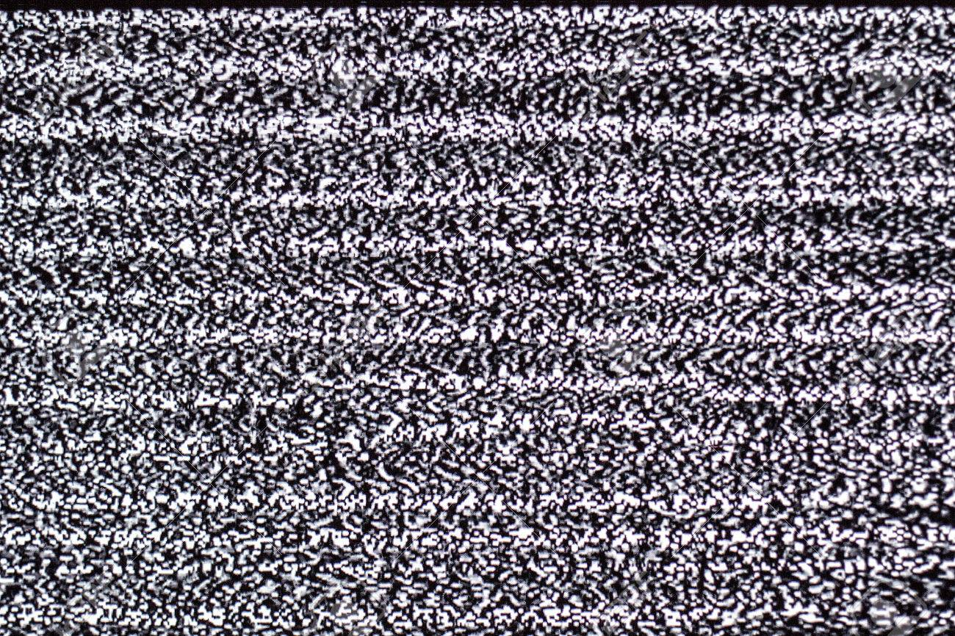
Layer 1: Optical Background
We turn on our detector and what do we see?
White noise…

Slide 9
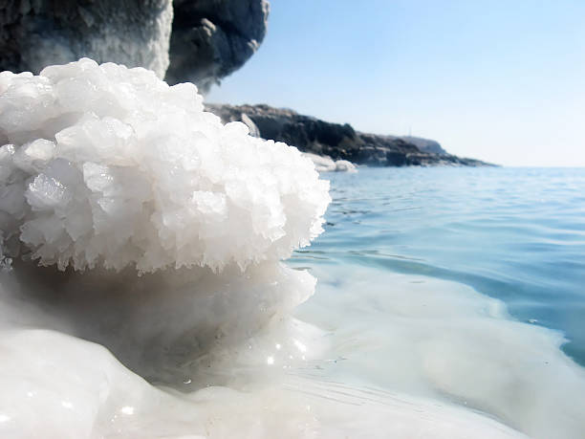
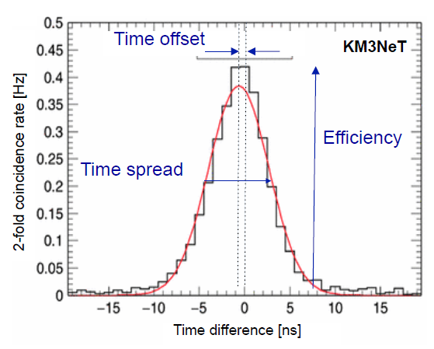
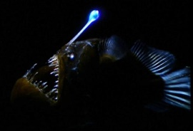
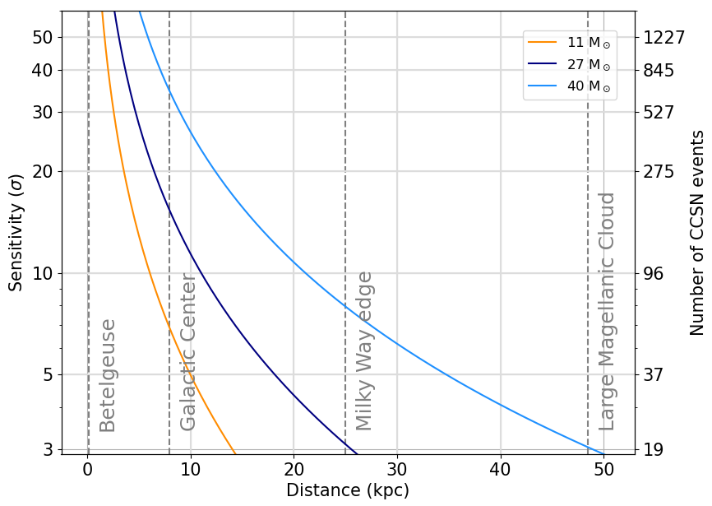
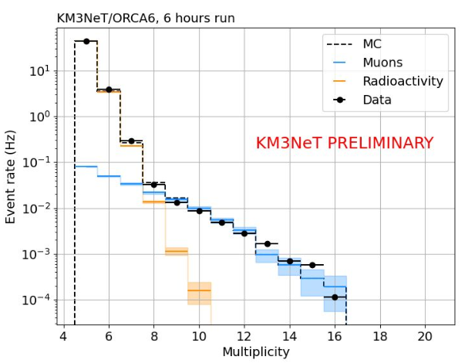
Layer 1: Optical Background
7 kHz random background, mostly from ⁴⁰K decays
Constant natural source to calibrate the charge and timing of PMTs
Can use single DOM variables to search for supernova neutrino bursts
⁴⁰K
⁴⁰Ca
β
KM3NeT Preliminary
KM3NeT Preliminary
ORCA24 & ARCA29
Supernova excess may be seen here

Slide 10
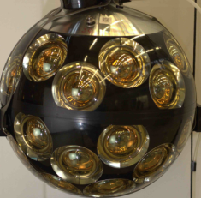
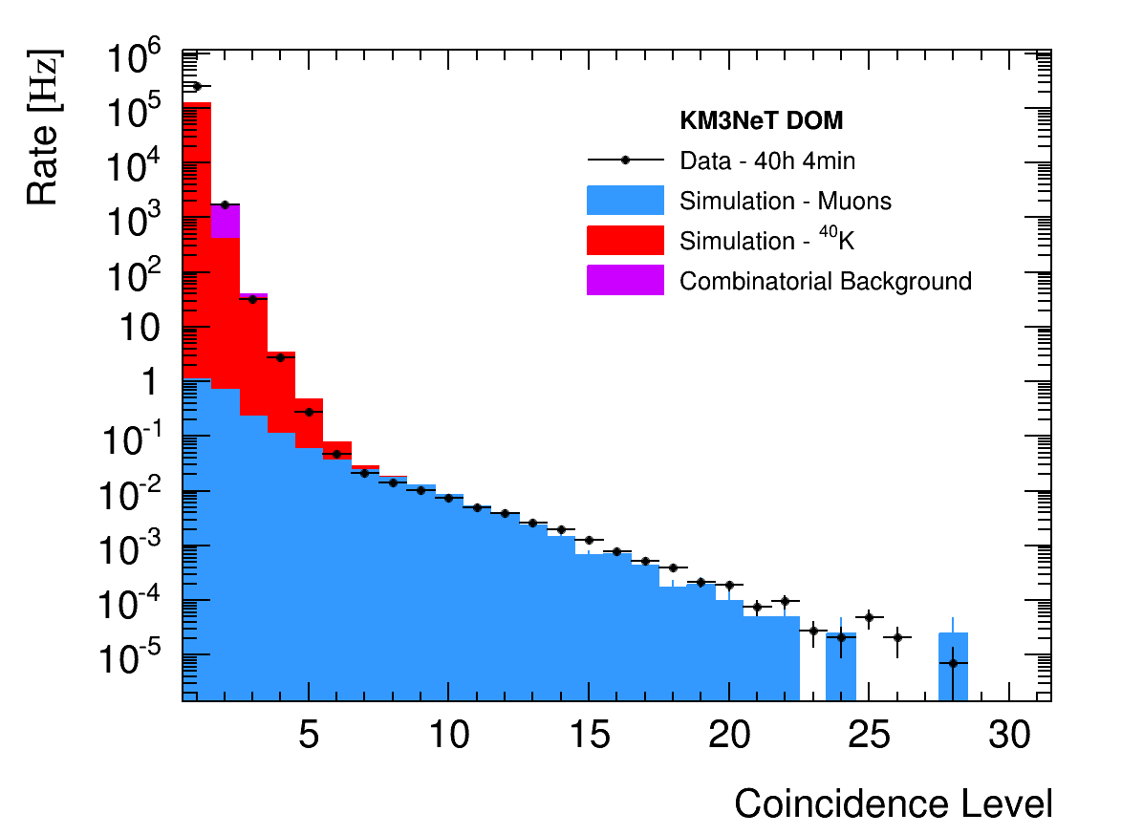
Trigger
Optical background mostly from ⁴⁰K decays in the water
Measured: 8 kHz uncorr., 340 Hz level-two coinc. / PMT [Eur. Phys. J. C 74, 3056 (2014)]
Look for coincidences in time and PMT direction to reduce trigger rate.
Causality further restricts space and time correlations for extra power.
Final trigger rate ~60 Hz, with 70% of events containing a cosmic ray muon.
β
⁴⁰K
⁴⁰Ca
⁴⁰Ca
β
⁴⁰K
⁴⁰K
⁴⁰K
β
⁴⁰Ca

Slide 11
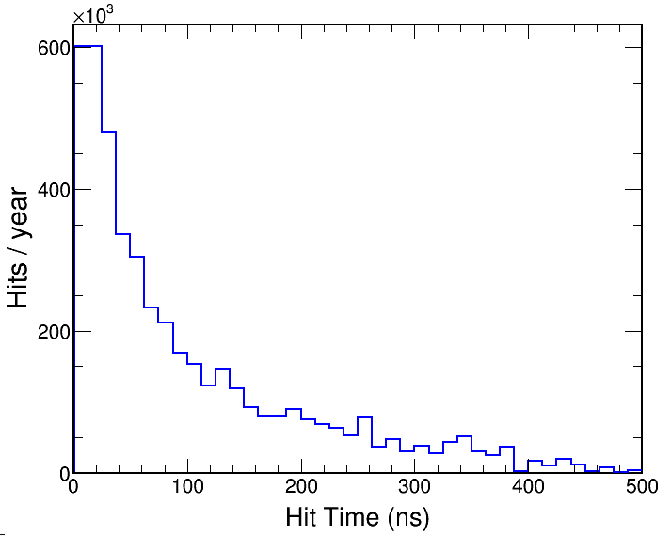
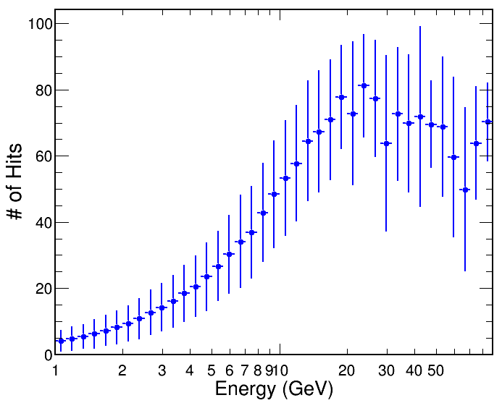
Optical Noise
Optical background in full detector ~450 MHz
Neutrino events ~40 hits in a ~500 ns window
Expect 230 noise hits (~15% purity)
Trigger approach ~5 ns time residuals
Calibrated using 2-fold coincidences
Can achieve ~2 noise hits / trigger (~95% purity)
ν_{μ}-CC
ν_{μ}-CC

Slide 12
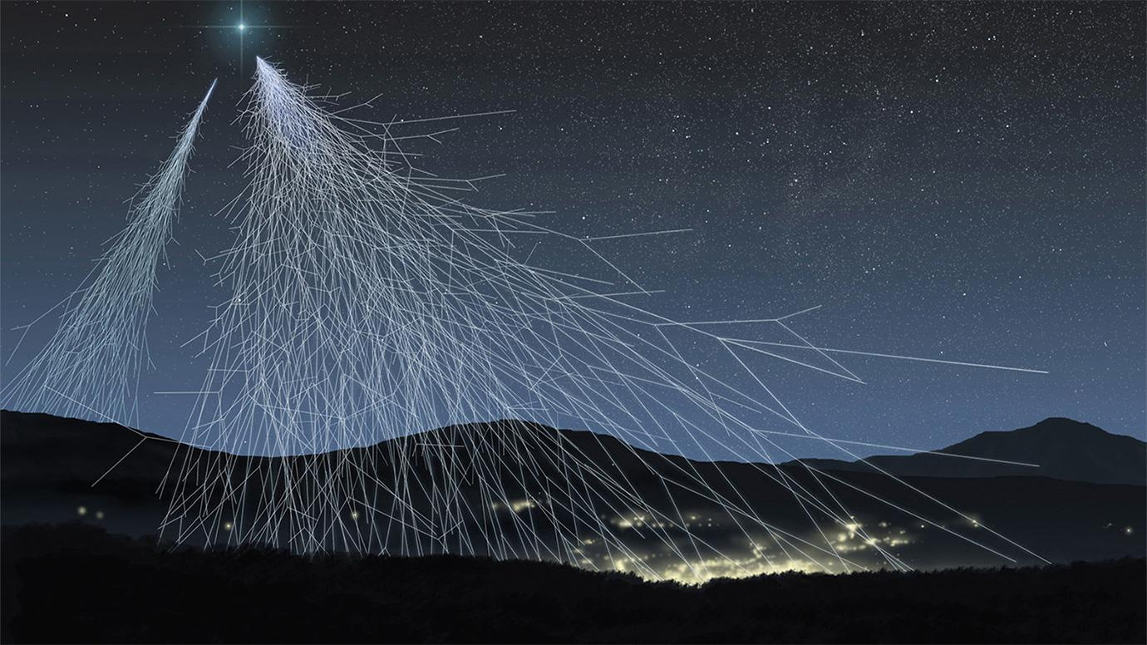
Layer 2: Cosmic Rays
Once optical noise is filtered, we see particles…

Slide 13
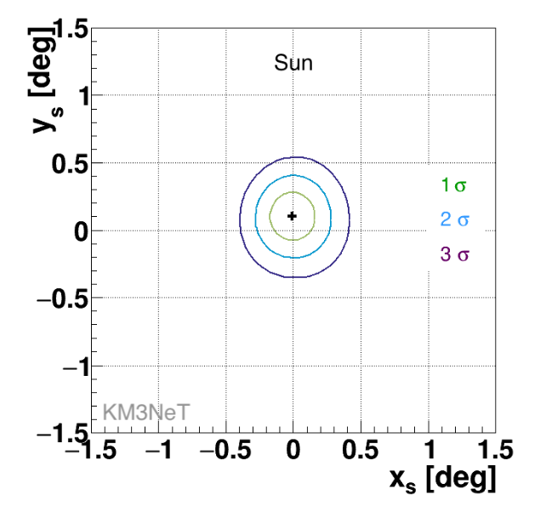
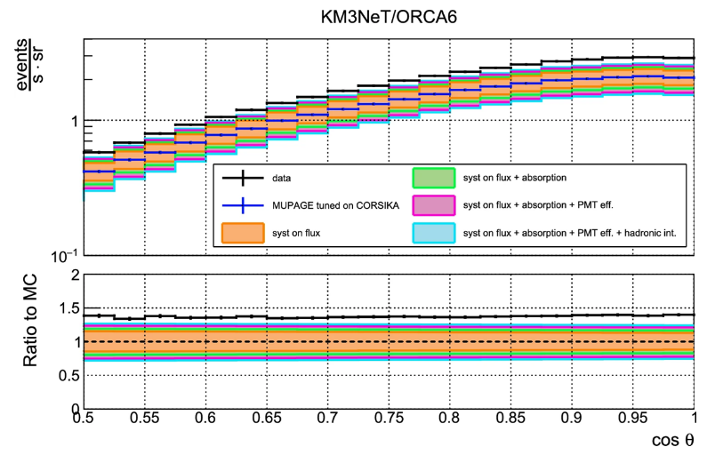
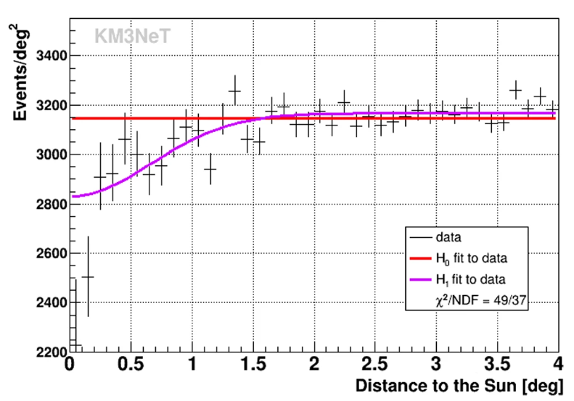
Layer 2: Cosmic Rays
Mostly muons coming from above
Signal from Cherenkov light with distinct space-time correlation between DOMs
Reconstruction based on simultaneous fit of light for each PMT in the detector according to PDFs from physics hypotheses
Excellent source of particles for calibration:
  Timing calibration between DOMs and DUs
  Orientation calibration with Sun and Moon shadows
  Measurement of water properties from stopping muons
Also exploring cosmic ray physics:
  Muon deficit puzzle
  Mass composition of cosmic rays
  Hadron composition of air showers
  Constraining models of neutrino production in the atmosphere
Eur. Phys. J. C 83, 344 (2023)
Eur. Phys. J. C 84 (2024) no.7, 696

Slide 14
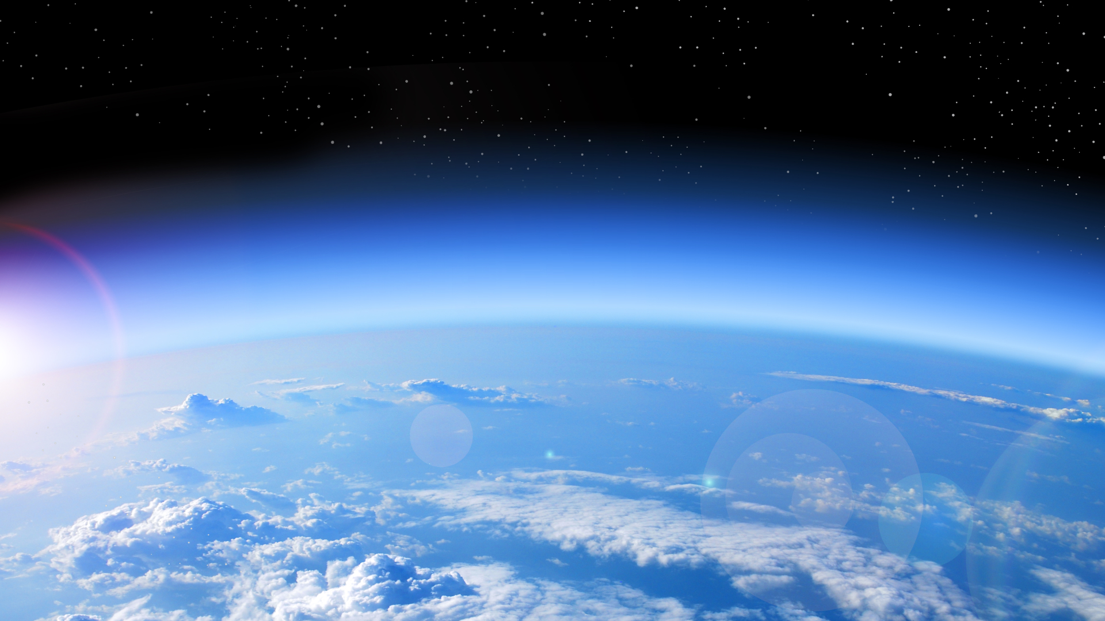
Layer 3: Atmospheric Neutrinos
Cosmic
Ray
π⁺
π⁻
μ⁻
μ⁺
e⁺
ν_{e}
e⁻
ν_{μ}
ν̅_{e}
ν̅_{μ}
ν̅_{μ}
ν_{μ}

Slide 15

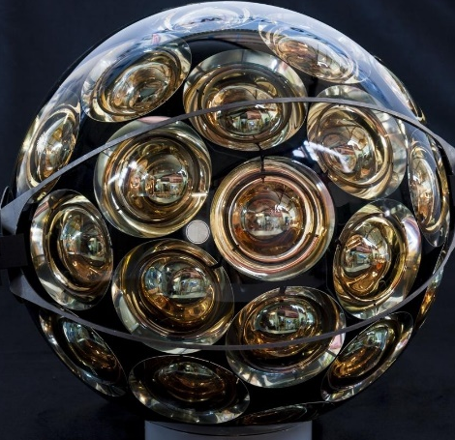
Neutrino Oscillations
If you look carefully…

Slide 16
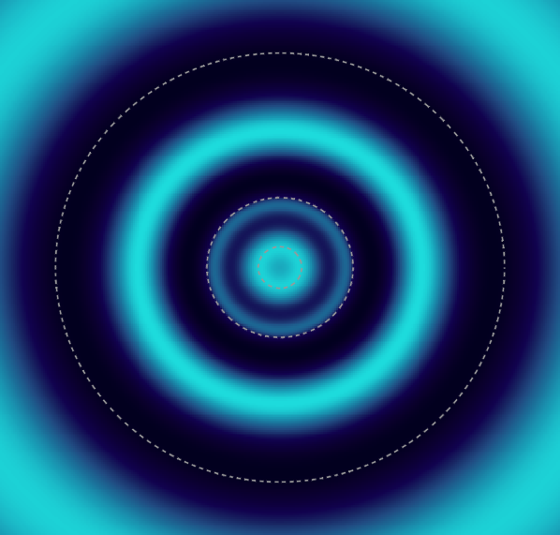
Neutrino Oscillations
If you look carefully, there will be rings of neutrinos…
Muon neutrinos at 4 GeV

Slide 17
Neutrino Oscillations
If you look carefully, there will be rings of neutrinos…
Muon neutrinos at 4 GeV

Slide 18
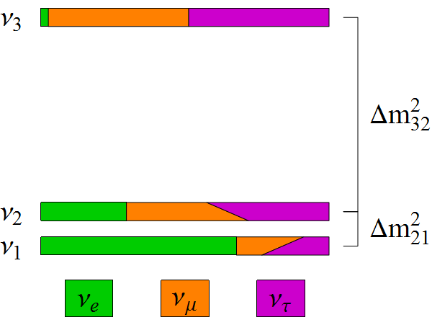
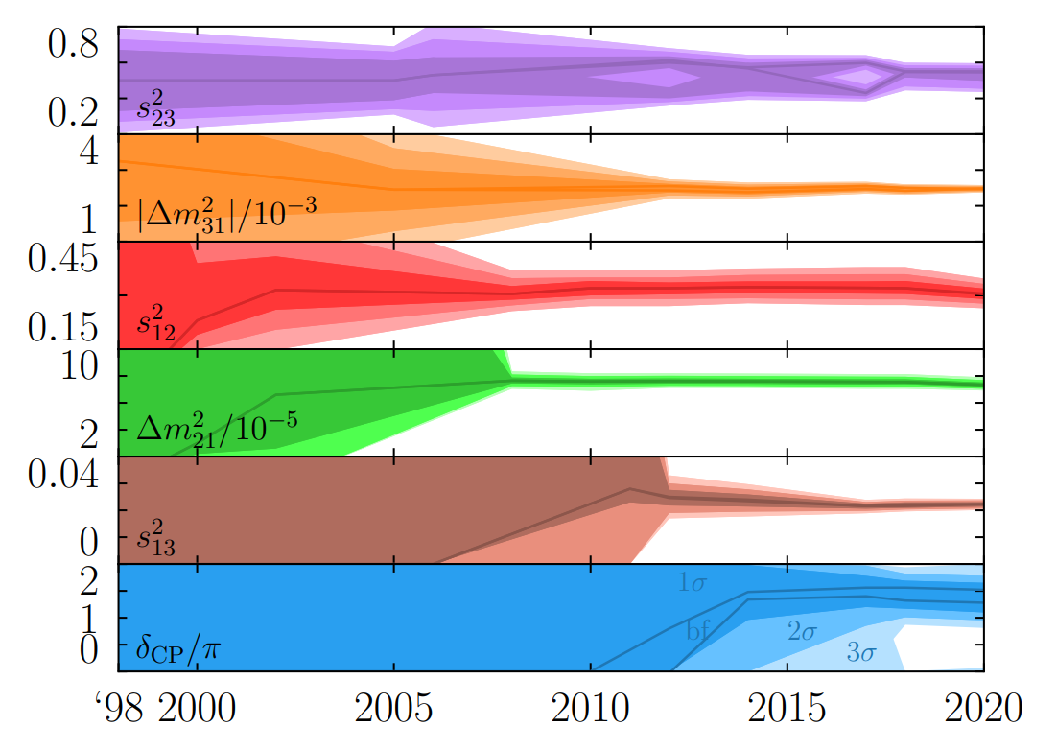
Neutrino Oscillations
A comprehensive program for measuring oscillation parameters has been in place for several decades
Two independent differences in mass-squared (Δm²₂₁, Δm²₃₂)
3 mixing angles (θ₁₂, θ₁₃, θ₂₃) and 1 CPV phase δ_{CP}
sin²θ₁₃
~ sin²θ₂₃
~ sin²θ₁₂
cosδ_{CP}
arXiv:2212.00809

Slide 19
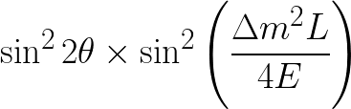
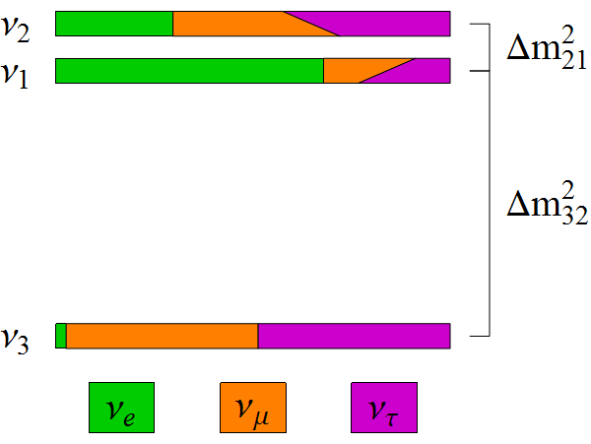
Missing Pieces
symmetries
Is θ₂₃ = π/4? Underlying symmetry?
Do neutrinos violate CP? (δ_{CP})
What is the mass ordering? (Mass Hierarchy)
Normal Ordering
Inverted Ordering
same?
Δm²₃₂ < 0 ?
(Δm²₃₁ < Δm²₃₂ ??)
JUNO
δ_{CP} ?

Slide 20
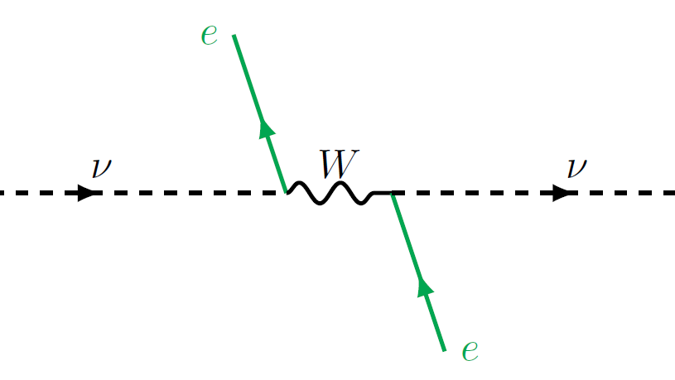
One weird trick to measure the
Mass Ordering…

Slide 21
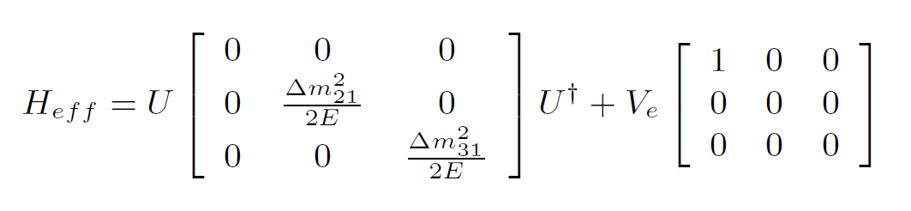
Matter Effects
H₀
V

Slide 22
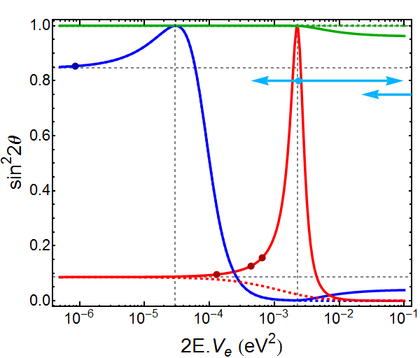
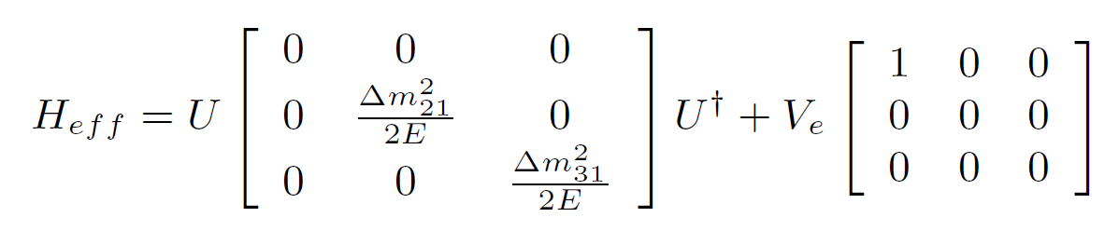
Resonances
θ₂₃
Δm²₂₁ cos2θ₁₂
Δm²₃₁ cos2θ₁₃
θ₁₂
θ₁₃

Slide 23
Resonances
θ₂₃
NH
θ₁₂
θ₁₃
IH

Slide 24
Resonances
θ₂₃
ORCA
JUNO
ARCA
θ₁₂
DUNE
θ₁₃
NOvA
T2K

Slide 25
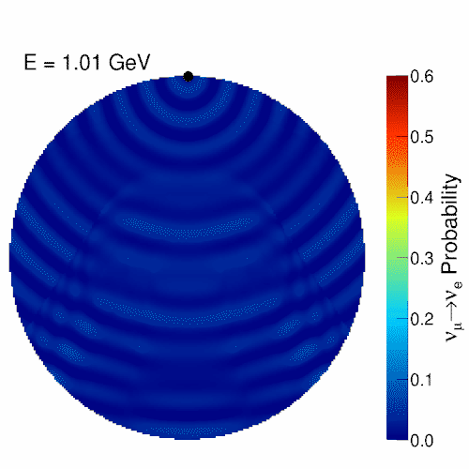
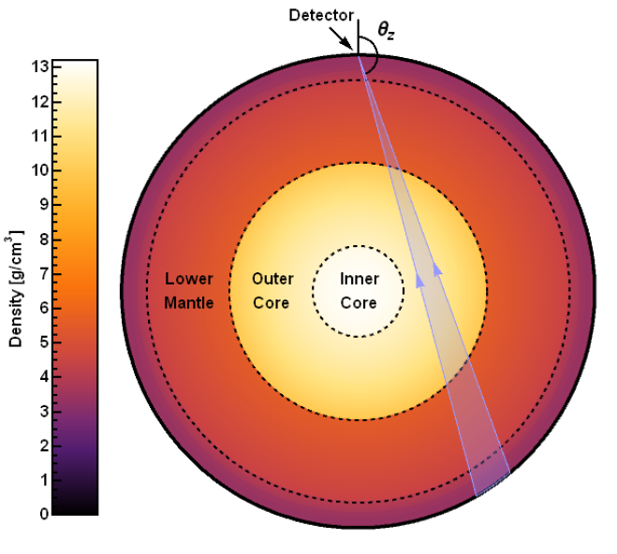
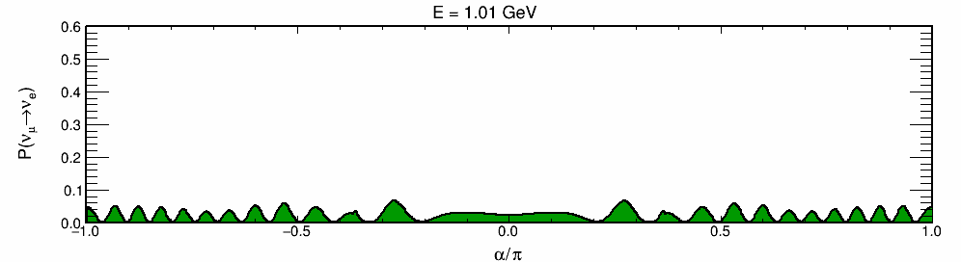
Atmospheric Neutrinos
Oscillations are resonant at certain energies
E_{res} ~ 7 GeV in Mantle
E_{res} ~ 3 GeV in Core
Nue appearance at the surface

Slide 26
Sensitive to Mass Ordering
at resonance energies

Slide 27
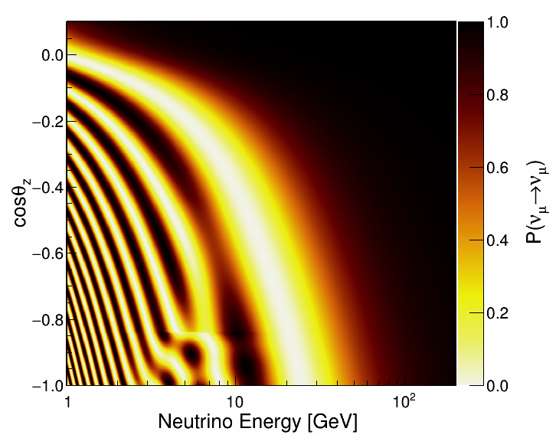
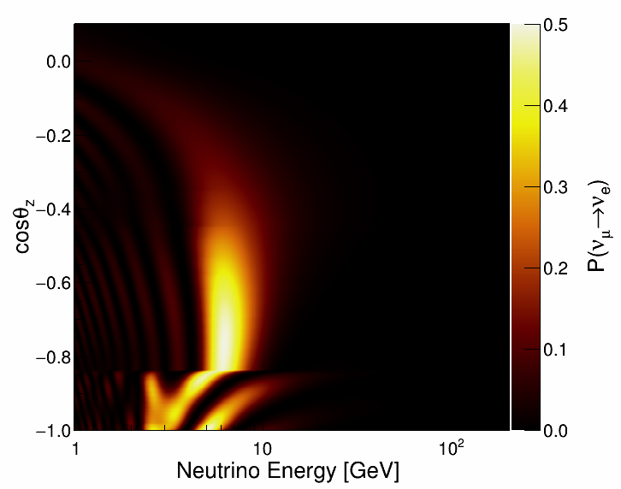
Oscillation Pattern
In general, measure the pattern of oscillation as a function of energy and direction
Also crucial to separate different neutrino flavours
Matter Effects

Slide 28

Layer 3: Atmospheric Neutrinos
The Earth is a great cosmic ray shield, but neutrinos don’t care
Distinct patterns of light can be used to identify neutrino flavours and background

Slide 29
Reconstruction
Start with a track or shower hypothesis
Use causality to perform a robust hit selection
Find vertex and direction that best match hit pattern
Estimate track range for computing track energy (0.24 GeV / m)
Estimate Shower energy and direction from hit distribution after initial fit to the vertex position and time
Track Hypothesis
Shower Hypothesis
θ_{C}

Slide 30




ORCA Reco Performance
Energy resolution: ~25% (Close to limit JHEP 05 (2017) 008)
Angular resolution: Better than 15 degrees at relevant energies
θ Res.
ν_{μ}-CC
ν_{e}-CC
ν_{μ}-CC
ν_{e}-CC
E Res.
E Res.

Slide 31

Data Already Here
Already collected more than 2.5 Mt-y of data
Today I will focus on latest analysis covering 715 kt-y (27% of available data)
Expect to update these results very soon with at least 1.5 Mt-y

Slide 32


Event Selection
We employ BDTs to summarize reconstructed quantities into background scores
3 selection regions are defined: High purity tracks, low purity tracks, and showers
Excellent agreement between data and simulation for neutrinos and atm. muons
High Purity
Low Purity
Showers
Tracks

Slide 33

Class Definitions
Tile the 2D space of track and atm. Muon BDT scores
Prioritized a very pure track-like sample

Slide 34



Event Selection
9751 neutrino candidates in our selection with similar numbers in each class
97% pure ν_{μ}-CC sample in high purity track-like class
91% accuracy in classifying ν_{e}-CC events as showers
~1300 ν_{e}-CC events expected in shower-like sample
High Purity
Tracks
Low Purity
Tracks
Showers

Slide 35


Oscillation Patterns
Analyze data in 2D space of energy and direction
Oscillation best fit describes data very well (-2logL p-value: 41%)

Slide 36

Goodness-of-Fit
Data total likelihood value consistent with toy simulations

Slide 37



Improved Measurement
New measurement uses 715 kt-y of data (65% increase over 2023 dataset)
Clear oscillation pattern in L/E
Slight preference for Inverted Ordering (IO)

Slide 38

Improved Measurement
Already providing relevant information with exposure equivalent to only 37 days of full ORCA detector
Fully consistent with world data

Slide 39


Systematic Uncertainties
Systematic Uncertainties
sin²θ₂₃ dominated by statistics
sin²θ₂₃ dominated by statistics
Δm²₃₁ impacted mostly by uncertainty on energy scale
Dominated by uncertainties on water properties
Δm²₃₁ impacted mostly by uncertainty on energy scale
Dominated by uncertainties on water properties

Slide 40


NMO Significance
Conversion from -2logL to p-value depends on choice of nuisance parameters
At NuFIT 5.0 best fit, NO hypothesis disfavoured at 1.7σ / 1.5σ in (UO/LO)
IO preference slightly stronger than expected (18%/21% p-value in UO/LO)
Working towards a more general statement as a function of sin²θ₂₃
Lower Octant
Upper Octant

Slide 41

And More Data is Coming
Current projections including detector construction schedule show 5σ NMO determination in reach within this decade when combined with JUNO
Data on tape

Slide 42



Measuring Tau Neutrinos
ORCA will have a significant sample of tau neutrinos
Already competitive with world measurements
arXiv:2502.01443

Slide 43



Unitarity Constraints
Neutrino2024
10.5281/zenodo.13841922
From tau neutrinos we may also learn more about unitarity of PMNS matrix
Some first constraints compatible with unitarity
Slight preference for non-unitarity in some combinations of parameters
Non-Unitary Mixing
arXiv:2502.01443

Slide 44



New Physics Models
JCAP 03 (2025), 039
Many other alternative models can be explored with the same datasets
Some examples published recently
Non-Standard Interactions
Decoherence
Neutrino Decay
JCAP 02 (2025), 073
JHEP 04 (2025), 105

Slide 45
Astrophysical Neutrinos

Slide 46

The Unknown
F. Halzen – MMTE 2022

Slide 47


Diffuse Analysis
Search for cosmic neutrinos via high-energy excess over the atmospheric background
Atmospheric neutrinos expected to taper off above 100 TeV scale
Sensitivities updated with 221 more days of ARCA21 data (4x larger than 2023 result)
Data and MC scaled up from 67 day sample

Slide 48
Uncharted Territory
At the highest energies, there’s darkness…

Slide 49
Uncharted Territory
At the highest energies, there’s darkness… most of the time

Slide 50

Uncharted Territory

Slide 51



Uncharted Territory
Significant event observed with huge amount of light
3672 PMTs (35%) were triggered in the detector
Based on simulations, muon energy estimated at ${120}_{−60}^{+110}$ PeV
Horizontal event (0.6° above horizon) as expected since earth opaque to neutrinos at PeV scale
1 in 110 million data events

Slide 52


Uncharted Territory
Significant event observed with huge amount of light
3672 PMTs (35%) were triggered in the detector
Based on simulations, muon energy estimated at ${120}_{−60}^{+110}$ PeV
Horizontal event (0.6° above horizon) as expected since earth opaque to neutrinos at PeV scale
Atmospheric neutrinos at least 2 orders of magnitude less likely

Slide 53

Uncharted Territory
The atmospheric muon flux drops too quickly to explain these energies
An EeV muon would be slowed down below 10 PeV within 30 km-we
At the best fit, muon would have to traverse 300 km-we of material (140 km)
Only at 5° from the best fit (5σ), would the distance reach 30 km
It is virtually impossible for a muon to survive this path to the detector and still deposit that amount of energy in the detector

Slide 54








Uncharted Territory
Event is very well reconstructed
Time residuals consistent with Cherenkov light at few ns precision
Obs: Lines numbered based on seabed layout

Slide 55


Uncharted Territory
Light profile consistent with at least 3 large energy depositions along the muon track
Characteristic of stochastic losses from very high energy muons
t_{hit}
t₀
x
Position of light emission along track
consistent with hit time assuming direct light

Slide 56


Uncharted Territory
Light profile consistent with at least 3 large energy depositions along the muon track
Characteristic of stochastic losses from very high energy muons
Space-time distribution of light consistent with shower hypothesis associated with these energy depositions
Low scattering is key to observing this richness of detail

Slide 57


Uncharted Territory
Energy of the muon estimated from simulations at fixed energies
Error dominated by intrinsic fluctuations in light yield
Dominant systematic is the uncertainty on the water absorption length
Assuming a E⁻² flux, neutrino energy is estimated at ${220}_{−110}^{+570}$ PeV

Slide 58

Uncharted Territory
Muon direction points back to RA = 94.3°, dec. = −7.8°
The uncertainty in the absolute orientation translates to a 1.5° uncertainty on the sky position
Several sources can be found within 3° of the observed direction, but no significant association is found given the large number of possible candidates

Slide 59

Uncharted Territory
The observation of KM3-230213A is certainly surprising given previous searches with no signal from IceCube and Auger
Quantifying this surprise depends strongly on the flux model
Under a single power-law (SPL) assumption, the KM3NeT event represents a ~2.5σ fluctuation from the global landscape

Slide 60

Uncharted Territory
Even as a single event, KM3-230213A has a strong impact on the global fits for SPL spectrum models due to long lever arm
The event may also hint at a new component, but a BPL model is not significantly favoured over a SPL
arXiv:2502.08173

Slide 61

Transient?
IC and Auger have exposures 45 and 30x larger than KM3NeT
However, much of that is time with 9 and 18 years of IC and Auger
For transients, IC and Auger are only 4.6 and 1.6x larger than KM3NeT
Transient
<0.4 / year in the entire universe
Easier to accomplish with beamed neutrino emission
KM3NeT
Time
IceCube
Auger
Size
A. Neronov, arXiv:2502.12986
KM3NeT Town Hall 2025

Slide 62
Conclusion
KM3NeT has been taking high quality data during construction phase
The KM3NeT detectors explore the physics of multiple layers of light seen by the multi-PMT DOM design
New improved oscillation results and much more data to come
Strong matter effects open a window to exciting new physics models
Searches for astrophysical sources are under way
An unprecedented event was observed in rich detail
Likely an astrophysical neutrino of ~200 PeV
Exciting new window into the most extreme environments in the universe
Stay tuned for more results to come!

Slide 63

Uncharted Territory
Local direction reconstruction very well established
No other solutions are consistent with the data
Best reconstructed event in all of KM3NeT data!
KM3NeT Preliminary

Slide 64

Event Breakdown

Slide 65



True Energy
Long tail of high energy events in track-like samples
Peak of distribution at a few tens of GeV

Slide 66


Layer 1: Optical Background
Supernova neutrinos can be explored at the DOM level
Characteristic multiplicity shape can be explored
Other DOM level characteristics also explored
If a supernova happens in the Galaxy, we’re ready!
ORCA24 & ARCA29
KM3NeT Preliminary
KM3NeT Preliminary

Slide 67



Layer 3: Atmospheric Neutrinos
First KM3NeT measurement of atm. Neutrino flux consistent with world data
Upgoing
Downgoing
Muon-like
arXiv:2504.09119
Neutrino-like

Slide 68



The Final Layer
Underneath a large atmospheric neutrino foreground, we search for cosmic neutrinos
Localized sources may provide a higher concentration
Look for excess of events within 5 degrees of known objects of interest

Slide 69



Point Source Analysis
Analysis done in 2D space of energy and distance from the source
KM3NeT sensitivity improving fast and approaching ANTARES soon

