Slide 1
Cosmology from three years of DESI (DR2)
Christophe Yèche
CEA-Saclay
IJCLab Seminar, Orsay, June 16 2025

Slide 2
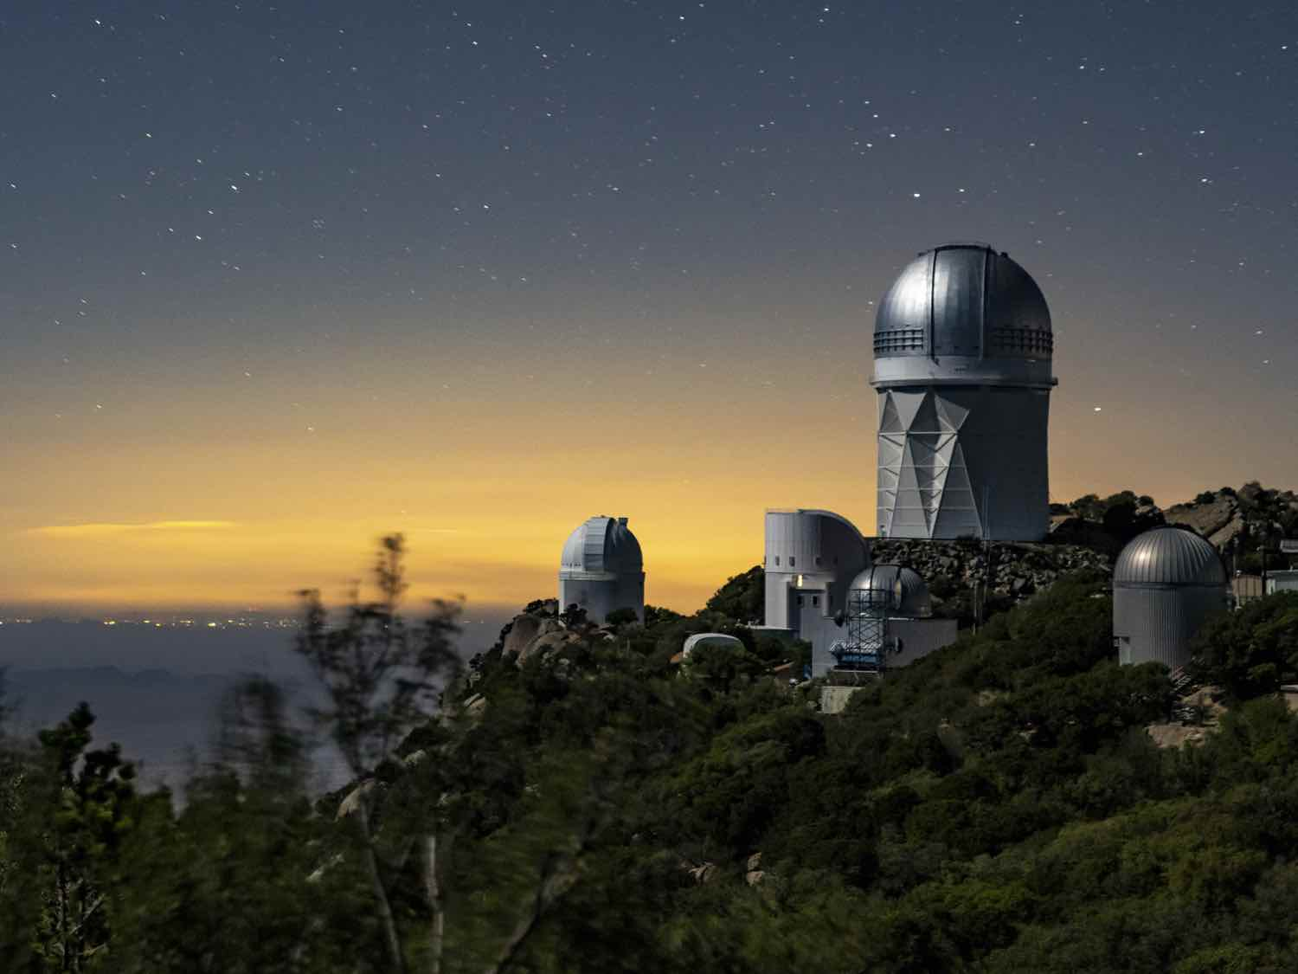
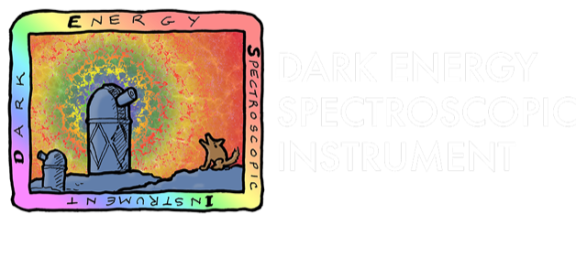









Thanks to our sponsors and
72 Participating Institutions!

Slide 3
Introduction
-
Baryonic Acoustic Oscillations (BAO)

Slide 4
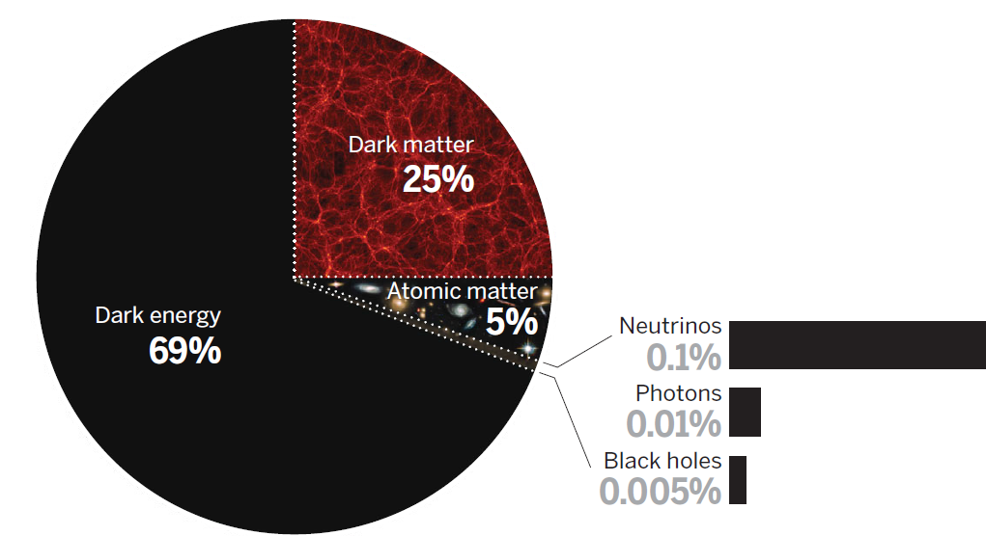

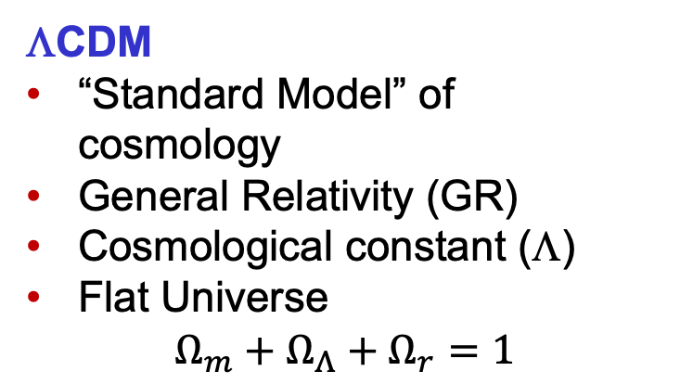
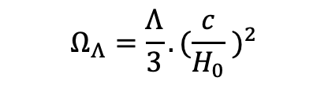
Context in Cosmology: ΛCDM
ΛCDM
“Standard Model” of cosmology
General Relativity (GR)
Cosmological constant (Λ)
Flat Universe
$$Ω_{m}+Ω_{Λ}+Ω_{r}=1$$
$$Ω_{m}= Ω_{cdm}+Ω_{b}$$
$$Ω_{Λ}=\frac{Λ}{3}.{(\frac{c}{H_{0}} )}^{2}$$
Extensions of ΛCDM
Equation of state of Dark Energy
Time evolving Dark Energy
Open questions
H₀ tensions
Time evolving DE (w₀w_{a}CDM)

Slide 5
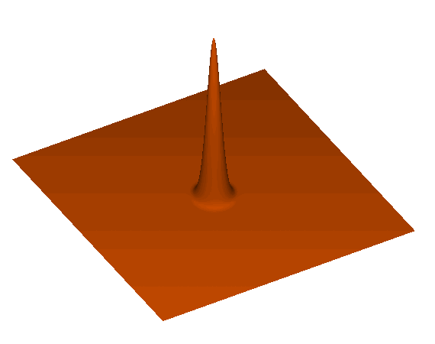
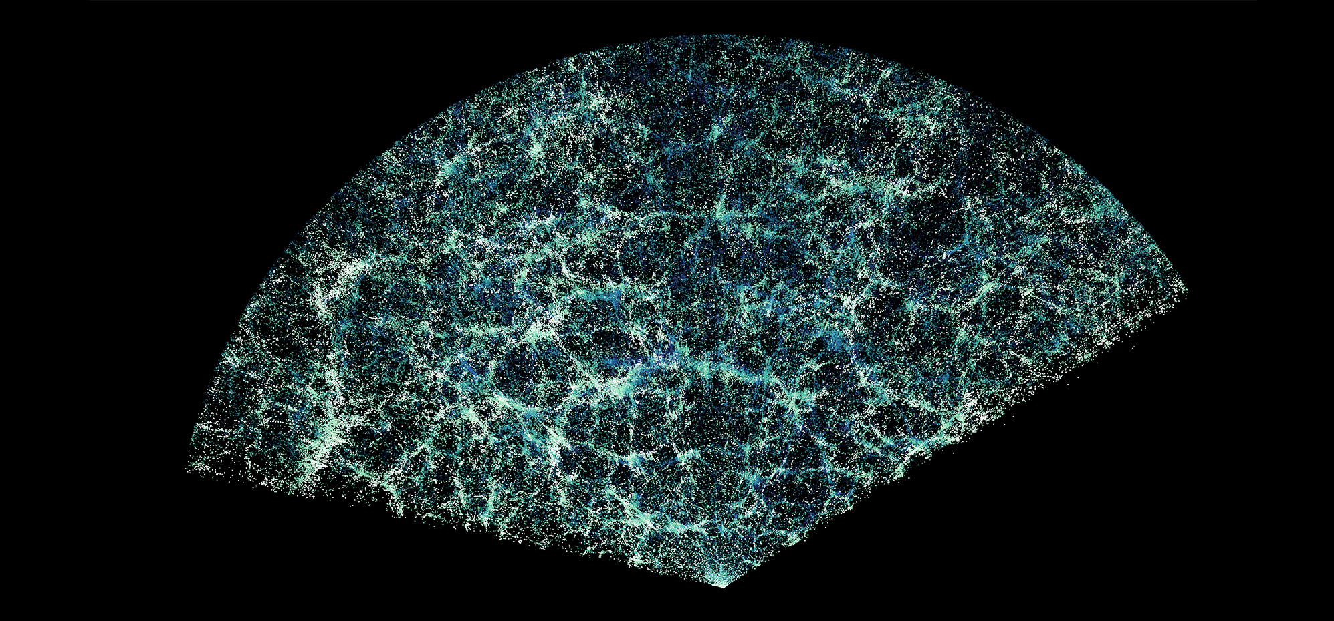

BAO, a standard ruler
150 Mpc
DESI year 1
A special distance
Sound waves propagate through relativistic plasma (baryons, electrons, photons) with a speed $\sim c/\sqrt{3}$
They freeze at recombination (z~1100 i.e 380,000 years)
Galaxies form in the overdense shells about r_{d} ~ 150 Mpc in radius from initial overdensities.
⇒ Standard Ruler: r_{d} ~ 150 Mpc in comoving distance

Slide 6
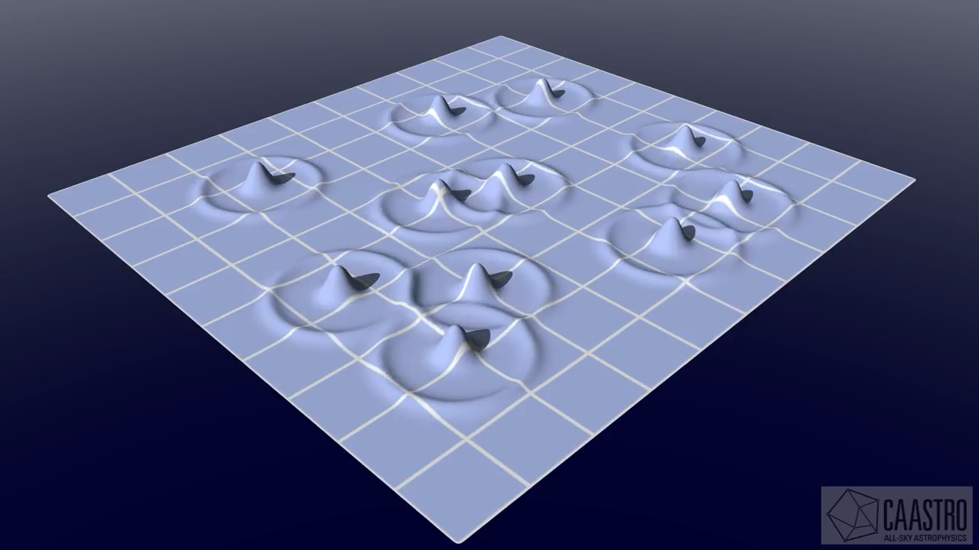
BAO: Correlation function
DESI year 1

Slide 7
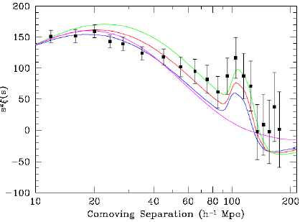
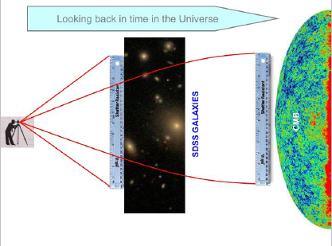
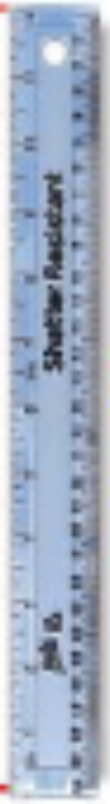
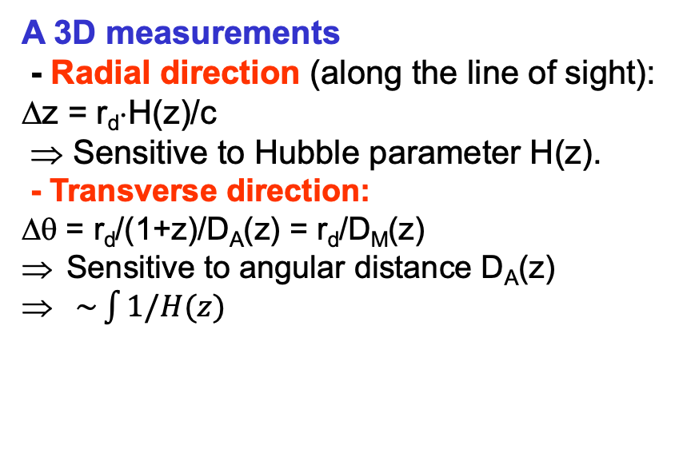
Observation of baryonic acoustic peak
First observation
In 2005: First observations of baryonic oscillations by 2 teams (2dFGRS and SDSS)
SDSS observe a peak at ~150 Mpc
SDSS: ~50 000 LRGs, <z> ~ 0.35
“Luminous Red Galaxies”
SDSS
Standard Ruler
D. Eisenstein et al.,
ApJ, 633, 560 (2005)
150 Mpc
A 3D measurements
- Radial direction (along the line of sight): Δz = r_{d}⋅H(z)/c
⇒ Sensitive to Hubble parameter H(z).
- Transverse direction:
Δθ = r_{d}/(1+z)/D_{A}(z) = r_{d}/D_{M}(z)
Sensitive to angular distance D_{A}(z)
$\sim \int{1/H(z)}$
Δθ

Slide 8
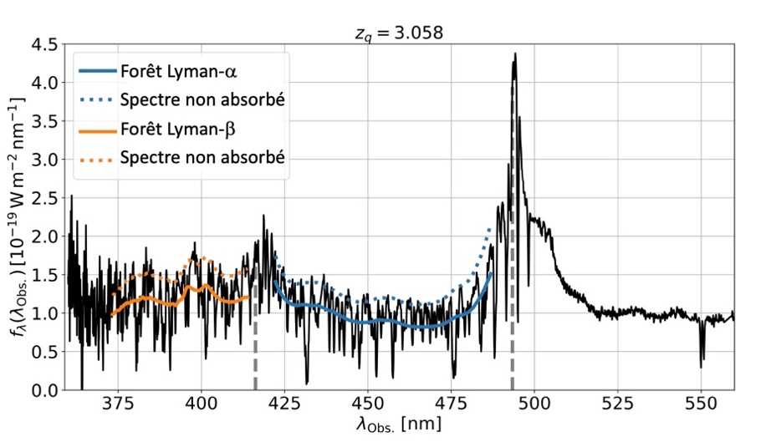
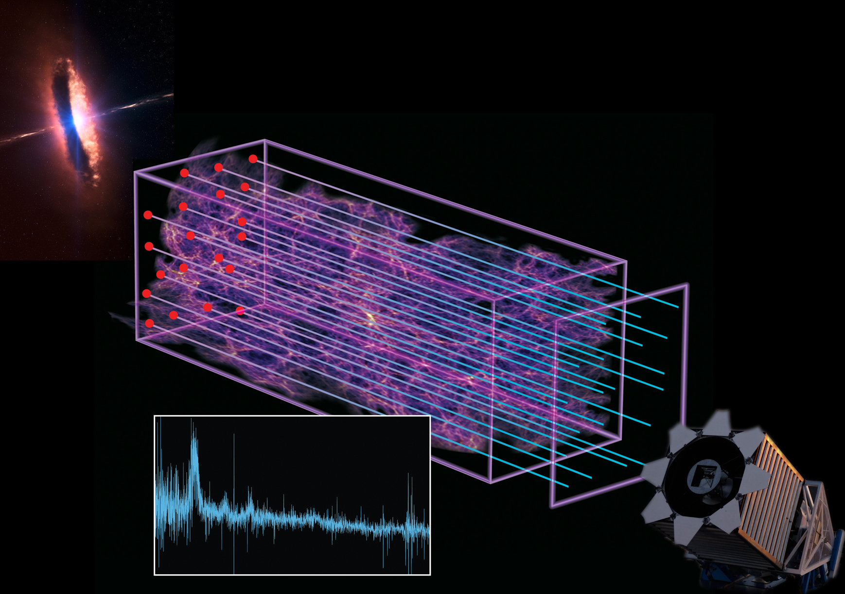
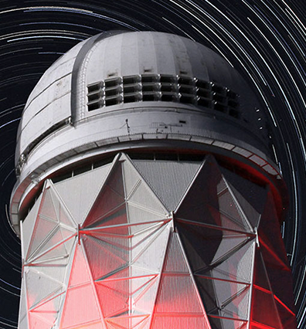
Another Tracer of Matter: Ly-α forest of quasars
  For z>2, no discrete tracer (galaxy) observable with DESI
  Use Ly-α forests of quasars (2.0<z<3.5)
  HI absorption in intergalactic medium (IGM) along the line of sight of quasars
Ly-α forest
Spectra without absorption
  We expect low density gas (IGM) to follow the dark matter density
  Compute correlation function between HI ‘clouds’
  Measure the location of BAO

Slide 9
Dark Energy
Spectroscopic Instrument
-
DESI

Slide 10
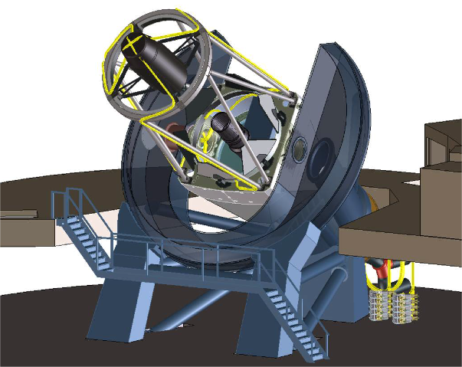
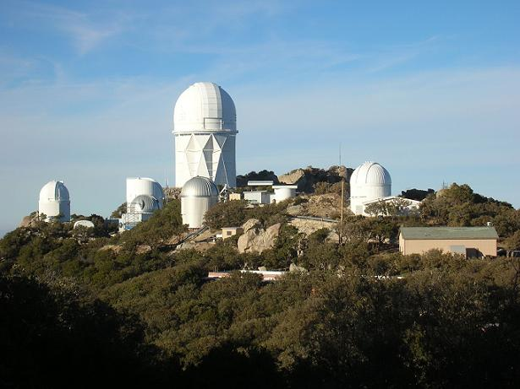
DESI Project
5000 fiber positioner
Corrector
~ 8 deg²
Scientific project
  3D map for 0<z<4
  Footprint ~14000 deg² (1/3 sky)
  International collaboration
  72 institutions (46 non-US)
  ~900 members
Mayall
4-m
Télescope
Mayall
Telescope
10 spectrographs
Instrument
  4-m telescope at Kitt Peak (Arizona)
  Wide FoV (~ 8 deg²)
  Robotic positioner with 5000 fibers
  10 spectrographs x 3 bands (blue, visible, red-NIR) ➝360-1020 nm

Slide 11
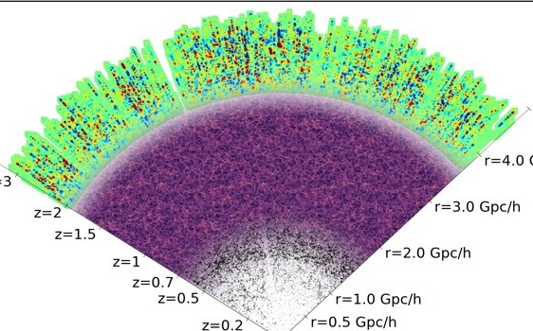
DESI tracers of the Matter
Five target classes
~40 million redshifts
in 5 years
3 million QSOs
  Ly-α z > 2.1
  Tracers 0.9 < z < 2.1
4
12 Gyr
16 million ELGs
0.6 < z < 1.6
2
10 Gyr
Redshift
8 million LRGs
  0.4 < z < 1.0
1
8 Gyr
Lookback time
0.7
13.5 million
Brightest galaxies
  0.0 < z < 0.4
0.2
2 Gyr

Slide 12
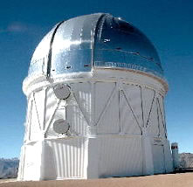
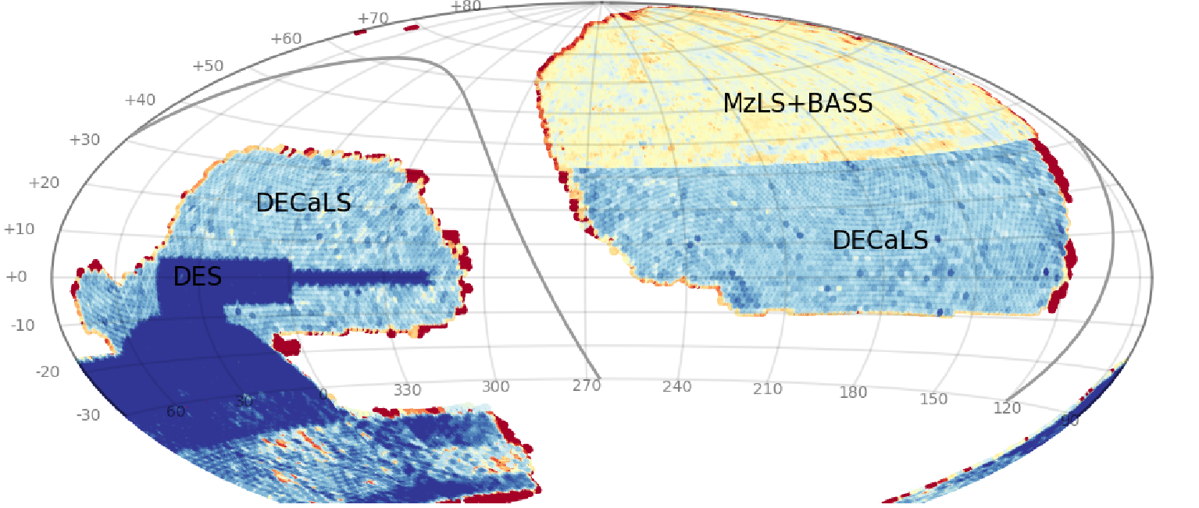
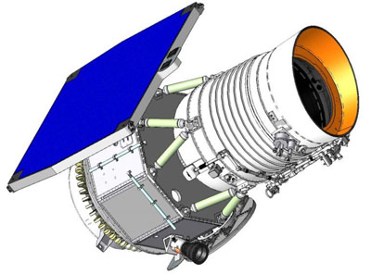
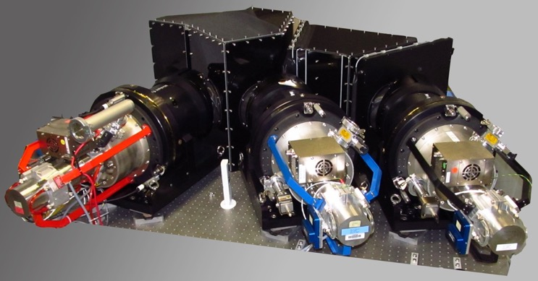
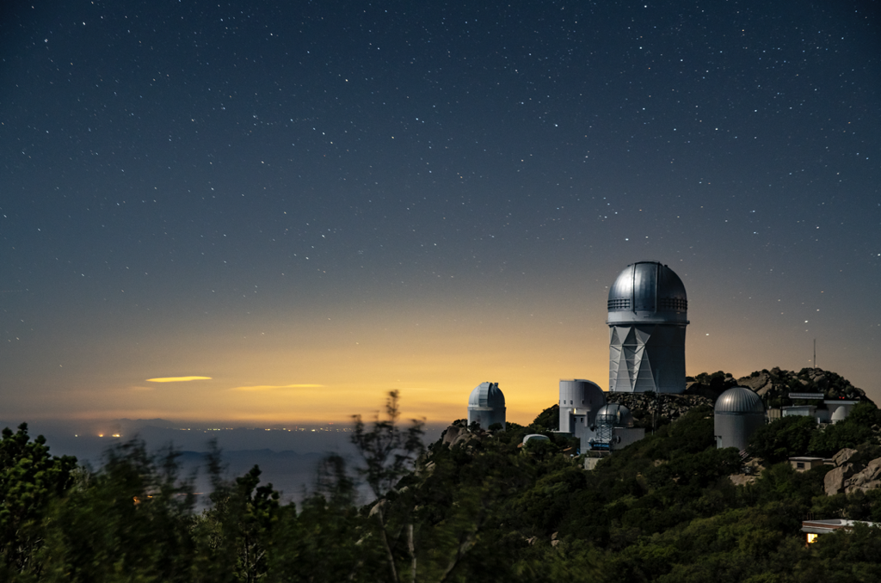
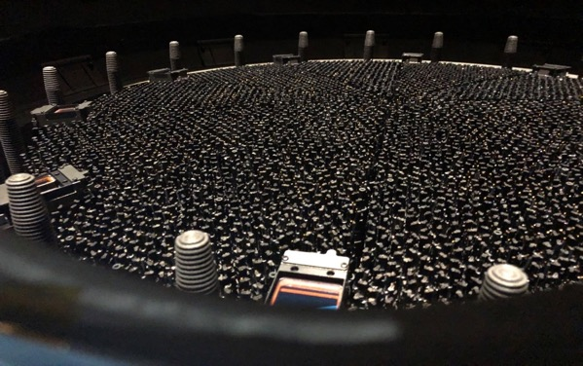
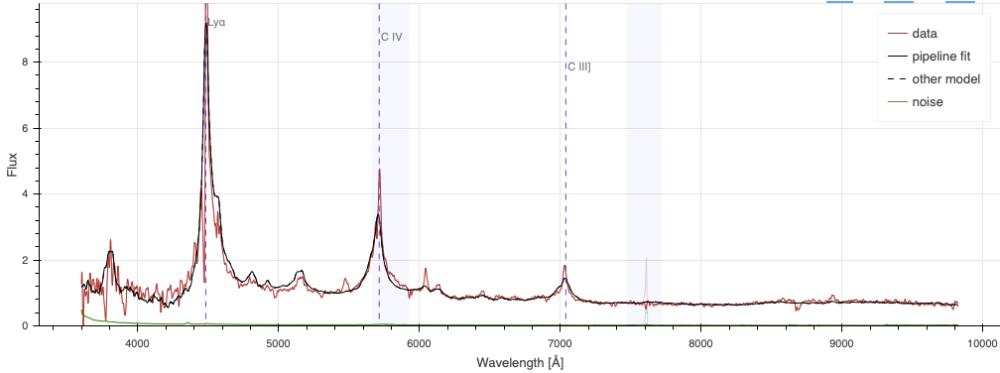
Rolling observations – Redshift factory
Imaging Surveys: optical grz bands
+ NIR with WISE
Target Selection
quasars
Contaminant: Stars
…and measure their redshift
Observation…
…of 5000 objects
every ~20mins…
Mayall Telescope
quasar

Slide 13
DESI DR2 footprint
  DESI footprint over 5 years ~14000 deg²
  DR2 (3 years) ~70% of final footprint
  Increase of V_{eff} by a 2.3 factor from DR1 to DR2
  14.3M discrete tracers (galaxies and quasars), 800k Ly-α forests

Slide 14
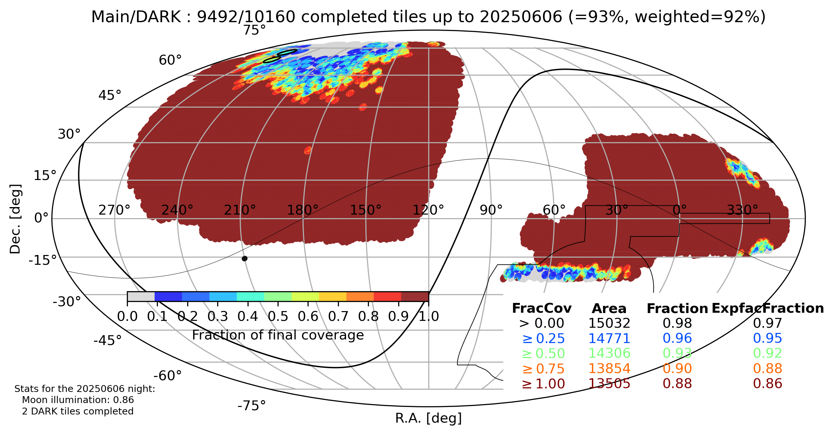
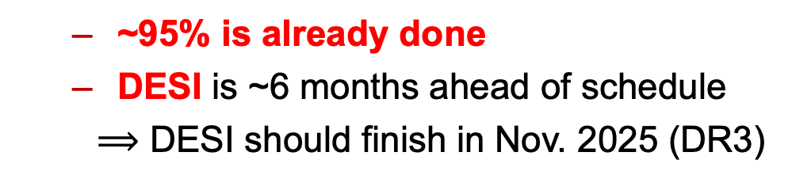
Status of DESI observations
  ~95% is already done
  DESI is ~6 months ahead of schedule
  $⟹$ DESI should finish in Nov. 2025 (DR3)

Slide 15
BAO
Measurements

Slide 16
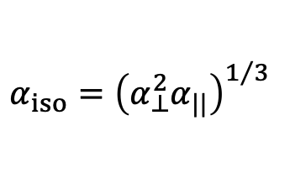
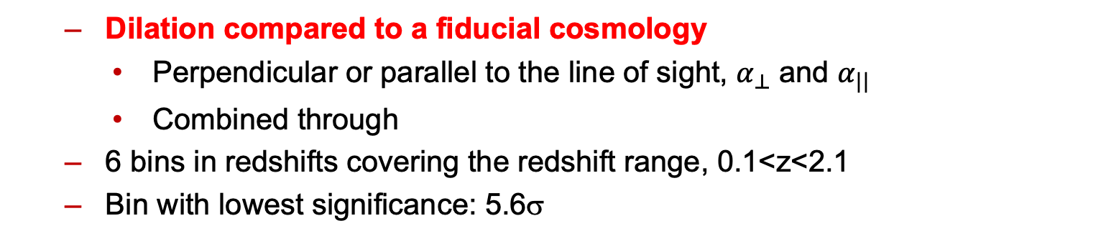
Results: a few examples
BGS z=0.30
LRG3+ELG1 z=0.93
QSO z=1.48
Precision: 0.93%
Significance: 14.7σ
Precision: 0.45%
Significance: 5.6σ
Precision: 1.5%
  Dilation compared to a fiducial cosmology
    Perpendicular or parallel to the line of sight, $α_{⊥}^{ }$ and $α_{||}$
    Combined through
  6 bins in redshifts covering the redshift range, 0.1<z<2.1
  Bin with lowest significance: 5.6σ
$$α_{iso}={\left(α_{⊥}^{2}α_{||}\right)}^{1/3}$$

Slide 17
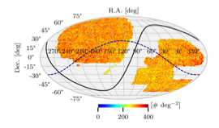
Systematics Error Budget
  Observational effects in data (imaging, fiber assignment,…)
  Reconstruction algorithm
  Covariance matrix construction
  Incomplete theory modelling
  Choice of fiducial cosmology
  Galaxy-halo (HOD) model uncertainties

Slide 18
Systematics Error Budget
  Observational effects in data
  (imaging, fiber assignment,…)
  Reconstruction algorithm
  Covariance matrix construction
  Incomplete theory modelling
  Choice of fiducial cosmology
  Galaxy-halo (HOD) model
No effect on BAO

Slide 19
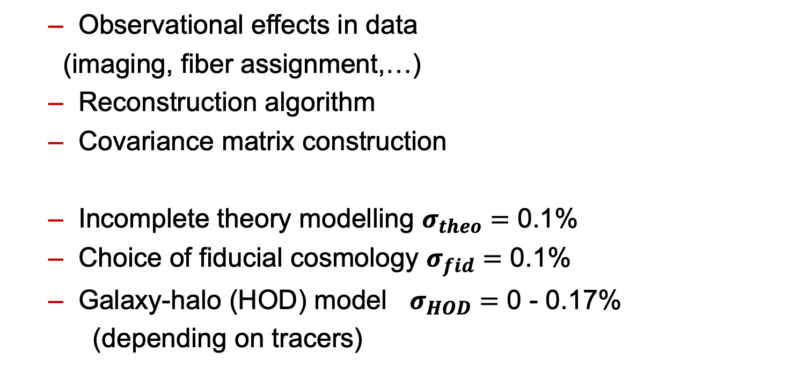
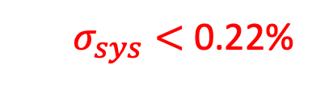
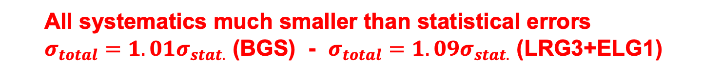
Systematics Error Budget
  Observational effects in data
  (imaging, fiber assignment,…)
  Reconstruction algorithm
  Covariance matrix construction
  Incomplete theory modelling $σ_{theo}=$ 0.1%
  Choice of fiducial cosmology $σ_{fid}=$ 0.1%
  Galaxy-halo (HOD) model $σ_{HOD}=$ 0 - 0.17%
  (depending on tracers)
No effect on BAO
  $σ_{sys}<$0.22%
  All systematics much smaller than statistical errors
  $σ_{total}=1.01σ_{stat.}$ (BGS) - $σ_{total}=1.09σ_{stat.}$ (LRG3+ELG1)

Slide 20
Stability of the results
  Comparison with the baseline analysis for different configurations (with/without reconstruction, power-spectrum, broadband modeling priors damping parameters, imaging weights, footprint, mag mass )
  Extremely stable results

Slide 21
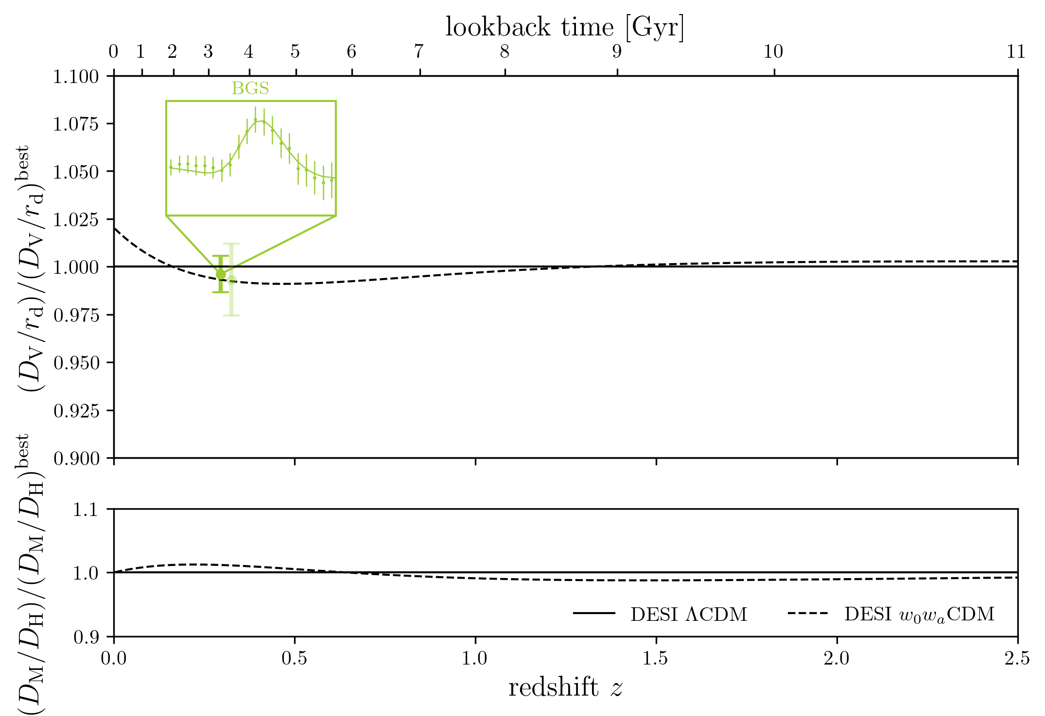
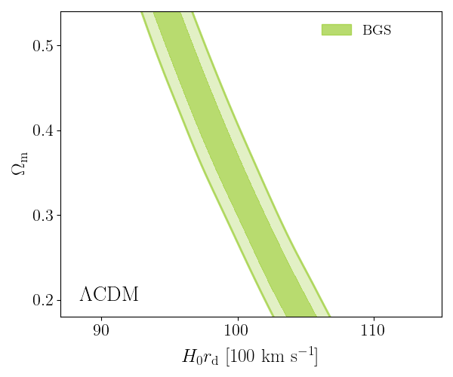

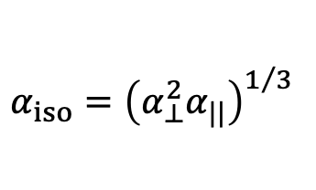
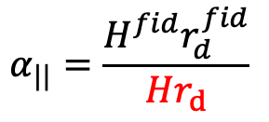
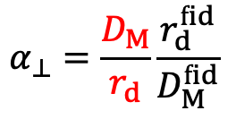
DESI DR2: BGS
$$α_{⊥}=\frac{D_{M}}{r_{d}}\frac{r_{d}^{fid}}{D_{M}^{fid}}$$
$$α_{||}=\frac{H^{fid}r_{d}^{fid}}{Hr_{d}}$$
$$α_{iso}={\left(α_{⊥}^{2}α_{||}\right)}^{1/3}$$
In ΛCDM, the α parameters
depend on H₀r_{d} and Ω_{m}
0.0 0.5 1.0 1.5 2.0 2.5
Redshift
$$H\left(z\right)≡H_{0}\sqrt{Ω_{m }{\left(1+z\right)}^{3}+(1−Ω_{m })}$$
  Friedman equation for ΛCDM
  Limitation due the cosmic variance (small part of the visible Universe)

Slide 22
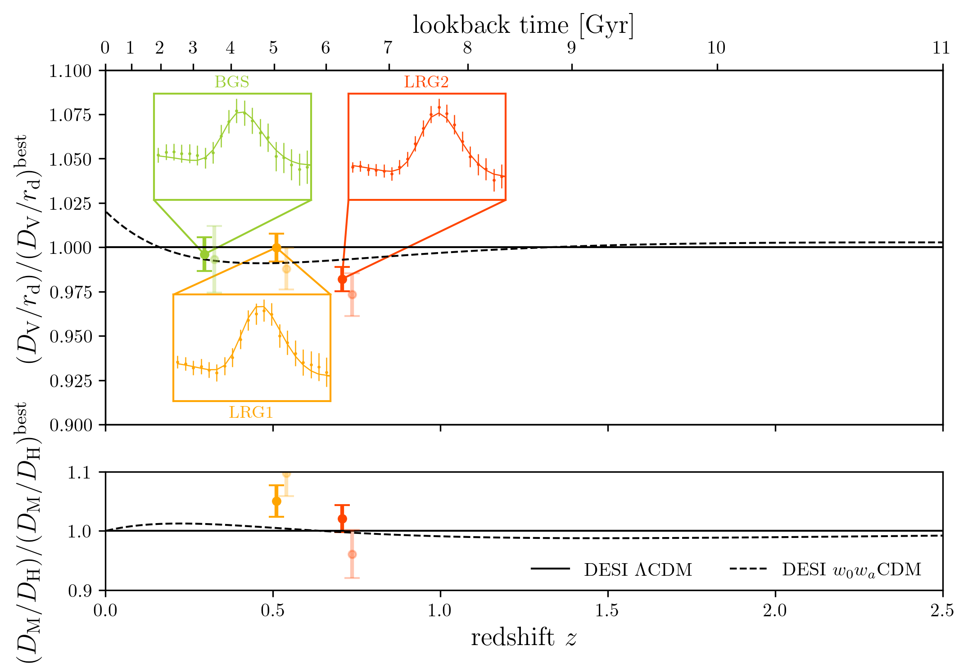
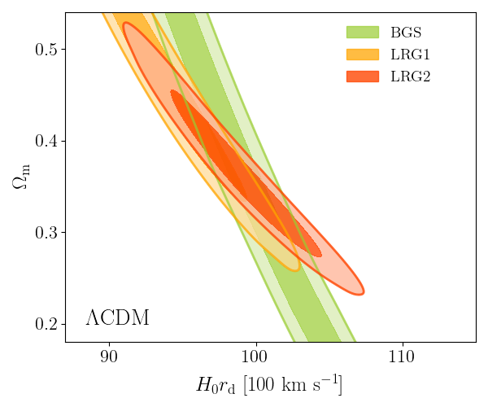
DESI DR2: BGS + LRG
0.0 0.5 1.0 1.5 2.0 2.5
Redshift
  LRG: Main tracer in SDSS, precise measurement in DESI

Slide 23
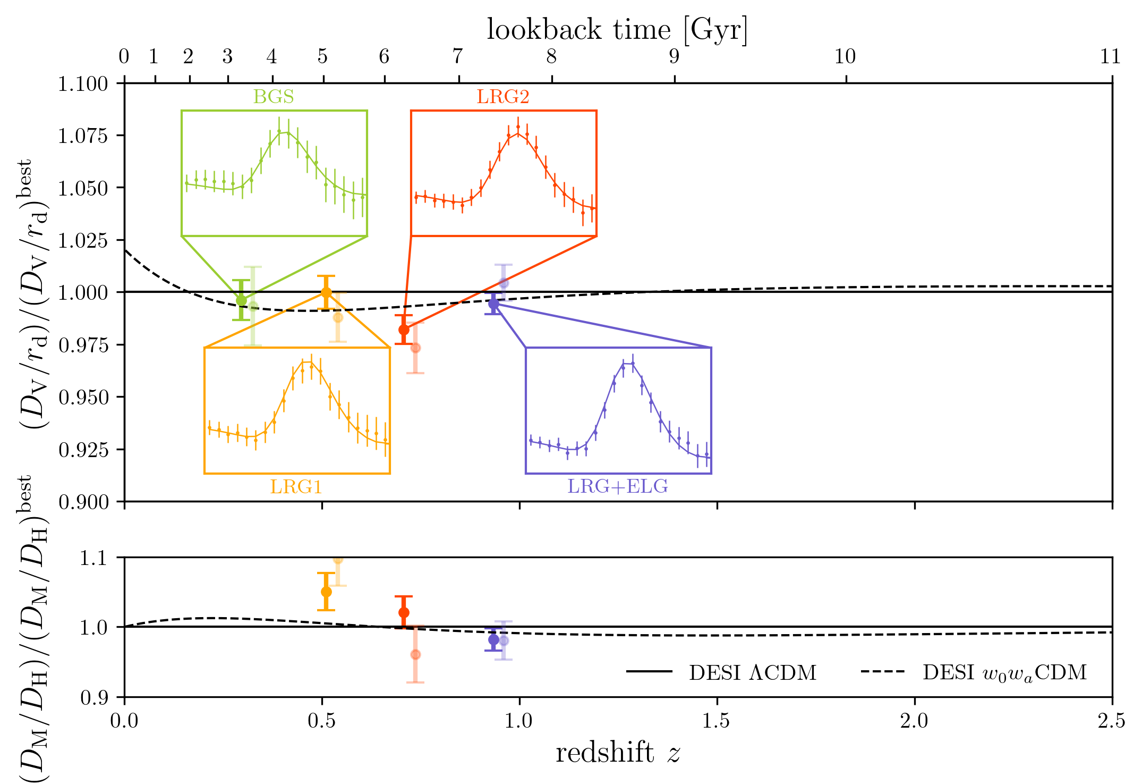
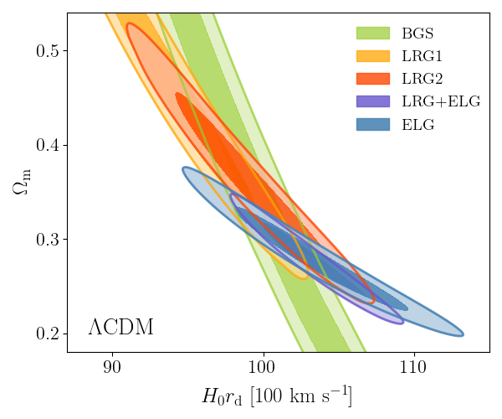
DESI DR2: BGS + LRG + ELG
0.0 0.5 1.0 1.5 2.0 2.5
Redshift
  ELG: Main tracer in DESI, precise measurement
  x 2.7 with DR2 compared to DR1

Slide 24
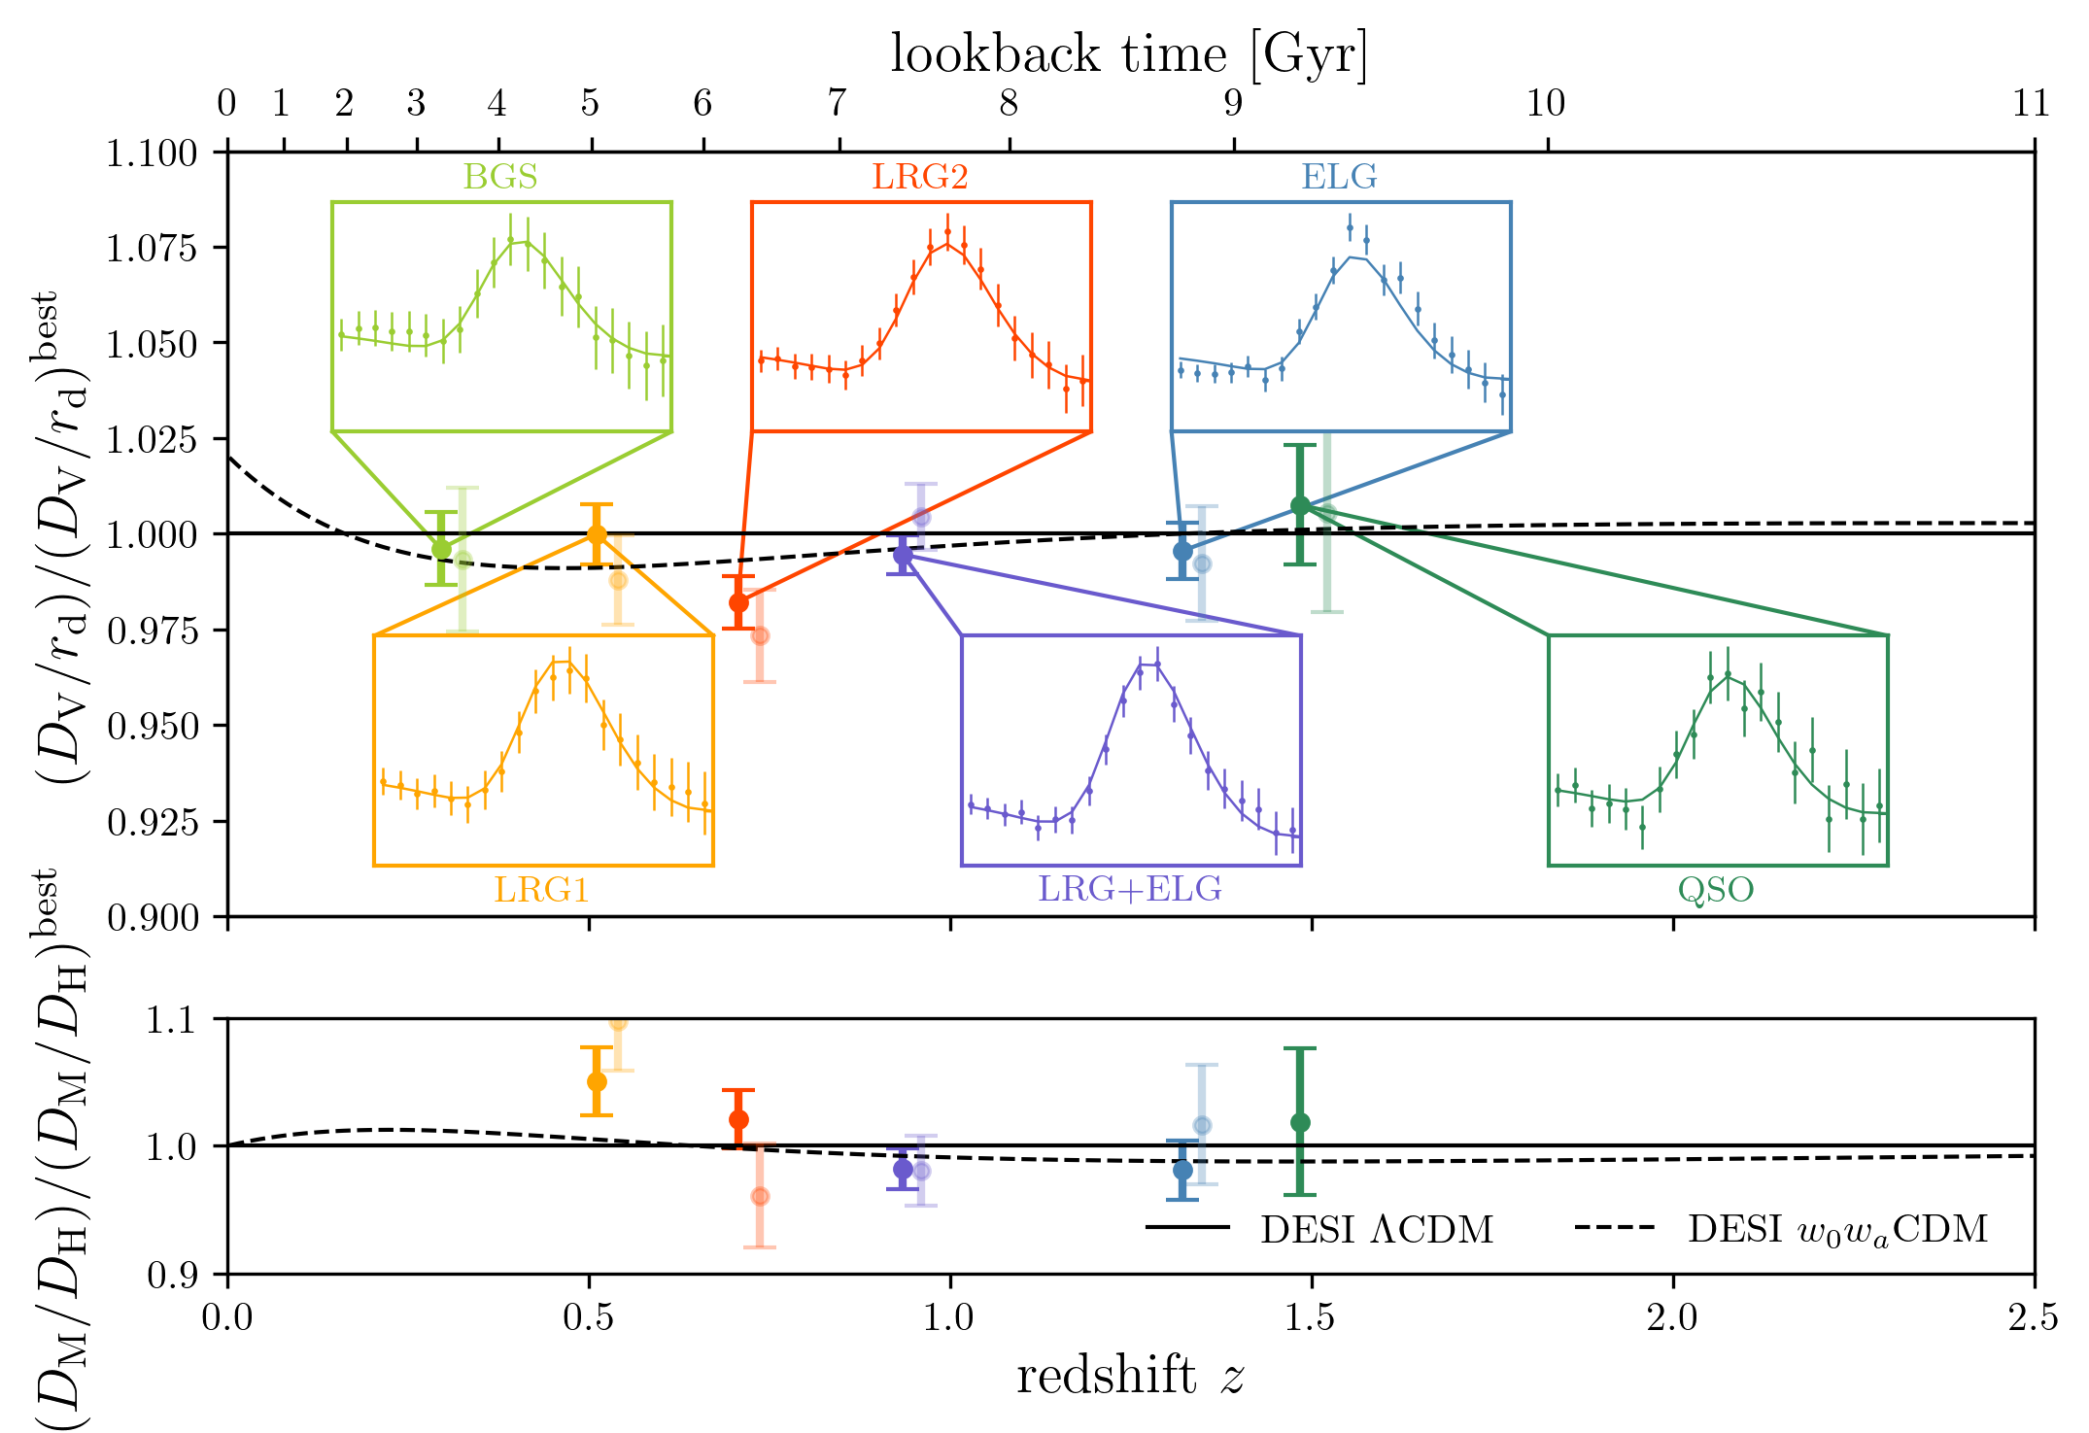
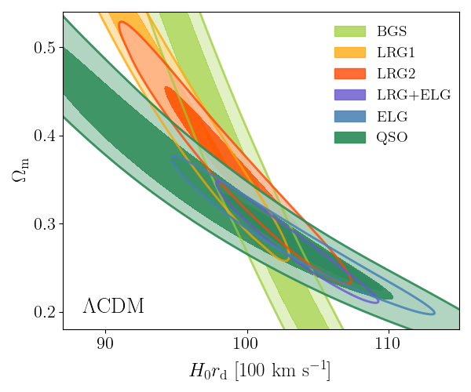
DESI DR2: BGS + LRG + ELG + QSO
0.0 0.5 1.0 1.5 2.0 2.5
Redshift
  QSO: huge volume but small density (shot noise limitation)

Slide 25
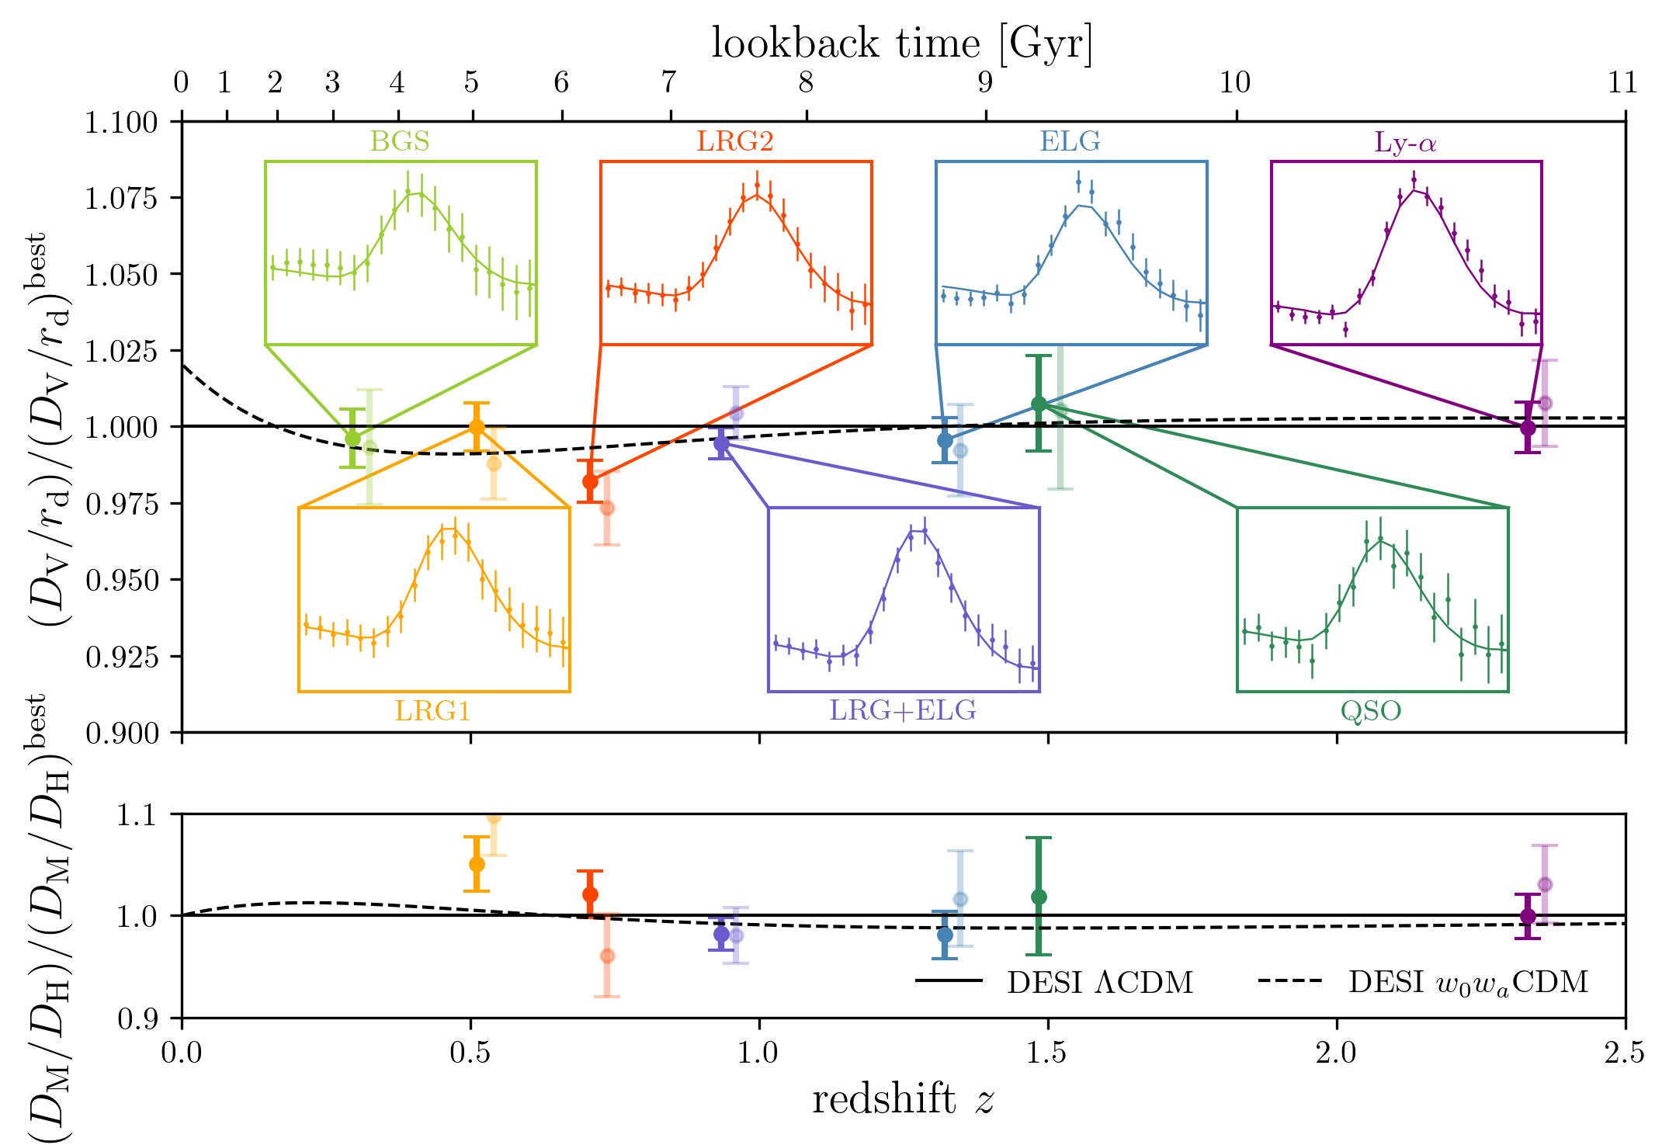
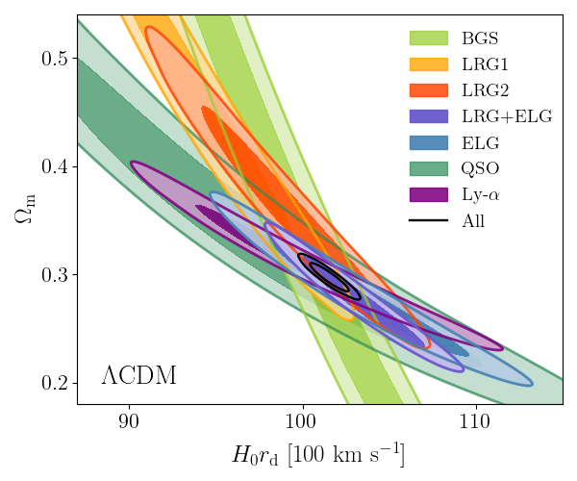
DESI DR2: BGS + LRG + ELG + QSO + Ly-α
0.0 0.5 1.0 1.5 2.0 2.5
Redshift
  Different dependence as a function of redshift (Ω_{m},r_{d})
  Break the degeneracy without knowing r_{d}

Slide 26
Cosmological Interpretation

Slide 27
DESI - Hubble diagram
Planck ΛCDM
  ~14M discrete tracers with 0.1<z<2.1 in 6 redshift bins
  Precision on BAO: from 1.5% (QSO) to 0.45% (LRG3+ELG1)
  With Ly-α forest of QSOs at z~2.3 : precision on BAO 0.7%
  Excellent agreement between DESI DR1 and DR2
  Consistent with ΛCDM but small tension with Planck ΛCDM : 2.3σ

Slide 28
Ω_{m} – H₀r_{d} Comparison CMB/BAO
  Consistent results DR1/DR2
  2.3σ discrepancy between CMB (PR4) and DESI
  2.0σ discrepancy between CMB (PR4+ACT) and DESI
  2.7σ discrepancy between CMB (ACT-alone) and DESI

Slide 29
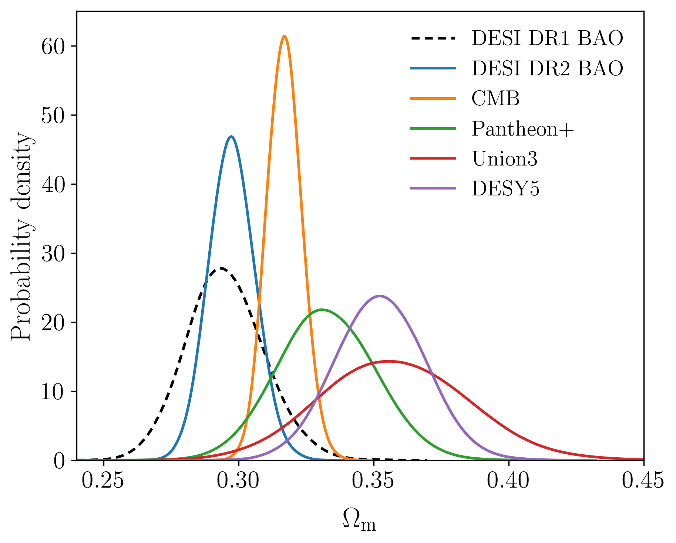
Ω_{m} - Tensions in ΛCDM
  Consistent results DR1/DR2
  Comparable precision on Ω_{m} for DESI and CMB
  2.3σ discrepancy between CMB and DESI
  Discrepancies with SNIa samples
    Pantheon+: 1.7σ
    Union3: 2.1σ
    DESY5: 2.9σ

Slide 30
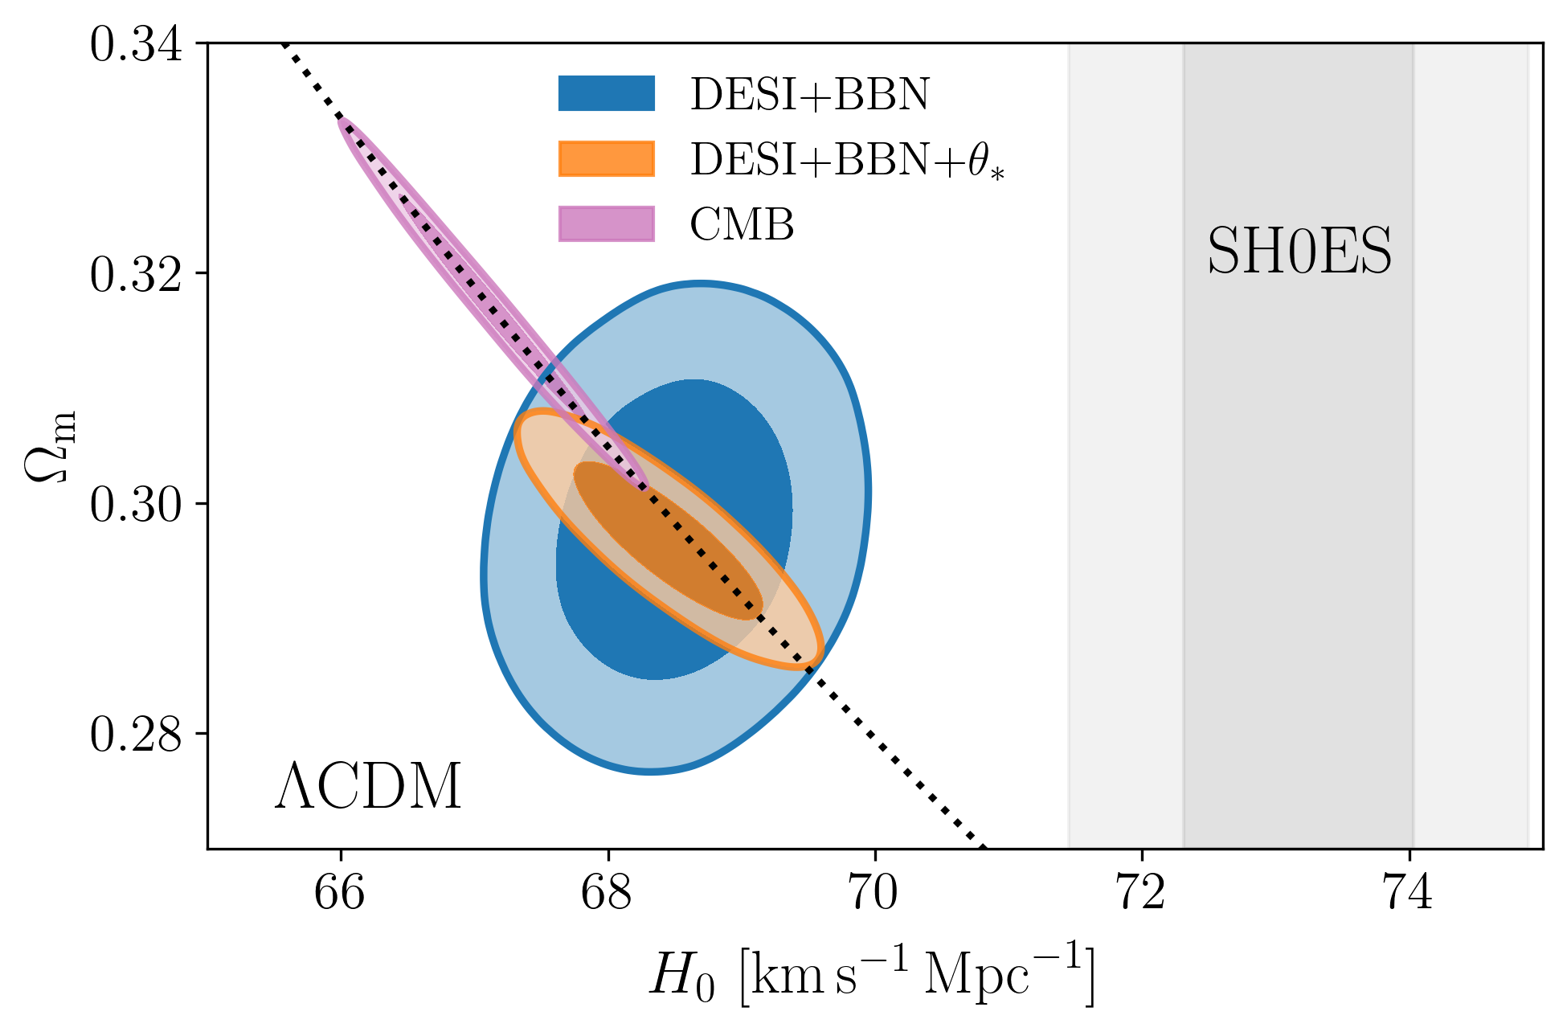
Hubble constant in ΛCDM
SNIa and
Cepheid
θ∗ : CMB angular scale
  Main tension in cosmology: 5σ discrepancy between CMB and late measurements (SNIa)
  Big Bang Nucleosynthesis (BBN) can be used to measure r_{d}
  DESI + BBN (without CMB), tension with SNIa (SH0ES): 4.5σ

Slide 31
Beyond ΛCDM: Dark Energy - Equation of State
Extensions of ΛCDM
Equation of state of Dark Energy
Time evolving Dark Energy
ΛCDM
  For ΛCDM, we expect w=-1, i.e. w₀=-1 and w_{a}=0
  Combining DESI+CMB: 3.1σ effect
  Combining DESI+CMB+SN: 2.8σ to 4.2σ effect depending on the SN sample
  Stronger Indications of dynamical dark energy with DR2

Slide 32
Dynamical Dark Energy – Parametrization
CMB + DESI + SN(Union3)
  Significance does not depend on parametrizations

Slide 33
Dynamical Dark Energy – Robustness
  Combining with early-Universe prior on (θ∗,ω_{b},ω_{bc}) from CMB shows preference for evolving DE.
  Excluding z<0.1 SNIa reduces the tension but the best fit is far for ΛCDM
  Replacing CMB with DES 3x2pt continues to show a preference for evolving DE

Slide 34
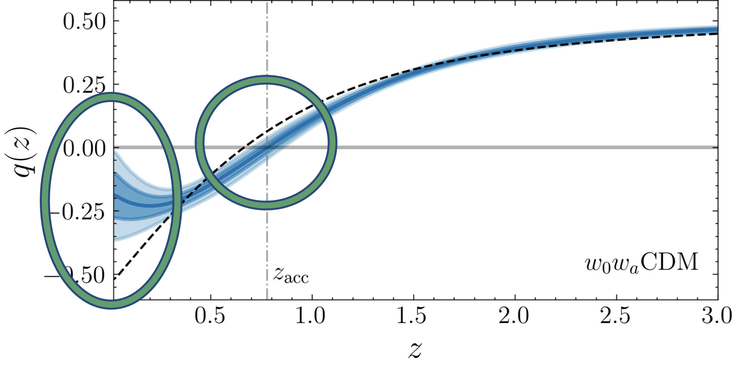


Dynamical Dark Energy
Acceleration is lower than $ΛCDM$ at present.
Acceleration started earlier than in $ΛCDM$.
Deceleration parameter
Redshift

Slide 35
Dynamical Dark Energy – Models
Quintessence
  Mirage Dark Energy is preferred to Thawing (Quintessence) models
  “Mirage” models mimic ΛCDM and <w> ~ -1 whereas there is a real time evolving Dark Energy

Slide 36




Sum of neutrino masses - Bayesian
  CMB is sensitive to $\sum{m_{μ}}$
  BAO measures $Ω_{m}$ and breaks the degeneracies
Limits at 95% CL:
  For ΛCDM with CMB alone:
  For ΛCDM with CMB + DESI:
  For w₀w_{a}CDM with CMB + DESI + SN
$$Σm_{ν}<210 meV$$
$$Σm_{ν}<64 meV$$
$$Σm_{ν}<130 meV$$

Slide 37



Sum of neutrino masses - Frequentist
ΛCDM
w₀w_{a}CDM
  Our “real” sensitivity on $\sum{m_{ν}}$ is σ ~ 40 meV with ΛCDM
  Because of the tension on $Ω_{m }$the limits artificially are too stringent
Limits at 95% CL with Feldman-Cousins:
  For ΛCDM with CMB + DESI:
  For w₀w_{a}CDM with CMB + DESI + SN
$$Σm_{ν}<53 meV$$
$$Σm_{ν}<126 meV$$

Slide 38
Conclusions

Slide 39

Summary: Results from DESI BAO DR2
  BAO results with DR2
    With three years (DR2), DESI provides the most precise measurement of BAO over 0<z<3.5
    DR2 results confirm DR1 results
    In ΛCDM, DESI is in slight tension with CMB (~2σ) and DESI prefers lower $Ω_{m}$
    Stronger indications of time-varying Dark Energy equation of state with DR2, especially when SNIa are added
      $⟹$ a 2.8σ to 4.2σ effect, not 5σ yet!
  What next?
    BAO: Full dataset for DESI in 2026 (+ Full shape analysis)
    SNIa: ZTF and LSST homogeneous sample at z<0.1
    CMB: ACT, SPT and in the long term SO and CMB-S4

Slide 40

DESI and DESI-II Timelines
  DESI (DR1-DR3) should finish in Nov. 2025
  Continuation of DESI (DR4-DR5) to end of 2028 with an extension of the footprint and an increase of the completeness
  DESI-II (2029): Dark Matter, high-density and high-z programs

Slide 41

DESI and DESI-II DE program
LBG/LAE
  DESI (DR1-DR3) is focused on the studies of DE
  DESI (DR4) :
    Extension of footprint
    Denser in DE region
  DESI-II:
    higher-density at low-z
    high-z programs
Ly-α
of LBG
ELG
ELG
LBG/LAE
Ly-α
of LBG

Slide 42
Additional Slides

Slide 43

Main science at DESI
Baryonic Acoustic Oscillations (BAO)
  σ(ΒΑΟ) ~0.2 % for 0.0<z<1.1
  σ(ΒΑΟ) ~0.3% for 1.1<z<1.9
  σ(ΒΑΟ) ~0.5% for 1.9<z<3.5
  SDSS(BOSS+eBOSS) few % measurements
Redshift Space Distorsion (RSD)
  Multiple few % measurements over wide redshift range (z<2)
  ~10x better compared to SDSS
Neutrino masses
  σ(Σm_{ν}) ~20 meV
  Current limit : Σm_{ν} <~100 meV, @ 95 CL
Non-Gaussianity (f_{NL})
  σ(f_{NL})~4 with k dependence of bias
  As precise as Planck with a different technique

Slide 44


Density Field Reconstruction
Reconstruction
  BAO peak distorted by movements of tracers due to density field
  Estimation of the Zeldovich displacement from the observed field
  Reconstruction: correction of the displacements
  Improve both precision and accuracy

Slide 45
DESI DR2 dataset
LRG
ELG
BGS
QSO
  Biggest ever BAO dataset (both in N_{tracer} and volume)
    14.3 M discrete tracers (BG, LRG, ELG and QSO)
    Effective cosmic volume V_{eff}= 42 Gpc³
    Increase of V_{eff} by a 2.3 factor from DR1 to DR2

Slide 46
Example of systematics: Imaging
Quasar target
density
  Non-homogeneity in target selection due variations of imaging catalogs (depth, dust contaminants,…)
  Regression methods developed to correct those effect
  Same measurements of BAO with/without corrections
  BAO almost insensitive to imaging effects

Slide 47
Dark Energy – Hubble Diagram
  Combining DESI+CMB+SN: 2.8σ to 4.2σ effect depending on the SN sample
  Better agreement with w₀w_{a}CDM model

Slide 48
Dark Energy – Significance
CMB (including lensing)
Three SNIa sample

Slide 49
Comparison DESI/SDSS at z~0.7
  1.5σ to 2.3σ discrepancy depending on the correlations between the two samples at z~0.7
  Much better agreement with DR1 than with DR2

Slide 50
Phantom Crossing
  w<-1 (phantom regime), possible with multiple fields…
  Phantom crossing at z~0.4
  Binned approach (blue dots) consistent with CPL parametrization

Slide 51
Comparison DESI/ACT
DESI paper
  2.3σ discrepancy with CMB (DESI paper)
  Adding ACT to PR4 2.3σ 2.0σ
  Adding recent ACT results, it varies from 1.4σ to 3.2σ

Slide 52
Comparison DESI/ACT
ACT paper
ACT+DESI paper - Baseline
DESI paper
  Several comparisons were tested

