Slide 1


Coordination panel meeting
iSAS project
30th September, 2025

Slide 2
iSAS Coordination panel meeting
Agenda
Agenda items
Project status report
  CA, NDA & AMD update
  External relations Policy briefing report
  Work plan w/ up-to-date milestones & deliverables
AOB
Notes will be found in the Indico page
iSAS project Indico page

Slide 3
iSAS project status report
Coordination panel meeting
30th September, 2025

Slide 4
iSAS Coordination panel meeting
Consortium Agreement, shared NDA, amendment
  Consortium Agreement (CA)
    v3 sent with Sept 29 due date for last review before signature process:
    HZB asked for modifications
    Background missing for DESY, CERN & Lancaster University
  Shared NDA
    For industrial partners
    Signed by ACS, Euclid & Zanon
    Cryoelectra, Plasmatherm, RI non responsive
  Amendment (AMD) to the Grant Agreement
    Nikhef will not join the consortium formally
    Other modifications to be included in RP1 report, tbc by PO (new PO: Sotirios Kakarantzas)

Slide 5
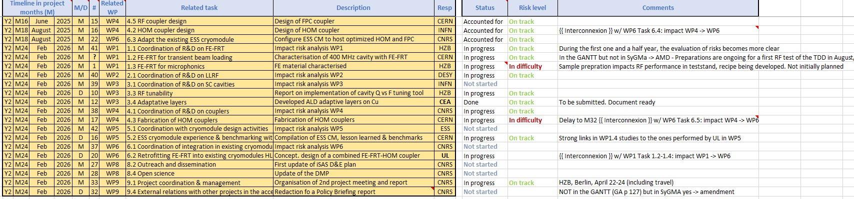
iSAS Coordination panel meeting
iSAS work plan
Milestones & Deliverables status by timeline:
3 milestones of summer accounted for, 17 to go all in Feb + end of RP1 report

Slide 6
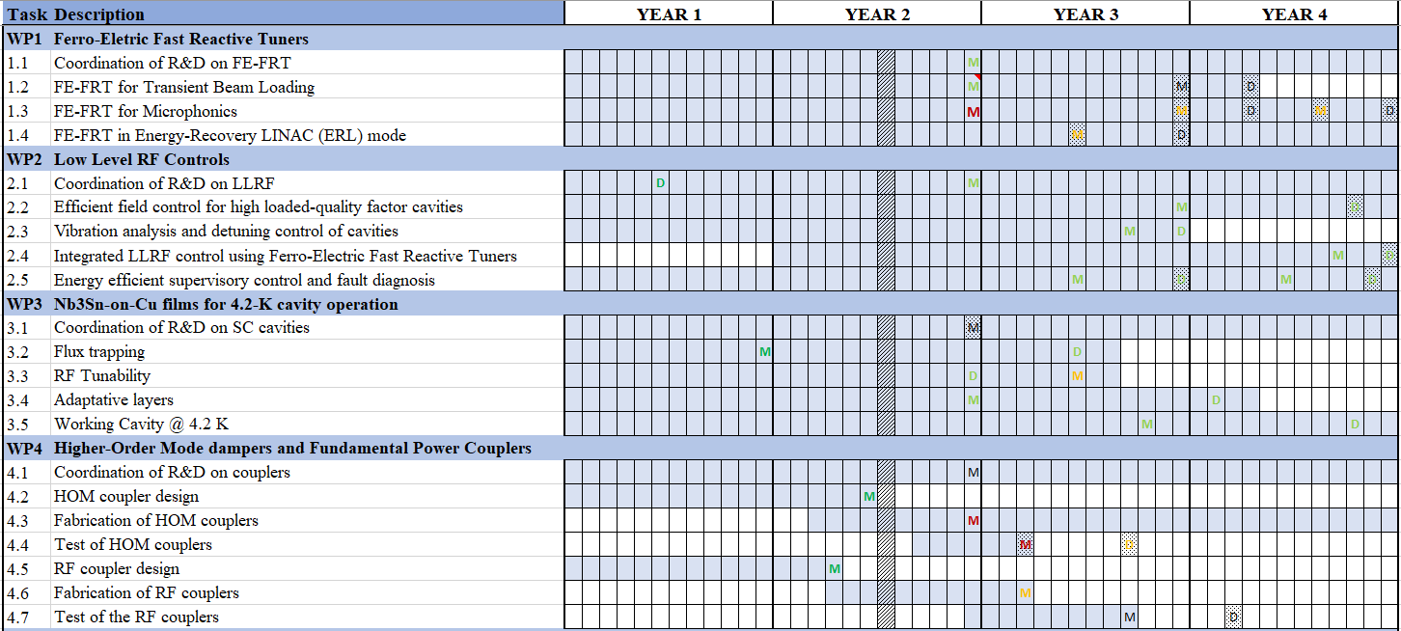
iSAS Coordination panel meeting
Risks to mitigate or difficulties
From last feedback update, in WPs presentations & work plans
GANTT chart sum-up

Slide 7
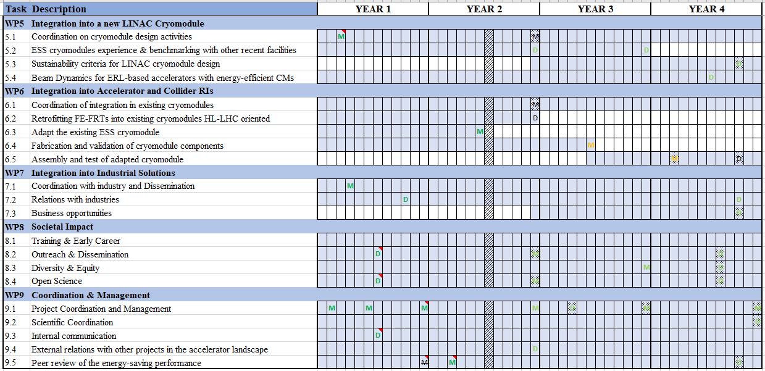
iSAS Coordination panel meeting

Slide 8
iSAS Coordination panel meeting
Upcoming related meetings
Every other meeting the Coordination panel becomes the Steering committee (includes the WP leaders & deputies), so as to integrate a cross-coordination of feedback
Indico page for Coordination panel - Steering committee meetings
  Steering committee – Nov 4 at 10 am CET
  Coordination panel - Dec 16 at 10 am CET
  Steering committee – Jan 27 at 10 am CET
  Coordination panel – March 10 at 10 am CET
  Steering committee – April 21 at 10 am CET
  Coordination panel – June 2 at 10 am CET

Slide 9
iSAS Coordination panel meeting
Upcoming other project meetings
Governing Board meeting
  Online, Oct 1 at 2 pm CET
Mid-term Advisory Board meeting
  Online, Oct 7 at 9:30 am CET
2nd yearly project meeting
  Hosted by HZB in Berlin (w/ online connection as well), April 22-24, 2026
  To be cross-checked with KIT to coordinate with INFRATECH event

Slide 10
Thank you!

