Slide 1


Coordination panel meeting
iSAS project
4th November, 2025

Slide 2
iSAS Coordination panel meeting
Agenda
Agenda items
Project status report
  CA, NDA & AMD update
  Mid-term Advisory board recommendations
  External relations Policy briefing report
  Berlin annual meeting update
  Work plan w/ up-to-date milestones & deliverables
AOB
Notes will be found in the Indico page
iSAS project Indico page

Slide 3
iSAS project status report
Coordination panel meeting
4th November, 2025

Slide 4
iSAS Coordination panel meeting
Consortium Agreement, shared NDA, amendment
  Consortium Agreement (CA)
    v4 sent
    Signature process tbd
  Shared NDA
    For industrial partners
    Signed by ACS, Cryoelectra, Euclid, RI, Zanon
    Plasmatherm out
    CNRS is signing now
  Amendment (AMD) to the Grant Agreement
    Nikhef will not join the consortium formally
    Other modifications to be included in AMD confirmed by PO
    To be finalised before the end of the reporting period (before Feb 2026)

Slide 5
iSAS Coordination panel meeting
Mid-term Advisory board meeting
  WPs presented recommendations implemented from Padova meeting
    Well received by Advisory board
  Recommendations
    "We had requested a dedicated meeting to discuss mitigation measures for the significant delay, mainly caused by the production delay of the five RF cells.
    For WP1 to WP3, there was nothing particular to report, especially with the granted extension, other than encouraging the teams to maintain their current pace to meet the milestones planned for next February.
    In WP4, we discussed the lack of response from LASA. It was recommended to contact them at high level to discuss recovery plan and to restore close communications.
    In summary, it would be useful to hold a dedicated meeting to address the current bottlenecks, after which we could formulate concrete recommendations."

Slide 6
iSAS Coordination panel meeting
iSAS project extension?
  Delays impact foreseen
    We now have a better idea of how much of a delay the procurement difficulties will most likely affect the project timeline ~ 9 months
    Should be discussed at a later stage w/ PO
    For now, letting him know about our anticipation & mitigation measures planned is enough

Slide 7
iSAS Coordination panel meeting
WP4
  1.3 GHz HOM
    Recovery plan
    LASA in agreement with proposal by team at CNRS
    More generic dumping system (BLA)
    Most suitable for PERLE as well as Brixsino (INFN LASA)
    Same budget to foresee
    WP4 meeting follow-up to arbitrate last technical details of recovery plan

Slide 8
iSAS Coordination panel meeting
WP9 Policy briefing report
  WP9.4 External relations with other projects in the accelerator landscape
    Policy briefing report - D32 due M24 Feb 2026
    "Redaction for a Policy Briefing report in order to ensure that our project’ impact, contribution to EU policy goals and recommendations can inform future policy and programme development. This deliverable will be updated in the second RP" GA p90
  Expectations
    Added at evaluation stage by ex-PO
    To be clarified w/ PO
      How is iSAS integrated into the European strategy goals for accelerators and colliders?
      How can iSAS parametric design be included into the accelerators landscape’s discussions (impact beyond XFEL ESS & CERN)?

Slide 9
iSAS Coordination panel meeting
Berlin annual project meeting
  Invited talk
    Oliver Brüning proposed to present European strategy goals for accelerators and colliders
  2nd Save the date
    To be sent out soon
    As soon as details of time of arrival & departure from meeting as well as hotel recommendations are set

Slide 10
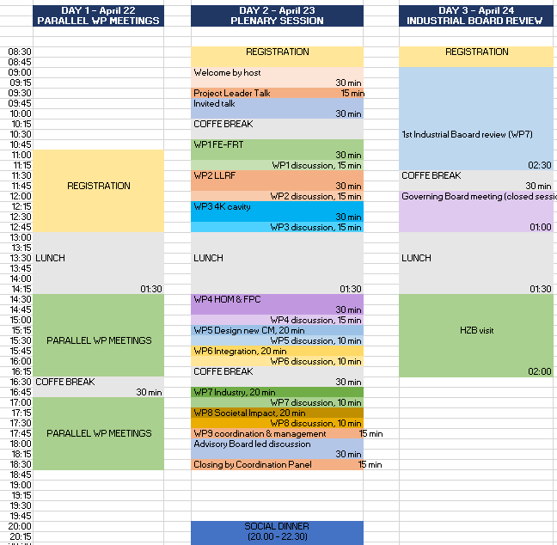

Slide 11
iSAS Coordination panel meeting
IB meeting feedback
  Industrial partners update
    Cryoelectra signed NDA – cooperation to be reignited
    New contact from RI to get up to speed Lucas Zweilbaümer
  Next meeting: & 1st technical review
    At Berlin annual meeting
    Started working in duos:
      WP1 & Euclid
      WP2 & Cryoelectra (tbc)
      WP3 & Zanon
      WP4 & RI
      WP5 & ACS

Slide 12
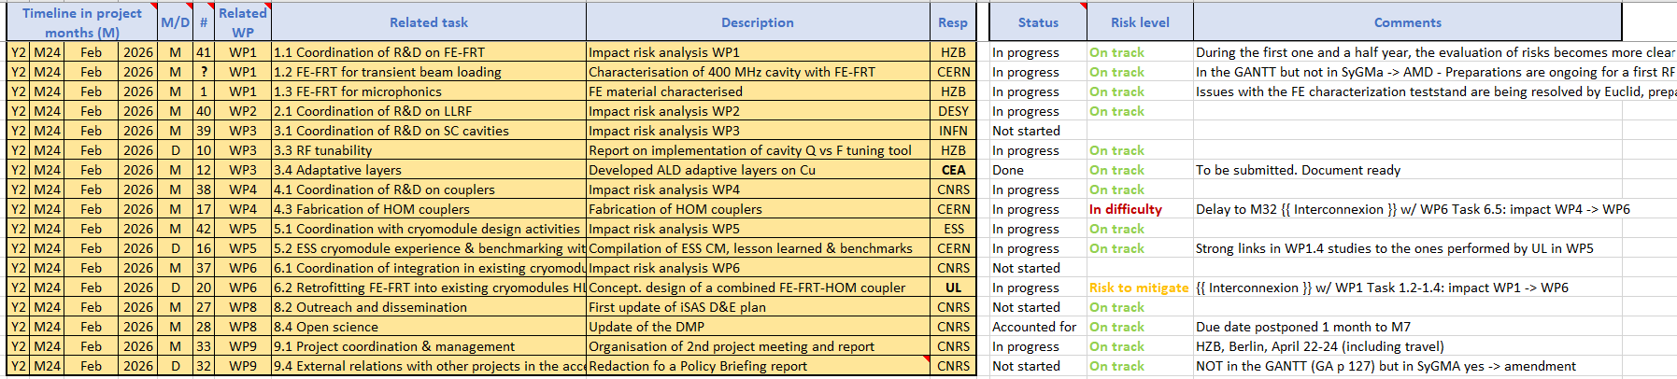
iSAS Coordination panel meeting
iSAS work plan
Milestones & Deliverables status by timeline:
3 milestones of summer accounted for, 17 to go all in Feb + end of RP1 report

Slide 13
iSAS Coordination panel meeting
Upcoming related meetings
Every other meeting the Coordination panel becomes the Steering committee (includes the WP leaders & deputies), so as to integrate a cross-coordination of feedback
Indico page for Coordination panel - Steering committee meetings
  Steering committee - Dec 16 at 10 am CET
  Steering committee – Jan 27 at 10 am CET
  Coordination panel – March 10 at 10 am CET
  Steering committee – April 21 at 10 am CET
  Coordination panel – June 2 at 10 am CET

Slide 14
iSAS Coordination panel meeting
Upcoming other project meetings
2nd yearly project meeting
  Hosted by HZB in Berlin (w/ online connection as well), April 22-24, 2026
  To be cross-checked with KIT to coordinate with INFRATECH event

Slide 15
Thank you!

