Slide 1

iSAS Coordination panel meeting
10th March, 2026

Slide 2
iSAS Coordination panel meeting
Agenda
Agenda items
  RF2.0 & iSAS project update, Barcelona meeting, TIARA meeting
  Amendment (AMD), Consortium Agreement (CA)
  End of RP1, milestone & deliverable validation, periodic report, Review meeting
  iSAS Workplan update
  AOB
Presentation(s) available on:
iSAS project Indico page

Slide 3
RF2.0 & iSAS project proposal update
Steps taken
Involvement of EU project managers to support the project development
RF2.0 + iSAS 1st concept paper prepared (iterative process)
Presentation of RF2.0 project last Steering committee by project coordinator
Ideas structured into WPs at Barcelona meeting Feb 26th-27th at RF2.0 annual meeting (ALBA)
Coordinator chosen: Giovanni De Carne, RF2.0 project coordinator from KIT
Draft cost evaluation from CERN on technologies
Next steps
TIARA meeting March 18th for presentation & comments
Proposal to submit to INFRATECH call by June 16

Slide 4
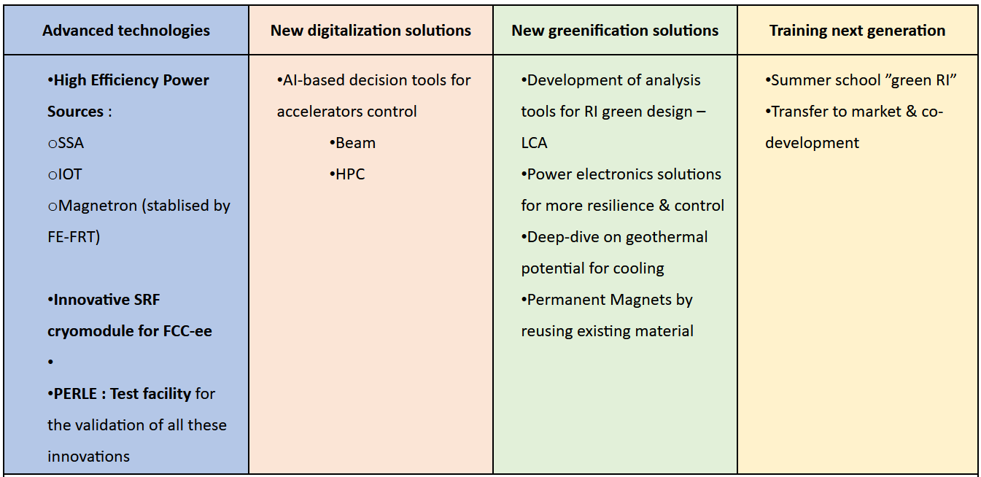
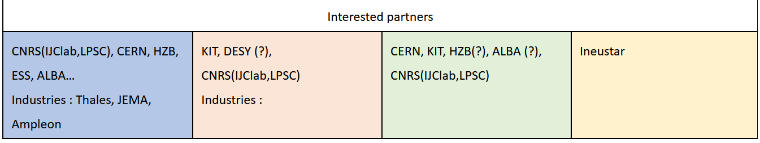
RF2.0 & iSAS project proposal update

Slide 5
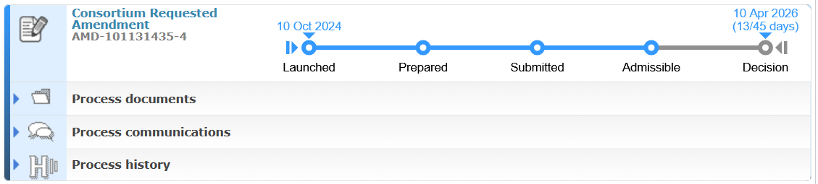
Amendment to the Grant agreement
Amendment (AMD) in progress
Amendment signed
Now in Decision phase
2nd AMD needed after the 1st (cannot open 2 in parallel) to extend the project manager’s contract

Slide 6
Consortium agreement
Consortium Agreement (CA) in progress
Signature process has been started
2 institutes have signed already: ESS & VUB
4 institutes have responded & have started the process
Shared NDA for industrial partners done

Slide 7
End of RP1
Milestones & deliverables
11 accounted for
2 pending, expected for 2nd week of March
1 no news
No WP closure foreseen (iSAS not structured that way, all WPs end at the end of the project)
Consequence of AMD still in process
1 not yet accountable because not added yet
1 still considered due because delay not yet formalised
Next steps
RP2 opened since March 1st for next 2 project years (until Feb 2028)
Periodic report due April 30 & Review meeting June 1st to present it

Slide 8
Milestones & deliverables validation process
To be discussed
Reading review by Achille for February 15 M&D
To note: August 2026 due date for 6 different M/D, Feb 2027 due date for 9 different M/D
  How to organise the validation process in order to enable a higher standards review?

Slide 9
Periodic report
End of RP1 report
Technical report (Part B) template shared by PO (not all sections relevant to this project)
Most notably:
  1.2 Explanation of the work carried out per WP
  1.3 Impact - progress of the project so far towards delivering scientific impact
Due 60 days after end of RP1 (end of April)
  1st draft to be ready early enough to be reviewed carefully – at least by April 16

Slide 10
Review meeting
To present the periodic report to the PO & external expert
Review meeting – June 1st 09:00 to 12:30 am CET
No objections raised to the nomination of the external exert
  Bruno Miguel Soares GONÇALVES
    European Fusion Development Agreement - Joint European torus (EFDA-JET)
    Instituto de Plasmas e Fusão nuclear, Instituto Superior Técnico
Questions & comments expected from PO & external expert
It will examine
the degree to which the work plan has been carried out and whether all deliverables were completed
whether the objectives are still relevant and provide scientific or industrial breakthrough potential
the management procedures and methods of the project
the beneficiaries’ contributions and their integration within the project
the expected potential scientific, technological, economic, competitive and social impact, and plans for using and disseminating results
compliance with other grant agreement obligations

Slide 11
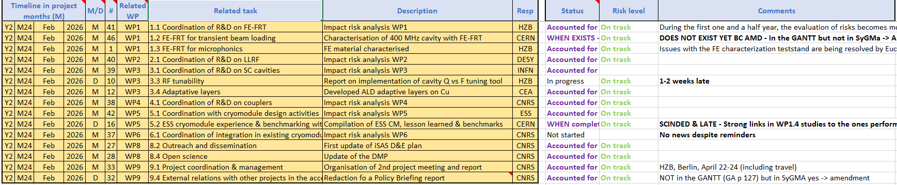
Work plan
Milestones & Deliverables status by timeline for the end of the 2nd project year

Slide 12
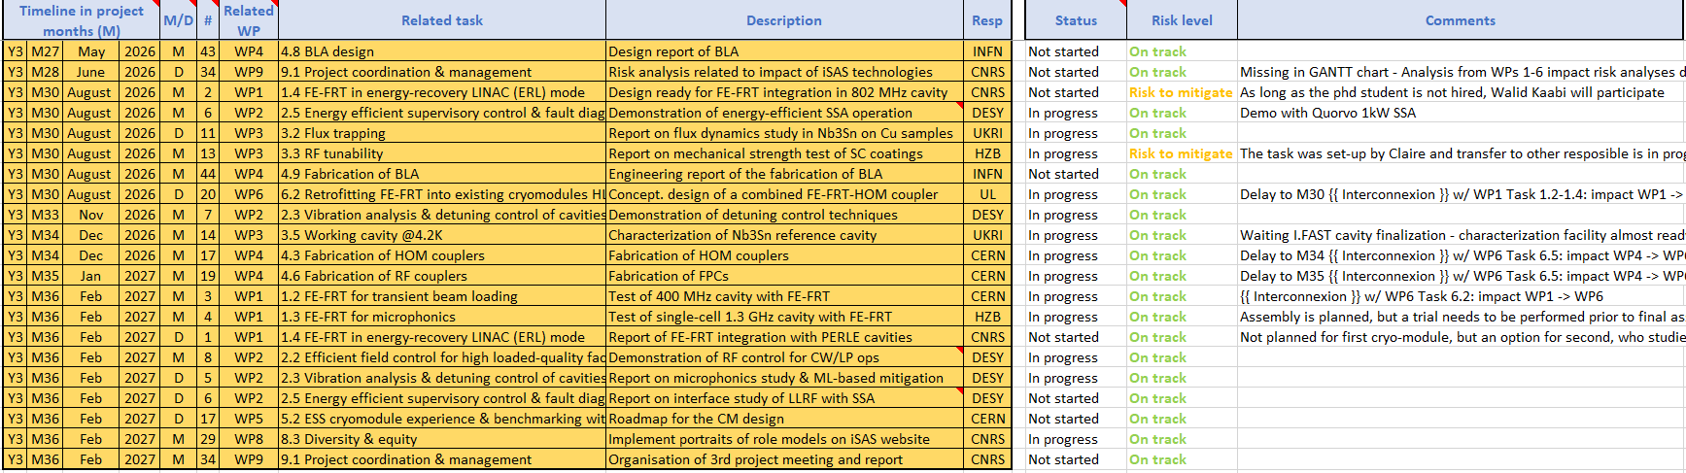
Work plan
Milestones & Deliverables status by timeline for the 3rd project year
2 milestones due August with risk to mitigate to look into

Slide 13
Upcoming related meetings
Every other meeting the Coordination panel becomes the Steering committee (includes the WP leaders & deputies), so as to integrate a cross-coordination of feedback
Indico page for Coordination panel - Steering committee meetings
  Steering committee – April 21 at 10 am CET
  Coordination panel – June 2 at 10 am CET

Slide 14
Upcoming other meetings
iSAS project Indico page
  2nd annual project meeting in Berlin – April 22-24
    Advisory board discussion – April 23 pm
    Industry 1st review – April 24 am
    Governing board - April 24 am
  Review meeting – June 1st 09:00 to 12:30 am CET

Slide 15
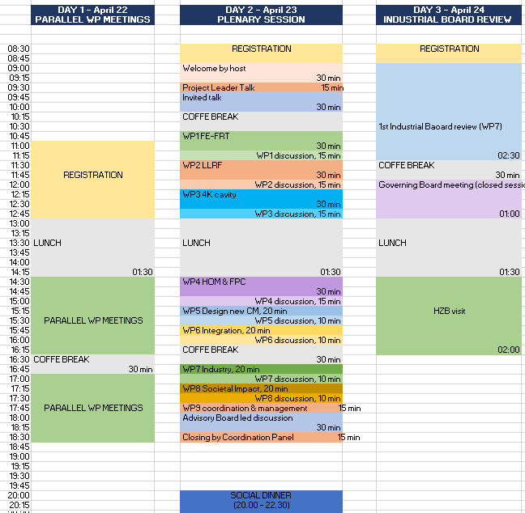

Slide 16
Thank you!

Slide 17
Back up

