Slide 1
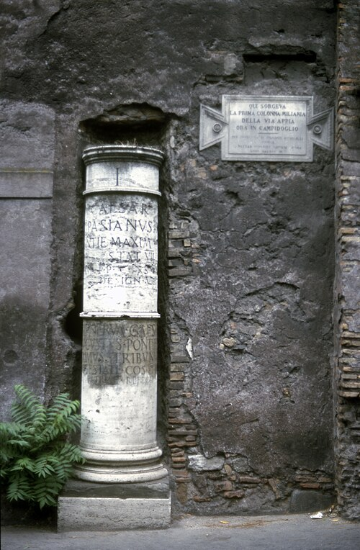

iSAS WP1 Overview
Steering Committee Meeting, 16.12.2025
Focus on upcoming February Milestones
Axel Neumann, HZB for WP1 Steering Committee Meeting report
Funded by the European Union. Views and opinions expressed are however those of the authors only and do not necessarily reflect those of the European Union or the European Commission. Neither the European Union nor the granting authority can be held responsible for them.
https://de.wikipedia.org/wiki/Datei:14_559_Via_Appia_antica,_Meilenstein_1.jpg

Slide 2


Task#1 Energy Savings from RF power
How do we aim to demonstrate sustainable, thus lower carbon footprint low-RF power operation?
Increase the efficiency of intrinsically efficient RF power source by better integrating them in cavity LLRF field control and requirements by accelerator/beam settings → WP2
Develop novel fast tuning systems compensating detuning by mechanical vibrations or beam induced transients, which both are usually compensated by adding a significant power overhead → WP1 aka FE-FRT
All this should of course not compromise the stability and reliability of operation, better even improve it beyond current state of the art. The savings in RF power should be significant, to justify any required modification to a cavity system → retro-fitting to existing systems would be pure gold
https://www.bundesbank.de/de/aufgaben/themen/entwicklung-der-goldbestaende-645380

Slide 3
WP1: FE-FRT (Official overview)
HZB, CERN, CNRS, Uni.Lancaster
Convener: Axel Neumann (HZB), deputy Alick Macpherson (CERN)
Main contacts with other partners: Alick Macpherson (CERN), Walid Kaabi (CNRS), Graeme Burt (Uni.Lanc.), industry: Alexei Kanareykin (Euclid Techlabs)
Official isas structure
Task 2.4 Integrated LLRF control using FE-FRT
Task 3.3 RF tunability, FE-FRT for Nb3SN coated cavities?
Task 1.1: Coordination of R&D on FE-FRT – M1-M48 (HZB)
• General coordination by HZB.
Task 1.2: FE-FRT for Transient Beam Loading – M1-M40 (CERN)
• Design a full FE-FRT-based 400 MHz tuner, applicable to LHC transient detuning scenarios.
• Perform full RF, mechanical and cryogenic evaluation of the FE-FRT-equipped . LHC cryo-module.
• Use design lessons learned to design a tuner for transient detuning of FCC 800 MHz multi-cell cavities.
Task 1.3: FE-FRT for Microphonics – M1-M48 (HZB)
• Establish characteristics and performance of FE-FRT ferroelectric material at frequencies ≥1300 MHz.
• Design, fabricate and validate an FE-FRT for microphonics suppression on a single-cell 1.3 GHz cavity.
• Design, fabricate and validate an FE-FRT for multi-cell cavity at 1300 MHz, in a cryomodule-like setup.
Task 1.4: FE-FRT in Energy-Recovery LINAC (ERL) mode – M1-M48 (CNRS)
• End-group design study for integration into ERL-type cavity, study HOM+BBU properties.
• FE-FRT design study for RF and mechanical integration into upgraded ERL cavity.
Task 6.2: Retrofitting Fast Reactive Tuners into existing cryomodules HL-LHC oriented – M1-M24
Study of frequency domain multiplexor-based HOM coupler
Study the effect of HOMs on FE-FRT operation to define max leakage
Study the heating due to high fundamental power in the coupler
Strong link to Tasks 1.2-1.4

Slide 4
iSAS timeline and milestones
FRT design and fabrication
Nov 2024 Design of TTD1
June 2025 Fabrication of TDD1
FE ceramics
Material characterized at 400 MHz
High voltage breakdown tests performed
Test of TDD1 (cold test with high power)
Dryrun at room temperature in Q3 2025
Cold test (low power) performed
July 2024 Design and fabrication of teststand
April 2025 LLRF control ready
Sample preparation established
High power test in Q1/2 2026
Integration study into LHC ¼ cryo-module
Not started
timeline
Task 1.2: FE-FRT for Transient Beam Loading – M1-M40 (CERN)
iSAS funds:
0.44 M€
FRT design and fabrication
May 2025 RF design ready
June 2025 Mechanical design
FE ceramics
Material characterized at 1300 MHz (FERMAT, Euclid)
Sample preparation: Cutting, grinding, lapping, polishing
Single cell test with prototype
2-cell cavity being prepared at RI
Critically coupled, but with blade tuner +piezos
Preparation of LLRF system started (RFSoC)
Tuner ready for Q1-2 2026
Sample analysis
Microphonics compensation proof of principle test
Multi-cell test (fully equipped cavity)
TESLA cavity in HoBiCaT with FPC and classic tuner
FE-FRT second version, e.g. optimized also for higher stored energy
Final LLRF + FE-FRT test
Task 1.3: FE-FRT for Microphonics – M1-M48 (HZB)
MS3/ Feb 27
iSAS funds:
0.57 M€
MS41/ Feb 26 Risk analysis
MS1/ Feb 26
MS4/ Feb 27
MS5/ Oct 27

Slide 5
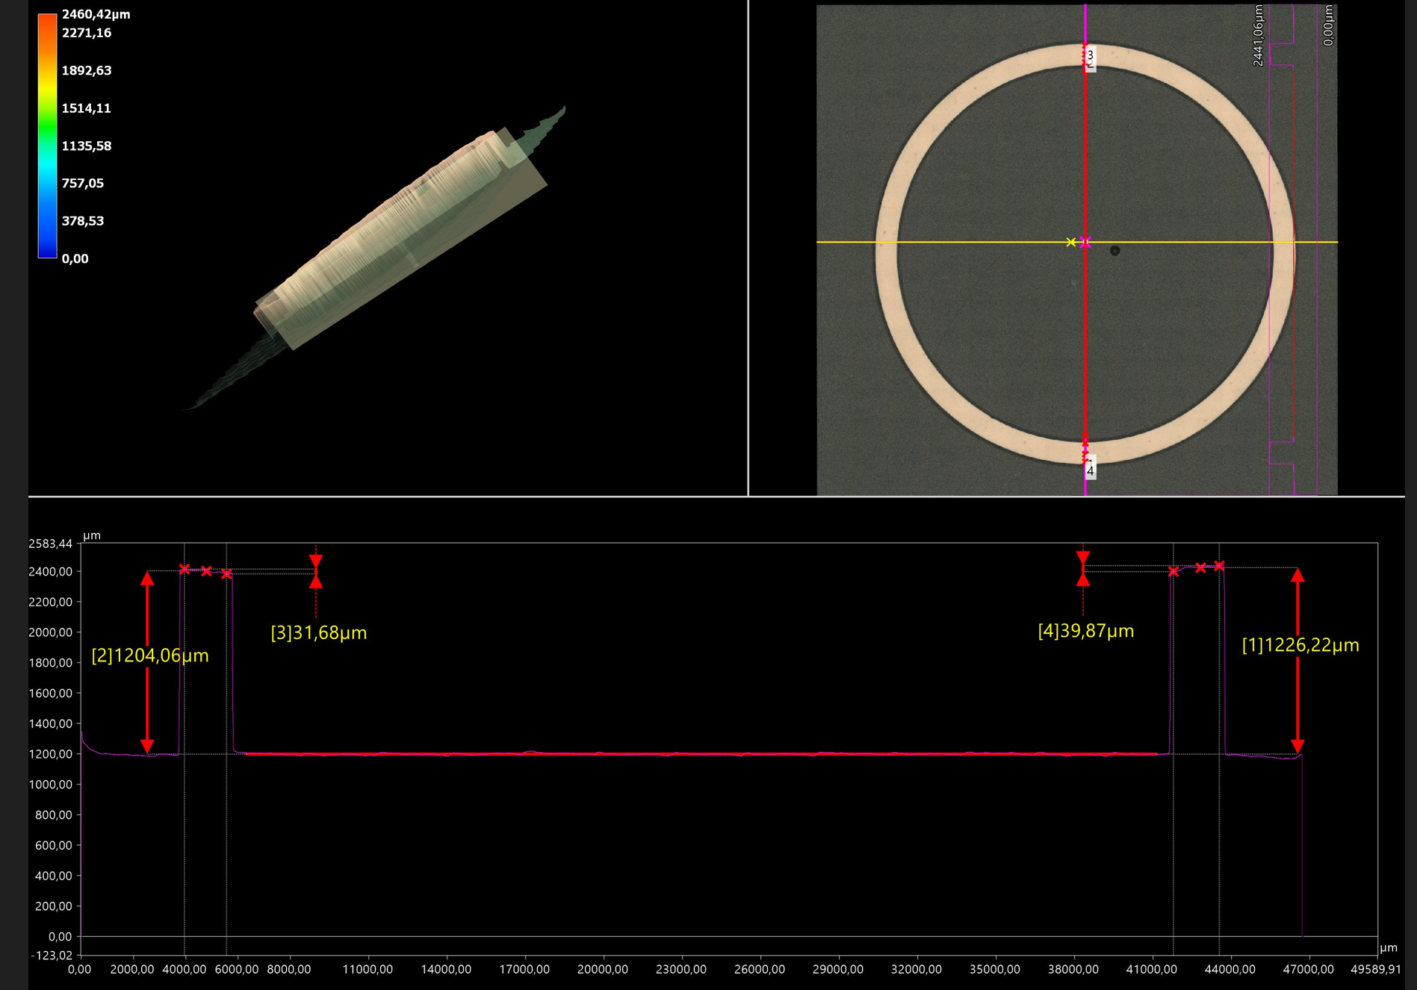
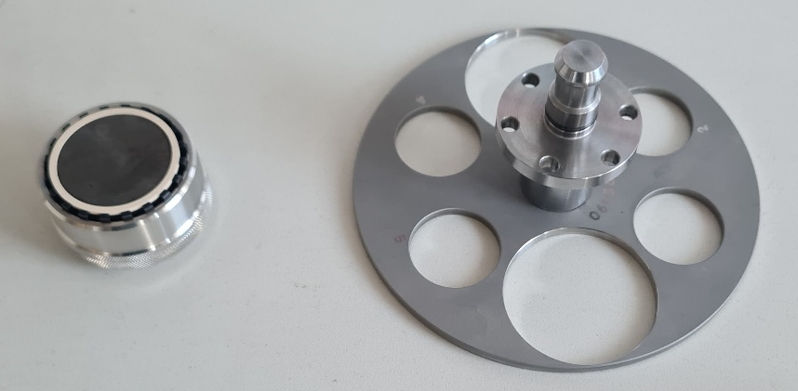
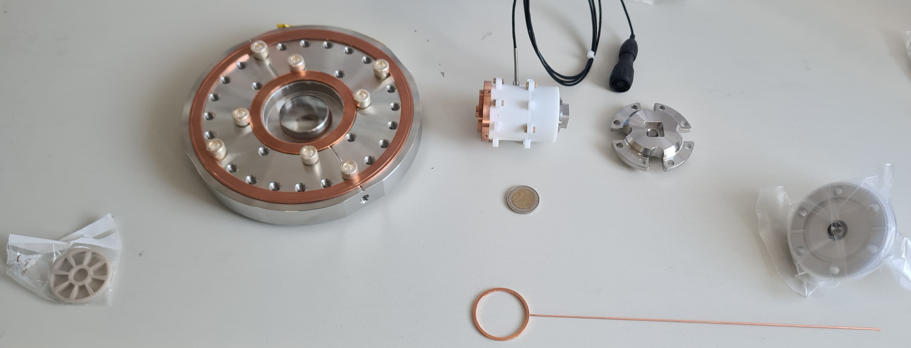
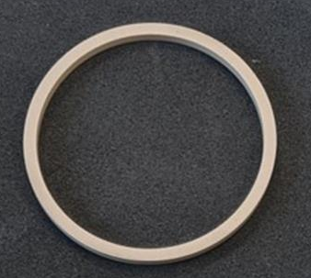
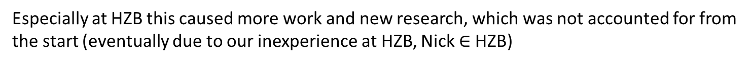
Observed issues (selection, MS1 related)
Problems?
The ferroelectric ceramics are the key component: They need to reach about 8V/µm without discharge
HZB reached 3.6V/µm in FERMAT: Reason mostly problems with surface finish and parallelism of surface → FERMAT design probes quality of sample by RF mode distribution, here also under N₂ atmosphere
CERN reached 7.2V/µm in HV teststand under vacuum
The ceramics need to properly attach to the surrounding Cu matrix, capacitor structure
Sample surface finish and parallelism/flatness of both ceramics surfaces need to be controlled to an high level → Currently studies ongoing at CERN (successful), HZB and Euclid to improve on this See talks by Alena, Nick, Sam and Alexei
FE-FRTs are very compact devices and house fragile ceramics: The design needs to avoid discharges, a safe assembly, at best particulate free assembly and lower sensitivity to mechanical tolerances
Especially at HZB this caused more work and new research, which was not accounted for from the start (eventually due to our inexperience at HZB, Nick $∈$ HZB)

Slide 6
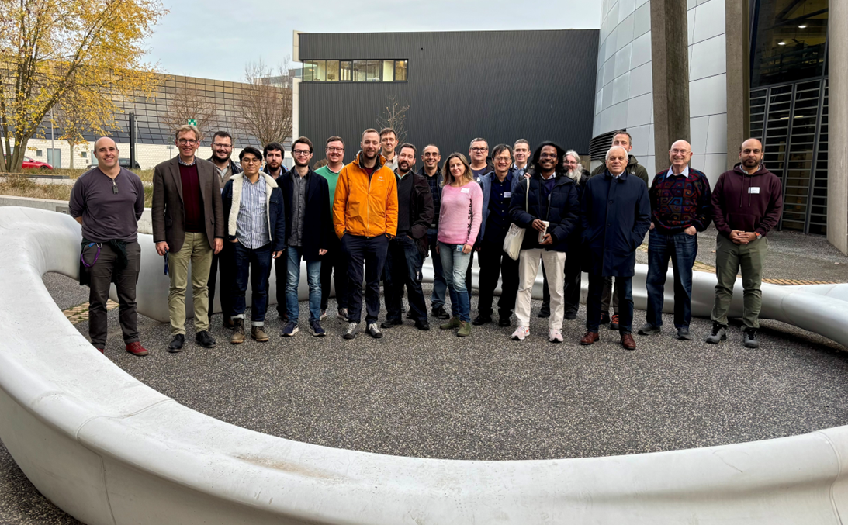
Impact on MS1: Material characterized at 1300 MHz
Milestone
In principle we have a data set for 1300 MHz measured with FERMAT teststand at HZB, but results are not satisfactory: FERMAT was improved at EUCLID, arrived back at HZB in December 2025
New measurement campaign with FERMAT in January/February 2026 with a newly hired phd student (non iSAS) and an internship student from University of Basque country
Studies of grinding, lapping and polishing of ceramics started with Lapmaster/Wolters company and other companies, several grinding polishing attempts at HZB, material characterization with XRD, etc…
Metallization studies started with several companies/institutions
Ongoing cold test at CERN and further HV breakdown tests will give further insight
Great exchange on BST ferroelectrica and their properties during FE-FRT workshop in November at HZB: 26 participants from three companies and nine research institutions/universities with 24 presentations of which eleven were iSAS related. Thanks to Nick Shipman for organizing this great event! U Lancaster (Graeme Burt) will host FE-FRT 2026!

Slide 7
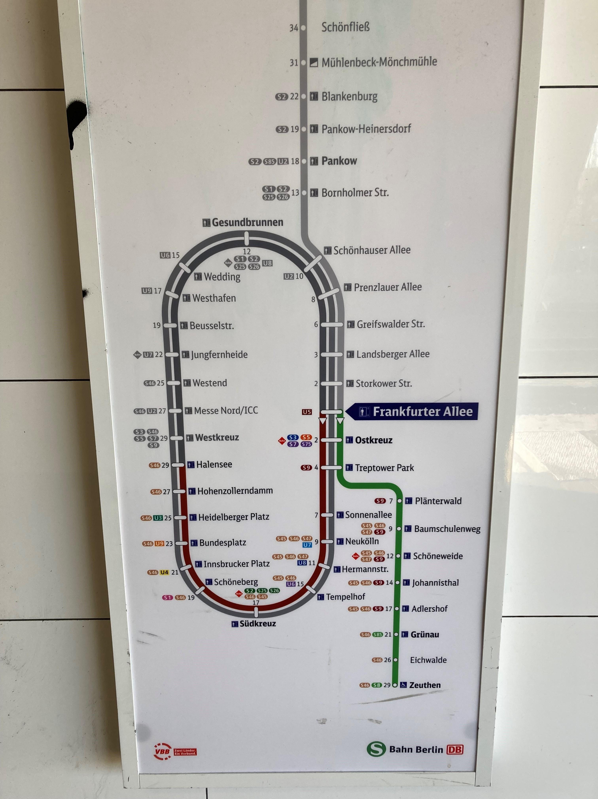


Thanks for your attention
Energy efficient multi-turn people transport Linac in Berlin (but not so reliable anymore ☹, BBU?)
HORIZON-INFRA-2023-TECH-01-01
CEA, CERN, CNRS, DESY, EPFL, ESS, HZB, INFN, NIKHEF, UKRI, univ. Brussels, univ. Lancaster
Thanks to all iSAS WP1 members for materials and their actual work!

