Slide 1

WP2: Low Level RF controls 16.12.2025
DESY, HZB, CNRS
Convener & deputy: Julien Branlard (DESY) & Christian Schmidt (DESY)
Main contacts with other partners: Axel Neumann (HZB), Christophe Joly (CNRS)
Task 2.1: Coordination of R&D on LLRF – M1-M48
Task 2.2: Efficient field control for high loaded-quality factor cavities – M1-M48
Task 2.3: Vibration analysis and detuning control of cavities – M1-M36
Task 2.4: Integrated LLRF control using Ferro-Electric Fast Reactive Tuners– M13-M48
Task 2.5: Energy efficient supervisory control and fault diagnosis– M1-M48
2026 milestone M24
2026 milestone M30
2026 milestone M33

Slide 2
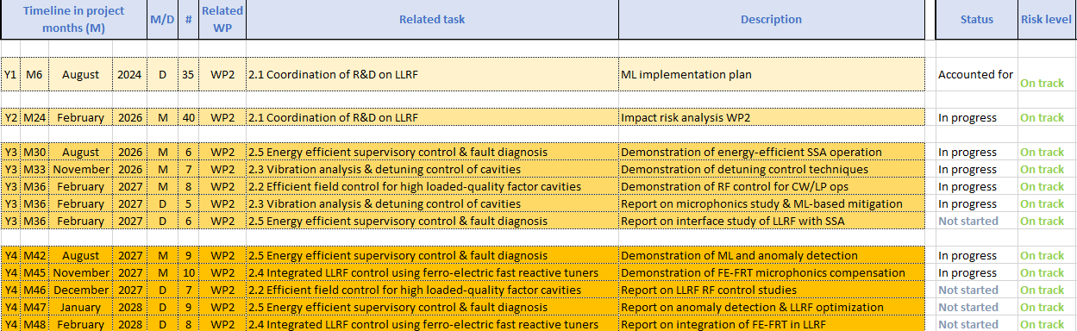
WP2 – LLRF: status/evolution of Task 2.1
Task 2.1: Coordination of R&D on LLRF – M1-M48
Opened position to support iSAS R&D activities
Candidate found, starts in December 2025 Counter-offer from industry…
How the delay in hiring was mitigated → risk analysis WP2
Industrial Support
Initial attempt with Cryoelectra didn’t work
Euclid Techlabs is now the official industrial partner for WP2
Milestones in 2026
02 / 2026 Impact risk analysis WP2 (Task 2.1)
08 / 2026 Energy efficient supervisory control and fault diagnostics (Task 2.5)
09 / 2026 Vibration analysis and detuning control of SRF cavities (Task 2.3)

Slide 3
WP2 – LLRF: status/evolution of Task 2.1
2026 milestone M24
Milestone M24 - Impact risk analysis WP2 (Task 2.1)
Identified risks and mitigation strategies
Hiring difficulties
Mitigation 1: offloading work on DESY personnel (i.e. no new hire)
Clearly should only be a temporary solution
Mitigation 2: (plan B) consulting from retirees (expertise extremely valuable)
Availability of FE-FRT for integration to LLRF
Mitigation 1: simulation work
Mitigation 2: new approaches for detuning control can be implemented with piezo
Working with industry on efficient control of SSPA
Mitigation 1: acquired our own amplifier to demonstrate proof of principle
Mitigation 2: plan to launch an in-kind contract with vendor sponsored by EuXFEL

Slide 4
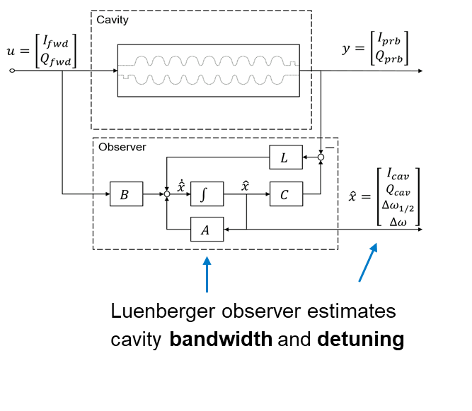
WP2 – LLRF: status/evolution of Task 2.5
2026 milestone M30
Milestone M30 – Energy efficient supervisory control and fault diagnostics (Task 2.5)
• Develop fault diagnosis and anomaly detection of LLRF systems using ML approaches
Luenberger Observer to estimate cavity bandwidth and detuning
Publication in arXiv, pending approval in in Physical Review special topic Accelerator and Beam
iSAS mentioned in acknowledgement
Development of anomaly detection in FW based on ML
Publication at IPAC 2025
https://doi.org/10.18429/jacow-ipac25-thps134
Calibration influence of environmental based on ML
Publication at IPAC 2025
https://doi.org/10.18429/jacow-ipac25-thps135

Slide 5
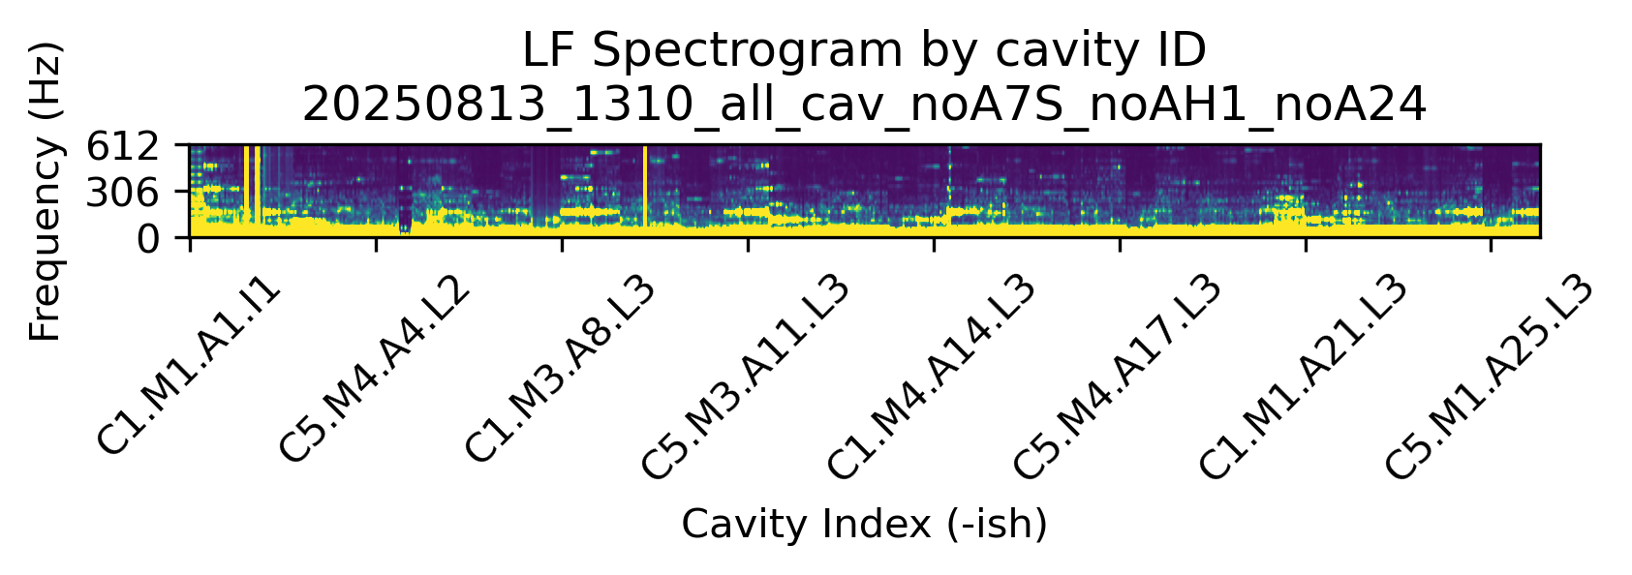
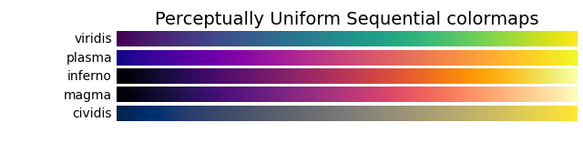
WP2 – LLRF: status/evolution of Task 2.3
2026 milestone M33
Milestone M33 – Vibration analysis and detuning control of cavities (Task 2.3)
Characterize environmental disturbances. DONE + more to come
Vibration measurement at XFEL (CMTB and AMTF)
2025-08-13 XFEL w.o. AH1, A7S, A24
Courtesy J. Einstein-Curtis
612
low
Vibration Amplitude
high
306
Frequency (Hz)
0
CS1
CS2
CS3
CS4
CS5
CS6
CS7
CS8
CS9
CryoString#

Slide 6
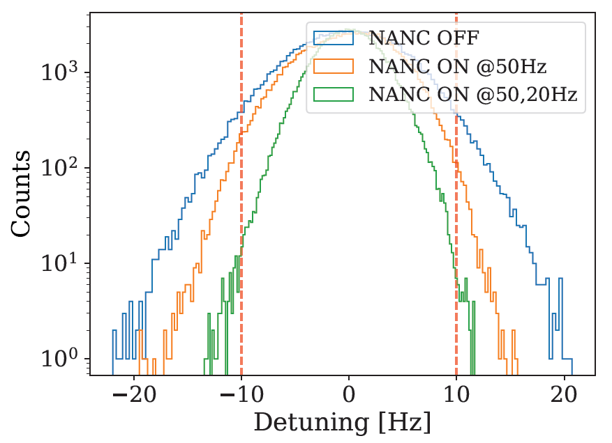
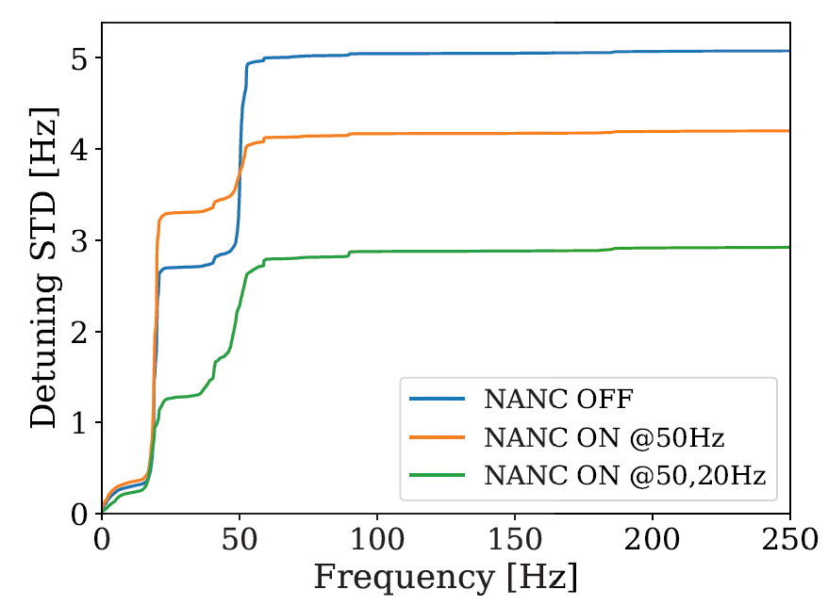
WP2 – LLRF: status/evolution of Task 2.3
2026 milestone M33
Milestone M33 – Vibration analysis and detuning control of cavities (Task 2.3)
Microphonics suppression to allow high gradient operation
Development of Narrow bandwidth Active Noise Cancellation (NANC) algorithm and demonstration at SLAC (LCLS-II)
With NANC off, the cavity could operate at max 9 MV/m With NANC on, the cavity can be operated at 16 MV/m (78% improvement!!!)
Courtesy B. Richter, J. Diaz
UNPUBLISHED
UNPUBLISHED

Slide 7
WP2 – LLRF: plans to achieve milestones & deliverables
2026 Deliverables and Milestones are well on track

