Slide 1


WP4: High-Order Mode (HOM) dampers Fundamental Power couplers (FPC) Steering Committee, December 16, 2025
All information contained in this presentation and any accompanying documents is for iSAS project only, and must be treated as strictly confidential.
Any dissemination, distribution or other use of this information without the consent of its owner is prohibited.
Funded by the European Union. Views and opinions expressed are however those of the authors only and do not necessarily reflect those of the European Union or the European Commission. Neither the European Union nor the granting authority can be held responsible for them.

Slide 2
WP4: HOM et FPC
CERN, CNRS ( IJCLab, LPSC), INFN
Convener: Y. GOMEZ MARTINEZ (CNRS/ LPSC)
Main contacts with other partners: V. PARMA (CERN), P. DUCHESNE (CNRS/IJCLaB), D. GIOVE (deputy INFN)
Task 4.1: General coordination of WP4 March 24 – March 28 CNRS, INFN
Task 4.2: HOM coupler design March 24 – August 25 INFN, CNRS, CERN
At 800MHz and 1,3 GHz with the goal to minimize static and dynamic heat loads on the cryogenic circuits of the cryomodule
Task 4.3: Fabrication of HOM couplers May 25 – February 28 CERN, CNRS, CERN
4 HOMs 800 MHz and 1 HOM at 1,3 GHz with the goal of employing cost and production-time reduction techniques
Task 4.4: Test of HOM couplers Nov 25 – Mai 26 CNRS, INFN
On mono-cell and multi-cell 800 MHz and 1,3 GHz mock-up cavities at 300 K
Task 4.5: FP coupler design March 24 – June 25 CERN, CNRS
With the goal to improve sustainability
Task 4.6: Fabrication of FP couplers July 25 – Mai 26 CERN, CNRS
4 new 800 MHz FPC with the goal of employing cost and production-time reduction techniques.
Task 4.7: Test of FP couplers Feb 26 – November 26 CERN, CNRS
Preparation & RF conditioning 800 MHz, 50 kW CW

Slide 3
WP4 – HOM et FPC: status/evolution of Task 4.1
General coordination of WP4
Past developments
18 WP4 meetings held / two technical review ( 800 MHz & FPC)
2 technical reviews done ( 800MHz HOM couplers & 800MHz FPC couplers)
Two milestones (FPC and HOM design report) sent in time
Current developments
With WP6 : Post doc position transfer INFN to IJCLab on progress
WP4 agrees with the new dates of milestones proposed by the project. To define the new dates for deliverables.
INFN, CNRS and CERN: Preliminary proposal to change the design, fabrication and test of a 1,3 GHz HOM couplers for designing, manufacturing and testing of a Beam Line Absorbers (BLA) in the process of being accepted by all participants
WP4 work plan update
2026 milestones :
Participation to the iSAS intermediary report with the impact risks (January 2026)
Report of the manufacture of 800 MHz HOM coupler ( Decembre 2026)

Slide 4
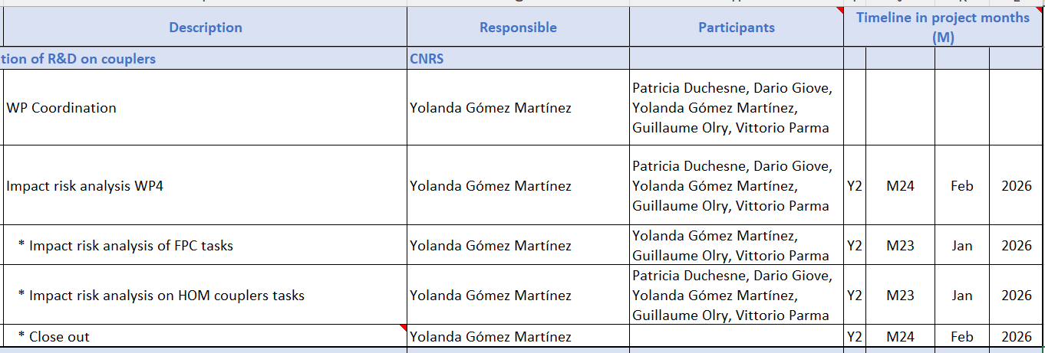
WP4 – HOM et FPC: status/evolution of Task 4.1
General coordination of WP4. Work plan

Slide 5
WP4 – HOM and FPC: status/evolution of Task 4.2
800 MHz HOM coupler design.
Past developments
Studies done:
RF calculations studies (P.Duchesne/IJCLab/CNRS)
Thermal calculations (P.Duchesne/IJCLab & K .Candera/CERN)
Preliminary multipacting simulations (A.Placais/LPSC/CNRS)
Update of the design carried out by IJClab (S. Blivet, G. Olivier, P.Duchesne) taking into account the remarks from the CERN (M.Garlasche & S. Barriere ) feasibility fabrication study

Slide 6
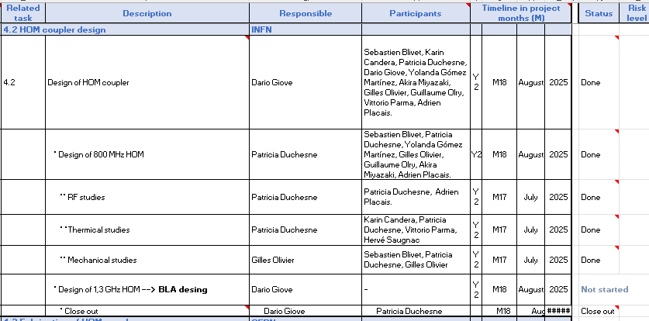
WP4 – HOM and FPC: status/evolution of Task 4.2
800 MHz HOM coupler design. Work plan
Milestone for 800 MHz HOM coupler finished
Proposition to change design 1,3 GHz to BLA design. To be included inside the task 4.2? milestone ‘Design report of HOM couplers’ to update with the design report of BLA or to do a new milestone deadline M27 May 2026?

Slide 7
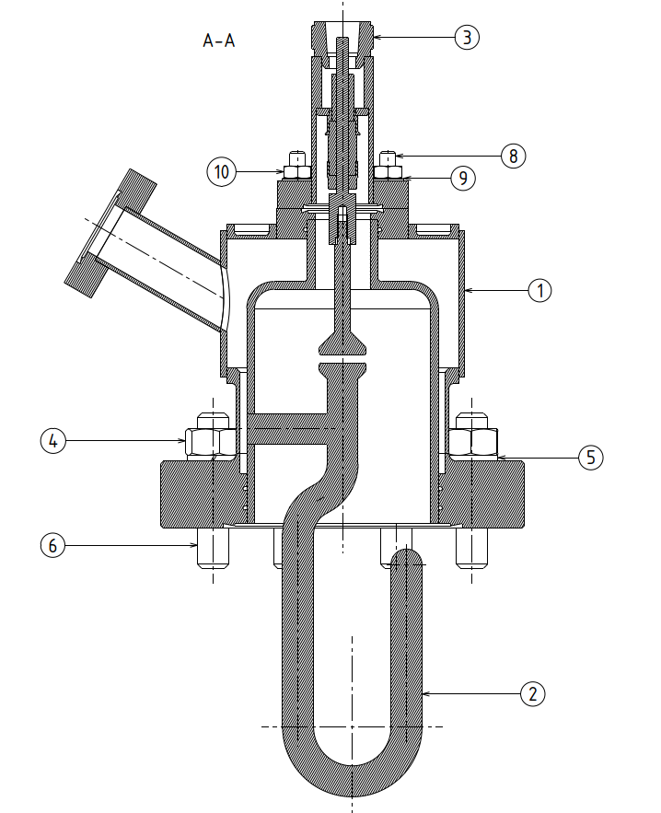
WP4 – HOM and FPC: status/evolution of Task 4.3
Fabrication of 800 MHz HOM couplers.
Past developments
Feasibility fabrication study (M.Garlasche & S. Barriere / CERN)
Coupler design file ( drawings and step) sent ( 8/12/2025) by IJC Lab ( P.Duchesne) to CERN taking into account the remarks from the CERN feasibility fabrication study
Current developments
CERN give it a second round of check and prepare it for production
c/o IJC Lab ( S.Blivet, G.Olivier and P.Duchesne)

Slide 8
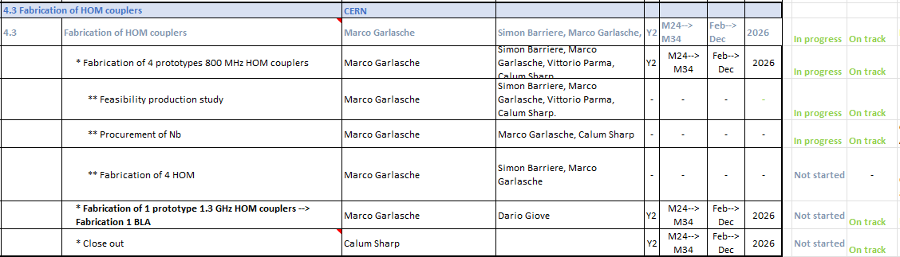
WP4 – HOM and FPC: status/evolution of Task 4.3
Fabrication of 800 MHz HOM couplers. Work plan.
With new milestone dates all on track
CERN is going to use the Nb in stock to manufacture the 4 HOM couplers. An order to remplace the Nb used is on progress.
Coupler design file ( drawings and step) sent( 8/12/2025) by IJC Lab ( P.Duchesne) to CERN taking into account the CERN request. CERN give it a second round of check and prepare it for production.
Proposition: to change 1,3 GHz HOM to BLA manufacture. To be included inside the task 4.3 and the report of fabrication of BLA to be included in the milestone 4.3 ‘report of fabrication of HOM couplers’ planned for M34 (December 2026) or new one planned for summer 2026?)

Slide 9
WP4 – HOM et FPC : status/evolution of Task 4.4
Test of 800 HOM couplers
Past developments
Nothing to report
Current developments
Nothing to report

Slide 10
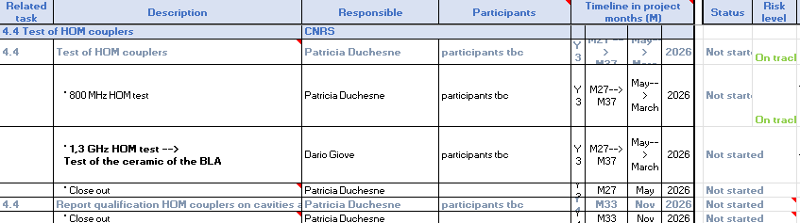
WP4 – HOM et FPC : status/evolution of Task 4.4
Test of 800 HOM couplers . Work plan
With new milestone dates all on track
To change the test of 1,3 GHz coupler to test of the ceramic of the BLA: to be included inside the task 4.4 and ‘report test of BLA’ to be included in the milestone 4.4 ‘report of test of HOM couplers’ planned for M37 (March 2027)?)

Slide 11
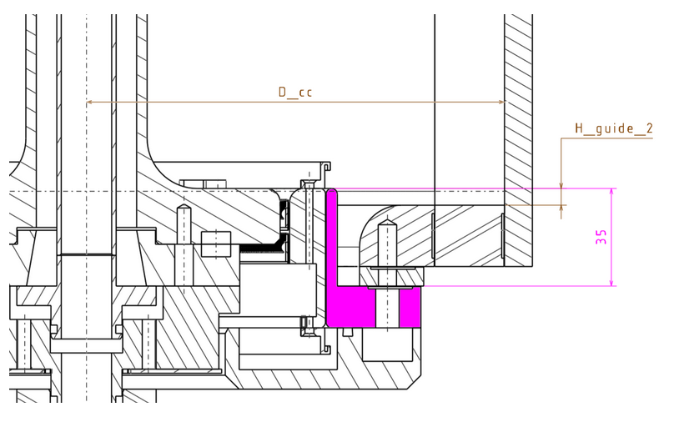
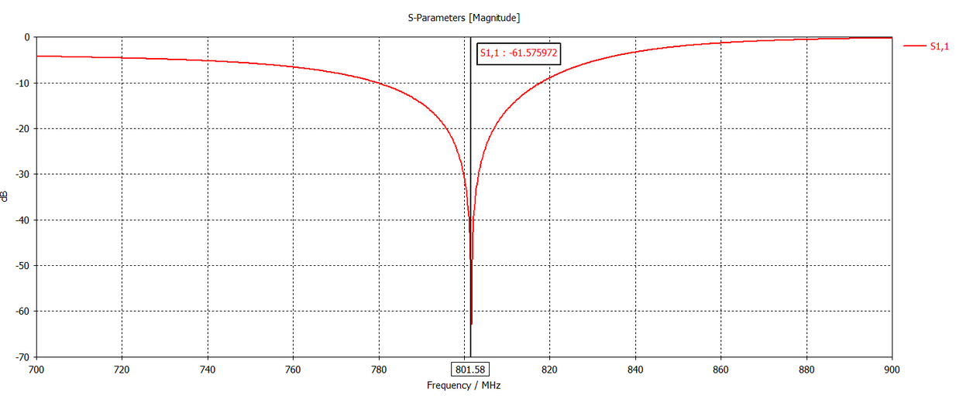
WP4 – HOM and FPC: status/evolution of Task 4.5
FP coupler design
Past developments
Studies done :
RF ( P. Duchesne/IJCLab & J.Angot/LPSC) and preliminary multipactor studies ( A. Placais & Y. Gómez/ LPSC)
Thermal studies (C.Sharp & K. Candera / CERN & P. Duchesne/IJCLab)
Integration in the WP6 cryomodule and test bench (G.Olivier & S. Blivet/ IJCLab)
Assembly of the coupler ( C.Sharp/CERN)
Update of the design carried out by J. Angot ( LPSC) & P.Duchesne ( IJC Lab) taking into account the remarks from the CERN ( C.Sharp) feasibility fabrication study
H_guide = 13.0 +0 -0.05
D_cc=193.3 +0 +0.05
c/o J. Angot (LPSC) and P.Duchesne (IJCLab) for re-using SPL condensateurs

Slide 12
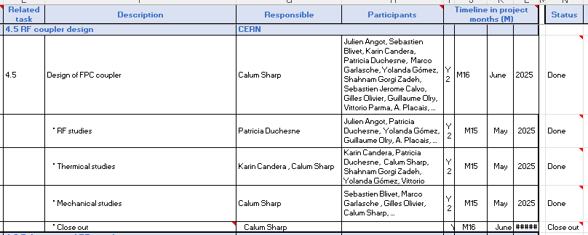
WP4 – HOM and FPC: status/evolution of Task 4.5
FP coupler design
Milestonefinished

Slide 13
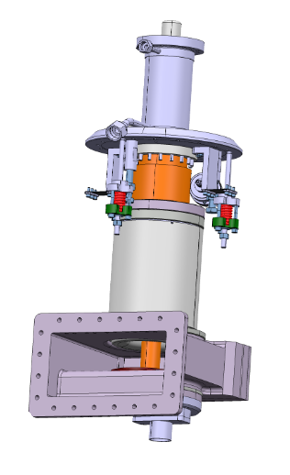
WP4 – HOM and FPC: status/evolution of Task 4.6
Fabrication of FP couplers
Past developments
Feasibility production (C. Sharp/CERN) study
Current developments
Drawings expected for beginning 2026
c/o S.Blivet

Slide 14
WP4 – HOM and FPC: status/evolution of Task 4.7
Test of FP couplers
Past developments
RF conditioning at 800 MHz@ 50 kW CW chosen ( on technical review carried out on 13/05/2025)
Current developments
Nothing to report

Slide 15
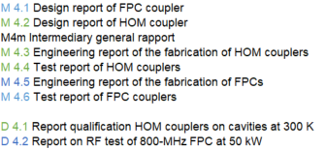
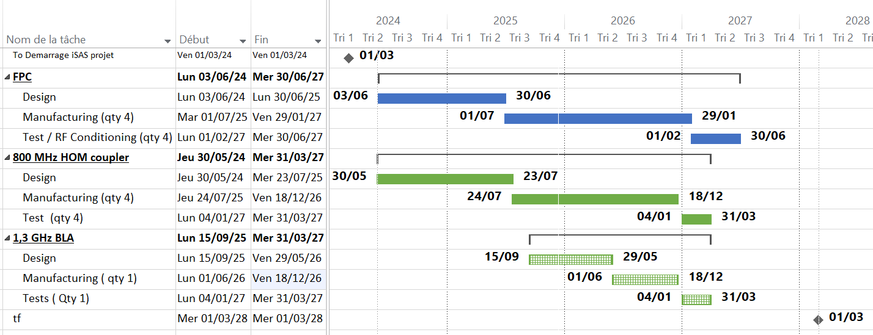
WP4 – HOM et FPC :
plans to achieve milestones & deliverables
With the new dates of the milestones dates proposed by the project on 01/10/25:
M4.1
M4.2
M4m
D4.1
D4.2
M4.5
M4.6
M4.3
M4.4
today

Slide 16
Thank-you for your attention
Yolanda Gómez Martínez on behalf of the WP4 team:
CERN : Sebastien Jerome Calvo, Karin Canderan, Marco Garlasche, Vittorio Parma, Calum James Sharp …
INFN : Dario Giove (deputy), …
CNRS / IJCLab : Patricia Duchesne, Gilles Olivier, Guillaume Olry, Sebastien Blivet, …
CNRS / LPSC : J. Angot, Yolanda Gómez Martínez (convener), Adrien Plaçais.

