Slide 1


WP5: Integration into a new LINAC Cryomodule Steering Committee, Dec 16, 2025 (Short update) WP Leader: Nuno Elias (ESS) WP Deputy: Vittorio Parma (CERN)
All information contained in this presentation and any accompanying documents is for iSAS project only, and must be treated as strictly confidential.
Any dissemination, distribution or other use of this information without the consent of its owner is prohibited.
Funded by the European Union. Views and opinions expressed are however those of the authors only and do not necessarily reflect those of the European Union or the European Commission. Neither the European Union nor the granting authority can be held responsible for them.

Slide 2
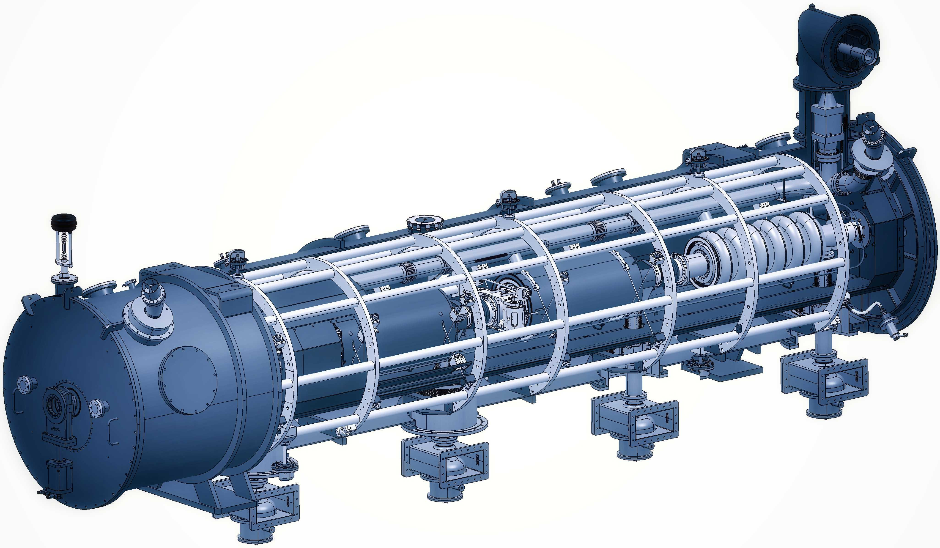
WP5: Integration into a new LINAC Cryomodule
ESS | CNRS | CERN | EPFL
WP Leader: Nuno Elias (ESS)
Main contacts with other partners: G. Olry (CNRS), V. Parma. CERN); M. Siedel (EPFL)
The design of any LINAC cryomodule is optimised to meet the specific research objectives of the accelerator facility, while addressing common challenges such as high-power electric fields, ultra-low temperatures, ultra-high vacuum, precise alignment, etc.
WP5's main goal is to tackle the common engineering challenges of integrating iSAS technologies into a parametric design of a new cryomodule. , building on developments made with ESS cryomodules whilst benchmarking against other facilities
In addition, to unlock the full energy-saving capability of this cryomodule, the objective of WP5 is to also address the challenging beam dynamics requirements when operating the new cryomodule in Energy Recovery Linacs with recirculating beams.

Slide 3
WP5: Integration into a new LINAC Cryomodule
ESS | CNRS | CERN | EPFL
Convener: Nuno Elias (ESS)
Main contacts with other partners: G. Olry (CNRS), V. Parma. CERN); M. Siedel (EPFL)
Task 5.1: Coordination on cryomodule design activities– M1-M48
• General coordination by ESS as described above.
Task 5.2: ESS cryomodules experience and benchmarking with other recent facilities– M1-M36
• Compile the lesson learned from the ESS CM testing activities, technical commissioning, and initial operation.
• Benchmarking with projects in the implementation phase (worldwide).
• Develop a roadmap to develop a new, sustainable CM design.
Task 5.3: Sustainable criteria for LINAC cryomodule design– M24-M48
• Integrate findings from the other iSAS WPs into a generic CM design.
• Explore the sustainability criteria for the design.
Task 5.4: Beam Dynamics for ERL-based accelerators with energy-efficient cryomodules – M1-M48
• Simulate the beam dynamics of ERL-based accelerators when the energy efficient CM is included.
• Study the lattice design to optimize the beam and energy saving performances.

Slide 4
WP5: Integration into a new LINAC Cryomodule
ESS | CNRS | CERN | EPFL
Work Plan

Slide 5
WP5 – Coordination: status/evolution of Task 5.1
Task 5.1: Coordination on cryomodule design activities– M1-M48
• General coordination by ESS as described above.
Milestone 5.1 : In-person WP kick-off meeting at ESS (Due date: M3 or Jun-2024)
Milestone 5.1 : Impact Risk analysis (Due date: M24 or Feb-2026
Deliverable 5.1 : Compilation of ESS CM lessons learned & benchmarks (Due date: M24 or Feb-2026)
Deliverable 5.2 : Roadmap for the CM design (Due date: M36 or Feb-2027)
Deliverable 5.3 : Parametric design for a sustainable CM with iSAS tech. (Due date: M46 or Dec-2027)
Deliverable 5.4 : Report on beam dynamics study for ERL with iSAS CM (Due date: M43 or Sep-2027)
M5.1
D5.1
D5.2
D5.3
Y0
Y1
Y2
Y3
D5.4
Y4
Task 5.1
Task 5.1
M
M
Task 5.2
Task 5.2
D
D
D
D
D
Task 5.3
Task 5.3
D
D
Task 5.4
Task 5.4
D
D
D
D
D
Mar
2024
Mar
2025
Mar
2026
Mar
2027
Feb
2028

Slide 6
WP5 – Coordination: status/evolution of Task 5.1
Task 5.1: Coordination on cryomodule design activities– M1-M48
• General coordination by ESS as described above.
Past developments
Regular WP5 meetings + dedicated meetings task specific
Mar24; Apr24; Jul24; Sep24; Jan25 + (12-19)Nov24_T5.2 ; (7)Mar25_T5.4; Jul25; Sep25, Oct25
Milestone 5.1 : “In-person WP kick-off meeting at ESS” : Completed
Recruitment PhD student (EPFL): Started: (Apr-2024) ; Completed (Oct-2024): L. Vanhecke
Recruitment Junior Engineer/Scientist (ESS): Started: (Mar-2025) ; Completed (Oct-2025): E. Simpson
Included Industrial Partner (ACS) to participate in the WP5 meetings.
Current developments
Preparation of in-Person Meeting at IJCLab Planned: (28-Jan-2026):
§ Preparation to start T.5.3. /
§ Finalize M.5.1 and M.5.2 February milestones (ESS, CERN, IJCLab)

Slide 7
WP5 – Experience/Benchmark CMs: status of Task 5.2
Task 5.2: ESS cryomodules experience and benchmarking with other recent facilities – M1-M36
• Compile lesson learned from the ESS CM testing activities, technical commissioning, initial operation.
• Benchmarking with projects in the implementation phase (worldwide).
• Develop a roadmap to develop a new, sustainable CM design.
Past developments
Discussions with relevant people: ESS CM lifecycle
Gathering of relevant high-level information
Preliminary table-of-contents for ESS CM lessons learned report
Developing of on the ‘ESS CM lessons learned’ report structure
Alignment with CM ‘benchmarking template’
Current developments
New member in place (2 year assignment), report used as a good tool for training
Drafting Report Ongoing.
• Compile lesson learned from the ESS CM testing activities, technical commissioning, initial operation.
Deliverable 5.1 : Compilation of ESS CM lessons learned & benchmarks (Due date: M24 or Feb-2026)
Deliverable 5.2 : Roadmap for the CM design (Due date: M36 or Feb-2027)

Slide 8
WP5 – Experience/Benchmark CMs: status of Task 5.2
Task 5.2: ESS cryomodules experience and benchmarking with other recent facilities – M1-M36
• Compile lesson learned from the ESS CM testing activities, technical commissioning, initial operation.
• Benchmarking with projects in the implementation phase (worldwide).
• Develop a roadmap to develop a new, sustainable CM design.
Past developments
Definition of benchmarking parameters
Definition of benchmarking facilities (ESS, SNS, LHC, PIP-II, XFEL, LCLSII)
Definition of a benchmarking questionnaire (framework structure for response)
Identification of the contact list (experts) people in the different facilities
Bibliographic search completed to propose a suggestion to every answer (reviewing can be easier than completing a blank questionnaire)
Complete of the Questionnaire (pre-filled for LHC and ESS)
• Benchmarking with projects in the implementation phase (worldwide).
Deliverable 5.1 : Compilation of ESS CM lessons learned & benchmarks (Due date: M24 or Feb-2026)
Deliverable 5.2 : Roadmap for the CM design (Due date: M36 or Feb-2027)

Slide 9
WP5 – Experience/Benchmark CMs: status of Task 5.2
Task 5.2: ESS cryomodules experience and benchmarking with other recent facilities – M1-M36
• Compile lesson learned from the ESS CM testing activities, technical commissioning, initial operation.
• Benchmarking with projects in the implementation phase (worldwide).
• Develop a roadmap to develop a new, sustainable CM design.
Current developments
First trial with LHC and ESS to get a feedback on the proposed questions
Distribution of the questionnaire to the facilities (LHC, ESS, XFEL, SNS, LCLS-II, PIP-II)
Received answers to the questionnaire
Follow-up meetings ongoing to further discuss the details of the answers
• Benchmarking with projects in the implementation phase (worldwide).
Deliverable 5.1 : Compilation of ESS CM lessons learned & benchmarks (Due date: M24 or Feb-2026)
Deliverable 5.2 : Roadmap for the CM design (Due date: M36 or Feb-2027)

Slide 10
WP5 – Design new CM: status/evolution of Task 5.3
Task 5.3: Sustainable criteria for LINAC cryomodule design – M24-M48
• Integrate findings from the other iSAS WPs into a generic CM design.
• Explore the sustainability criteria for the design.
Past developments
This task is set to start on M24 (Mar26)
Current developments
Started conversations within the WP
Attention to Sustainability criteria strategies applied to “Technology Areas”.
Attention to implementation of performance criteria of technology areas and its integration.
Breakdown of CM sub-systems (<- input from benchmarking)
Discussions on KPI associated with each sub-system.
Brainstorming of ideas initiated in Oct (focus on design decision trees, standardization of components
Plan in-person meeting at IJCLAB in 28-Jan-2026, to prepare for a smooth start, meeting focus mostly on task 5.3.prepare with parametric design (create a team)
Deliverable 5.3 : Parametric design for a sustainable CM with iSAS tech. (Due date: M48 or Feb-2028)

Slide 11


WP5 – Design new CM: status/evolution of Task 5.4
Task 5.4: Beam Dynamics for ERL-based accelerators with energy-efficient cryomodules – M1-M48
• Simulate the beam dynamics of ERL-based accelerators when the energy efficient CM is included.
• Study the lattice design to optimize the beam and energy saving performances.
Past developments:
Meetings with PERLE collaboration, discussing details on the RF structure and HOM’s
Evaluated and tested beam dynamics codes to enable ERL simulations
Written code to enable flexible simulations and gathering of results
Benchmarking of beam dynamics tracking codes
Development of Multi bunch and multi pass simulation
Current developments:
General SRF cavity beam dynamic studies
short-range and long-range wakefields (HOM’S)
Development of Wakefield and Beam Loading models in RF track
single- and multi-bunch instabilities (iSAS/PERLE) cavity / lattice in RF-Track
General energy recovery efficiency studies after the degrading of beams throughout an ERL or ERL collider
Evaluate ERL collider/light source applications for iSAS technology and perform studies on these applications
Deliverable 5.4 : Report on beam dynamics study for ERL with iSAS CM (Due date: M43 or SEP-2027)

Slide 12
WP5 – Title: points of attention
Points of attention: (none)
Setup of regular meetings (1/month)
Aligning with WP6 on design and integration
Deadline of Task 5.4 (ERL beam studies in Sep-2027: 5month earlier than eop)

Slide 13
WP5 – Title: financial status
Financial status :
No deviations reported

Slide 14
Thank you

