Slide 1


WP6:Integration into Accelerator and Collider RIs
16 Dec 2025
refurbished slides from Advisory BOard
All information contained in this presentation and any accompanying documents is for iSAS project only, and must be treated as strictly confidential.
Any dissemination, distribution or other use of this information without the consent of its owner is prohibited.
Funded by the European Union. Views and opinions expressed are however those of the authors only and do not necessarily reflect those of the European Union or the European Commission. Neither the European Union nor the granting authority can be held responsible for them.

Slide 2
WP6: Integration into Acc&Collider RIs
Institutes participating: CNRS, CEA, ESS, INFN, Uni. Lancaster
Convener: G. Olry (CNRS/IJCLab)
Main contacts with other partners : A. Madur, deputy (CEA), N. Elias (ESS), D. Giove (INFN), G. Burt (UL) + in WP4: Y. Gomez Martinez (CNRS/LPSC) and V. Parma (CERN)
Task 6.1 (CNRS): Coordination – M1-M48
  • General coordination in collaboration with WP4 on HOM and RF couplers and WP1 on FE-FRT development.
Task 6.2 (UL, CNRS): Retrofitting Fast Reactive Tuners into existing cryomodules HL-LHC oriented – M1-M24
  • Investigate if the existing cavity end group can be used with an FE-FRT by combining the FE-FRT and a HOM coupler into a single device.
Task 6.3 (CNRS, CEA, ESS): Adapt the existing ESS cryomodule – M1-M18
  • Adaptation of the existing ESS cryomodule into a new configuration which will integrate a completely new cavity string equipped with the optimized HOM and FPC couplers developed in WP4
Task 6.4 (INFN, CNRS, ESS, UL): Fabrication and validation of cryomodule components – M1-M30
  • Fabrication, preparation and test of the critical components (SRF cavity, tuning systems, HOM couplers, ...)
Task 6.5 (CEA CNRS, ESS): Assembly and test of adapted cryomodule – M30-M48
  • Assembly and cryogenic & RF test of the cryomodule.

Slide 3
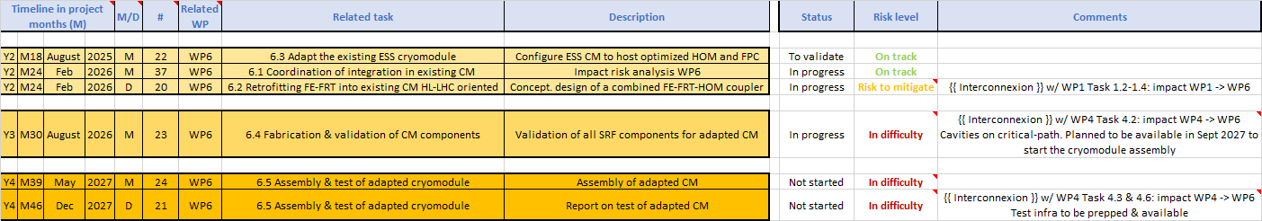
WP6 Task 6.1 - General coordination : status/evolution
Done
  10 meetings in 2025 + joint meetings with WP4 and also WP5.
On-going:
  WP4 PostDoc position initially for HOM couplers: redirected to power couplers activity (RF conditioning), HOM couplers (RF measurements) and beam line absorbers studies → linked to WP6. → Agreed between partners. First interview with a PhD Student from Northern Illinois Univ (PhD defense on June 2026)
Mid-term:
  Nov 2025: Post-doc position to be published → delayed (need to receive the funds)
  Dec 2025: Work plan to be completed → delayed (1st draft but not finalized)
  Feb 2026: Risk analysis to be finalized but cavities are still “targeted”

Slide 4
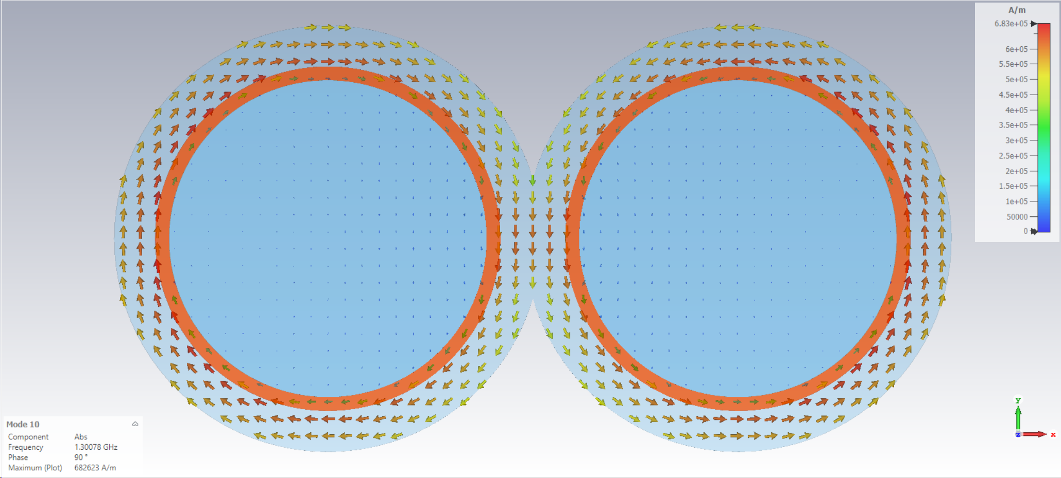
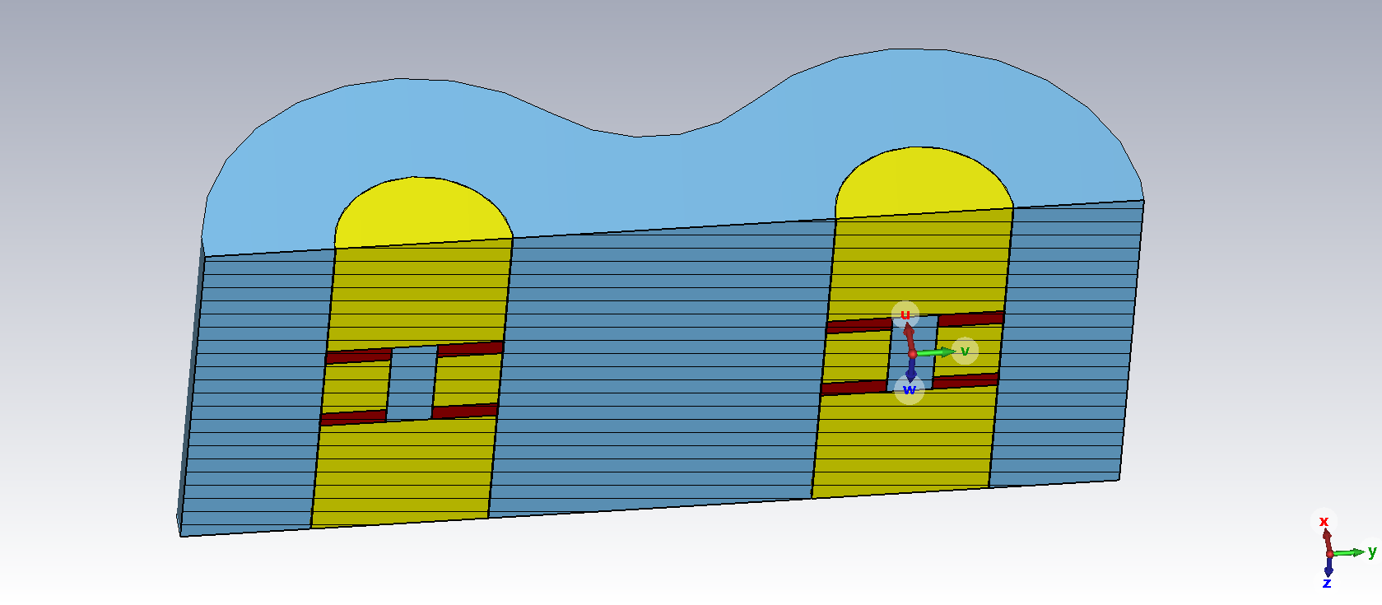
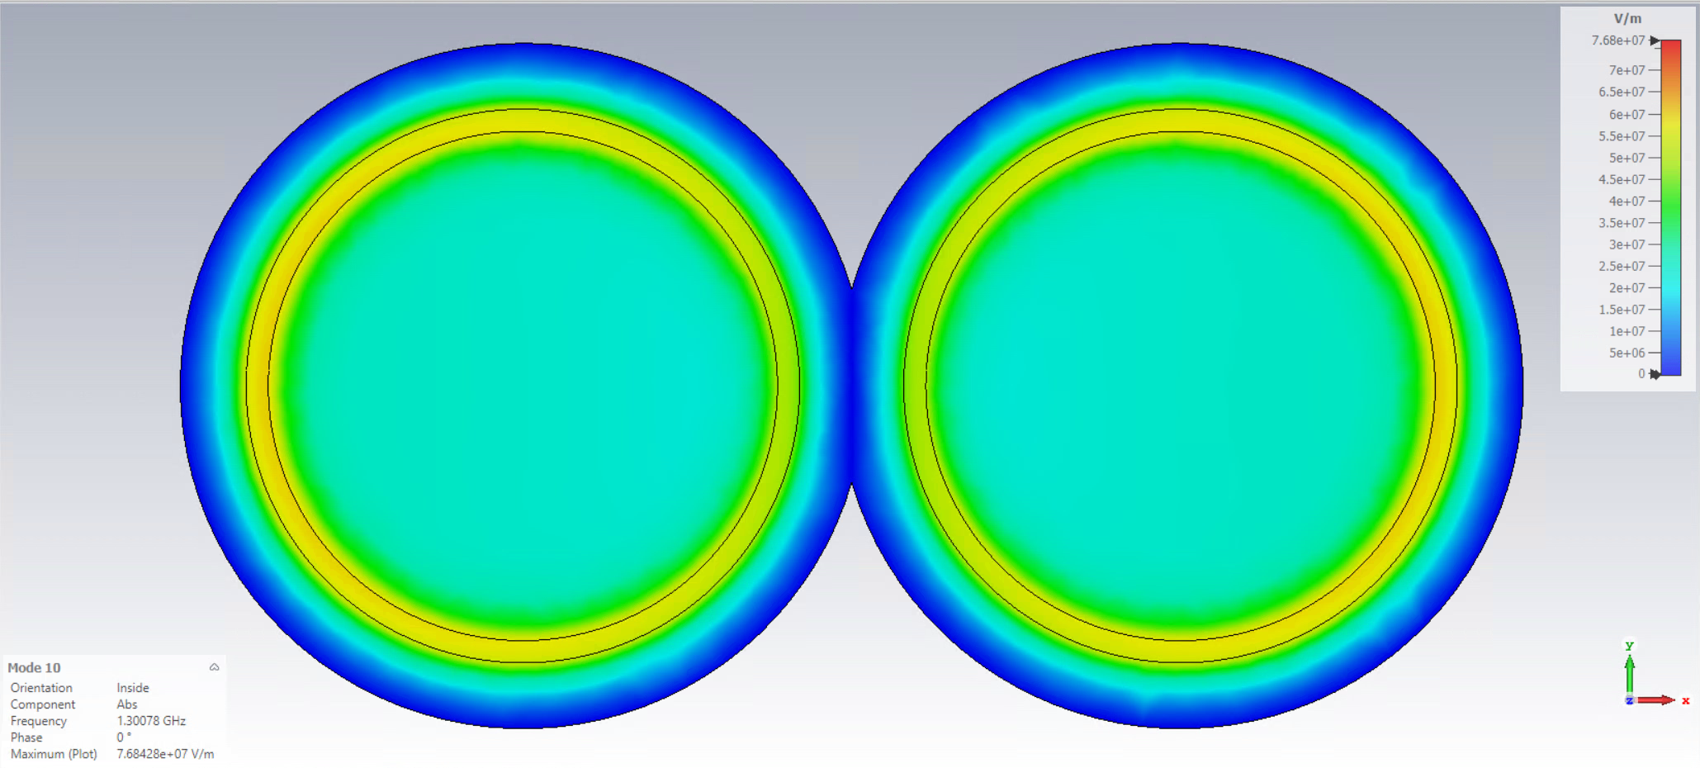
WP6 Task 6.2 – Retrofitting FRT: status/evolution
Current developments
  Working in a new “dipole” FRT design that may integrate easily with a HOM coupler
  Simplifies biasing, reduces harmonics, and couples to a twin-ax line which can inductively couple to HOM coupler
  Study of harmonic generation continues, working on an equivalent circuit for an FRT to study this, using mixers.
Mid-term developments
  Need an FRT design to finalize the study as we need to know the mode spectrum.
  Start on the integrated HOM coupler design soon
→ D20 delivery in Feb 2026 might be better to delay (Aug 26) as we started 6 months late. Could deliver something by Feb 2026 but it would not be complete.

Slide 5
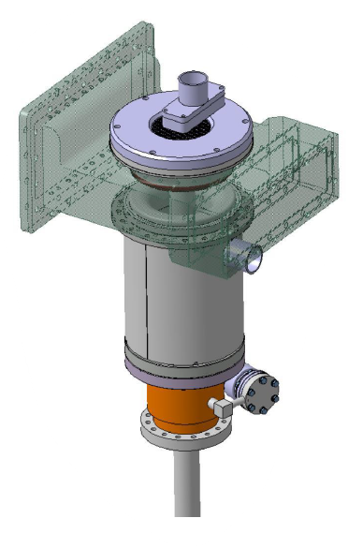
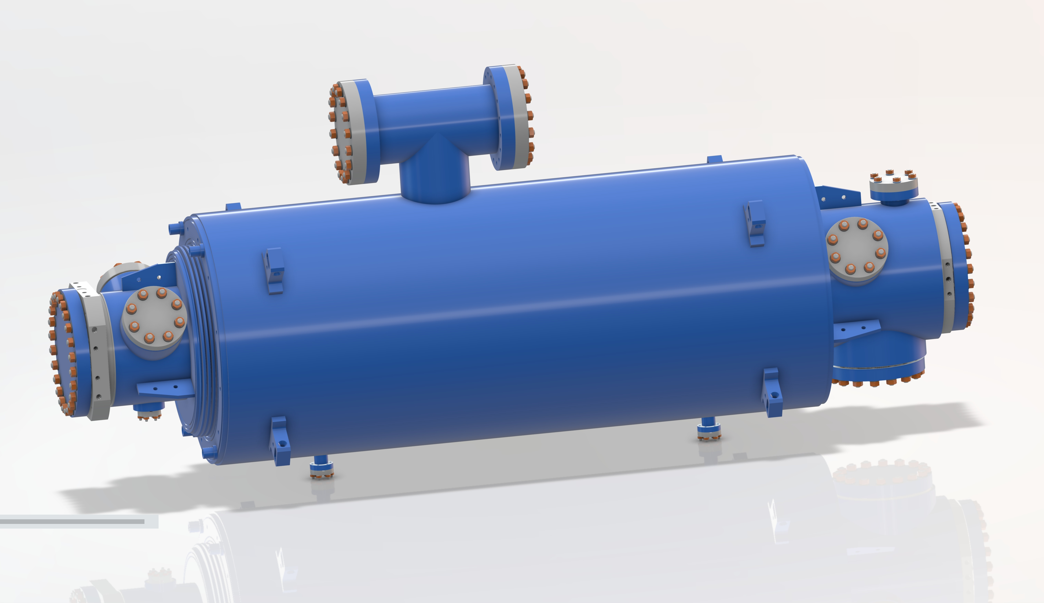
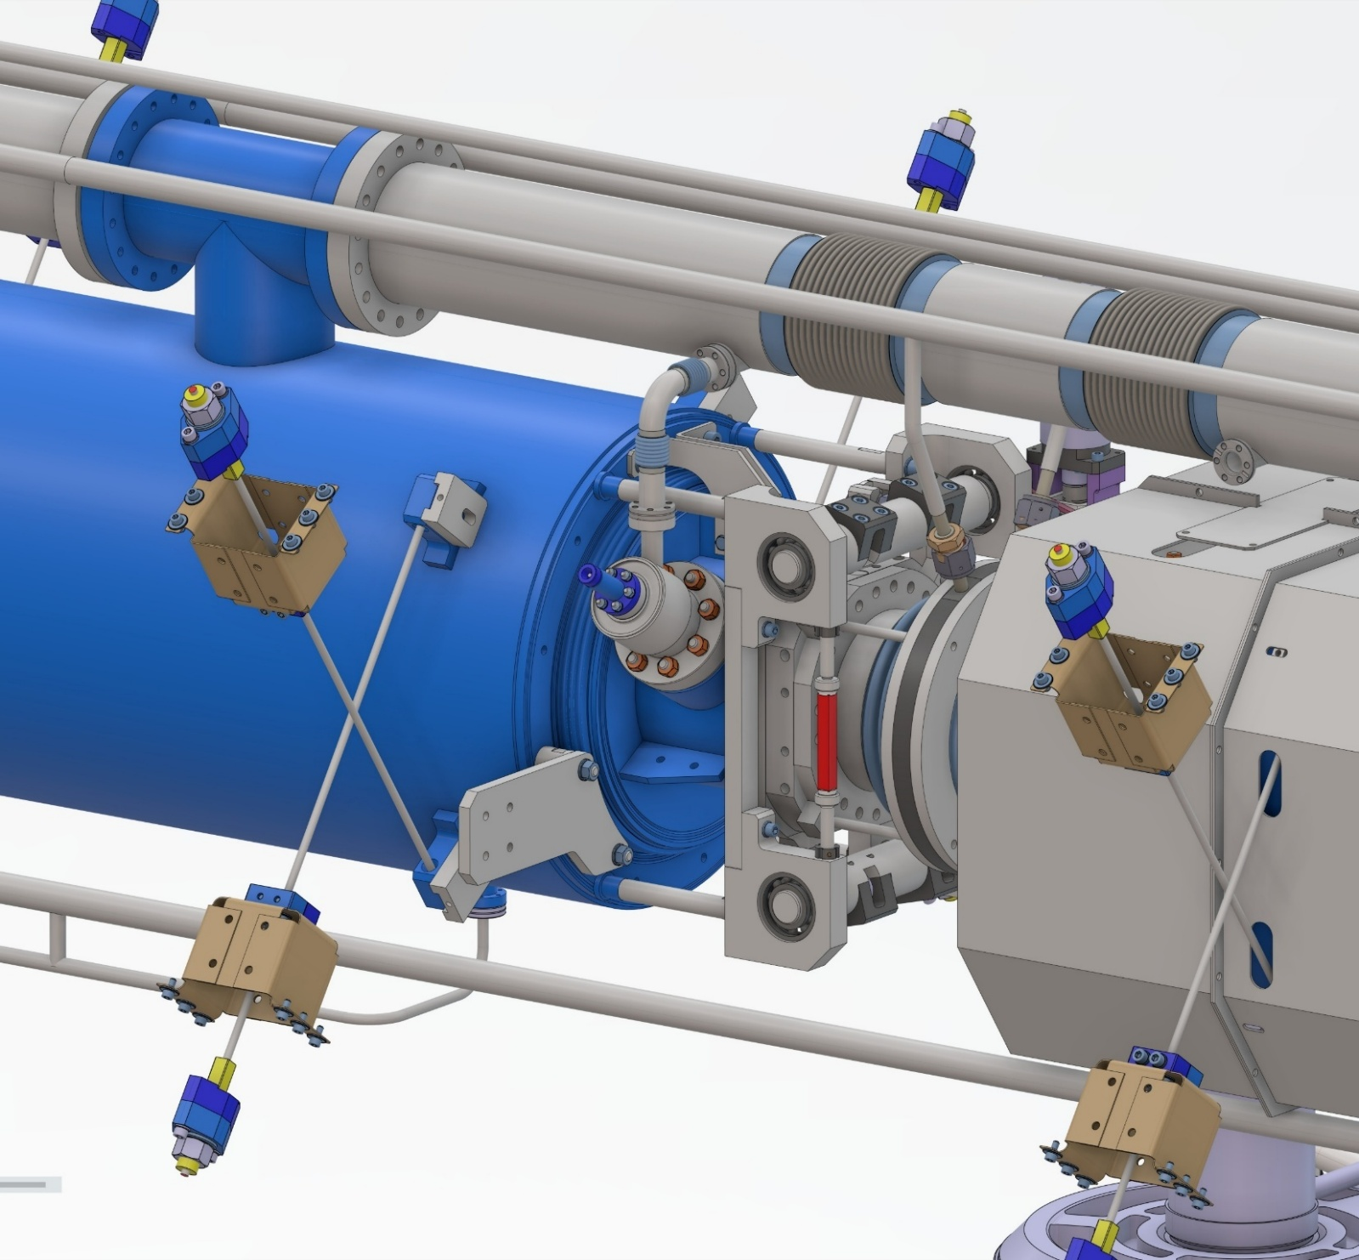
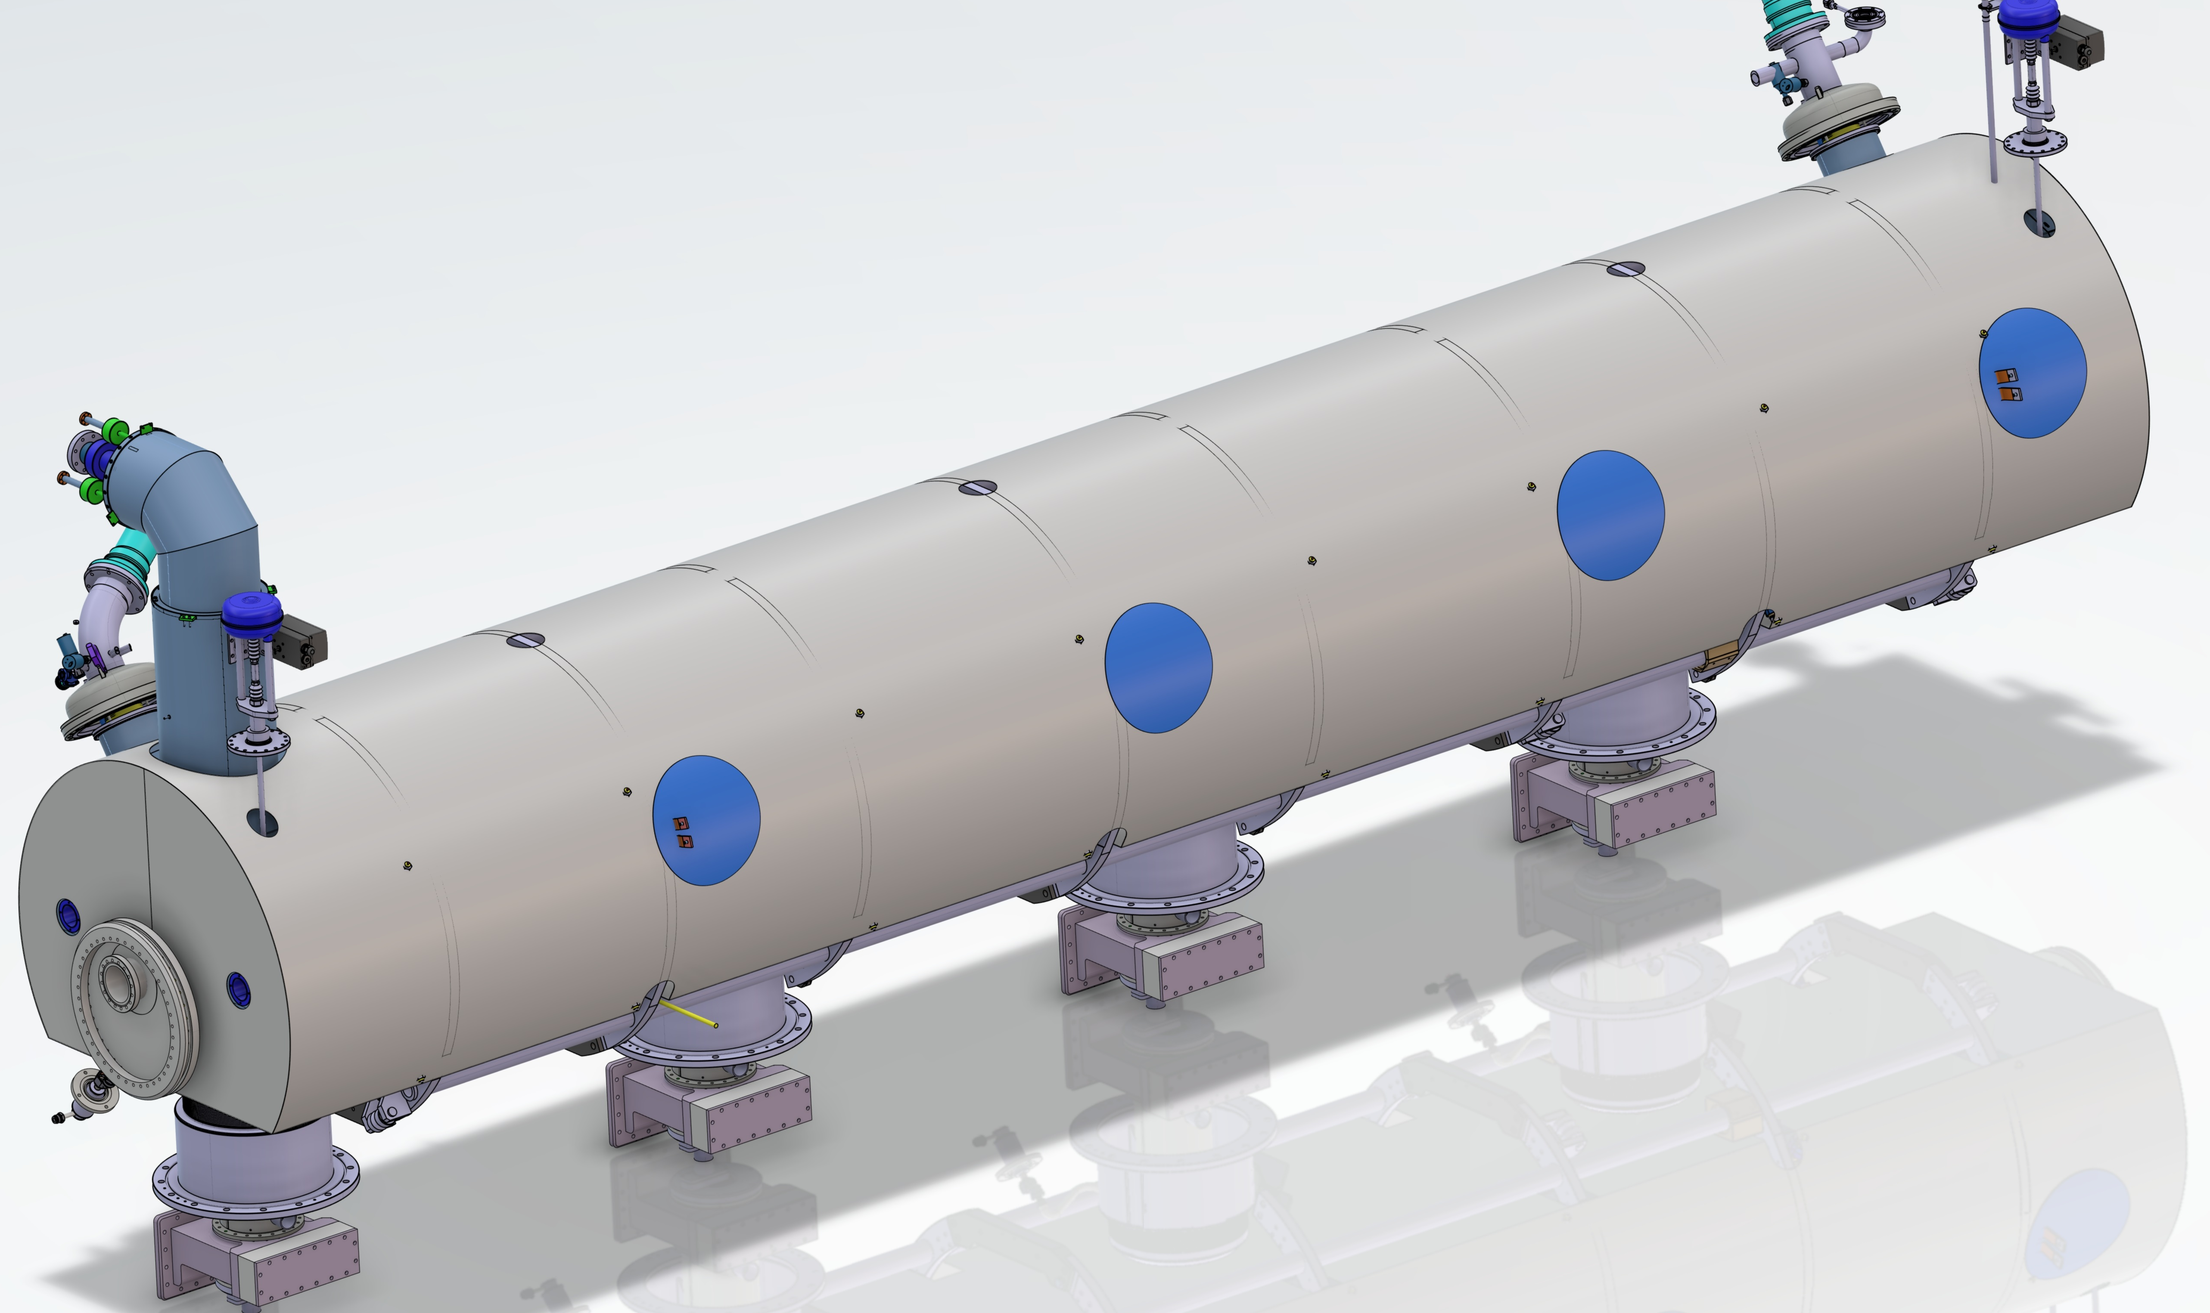
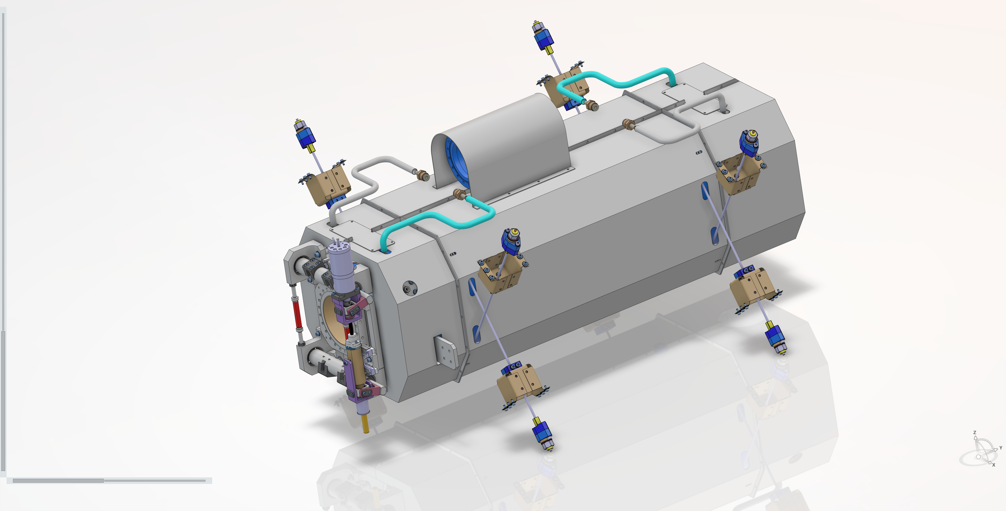
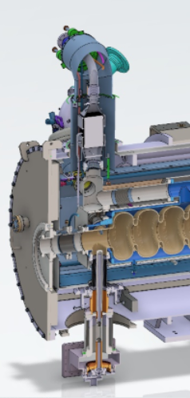
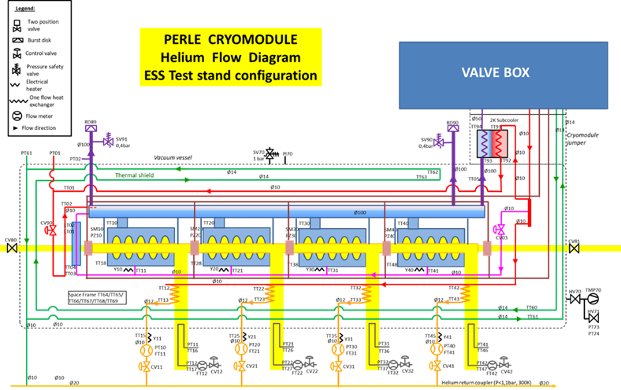
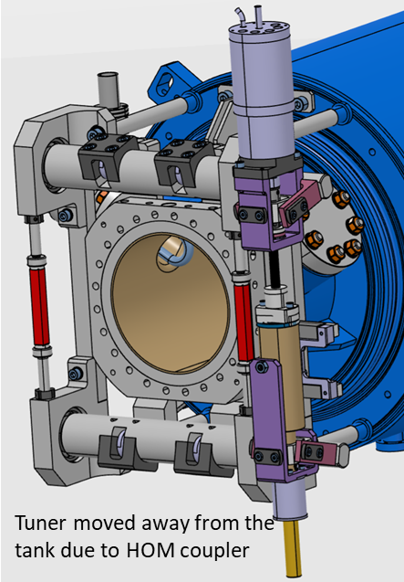
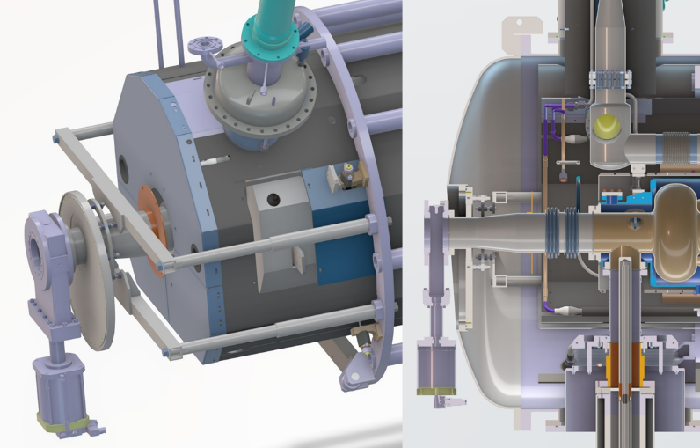
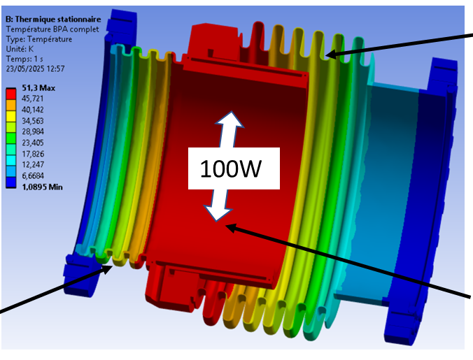
WP6 Task 6.3 – Adapt the existing ESS cryomodule: status/evolution
cavity
HOM coupler
Power coupler
90% accomplished
Past developments
  New 5cell cavity design
  Mechanical integration of HOM and power couplers
  New magnetic shields designs
  Adaptation of the Myrrha tuning systems
  First Beam line absorber design
  New end-cap design including warm-to-cold transition
  Definition of the P&ID (Piping and Instrumentation Diagram) incl. the new cryo lines for HOM couplers and beam line absorbers
Warm magnetic shield
Cold magnetic shield
P&ID
Tuning system
New end-cap design
Beam line absorber

Slide 6
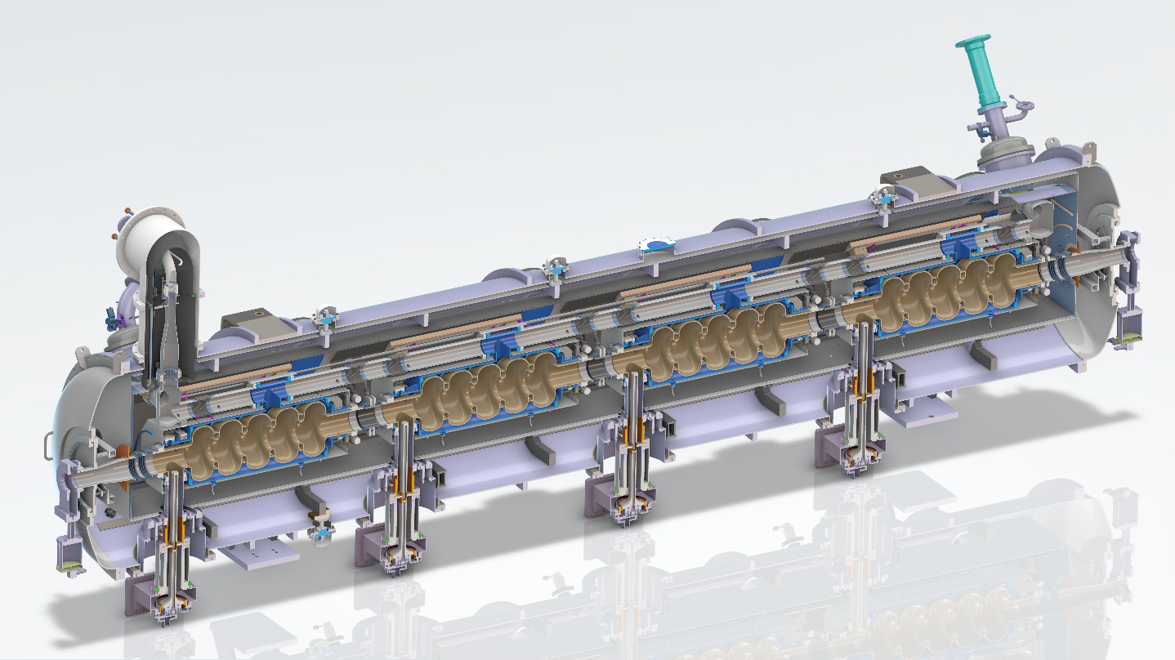
WP6 Task 6.3 – Adapt the existing ESS cryomodule: status/evolution
Current developments
  Cryogenic circuit to be finalized to include the 2 configurations (Test stand at Lund and PERLE at Orsay)
  NDA between IJCLAB and CEA under discussion: needed to order the 4 doube-walls tubes of the power couplers. Mitigation: modify/adapt the double-wall tube design of the ESS Spoke cavity → done (request for quotation)
Mid-term (2026)
  Technical drawings of the end-cap and cryogenics lines in January 2026

Slide 7
WP6 Task 6.4 - Fabrication and validation of cryomodule components: status/evolution
FABRICATION
Components provided by WP4:
4 Hook type HOM couplers
4 Power Couplers (modified SPL type)
Components provided by WP6:
Past developments (Ordered in 2024)
Niobium → received (June 2025)
Current developments: to be ordered in 2025
x4 5-cell cavities (but still on the critical path) → order done in November. Kick-off meeting on Dec 19th
x1 warm magnetic shield → raw material ordered in November
x4 cold magnetic shields → raw material ordered in November
Developments for 2026 : A LOT OF PROCUREMENTS !!!
x1 warm magnetic shield → Fabrication in March (not on critical path).
x4 cold magnetic shields → Fabrication in March (not on critical path).
x4 Double-wall tubes (not on critical path).
x2 new dished end-caps (not on critical path).
x2 gate valves (not on critical path).
Impact on the M6.2 and M6.3 milestones
And D6.2 deliverable

Slide 8
WP6 Task 6.4 - Fabrication and validation of cryomodule components: status/evolution
Developments for 2027
x4 Tuning systems (not on critical path).
Instrumentation (not on critical path).
MLI (not on critical path).
Cryogenic circuits (not on critical path).
Beam Line Absorbers (active cooling): warm (x2) cold (x3). see iSAS WP4!
VALIDATION
Developments for 2026
HOM and power couplers → see WP4
Developments for 2027
5cell cavities → test at INFN LASA. Mitigation plan: adaptation of the existing vertical cryostat to host bare cavity...done! New reservoir was ordered in October. Should be operational in March 2026.
Tuning systems → dedicated cryostat: operational and available.

Slide 9
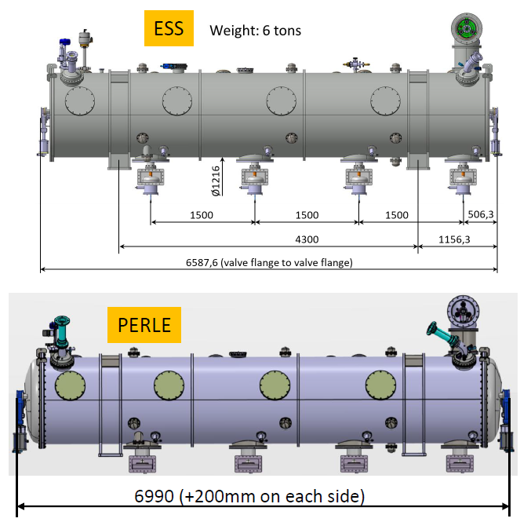


WP6 Task 6.5 - Assembly and test of adapted cryomodule status/evolution
• Clean room assembly of the cavity string and cryostating phase.
(just) started.
detailed inventory of tools and equipment available at CEA to be done in January
• Preparation of the test stand @ Lund.
Started.
Points of attention during the technical review:
Cryomodule footprint (+40cm total) into the bunker
Air cooling needed for the PERLE power couplers (vs. water cooling for ESS power couplers)
PERLE doorknobs dimensions vs. ESS ones : to be checked
• Cryogenic and RF test of the cryomodule.
Not started (→ 2028)

Slide 10
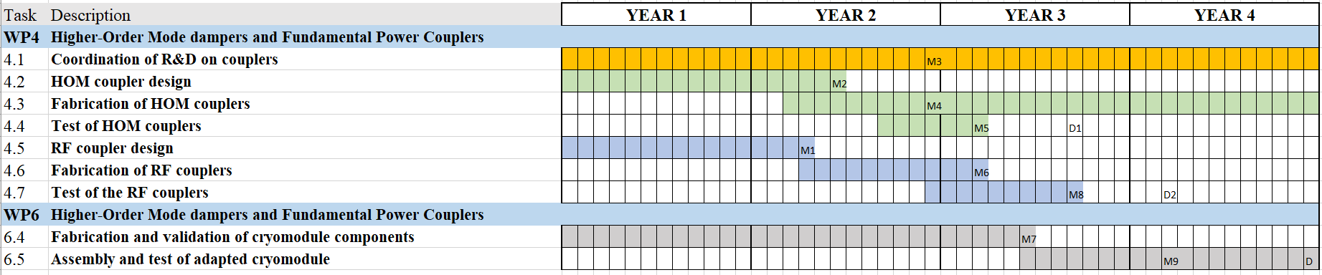
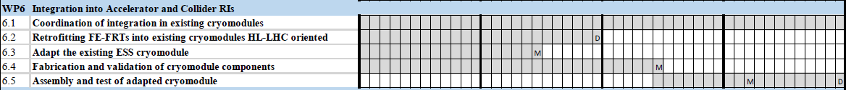
WP6 : plans to achieve milestones & deliverables
Planning
Feb 2025
Feb 2026
Feb 2027
Feb 2028
Due date
Milestones
M6.1
OK
M6.2
April 2026 → Sept 2027
M6.3
May 2027 → May 2028
Deliverables
D6.1
Feb 2026 → Aug 2026
D6.2
Feb 2028 → Nov 2028
→ Extension of the contract needed

Slide 11
WP6: points of attention
Points of attention
  5cell cavities fabrication: still on critical path.
  Time schedule is super tight
  No spare components
  Availability of the budget in due time to order the components in 2026 and 2027

Slide 12
WP6 : Highlights to be shared on the iSAS website

