Slide 1


WP4: High-Order Mode (HOM) dampers Fundamental Power couplers (FPC) Steering Committee, January 27, 2026
All information contained in this presentation and any accompanying documents is for iSAS project only, and must be treated as strictly confidential.
Any dissemination, distribution or other use of this information without the consent of its owner is prohibited.
Funded by the European Union. Views and opinions expressed are however those of the authors only and do not necessarily reflect those of the European Union or the European Commission. Neither the European Union nor the granting authority can be held responsible for them.

Slide 2
WP4 – HOM dampers and FPC :
General points
With WP6 :
Post doc position transfer INFN to IJCLab on progress
With WP7:
Questions (about the intellectual property, confidentiality…) for the participation of RI. Oscar Azzolini invited in the next WP4 meeting
Validation of WP4 amendment:
With new dates for the milestones M4.3, M4.4, M4.5 and M4.6 and for the deliverables D4.1 and D4.2
INFN, CNRS and CERN: Proposal to change the design, fabrication and test of a 1,3 GHz HOM couplers for designing, manufacturing and testing of a Beam Line Absorbers (BLA) within 3 new tasks
Discussion on financial aspects for the 3 new BLA tasks not yet conducted :
Expenses are foreseen:
7 k€ for the experimental setup
for BLA manufacture ( dielectric + brazing) estimation on progress
Adele de Valera : ‘the financial aspects will be discussed at both levels, WP4 & project coordination’
At coordination project or European union level, if there are instructions on this type of situation (tasks switching), please tell me.
Once the expense known, a discussion will be held internally in WP4

Slide 3
WP4: HOM et FPC
CERN, CNRS ( IJCLab, LPSC), INFN
Convener: Y. GOMEZ MARTINEZ (CNRS/ LPSC)
Main contacts with other partners: V. PARMA (CERN), P. DUCHESNE (CNRS/IJCLaB), D. GIOVE (deputy INFN)
Task 4.1: General coordination of WP4 March 24 – March 28 CNRS, INFN
Task 4.2: HOM coupler design March 24 – August 25 INFN, CNRS, CERN
At 800MHz and 1,3 GHz with the goal to minimize static and dynamic heat loads on the cryogenic circuits of the cryomodule
Task 4.3: Fabrication of HOM couplers May 25 – February 28 CERN, CNRS, CERN
4 HOMs 800 MHz and 1 HOM at 1,3 GHz with the goal of employing cost and production-time reduction techniques
Task 4.4: Test of HOM couplers Nov 25 – Mai 26 CNRS, INFN
On mono-cell and multi-cell 800 MHz and 1,3 GHz mock-up cavities at 300 K
Task 4.5: FP coupler design March 24 – June 25 CERN, CNRS
With the goal to improve sustainability
Task 4.6: Fabrication of FP couplers July 25 – Mai 26 CERN, CNRS
4 new 800 MHz FPC with the goal of employing cost and production-time reduction techniques.
Task 4.7: Test of FP couplers Feb 26 – November 26 CERN, CNRS
Preparation & RF conditioning 800 MHz, 50 kW CW
Initial

Slide 4
WP4 – HOM dampers et FPC: status/evolution of Task 4.1
General coordination of WP4
Task 4.1: General coordination of WP4 March 24 – March 28 CNRS, INFN
Task 4.2: HOM coupler design March 24 – August 25 INFN, CNRS, CERN
At 800MHz with the goal to minimize static and dynamic heat loads on the cryogenic circuits of the cryomodule
Task 4.3: Fabrication of HOM couplers May 25 – December 2026 CERN, CNRS, CERN
4 HOMs 800 MHz with the goal of employing cost and production-time reduction techniques
Task 4.4: Test of HOM couplers Nov 25 – September 27* CNRS, INFN
On mono-cell and multi-cell 800 MHz at 300 K
Task 4.5: FP coupler design March 24 – June 25 CERN, CNRS
With the goal to improve sustainability
Task 4.6: Fabrication of FP couplers July 25 – January 27 CERN, CNRS
4 new 800 MHz FPC with the goal of employing cost and production-time reduction techniques.
Task 4.7: Test of FP couplers Feb 26 – December 27* CERN, CNRS
Preparation & RF conditioning 800 MHz, 50 kW CW
Task 4.8: BLA design January 26– May 26 INFN, CNRS
With the goal to cover a very significant gap in the sector
Task 4.9: Fabrication of BLA May 26 – August 26 INFN, CNRS
Build at least 1 prototype of the 1,3 GHz BLA with the goal of employing cost and production-time reduction techniques
Task 4.10: Test of ceramics of BLA January 26 – September 27 INFN, CNRS, CERN
At room and cryogenic temperature
Only 800 MHz HOMC ( not 1,3 GHz HOMC)
Proposition
New tasks about BLA
*New deliverables dates

Slide 5
WP4 – HOM dampers and FPC: new Task 4.8
BLA design
Proposed developments
The work proposed will follow two different approaches:
to study and manufacture a BLA at 1,3 GHz with conduction cooling technology dedicated to power up to 30 W nominal (thus meeting Brixsino's requirements with a 300% margin but also being useful for situations requiring power outputs of this order);
to study the feasibility of this conduction cooling technology at 800 MHz up to 120 W nominal, thus covering a very significant gap in the sector so the requirements of the iSAS WP6 cryomodule.
The main studies proposed are:
Definition of the 1,3 GHz and 800 MHz BLAs specifications in term operating temperatures, maximal frequency in addition to the nominal power mainly. (INFN for 1,3 GHz and IJC Lab for 800 MHz)
Taken into account the BLA specifications and the material that exist, the choice of the more promising ceramic and the company which produce it (INFN and IJC Lab)
The choice of the BLA structure (European X-FEL /LCLS or other) (INFN)
Mechanical studies to adapt the structure chosen to the environment (diameter, large, …) of BriXSino for 1,3 GHz BLA and WP6 800 MHz cryomodule of iSAS for the 800 MHz BLA. (INFN)
RF simulations for both models at 1,3 GHz and 800 MHz in the range of frequencies of the specification and for the ceramic chosen (loss tangent, permittivity and permeability at cryogenic temperatures) to validate the damping of the HOM (IJC Lab).
Thermal simulations for both models at 1,3 GHz and 800 MHz to minimize static and dynamic heat loads on the cryogenic circuits of the cryomodule (INFN).
Proposition

Slide 6
WP4 – HOM dampers and FPC: new Task 4.9
Fabrication of BLA
Proposition
Proposed developments
Build at least 1 prototype of the 1,3 GHz BLA following the specification reducing the production costs by exploiting different solutions in manufacturing (clamping and brazing technology for example). An attention particular to the definition of the ceramic tolerance will be carry on.
R&D on alternative manufacturing for large production will be further pursued.

Slide 7
WP4 – HOM dampers and FPC: new Task 4.10
Test of BLA’s ceramics
Proposition
Proposed developments
Testing the ceramic of the BLA by developing test stands, measurement of proprieties (loss tangent, permittivity and permeability) at the chosen ceramic up
at room temperature (at CLIC test Stand at CERN)
or/and at cryogenic temperature (at the future IJClab test stand) (CERN and IJClab)
Explore various ceramic materials for the BLA applications at cryogenic temperature
Provide and update the precise material parameters to Task 4.8 at cryogenic environment

Slide 8
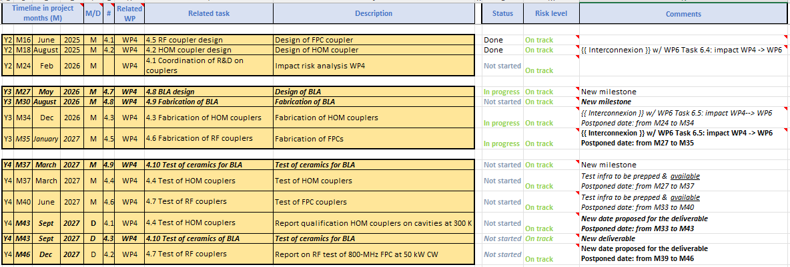
WP4 – HOM et FPC: status/evolution of Task 4.1
General coordination of WP4. Work plan
BLA: New milestones and deliverable
Dates proposed for the deliverables D4.1 and D4.2
Dates for the milestones M4.3, M4.4, M4.5 and M4.6 updated

Slide 9
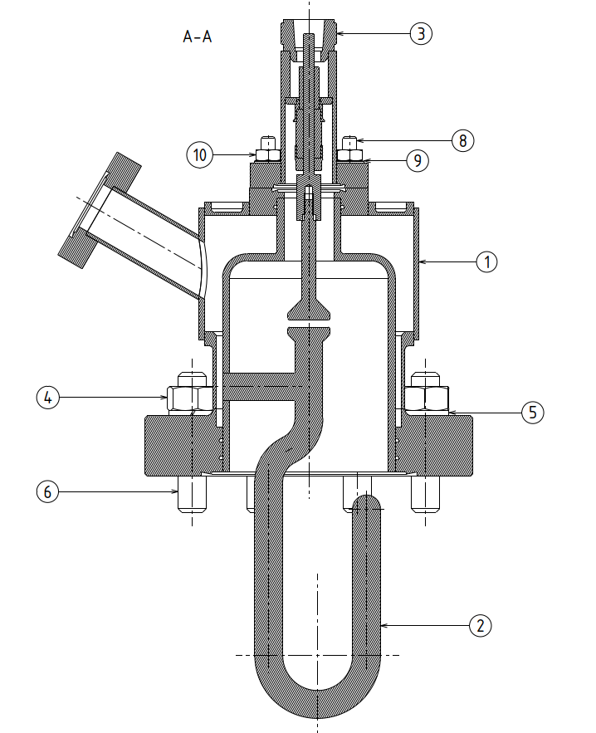
WP4 – HOM and FPC: status/evolution of Task 4.3
Fabrication of 800 MHz HOM couplers
Past developments
Feasibility fabrication study (M.Garlasche & S.Barriere / CERN) done
Functional coupler design file ( drawings and step) sent ( 8/12/2025) by IJC Lab ( P.Duchesne) to CERN taking into account the remarks from the CERN feasibility fabrication study
The functional coupler design have been accepted by the CERN (12/2025)
Current developments
All material have been received
Manufacturing drawings on progress
Production planning expected in the coming weeks
c/o S.Blivet

Slide 10
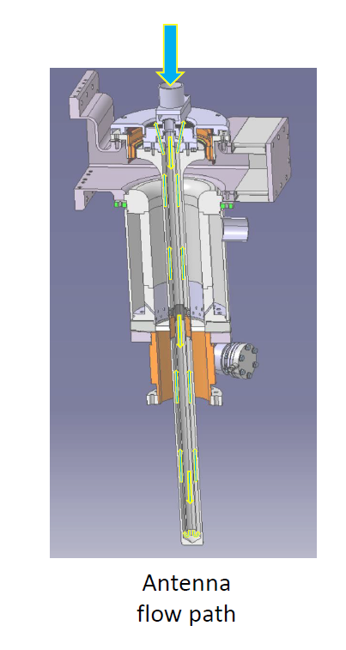
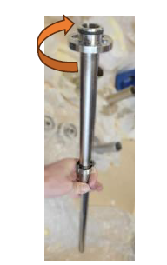
WP4 – HOM dampers and FPC: status/evolution of Task 4.6
Fabrication of FP couplers
Past developments
Feasibility production (CERN) study
Current developments
FPC compatibility with the ESS test bench on progress:
In mounting: The air cane is likely too long to be inserted of the air-side parts of the FPC on the cryomodule from below. To split the air cane into two parts is under development along with the associated assembly sequence.
Question raised of who will provide the air-cooling supply (by C. Sharp)
Manufacturing drawings expected for beginning 2026
Air cane
c/o C. Sharp

Slide 11
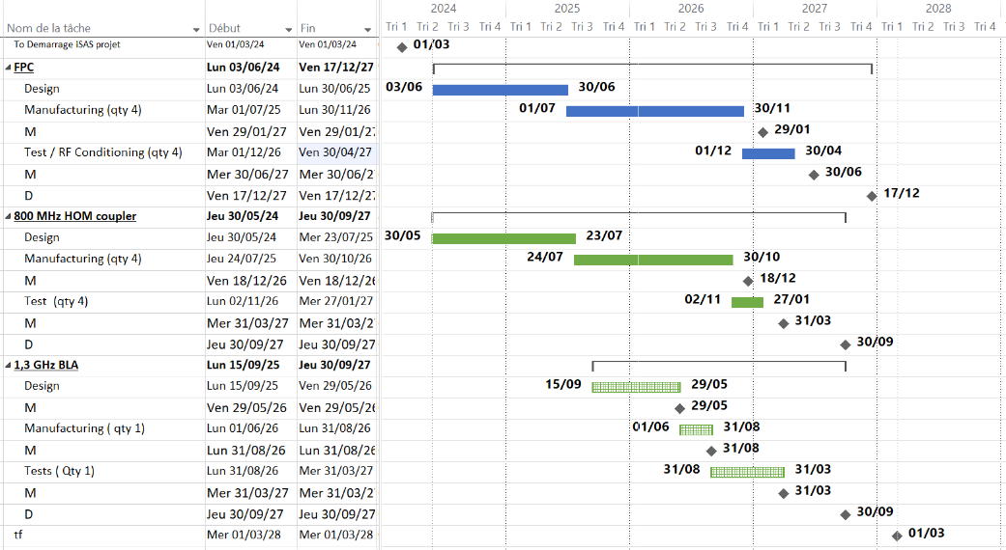
WP4 – HOM dampers et FPC :
plans to achieve milestones & deliverables
today

Slide 12
Thank-you for your attention
Yolanda Gómez Martínez on behalf of the WP4 team:
CERN : Simon Barriere, Sebastien Calvo, Karin Canderan, Marco Garlasche, Vittorio Parma, Calum Sharp
INFN : Dario Giove (deputy)
CNRS / IJCLab : Sebastien Blivet, Patricia Duchesne, Akira Miyazaki, Gilles Olivier, Guillaume Olry
CNRS / LPSC : J. Angot, Yolanda Gómez Martínez (convener), Adrien Plaçais

Slide 13
WP4 – HOM et FPC: status/evolution of Task 4.1
General coordination of WP4. Work plan
BLA: New milestones and deliverable
Dates proposed for the deliverables D4.1 and D4.2
Dates for the milestones M4.3, M4.4, M4.5 and M4.6 updated

Slide 14
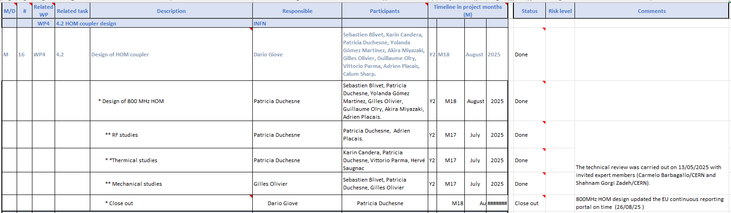
WP4 – HOM and FPC: status/evolution of Task 4.2
800 MHz HOM coupler design. Work plan
Task finished

Slide 15
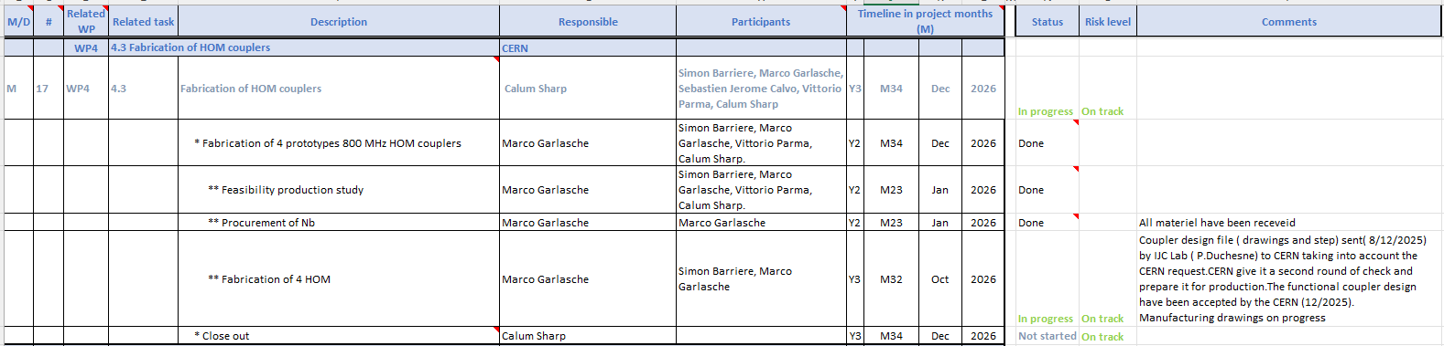
WP4 – HOM dampers and FPC: status/evolution of Task 4.3
Fabrication of 800 MHz HOM couplers. Work plan.

Slide 16
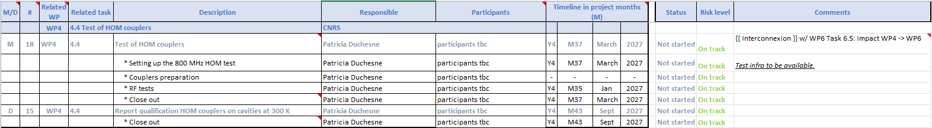
WP4 – HOM dampers et FPC : status/evolution of Task 4.4
Test of 800 HOM couplers . Work plan

Slide 17
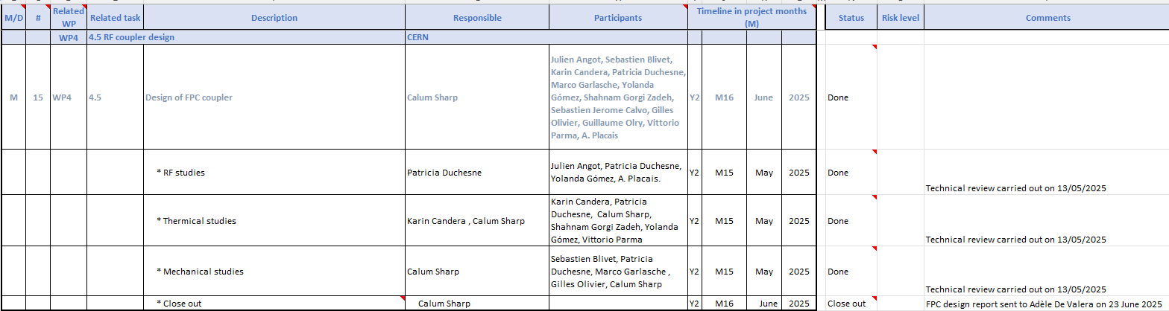
WP4 – HOM and FPC: status/evolution of Task 4.5
FPC coupler design. Work plan
Task finished

Slide 18
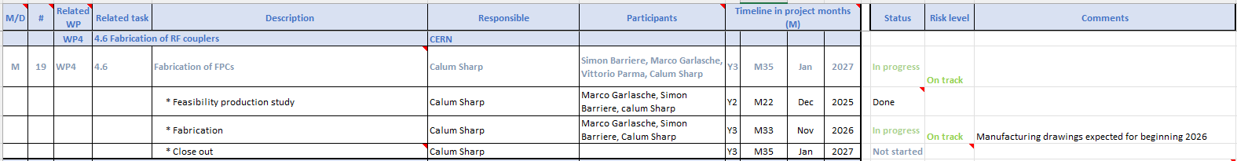
WP4 – HOM dampers et FPC : status/evolution of Task 4.6
Fabrication of FP couplers. Work plan

Slide 19
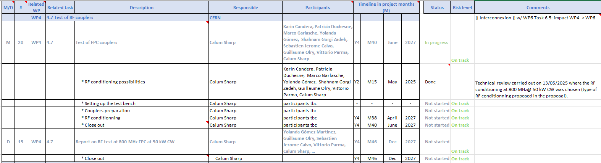
WP4 – HOM dampers et FPC : status/evolution of Task 4.7
Test of FP couplers. Work plan

