Slide 1


WP6:Integration into Accelerator and Collider RIs 27-01-2026
All information contained in this presentation and any accompanying documents is for iSAS project only, and must be treated as strictly confidential.
Any dissemination, distribution or other use of this information without the consent of its owner is prohibited.
Funded by the European Union. Views and opinions expressed are however those of the authors only and do not necessarily reflect those of the European Union or the European Commission. Neither the European Union nor the granting authority can be held responsible for them.

Slide 2
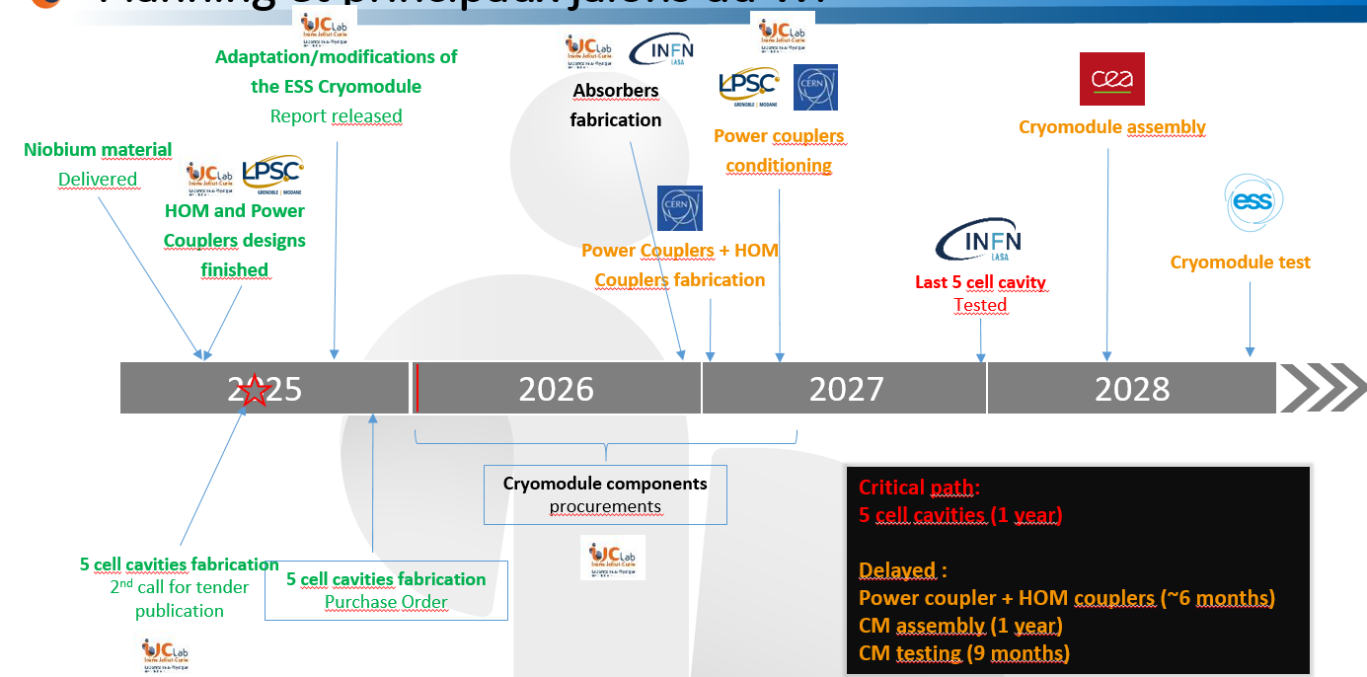
WP6: points of attention
Points of attention
The overall schedule is very tight
5cell cavities: fabrication started (kick-off meeting last week) but still on critical path.
HOM and FPC from WP4: started to fall behind schedule by a few months. Not yet critical.
No spare components: try to include some components (depending on the additional cost) such as stepper motors, piezo actuators for the tuning systems.
Availability of the budget (mainly the matching funds) in due time to order some of key components (HOM couplers, magnetic shields...) this year(5 orders between 50k€ and 100k€; for a total of about 300k€)

