Slide 1

iSAS Steering committee meeting
27th January, 2026

Slide 2
iSAS Steering Committee meeting
Agenda
Agenda items
  Report from the Coordination Panel
  Policy briefing report draft comments
  RF2.0 & iSAS project update
  WPs points of attention

Slide 3
Consortium agreement
Consortium Agreement (CA) in progress
v4 sent
Signature process to be started by Julie Gendron
Shared NDA for industrial partners done

Slide 4
Amendment to the Grant agreement
Amendment (AMD) in progress
New PO: Sotiris Kakarantzas replaced by Eva Flora Varga
Amendment request letter with amended Grant Agreement & updated GANTT chart sent

Slide 5
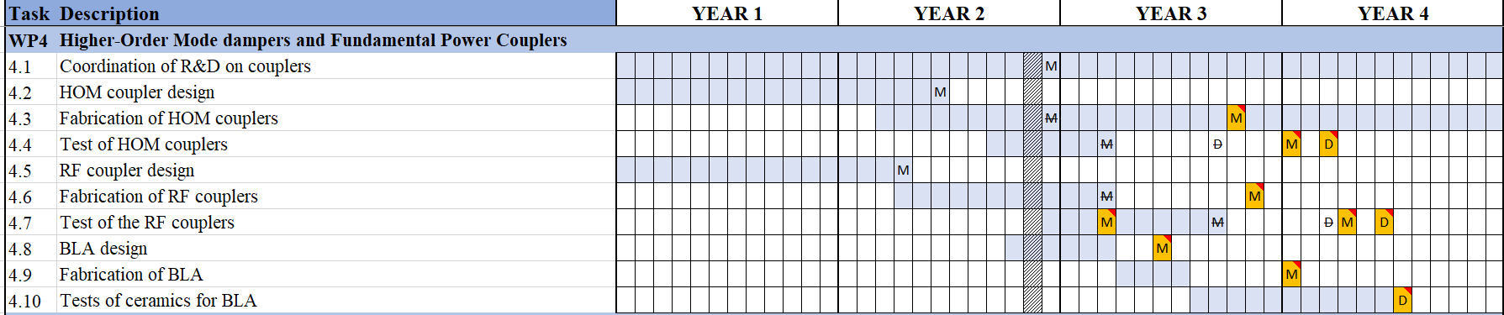
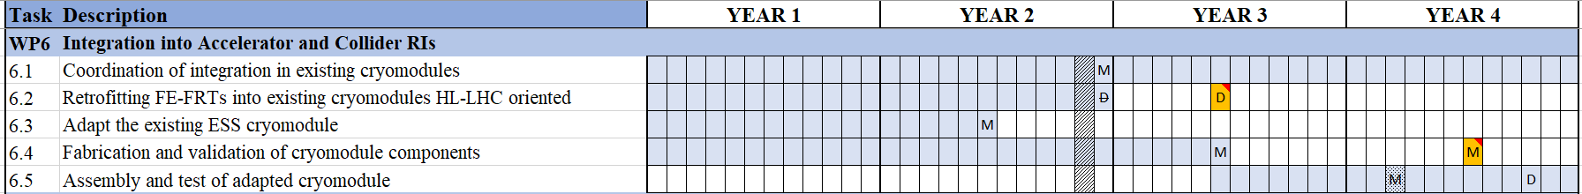
Amendment to the Grant agreement

Slide 6
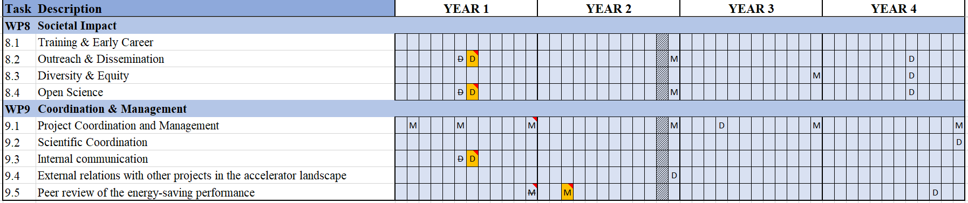
Amendment to the Grant agreement

Slide 7
RF2.0 & iSAS project proposal update
Steps taken
RF2.0 + iSAS concept paper prepared
Presentation of RF2.0 project last Steering committee by project coordinator
Next steps
Barcelona meeting Feb 26th-27th at RF2.0 annual meeting
TIARA meeting March 18th for presentation & comments
Notes:
To be clarified to proceed
Evaluators’ recommendations on a detailed project proposal
TIARA approval
Who would take the lead as Coordinator?
Etc.

Slide 8
Policy briefing report
To be discussed
1st draft ready early Jan
Updated template sent by new PO on Jan 19 – draft updated subsequently
Draft presentation & comments
Notes:
To be clarified to proceed
Evaluators’ recommendations on a detailed project proposal
TIARA approval
Who would take the lead as Coordinator?
Etc.

Slide 9
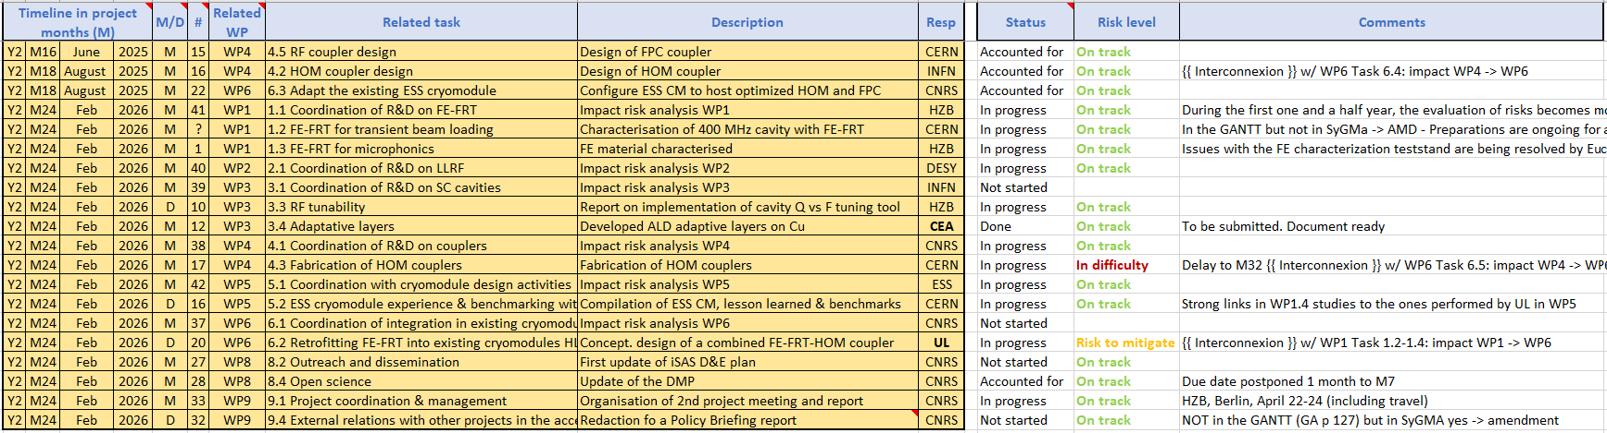
Work plan
Milestones & Deliverables status by timeline for the end of the 2nd project year
to be updated post Steering Committee feedback:

Slide 10
Upcoming related meetings
Every other meeting the Coordination panel becomes the Steering committee (includes the WP leaders & deputies), so as to integrate a cross-coordination of feedback
Indico page for Coordination panel - Steering committee meetings
  Coordination panel – March 10 at 10 am CET
  Steering committee – April 21 at 10 am CET
  Coordination panel – June 2 at 10 am CET

Slide 11
Upcoming other meetings
iSAS project Indico page
  2nd annual project meeting in Berlin – April 22-24
  Advisory board discussion – April 23 pm
  Industry 1st review – April 24 am
  Governing board - April 24 am

Slide 12
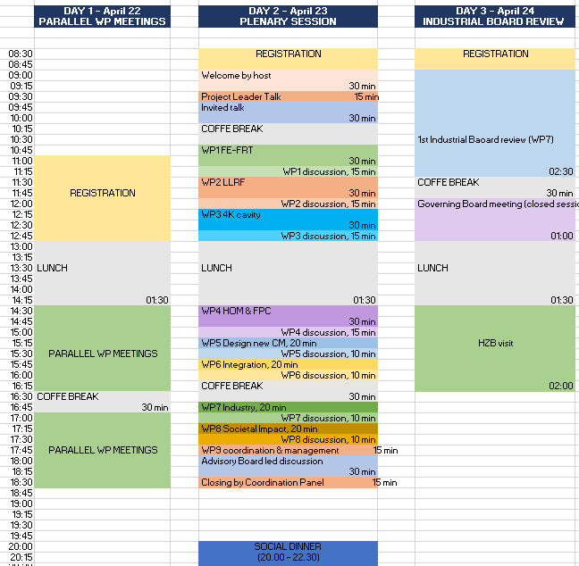

Slide 13
Thank you!

Slide 14
Back up

Slide 15

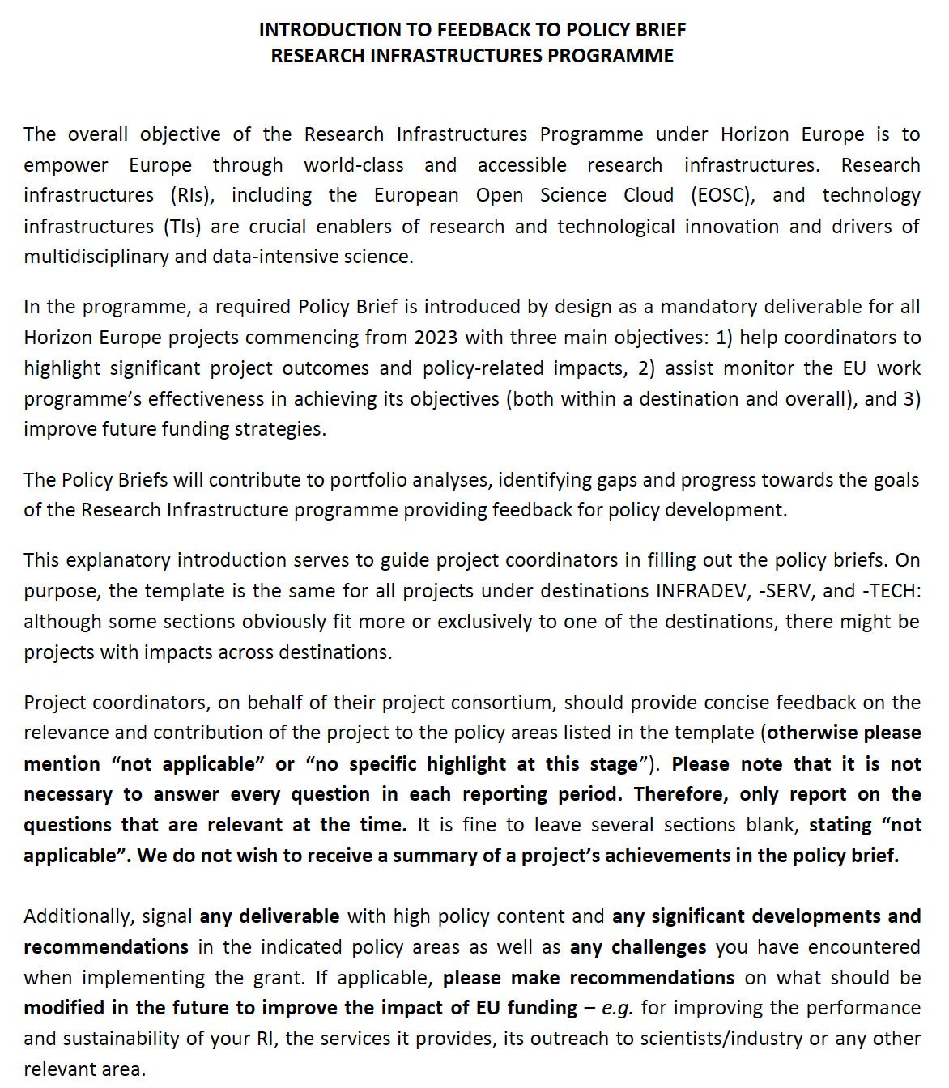
Policy brief
Deliverable imposed by EU due in February 2026 on « Policy implications and recommendations »
Explanatory document provided

Slide 16
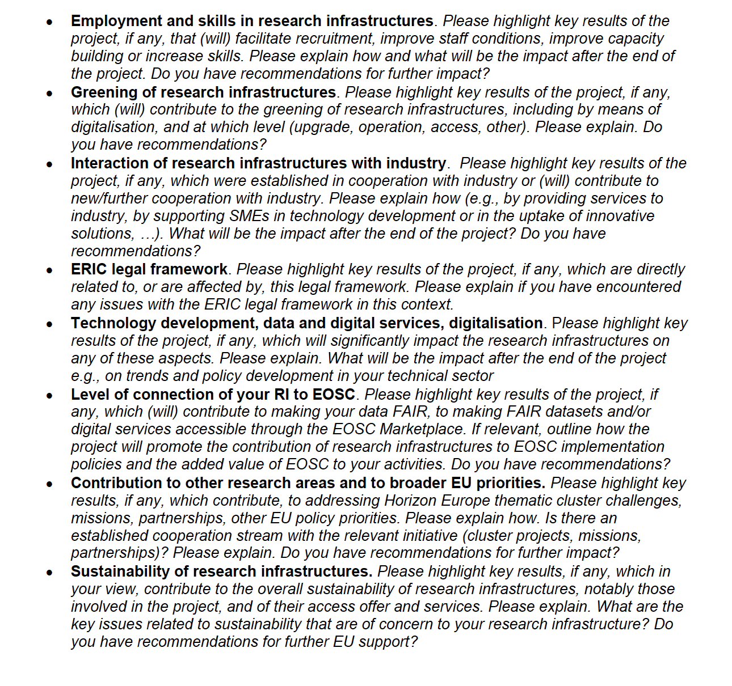
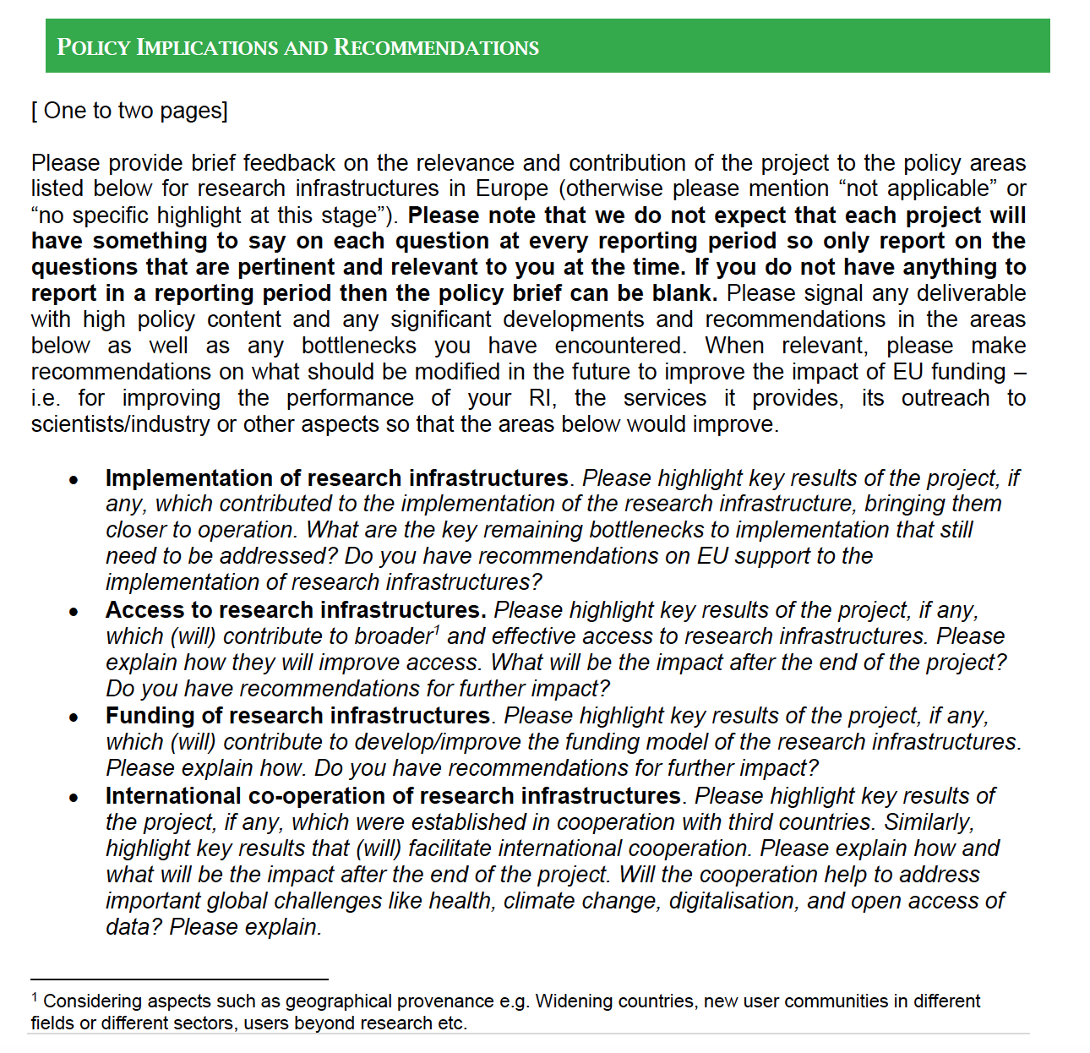
Policy brief
Template imposed by the EU

Slide 17
Policy brief
N/A
N/A
Cost of operation of RI can be reduced with iSAS technos (thin films, ERL and FE-FRT)
Industry : develop cost these efficient technologies ➔ CP
If successful technos if iSAS (thin films, ERL and FE-FRT, CM test at PERLE, parametric design of CM), we can attract other partners (EU or outside EU)
Links with IFAST
➔ CP
N/A ?

Slide 18
Policy brief
More expertise in the topics developed by iSAS in the different labs ➔ MB
We can green the RI if we retrofit the iSAS technos in ESS, XFEL, LHC ➔ MB
We are trying to involve the industry in the development of the new technos, some industry on board for the next EU projects ➔ CP
N/A
Ask 1-2 lines to each WP leader ➔ CP
Ask Ketel Turzo ➔ MB
Technos developed within iSAS can benefit light sources, accelerators for neutron production / fusion studies, radioisotopes production ➔ CP
To address global warming : all topics of iSAS aim to reduce energy consumption of accelerators: FE-FRT, thin films, ERL, sustainable cryomodule design ➔ MB

Slide 19
Policy brief
Document will be be drafted by Maud Baylac and Cristian Pira for end of January
Any relevant input ? Please contact Maud (baylac@lpsc.in2p3.fr)

Slide 20
RF2.0 project presentation
RF2.0
Research Facility 2.0 project Coordinator Giovanni De Carne from Karlsruhe Institute of Technology (KIT)
Aim: accelerators are designed, operated, and supplied with 100% renewable energy, nearly independent of the public power grid while significantly reducing environmental impact
More info: https://rf20.eu/
Follow up project RF2.0 + iSAS
Suggestion from RF2.0 reporting period evaluation because of the 2 projects complementarities
RF2.0 + iSAS concept paper prepared to be discussed as a 1st step
Notes:
To be clarified to proceed
Evaluators’ recommendations on a detailed project proposal
TIARA approval
Who would take the lead as Coordinator?
Etc.

Slide 21
Framework requirements
INFRATECH 2026
Budget: EU contribution of between EUR 5.00 and 10.00 million
Expected Outcomes among:
  increased greening and resilience of research infrastructures
  increased efficiency of research infrastructures through digitalisation
  co-development with industry
Scope:
  complementary with HORIZON-INFRATECH-01-01 actions from preceding years
  at least 2 Research infrastructures beneficiaries
  R&D of new scientific instrumentation, tools, digitalisation, and methods
  their technology validation and prototyping
  training of RI staff for the operation and use of these new solutions
  developments for the specific use case are expected to go beyond TRL 4
  integration of the gender dimension where applicable
Call closure: June 16, 2026

