Slide 1

WP2: Low Level RF controls 10.07.2025
DESY, HZB, CNRS
Convener & deputy: Julien Branlard (DESY) & Christian Schmidt (DESY)
Main contacts with other partners: Axel Neumann (HZB), Christophe Joly (CNRS)
Task 2.1: Coordination of R&D on LLRF – M1-M48
Task 2.2: Efficient field control for high loaded-quality factor cavities – M1-M48
Task 2.3: Vibration analysis and detuning control of cavities – M1-M36
Task 2.4: Integrated LLRF control using Ferro-Electric Fast Reactive Tuners– M13-M48
Task 2.5: Energy efficient supervisory control and fault diagnosis– M1-M48

Slide 2
WP2 – LLRF: status/evolution of Task 2.1
Task 2.1: Coordination of R&D on LLRF – M1-M48
• Collaboration meetings
Status update of the different labs
Opened position to support iSAS R&D activities
Candidate found, starts in September December 2025
  Issues with work permit
Will be announced on iSAS website after official starting date
Next: Milestone 02 / 2026 Impact risk analysis WP2

Slide 3
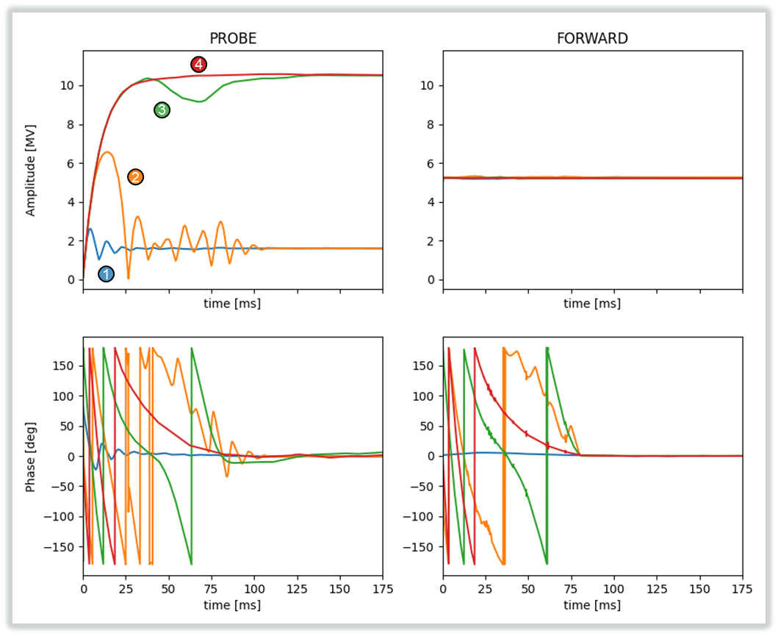
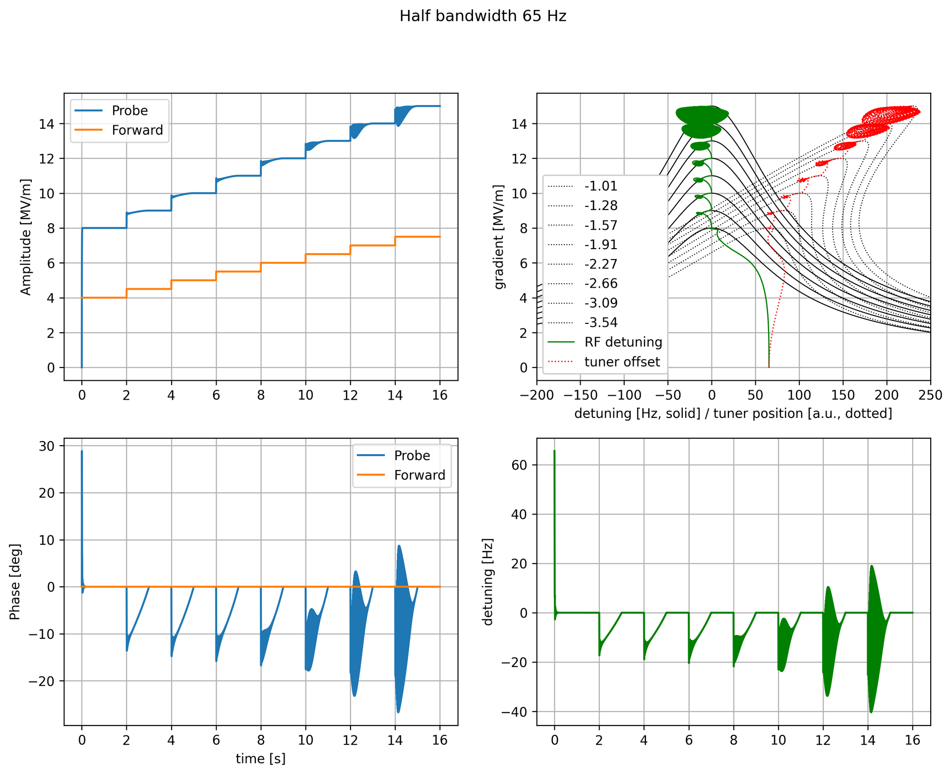
WP2 – LLRF: status/evolution of Task 2.2
Task 2.2: Efficient field control for high loaded-quality factor cavities – M1-M48
Developed approach to fill single cavity with very narrow bandwidth in pulsed mode
  Resonance filling, SEL vs. GDR, power overhead minimization
  Publication in preparation for LLRF workshop in October 2025
Courtesy: Bozo Richter
Modulation of the RF drive signal
Maintaining the resonance frequency with tuning

Slide 4
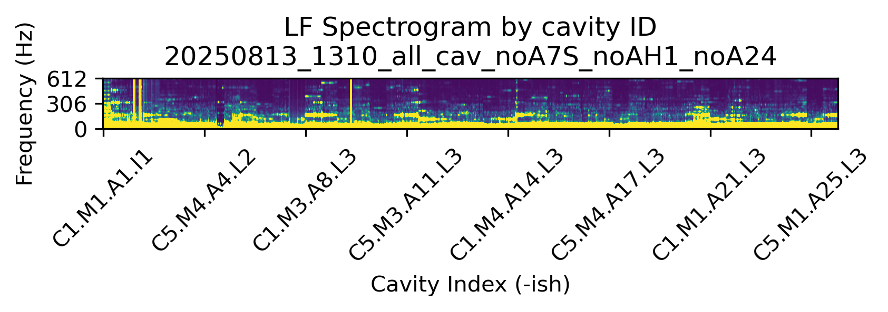
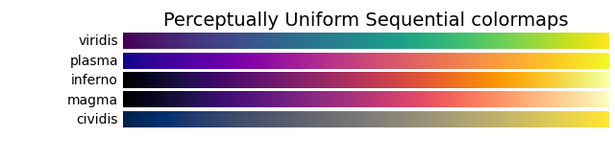
WP2 – LLRF: status/evolution of Task 2.3
Task 2.3: Vibration analysis and detuning control of cavities – M1-M36
Characterize environmental disturbances and transfer to the cavity perturbation.
Vibration measurement at XFEL (CMTB and AMTF)
  Vibrations in XFEL (warm), isolation vacuum pumps at the CS connections (frequency steps)
2025-08-13 XFEL w.o. AH1, A7S, A24
612
Courtesy: Joshua Einstein-Curtis
low
Vibration Amplitude
high
306
Frequency (Hz)
0
CS1
CS2
CS3
CS4
CS5
CS6
CS7
CS8
CS9
CryoString#
Cavity Index
More efficient detuning compensation
Changed Lorentz force detuning compensation scheme at XFEL + FLASH (with piezo (https://doi.org/10.18429/jacow-ipac25-thps040)

Slide 5
WP2 – LLRF: status/evolution of Task 2.4
Task 2.4: Integrated LLRF control using Ferro-Electric Fast Reactive Tuners – M13-M48
• Integrate a ferro-electric fast reactive tuner (FE-FRT) with a digital LLRF system
1st step towards simulation of integrated FE-FRT in LLRF for PERLE (IJC-Lab and CERN)
  Discussion on FE-FRT model between IJC-Lab and HZB started
Following progress about FE-FRT construction → see WP01
  FE-FRT workshop in Berlin Nov. 2025
Regulation loop simulation
  Adaptation of a Simulink SC cavity model including RF and Piezo regulation for PERLE has been started

Slide 6
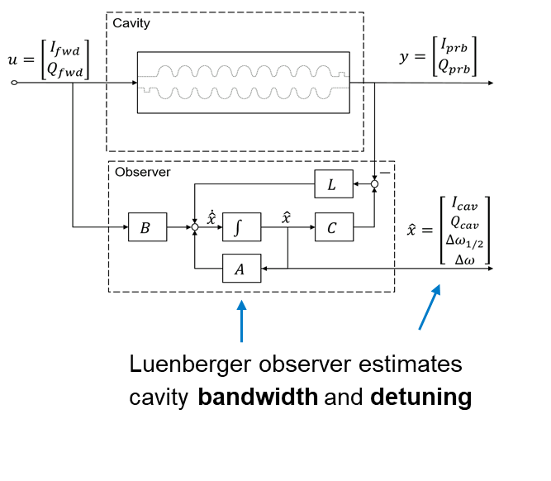
WP2 – LLRF: status/evolution of Task 2.5
Task 2.5: Energy efficient supervisory control and fault diagnosis– M1-M48
• Develop fault diagnosis and anomaly detection of LLRF systems using ML approaches
Luenberger Observer to estimate cavity bandwidth and detuning
Publication in arXiv, sent for review in Physical Review special topic Accelerator and Beam
iSAS mentioned in acknowledgement
Development of anomaly detection in FW based on ML
Presentation at IPAC 2025
  https://doi.org/10.18429/jacow-ipac25-thps134
Calibration influence of environmental based on ML
Presentation at IPAC 2025
  https://doi.org/10.18429/jacow-ipac25-thps135

Slide 7
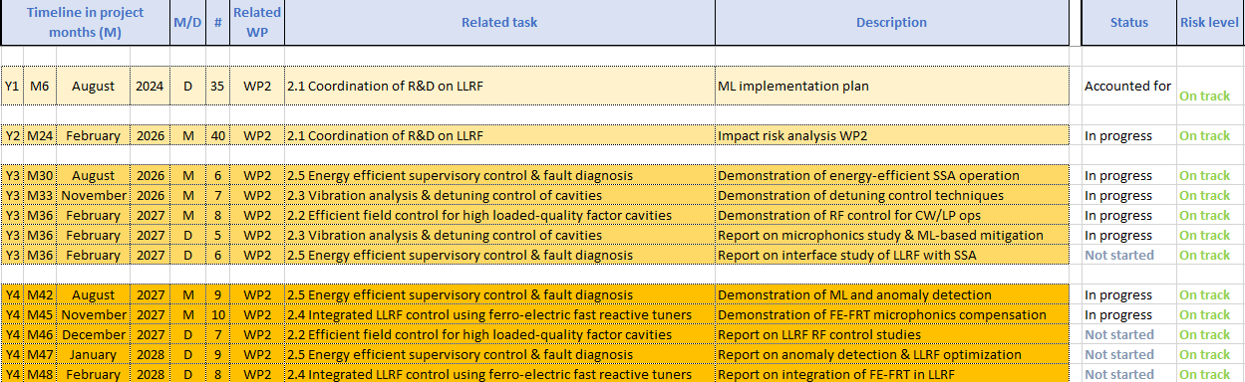
WP2 – LLRF: plans to achieve milestones & deliverables
Deliverables and Milestones are on track (no changes to last report)
Next Milestone is Impact risk analysis for Feb. 2026

