Slide 1


WP1: FE-FRT Midterm advisory board meeting 07.10.25
All information contained in this presentation and any accompanying documents is for iSAS project only, and must be treated as strictly confidential.
Any dissemination, distribution or other use of this information without the consent of its owner is prohibited.
Funded by the European Union. Views and opinions expressed are however those of the authors only and do not necessarily reflect those of the European Union or the European Commission. Neither the European Union nor the granting authority can be held responsible for them.

Slide 2
WP1: FE-FRT (Official overview)
HZB, CERN, CNRS, Uni.Lancaster
Convener: Axel Neumann (HZB), deputy Alick Macpherson (CERN)
Main contacts with other partners: Alick Macpherson (CERN), Walid Kaabi (CNRS), Graeme Burt (Uni.Lanc.), industry: Alexei Kanareykin (Euclid Techlabs)
Task 2.4 Integrated LLRF control using FE-FRT
Task 3.3 RF tunability, FE-FRT for Nb3SN coated cavities?
Task 1.1: Coordination of R&D on FE-FRT – M1-M48 (HZB)
• General coordination by HZB as described above.
Task 1.2: FE-FRT for Transient Beam Loading – M1-M40 (CERN)
• Design a full FE-FRT-based 400 MHz tuner, applicable to LHC transient detuning scenarios.
• Perform full RF, mechanical and cryogenic evaluation of the FE-FRT-equipped . LHC cryo-module.
• Use design lessons learned to design a tuner for transient detuning of FCC 800 MHz multi-cell cavities.
Task 1.3: FE-FRT for Microphonics – M1-M48 (HZB)
• Establish characteristics and performance of FE-FRT ferroelectric material at frequencies ≥1300 MHz.
• Design, fabricate and validate an FE-FRT for microphonics suppression on a single-cell 1.3 GHz cavity.
• Design, fabricate and validate an FE-FRT for multi-cell cavity at 1300 MHz, in a cryomodule-like setup.
Task 1.4: FE-FRT in Energy-Recovery LINAC (ERL) mode – M1-M48 (CNRS)
• End-group design study for integration into ERL-type cavity, study HOM+BBU properties.
• FE-FRT design study for RF and mechanical integration into upgraded ERL cavity.
Task 6.2: Retrofitting Fast Reactive Tuners into existing cryomodules HL-LHC oriented – M1-M24
Study of frequency domain multiplexor-based HOM coupler
Study the effect of HOMs on FE-FRT operation to define max leakage
Study the heating due to high fundamental power in the coupler
Strong link to Tasks 1.2-1.4

Slide 3

WP1 – FE-FRT: status/evolution of Task 1.1
coordination
Past developments
Intensified the exchange by moving to a biweekly meeting schedule
Started exchange of personnel, e.g. HZB engineer (A. Frahm) visited CERN to discuss design and fabrication of FE-FRT parts
Participation in several workshops to advertise iSAS based FRT/ERL developments: E.g., talks at ERL workshop 2024 at KEK, Tsukuba, TTC meeting at Lund 2024, both sustainability working groups, talk at Helmholtz ARD-ST3 workshop on sustainability (ERLs), recently SRF 2025
Current developments
Intensified the exchange by moving to a biweekly meeting schedule
HZB colleagues will attend CERN’s high power vertical test in about October
Invited talk by Sam Smith at SRF 2025 in Tokyo last month (Towards high power tests of an FE-FRT for transient detuning), also a poster about FE-FRT by U. Mainz was presented
Ongoing discussions with WP3 about FE-FRT tuner for coated cavities
Workshop at HZB about
https://events.hifis.net/event/2275/

Slide 4
WP1 – FE-FRT: status/evolution of Task 1.2
FE-FRT for transient beam-loading

Slide 5
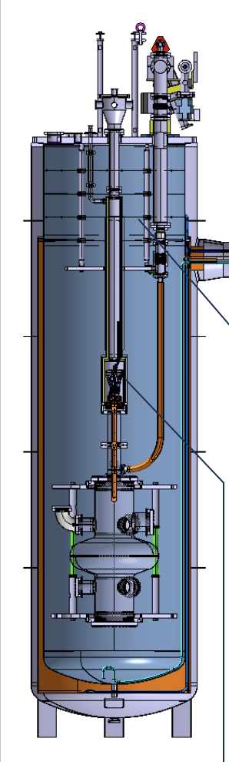
WP1 – FE-FRT for transient beam-loading: status/evolution of Task 1.2
Past developments
HV breakdown tests were performed with W. Wünsch’s group at CERN and showed a breakdown limit below the expected theoretical value, that a second test was performed with 0.8 mm thickness sample. It demonstrated 7.1 V/µm (target 8V/µm) within reach of our target
A first cold test of TDD1 failed because of required re-machining of the baffles in the VST/anti-cryostat and got thus delayed by overbooked CERN workshop
Current developments
The cold test of the TDD1 is now planned for mid to last third of October at CERN
A high power test will follow in first half of 2026, once the results of the low power cold test were under review

Slide 6
WP1 – FE-FRT: status/evolution of Task 1.3
FE-FRT for microphonics

Slide 7
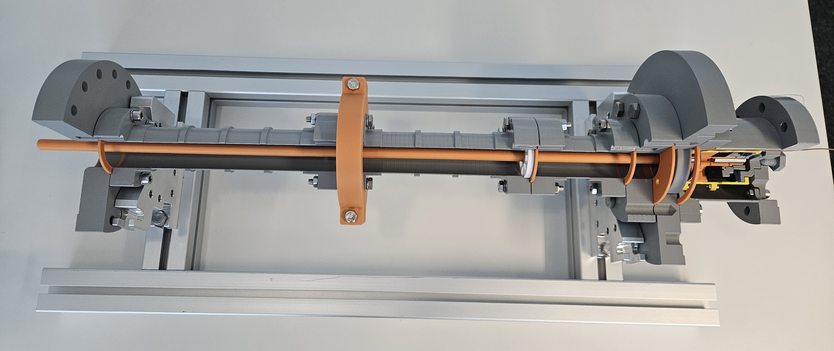
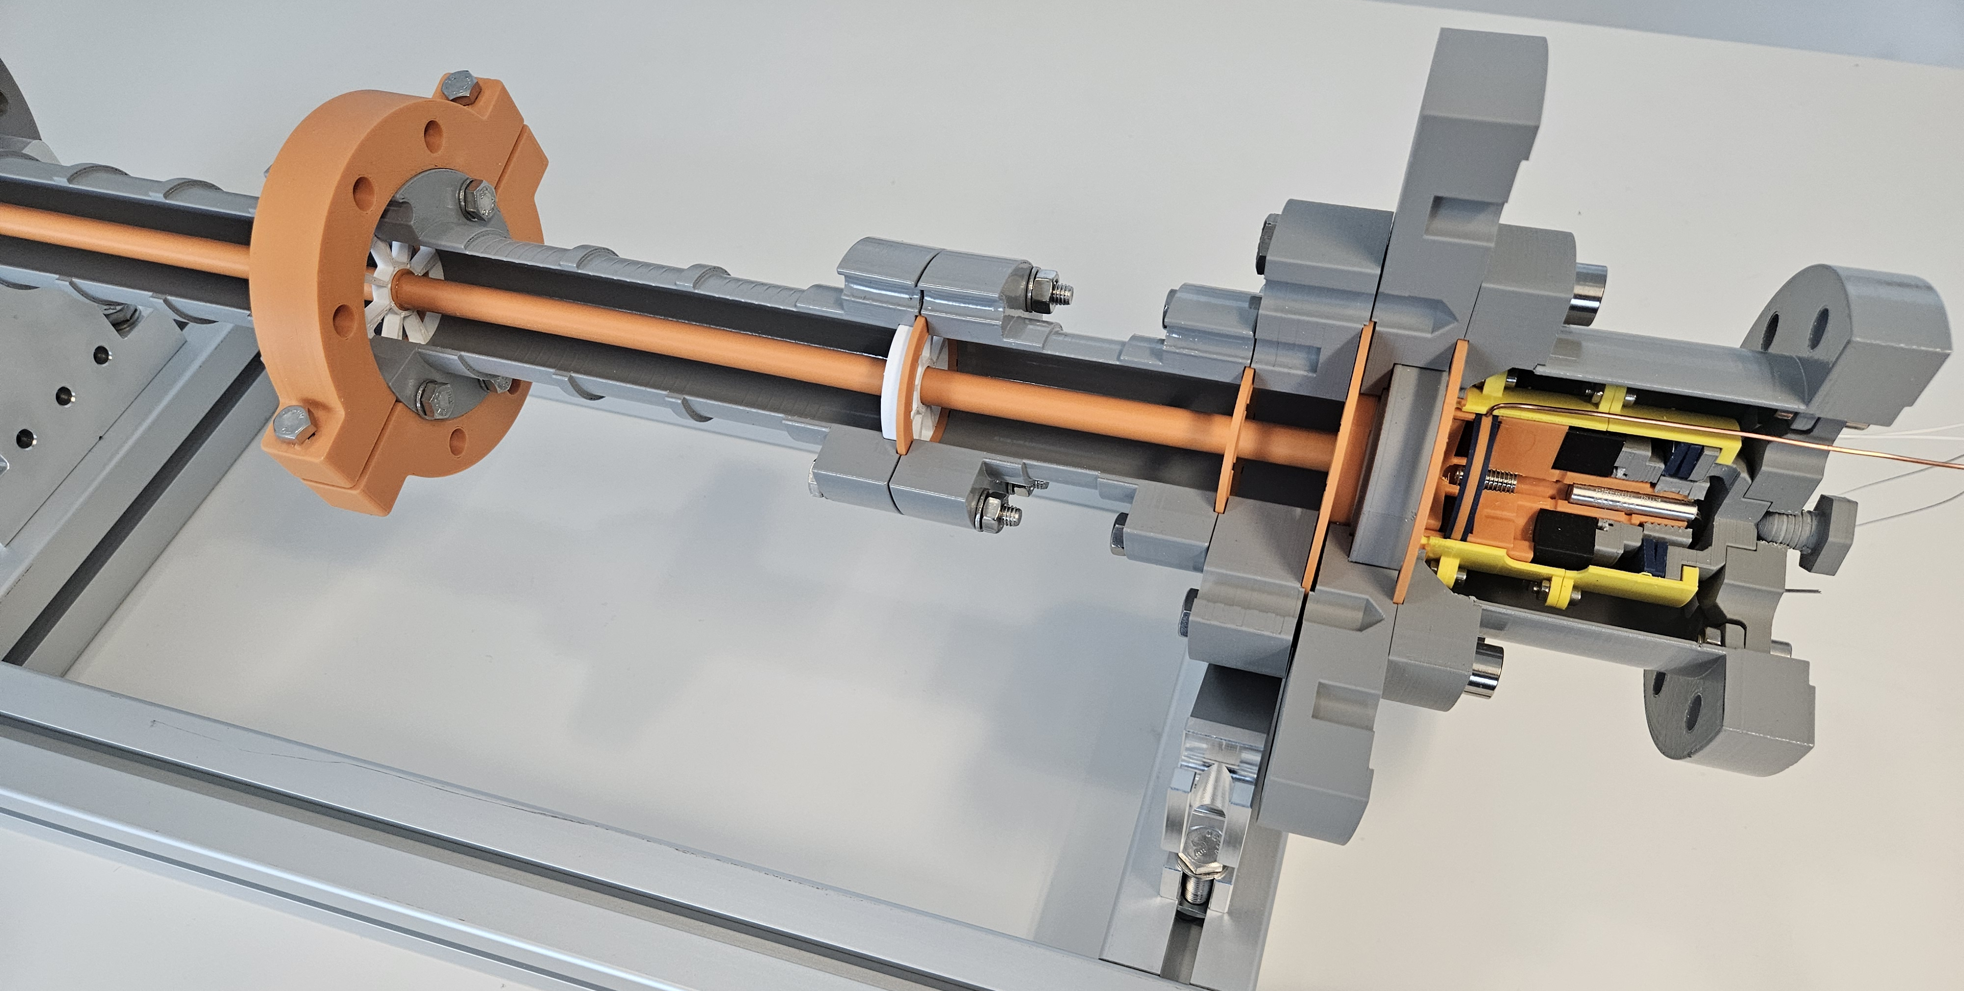
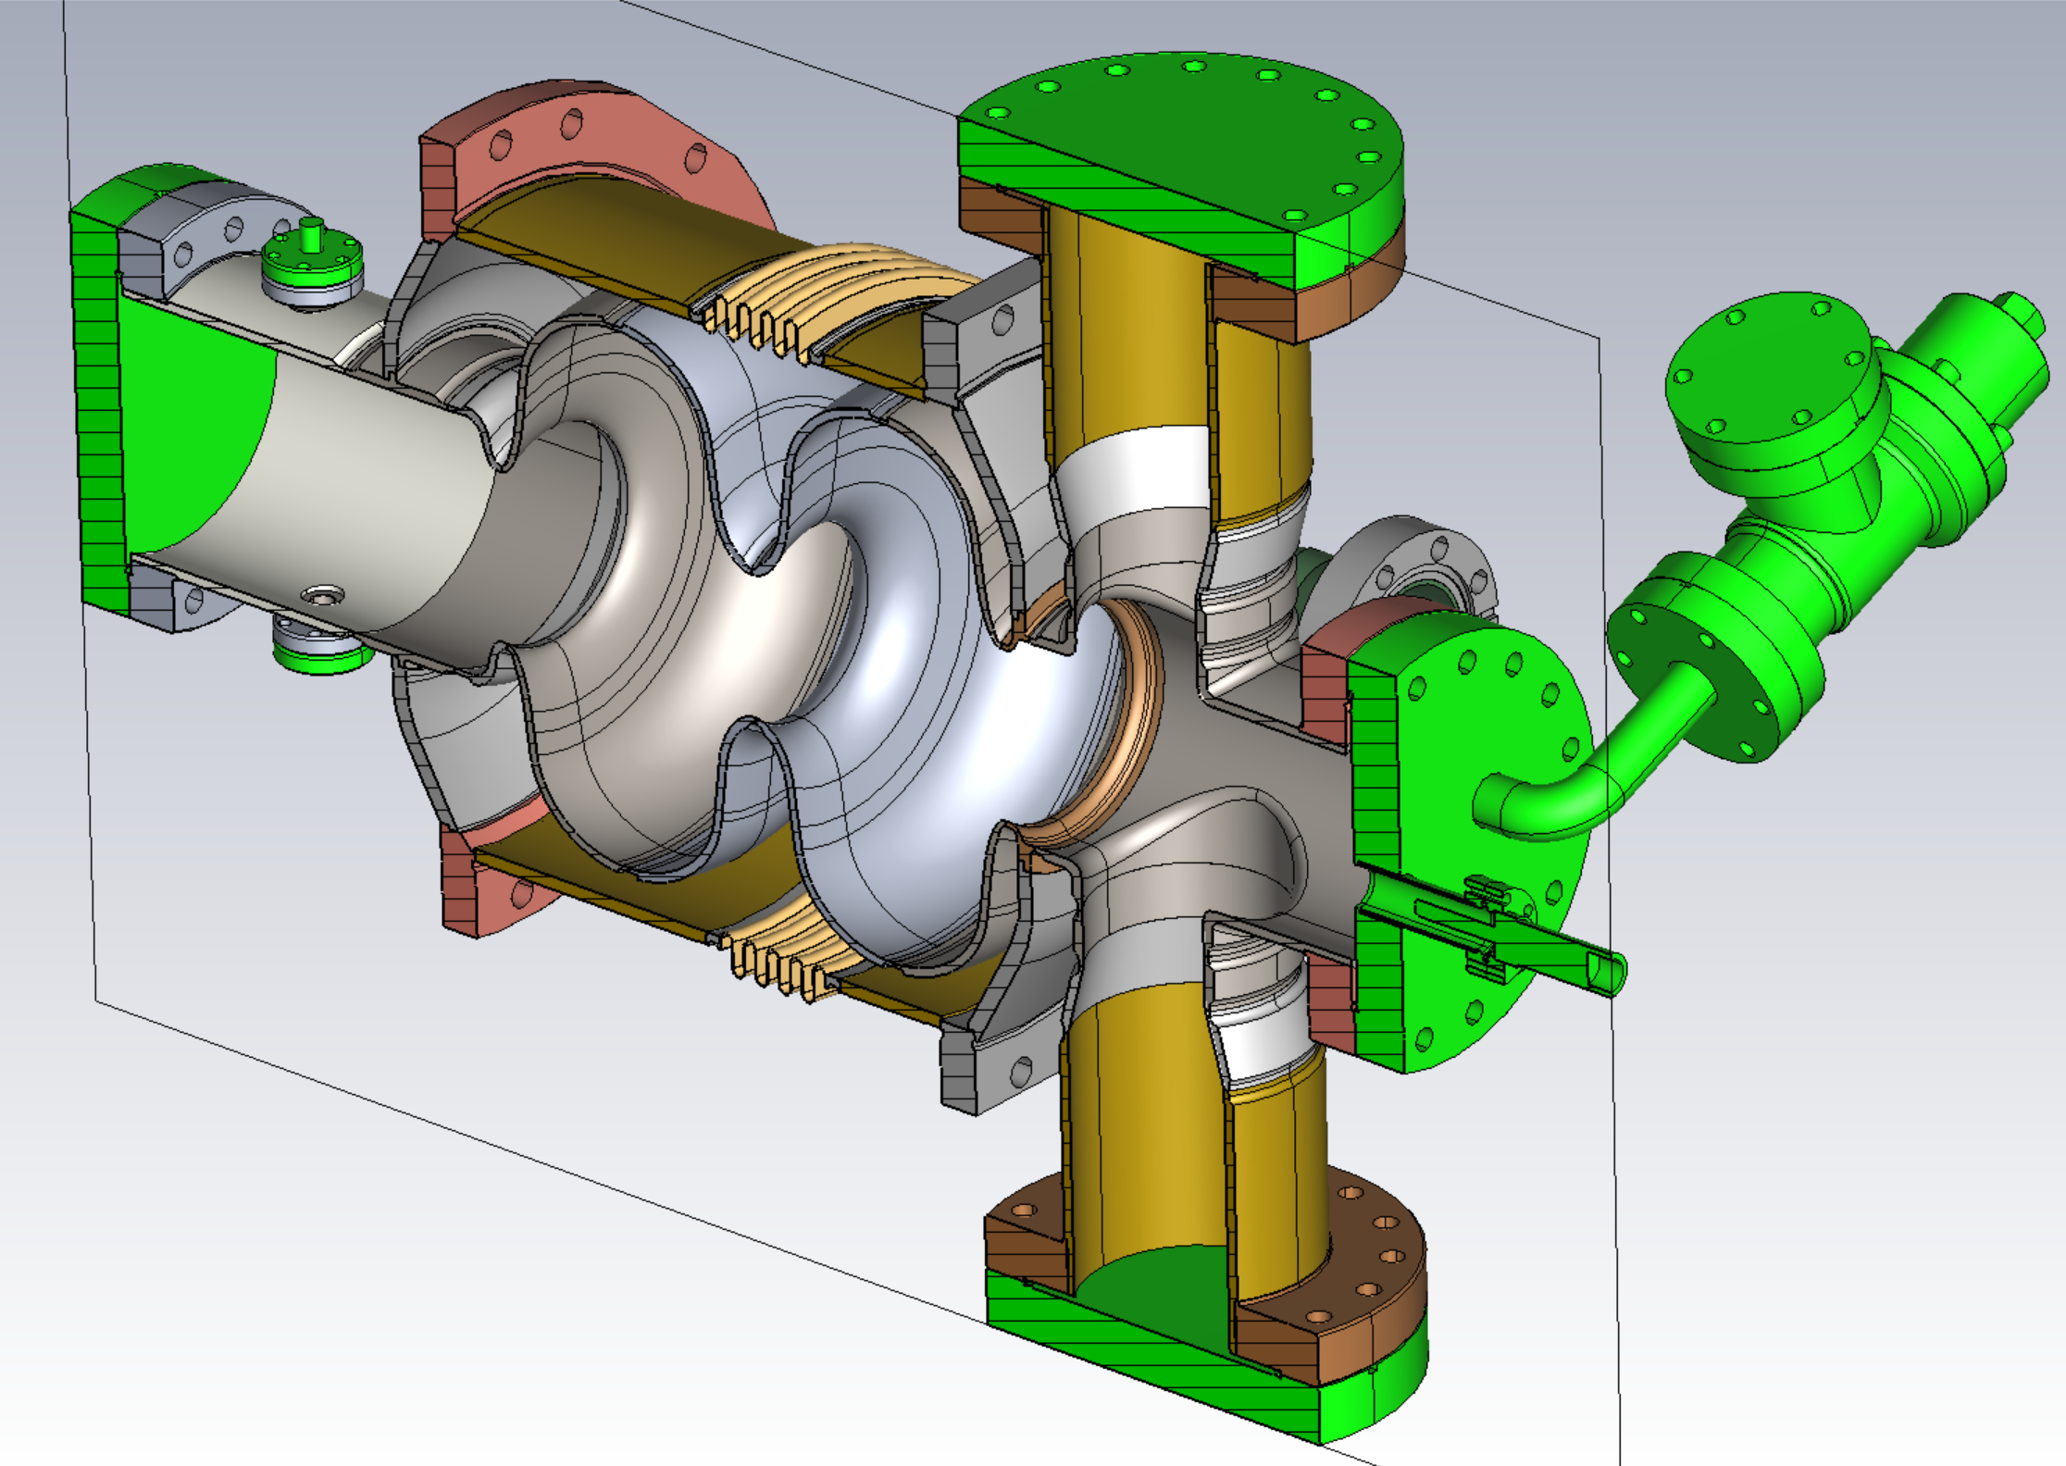
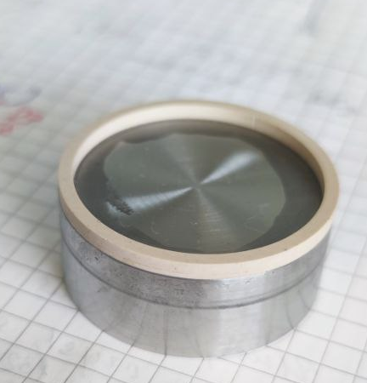
WP1 – FE-FRT for microphonics: status/evolution of Task 1.3
Past developments
RF design done for single cell test prototype
Fabrication and procurement of parts for FE-FRT microphonics prototype
3D printed model for assembly test was produced
Cutting and polishing techniques for FE ceramics were tested and showed first success
Current developments
Preparation of the “single cell” cavity (2-cell bERLinPro booster) is ongoing with iSAS industry partner
Meetings are held with Euclid Techlabs to discuss the final modification for FERMAT FE ceramics teststand → MS 1, due Fe. 2026
Improvement and studies of ceramic cutting, treatment, grinding, polishing, coating, etc…

Slide 8
WP1 – FE-FRT in Energy-Recovery LINAC (ERL) mode : status/evolution of Task 1.4
Past developments
Task 1.4 is mainly represented by W. Kaabi of IJCLab within WP1 to observe the development within WP1
To fulfill MS2, a meeting between WP6 and WP1 is required to align the developments within task 6.2 (retrofitting FRTs), the developments at CERN for potential FRTs for 800 MHz use cases. This will at best deliver a design for PERLE.
Current developments
There is still no dedicated personal at IJCLab/Perle working on task 1.4, as described above
The upcoming WP1/WP6 combined meeting will show potential solutions towards this issue

Slide 9
WP1– FE-FRT: points of attention
Points of attention
Strong interaction with U Lancaster (WP6), several labs work on FE-FRT for 1300 MHz microphonics application: HZB, U Lancaster (UK XFEL), U Mainz (external iSAS, MESA), potential interest at JLab (USA), contacted colleagues at KEK
Clarification of IJCLab involvement for WP1 required to secure MS fulfillment and to allow benefit for PERLE 2nd cryo-module (energy saving as selling argument?) → Common meeting between WP1 and WP6 is planned
Euclid is a strong partner for WP1, as being expert in FE ceramics and manufacturer of FRT prototypes, ceramics teststand → Continuous exchange of know-how
FCC use cases will impact, how much 800 MHz developments align with PERLE FRT designs. At best, this allows to fulfill MS2 for PERLE within WP1
The collaboration with W. Wünsch group at CERN for the HV breakdown tests are under way and a great example of expanded collaboration driven by iSAS/CERN and European RF accelerator roadmap panel

Slide 10
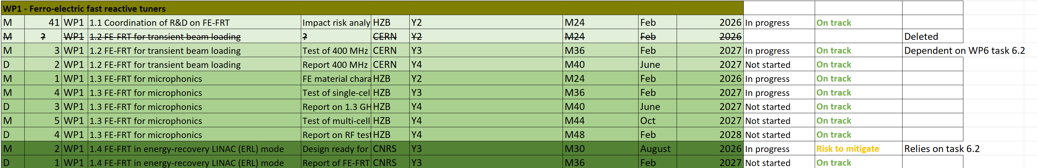
WP1 – FE-FRT: plans to achieve milestones & deliverables
Milestones & deliverables on track?
The iSAS Milestones and deliverables are on track. The detailed internal MS list shows some risk for task 1.3 regarding the ceramics treatment prior installation into the FRT. This is being worked on by including a material scientist into the task (A. Prudnikava).
MS2 is also under risk, as there is no dedicated co-worker assigned, but it will be covered by a collaborative effort between WP6 and WP1.

