Slide 1


MID-TERM ADVISORY BOARD MEETING Frederick Bordry, Chairperson Online meeting, Oct 7th, 2025
Funded by the European Union. Views and opinions expressed are however those of the authors only and do not necessarily reflect those of the European Union or the European Commission. Neither the European Union nor the granting authority can be held responsible for them.
All information contained in this presentation and any accompanying documents is for iSAS project only, and must be treated as strictly confidential. Any dissemination, distribution or other use of this information without the consent of its owner is prohibited.

Slide 2
Agenda
Agenda items
Status of the iSAS project coordination
Presentation of monitoring templates outline
WPs short update (highlights presentation & work plan M19)
Feedback from Advisory Board members and discussion
AOB
Notes will be found in the iSAS project Indico page

Slide 3
Advisory Board recommendations reminder
Specific Comments related to work packages
WP1
No major criticalities are expected as long as the necessary workforce and assembly
facilities are available at the appropriate time. Additionally, potential RF power savings could
become significant depending on beam specifications and sensitivity to microphonics and
beam loading
WP2
The presentation shows the valuable quality of the work and the large effort that has been invested so far into the WP 2 activities. The participating teams master very well all the challenging technical aspects. The plans and the next stages of R&D look appropriate and effective
WP3
There is a significant complementarity between iFAST and ISAS projects. Therefore, it essential to develop a clear and well-structured description for the purpose of EU reporting that clearly differentiates the work carried out in each project
WP4
It would be beneficial to organize a review with experts to ensure that the decision on whether or not to condition the couplers fully considers all associated risks and opportunities

Slide 4
Advisory Board recommendations reminder
Specific Comments related to work packages
WP5
It would be beneficial for the cryomodule survey to include questions about availability (time during which the module remains in an operable state). Additionally, it would be valuable to engage with CERN's availability team, which has already developed relevant indicators and a survey
WP6
The progress is strongly correlated to those of WP1, WP2, WP4 and WP5. The timeline appears quite optimistic. However, without a detailed resource plan and clear commitments from the involved laboratories, it is challenging to assess the feasibility of these plans. The manufacturing of the 5-cell cavity is undoubtedly a critical path item
WP7
The innovative technology developed in iSAS has the potential to offer a lasting competitive edge for high-tech industries, with significant opportunities for widespread commercialization and market deployment. But iSAS lacks the critical mass needed to sustain industry interest throughout the project's duration. It would be wiser to collaborate with the various Big Science industry liaison officers to sponsor the project, to maximize its impact, and actively explore pathways for potential technology spin-offs. These efforts will help unlock new applications and markets, particularly for energy-saving SRF solutions

Slide 5
Advisory Board recommendations reminder
Main recommendations
1 Develop an internal resource plan, with interim milestones through 2025 (at a level of detail useful only for monitoring by program coordinators), to ensure progress can be measured, even in the absence of formal milestones and deadlines
2 To maintain a clear view of project progress, we recommend implementing a milestone trend analysis. We also recommend implementing Earned Value Management (EVM) to better track project progress and identify cost and schedule variances as quickly as possible
3 Develop a resource plan (personnel and budget). It is also important to validate in this plan the availability of infrastructure (e.g., a clean room) in accordance with the schedule
4 We regret not having a presentation of WPs 8 and 9. We recommend a presentation at the next annual meeting

Slide 6
Advisory Board recommendations reminder
Specific questions addressed to the Advisory Board
1 the development of the energy performance metric for iSAS energy-saving technologies
Maud Baylac's presentation provided a good basis for quantifying the energy savings of the iSAS project technologies. The proposed metrics for energy savings seem reasonably organized. We recommend keeping them simple initially; depending on the results, they can be updated to include more criteria, but given the short deadline, measuring only in terms of energy for operation is acceptable. We support the approach focused on OPEX instead of CAPEX. It would be good to have an estimate of energy savings (as mentioned for WP4), to define the methods for measuring the energy used, and at the end of the project, to compare the two. The most significant will be the cryomodule of WP6, which will have implemented most of the progress made in the other WPs and which will be installed for PERLE
2 the connection of iSAS to the industry
As iSAS technologies emerge, iSAS's objective is to plan concrete co-developments with industry to accelerate the achievement of a Technology Readiness Level (TRL) sufficiently advanced for large-scale deployment of new energy-saving solutions in current and future RIs, as well as to pave the way for industrial applications. We didn't see much point in the morning's presentations by industrial firms, which were often unrelated to the iSAS project (except Euclid Techlabs)

Slide 7
Advisory Board recommendations reminder
Specific questions addressed to the Advisory Board
3 the dissemination and communication plans
Regrettably, the absence of a presentation for WP8 hindered our ability to provide a comprehensive assessment in this area. Additionally, we did not observe a formal communications strategy or plan. However, it is noteworthy that the project website is established and serves as a valuable information resource. Numerous presentations on iSAS have been delivered at various conferences and workshops, with the first article scheduled for presentation at IPAC 2025. To enhance transparency and accessibility, we recommend creating a dedicated repository on the website for all iSAS-related presentations and articles. Furthermore, publishing the results of the survey conducted under WP5 would provide valuable insights. Effective communication should highlight not only the scientific impact of the project but also its role in training and developing young scientists who have contributed to its success

Slide 8
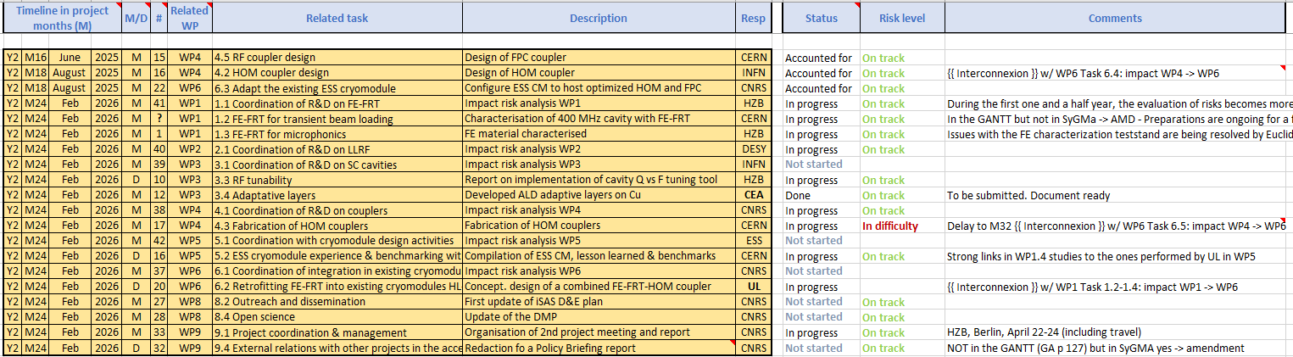
iSAS work plan
Milestones & Deliverables status by timeline:
3 milestones of summer accounted for, 17 to go all in Feb + end of RP1 report

Slide 9
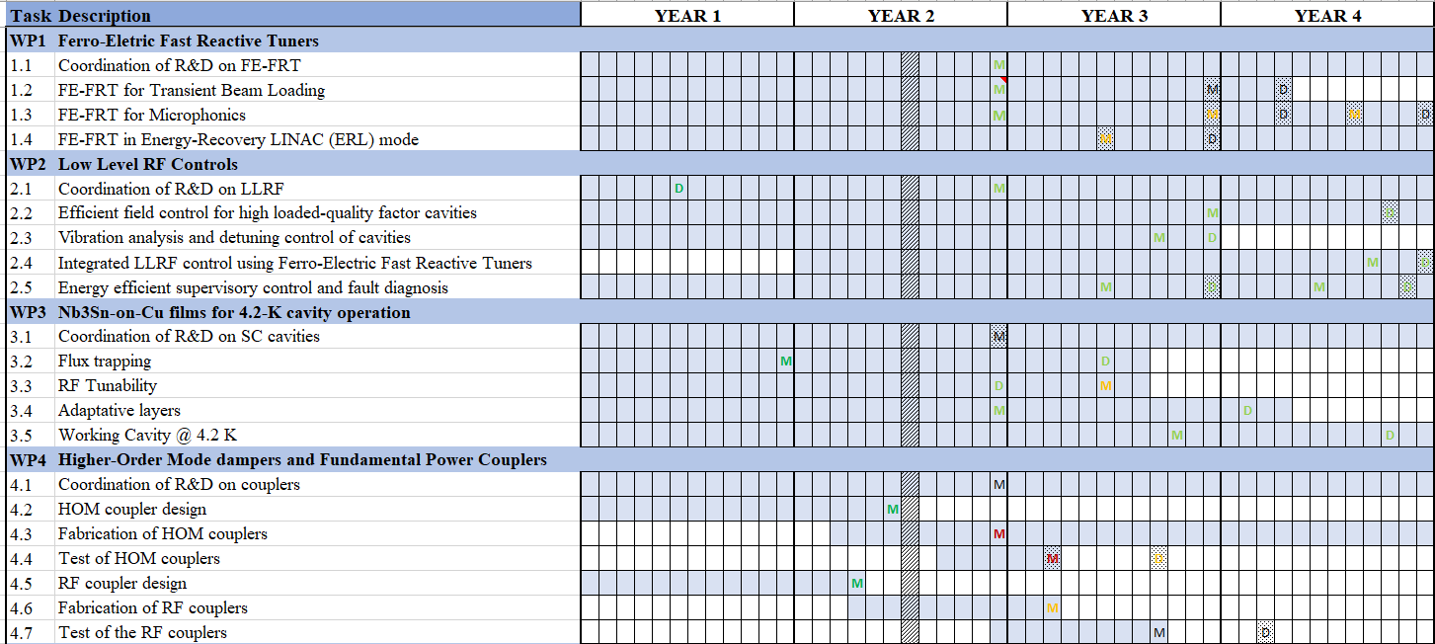

Slide 10
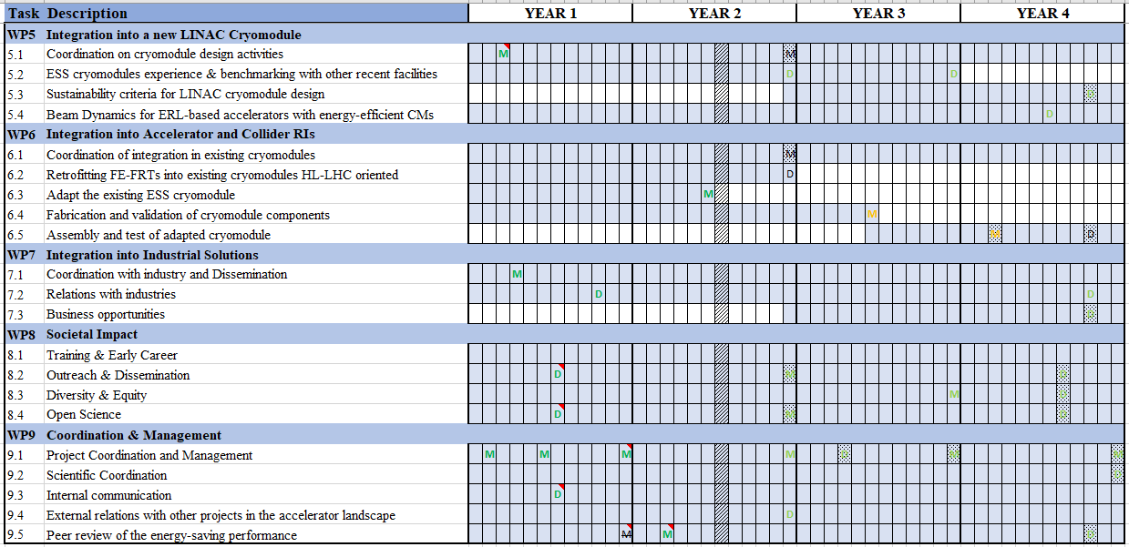

Slide 11
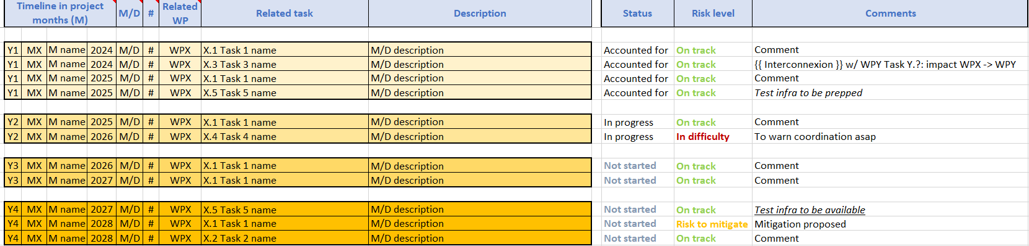
Monitoring template outline
To be updated for upcoming instances
WP timeline tab updated

Slide 12
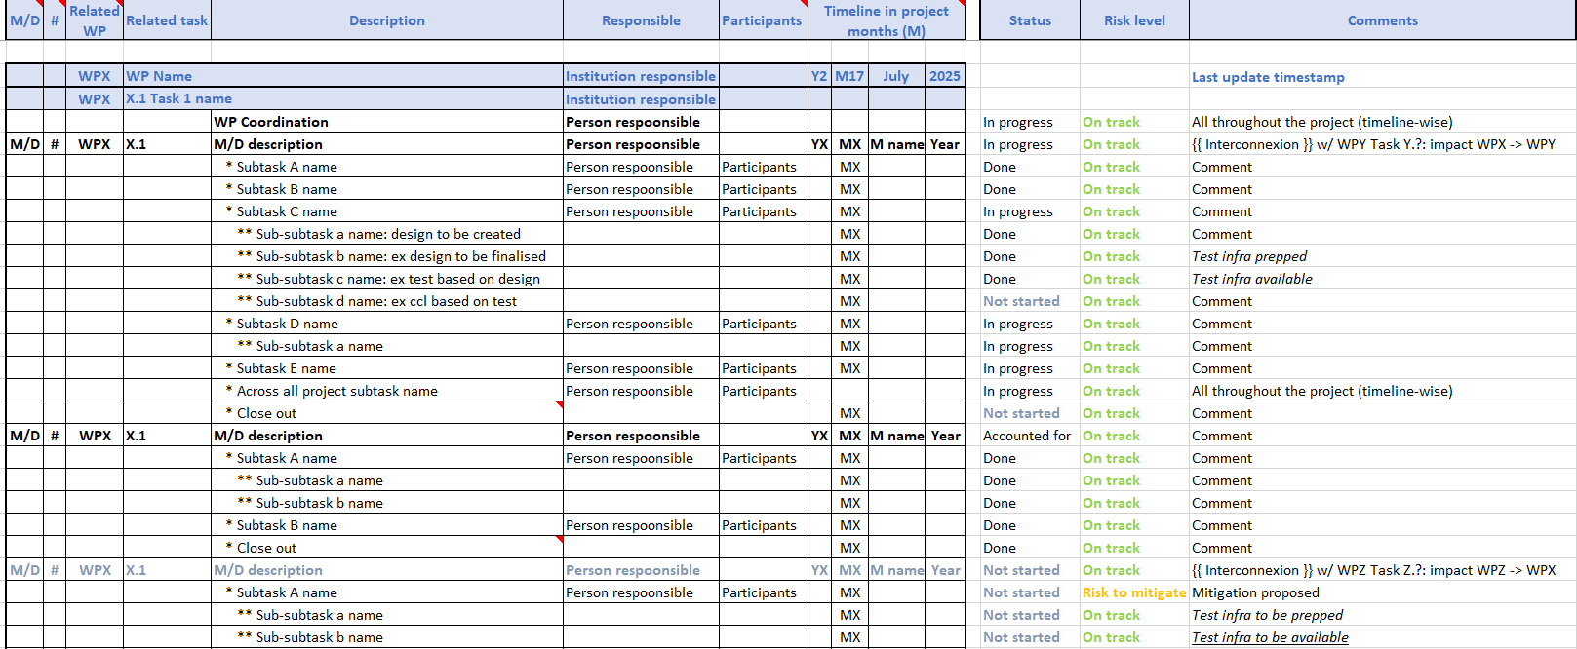
Monitoring template outline
To be updated for upcoming instances
WP detailed work plan tab for the month of update

Slide 13
Monitoring template outline
To be updated for upcoming instances
WP detailed work plan tab for the month of update
Progress between updates seen by switching tabs from i.e. M17 tab to M19 tab

Slide 14
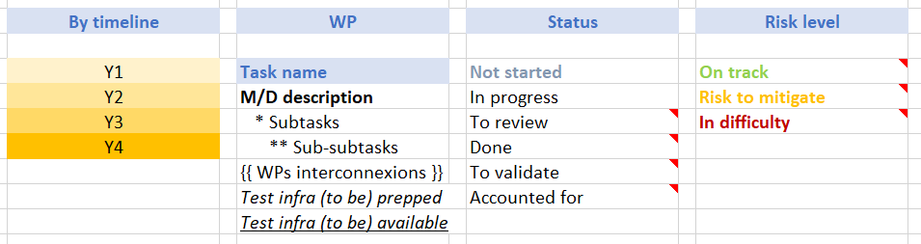
Monitoring template outline
To be updated for upcoming instances
Notes:
Risk to mitigate : if nothing changes, anticipated that we’re going to leave the tracks down the line, so priorisation to get higher or creative solution to be found within the current parameters of the project
In difficulty: tracks already left and change in current parameters of the project is necessary – to be discussed w/ PO (AMD)

Slide 15
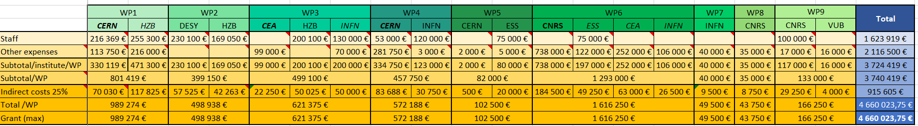
Budget template outline
To be updated yearly for iSAS annual meeting
By WP separating staff from other expenses

Slide 16
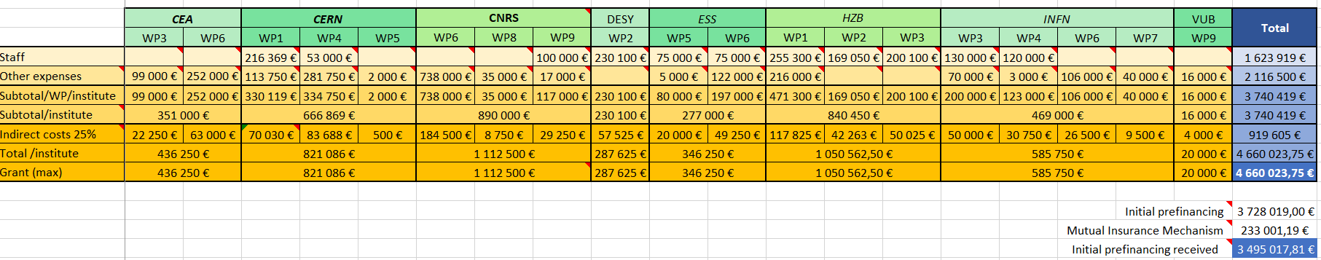
Budget template outline
To be updated yearly for iSAS annual meeting
By beneficiary institution separating staff from other expenses

Slide 17
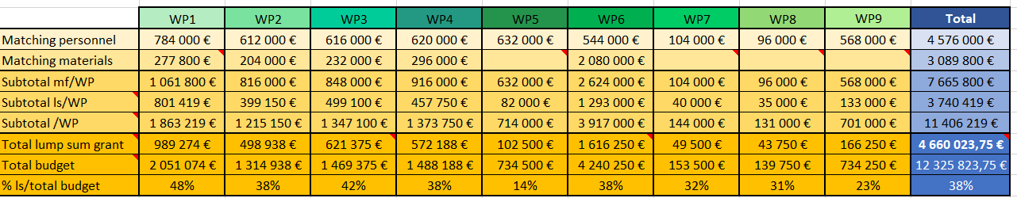
Budget template outline
To be updated yearly for iSAS annual meeting
Structure of tabs for Expected, Expenses, Deviations per WP & per beneficiary institution
Reminder of agreed matching funds

Slide 18
Upcoming project meetings
Coordination panel & Steering committee meetings
Steering committee – Nov 4 at 10 am CET
Coordination panel - Dec 16 at 10 am CET
Steering committee – Jan 27 at 10 am CET
Coordination panel – March 10 at 10 am CET
Steering committee – April 21 at 10 am CET
Coordination panel – June 2 at 10 am CET
Industry Board meeting
Oct 30 at 3 pm CET
2nd yearly project meeting
Hosted by HZB in Berlin (w/ online connection as well), April 22-24, 2026
Including Governing Board in-person meeting w/ online option (exact time tbd soon)
Including Advisory Board recommendations & companies participation

Slide 19
Thank you!

Slide 20
Back up

Slide 21
Consortium Agreement, shared NDA, amendment
Consortium Agreement (CA)
v3 sent with Sept 29 due date for last review before signature process:
Background missing for DESY
CERN, EPFL & HZB asked for opposite modifications on 5.2 on contractual liability & gross negligence
Provisional CA v4 available to negotiate w/ HZB & EPFL
Note: GB not allowed to interfere with this negotiation process.
Shared NDA
For industrial partners
Signed by ACS, Euclid & Zanon
Cryoelectra, Plasmatherm missing the legal entity, non-responsive
RI willing to sign
Does GB agree to exclude any partner who has not signed the NDA, until a suitable resolution is achieved?
Amendment (AMD) to the Grant Agreement
Nikhef will not join the consortium formally
Other modifications to be included in RP1 report, tbc by PO (new PO: Sotirios Kakarantzas)

Slide 22
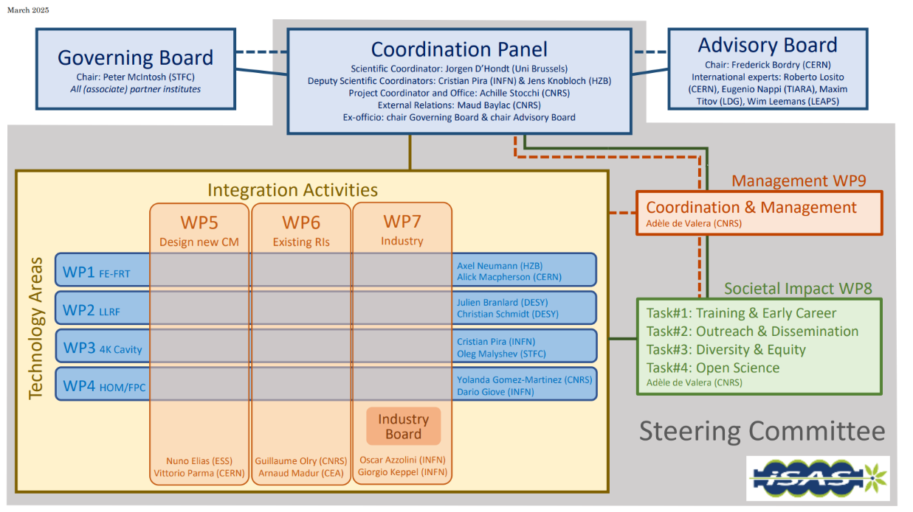
Instances (as formalised in the CA)
Governing Board & Advisory Board Chairs ex-officio members of Coordination panel to better communication between instances
Advisory Board reports back to the Coordination panel for yearly project meetings and upon ad hoc request in counsel
Coordination panel becomes Steering Committee every other meeting to allow for scientific cross-coordination between Coordination & WP Leaders as well as between WPs
Industry Board including WP Leaders to enable co-development

Slide 23
Governing Board
Beneficiaries: Peter McIntosh (Chairperson)
Jérôme Schwindling (CEA)
Vittorio Parma (CERN)
Achille Stocchi (CNRS)
Hans Weise (DESY)
Nuno Elias (ESS)
Jens Knobloch (HZB)
Attilio Sequi (INFN)
Michael Tytgat (VUB)
Associated partners: Oleg Malyshev (UKRI)
Graeme Burt (University of Lancaster)
Mike Seidel (EPFL)
Jorgen D'Hondt (Nikhef)
Tomas Junquera (ACS)
Birger Nordmann (Cryoelectra)
Alexei Kanareykin (Euclid Techlabs)
Filippo Casazza (Plasmatherm)
Alexander Navitski (Research Instruments)
Ambra Gresele (Zanon)
Coordination panel
Mandated: Achille Stocchi (Chairperson)
Jorgen D'Hondt (Scientific Coordinator)
Cristian Pira (Deputy Scientific Coordinator)
Jens Knobloch (Deputy Scientific Coordinator)
Maud Baylac (External Relations)
Peter McIntosh (Ex-officio)
Frederick Bordry (Ex-officio)
Steering committee
Mandated: Coordination panel (Ex-officio)
Axel Neumann & Alick MacPherson (WP1)
Julien Branlard & Christian Schmidt (WP2)
Cristian Pira & Oleg Malyshev (WP3)
Yolanda Gomez-Martinez & Dario Giove (WP4)
Nuno Elias & Vittorio Parma (WP5)
Guillaume Olry & Arnaud Madur (WP6)
Oscar Azzolini & Giorgio Keppel (WP7)
Adèle de Valera (WP8)
Adèle de Valera (WP9)
Advisory Board
Mandated: Frederick Bordry (Chairperson)
Roberto Losito (CERN)
Eugenio Nappi (TIARA)
Maxim Titov (LDG)
Wim Leemans (LEAPS)

Slide 24
Industry Board
Industry Board members: Oscar Azzolini (Chairperson)
WP Leaders (Ex-officio)
Mandated by companies: Arthur Iziquel (Accelerators and Cryogenic Systems)
Alexei Kanareykin (Euclid Techlabs)
Alexander Navitski (Research Instruments)
Ambra Gresele (Zanon Research & Innovation)
Birger Nordmann (Cryoelectra)
Filippo Casazza (Plasmatherm)

