Slide 1


WP4: High-Order Mode (HOM) dampers & Fundamental Power couplers (FPC)
7/10/2025
All information contained in this presentation and any accompanying documents is for iSAS project only, and must be treated as strictly confidential.
Any dissemination, distribution or other use of this information without the consent of its owner is prohibited.
Funded by the European Union. Views and opinions expressed are however those of the authors only and do not necessarily reflect those of the European Union or the European Commission. Neither the European Union nor the granting authority can be held responsible for them.

Slide 2
WP4: HOM et FPC
CERN, CNRS ( IJCLab, LPSC), INFN
Convener: Y. GOMEZ MARTINEZ (CNRS/ LPSC)
Main contacts with other partners: V. PARMA (CERN), P. DUCHESNE (CNRS/IJCLaB), D. GIOVE (deputy INFN)
Task 4.1: General coordination of WP4 March 24 – March 28 CNRS, INFN
Task 4.2: HOM coupler design March 24 – August 25 INFN, CNRS, CERN
At 800MHz and 1,3 GHz with the goal to minimize static and dynamic heat loads on the cryogenic circuits of the cryomodule
Task 4.3: Fabrication of HOM couplers May 25 – February 28 CERN, CNRS, CERN
4 HOMs 800 MHz and 1 HOM at 1,3 GHz with the goal of employing cost and production-time reduction techniques
Task 4.4: Test of HOM couplers for WP6 Nov 25 – Mai 26 CNRS, INFN
On mono-cell and multi-cell 800 MHz and 1,3 GHz mock-up cavities at 300 K
Task 4.5: FP coupler design March 24 – June 25 CERN, CNRS
With the goal to improve sustainability
Task 4.6: Fabrication of FP couplers July 25 – Mai 26 CERN, CNRS
4 new 800 MHz FPC with the goal of employing cost and production-time reduction techniques.
Task 4.7: Test of FP couplers Feb 26 – November 26 CERN, CNRS
Preparation & RF conditioning 800 MHz, 50 kW CW

Slide 3
WP4 – HOM et FPC : status/evolution of Task 4.1
General coordination of WP4
Past developments
  15 WP4 meetings held
  2 technical reviews done (HOM and FPC)
  Review with experts to ensure that the decision on whether or not to conditioning the couplers fully considers all associated risks and opportunities ( recommendation of iSAS Advisory Board) done.
  2 milestones achieved:
    FPC design report (C.Sharp) on June 25
    HOM design report (only about 800 MHz HOM. P.Duchesne on behalf of D.Giove on August 25)
Current developments
  With WP6 : Assign the activity of recruitment of postdoc staff and its budget from the beneficiary INFN to the CNRS.
    Formal confirmation of Dr. Giove (INFN-Milano Local Responsible of the funds) and of dr. Pira (INFN Project National Responsible) sent
    Anna Francescon ( INFN Financial Officer) confirm that for INFN these statements are sufficient (08/07/2025).
    Adele de Valera (iSAS project manager) relay request via the EU Portal
    Transfert money in progress

Slide 4
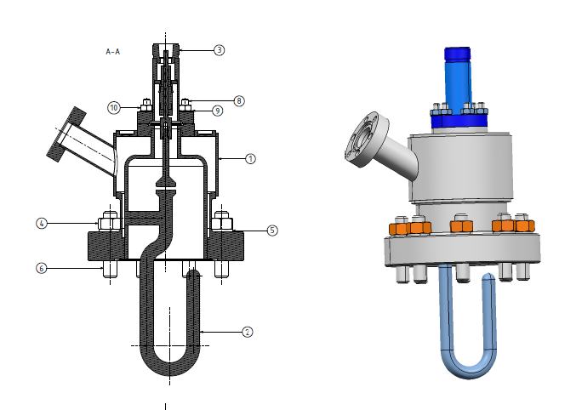
WP4 – HOM et FPC: status/evolution of Task 4.2
HOM coupler design
Past developments
  800 MHz HOM design validated using a standard Allectra n-feedthrough
  Task finished for 800 MHz HOM
Courtesy of S.Blivet (IJCLab)
Current developments
  Preliminaires studies
  To do a recovery plan for the design of the 1,3 GHz HOM (INFN)

Slide 5
WP4 – HOM et FPC : status/evolution of Task 4.3
Fabrication of HOM couplers
Past developments
  800 MHz HOM functional design drawings done
  Drawings for production in progress
Current developments
  Plans technical design ready to manufacture in progress (IJCLab with CERN feedback on fabricability)
  Niobium order (4 months of procurement)(CERN)
  Note: RF feedthroughs and the top copper antenna purchase by IJCLab

Slide 6
WP4 – HOM et FPC : status/evolution of Task 4.4
Test of HOM couplers
Past developments
  Nothing to report
Current developments
  A list of the main tasks to be carried out in order to have the 800 MHz test bench operational and estimate the time required for the completion of the tasks in progress (IJC Lab)

Slide 7
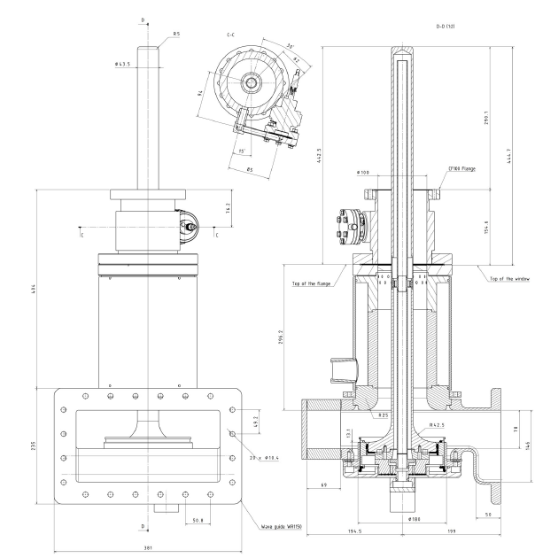
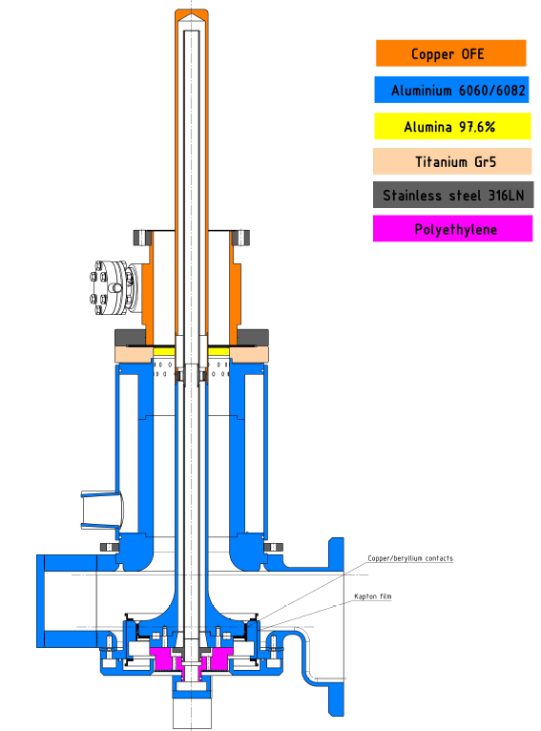
WP4 – HOM et FPC : status/evolution of Task 4.4
FP coupler design
Past developments
  FPC design validated
Current developments
  Nothing to report, completed task
Courtesy of G. Olivier & S. Blivet(IJCLab)

Slide 8
November/December
WP4 – HOM et FPC : status/evolution of Task 4.5
Fabrication of FP couplers
Past developments
  Nothing to report
Current developments
  Drawings ready to manufacture in progress (CERN)
    In November/ December 2025 functional drawings done

Slide 9
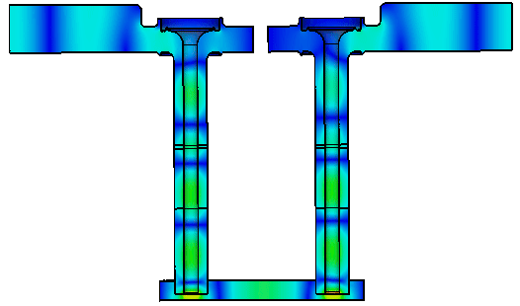

WP4 – HOM et FPC : status/evolution of Task 4.6
Test of FP couplers
Past developments
  On 13 May 25, the strategy chosen was to do the RF conditioning at 800 MHz.
  To utilize:
    the 704 MHz test box at 800 MHz with the dtip of 18,5 mm ±1,5 mm.
    the test area with 800 MHz IOT
Current developments
  A list of the main tasks to be carried out in order to have the 800 MHz test bench operational and estimate the time required for the completion of the tasks
S1,1(dB)
$f=801 MHz, d_{tip}=18.5 mm$, P_{in}=0.5 W
Courtesy of C. Sharp (CERN)

Slide 10
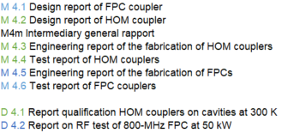
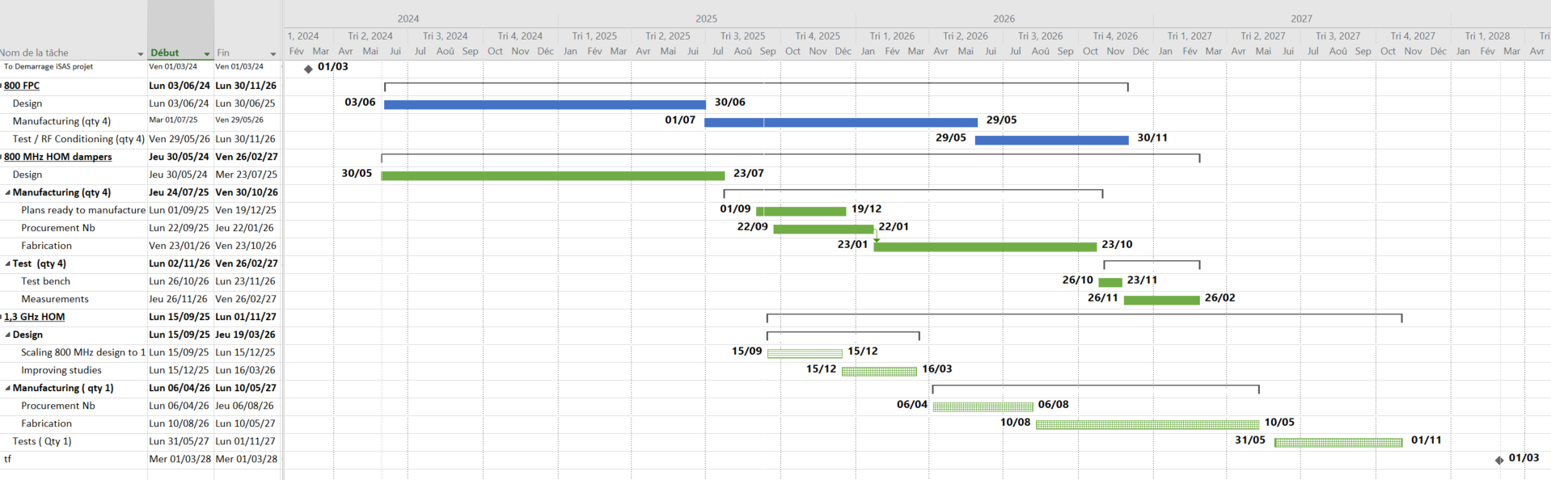
WP4 – HOM et FPC :
plans to achieve milestones & deliverables
With the initial dates of the milestones:
M4.1
M4m
M4.5
M4.6
D4.2
M4.2
M4.3
M4.4
D4.1
FPC
800 MHz HOM
1,3 GHz HOM
Estimation of delay in progress
(recovery plan for the design by INFN)
M4.4
D4.1
M4.3
today

Slide 11
WP4 – HOM et FPC :
plans to achieve milestones & deliverables
With the new dates of the milestones dates proposed by the project on 01/10/25:
M4m
M4.1
M4.2
D4.1
D4.2
M4.5
FPC
M4.6
M4.3
800 MHz HOM
M4.4
1,3 GHz HOM
Estimation of delay in progress
(recovery plan for the design by INFN)
M4.4
D4.1
M4.3
today

Slide 12
WP4 – HOM et FPC :
plans to achieve milestones & deliverables
Milestones & deliverables on track?
  In difficulty for initial M4.3 & M4.4 & D4.1 HOM fabrication and test.
Plans to achieve milestones & deliverables
  The new dates of the milestones seems achievable except for the 1,3 GHz HOM. Urge to have INFN recovery plan for 1.3GHz HOM design to discuss.
  To discuss about news dates for the deliverables.

Slide 13
WP4 – HOM et FPC : points of attention
Points of attention
  1.3 GHz HOM design studies in high difficulty. First step to the its manufacturing and its testing.

Slide 14
WP4 – HOM et FPC : Highlights to be shared on the iSAS website
Highlights to be shared on the iSAS website?
  (e.g. news articles to relay, i.e. post-doc to hire or hired, upcoming workshops… )
A postdoc to hire at IJC Lab. Definition of the subject in progress (HOM couplers, absorbers, FPC...)

Slide 15
Thank you for your attention

