Slide 1
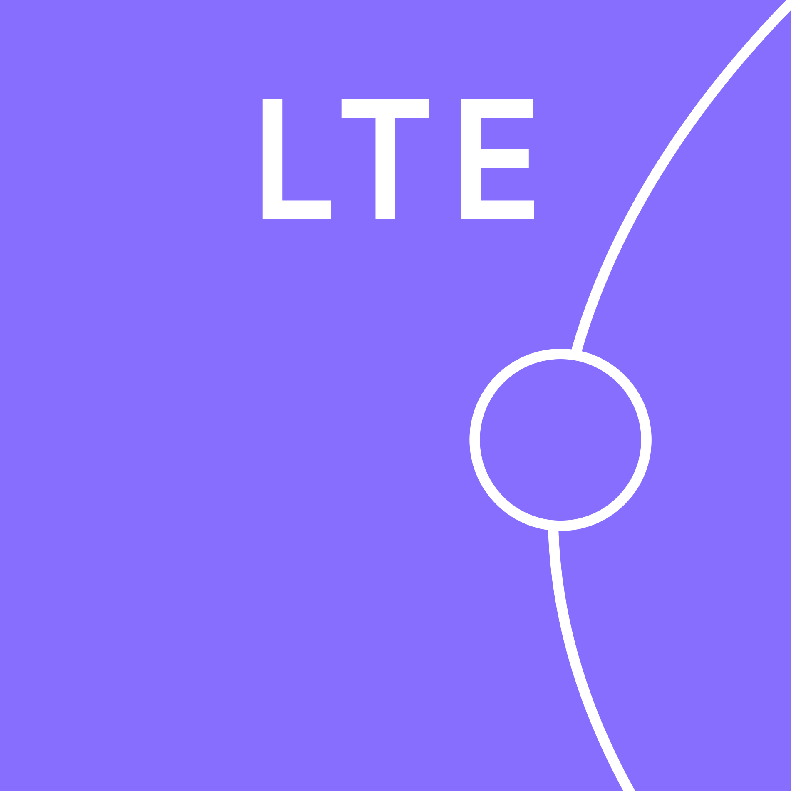






Bringing Metrological Precision to Scientific Networks: Digital Solutions for Ultra-Stable Time and Frequency Transfer
Idrogen : Antoine Back*, Cédric Esnault*, Monique Taurigna*, Chafik Cheikali*, Christelle Soulet*, Cédric Viou**, Michel Lours, Paul-Eric Pottie, Daniel Charlet*
REFIMEVE : Etienne Cantin***, Christian Chardonnet***, Anne Amy-Klein***, Benjamin Pointard, Rodolphe Le Targat, Neelam, Philip Tuckey, Paul-Eric Pottie
*: IJCLAB (Paris-Saclay, Paris-Cité and CNRS)
**: ORN (OP-PSL, Uni. Orléans, and CNRS)
***: LPL (USPN and CNRS)

Slide 2
Contents
Context - Motivations
Basics on Fiber Links
The REFIMEVE network
Advancing the Electronics: The Idrogen Board
Recent results at Observatoire de Radioastronomie de Nançay
Emerging Scientific and Technological Applications
EU perspective for the European fiber network
Outlook

Slide 3
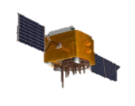
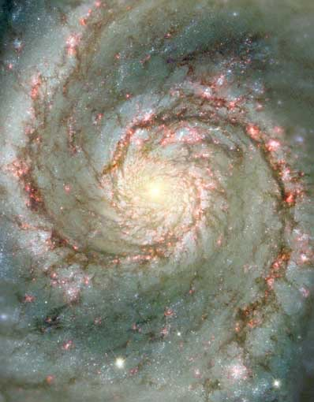
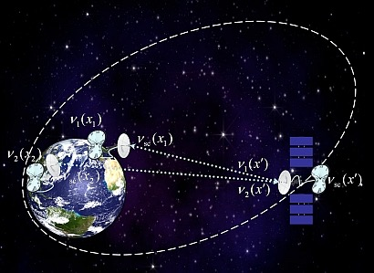

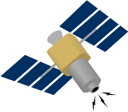

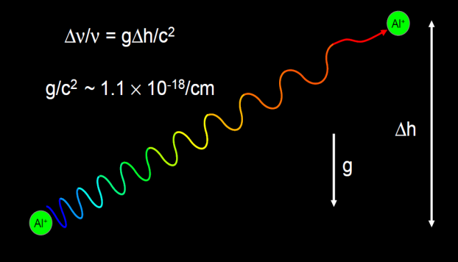
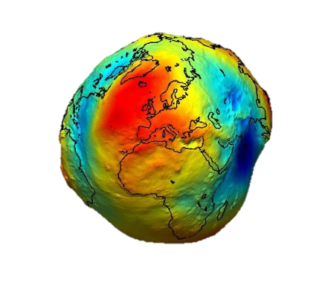


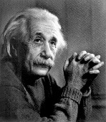
Motivations for time and frequency dissemination
Fundamental Scientific Applications
Dissemination of Time and Frequency from standards (atomic clocks, timescales)
for industry / society : Telecom and network synchronisation, smart grids, finance, manufacturing…
Definition & Variations in fundamental constants
Tests of Special &
General Relativity
Timing+syntonisation:
ms-ns, 1e-11-1e-15
Traceability
Sensing/Defense:
Positioning, Navigation and Timing
Large instruments, array of detectors
astronomy, astro particle, geoscience
multi-messenger astronomy, seismology
Earth Science and climate change
geodesy, chronometric leveling
synthetic aperture
global imaging
VLBI…
10⁻¹⁸/cm
Timing+syntonisation:
ns-ps, 1e-16
Comparisons
Timing+syntonistion:
ps, 1e-18 and better!
Comparisons
Timing+syntonisation:
ns, 1e-13-1e-16
Resiliency
Illustrations: courtesy N. Newbury, NIST

Slide 4
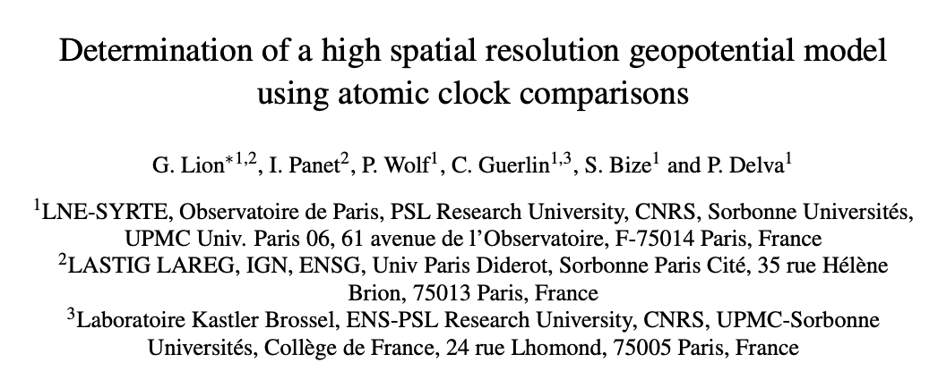
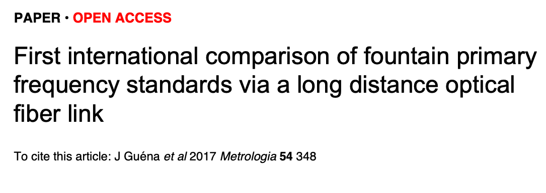
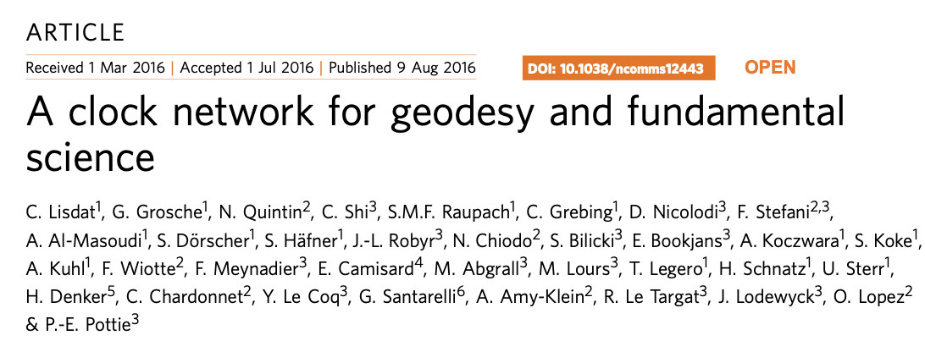
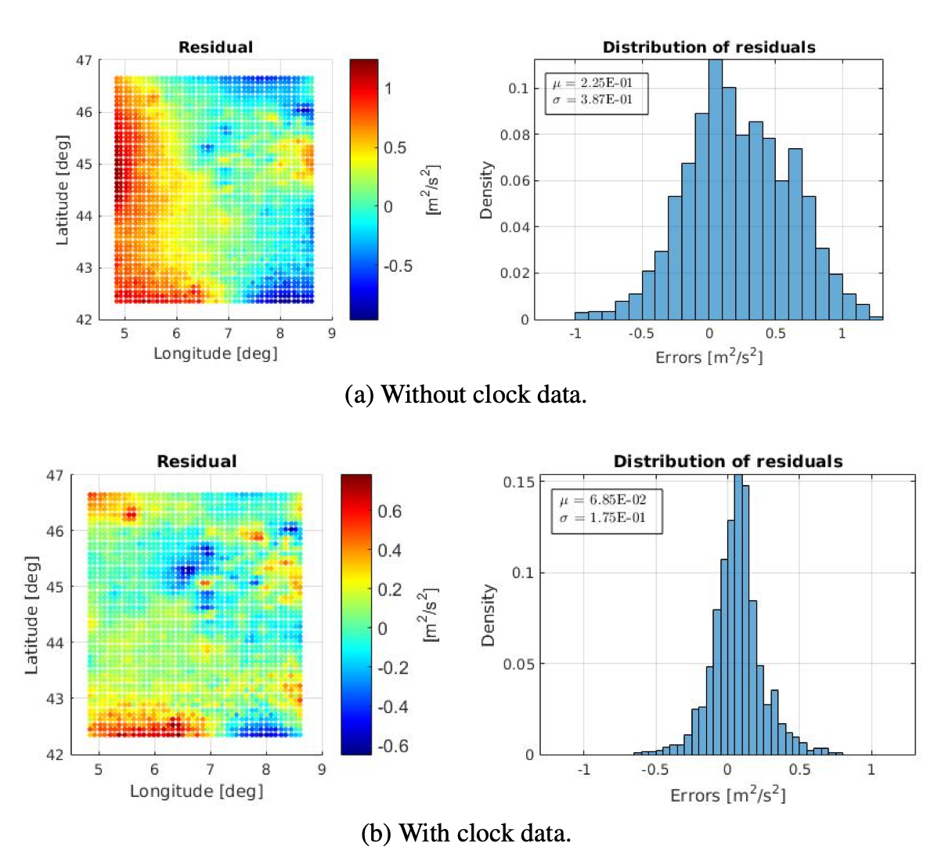

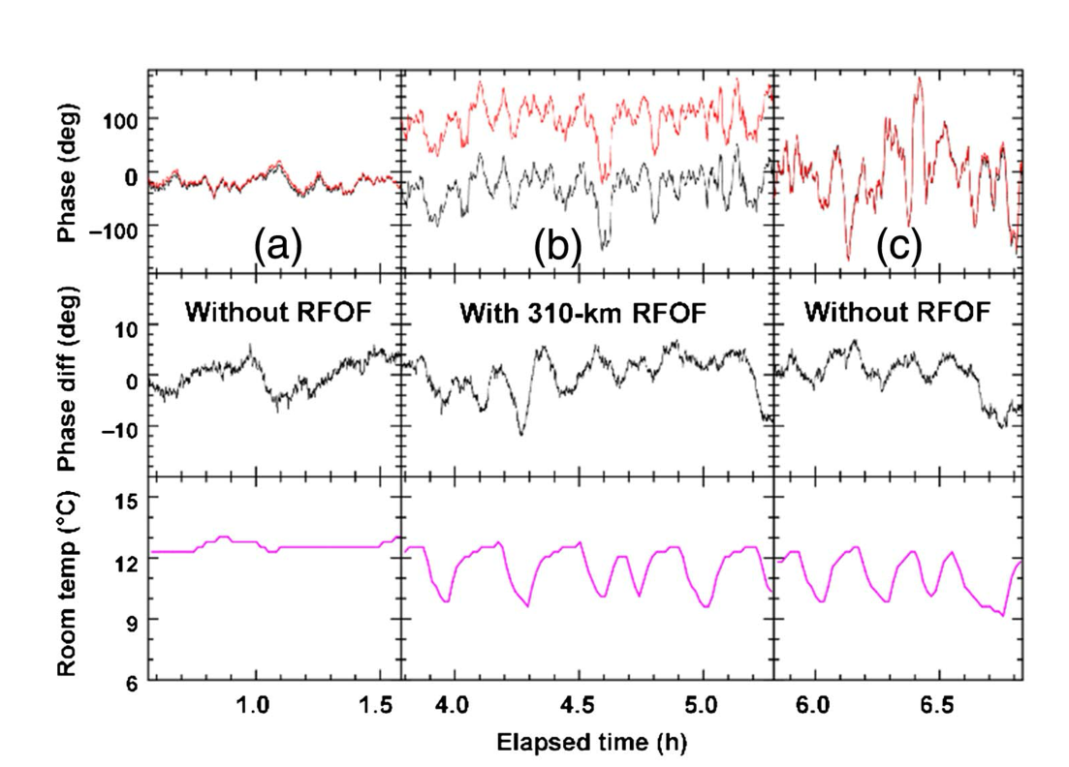
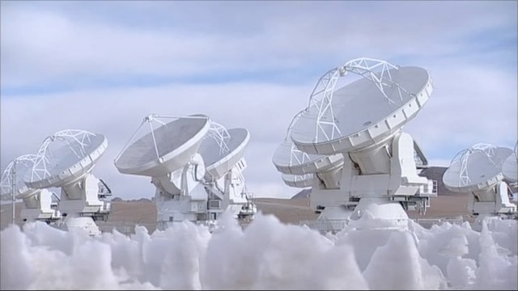
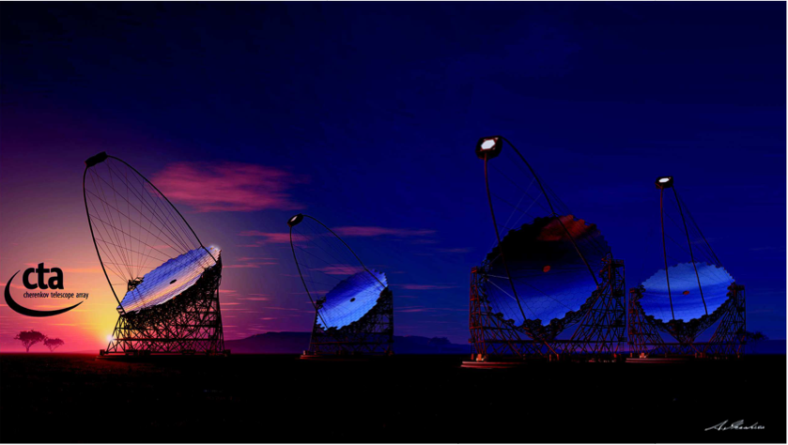

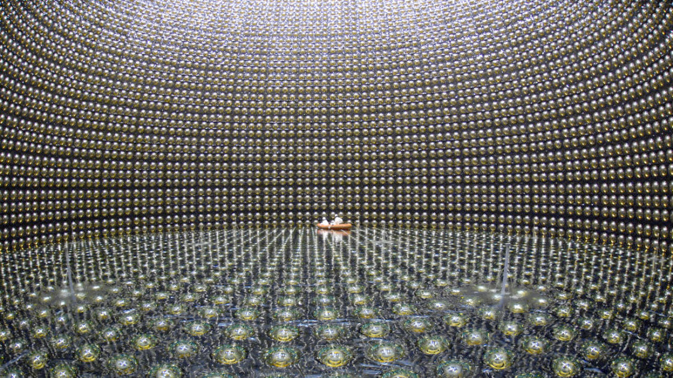

Scientific cases in astronomy and geodesy
Clocks comparisons
Geodesy
SKA
CTA
VLBI
Astronomy
KM3Net
Particle detectors
Y He et al., Optica, 5, 138–146 (2018).
see also :
C. Clivati et al., IEEE Trans. on UFFC 62, 1907–1912 (2015).
see also :
T. E. Mehlstäubler et al., Atomic clocks for geodesy. Rep. Progress in Physics 81, 064401 (2018).
Super-K
PAON IV / Idrogen

Slide 5
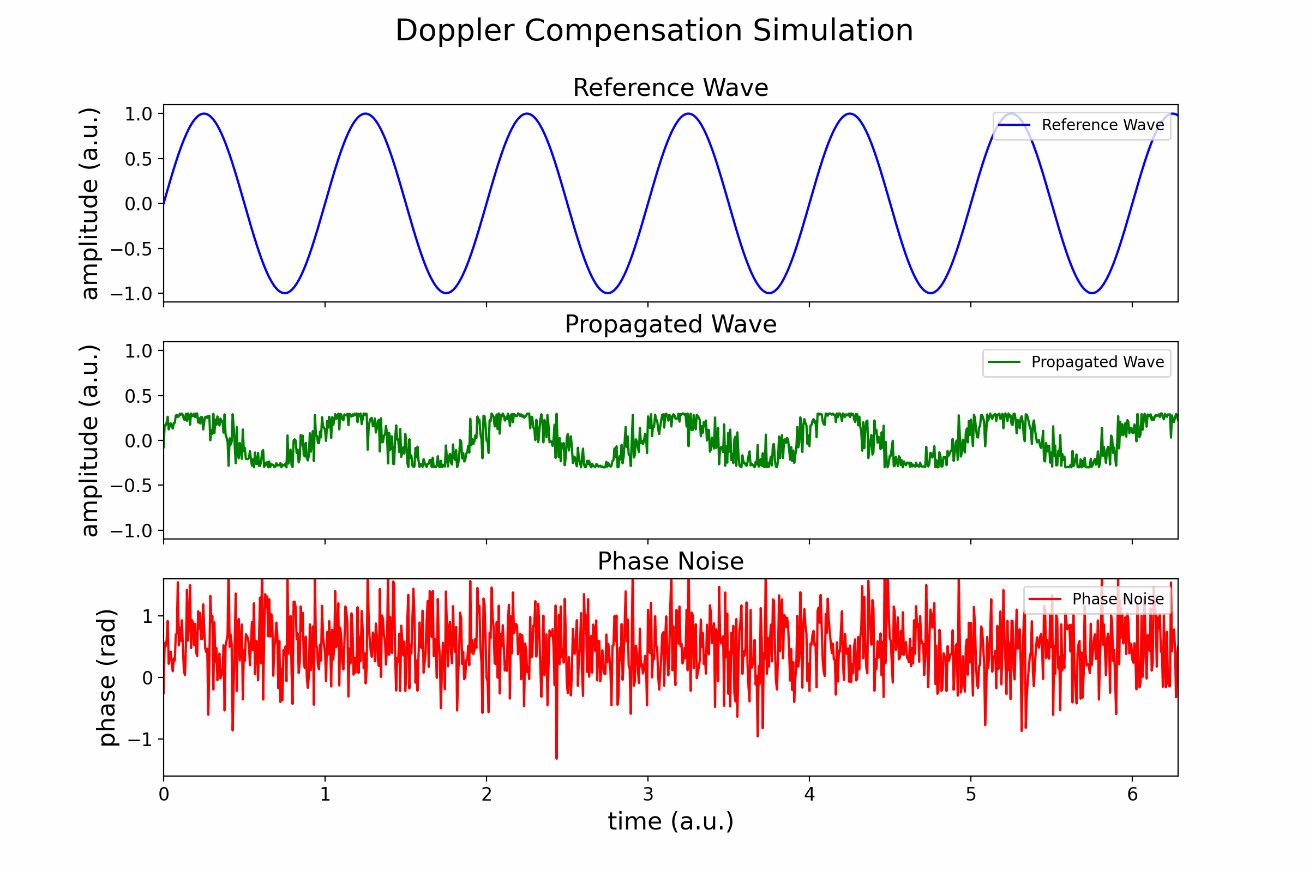
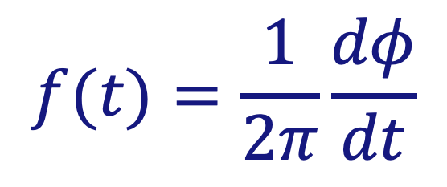
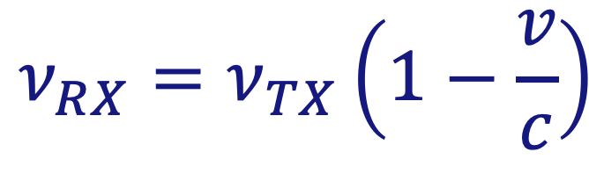
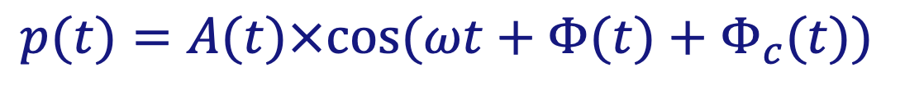
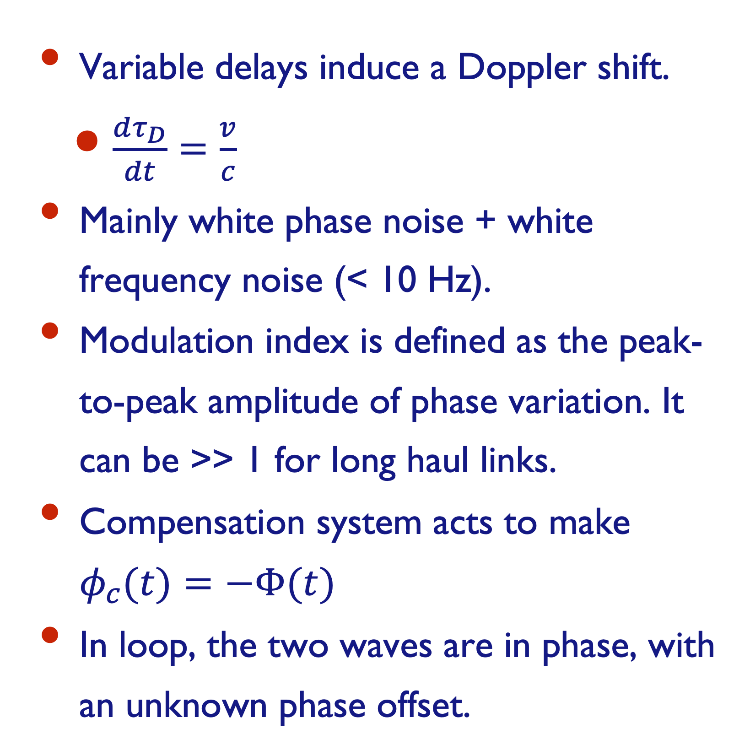
Doppler shift and Doppler canceller
Phase fluctuations induce frequency fluctuations:
$$f(t)=\frac{1}{2π}\frac{dφ}{dt}$$
Doppler shift:
$$ν_{RX}=ν_{TX}\left(1−\frac{v}{c}\right)$$
Variable delays induce a Doppler shift.
$\frac{dτ_{D}}{dt}=\frac{v}{c}$
Mainly white phase noise + white frequency noise (< 10 Hz).
Modulation index is defined as the peak-to-peak amplitude of phase variation. It can be >> 1 for long haul links.
Compensation system acts to make $φ_{c}(t)=−Φ(t)$
In loop, the two waves are in phase, with an unknown phase offset.
$$p(t)=A(t)×cos(ωt+Φ(t)+Φ_{c}(t))$$

Slide 6

Optical frequency transfer : key elements
𝜑_{correction} + 𝜑_{fiber} = 0
Unbalanced Michelson interferometer
Heterodyne detection: eliminates mutli-path
Fully bi-directional. A 2nd link transfers back the signal
Guided propagation: ensure paths reciprocity
Assumption : Forward noise = ½ Round-trip noise
→ corrects only reciprocal noise
Coherent regime if coherence length > 2L (need ultra-stable laser !)
Fundamental limits set at short term by the finite velocity of light in media
Michelson
Optical fiber
(delay line)
mirror
photonic device
laser
splitter
w
splitter
< propagation noise >
-𝜑_{fiber}
User
Photodiode
𝜑_{round trip} = 2𝜑_{Fiber}
Noise correction
Local End
opto-electronic compensation
Remote End
A second set-up on a second fiber transfers back the signal: « End-to-end » measurement, out of loop.
Multi-segment approach
Shorter delay, larger bandwidth
Signal regeneration with a narrow laser (a few kHz at 1 Hz bandwidth, free running)
Repeater
Station
N-1
Link
N-1
Repeater
Station
N
Link
N
Repeater
Station
N+1
Local
end
Remote
end
O. Lopez, et al.. OE 18, 16849–16857 (2010).
Repeater laser station (RLS) functionalities :
sends back signal to station N-1,
corrects the noise of next link N,
provides a user output
Multi-branches Laser Station (Hub station)
can correct the noise of several (~5) links
E.Cantin et al. New J. Phys. 23, 053027 (2021).

Slide 7
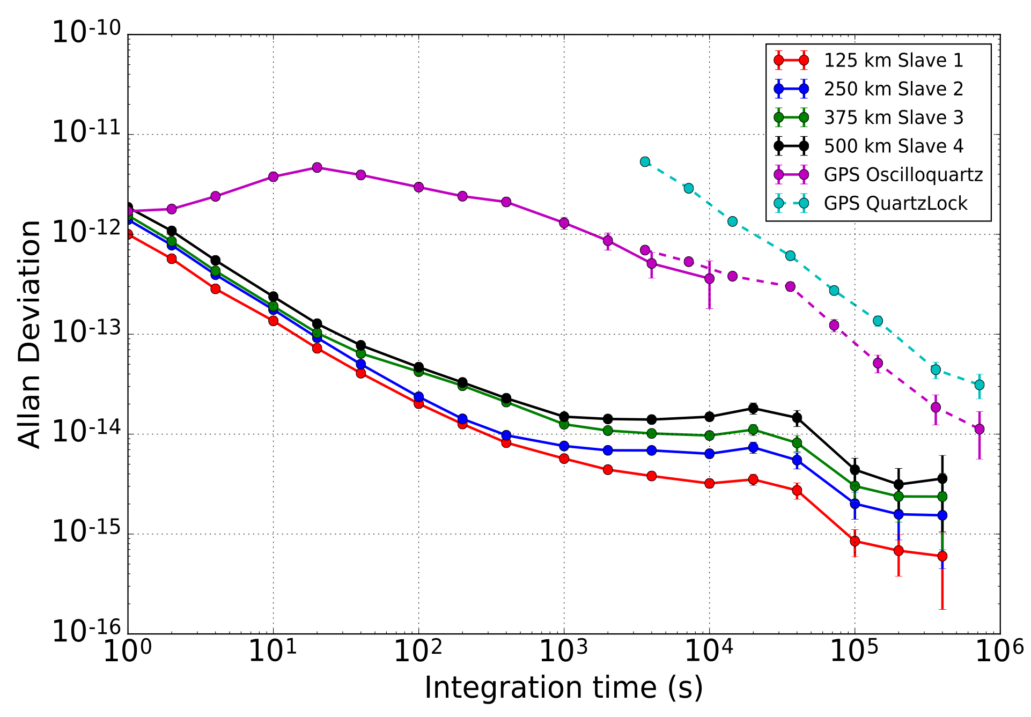
Radio-frequency and time transfer by White Rabbit: key elements
Based on 1Gb/s ethernet communication
Layer-1 syntonization (SyncE)
Local RF oscillators are phased locked with ~20-70 Hz bandwidth to a common RF frequency reference
All nodes of the network are locked to the frequency of the System timing master
Precise Time Protocol is used to retrieve precise time stamps
FPGA technology to implement a precise phase/time measurement with 20 ps resolution single shot (~ every 50 ms).
Static link asymmetry can be compensated for.
White Rabbit on 500-km uni-dir on spools
N. Kaur doi: 10.1109/TUFFC.2021.3134163. (2022)
N. Kaur, phdthesis https://hal.archives-ouvertes.fr/tel-01909292
See D. Charlet’s talk Thursday, 11:40

Slide 8
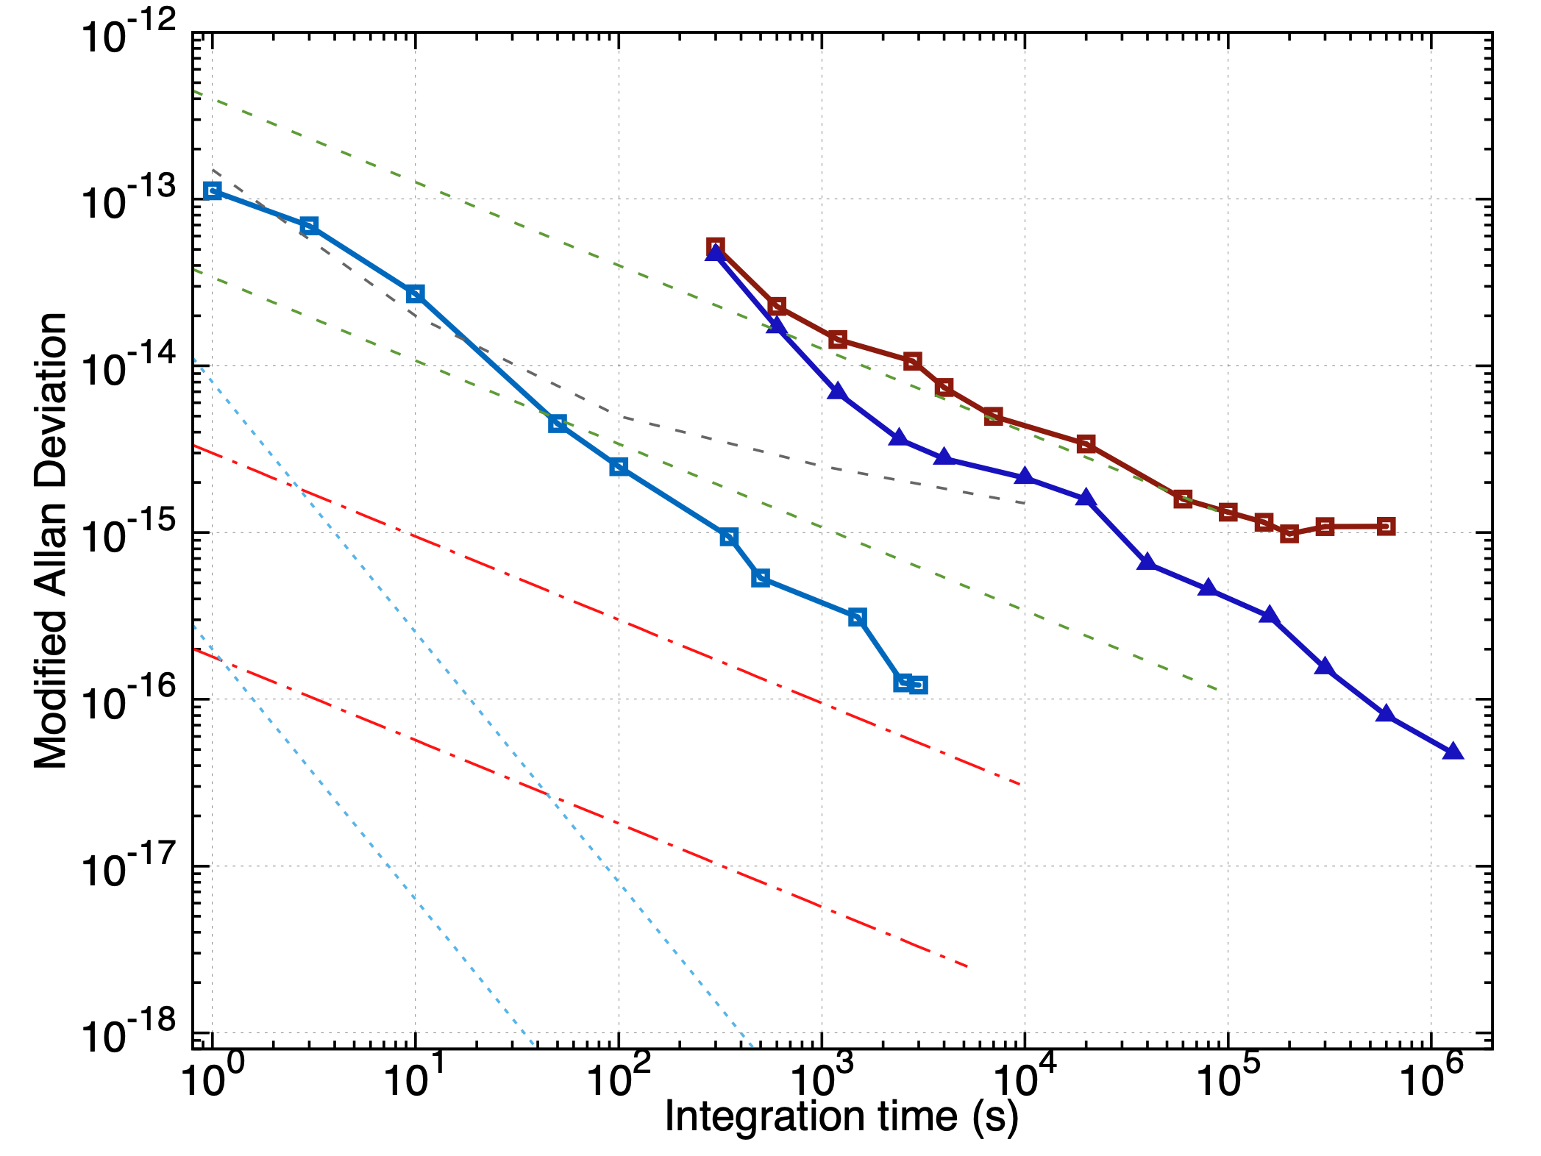
Coherent optical fiber links and white rabbit links
Fiber links: pro and contra
White Rabbit
Guided propagation:
Low noise
No interferences
Low optical losses
Excellent reciprocity
Major drawback
Point to point
μw clocks
GPS
optical clocks
GPS IPPP
TW-CP
Coherent Optical Links
Goal for SI-s re-definition
Coherent optical links are the only technique to date to enable optical clocks comparisons at continental scale
TW-CP : Two-Way Carrier Phase; IPPP : Precise Point Positioning with integer ambiguity resolution
see review: O. Lopez et al., CRAS, 16 (5), pp. 459-586 (2015) (2015)
CCTF task force at BIPM for the redefinition of the SI-s:
https://www.bipm.org/documents/20126/52354676/CCTF_2020_Task_force_Introduction_Finale.pdf/62bb4dc1-a662-a07e-dd9c-d9ed17829d70

Slide 9


Refimeve network map (2025)
VSL
4 international connections (DE, UK, IT; CERN)
+ Belgium-France cross-connection planned
Clocks @INRIM, PTB, NPL, and LTE connected.
REFIMEVE connects ~30 labs by 11/2025.
REFIMEVE connects 6 research infrastructures:
LSM, CERN,SOLEIL (done)
ESRF, IRAM, LOFAR (planned)
Link with EPOS-FR, …
FIRST-TF (Research federation) acts for the scientific animation of the French users connected by the fiber network.
EURAMET: 5 EU projects to develop technology, + run optical clock comparisons,…
ORB

Slide 10
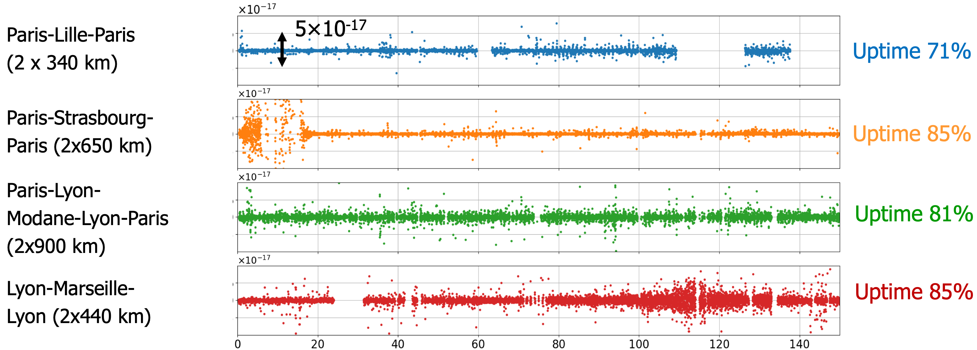
Towards a highly available signal
Relative frequency fluctuations vs time (days)
1000 s / point
4 links: {340,650,900,440} km x2 = 2x2330 km
>70% / 1/2 year (2022)
>90% uptime for several months
next objective: 90 % / year

Slide 11
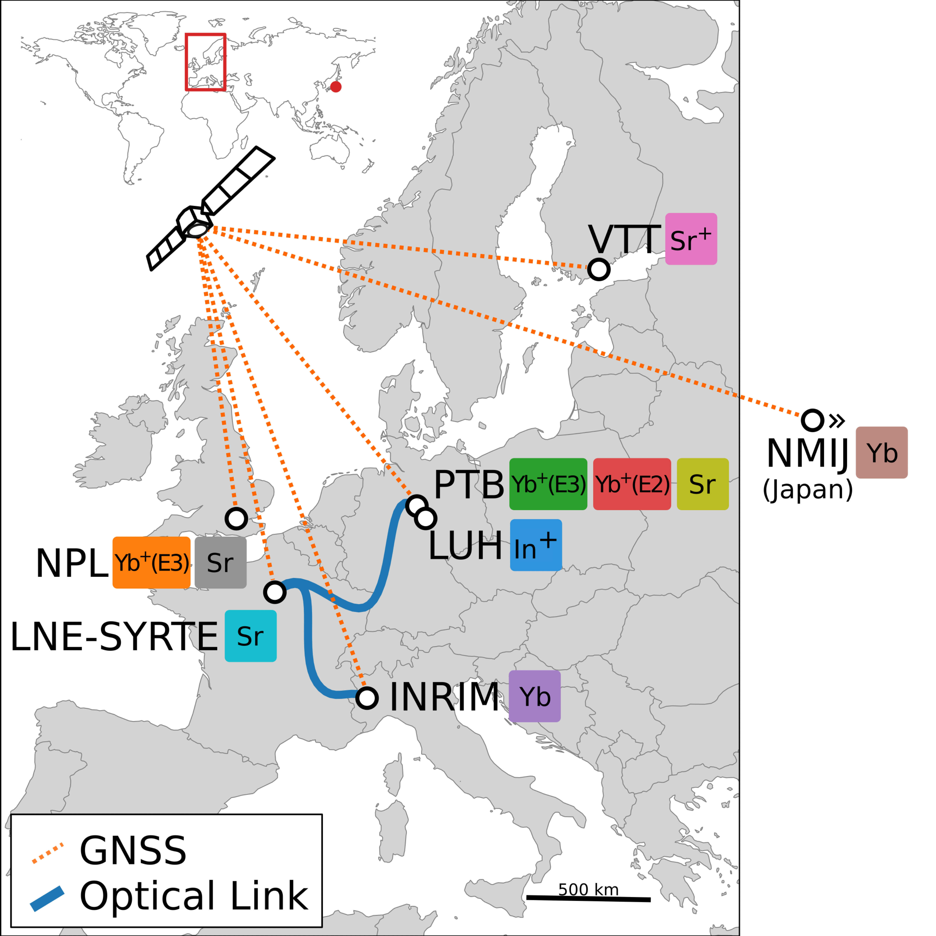
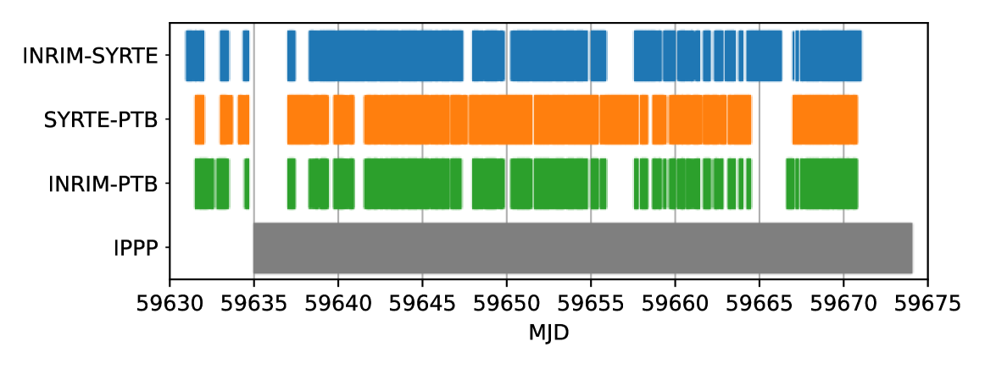
Clock comparisons: towards redefinition of the SI second
Coordinated international comparisons between optical clocks connected via fiber and satellite links
Robust optical clocks for international timescales (ROCIT)
https://empir.npl.co.uk/rocit/
10 optical clocks
6 countries
Fiber and Satellite links (GPS IPPP)
38 optical frequency ratios
Evaluation of the correlations
T. Lindvall et al., Optica, 12 (6), p. 843‑852, juin 2025, doi: 10.1364/OPTICA.561754.

Slide 12
Frequency Transfer and Time Transfer
Frequency transfer: delay fluctuation stabilisation
Time transfer : delays determination (both instrumental delays and propagation delay)
Precise sub-picosecond time transfer need a specific electronic development for exquisite instrumental delays stability and reproducibility
Illustration credits :
B. Liu, et al. doi: 10.3390/photonics9080522.
D. Chen, et al. doi: 10.3390/photonics9050293.

Slide 13
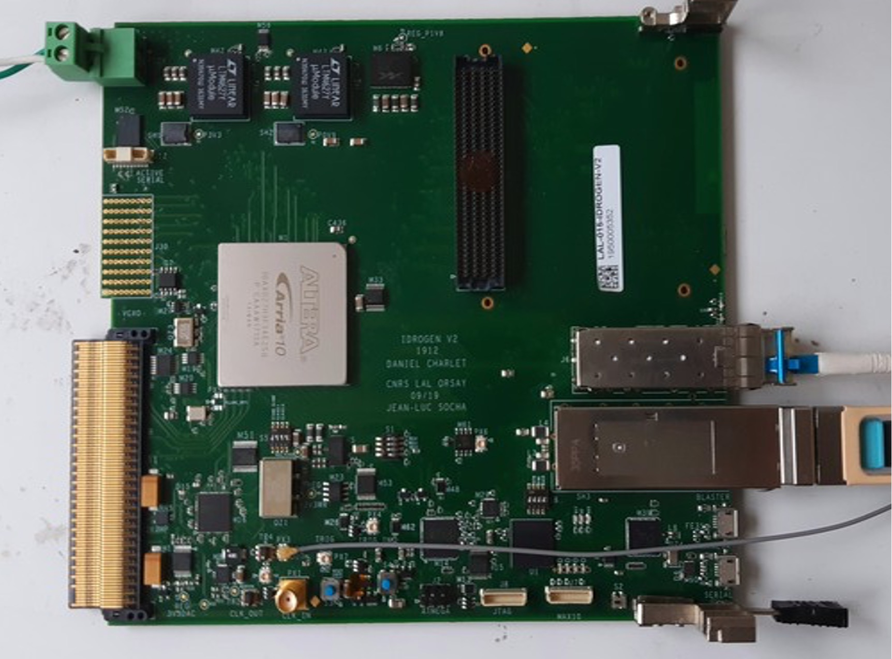
Advancing the Electronics: The Idrogen Board
See D. Charlet’s talk Thursday, 11:40
15 cm
FMC
Design & development: IJCLab
WR schematic from CERN improved
PCB design compliant with EMC rules
Micro Telecommunication Computing Architecture
Crate or Stand-alone mode available
Firmware development: ORN + IJCLab
Clock expertise and measurements: LTE
Simplified and improved clock design
Components upgrade: FPGA, VCXO, PLLs, …
RTM
FPGA
~15 cm
SFP+
AMC
VCXO.
QSFP+
USB
Additional functions on daughter boards
FPGA Mezzanine Card (FMC) carrier board:
ADC, DAC, Clock synthesis, ...
Front panel connectivity:
Small Form-factor Pluggable (SFP+) 1/2.5 Gb/s
Quad SFP+ (QSFP+) 40Gb/s
Universal Serial Bus (USB)
Backplane connectivity:
Advanced Mezzanine Cards (AMC)
l Gb/s ethernet IPbus, PCIe 4x Gen3 and Gen4
Intelligent Platform Management Bus, Clock & trigger lane
Rear Transition Modules (RTM)

Slide 14
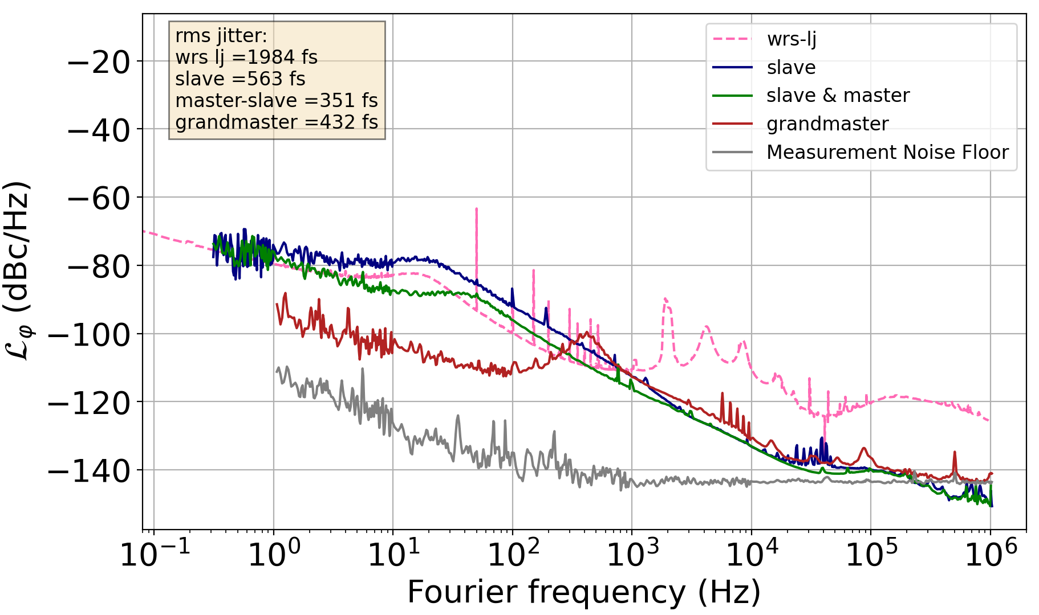
Idrogen: best in class WR end-node
High performance WR low jitter node :
Accuracy < 20 ps
rms time jitter < 1ps
High performance data acquisition system:
PCI express > 25 Gb/s Ethernet > 20-40 Gb/s
Configurable output clock
Crate (µTCA) or stand alone use
Main limitations :
PLL bandwidth
oscillator frequency ~125 MHz
Noise floor of some components
Integration bandwidth : 100 Hz- 1 MHz

Slide 15
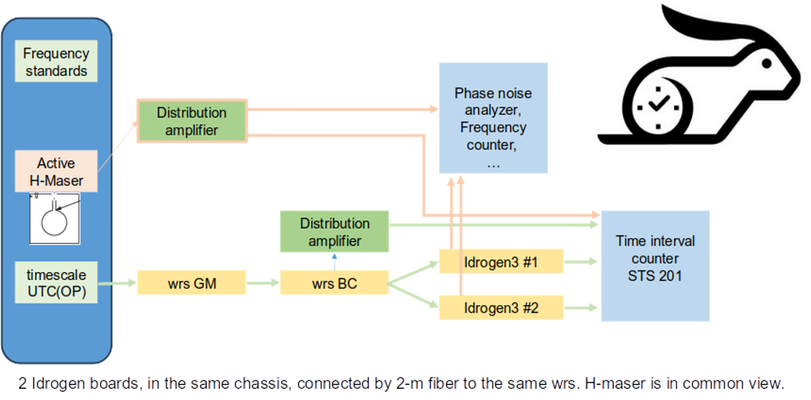
Measurement set-up at LTE

Slide 16
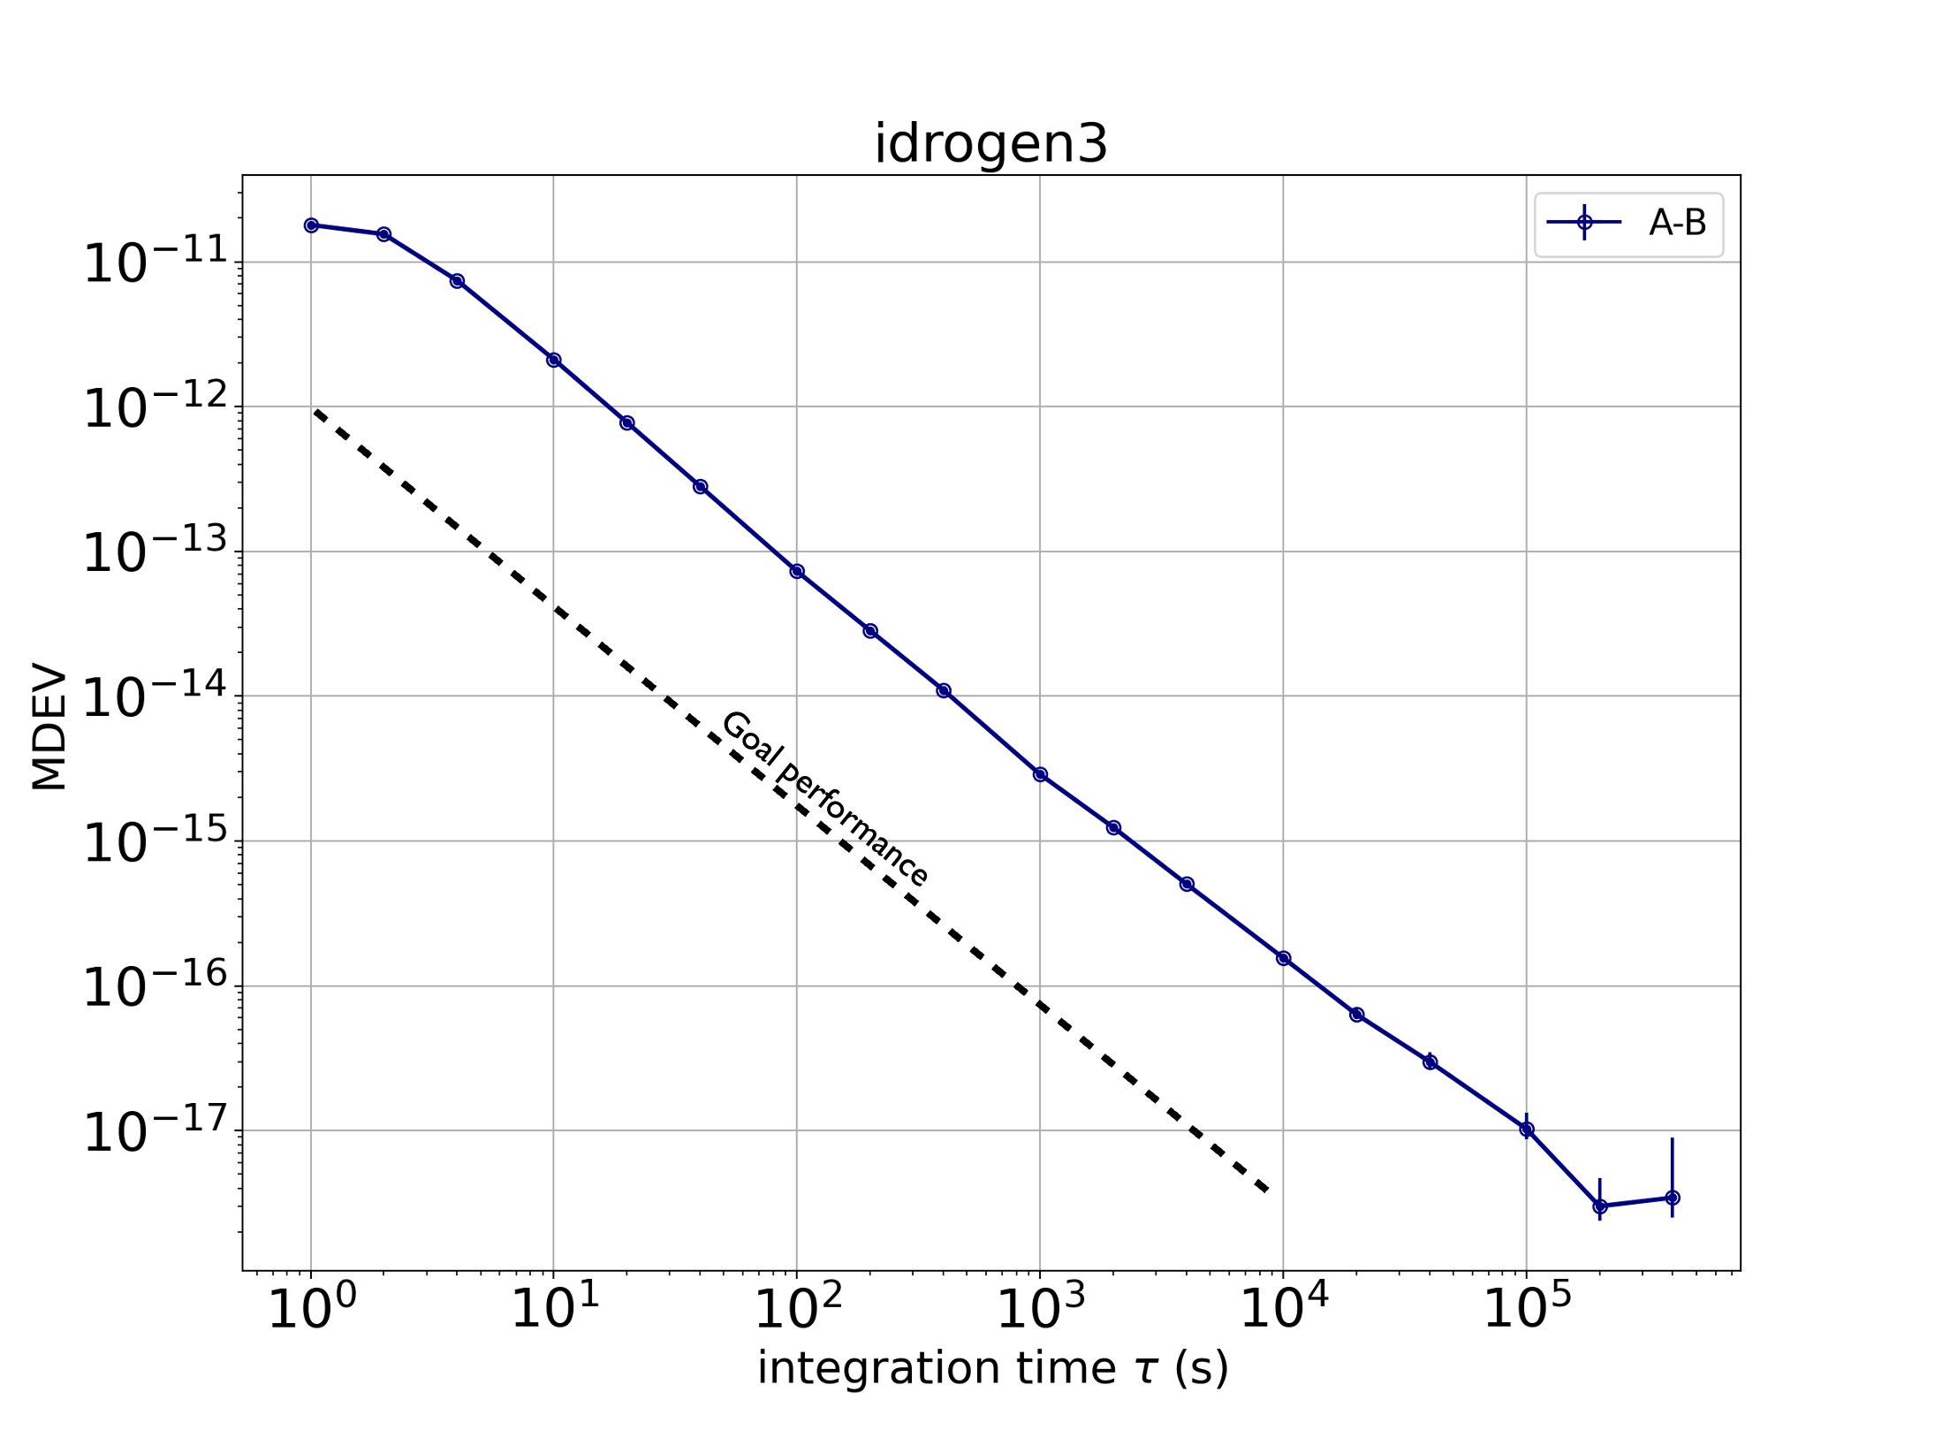
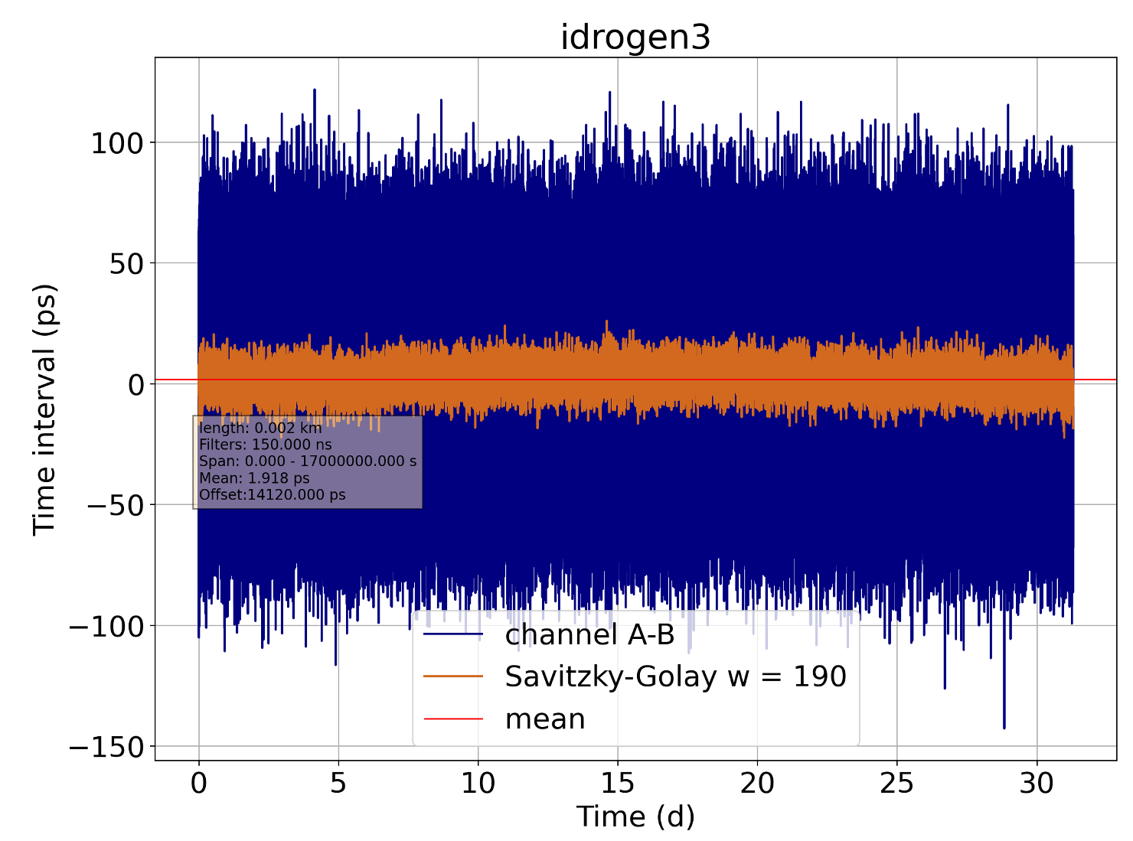
Idrogen : longterm performances
+30 days continuous acquisition
Time stability :
Modified Allan deviation < 1e-17 @ 3 days measurement time

Slide 17
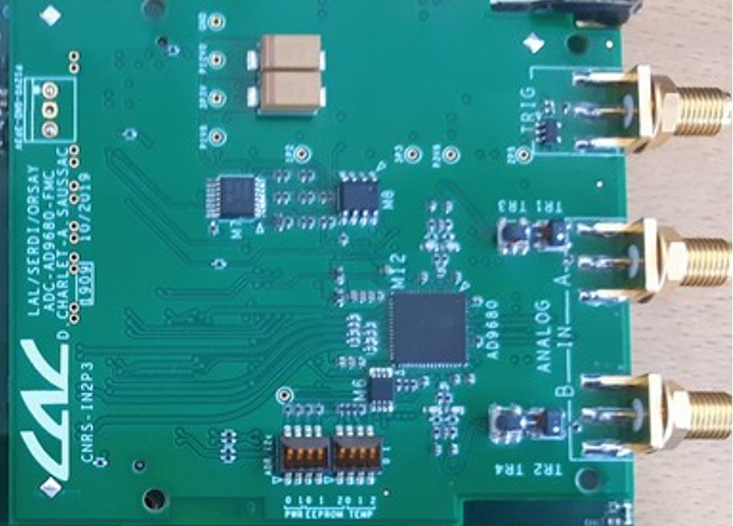
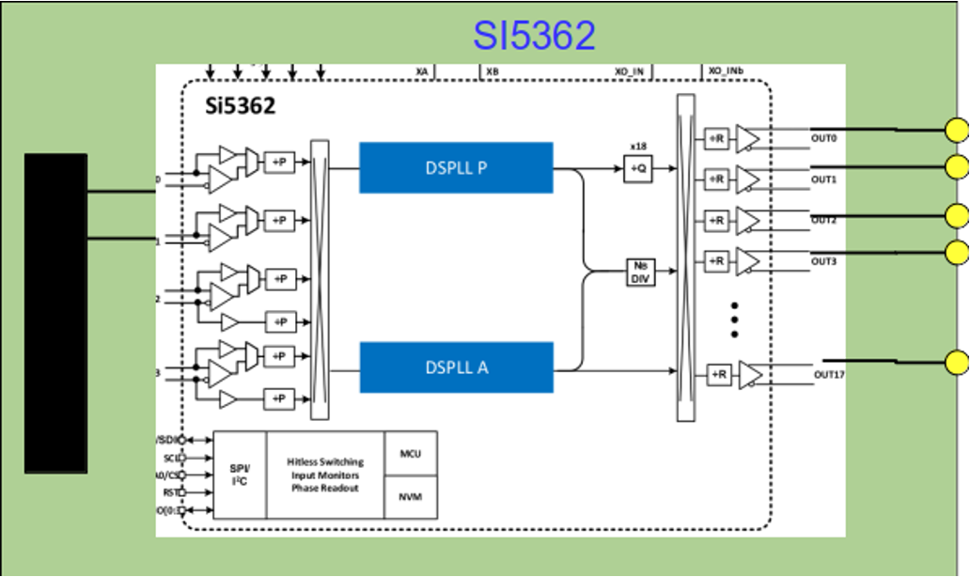
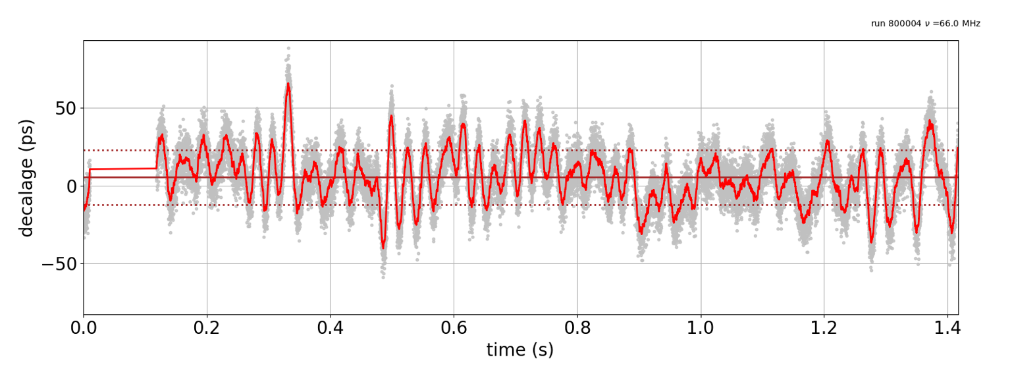
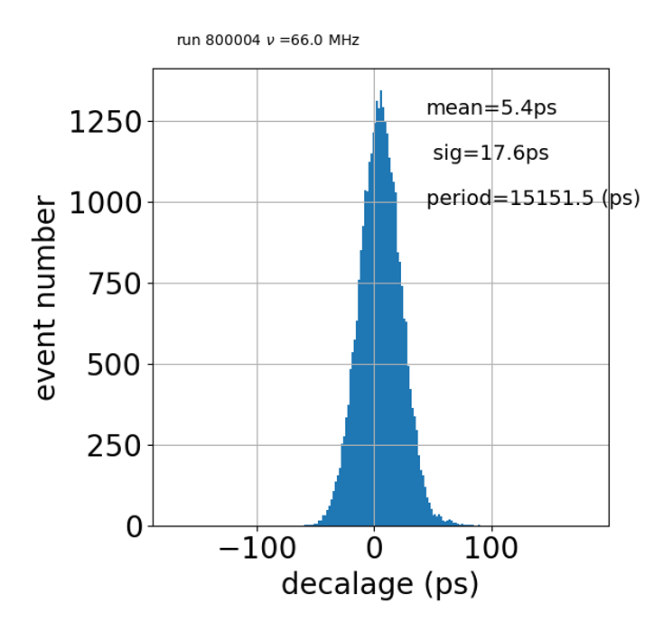
Acquisition and signal generation with extension boards
Acquisition main features:
2 channels, 14b, 500MSPS, JESD204B, 2GHz analog bandwidth
Signal generation main features:
clocked by idrogen3. > accuracy of the WR
4 outputs 10KHz to 2.75GHz
FMC board

Slide 18
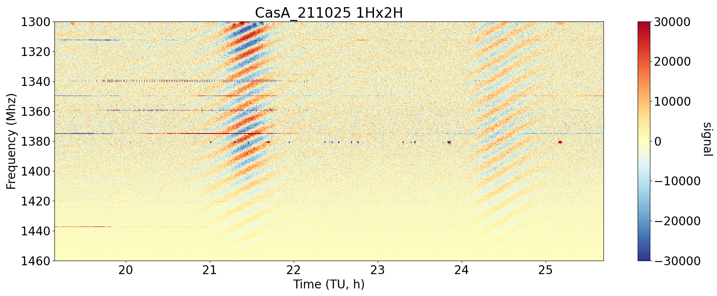
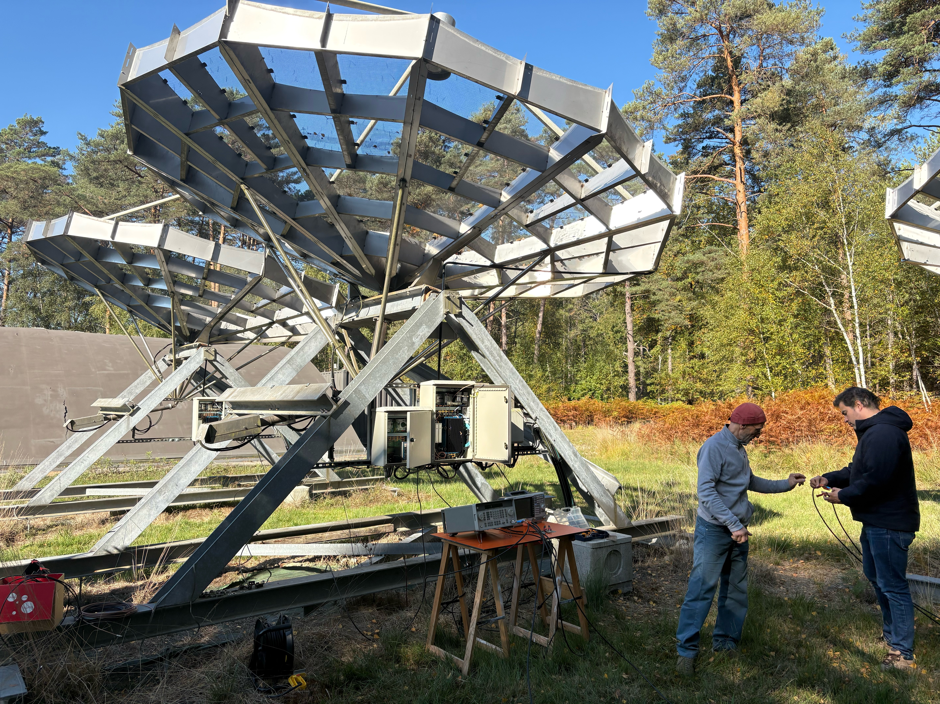
First synchronized acquisition at two radio antenna
Première expérience d’observation radio connectée en temps réel à la référence nationale UTC(OP).
idrogen
Nançay, 15/10/2025
Crédits image : Olivier Perdereau (IJCLAB).
PAON IV is a 4-antenna demonstrator at Observatoire de Radioastronomie de Nançay.
+300 km optical link connect ORN to OP through a multiplexed fiber pair of RENATER network (REFIMEVE).
Idrogen system is disciplined via WR on UTC(OP).
An extension board of Idrogen (one per antenna) acquire syntonously and synchronously @ 1 Gb/s.
The picture shows the stable interference pattern around 1.4 GHz versus time.
Next step: additional daughter board for an ultra-precise time transfer (<50 fs) on stabilized optical carrier.

Slide 19
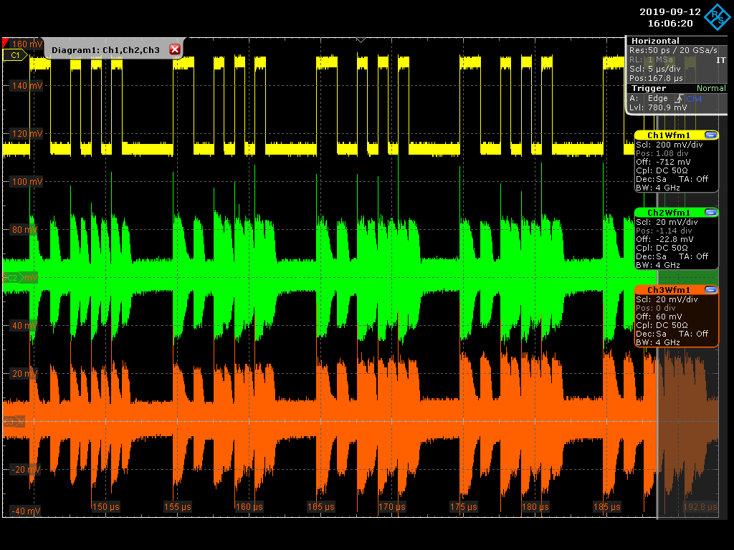
Next technological development: White FOX
Goal : ultra-stable and accurate time transfer for multi-messenger astronomy (« time-domain astronomy »)
Target : < 30 fs resolution at 1 second measurement time
How:
combine Idrogen as an ultra-precise time modem and the coherent optical frequency transfer technology
No ethernet protocol, no share with data traffic
Link bandwidth at the fundamental limits
Optical phase modulation
Optical demodulation
Technical choices
Frequency carrier: 125 MHz —> ~1.25 GHz (cf. phase noise curves)
Encoding time as a Barker code (the simplest)
Time delayed
TX Barker code
RX1 Barker code
RX2 Barker code
Prior demonstration on 50-km spools
F. Frank et al. , « A sub-ps stability time transfer method based on optical modems », (2018)
doi: 10.1109/TUFFC.2018.2833389.

Slide 20
Next steps at Nançay: nenuFAR, LOFAR, PTA
1824 antennas :
96 mini-arrays (MA) of 19 antennas each
spread over ~ radius 1000 m.
ORN, participating to European Pulsar Timing Array (EPTA), is among the stringest end-user of the REFIMEVE network, as for frequency accuracy (~1e-16) and as for time accuracy (ns)

Slide 21
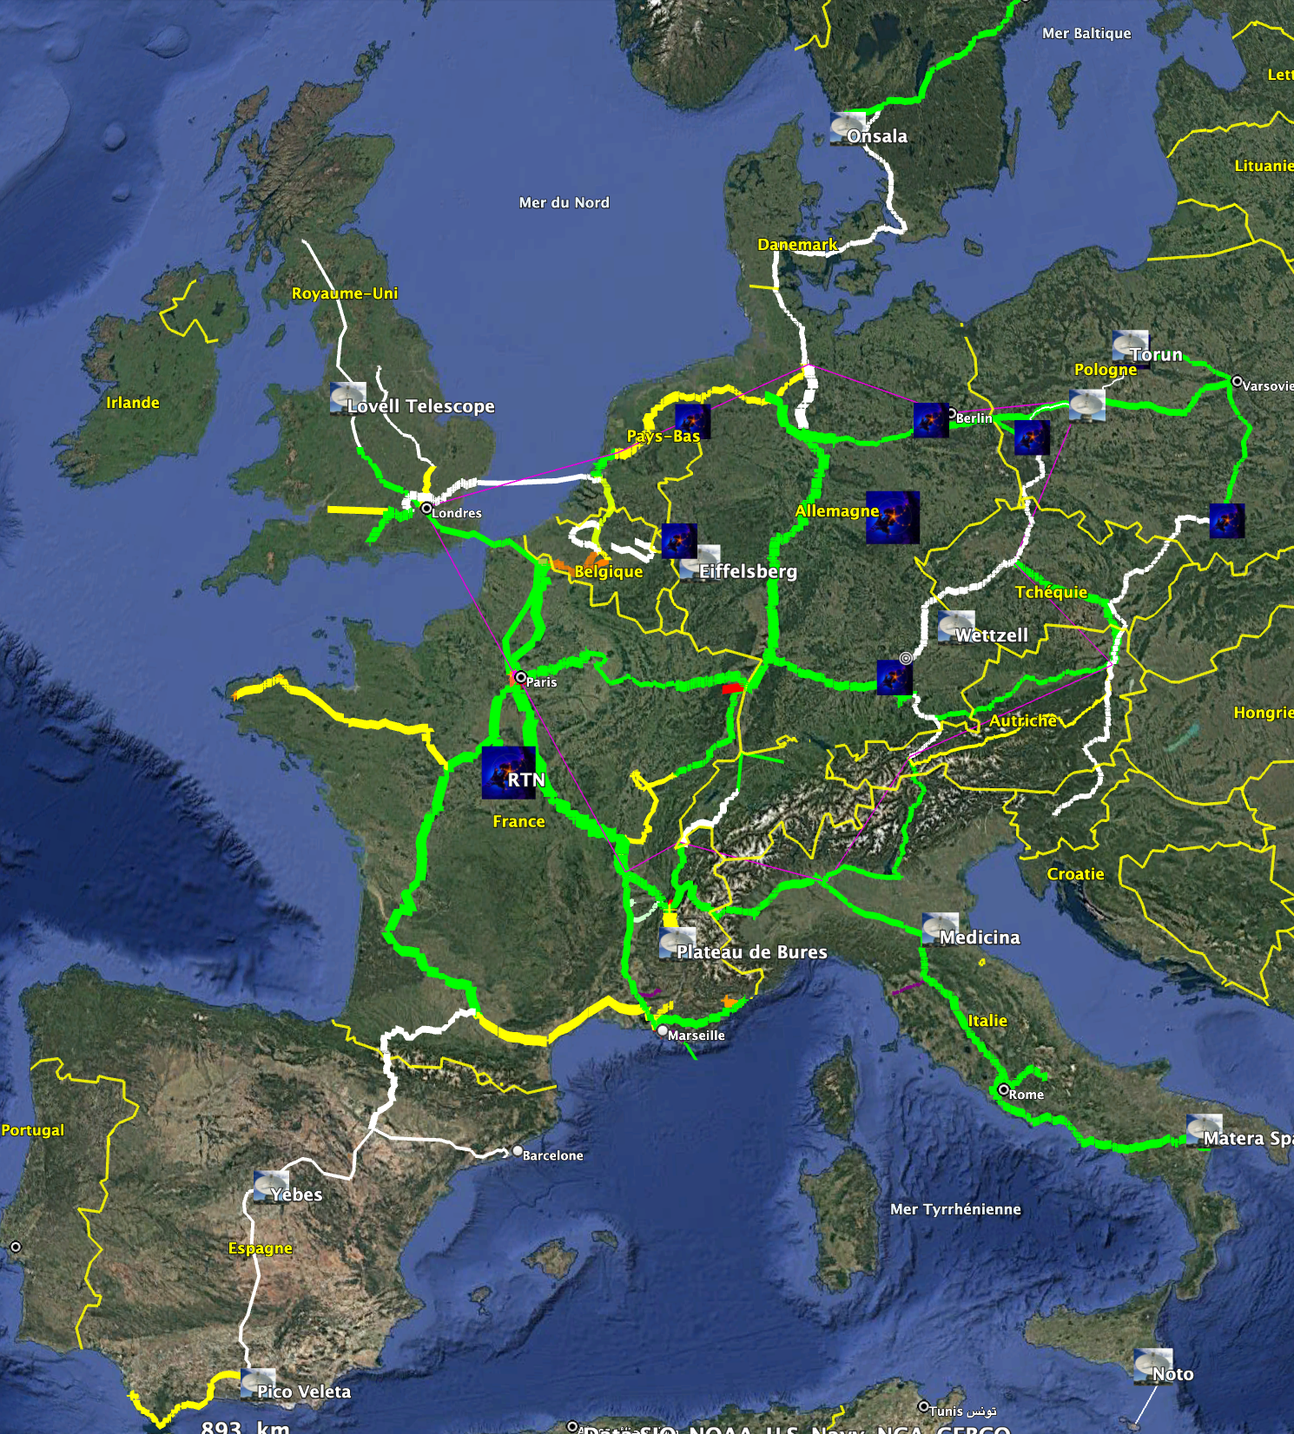
EU fiber network
The prospect of the fiber interconnection between major research infrastructures / observatories with time frequency references « in common view »
VLBI / LOFAR infrastructures
CERN is connected to REFIMEVE
KM3Net, EGO, Gran Sasso, subterranean laboratories
Efforts in EU to interconnect the national networks (cf. FOREST candidacy to ESFRI)
Connection Belgium and The Netherlands to be completed within next 2 years
WR deployment all over REFIMEVE happening now !
Network size ~12,000 km
CERN
IRAM
Gran Sasso
Virgo
KM3Net

Slide 22
Outlook
Summary - take away message
Fiber links can effectively disseminate time and frequency signals without degradation.
REFIMEVE is an optical fiber networks that connects major infrastructure, with very high up-time and show available signal over nationwide area.
Regular clock comparisons are operated with the European fiber network
Advanced electronic development enable precise timing with synchronous signal generation and signal acquisition
A first demonstration was recently made at ORN with PAON IV
Outlook
Very precise timing can be bring within the next 5 - 10 years in Europe to major infrastructures: VLBI stations, LOFAR, KM3net and EGO.
Another hot topic: quantum sensor networks and multi-messenger astronomy
Not addressed here : projects are going on to investigate fiber network sensing.

Slide 23







Fundings
LIOM, REMIF, REFIMEVE+, T-REFIMEVE, FIRST-FT
LOFIC
INSU
GRAM
EU Research infrastructure
CLONETS
CLONETS-DS
JRP:
NEAT FT, OFTEN, WRiTE, TIFOON
ITOC, ROCIT (clock comparisons)
H2020, Horizon Europe:
ICOF, SENSEI

Slide 24
Thank you for your attention !

