Slide 1





Commissioning and operation of the ThomX injector
Viktor Mytrochenko (IJCLab, Paris-Saclay university)
on behalf of the ThomX collaboration

Slide 2
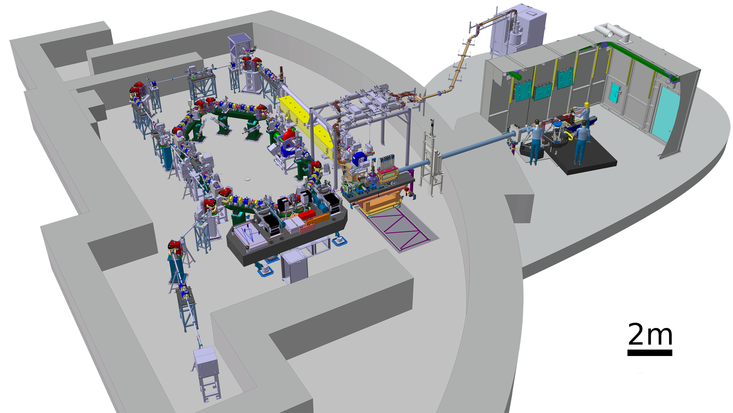
ThomX injector
Accelerating Section
BUNKER
Transfer Line
6 Dipoles
14 Quadrupoles
2 Dipoles for inj./extr.
8 Correctors
Experimental
X-hutch
RF Gun
Diagnostics:
7 BPMs
5 Diagnostic stations
3 ICTs
2 Faraday Cups
Set of beam loss monitors
The objective of the entire injector system is to provide the storage ring with high quality electron bunches. In the conventional storage rings beam has an “own life” after injection determined by the ring optics. The ThomX ring was designed with very small damping, so within 20 ms after injection, the beam quality in the ring is still strongly dependent on the properties of the injected beam.
11/06/2025

Slide 3
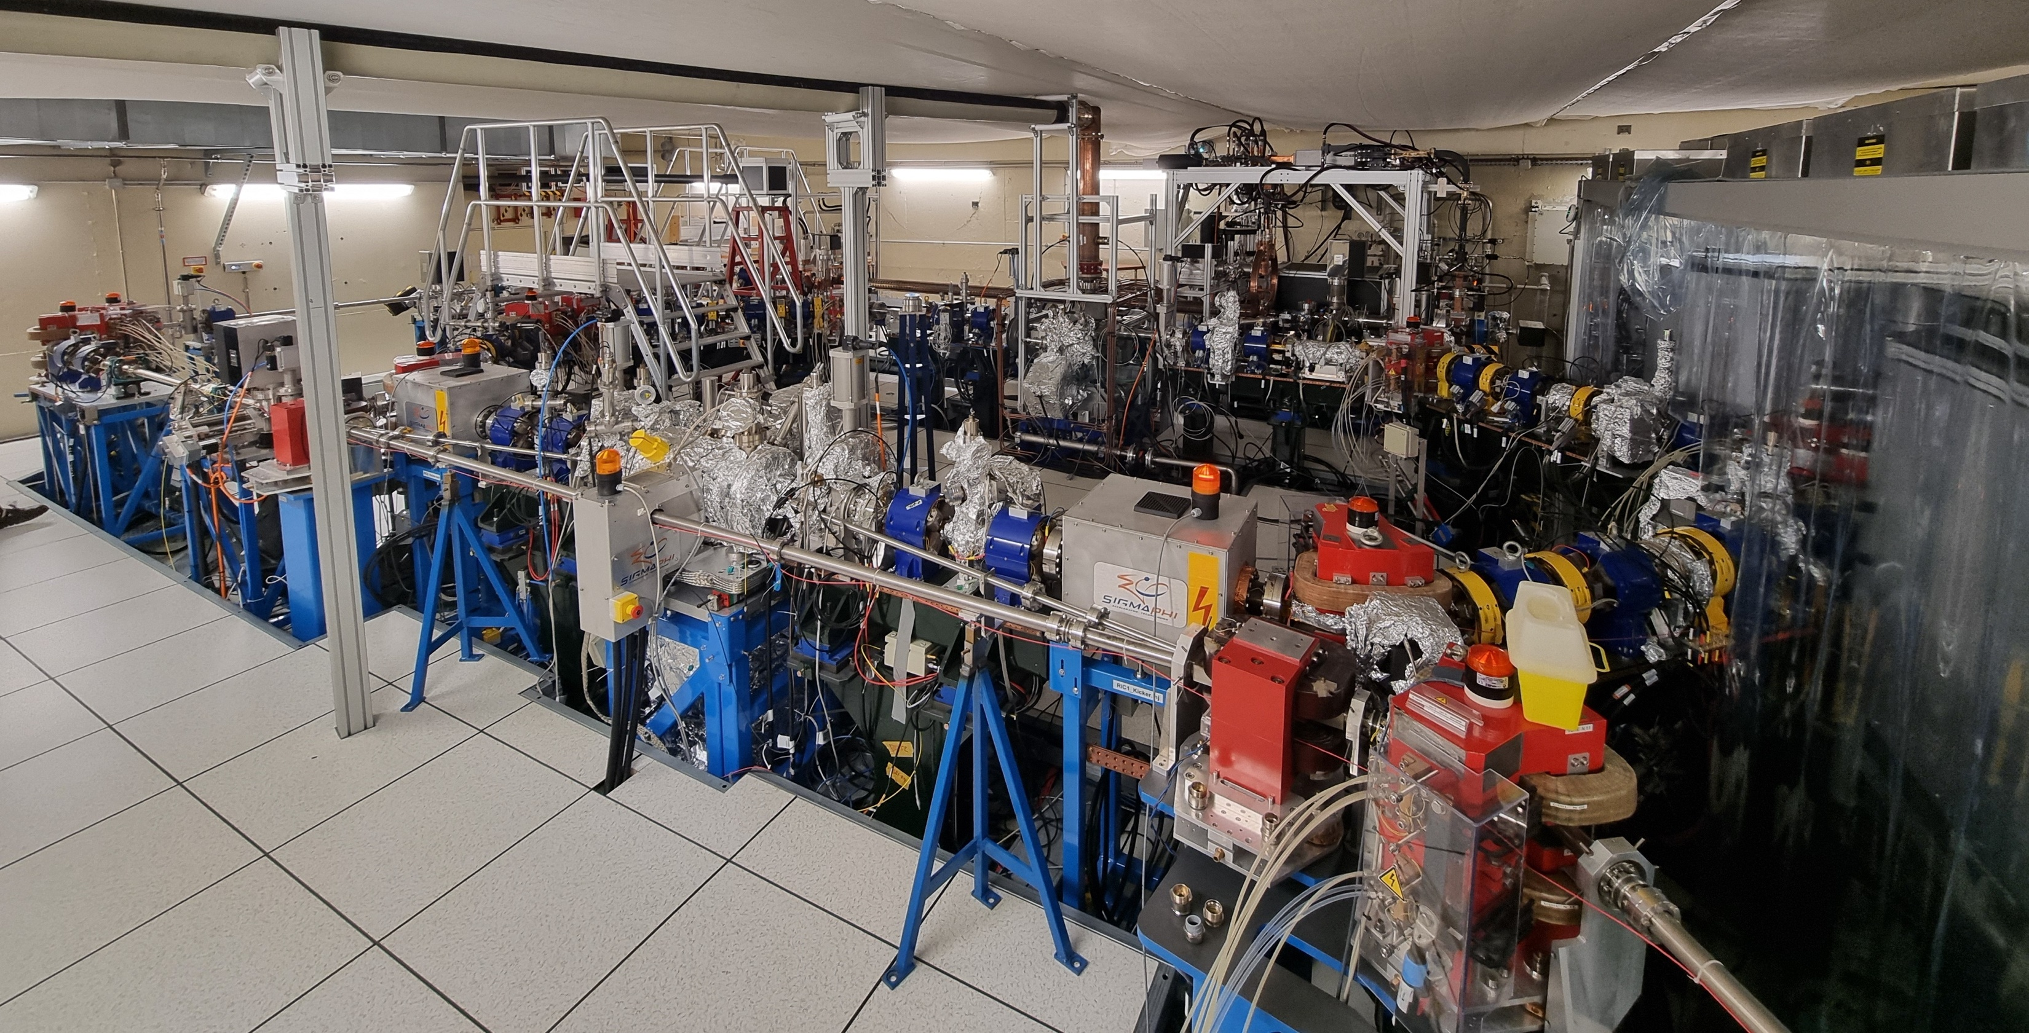
ThomX facility, April 2025
11/06/2025

Slide 4
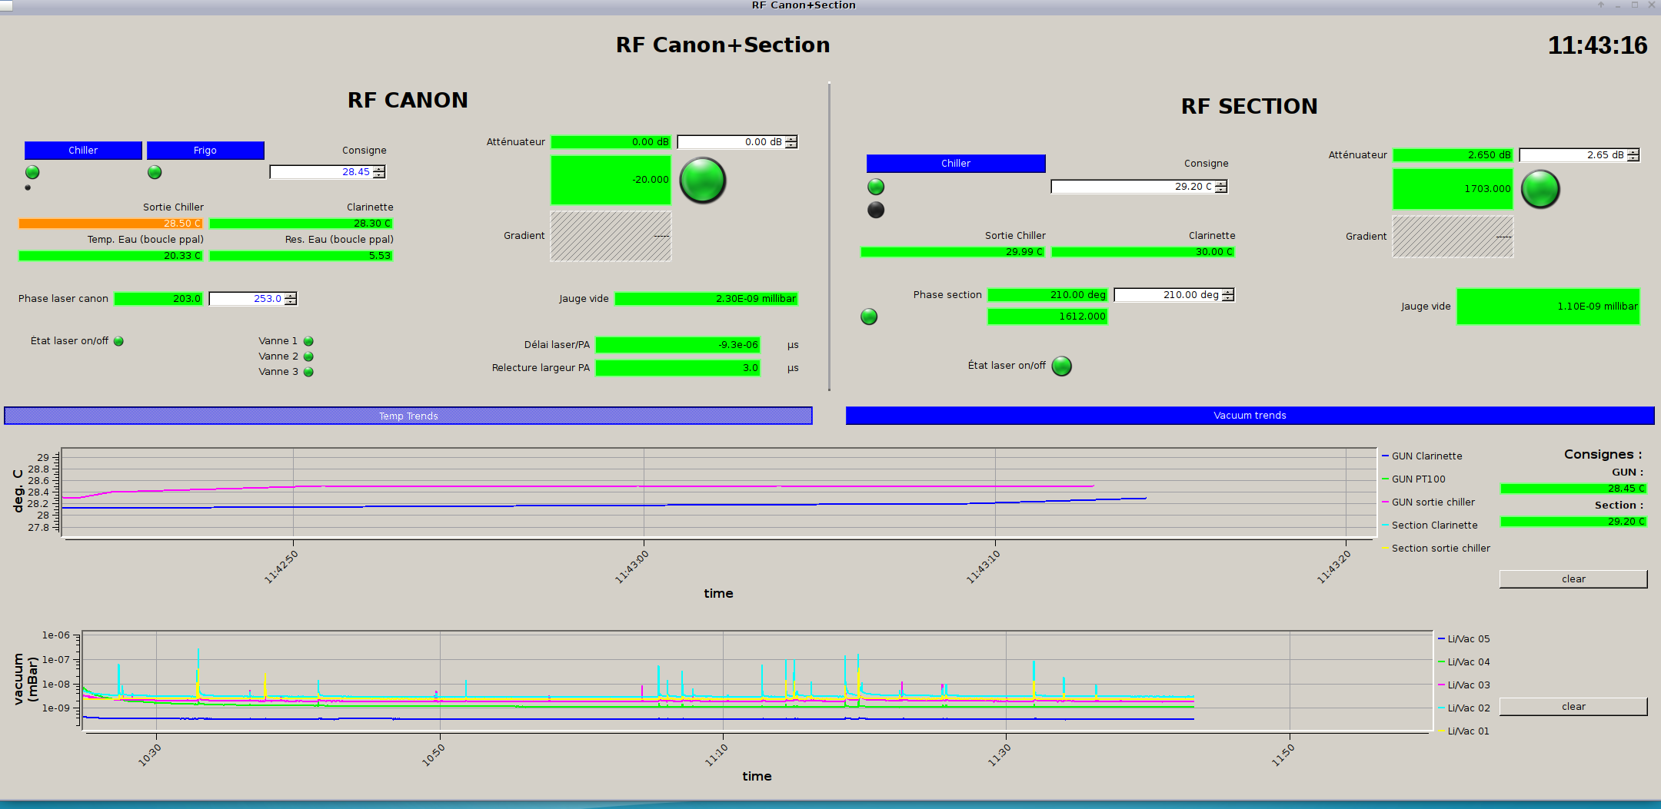
Support systems
Photocathode laser
3 GHz low level RF system
3 GHz high level RF system
Very sophisticated synchronization system
Power supply of beamline magnets
Vacuum system
Cooling and temperature stabilization system
Ventilation and air-conditioning system
All of these systems affect the beam characteristics to a greater or lesser extent, for example by causing phase drift of the accelerating fields, as well as synchronization of the laser pulse with respect to the RF gun field. Unfortunately, ThomX was not equipped with a precision system to measure the amplitude and phase of the RF signals of the linear accelerator, so we can only indicate that something is wrong by evaluating the beam characteristics.
11/06/2025

Slide 5
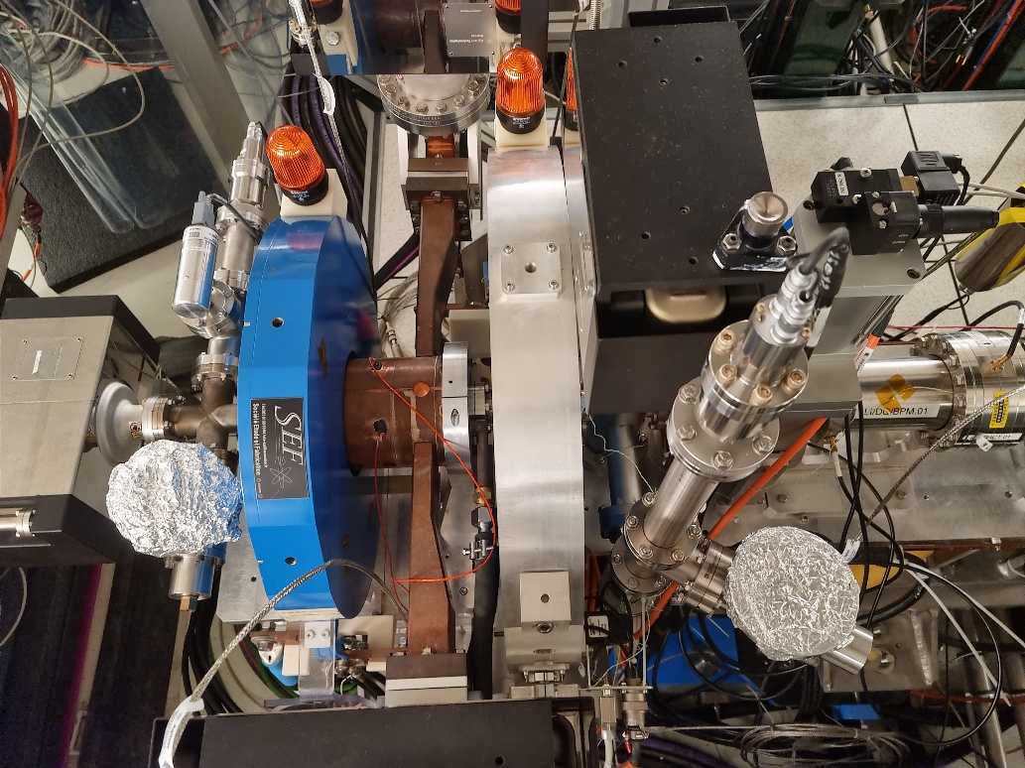
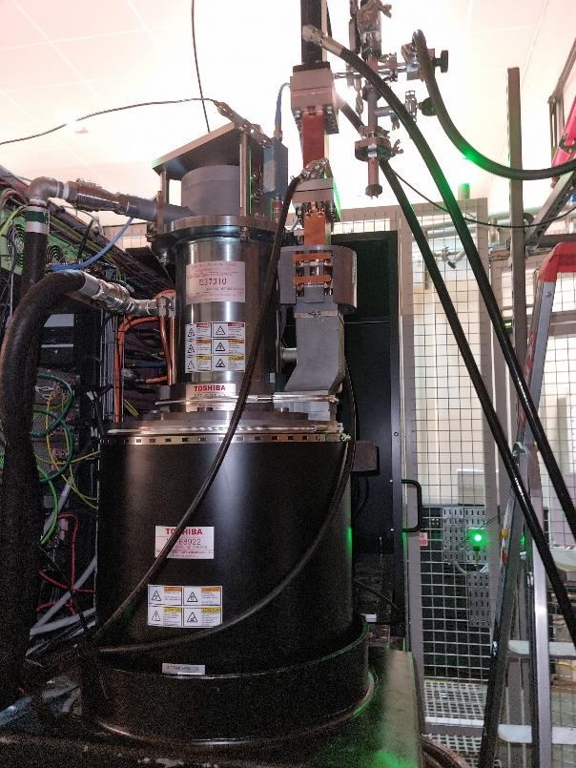
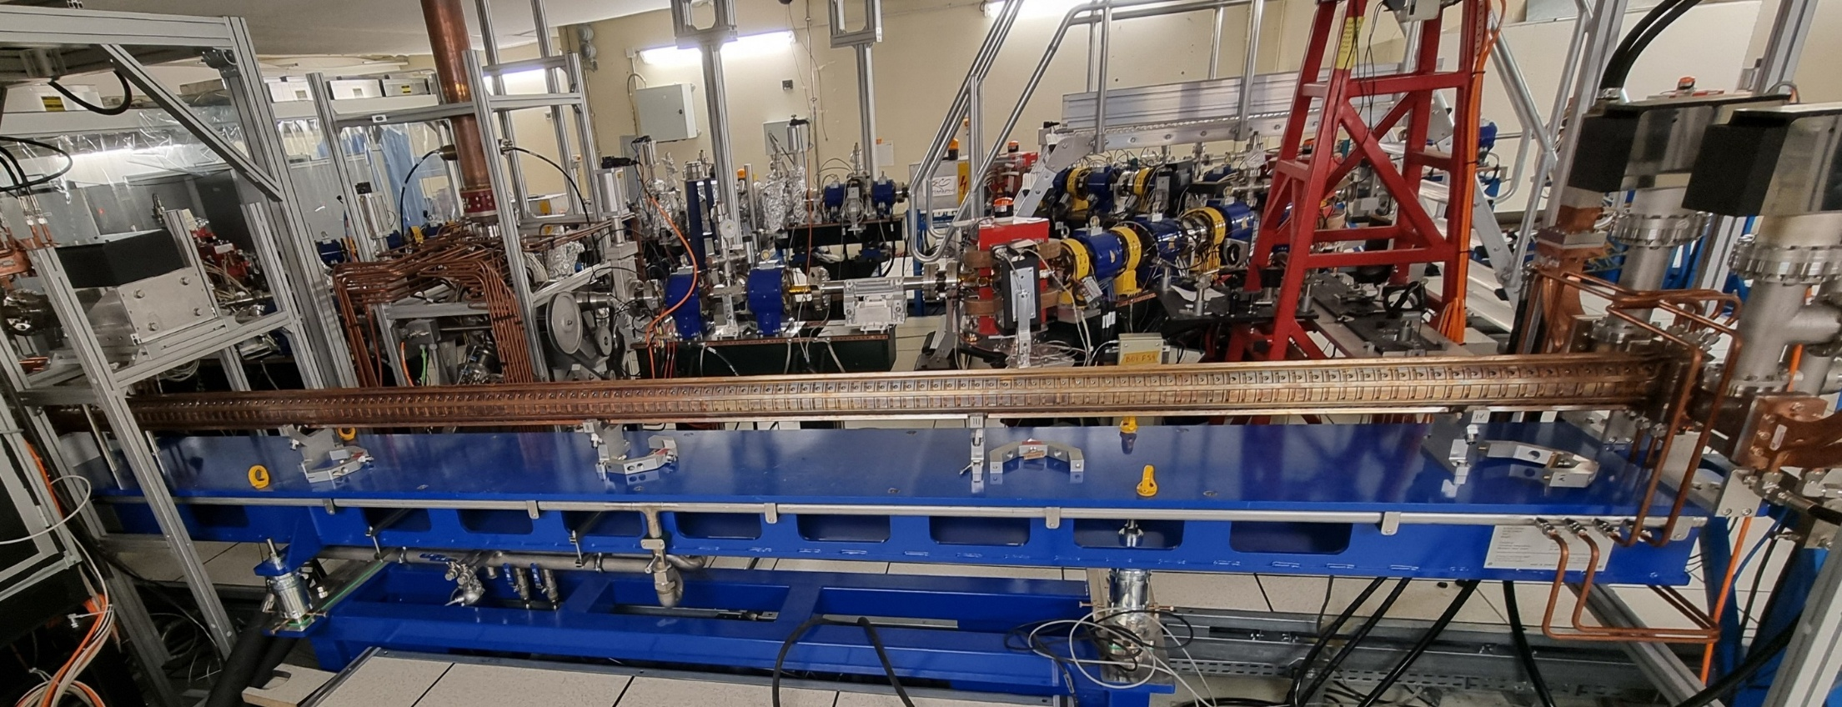
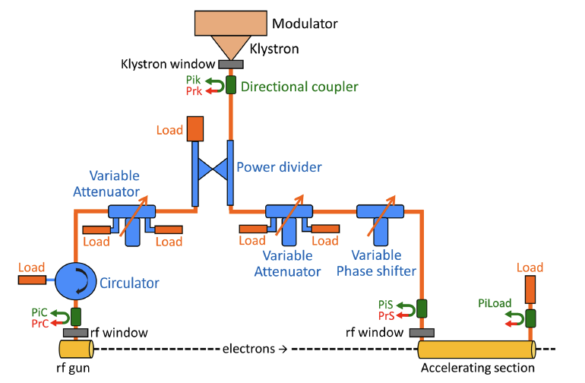
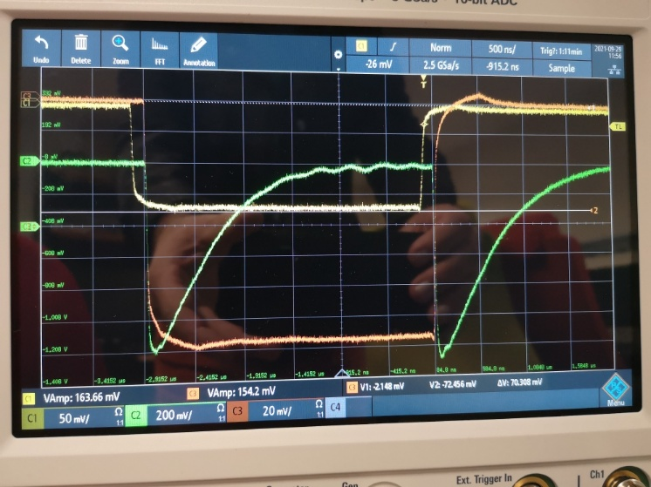
ThomX injector
Photocathode RF gun
Standard design of photoinjector (designed like the CTF3 model) + S-band RF structure + Transfer/Extraction Line
LAL design
made in-house
Injector specification
Parameter | Nom. value | Measured | Units
Energy | 50/70 | 50, 61.5, 70 | MeV
Charge, commissioning/nom. | 0.1/1 | ≤0.5 | nC
Nb. of bunches per RF pulse | 1 | 1
Energy spread, rms | <1 | 0.08 | %
Emittance (rms, normalized) | <5 | <5 | mm⋅mrad
Bunch length, rms | <5 | 3.9 | ps
Average current | 50 | 1 | nA
Pulse repetition rate | 50 | 10 | Hz
ScandiNova modulator,
3 GHz Toshiba klystron E37310
➜ 2.5-cell photocathode RF gun : Ez = 80 MV/m @ 6 MW to reach E = 5 MeV, Charge 0.1/1 nC
➜ S-band :4.8-meter long accelerating structure (2998.55 MHz) to reach ~45 MeV @ 9 MW
Accelerating structure
Linac RF
New accelerating structure(RI) for the 70 MeV upgrade
11/06/2025

Slide 6
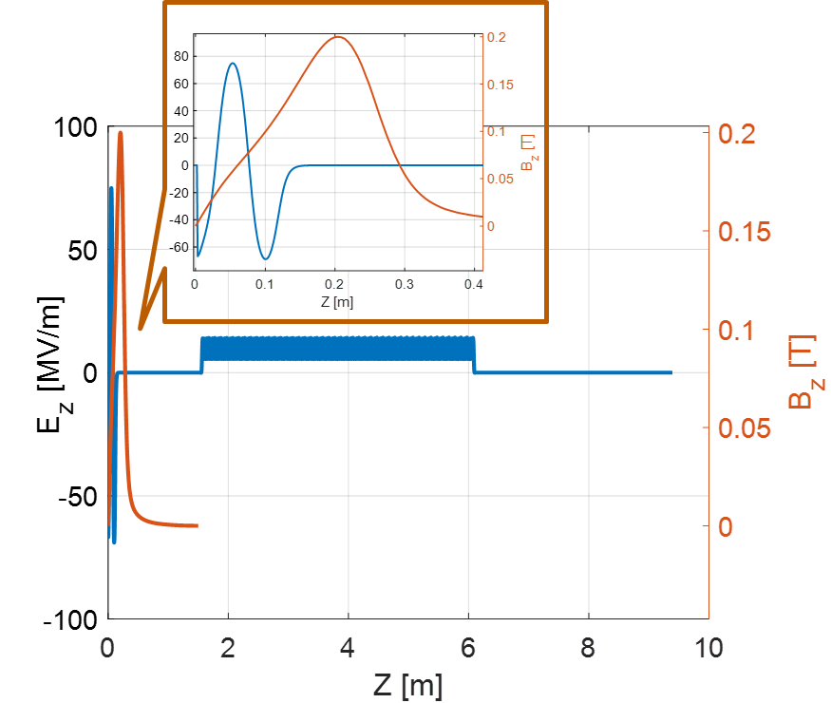
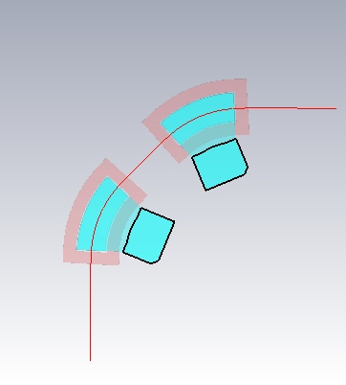
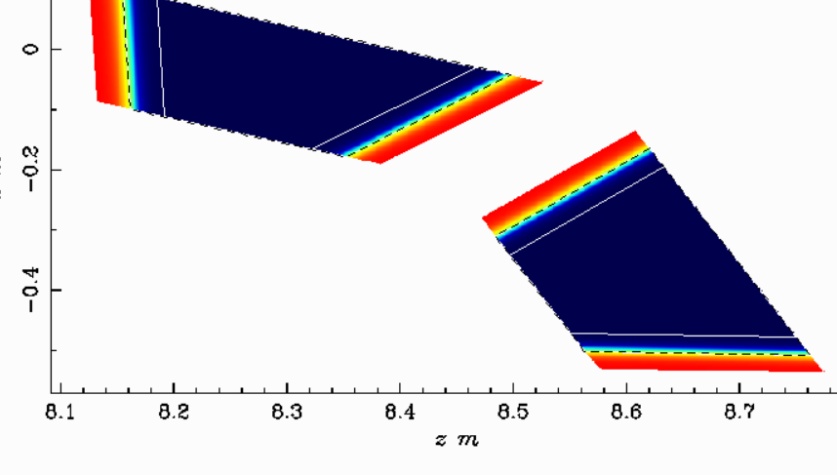
Simulation tools
The Astra (A Space Charge Tracking Algorithm) program package from DESY.
MAD-X (Methodical Accelerator Design) from CERN
AT (Accelerator Toolbox for Matlab)
OPERA-3d (an OPerating environment for Electromagnetic Research and Analysis)
CST Studio Suit
RF Track from CERN
CST results for reference particle tracking
On axis electromagnetic field maps used by the Astra code
Bends in Astra
11/06/2025

Slide 7
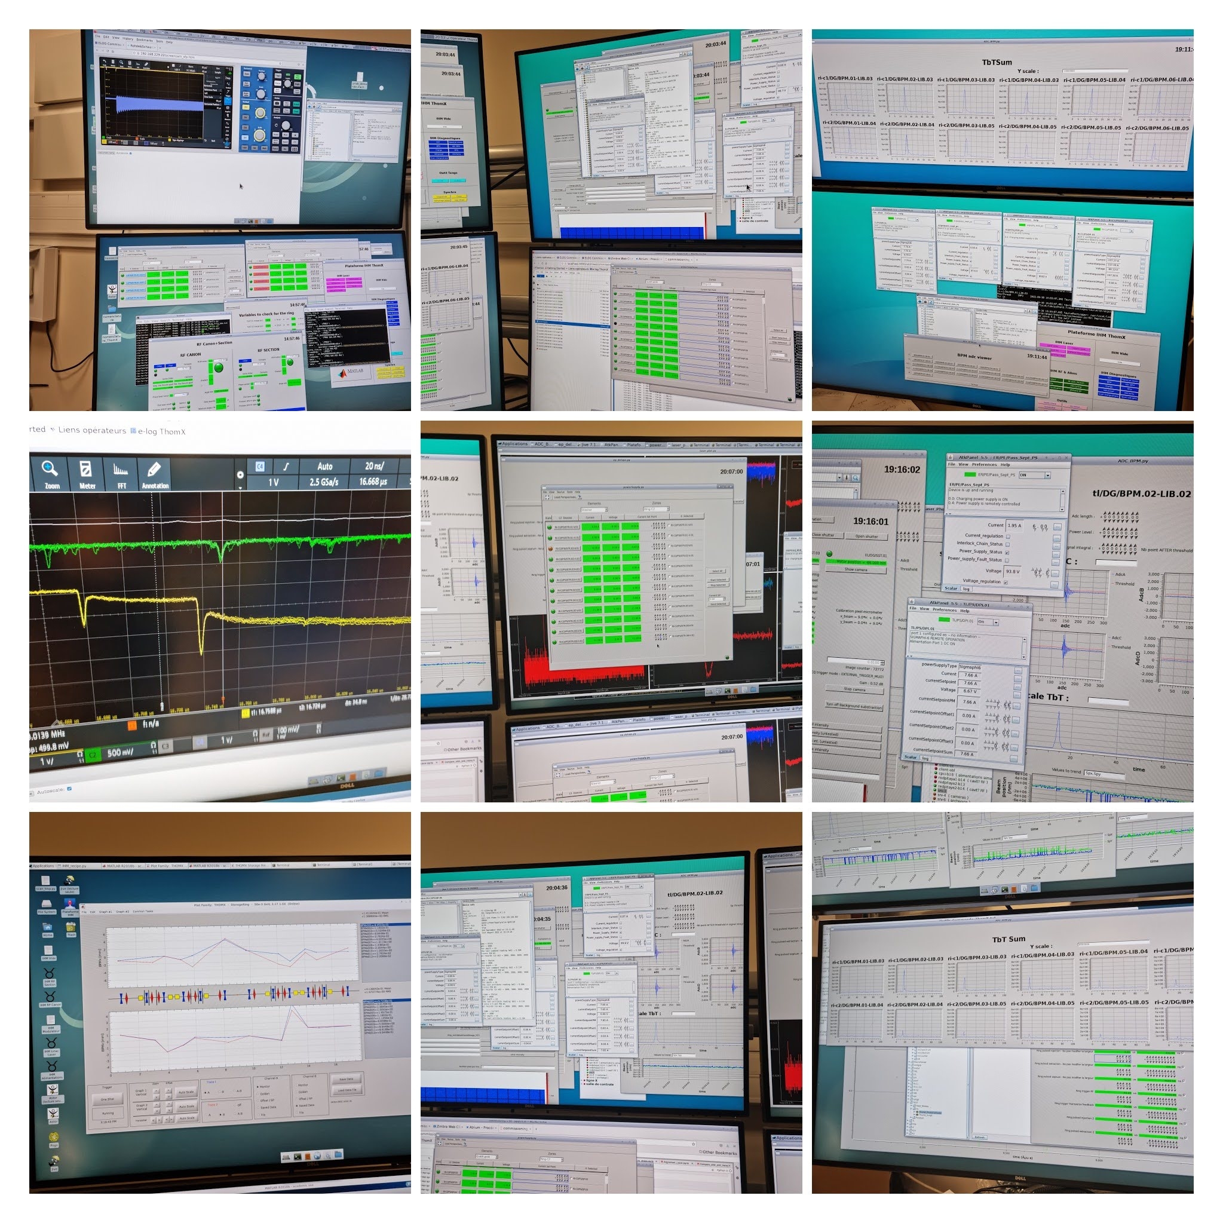
ThomX Control system
ThomX Control system is based on TANGO.
According to the TANGO website: "Tango Controls is a free, open-source toolkit for controlling devices of any type, hardware or software, and for building SCADA (supervisory control and data acquisition) systems."
ThomX is almost entirely remotely controlled. Each hardware unit or group of units has a device server that can be accessed via matlab or python scripts, as well as via the device program window.
The ThomX control room has several workstations, informally for the injector operator, the ring operator, the Fabry-Perot resonator operator, and the X-ray beam line operator beside the X-ray hutch.
In addition, a Matlab middle layer for accelerator control (MML) , has been implemented allowing the use of powerful tools developed by the accelerator community.
11/06/2025

Slide 8
ThomX injector commissioning steps
Commissioning of the relevant ThomX equipment.
Conditioning of the RF gun and the accelerator section.
Obtaining and characterizing the beam at the exit of the RF gun.
Aligning the laser spot with the axis of the radio frequency field on the photocathode.
Alignment of a solenoidal field axis with the RF field axis.
Transportation of the beam through accelerating section to the beam dump at the end of the straight beam line, beam alignment with straight line quadrupoles, beam characterization.
Turning on the transfer line dipoles (special permission was required), transporting the beam through the entire transfer line to the extraction beam dump, determining the beam characteristics.
Beam injection into the ring, injection optimization, beam characterizations.
Accelerating section replacement, conditioning the section.
Establishment of operating points for 40 MeV, 50 MeV, 61.5 MeV, 70 MeV.
Replacement the copper photocathode with a magnesium one, repeating some previous steps.
11/06/2025

Slide 9
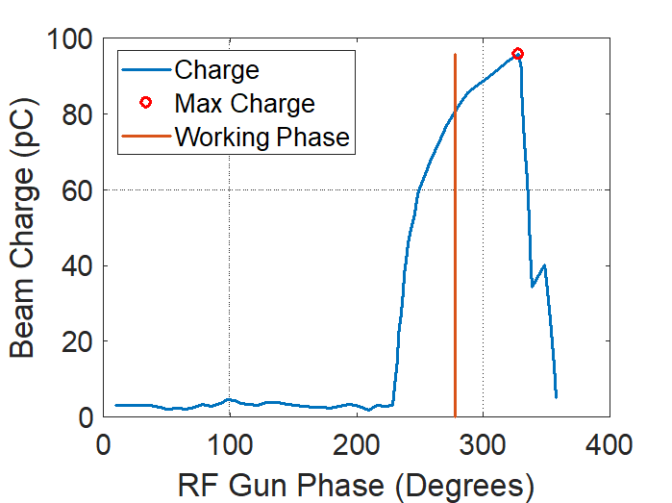
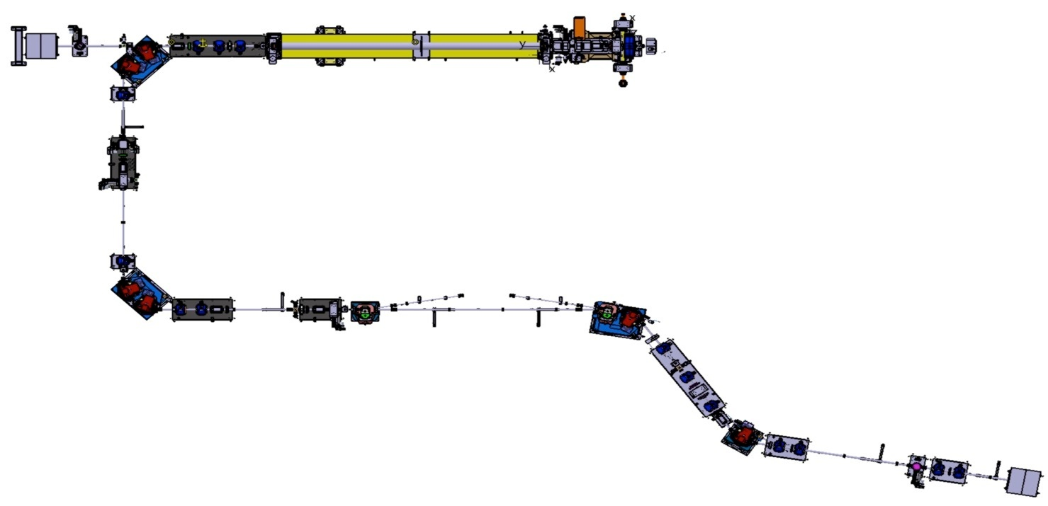
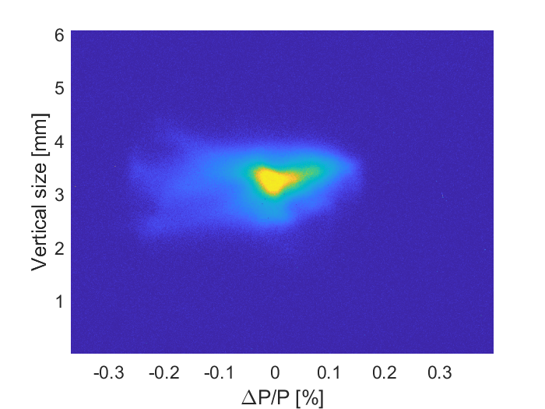
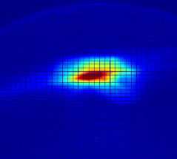
Linac, Transfer Line and Extraction Line
21/03/2025
RF-gun
04/08/2023
Dump
21/03/2025
21/03/2025
04/08/2023
ΔΡ_{rms}/Ρ = 0.08%
@ I_{sol} = 230 A,
50 MeV
04/08/2023
To ring
System of linear equations for the thick lens approximation is solved c.f. M.C. Ross et al. PAC87
21/03/2025
Dump
04/08/2023
09/12/2022
11/06/2025

Slide 10
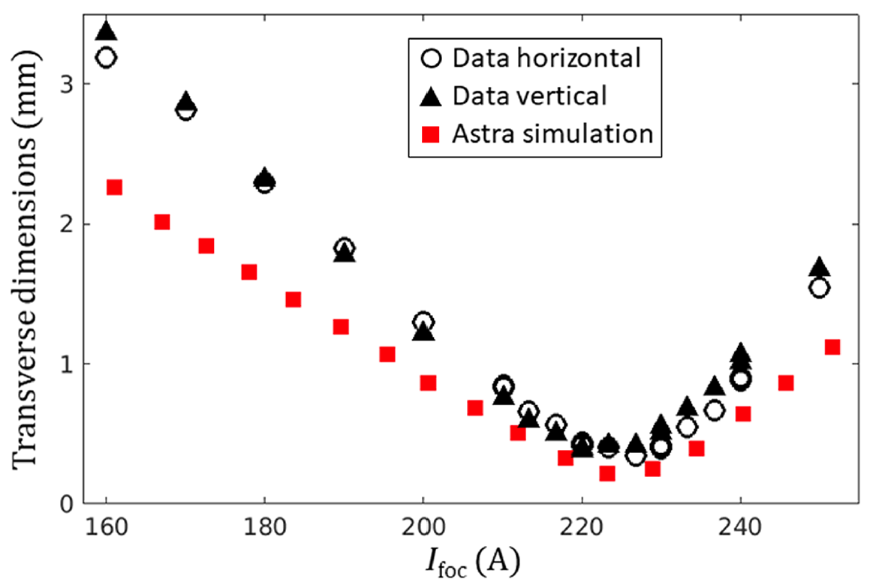
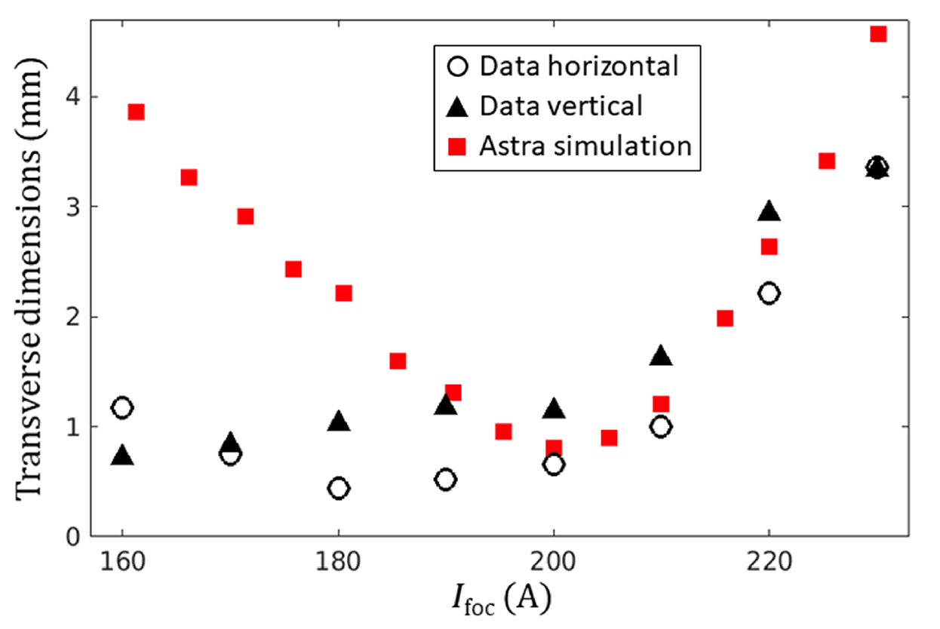
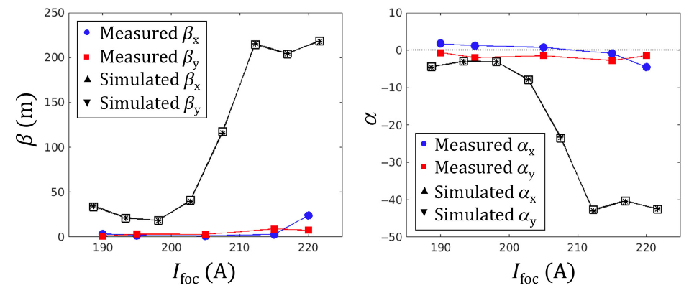
Comparison of measurements and simulations
11/06/2025

Slide 11
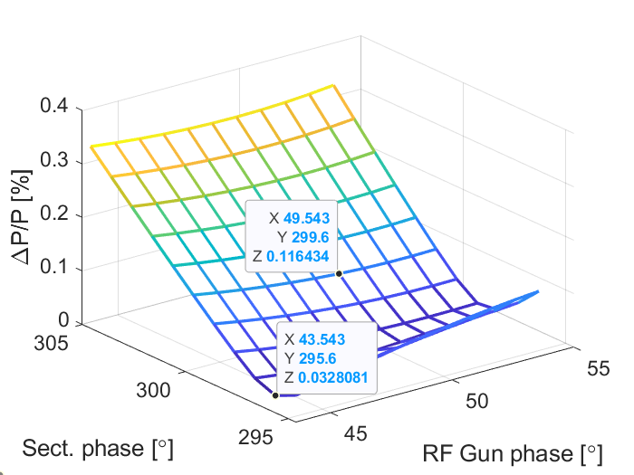
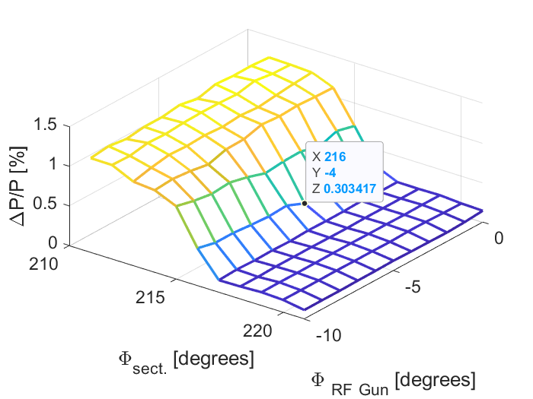
Linac 2D phase scan comparison
Simulation
Measurements
There are a reasonable correlations between the measured and simulated data around the working point. The significant disparity between the measured and simulated dependences is under investigation. Possible causes of the discrepancy can be due to the differences in transversal and longitudinal profiles of the laser pulse in simulation and in the experiments.
11/06/2025

Slide 12
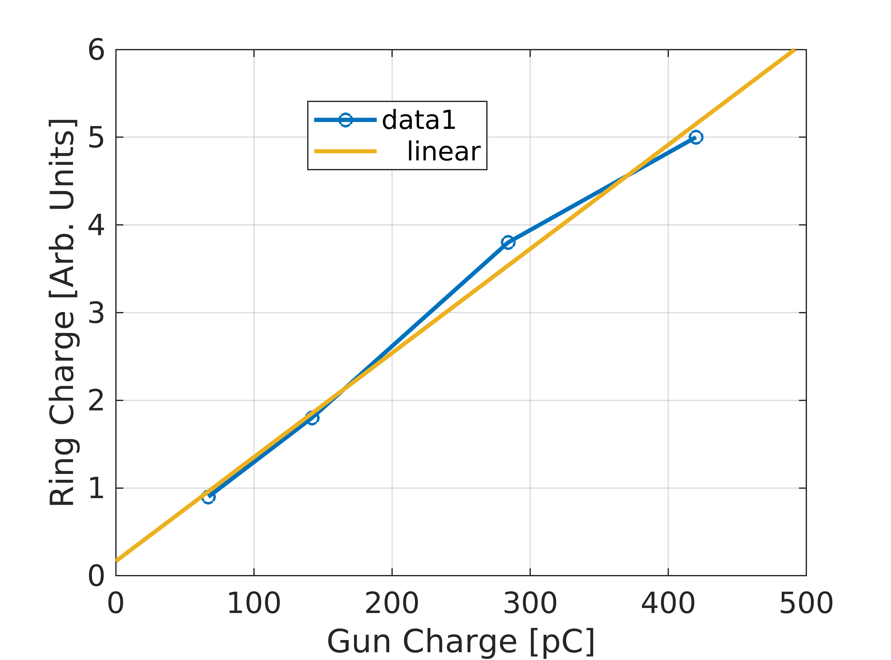
Resent data
After photocathode replacement maximum beam charge at the RF gun exit was about 0.5 nC at laser spot diameter of 1.3 mm at the cathode. Ring operation showed that just increasing RF Gun charge didn’t increase beam charge in the ring.
Therefore for each point of the RF Gun charge value the solenoid, the transfer line quadrupoles, steering magnets and injection elements were adjusted by looking at the beam loss monitor signals at ring injection. Ring kept unchanged.
In this way linearity of Ring charge vs. Linac charge was increased.
From that we can conclude:
Transport efficiency (and emittance) to be monitored while increasing the charge.
To be checked vs. X-ray flux
RF Gun charge: measured by BPM after the Gun.
Ring charge: integral of the TbT sum signal @2k turns.
11/06/2025

Slide 13
Summary
The commissioning of ThomX, in particular its injector, allowed the demonstration of the X-ray flux of 3 × 10¹⁰ ph/s.
In the coming months: increase of the beam charge from 0.5 nC to 1 nC with the Mg photocathode, operation at 50 Hz.
There are still some problem to be addressed:
  Long term beam stability
  Trigger to trigger beam stability
  Discrepancy between simulated and measured beam performances
Learned lessons: expertise doesn’t scale with the accelerator size (thorough subsystem commissioning, available technical support + physicists).
M. Alkadi, et al. "Commissioning of ThomX Compton source subsystems and demonstration of 10¹⁰ x-rays/s."
Phys. Rev. Accel. Beams 28 (2025): 023401
11/06/2025

Slide 14
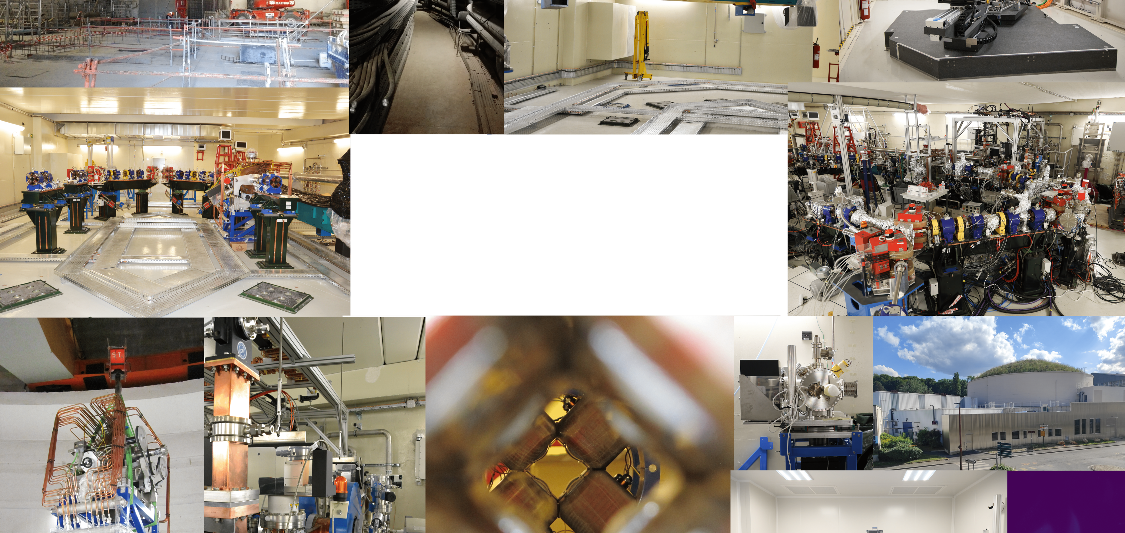

Thank you!

