Slide 1




DeLLight
(Deflection of Light by Light in vacuum)
with LASERIX @ IJCLab
Slowing down the light in vacuum with intense laser pulses

Slide 2

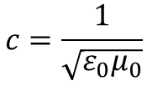

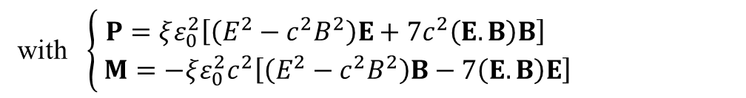
Slow down the speed of light in vacuum
Classical electrodynamics: Maxwell’s equations are « linear » in vacuum
D = ε₀E
B = μ₀H
$$c=\frac{1}{\sqrt{ε_{0}μ_{0}}}$$
${c, ε}_{0}$and $μ_{0}$ are universal constants
Quantum Electrodynamics : vacuum is filled of virtual e+/e- pairs
Nonlinear interaction between the electromagnetic fields, through the e+/e- pairs
⇒ Nonlinear optical polarization and magnetisation of the vacuum
D = ε₀E + P(E²,B²) = ε (E²,B²).E
B = μ₀H + μ₀M(E²,B²) = μ (E,B).H
Heisenberg and Euler, Z. Phys. 98, 714 (1936)
J. Schwinger, Phys. Rev. 82, 664 (1951)]
with $\left\{\begin{aligned}P=ξε_{0}^{2}\left[\left(E^{2}−c^{2}B^{2}\right)E+7c^{2}\left(E.B\right)B\right] \\ M=−ξε_{0}^{2}c^{2}\left[\left(E^{2}−c^{2}B^{2}\right)B−7\left(E.B\right)E\right]\end{aligned}\right.$
$$ξ^{−1}=\frac{45m_{e}^{4}c^{5}}{2α^{2}ℏ^{3}}≈3 {10}^{29} \text{J}\text{/}{\text{m}}^{\text{3}}$$
⇒ Vacuum optical index and speed of light depend on external fields E,B

Slide 3
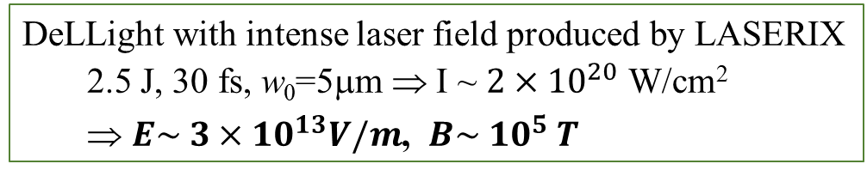
Slow down the speed of light in vacuum
The vacuum should behave as a nonlinear optical medium: The speed of light in vacuum should be reduced at macroscopic scale, in the classical (optical) sense, when vacuum is stressed by intense e.m. fields
It has never been observed
So far, search for vacuum birefringence using standard magnetic field (few Tesla)
Sensitivity limited by the intensity of the field
The advent of ultra-intense laser pulses, delivering ultra-intense electromagnetic fields in laboratory, opens a new promising window to observe the optical non linearity of vacuum : this is the goal of the DeLLight project
DeLLight with intense laser field produced by LASERIX
  2.5 J, 30 fs, w₀=5μm ⇒ I ~ ${2×10}^{20}$ W/cm²
  ⇒ $E\sim {3×10}^{13}V/m$, $B\sim {10}^{5} T$

Slide 4
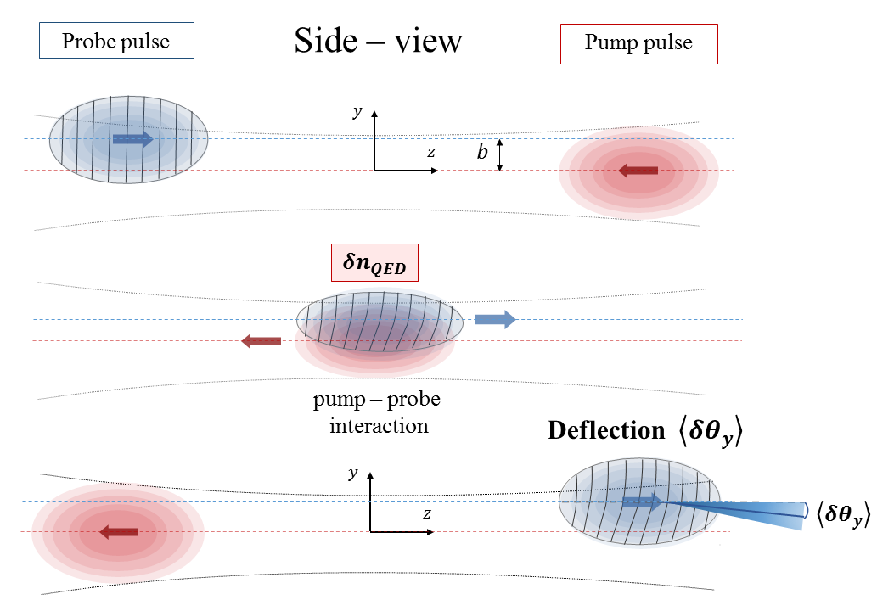




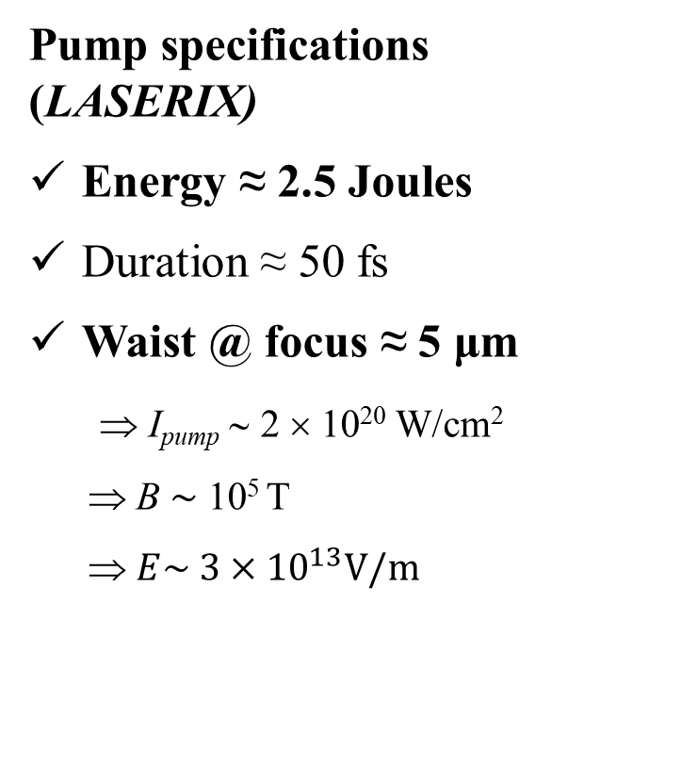
DeLLight with intense laser fields @LASERIX
Use highly focused laser pulses to achieve strong fields
Pump specifications (LASERIX)
Energy ≈ 2.5 Joules
Duration ≈ 50 fs
Waist @ focus ≈ 5 μm
⇒ I_{pump} ∼ 2 × 10²⁰ W/cm²
⇒ B ∼ 10⁵ T
⇒ $E\sim {3×10}^{13}V/m$
$$y$$
$$e$$
$$b$$
$$x$$
E₀
k₁
B₀
k₂
δn ∼ 3 × 10⁻¹³
δθ ∼ 0.1 prad

Slide 5
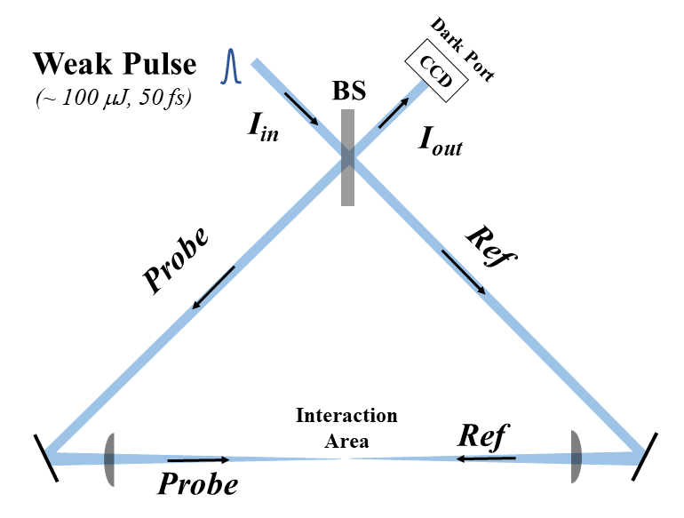
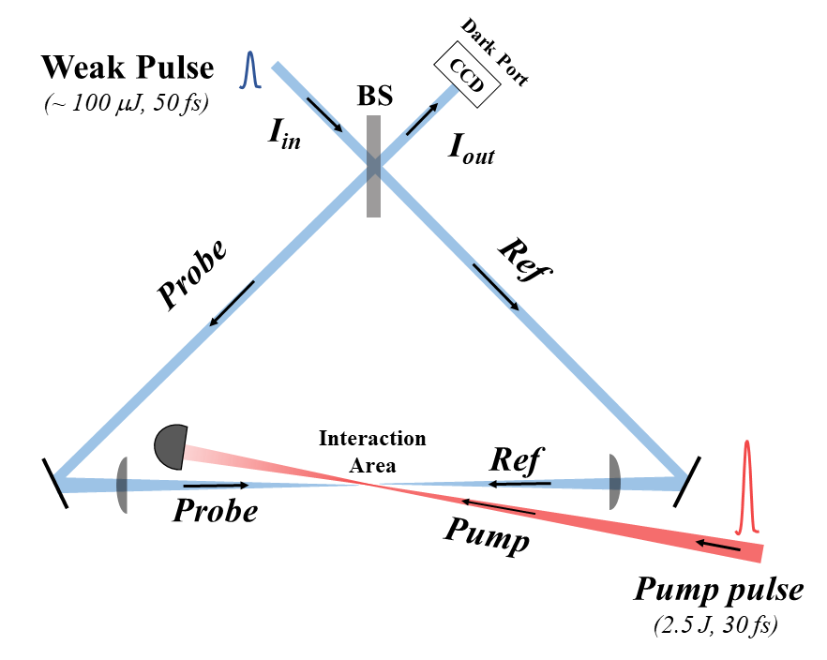
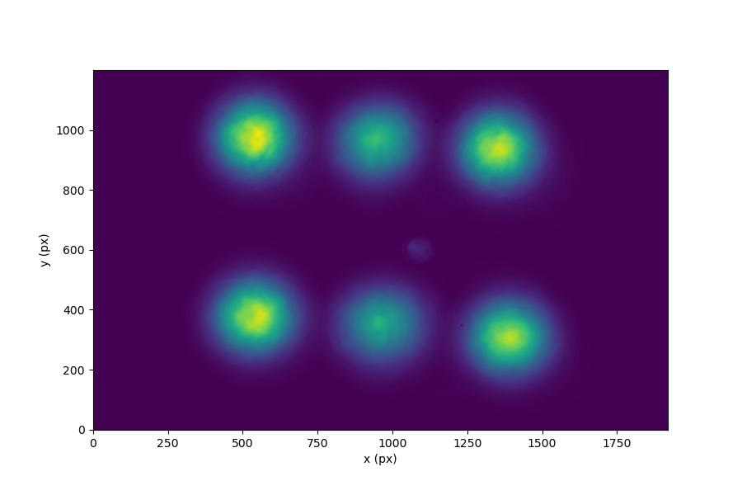


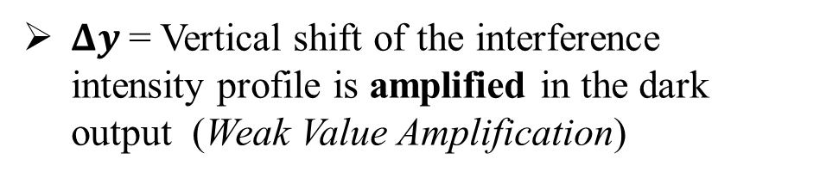
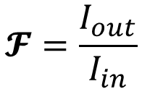

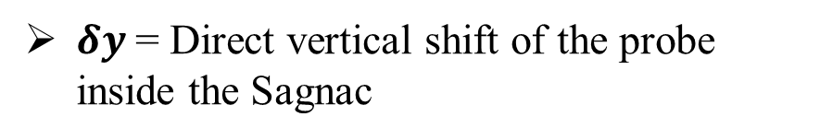

Refraction measured with a Sagnac Interferometer
$$Δy$$
Extinction factor in the dark output
$$𝓕=\frac{I_{out}}{I_{in}}$$
⇒
$δy$= Direct vertical shift of the probe inside the Sagnac
$Δy$= Vertical shift of the interference intensity profile is amplified in the dark output (Weak Value Amplification)
⇒
$$∆y=𝒜×δy$$
$$𝒜=±\frac{1}{2\sqrt{ℱ}}$$
Amplification factor
$$δy=f×δθ$$
« ON – OFF » measurements @ 5 Hz

Slide 6
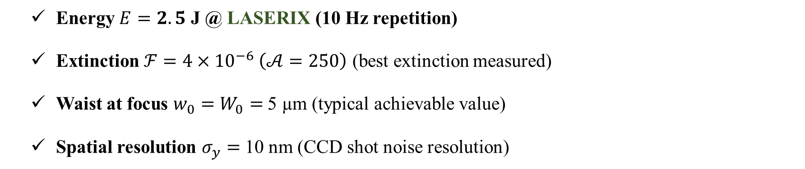

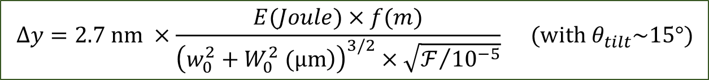
Expected signal and sensitivity
$$Δy=2.7 nm ×\frac{E(Joule)×f(m)}{{\left(\left.w_{0}^{2}+W_{0}^{2} (μm\right)\right)}^{3/2}×\sqrt{ℱ/{{10}^{−5}}}} (with θ_{tilt}\sim 15°)$$
Expected signal:
  Energy $E=2.5$ J @ LASERIX (10 Hz repetition)
  Extinction $ℱ=4×{10}^{−6} \left(𝒜=250\right)$ (best extinction measured)
  Waist at focus $w_{0}=W_{0}=$ 5 µm (typical achievable value)
  Spatial resolution $σ_{y}=$ 10 nm (CCD shot noise resolution)
$$∆y \sim 15 pm$$
ON-OFF measurements @ 5 Hz
Statistical sensitivity (without bias) : 1 sigma sensitivity within ~ 4 days with LASERIX

Slide 7
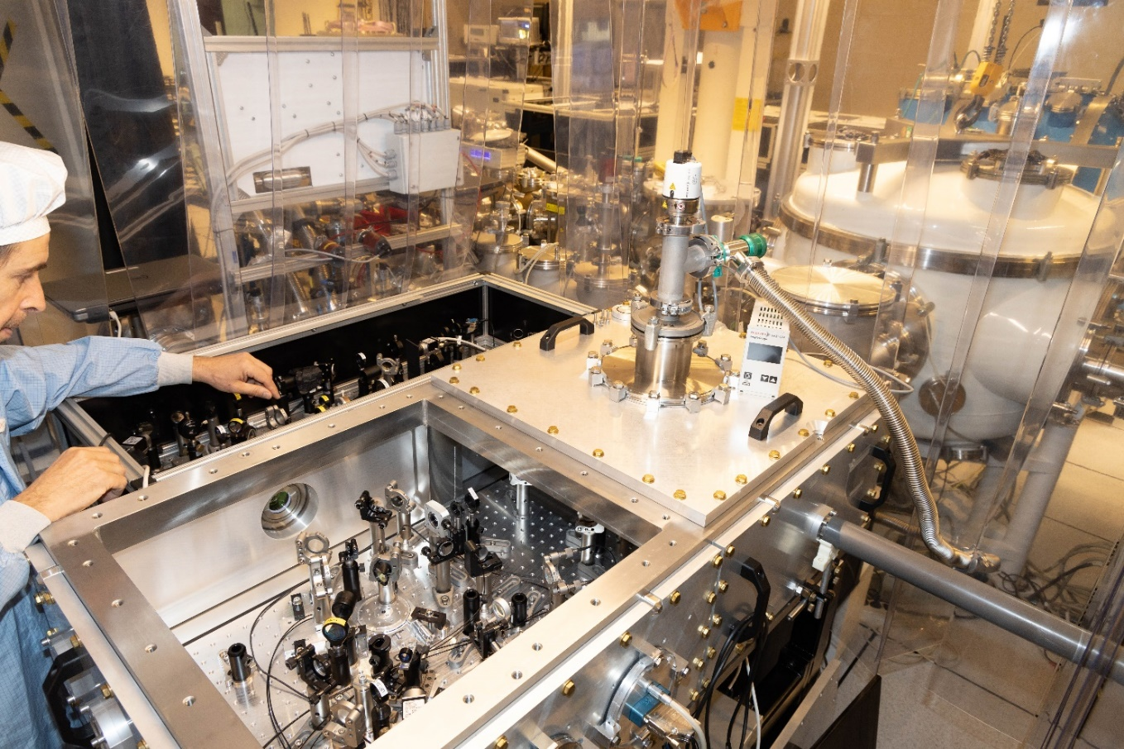
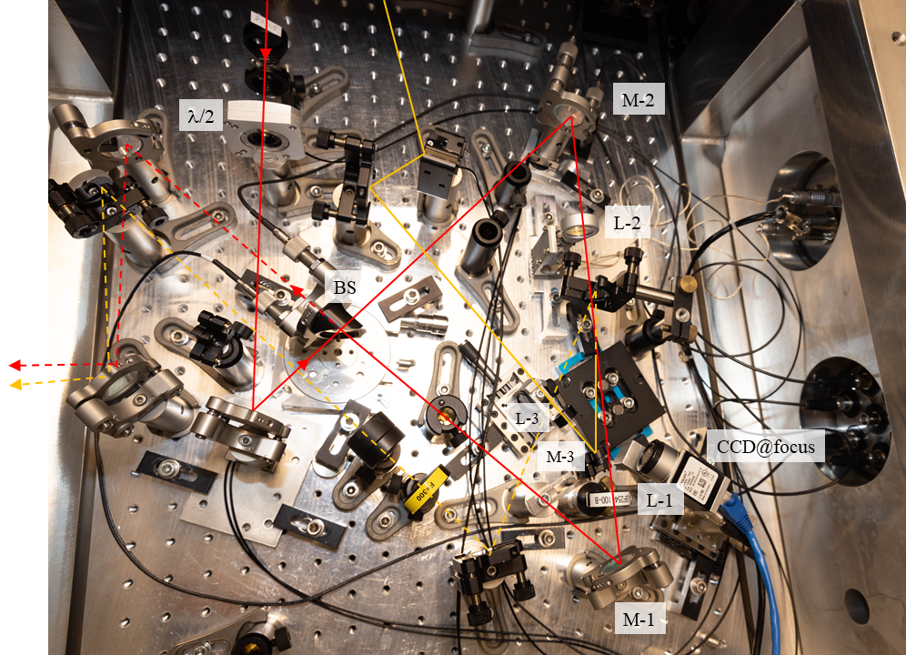
The DeLLight pilot experiment
Pilot experiment in vacuum chamber
Sagnac interferometer with focus of the probe and pump beams
→ DeLLight deflection measured in air with a low pump energy

Slide 8
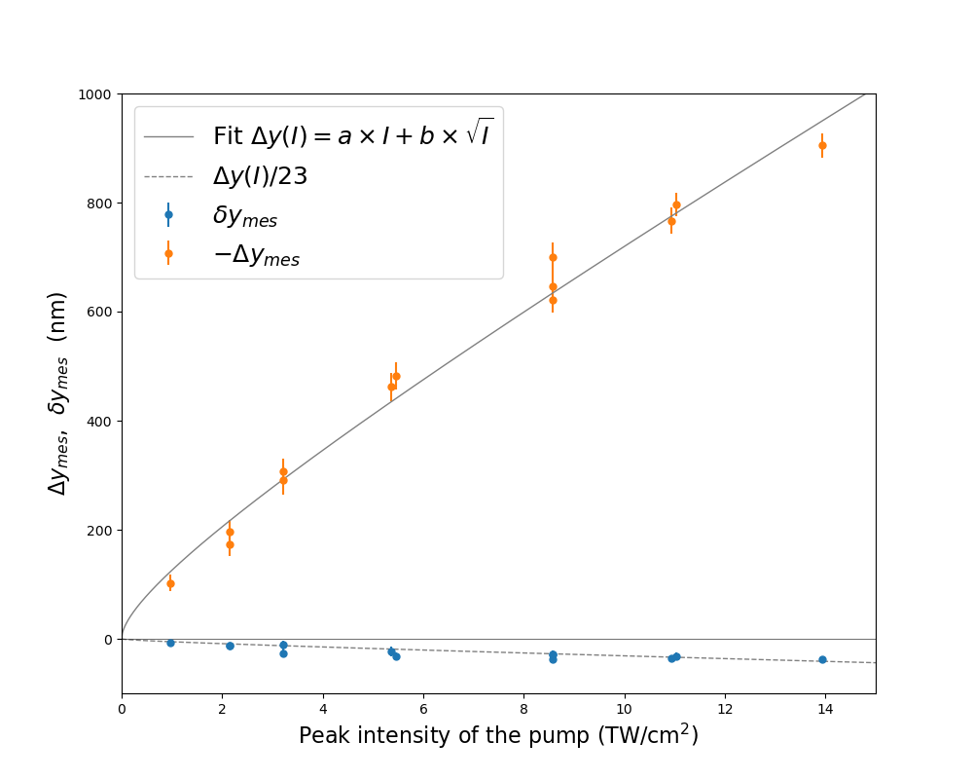
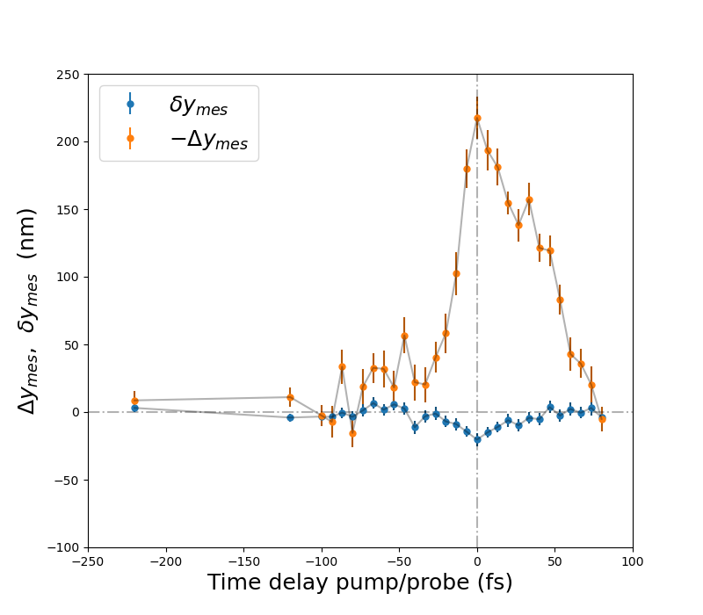
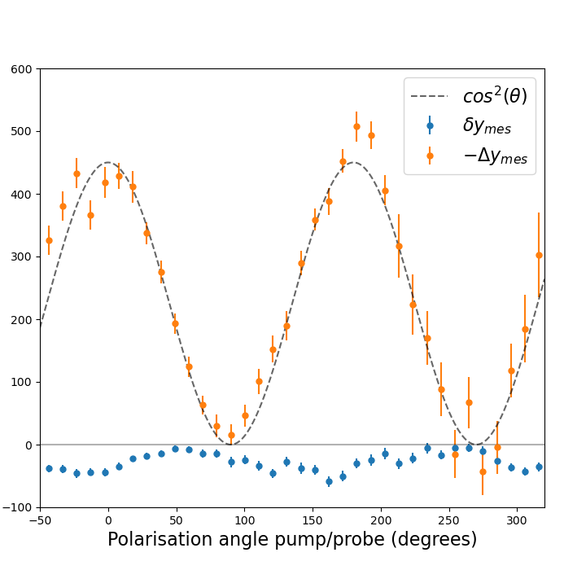
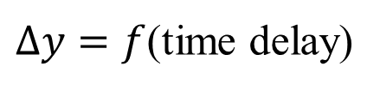
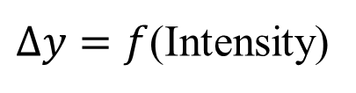


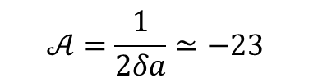
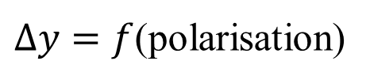
Measurement of the DeLLight signal in air
$Δy=f$(Intensity)
$Δy=f$(time delay)
$Δy=f$(polarisation)
${Δy}_{mes}, {δy}_{mes}$ (nm)
$≃$70fs
$$𝒜=\frac{1}{2δa}≃−23$$
Peak intensity of the pump (TW/cm²)
Time delay pump/probe (fs)
Polarisation angle pump/probe (deg.)
Validation of the DeLLight experimental method based on interferometric amplification !
More details in A. Kraych et al, Physical Review A 109.5 (2024)

Slide 9
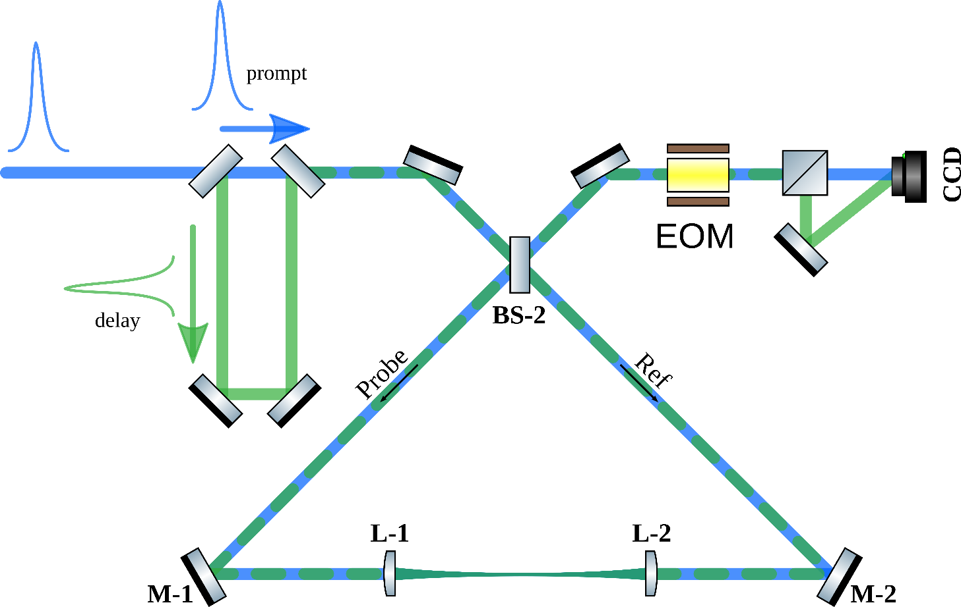
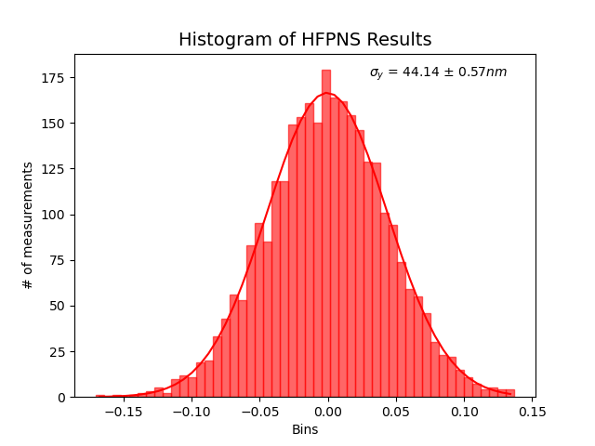
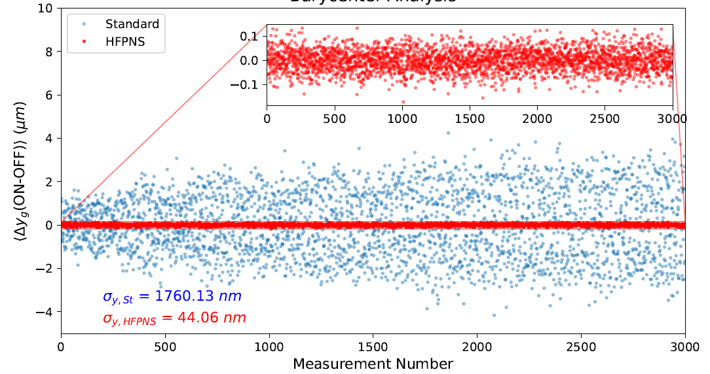

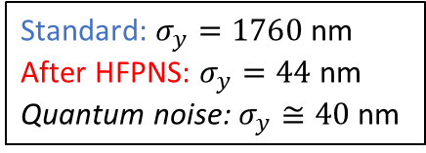
Spatial resolution: the quantum noise limit
Measurement and supression of the vibration-induced interferometric phase noise using a delayed (High Frequency) pulse
The ultimate quantum noise-limited special resolution has been achieved (Ali Aras’s thesis)
Prompt
Delay
$\left\langle ∆y\left(ON−OFF\right)\right\rangle$ (μm)
Standard: $σ_{y}=1760$ nm
After HFPNS: $σ_{y}=44$ nm
Quantum noise: $σ_{y}≅40$ nm

Slide 10
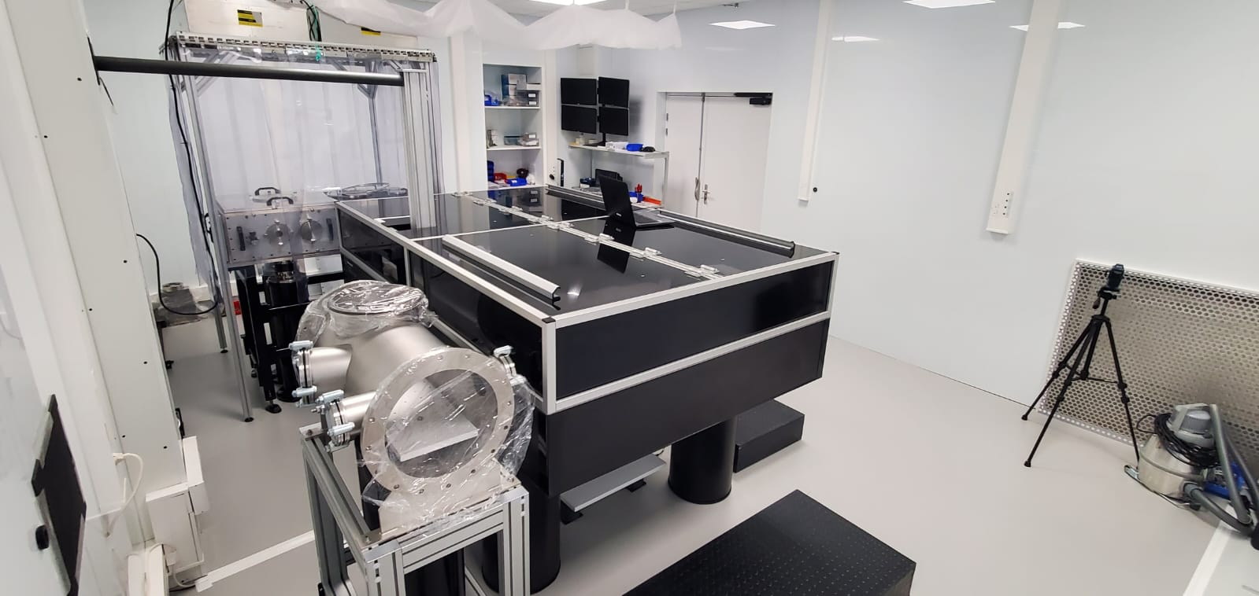
What next
Installation of the DeLLight Phase-1 (High energy LASERIX pulses in vacuum) currently in progress in a new dedicated experimental room
First measurements in vacuum with intense fields expected end of 2026
DeLLight Phase-2 using new generation intense lasers with high repetition rate
LAPLACE-HC@LOA (1-5 J, 100Hz) KALDERA@DESY (5J, 1kHz)
⇒ 3σ sensitivity in few hours !

Slide 11
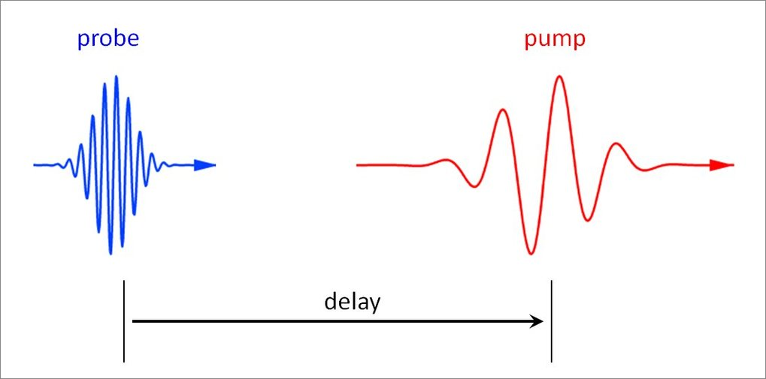
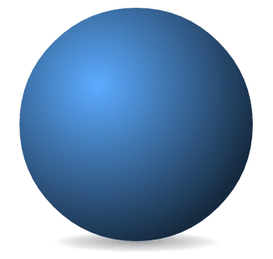
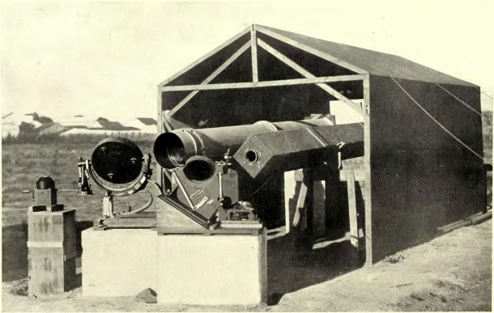


Conclusions
A positive measurement would demonstrate that the speed of light in vacuum can be reduced, in the classical sense on a macroscopic scale, in the presence of external e.m. fields.
Electromagnetic Lensing
Gravitational Lensing
?
$$\vec{G}$$
$$\vec{E}, \vec{B}$$
DeLLight
Eddington, 1919

